Slide 1

The Diurnal Ozone Climatology: applications for satellite comparisons
Natalya Kramarova, Stacey Frith, Luke Oman, P.K. Bhartia, Richard McPeters and Gordon Labow
SAGE III Science Team Meeting, October 29-30, 2019

Slide 2
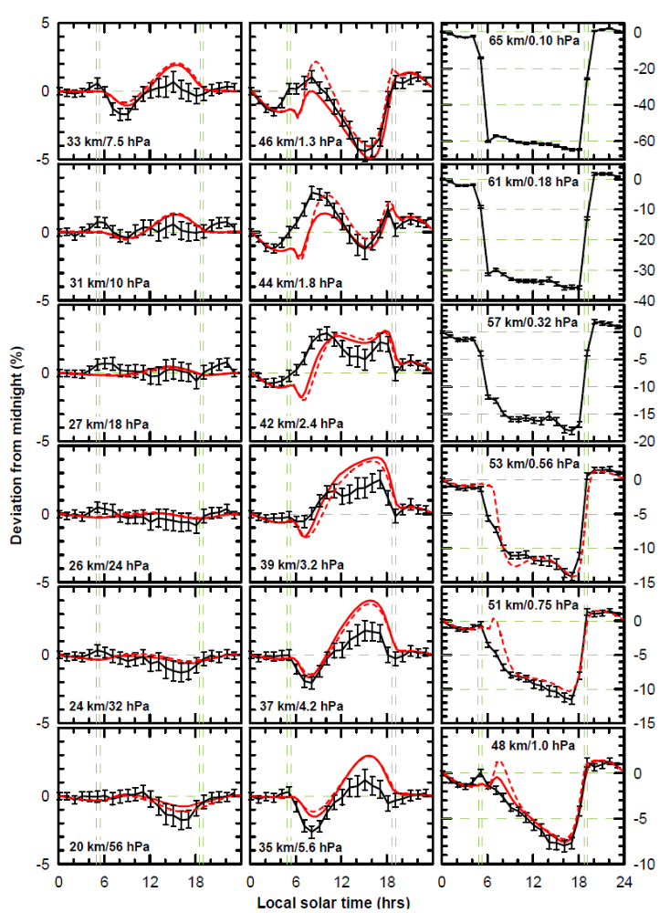
Ozone Diurnal Cycle
Ground-based Microwave measurements at Mauna-Loa
5
0
-5
-10
5
0
-5
0
-20
-40
-60
0 6 12 18 24
Local Solar Time
0 6 12 18 24
Local Solar Time
0 6 12 18 24
Local Solar Time
From Parrish et al., ACP, 2014, doi:10.5194/acp-14-7255-2014
SAGE III Science Team Meeting, October 29-30, 2019
Notes:
The model simulations use chemical and greenhouse gas conditions for 2005. The model results are from the Goddard Earth Observing System Chemistry Climate Model (GEOSCCM). It couples the comprehensive stratospheric/tropospheric chemistry package developed within the Global Modeling Initiative (GMI) (Duncan et al., 2007; Strahan et al., 2007; Oman et al., 2011) to version 5 of the GEOS GCM (Rienicker et al., 2011). It does not include a full representation of mesospheric processes but the processes controlling ozone in the middle to upper stratosphere are complete and the model diurnal cycle is thought to be realistic at altitudes < ∼ 52 km (0.5 hPa). The modeled diurnal variations are simulated using chemical and greenhouse gas conditions for 2005. Previous versions of the GEOSCCM have been thoroughly validated in the CCMVal-1 and CCMVal-2 model intercomparison campaigns.
> Comparisons with recent versions of the model are ongoing, but initial results indicate only small differences in the modeled diurnal cycle.

Slide 3
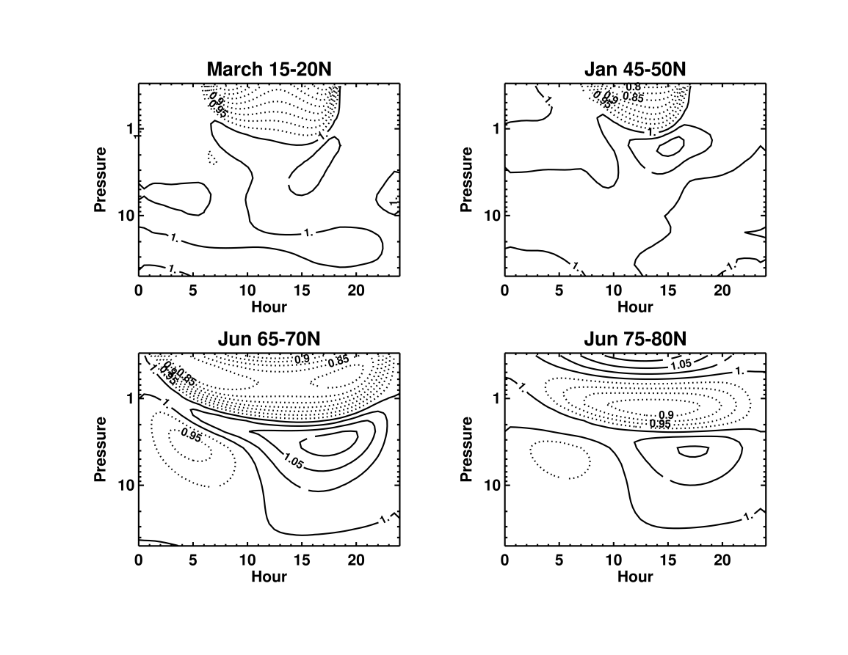
Diurnal ozone climatology
GEOS-GMI simulations:
The diurnal climatology is based on output from the NASA GMAO Version 5 GEOS general circulation model, GEOS-5, [Molod et al., 2015] coupled with the NASA Global Modeling Initiative (GMI) chemistry package [Strahan et al., 2007; Oman et al., 2013; Nielsen et al., 2017].
GEOS-GMI is run in replay mode [Orbe et al., 2017], with dynamics constrained by 3-hourly meteorological fields from the MERRA-2 (Gelaro et al., 2017).
The simulation are from 1/2017-12/2018, concurrent with ISS SAGE III mission.
SAGE III Science Team Meeting, October 29-30, 2019

Slide 4
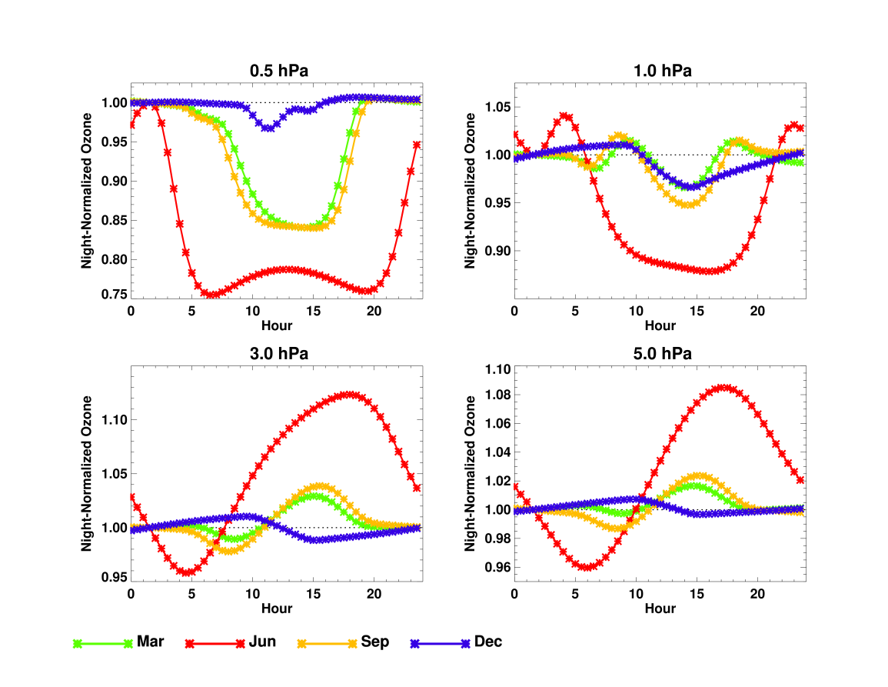
Diurnal ozone climatology
65N-70N
SAGE III Science Team Meeting, October 29-30, 2019

Slide 5
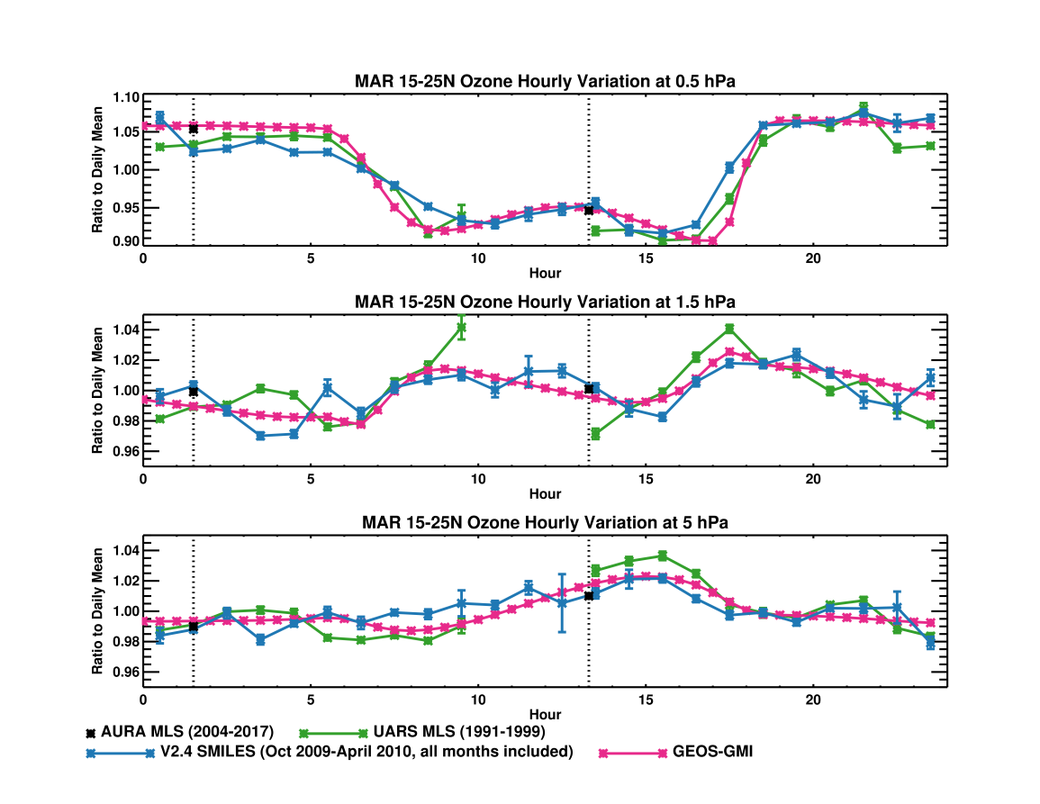
Comparisons between the model and measurements
SAGE III Science Team Meeting, October 29-30, 2019
Notes:
on the plot with the UARS MLS and SMILES, the seasonal cycle was removed from SMILES empirically by subtracting the 30-day running mean ozone from each daily value before binning by hour.

Slide 6
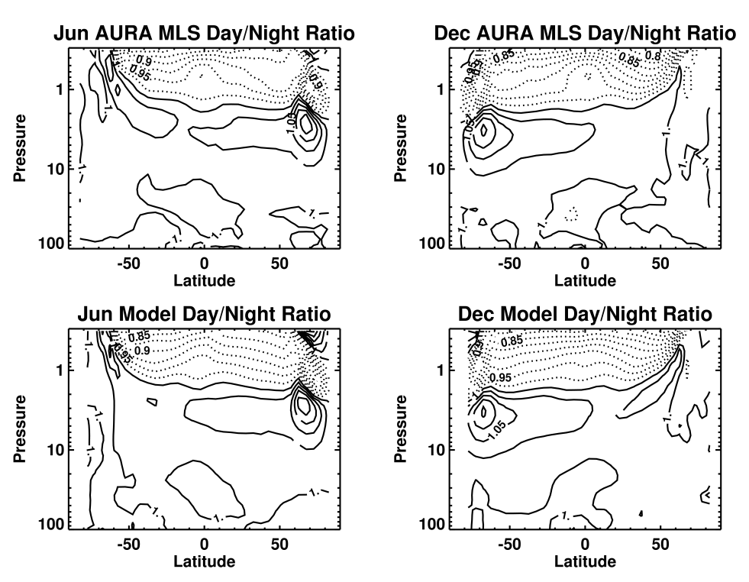
Ozone Day/Night ratios from the model and Aura MLS
SAGE III Science Team Meeting, October 29-30, 2019

Slide 7
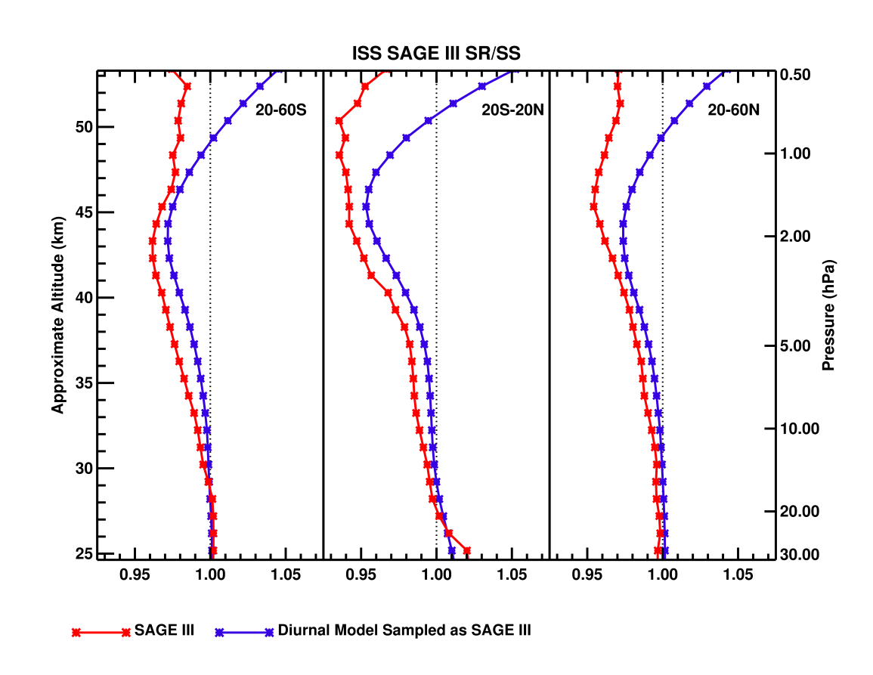
Example Diurnal Climatology Applications:
SAGE III Sunset/Sunrise differences
SAGE III Science Team Meeting, October 29-30, 2019

Slide 8
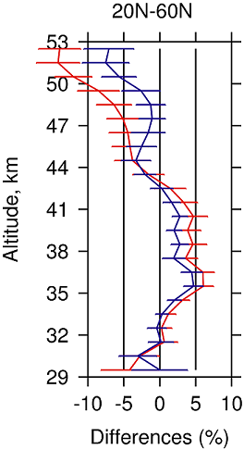
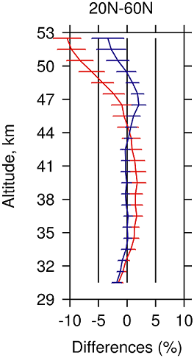
Example Diurnal Climatology Applications:
SAGE III/ISS Comparisons with OMPS LP
OMPS LP – SAGE III, 20N-60N
MLS day – SAGE III, 20N-60N
Differences with SAGE III; Differences with SAGE III adjusted to 1:30 pm
SAGE III Science Team Meeting, October 29-30, 2019

Slide 9
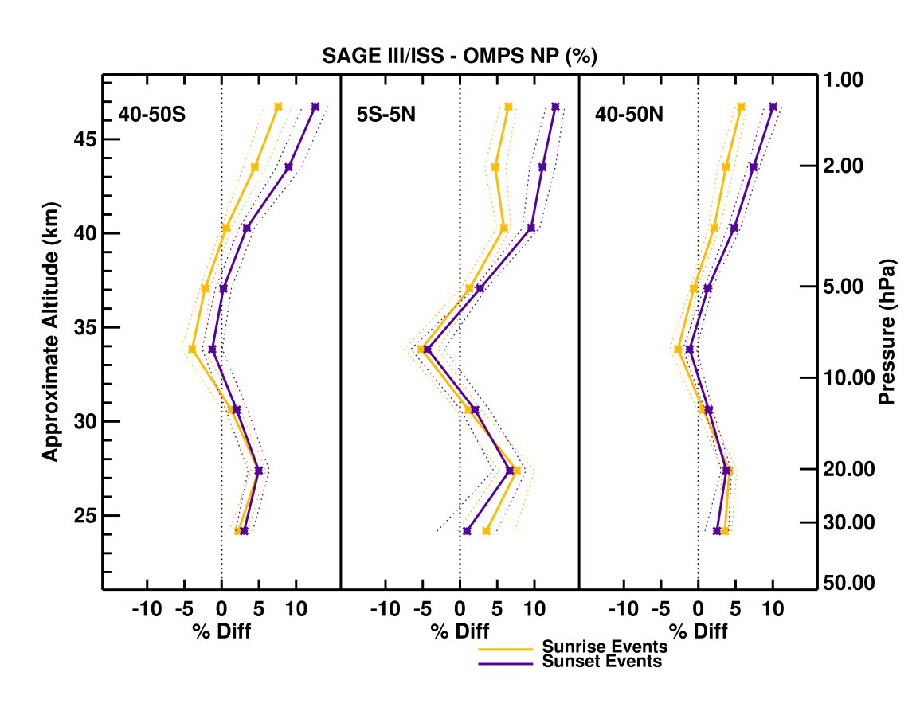
Example Diurnal Climatology Applications: SAGE III/ISS Comparisons with OMPS NP
SAGE III Science Team Meeting, October 29-30, 2019

Slide 10
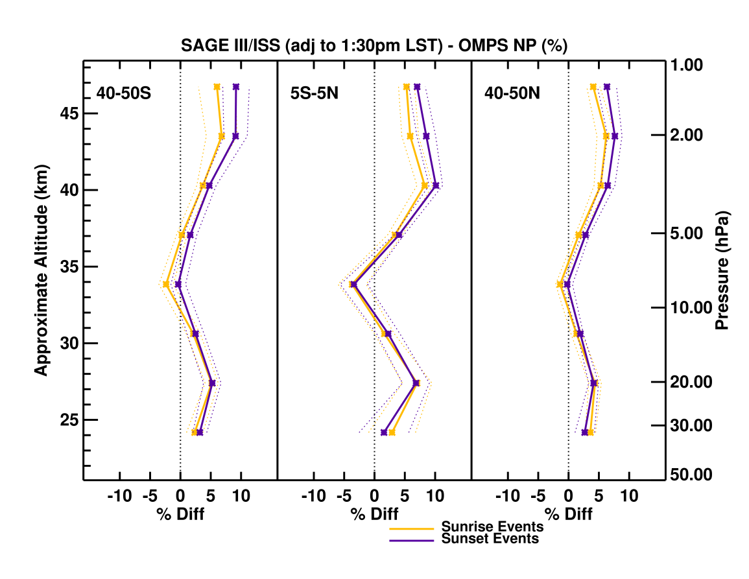
Example Diurnal Climatology Applications: SAGE III/ISS Comparisons with OMPS NP
SAGE III Science Team Meeting, October 29-30, 2019

Slide 11
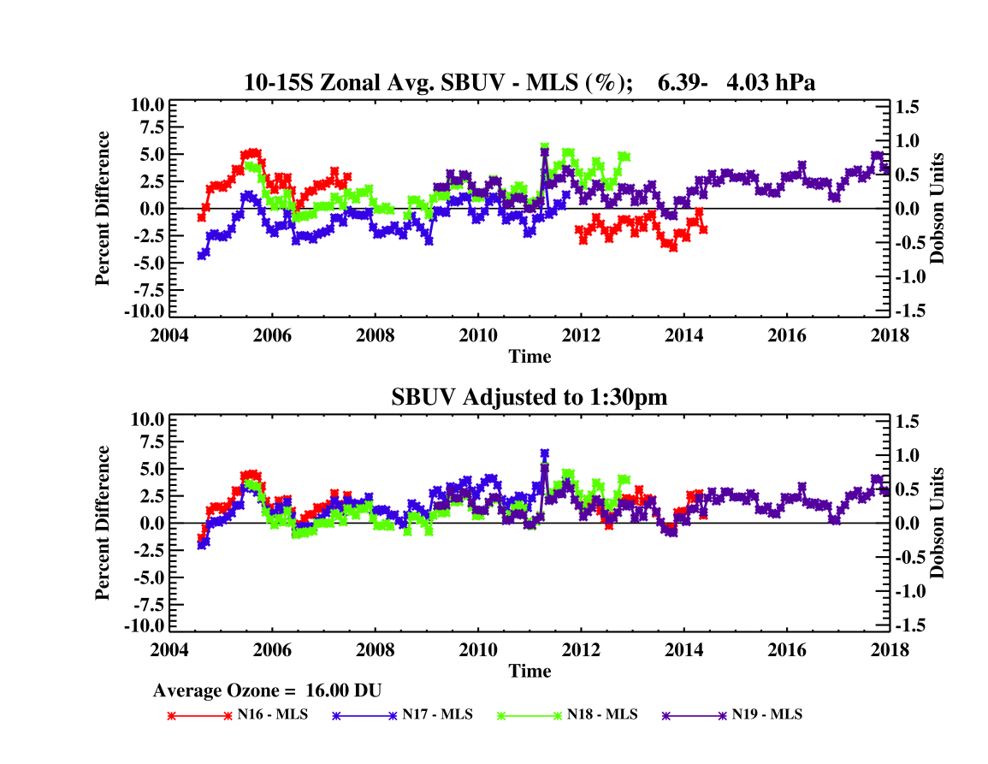
Example Diurnal Climatology Applications: Merging SBUV Ozone Records
SAGE III Science Team Meeting, October 29-30, 2019

Slide 12
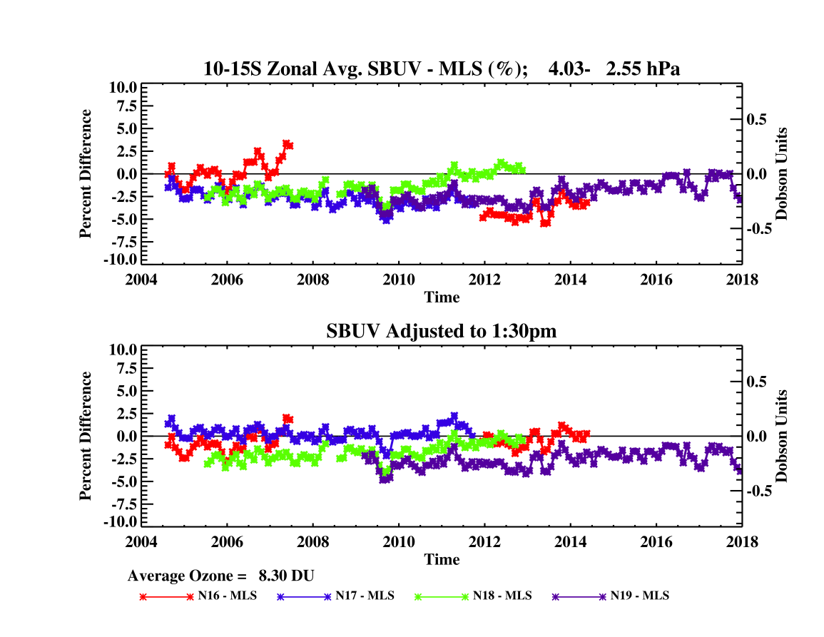
Example Diurnal Climatology Applications: Merging SBUV Ozone Records
SAGE III Science Team Meeting, October 29-30, 2019

Slide 13
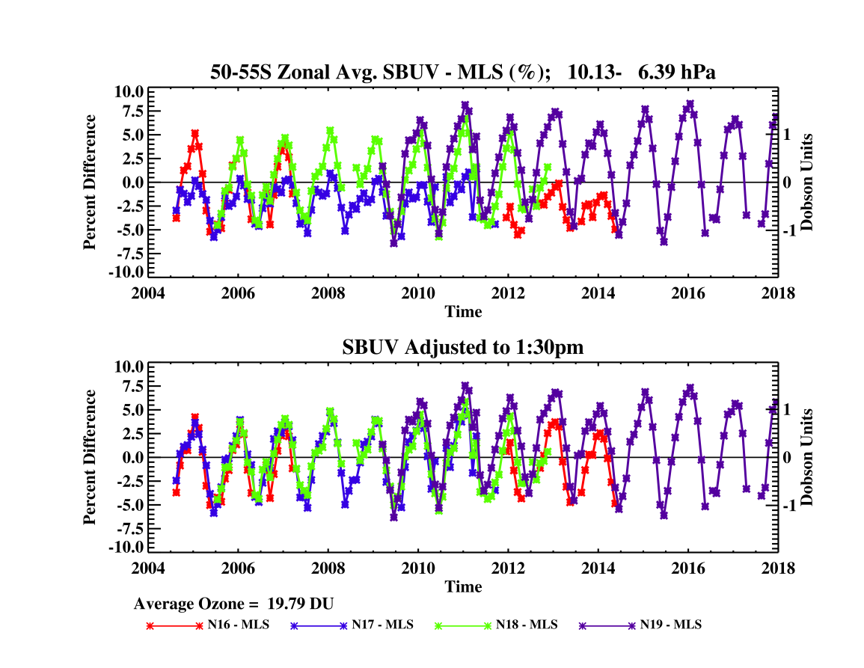
Example Diurnal Climatology Applications: Merging SBUV Ozone Records
SAGE III Science Team Meeting, October 29-30, 2019

Slide 14
SUMMARY:
We present a global, easily accessible climatology of the ozone diurnal cycle based on the NASA GEOS-GMI model with 30 minutes resolution (5° latitude bins, 1 km vertical resolution, 12 months). The climatology is expressed as the ratio of the O3 at given time to midnight.
We compare the climatology with UARS MLS, SMILES, Aura MLS and to previously published results including model analyses and diurnally resolved data from ground-based microwave radiometers. The GEOS-GMI diurnal climatology compares well with all sources; the most quantitative comparison against Aura MLS daytime to nighttime profiles ratios shows agreement typically within 2%.
The diurnal climatology depicts the largest variability during summer near the polar day boundary (65-70°). The amplitude and the altitude of the transitions from a mesospheric pattern of low daytime ozone and high ozone at night to a stratospheric pattern of low ozone in the morning and high ozone in the afternoon vary significantly with season, leading to very complicated diurnal patterns that are not easily characterized in data inter-comparisons.
We present a series of examples where the diurnal climatology helps to interpret ozone observations. For example, a large fraction of differences between ISS SAGE III sunset and sunrise measurements can be attributed to the diurnal ozone variations.
Frith et al., Atmos. Meas. Tech. Discuss., https://doi.org/10.5194/amt-2019-320, in review, 2019.
OMI/OMPS Science Meeting, May 16, 2018

