Slide 1
SAGE III/ISS and GloSSAC v2.0
Larry Thomason
NASA LaRC
Mahesh Kovilakam
SSAI

Slide 2
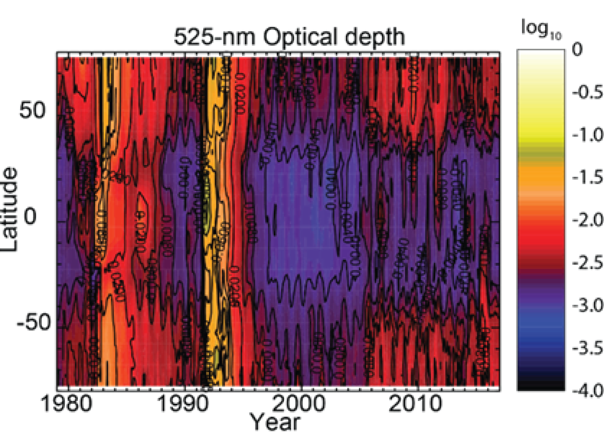
GloSSAC
From GloSSAC v1.1
GloSSAC (the Global Space-based Stratospheric Aerosol Climatology) is a multi-instrument 40-year climatology of aerosol optical properties produced to support global climate modeling
It evolved from a SAGE II-only climatology to produce ‘gap-free’ data sets for 1978 to 2004 (ASAP), to 2012 (CCMI), to 2016 (CMIP6), to 2018 (v2.0)
Prior to 2005, it is almost exclusively dependent on occultation measurements but afterward (until 2017) dependent on OSIRIS limb-scatter and CALIPSO lidar measurements
SAGE III/ISS contributes to v2.0 in two critical ways:
  Direct incorporation into the data set
  Assessing the consistency of the data set across multiple measurement strategies

Slide 3
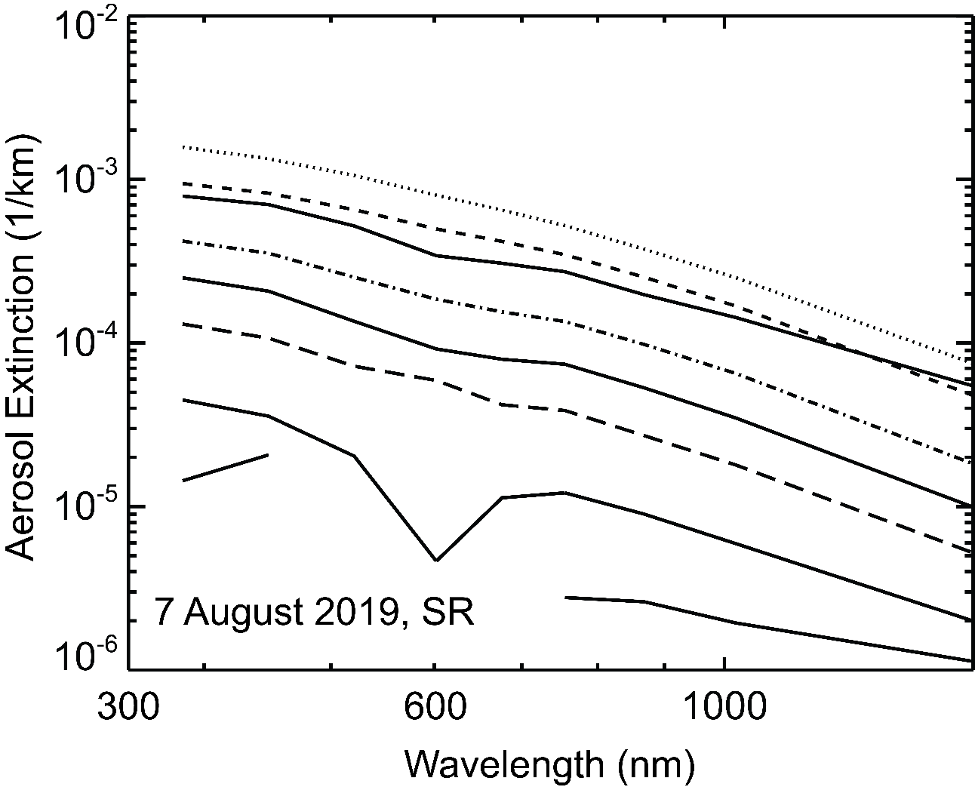
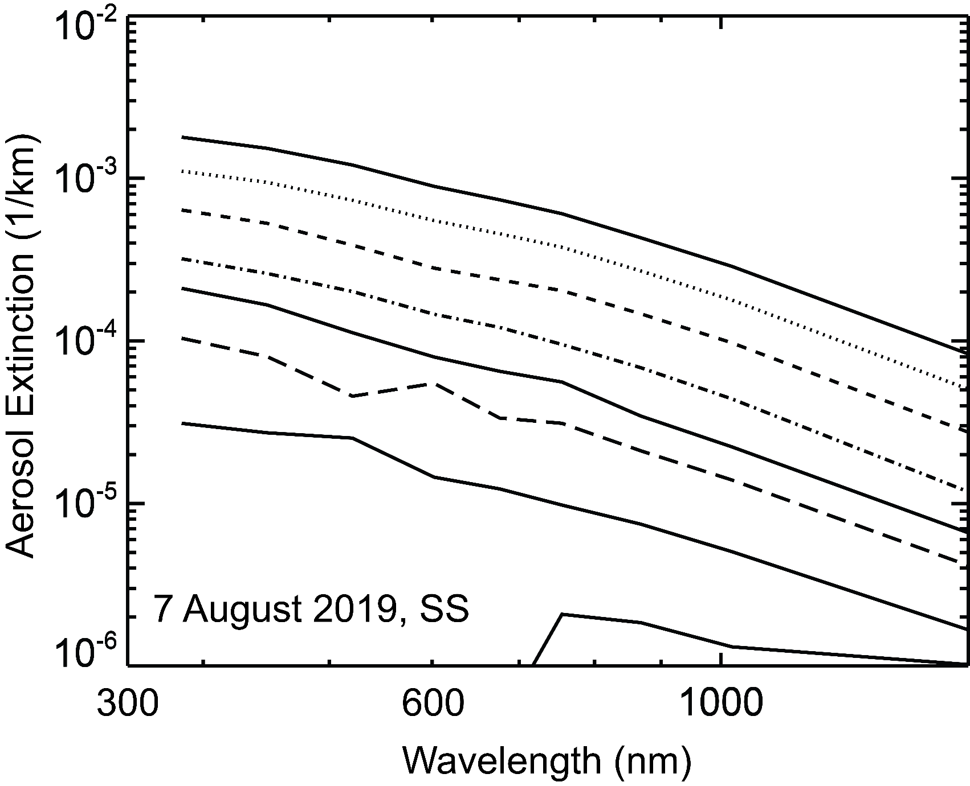
SAGE III Internal Consistency Checks (1):
Aerosol Spectra Examples
Seagull effect

Slide 4
SAGE III Internal Consistency Checks (2): Uncertainty evaluation
We observe that the lowest zonal variability in aerosol extinction coefficient ( and ozone) occurs in the tropics particularly above 20 km.
Thus we expect the reported uncertainty (solid lines and mainly a precision measure) to be close to but somewhat less than the observed zonal standard deviation for low latitude measurements. This is observed. Suggesting that reported precisions are reasonable.
Uncertainties are the lowest where ozone is the smallest and generally a minimum between 756 and 1020 nm at a few percent.
To my observation, I see two kinds of SAGE III/ISS events ones where noise is low and data quality is SAGE II-like and others where I suspect a ‘rough ride’ from the station leads to noisier events. For some applications, considering the difference in precision between events may be important.

Slide 5
GloSSAC and the OSIRIS/CALIPSO Period
A key part of making GloSSAC work, is ensuring consistency across 40 years of data (as much as possible, which of course is totally impossible)
  SAGE II remains the standard to which other instruments are conformed
Nominally, GloSSAC could use OSIRIS/CALIPSO provided aerosol extinction coefficient data products at ~525 nm throughout this period
However, we find that they have some mild to severe bias issues relative to SAGE II/III that require some conformance activities to reduce bias
At end, we feel that the new approach reduces the bias observed particularly at 1020 nm crossing the SAGE-to-not-SAGE borders but there are still some significant issues that require further thought
Somewhat disappointing how much conformance needs to be done. From the GloSSAC perspective, conformance at 10% is Ok but 20% is failure…

Slide 6
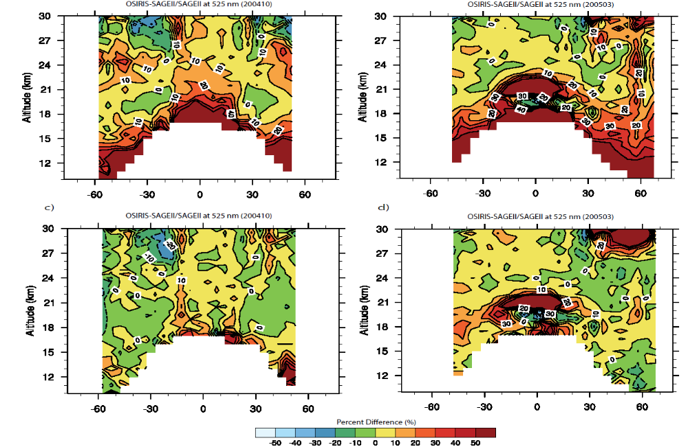
GloSSAC and OSIRIS, conformance requirements
OSIRIS and SAGE II agree rather well (with 10% or so) in the main stratospheric aerosol layer throughout their overlap period
Exceptions occur in the lower stratosphere and following a pair of smallish eruptions in 2002 and 2005.
A conformance process is applied derived from this overlap period is applied to all OSIRIS data
We suspect that OSIRIS values are biased relative to what a SAGE instrument would have seen following a number of volcanic events in between 2005 and 2017

Slide 7
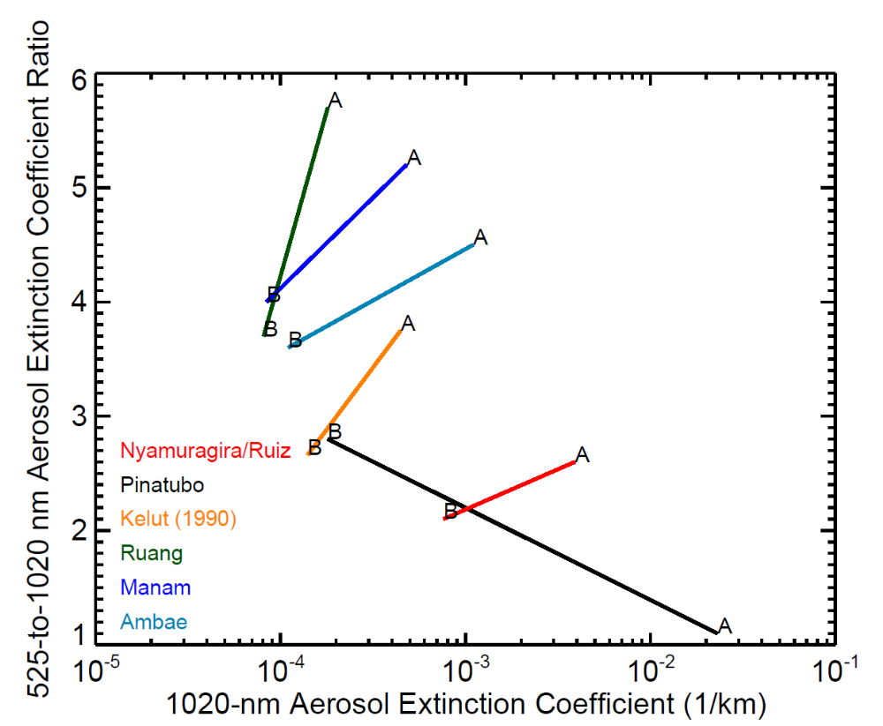
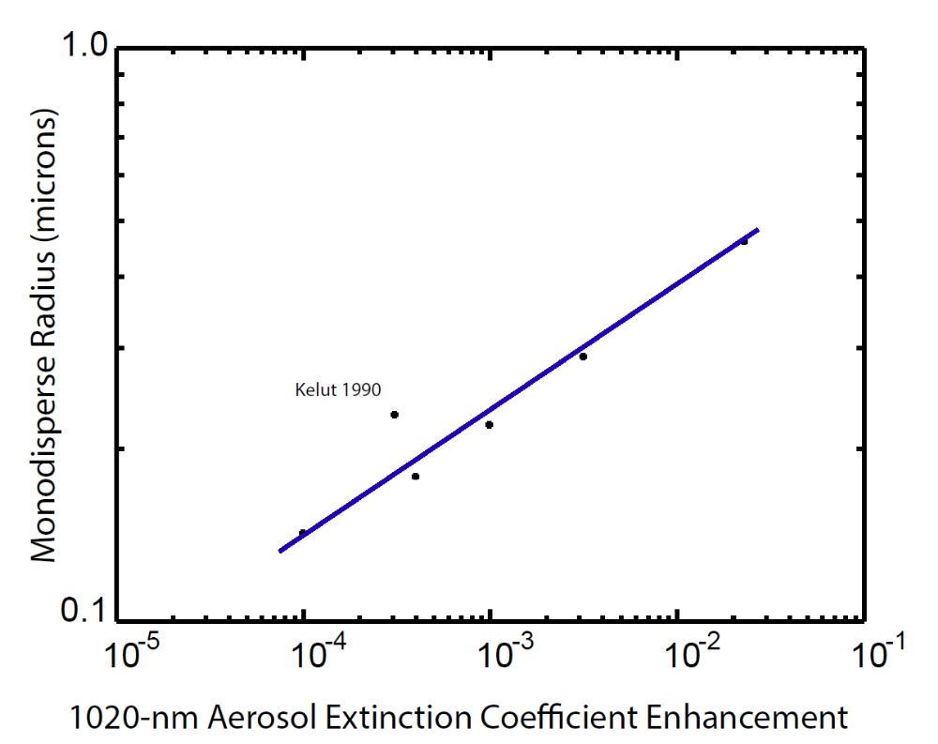
Bonus Slide:
Volcanos and Particle Size: SAGE Observations

Slide 8
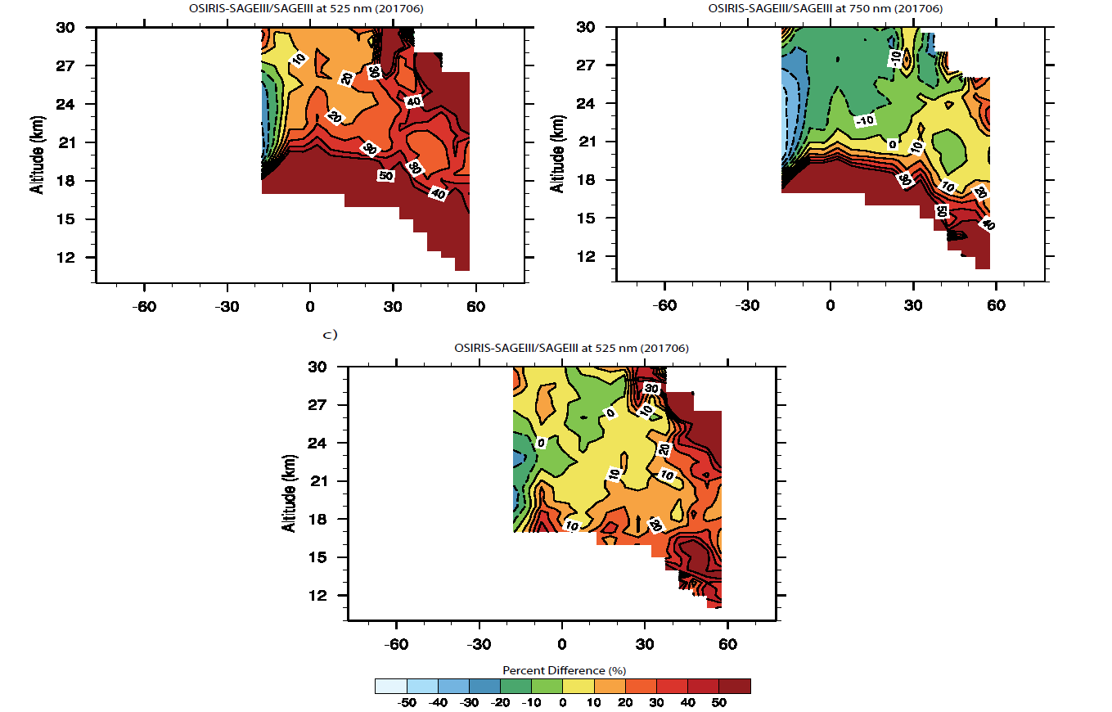
GloSSAC and OSIRIS, conformance requirements (Part II)
OSIRIS to SAGE III is similar to that observed during the SAGE II/OSIRIS overlap period with the bias perhaps somewhat larger
After application of the SAGE II-based conformance process, the differences are generally 10-20% except in the lower stratosphere possibly due to the Seagull effect

Slide 9
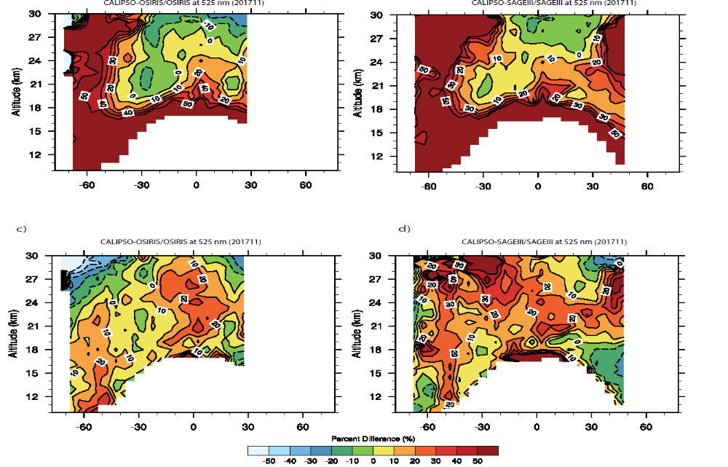
GloSSAC and CALIPSO, conformance requirements
CALIPSO and conformed OSIRIS agree with 10 to 20% in the main stratospheric aerosol layer equatorward of 40 degrees but rather poorly in the lower stratosphere and high latitudes
We do not use the new CALIPSO aerosol extinction product but rather use the stratospheric backscatter product and convert using an empirical extinction-to-backscatter-like conformance process
After this process, the overall agreement is within 10 to 30% at all altitudes for conformed OSIRIS and SAGE III/ISS
Based on SAGE III

Slide 10
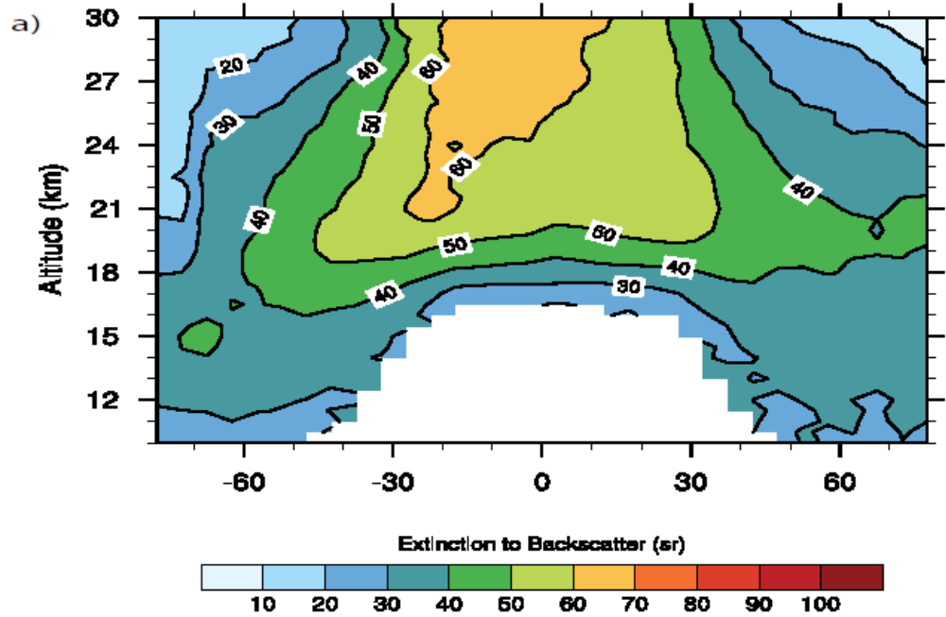
GloSSAC and the Occultation Gap Period
CALIPSO uses a fixed extinction to backscatter ratio of 50 to retrieve aerosol extinction coefficient at 532 nm
In general, ratioing conformed OSIRIS extinction to CALIPSO backscatter, we find in the mid to low latitude core a ratio of 40 to 60. However near the tropopause and in higher latitudes, we see much smaller values from (10 to 40)
Should note that this value is roughly a combination of extinction backscatter and bias correction and should not be interpreted physically

Slide 11
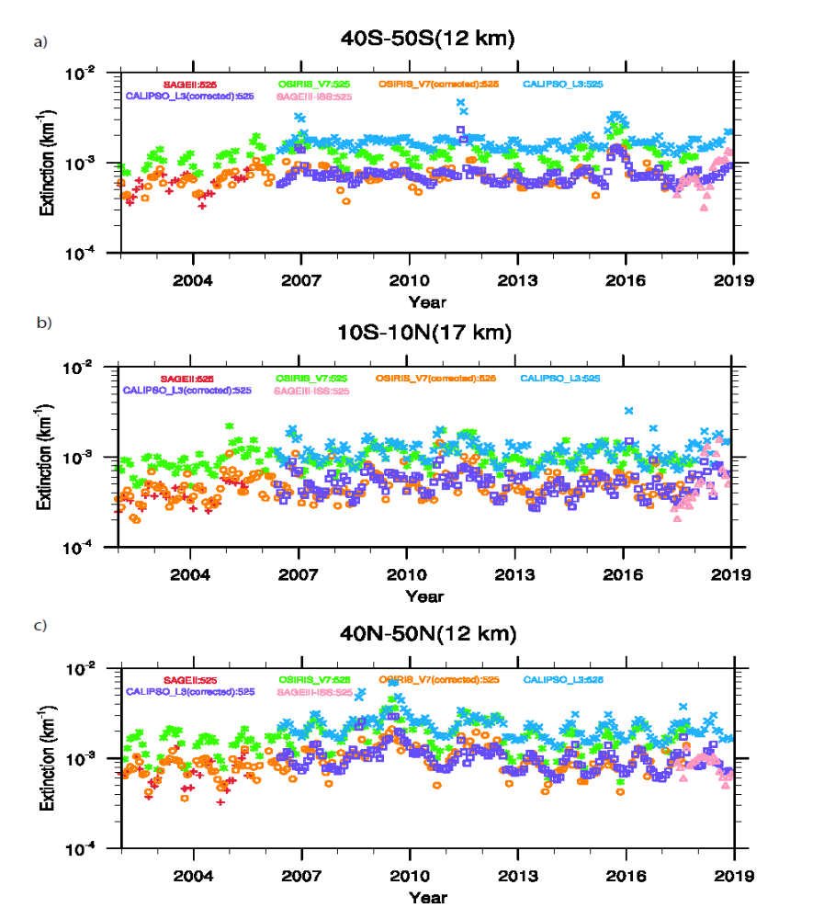
On aerosol extinction reconstruction in ‘trouble’ spots
The general outcome is that the conformance process significantly reduces bias between data sets, which, of course, was the whole idea.

Slide 12
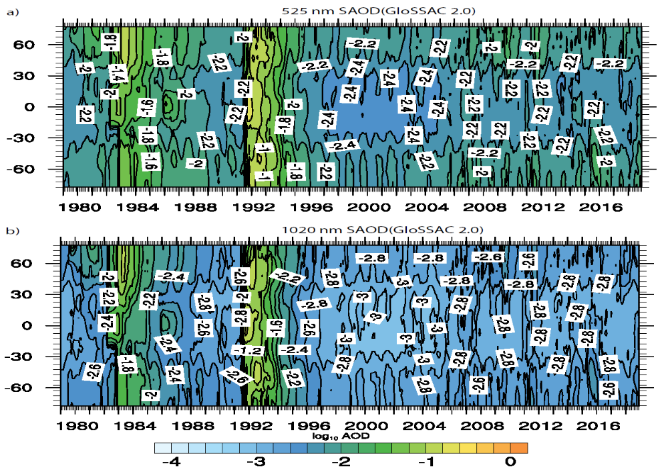
Aerosol Optical Depth from GloSSAc v2.0

Slide 13
Conclusions Future plans
For version 2.0, we feel that the new conformance approaches reduce the bias observed particularly at 1020 nm crossing the SAGE-to-not-SAGE borders but there are still some significant issues that require further thought particularly wavelength dependence in the OSIRIS/CALIPSO period
Clearly, disposing of the Seagull Effect is a high priority to the long term utility of the GloSSAC data set
  Will require a reassessment of the OSIRIS/CALIPSO era and the on-going mixed OSIRIS/CALIPSO/SAGE III
Can SAGE III/ISS help with infer particle size in the OSIRIS/CALIPSO era at least to the extent of improving inferences of 525 to 1020 nm extinction coefficient ratios?
How well can we link SAGE II aerosol to that from SAGE III/ISS
Will we ever have a trendable data set for this period to levels better than 20% or does the mix of measurements mean we will never get there?

