Slide 1
SAGE III Limb Scatter Retrievals
Glen Jaross, P.K. Bhartia, Natalya Kramarova | NASA Goddard Space Flight Center
Ghassan Taha | Universities Space Research Association
Philippe Xu | Science Applications International Corp.
SAGE 3 STM, 30-Oct., 2019

Slide 2
Proposed effort
Provide LaRC operational retrieval codes that will work for SAGE LS data
  Ozone and aerosol extinction
  Based on existing OMPS retrievals
Correct Level 1 radiances for problems affecting product accuracy
  Stray Light: out-of-band and out-of-field
  Tangent Height registration errors
Recommend LS operations scenarios
  Optimize product quality and usefulness

Slide 3
OMPS LS retrieval algorithms
Aerosol v1.5 algorithm
Ozone v2.5 algorithm
Computes extinction profile at 675 nm;
Radiances are normalized at 40 km;
Gamma size distribution in Mie calculation;
Chahine’s non-linear relaxation algorithm;
Cut off at cloud top;
Residuals calculated at 8 wavelengths.
3 UV pairs and 1 VIS triplet;
Radiances are normalized at 55 km for UV and 40 km for VIS ranges (no retrievals above);
Include the explicit aerosol correction by using LP-derived aerosols;
Algorithm uses realistic a priori covariance matrices instead of Tikhanov regularization;
Limited wavelengths allow us to better isolate instrumental issues

Slide 4
SAGE LS operations
Limb Scatter scan pattern
We’ve been working with 2 orbits of 9 scans each
TOA Reflectance
4 – 20 min. on day side
typically equatorial
two fast scans to 250 km
Sun-normalized signal
Wavelength (nm)
Notes:
Scan head heats up after use, so operators desire to limit heating
Approximately one scan per minute

Slide 5
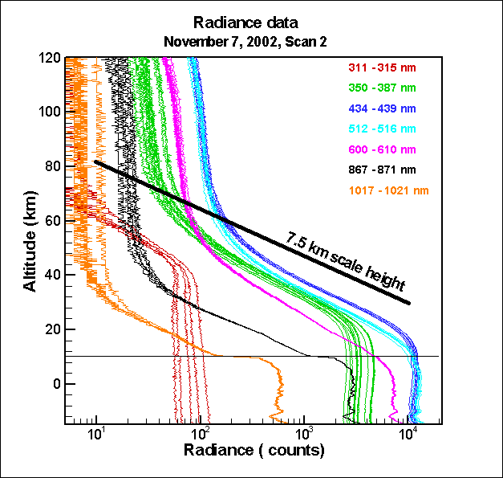
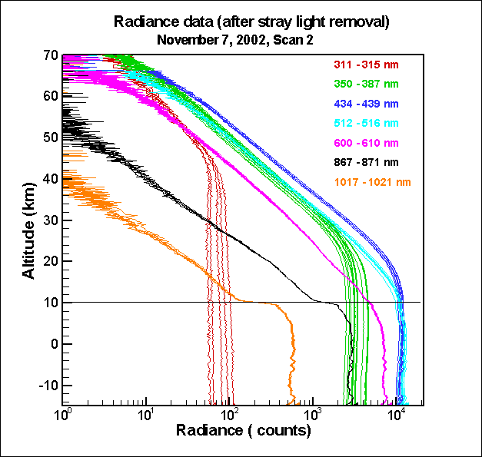
Out-of-Field stray light is primary challenge
M3-SAGE LS Signal
M3-SAGE LS Signal
Telescope scatters bright Earth signal into higher altitude angles (in-band)
Excess signal at retrieval normalization altitude
Primarily a VIS/NIR problem

Slide 6
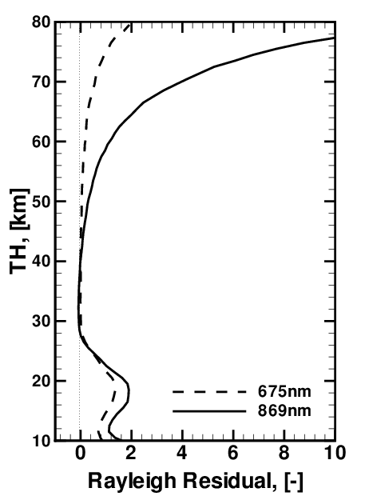
Assess stray light using Rayleigh residuals
OMPS residuals – Stray Light
Rayleigh residual=(I_{m}-I₀)/I₀
where I_{m} is the measured radiances and I₀ is the calculated radiance for a Rayleigh atmosphere only.
OMPS has relatively little residual stray light
Use wavelengths with little atmospheric absorption
OOF stray light is inherently worse at longer wavelengths due to greater vertical gradient in signal
( Percent )

Slide 7
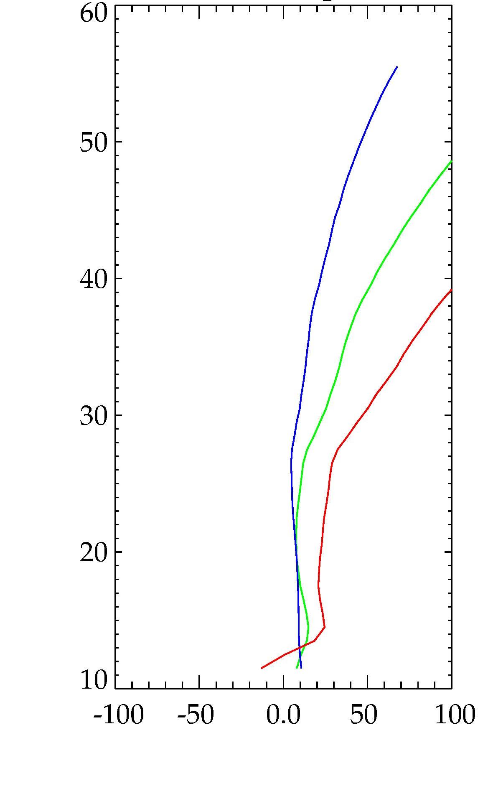
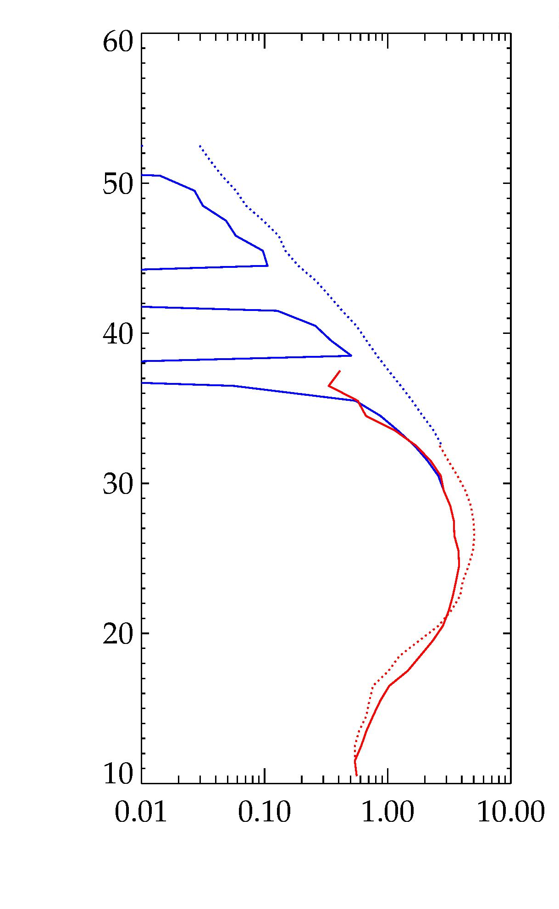
SAGE LS Rayleigh residuals
Suggests large levels of stray light
Ozone retrieval is not so bad due to wavelength triplet in VIS
353 nm
508 nm
UV
VIS
675 nm
Tangent Height (km)
Tangent Height (km)c
Percent Residual
O₃ Density × 10¹² (cm⁻³)

Slide 8
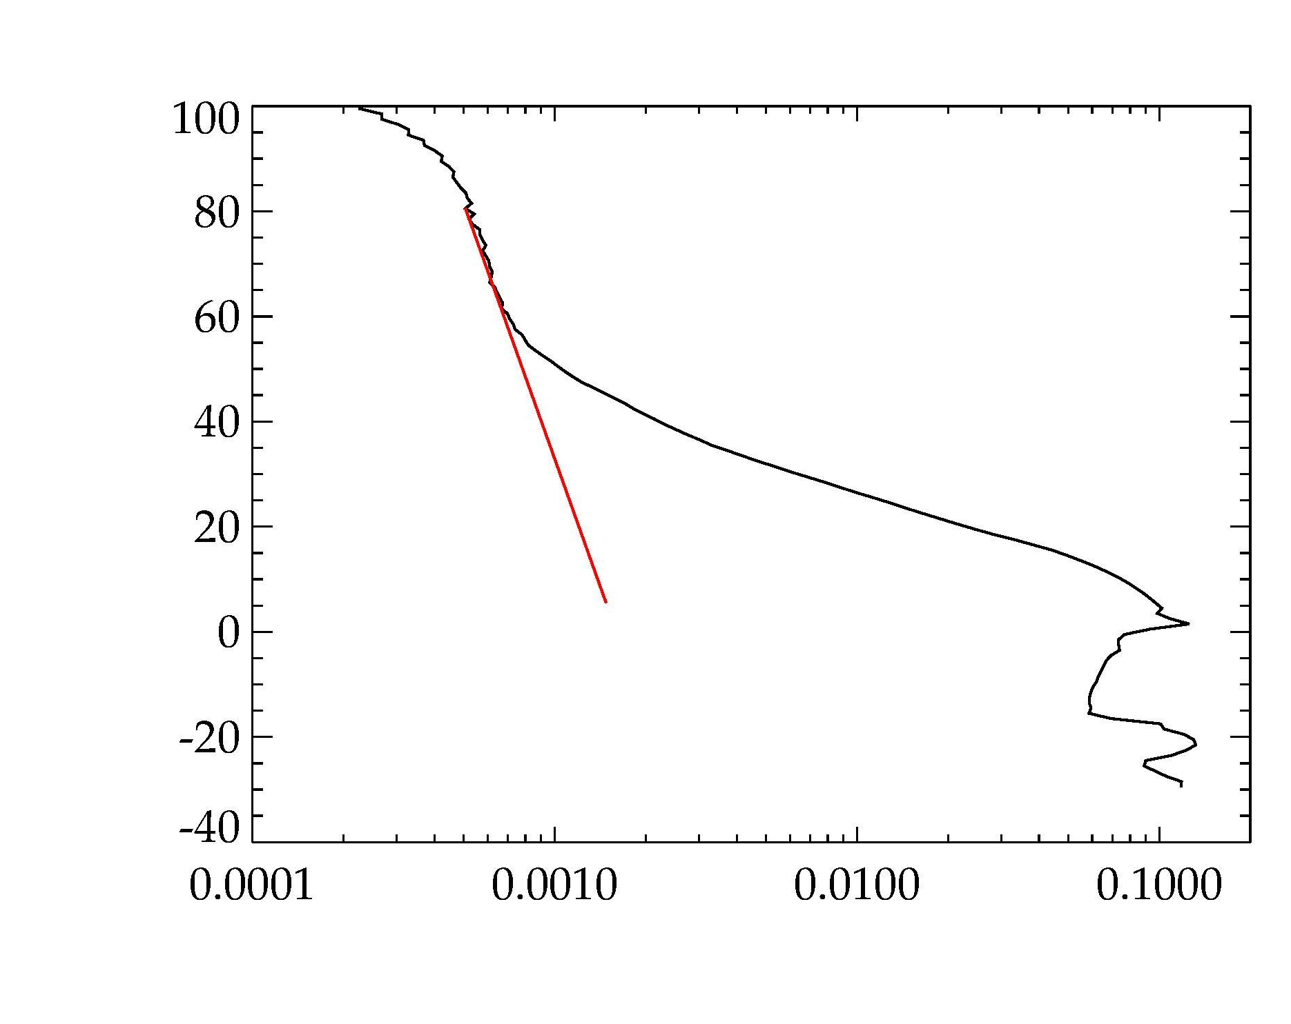
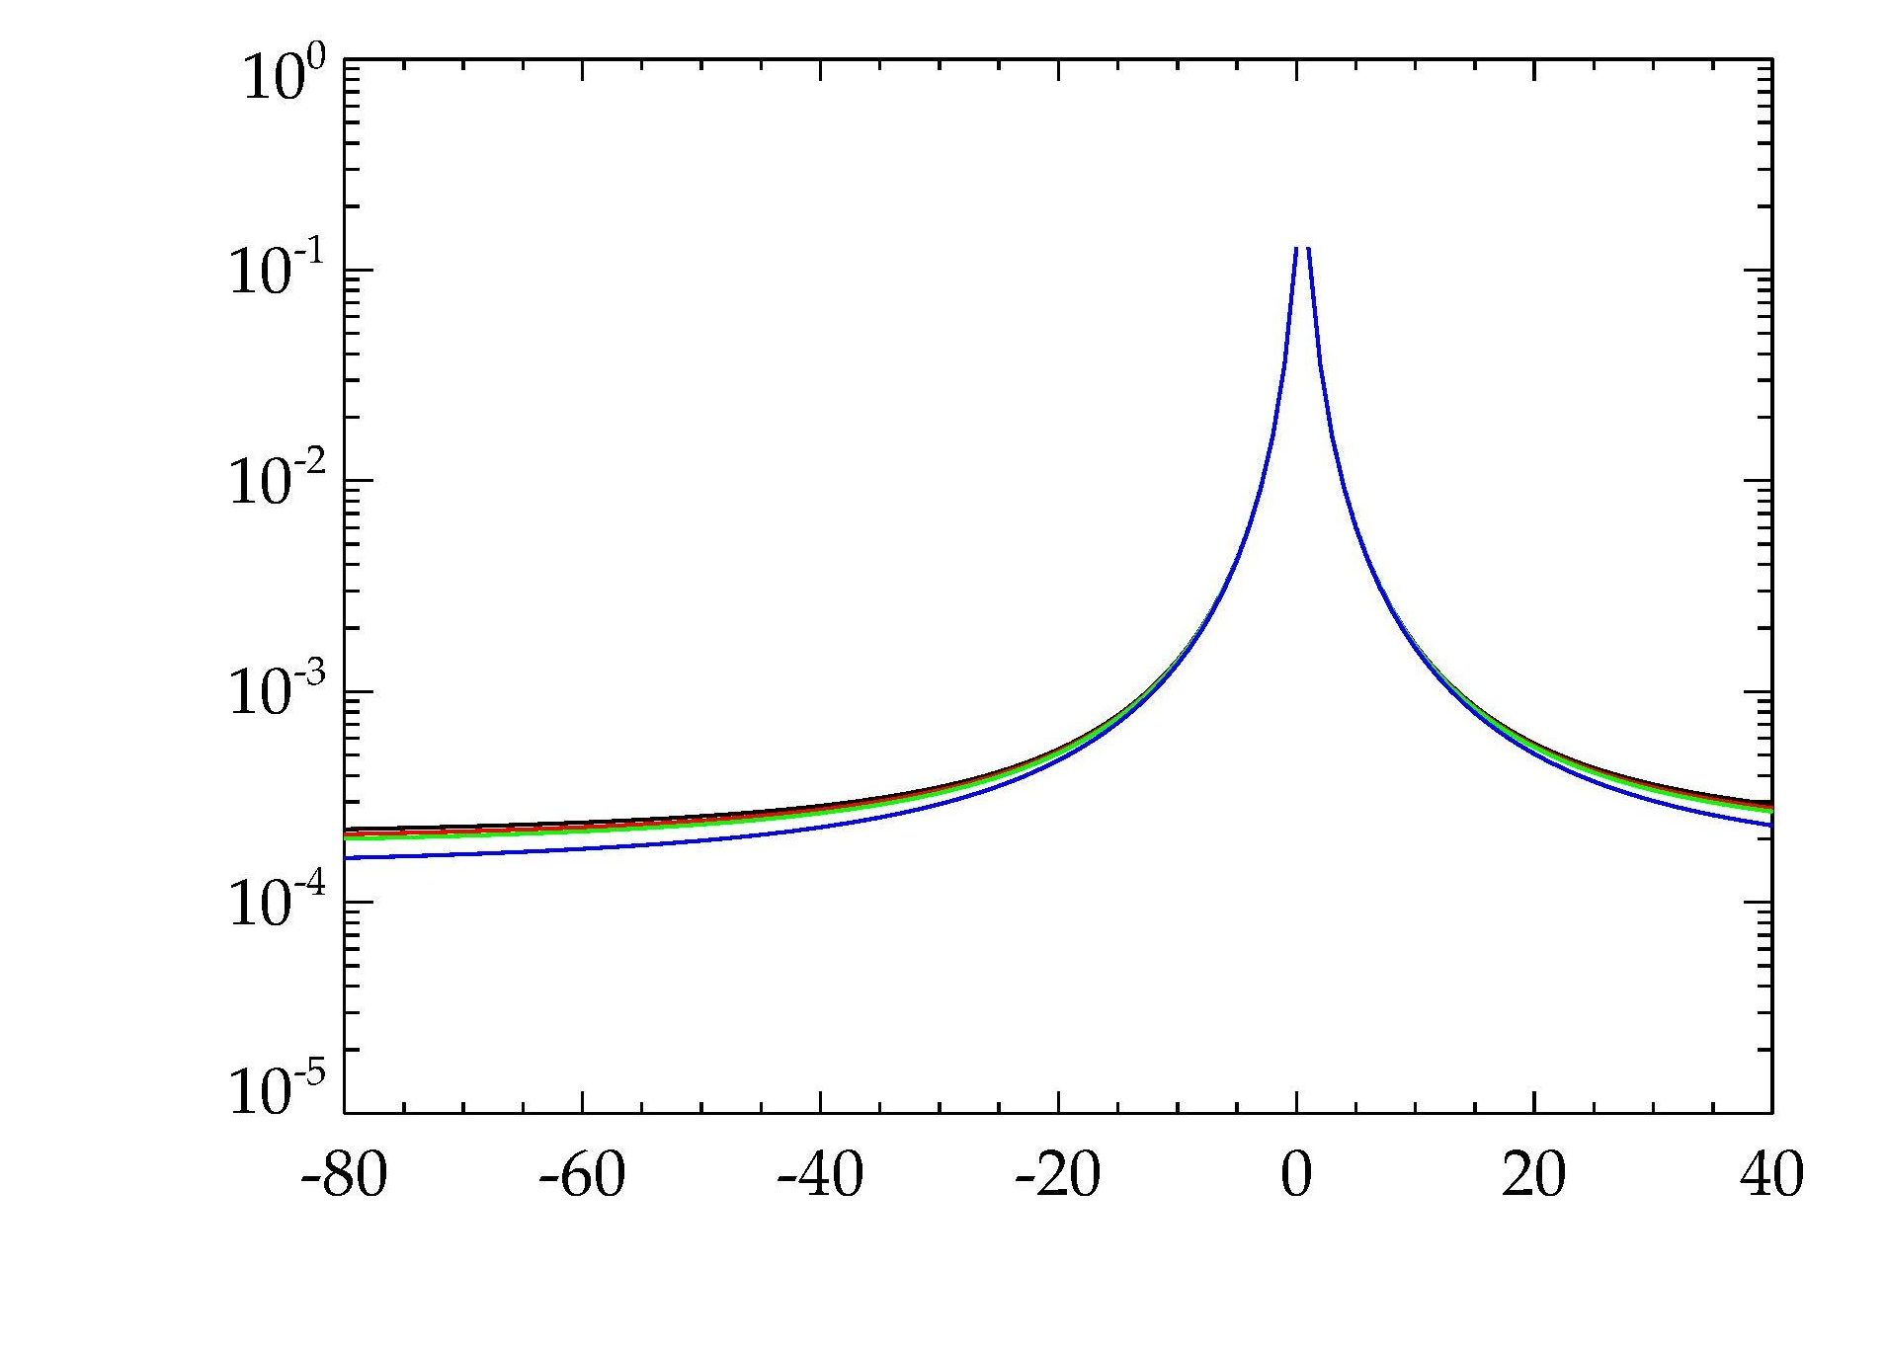
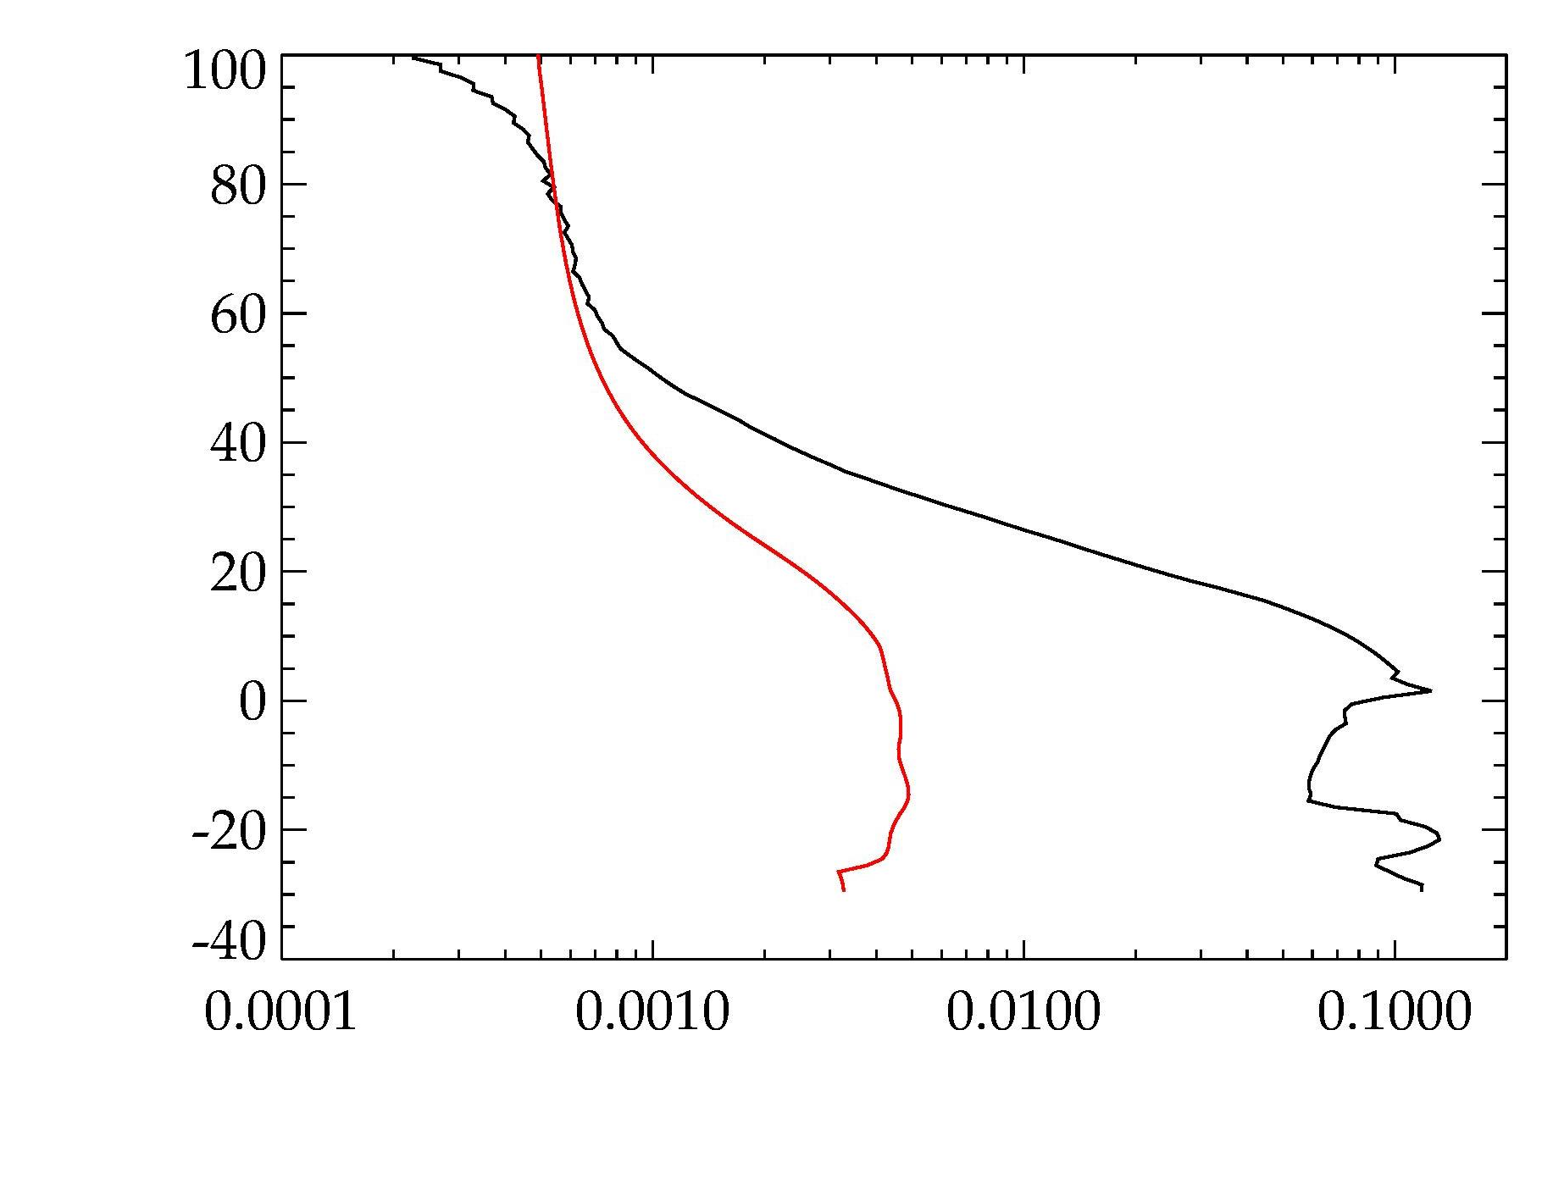
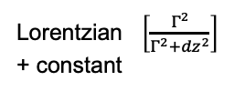
How best to correct for stray light ?
Empirical Fit Method
OR
Mirror scatter function deconvolution
Fit Range
675 nm
Lorentzian $\left[\frac{Γ^{2}}{Γ^{2}+{dz}^{2}}\right]$ + constant
Tangent Height (km)
Fractional Contribution
Predicted Stray Signal
Multiple wavelengths shown
Radiance Signal
TH diff from direct signal (km)
675 nm
Each method requires tuning to “truth”
Tangent Height
Radiance Signal

Slide 9
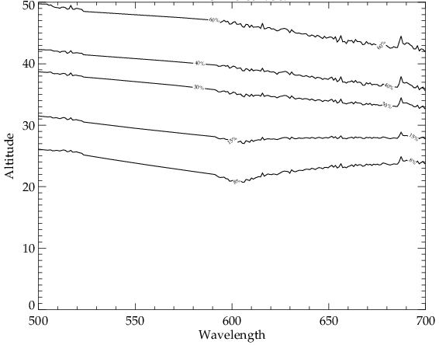
Lots of stray light !
Modeled stray light as a percent of useful signal across VIS ozone range
60%
Typical SL corrections achieve only a 10x reduction
40%
30%
15%
8%

Slide 10
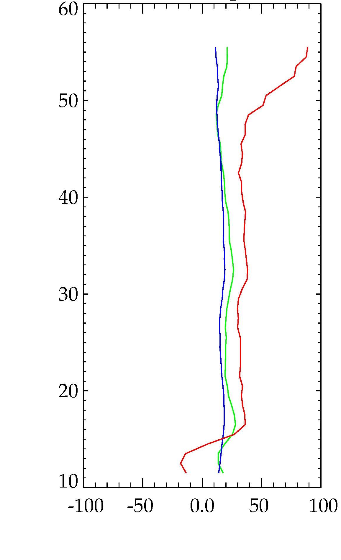
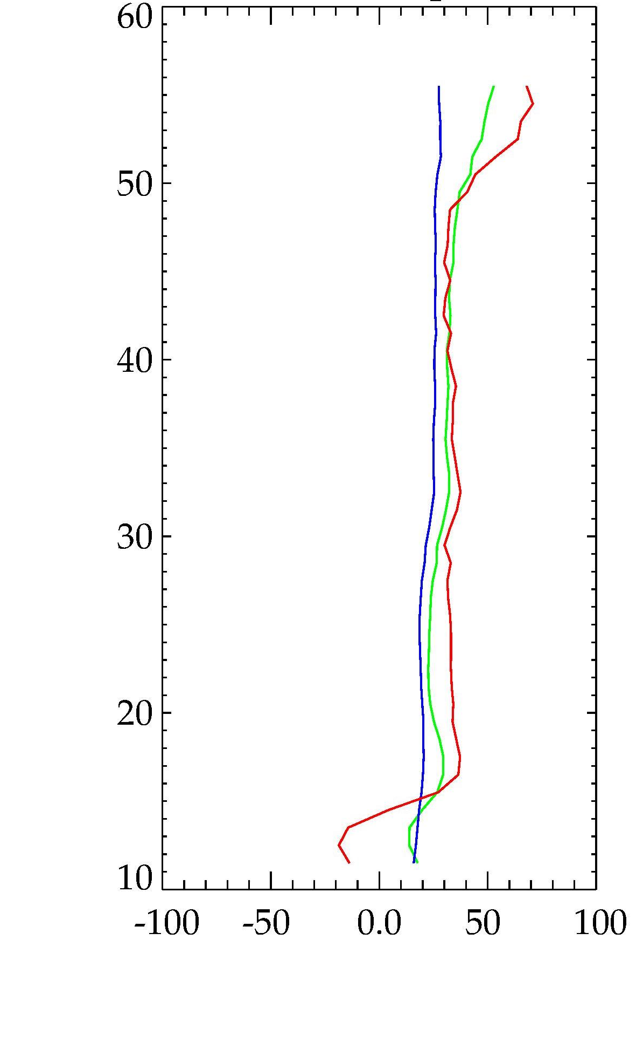
Post-correction Rayleigh residuals
Radiance Fit Method
Mirror Scatter Method
353 nm
508 nm
675 nm
Tangent Height
Tangent Height
Percent Residual
Percent Residual
There are significant differences, but hard to say which method is better

Slide 11
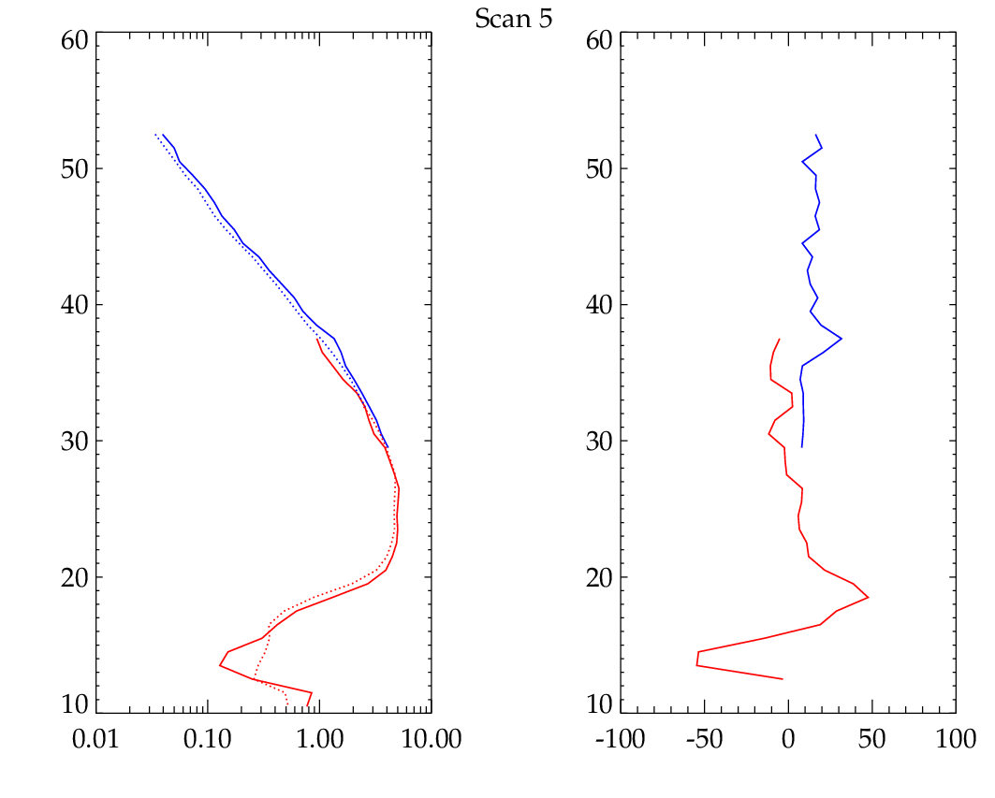
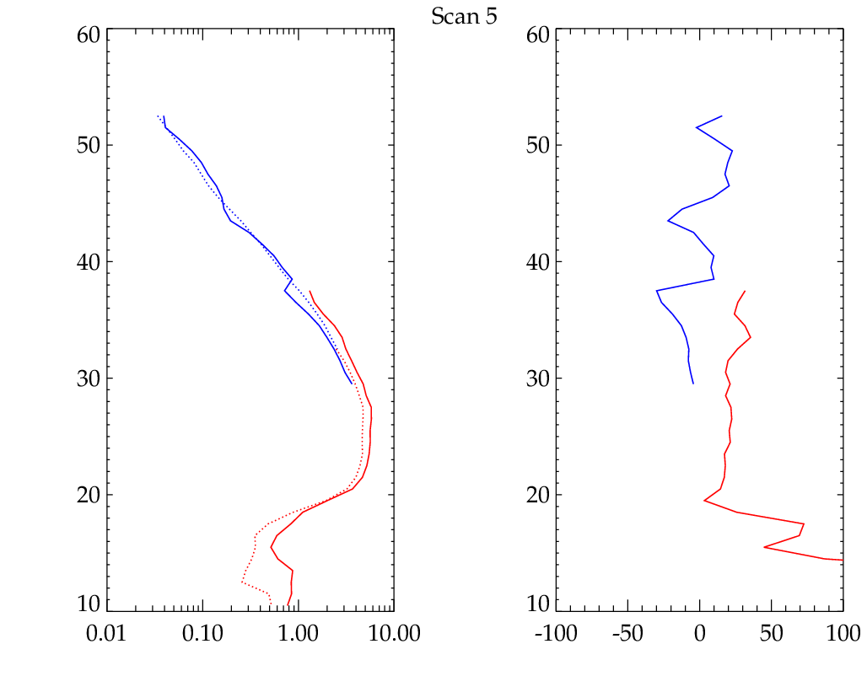
Sample retrieved ozone profiles
Comparisons to coincident OMPS measurements
Radiance Fit Method
Mirror Scatter Method
UV
VIS
Tangent Height
Tangent Height
O₃ Density × 10¹² (cm⁻³)
Percent Difference
O₃ Density × 10¹² (cm⁻³)
Percent Difference
Data are adjusted for TH errors based on the RSAS technique

Slide 12
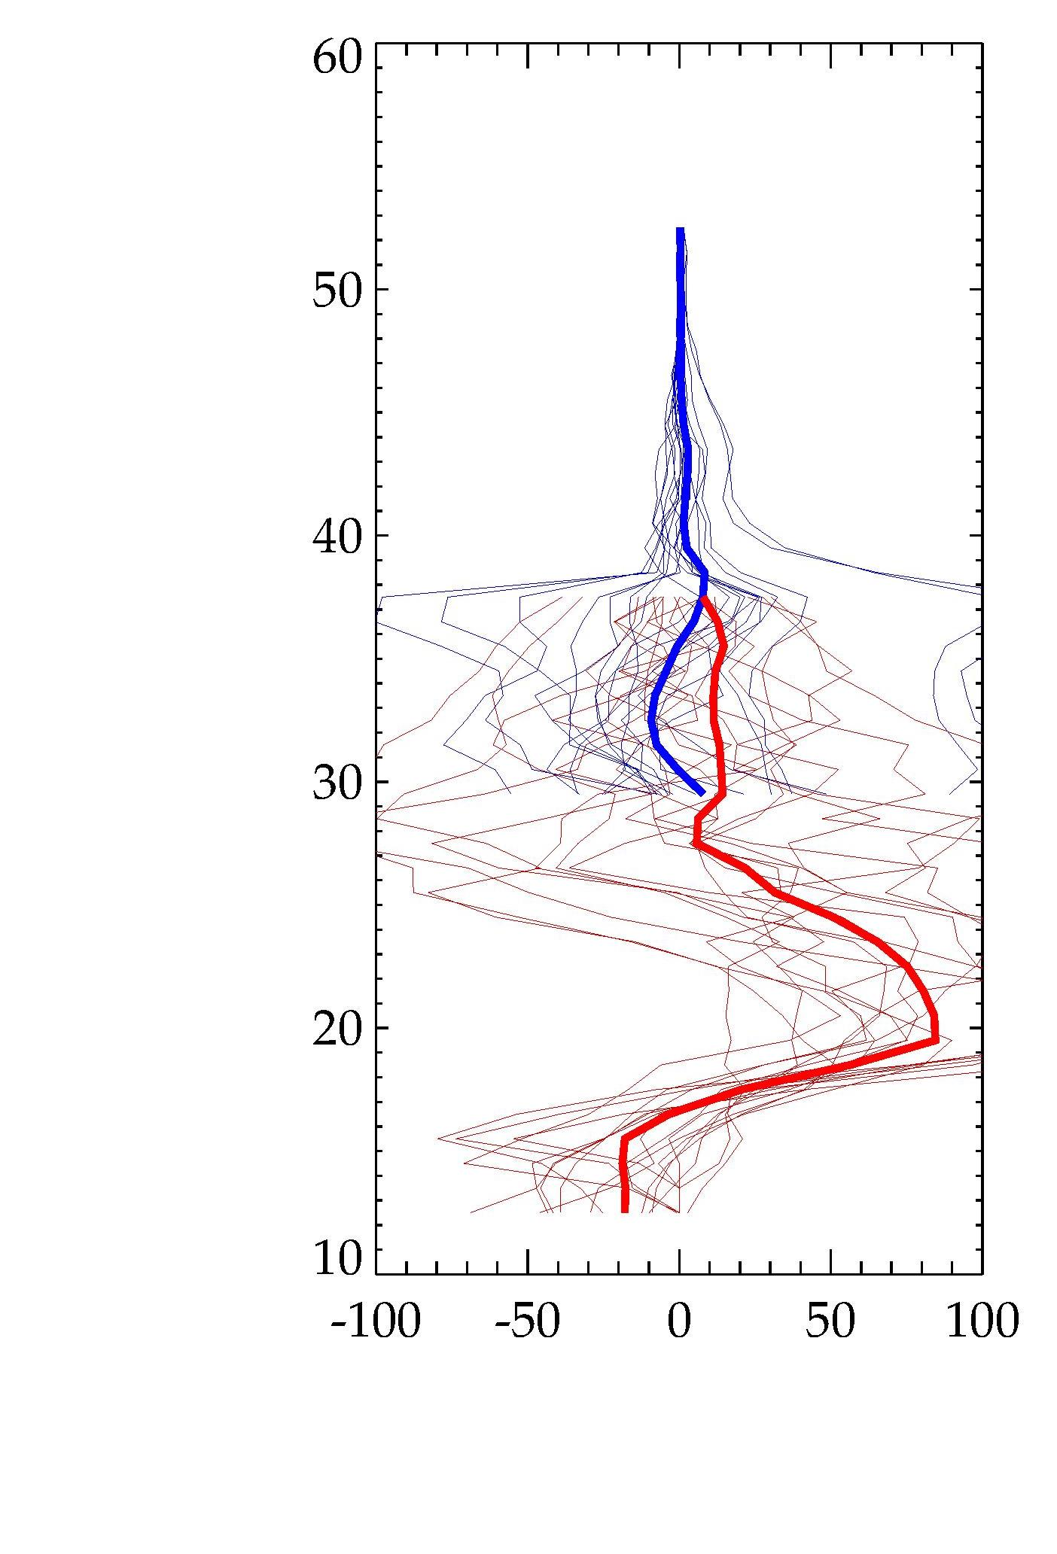
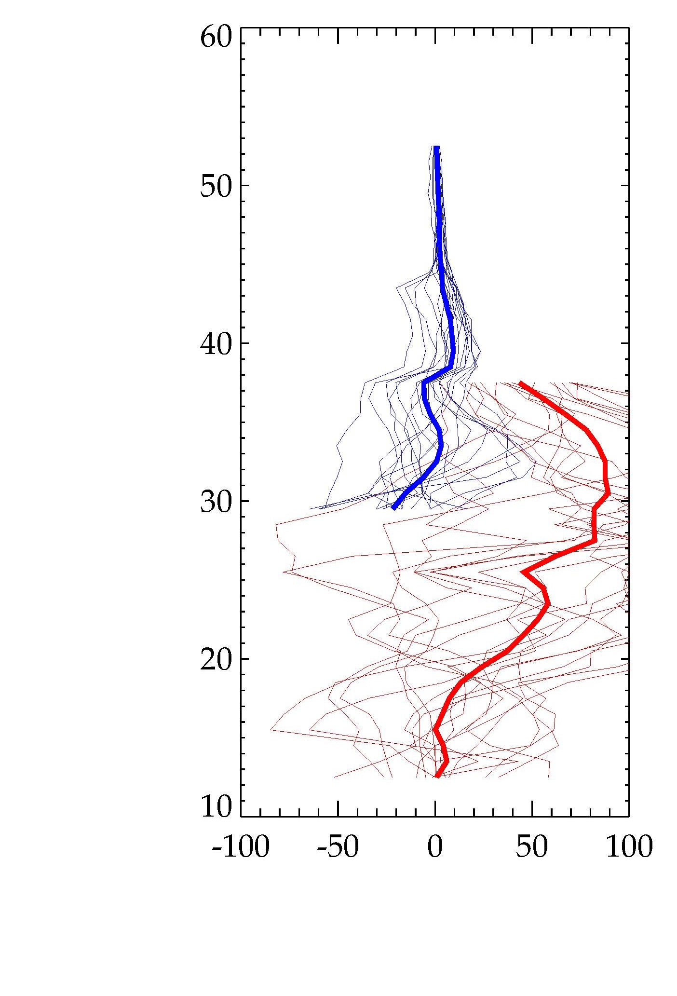
Two orbits (18 scans) have been processed
Ensemble difference vs. OMPS
Radiance Fit Method
Mirror Scatter Method
UV
VIS
Tangent Height
Tangent Height
Percent Difference
Percent Difference

Slide 13
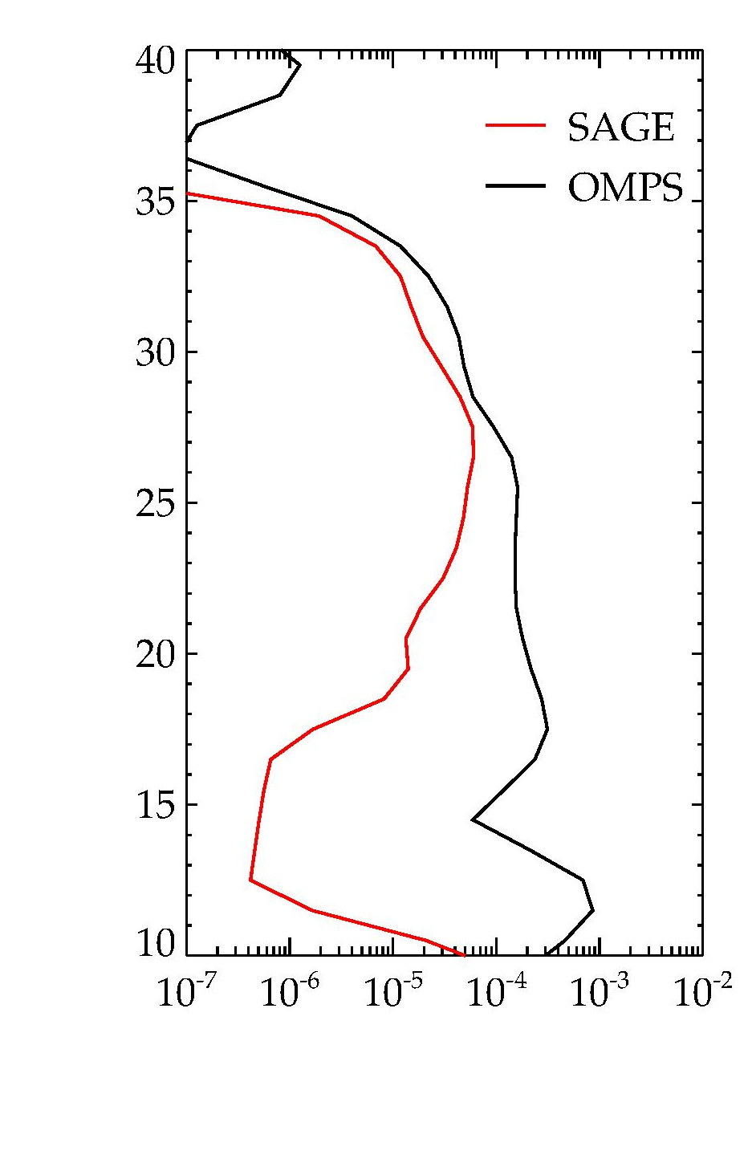
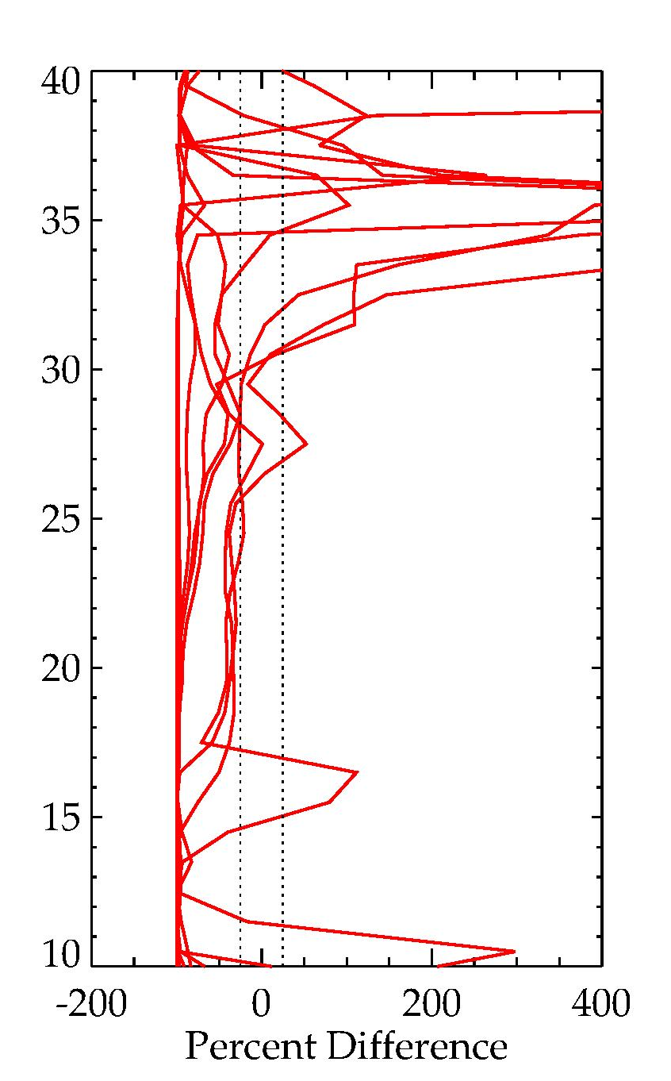
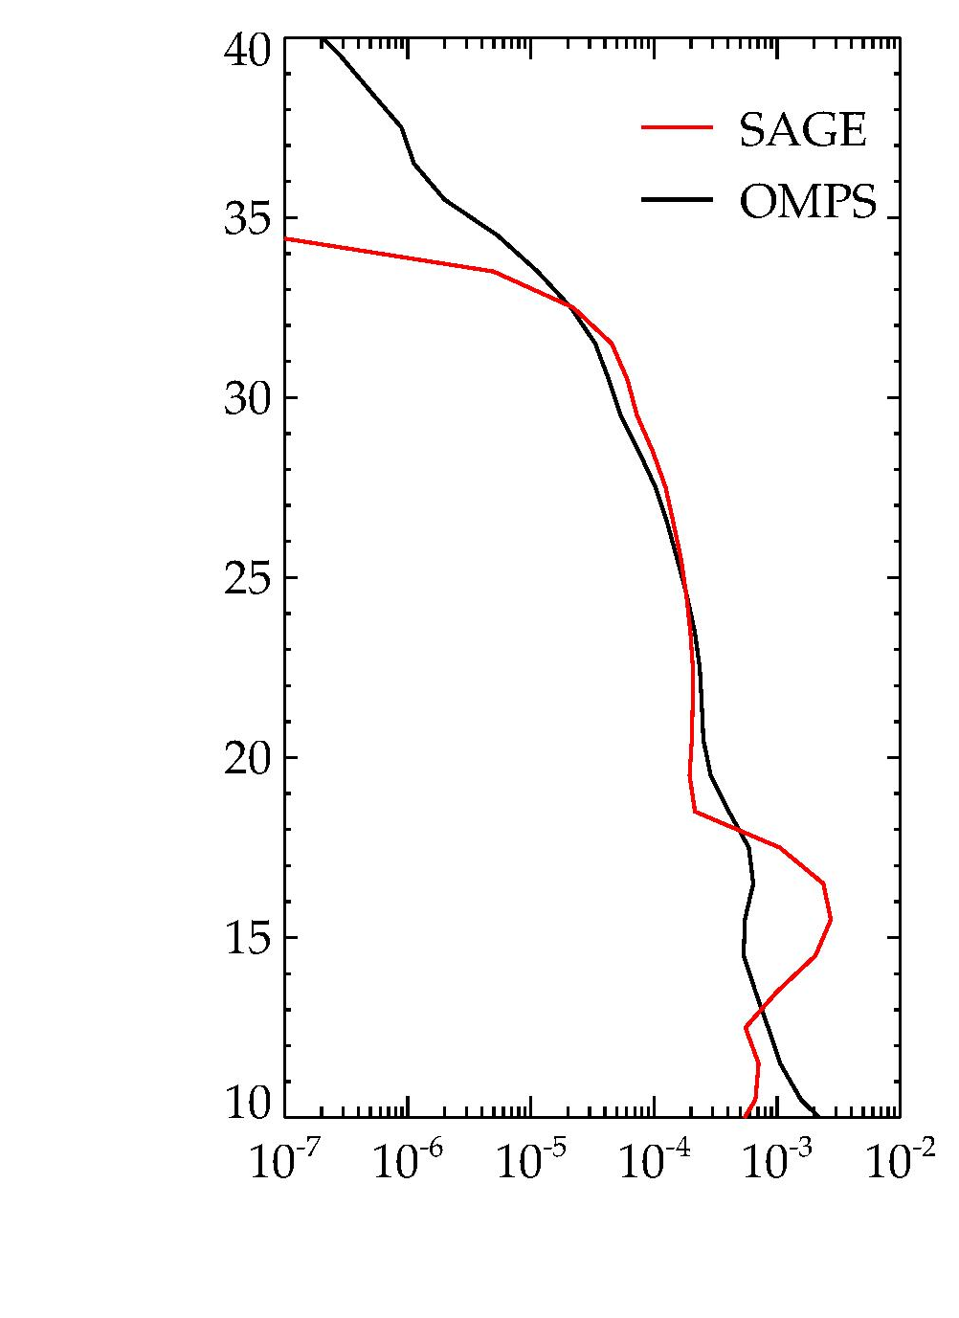
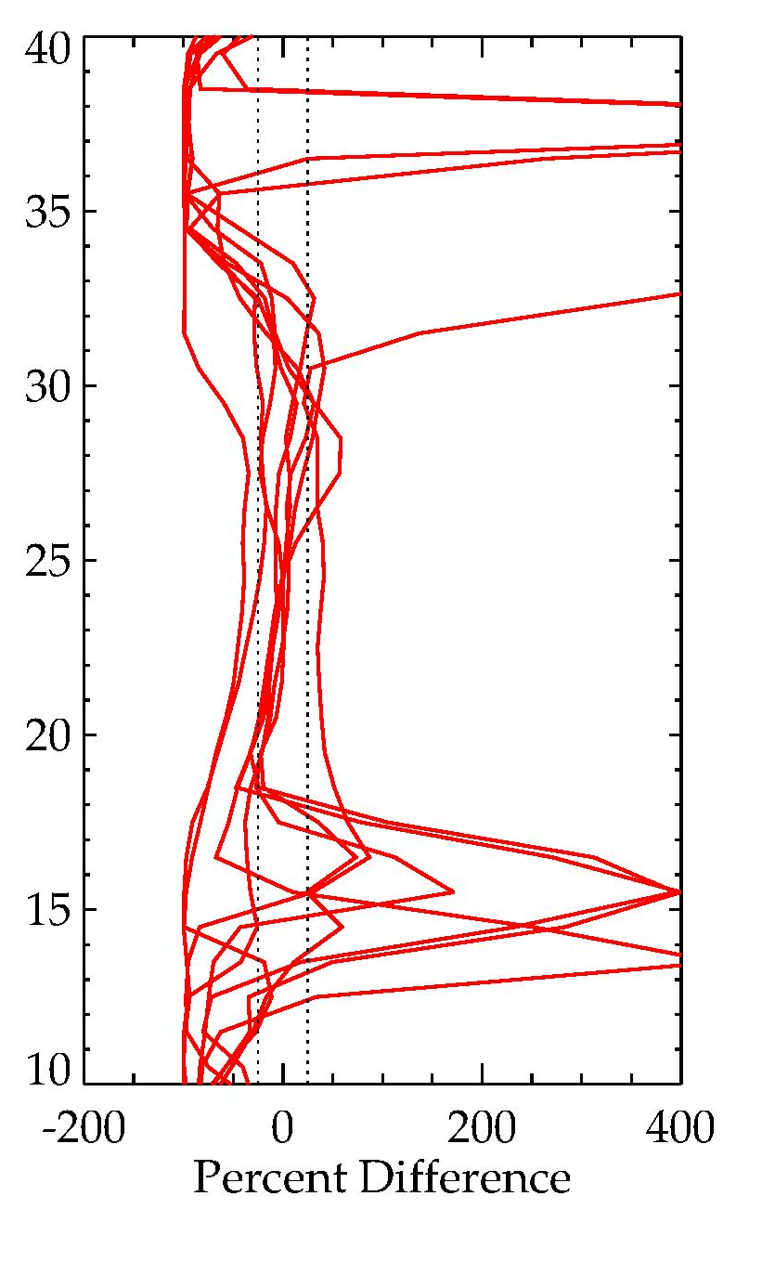
SAGE aerosol extinction (675 nm) compared to OMPS
Backward Scatter Orbit
Forward Scatter Orbit
Sample scan
9 scan comparison
Sample scan
9 scan comparison
Tangent Height (km)
Tangent Height (km)
Extinction Coeff. (km⁻¹)
Extinction Coeff. (km⁻¹)
Backscatter retrievals are more sensitive to radiance errors such as stray light
Notes:
Backscatter example neither best nor worst

Slide 14
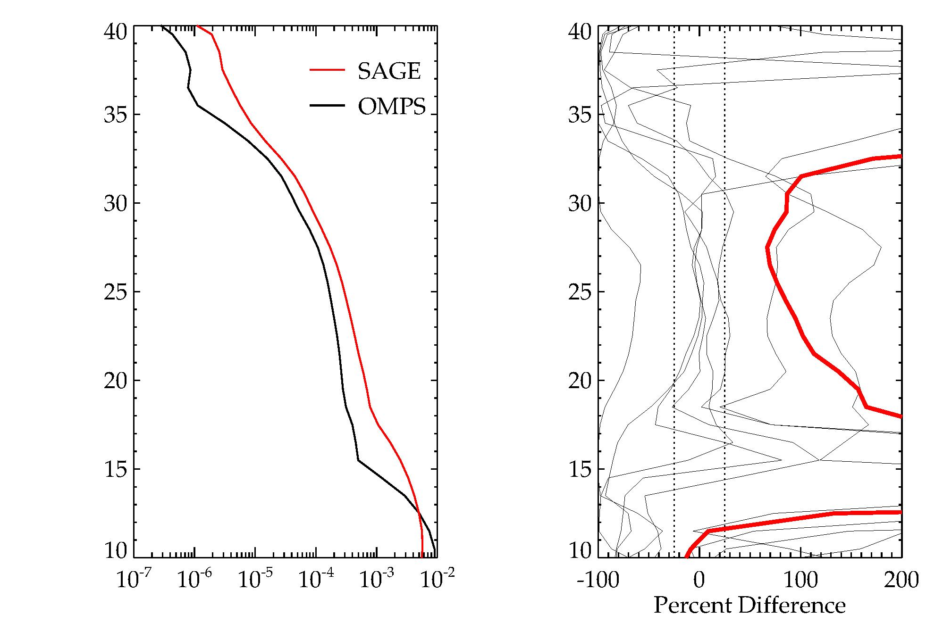
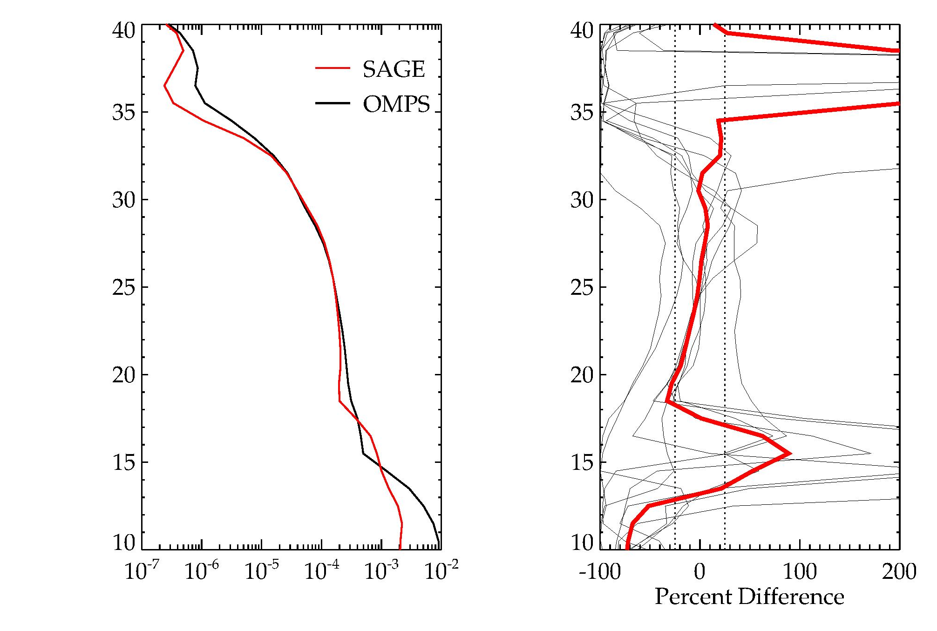
Forward scatter extinction profiles
Comparisons to coincident OMPS measurements
Radiance Fit Method
Mirror Scatter Method
Tangent Height
Tangent Height
Tangent Height
Tangent Height
Extinction Coeff. (km⁻¹)
Extinction Coeff. (km⁻¹)
Most scans are equally good for two techniques

Slide 15
Summary
SAGE stray light is a significant limitation
Difficult to tune stray light correction to work well for both ozone and aerosols
Forward scatter aerosol retrievals show most promise
Path Forward
Process data coincident with SAGE occultation
Concentrate LS operations on forward scattering
Begin work on production processing

