Slide 1
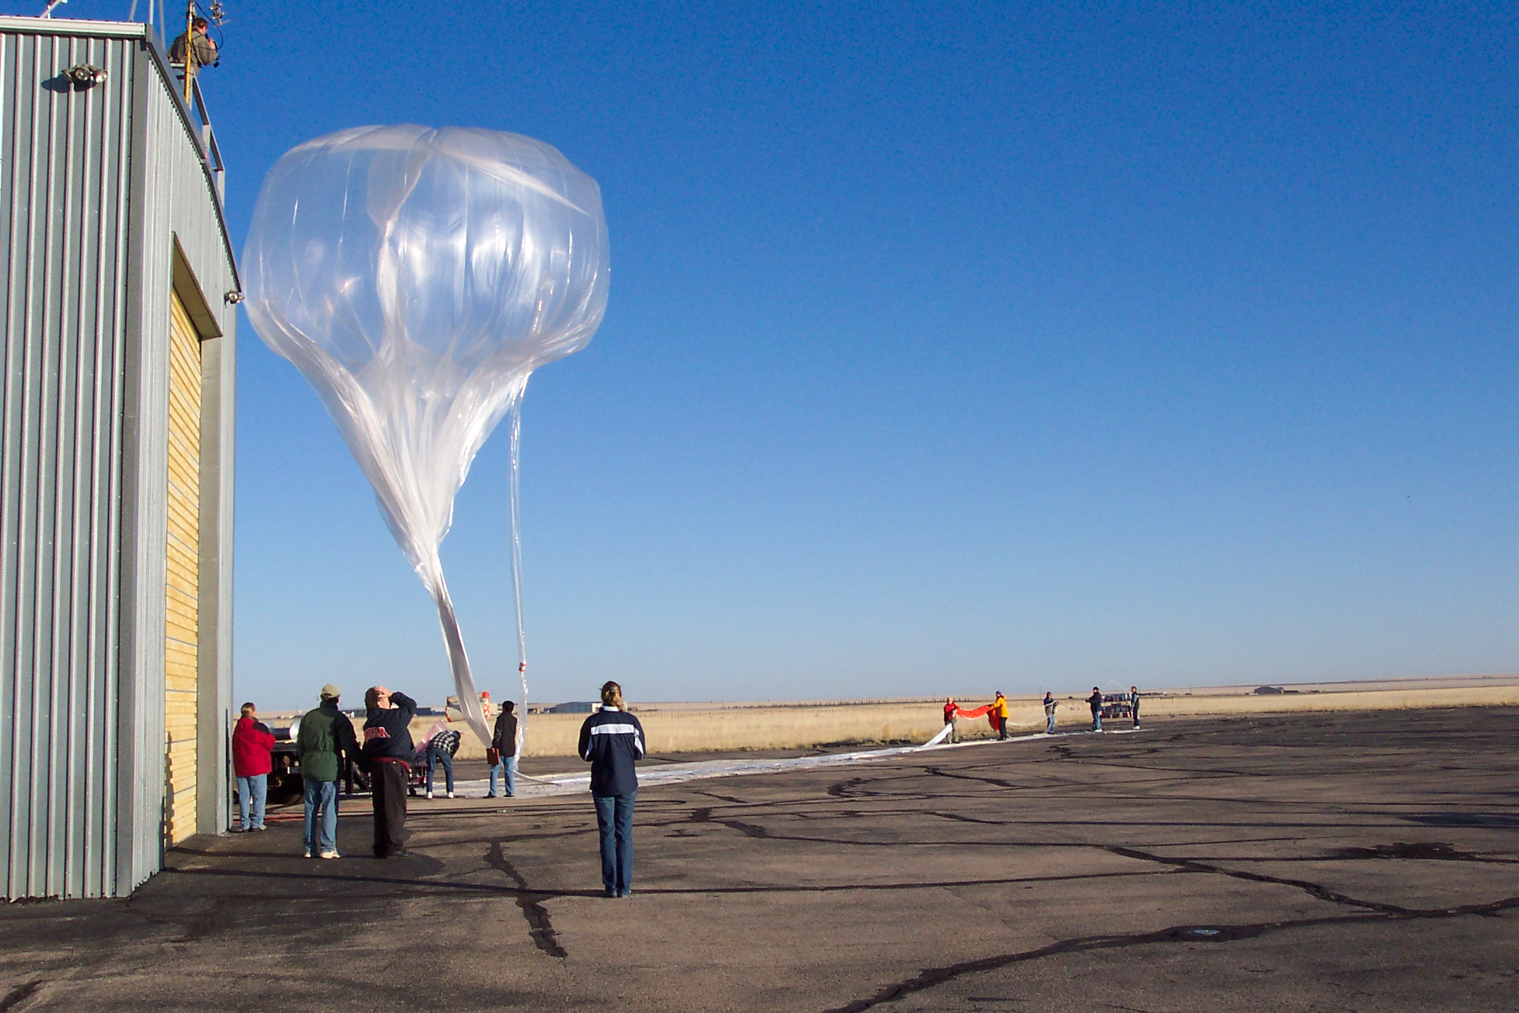




Optical Particle Counter Measurements for Comparison with Satellite Measurements of Extinction
Lars Kalnajs and Terry Deshler
LASP – University of Colorado, Boulder
With Assistance from the University of Wyoming

Slide 2
Objectives
Provide aerosol size distribution parameters for use by remote aerosol instruments, enhancing their ability to provide a broader range of aerosol properties
  Retrieve Aerosol Extinction and Surface Area Densities from In situ Size Distribution Measurements for comparison with, and use by, satellite instruments
Continue in situ balloon borne measurements of stratospheric aerosol size distributions to compare with SAGE III-ISS and other satellites
Augment an existing tropical balloon sounding site with aerosol instruments and performing regular tropical soundings
Maintain and enhance an in situ measurement capability to provide measurement data from regions with high aerosol loadings that may be opaque to limb sounding measurements during future volcanic eruptions

Slide 3
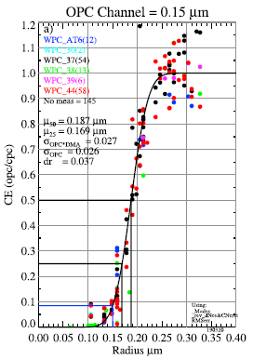

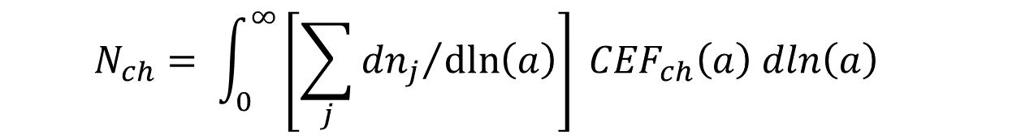
Deshler, T., Luo, B., Kovilakam, M., Peter, T., & Kalnajs, L. E. (2019). Retrieval of aerosol size distributions from in situ particle counter measurements: Instrument counting efficiency and comparisons with satellite measurements. Journal of Geophysical Research: Atmospheres, 124.
$$N_{ch}= \int_{0}^{∞}{\left[\sum_{j}{{{dn}_{j}}/{\operatorname{dln}\left(a\right)}}\right] {CEF}_{ch}\left(a\right) dln\left(a\right) }$$
Where for lognormal distributions,

Slide 4
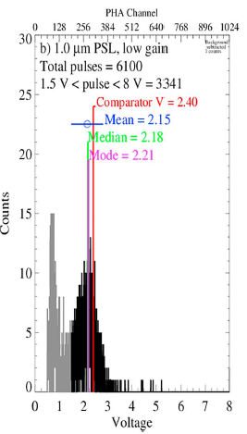
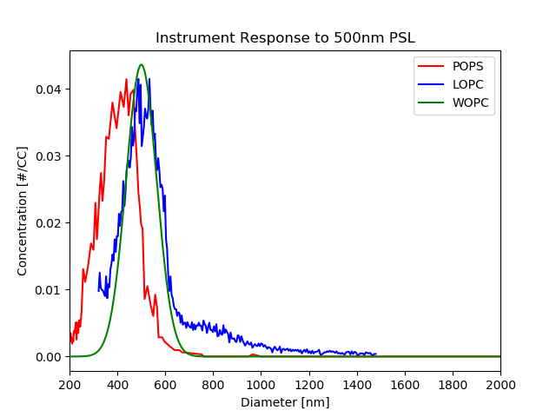
Inverting the cumulative counting efficiency curve leads to a Gaussian distribution as measured here
Wyoming
White light
OPC

Slide 5


Extinction calculations from in situ measurements
Is the extinction cross section, with m the index of refraction, the only tricky part of the calculation.
Calculation of index of refraction, m, requires:
  Water vapor and temperature profiles
  Sulfuric acid weight percent = f(wv, T) [Steele and Hamill, 1981]
  Palmer and Williams [1975] for m(300 K) = f(sulfuric acid weight percent)
  Lorentz-Lorenz for index of refraction = f(T, density of sulfuric acid, )

Slide 6
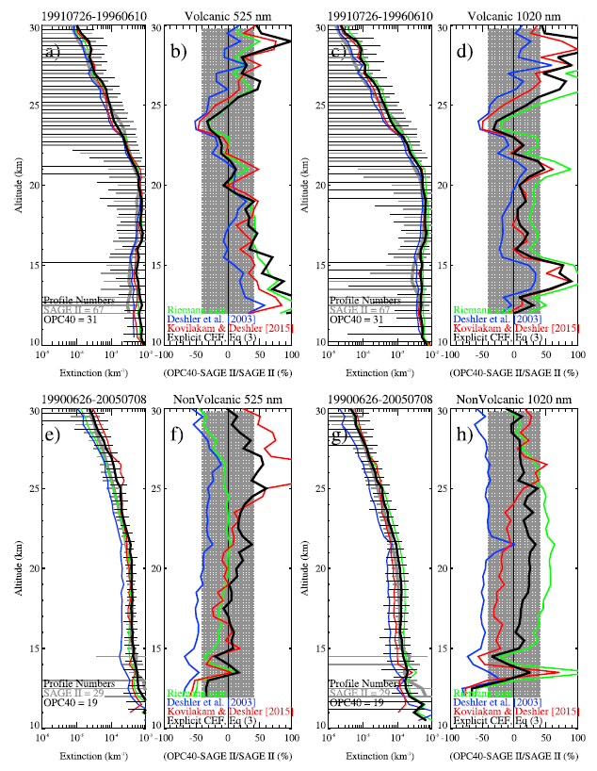
OPC Extinction at 525 and 1020 nm compared to SAGE II
Volcanic Period
Non-Volcanic Period

Slide 7
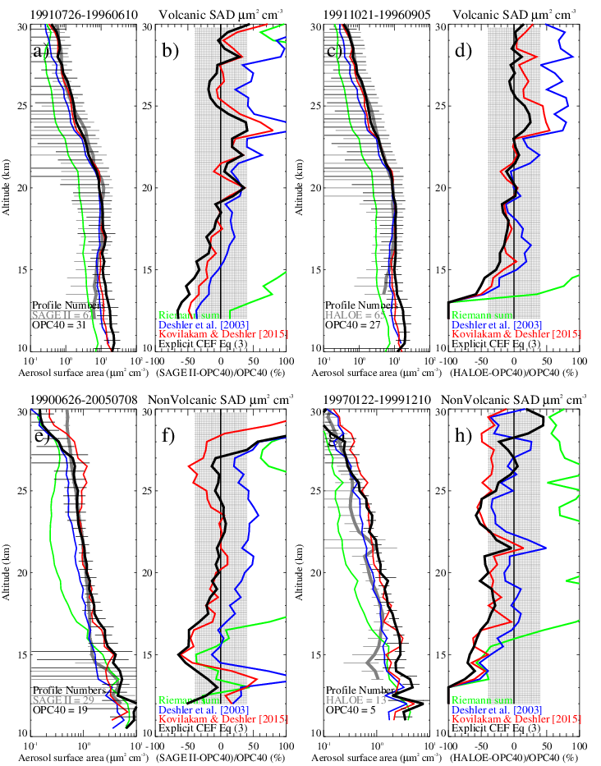
SAGE and HALOE SAD compared to OPC
Volcanic Period
SAGE II
HALOE
Non-Volcanic Period

Slide 8
Objectives
Provide aerosol size distribution parameters for use by remote aerosol instruments, enhancing their ability to provide a broader range of aerosol properties
  Retrieve Aerosol Extinction and Surface Area Densities from In situ Size Distribution Measurements for comparison with, and use by, satellite instruments
Continue in situ balloon borne measurements of stratospheric aerosol size distributions to compare with SAGE III-ISS and other satellites
Augment an existing tropical balloon sounding site with aerosol instruments and performing regular tropical soundings
Maintain and enhance an in situ measurement capability to provide measurement data from regions with high aerosol loadings that may be opaque to limb sounding measurements during future volcanic eruptions

Slide 9
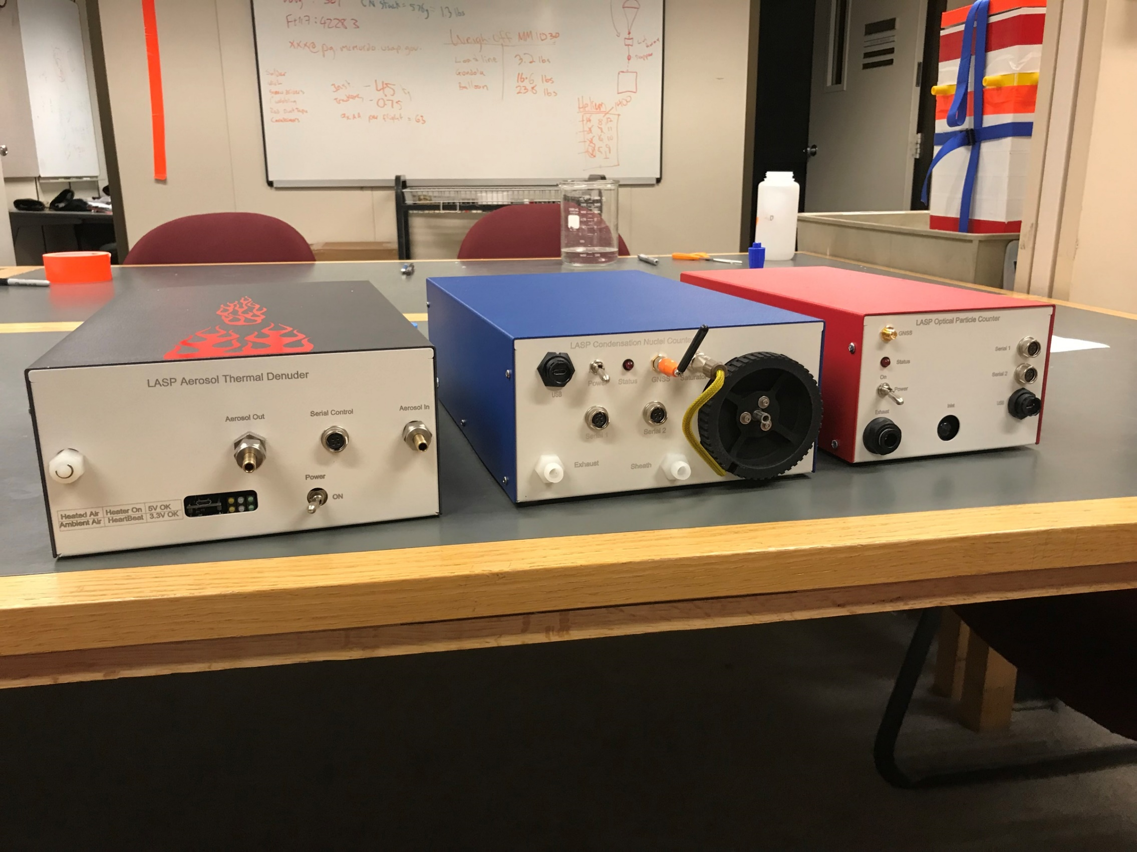
Optical Particle Counter
Condensation Nuclei Counter
Thermal Denuder

Slide 10
LASP Optical Particle Counter
Condensation Nuclei Counter
Size Range (radius) | 0.125 – 10μm
Size Bins | 2048 Raw, 1200 Effective, log spaced
Flow Rate | 20 LPM (660 cm³ per sample at 0.5Hz)
Concentration Range | 10⁻³ – 10³ cm⁻³ (at 0.1Hz)
Dimensions | 30cm x 10cm x 15cm
Mass | 2.4Kg (including battery)
Cost | ~$5K (component cost)
Light Source | 90mW 780nm Laser Diode
Detector geometry | 90º Scattering angle, 60º Acceptance
Detector | APD, non linear gain, 2 gain stages
Minimum Detectable Size (radius) | 0.007μm
Flow Rate | 1 LPM (33 cm³ per sample at 0.5Hz)
Sensitivity | 10⁻² – 10³ cm⁻³ (at 0.1Hz)
Dimensions | 30cm x 10cm x 18cm
Operation Time | 4 hours
Mass | 2.6Kg (including battery)
Cost | ~$4K (component cost)
Notes:
Add photos of completed LOPC and CNC

Slide 11
Activities / Commitments
Recent in situ particle counter flights
  Laramie, Wyoming (2), Boulder, Colorado (1), Timmons, Ontario, Canada (1)
  McMurdo Station, Antarctica (9)
Commitments (All projects)
  Tropical tropopause layer from Lagrangian balloons to be released from the Seychelles as part of Strateole 2, November 2019
  Final flight from Laramie, Wyoming, January 2020
  First tropical profile flights from Costa Rica, March 2020
  Additional profiles from McMurdo Station, April/May 2020

Slide 12
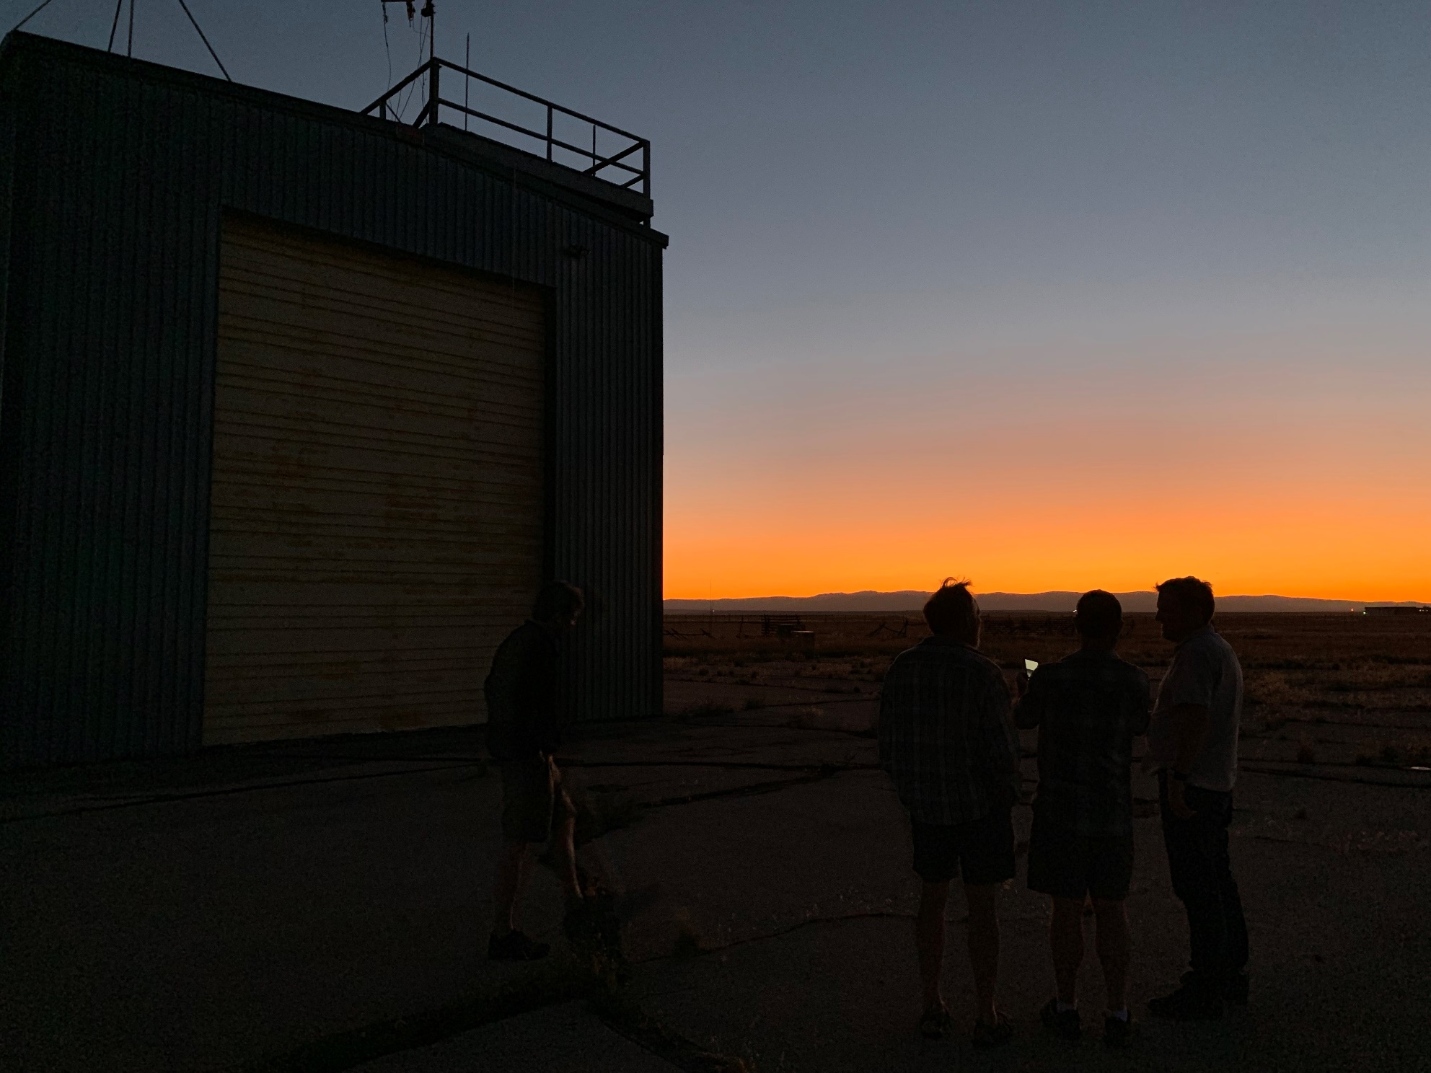
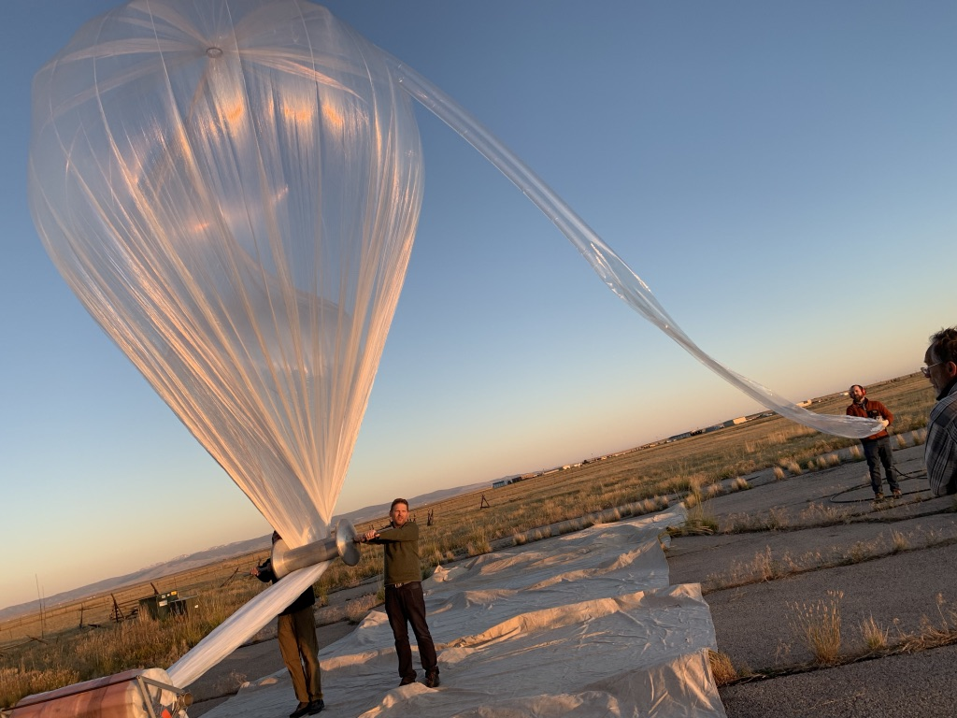
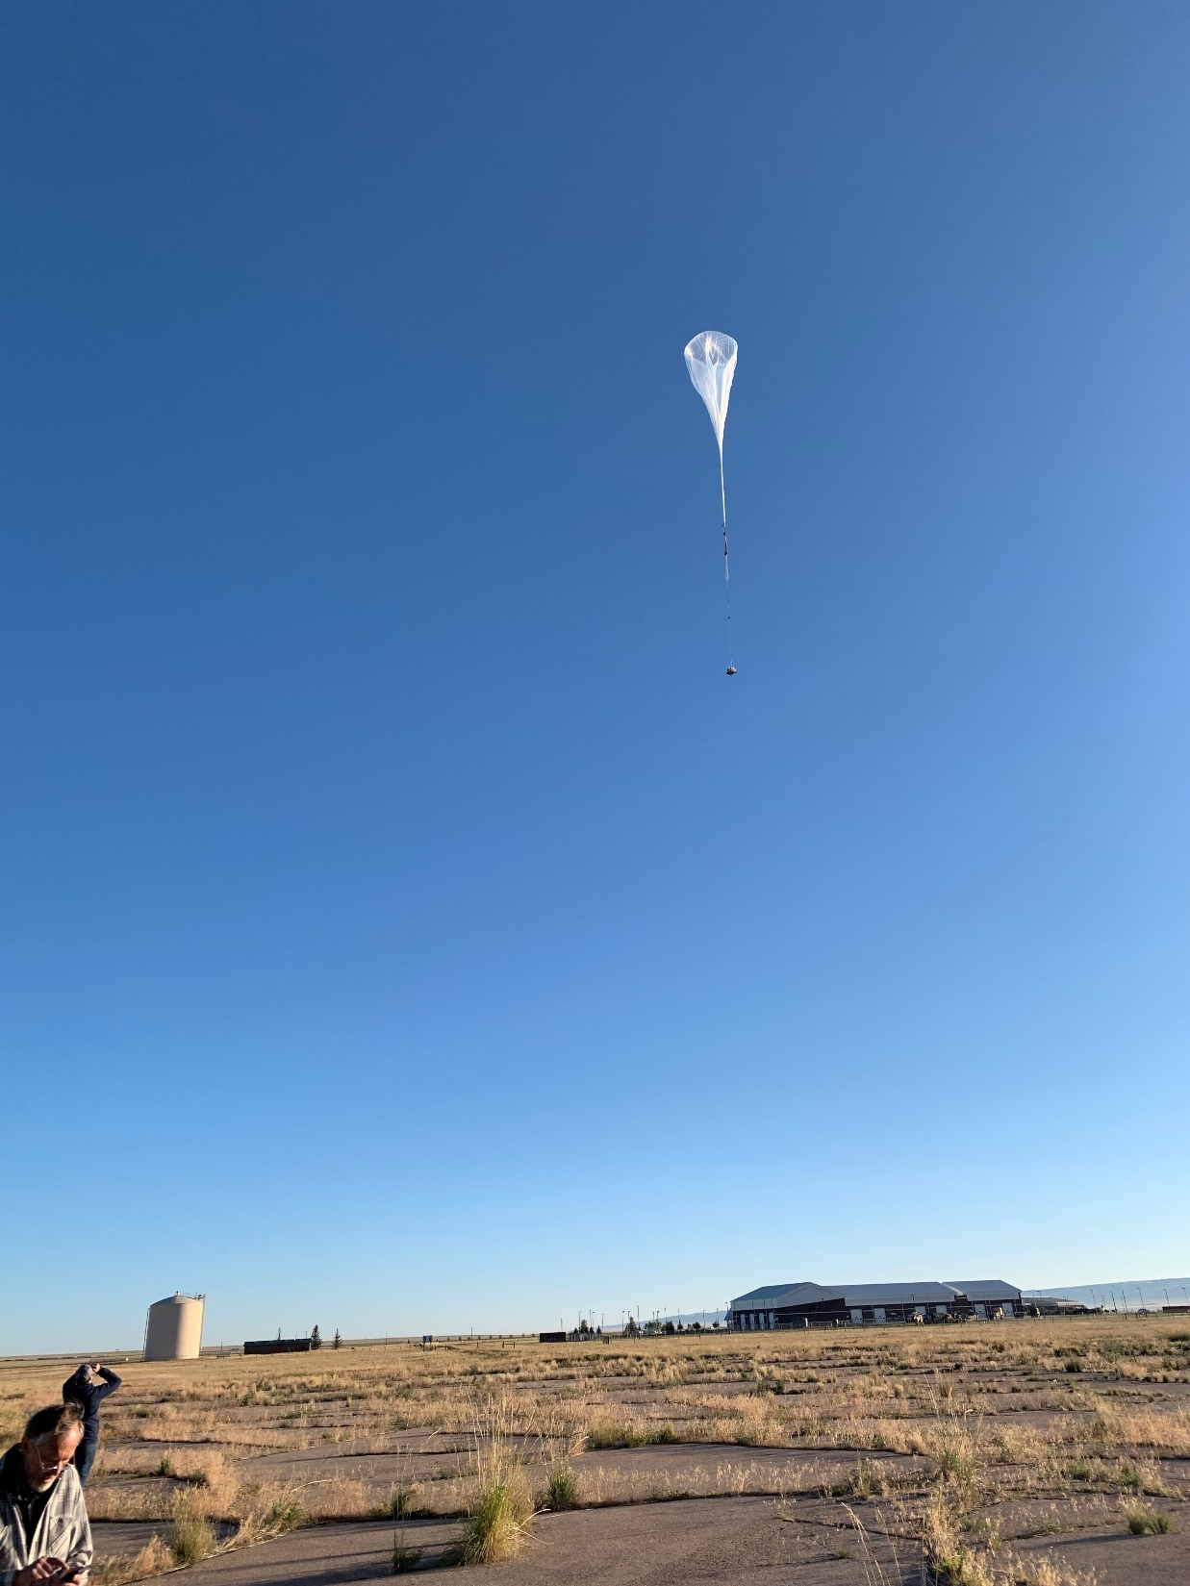
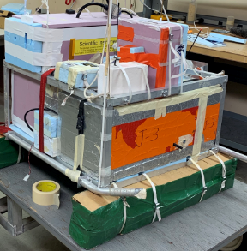
28 August 2019, Laramie, Wyoming

Slide 13
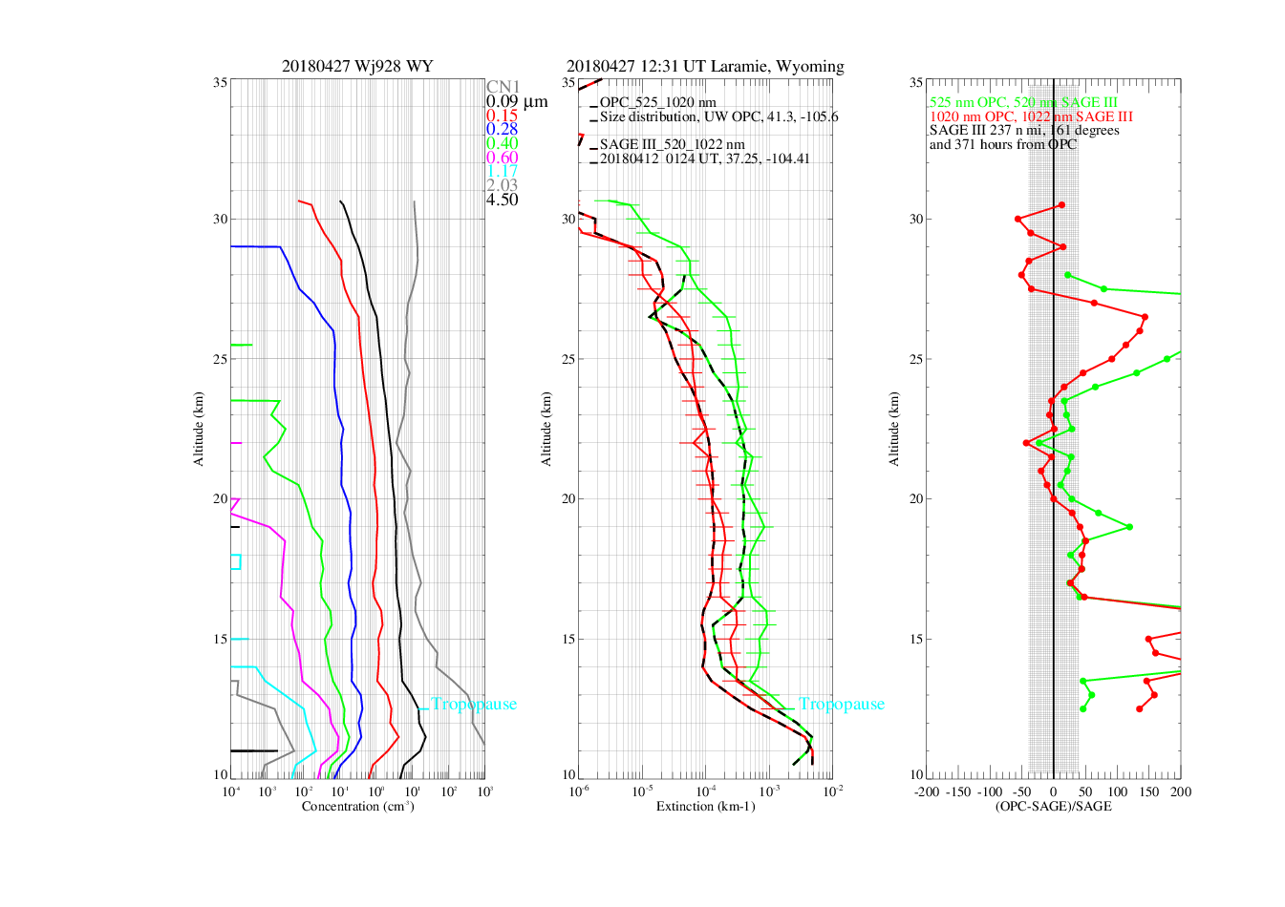

Slide 14
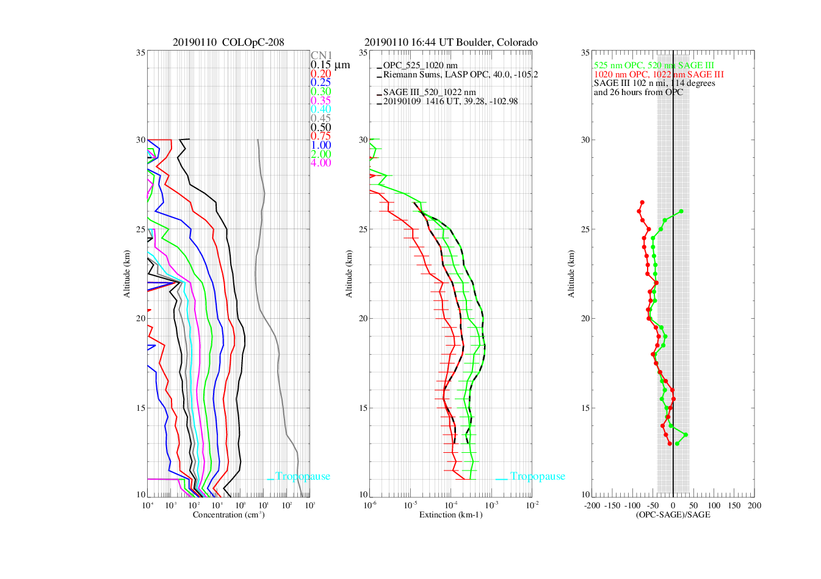

Slide 15
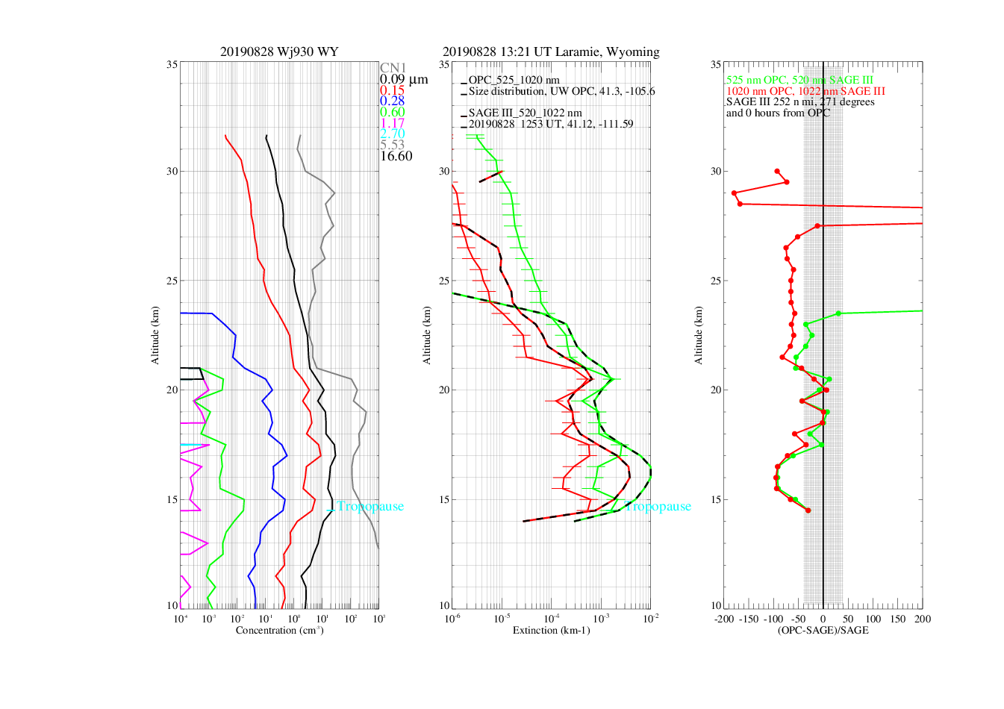
Raikoke /
Uluwan
Eruptions
Wildfire
Smoke

Slide 16
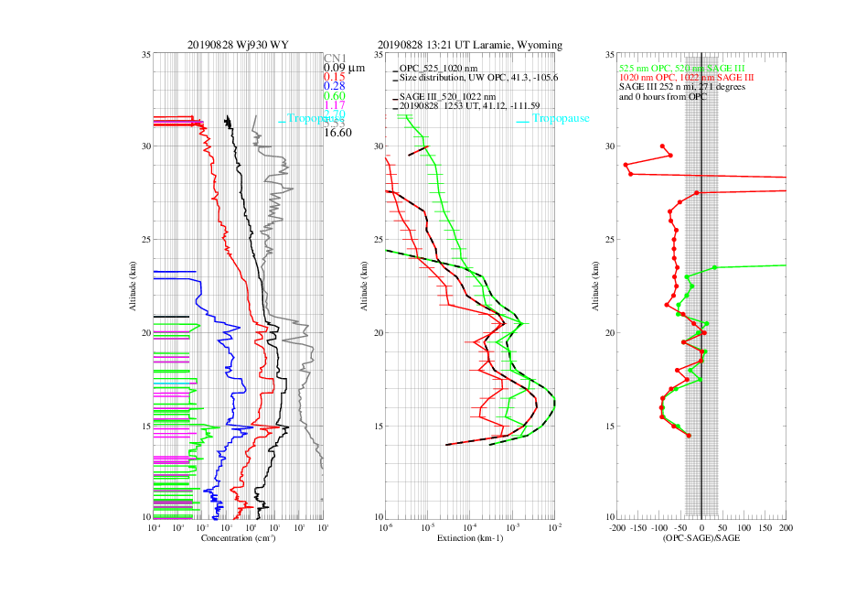
Raikoke /
Uluwan
Eruptions
Wildfire
Smoke

Slide 17
https://www.sciencemag.org/news/2019/09/sulfur-spewing-russian-volcano-turning-sunsets-purple

Slide 19
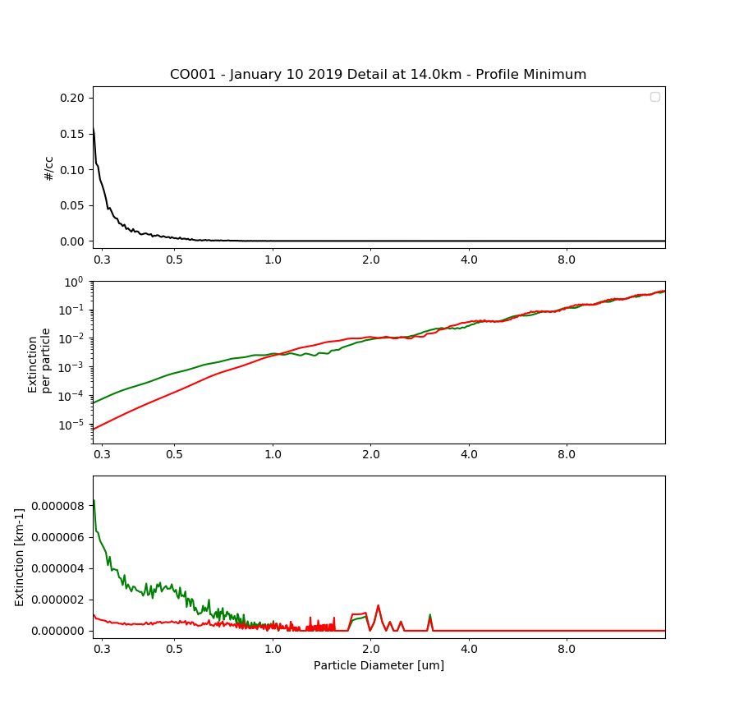
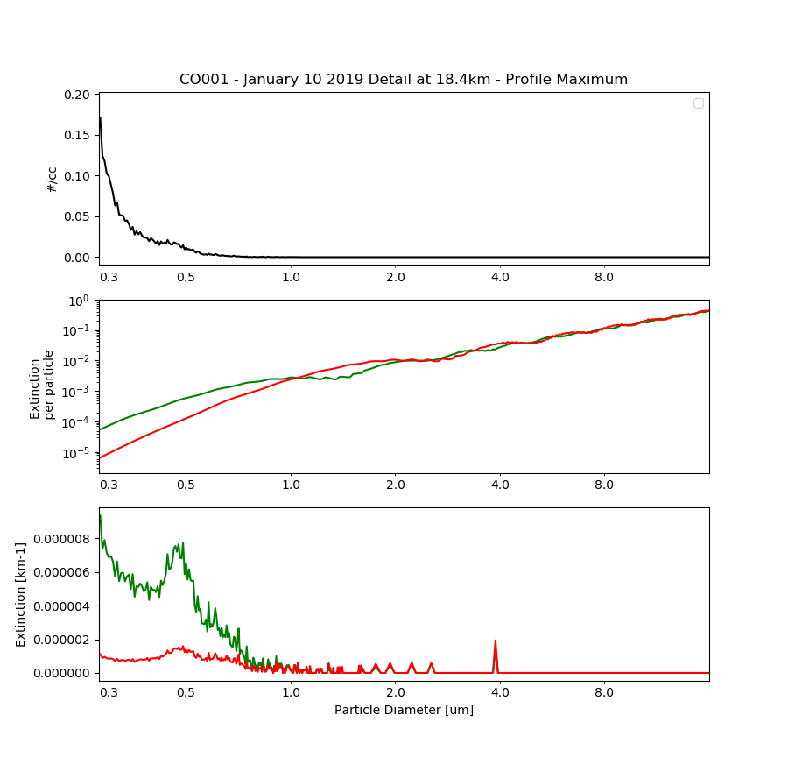

Slide 20
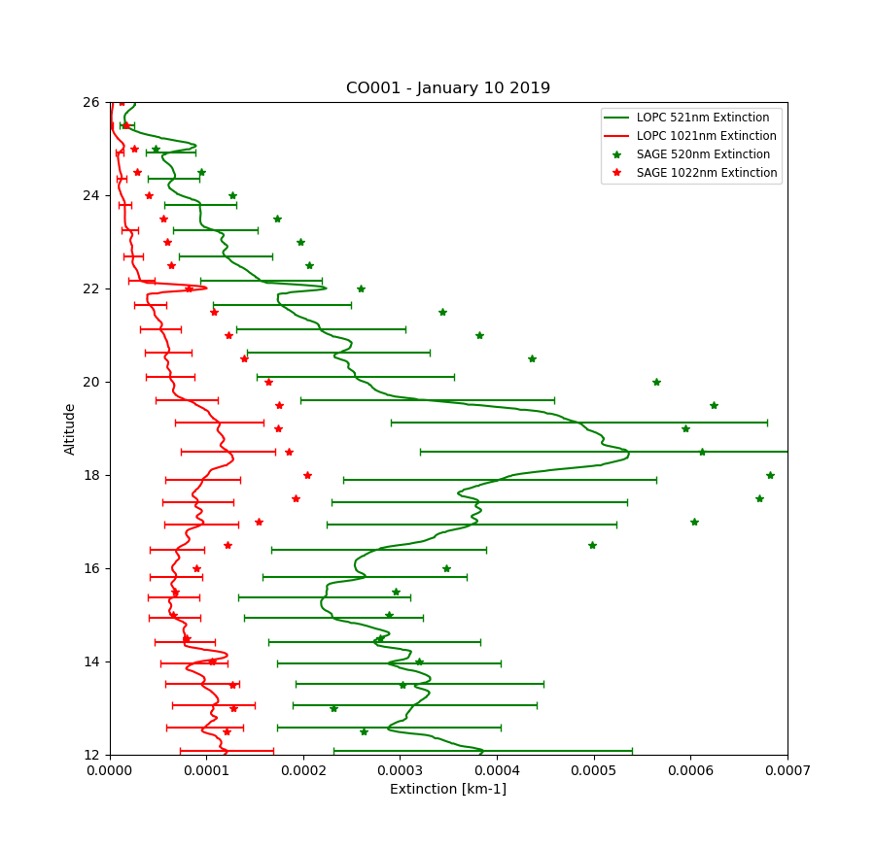

Slide 21
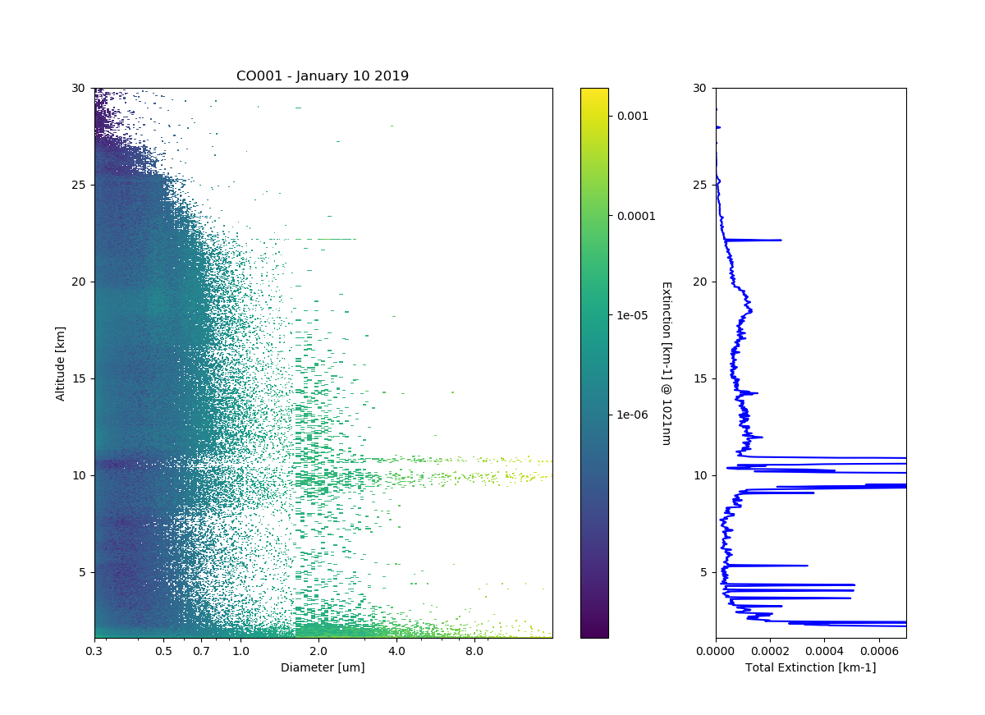

Slide 22
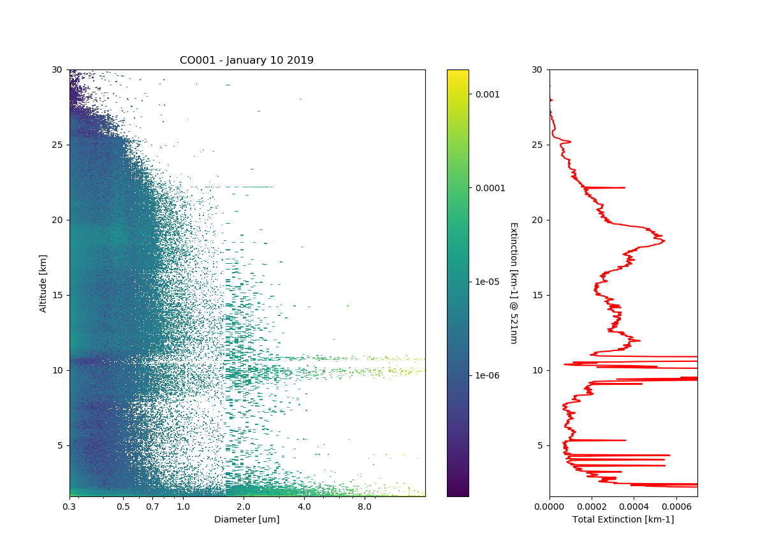

Slide 23
Objectives
Provide aerosol size distribution parameters for use by remote aerosol instruments, enhancing their ability to provide a broader range of aerosol properties
  Retrieve Aerosol Extinction and Surface Area Densities from In situ Size Distribution Measurements for comparison with, and use by, satellite instruments
Continue in situ balloon borne measurements of stratospheric aerosol size distributions to compare with SAGE III-ISS and other satellites
Augment an existing tropical balloon sounding site with aerosol instruments and performing regular tropical soundings
Maintain and enhance an in situ measurement capability to provide measurement data from regions with high aerosol loadings that may be opaque to limb sounding measurements during future volcanic eruptions

Slide 24
In situ LOPC and CNC measurements planned for comparison with SAGE III overpasses
Mid Latitudes
Tropics
One final aerosol comparison gondola to be flown from Laramie
Launch every 2-4 months from Colorado on small rubber balloons
Payload will consist of 2 packages, LOPC and CNC, and meet FAA/ICAO definition of light balloon
Payloads recovered and re-flown
Launch 3-4 payloads from a tropical location (nominally Costa Rica)
Coordinate with Ticosonde launches
LOPC/CNC combined payloads
Recoveries are less likely
Exploring smaller disposable OPC for some of these launches

