Slide 1
2nd Annual SAGE III/ISS Science Team Meeting
NASA Langley Research Center
October 29-30, 2019

Slide 2
Welcome
David Flittner

Slide 3
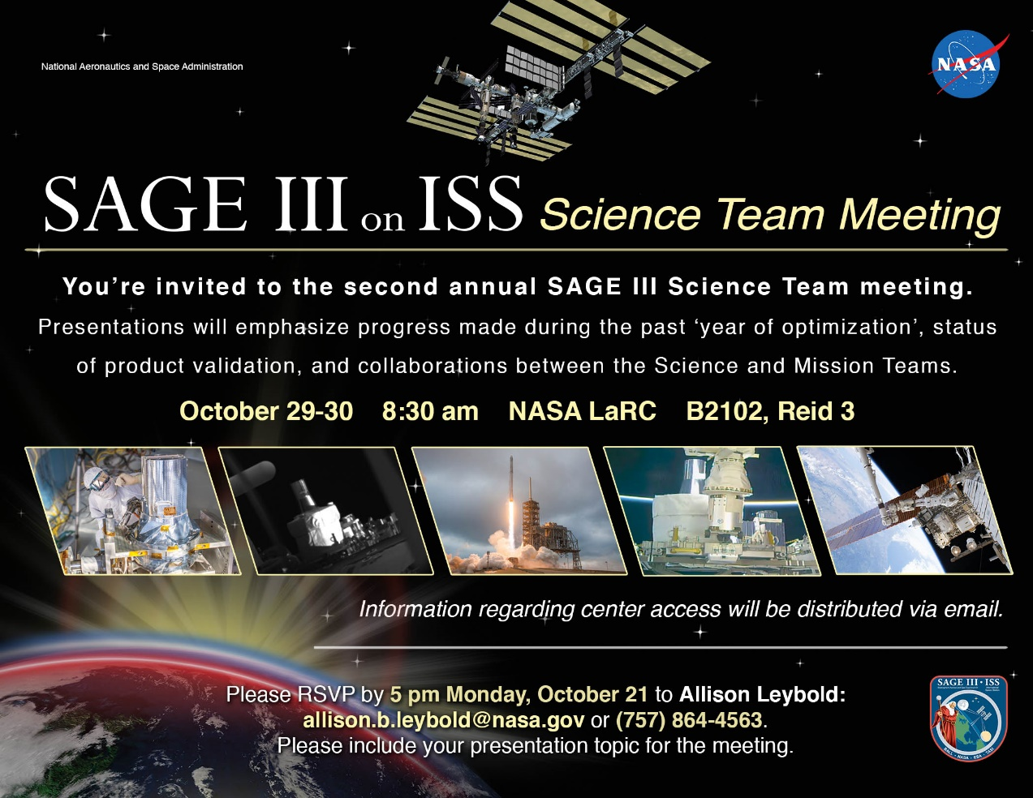
Welcome!

Slide 4
LOGISTICS
Internet access
  Wireless connection for visitors: log into “nasaguest” and open a clean browser window
  Wireless connection for NASA-badged employees: log into “nasa”
Call-in: 1-844-467-6272, #896850
Lunch
  Lunch will be on your own; the LaRC Cafeteria is at the north end of the building
Meeting location:
  Restrooms – out the door, left, then left
  Coffee, etc. in the back of the room
  Flight Mission Support Center (FMSC) on second floor

Slide 5
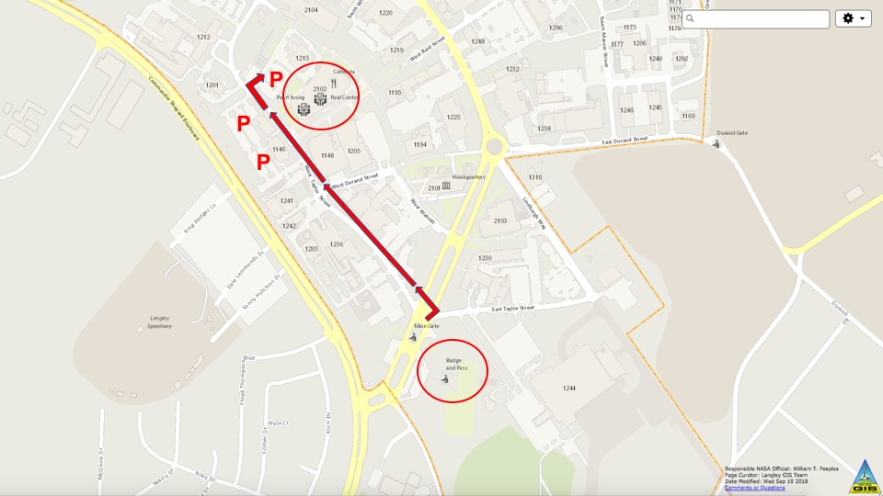
Directions to Meeting (Building 2102)
2102

Slide 6
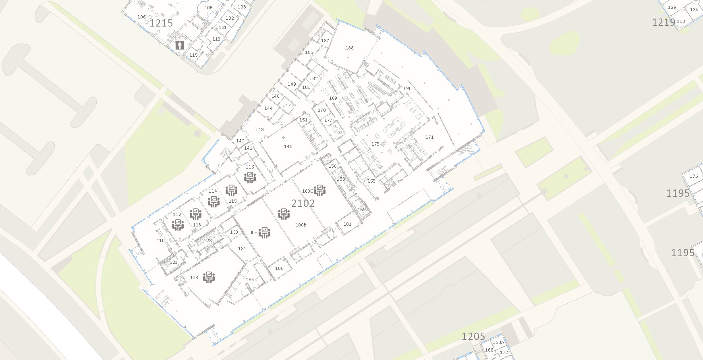
Building 2102
NACA
EATING SPACE
CAFETERIA
REID 3

Slide 7
Objectives
Communicate to the ROSES Science Team the status of:
  Mission
  Operations
  Data processing
  Validation
Initiate and foster collaborations amongst the Science Team and the Mission Team
Do good science…

Slide 8
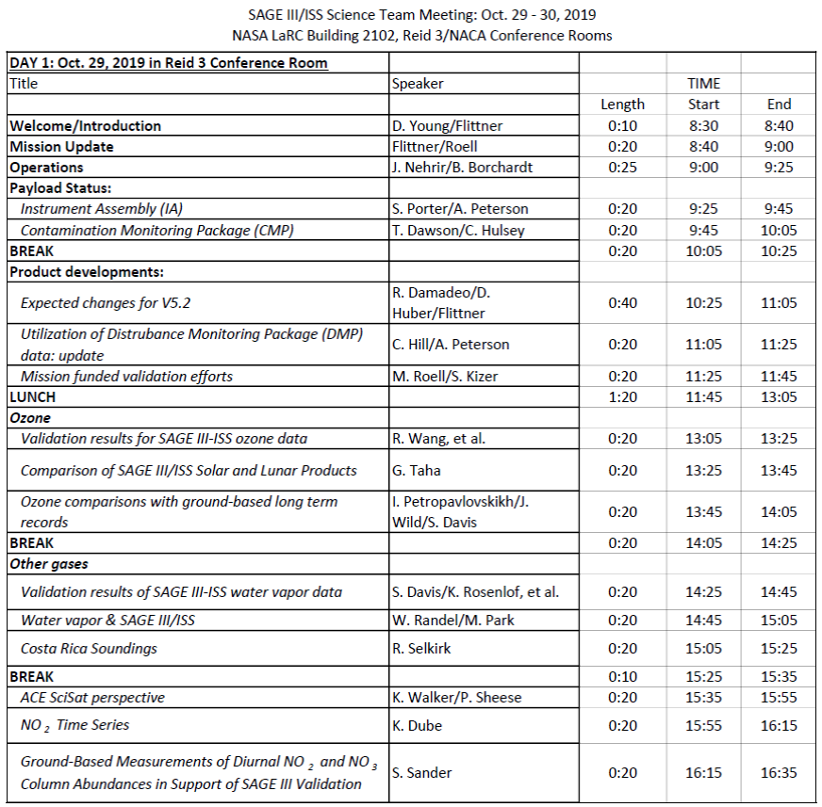
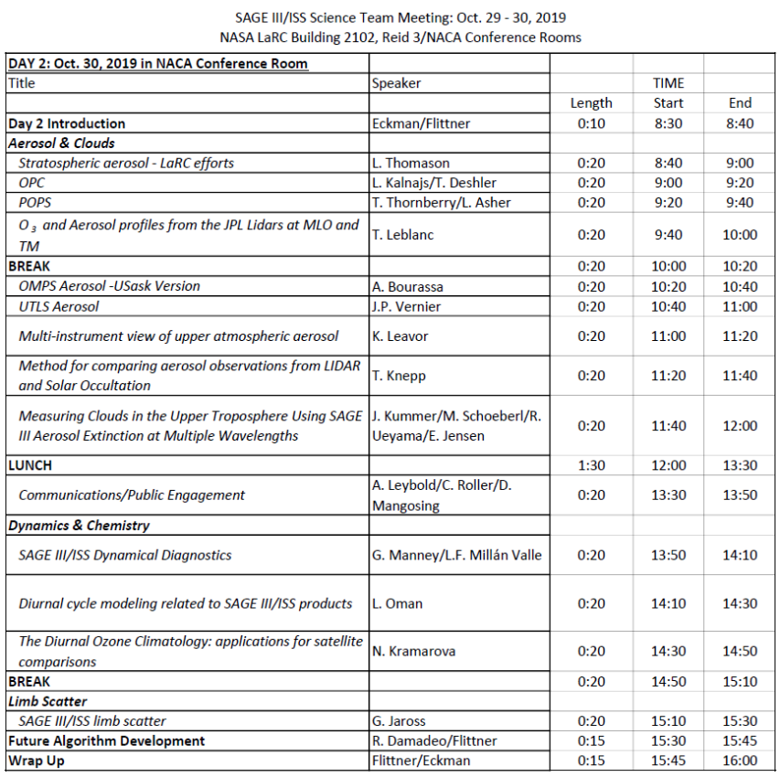
AGENDA

Slide 9
Mission Update
Marilee Roell
SAGE III/ISS Science Manager
David Flittner
SAGE III/ISS Project Scientist

Slide 10
Outline
Current status of mission
Road ahead

Slide 11
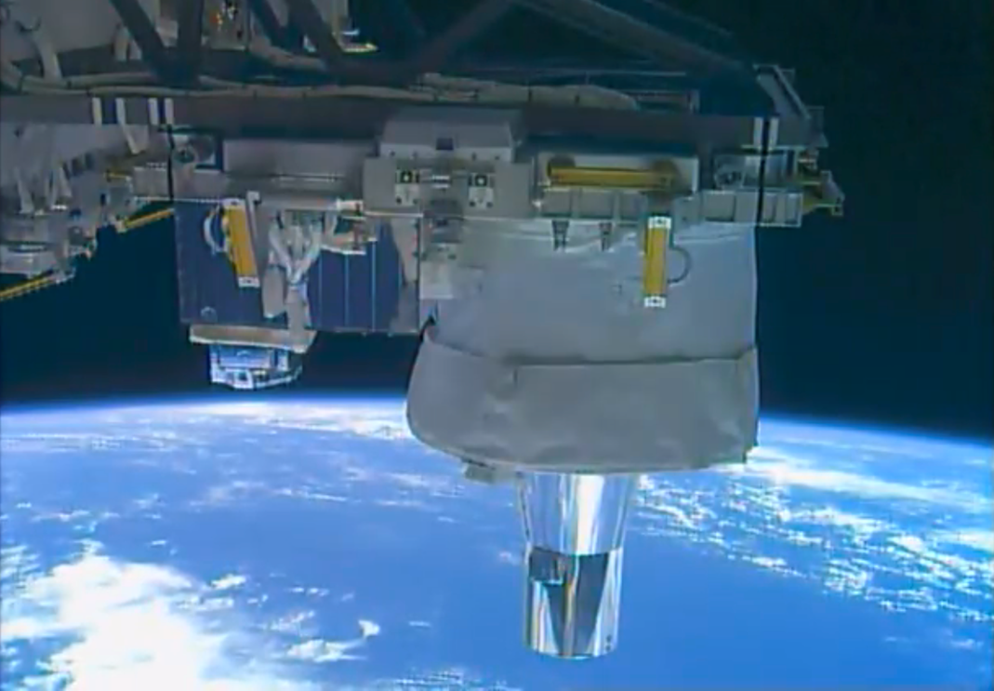
Business as Usual
After 2+ yrs of on-orbit operations, the payload is working like a champ
Operations Team continues to learn about life on ISS
Processing algorithm undergoing examination (never hurts to review your work)
Continued advancements in ground & flight S/W to improve science accumulation
Upgrading payload simulator
SAGE installed on ISS

Slide 12
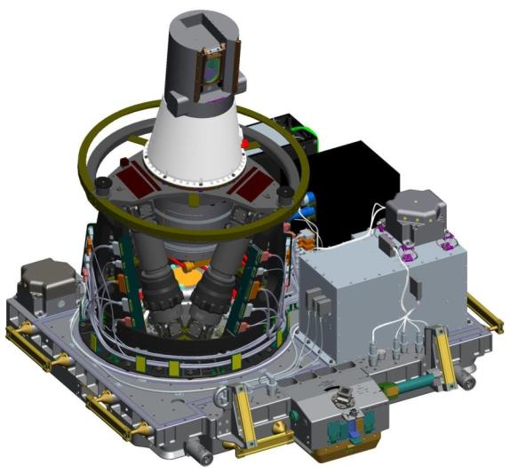
SAGE III/ISS Integrated Payload (IP)
Collaborative effort: NASA (SMD, HEOMD-ISS) & ESA
Sensor Assembly (SA)
Instrument Control Electronics (ICE)
Hexapod Mechanical Assembly
(HMA)
Hexapod Electronics Unit (HEU)
Contamination Monitoring Package (CMP)
Contamination Monitoring Package
(CMP)
Interface Adapter Module (IAM)
Disturbance Monitoring Package
(DMP)
ExPRESS Payload Adapter (ExPA)

Slide 13
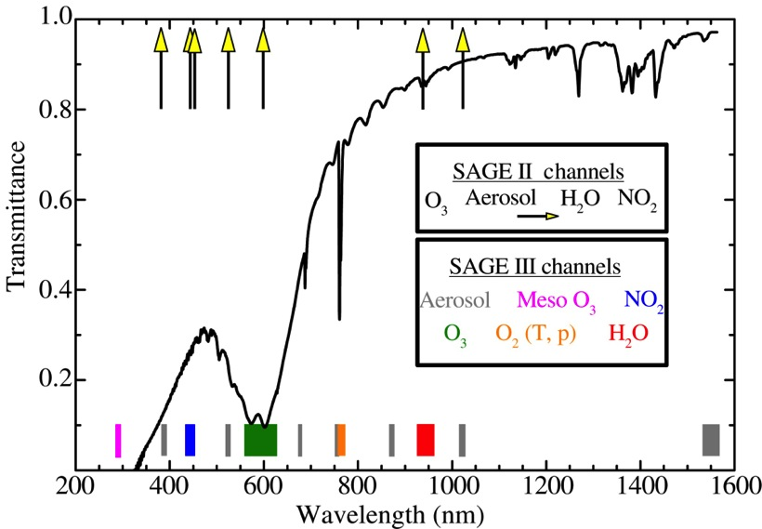
Spectral Sampling
SAGE III Solar:
Aerosol MesO₃ NO₂ O₃ O₂(T,p) H₂O
Limb
Lunar

Slide 14
Standard Data Products: Provisional version, V5.1
PRODUCT | Event Type | Vertical Range & Resolution [km] | Precision [%] | Accuracy Goal [%]
Spectral Transmission | Solar | 0* – 100, 0.75 | 0.1 | 0.1***
Aerosol Extinction & Optical Depth | Solar | 0* – 40, 0.75 | 5 | 5
Ozone# | Solar | 0* – 50, 0.75 | 5 | 5
Water Vapor# | Solar | 5* – 45, 0.75 | 10 | 10
Nitrogen Dioxide# | Solar | TP+2 – 45, 0.75 | 10 | 10
Ozone# | Lunar | 15* - 45, 1.5 | 5 | 6
Nitrogen Trioxide# | Lunar | 25 – 45, 1.5 | 15 | 10
Nitrogen Dioxide# | Lunar | 20 – 45, 1.5 | 10 | 10
Beta
Delayed
# concentration; * Or cloud-top/ISS; ** at 600 nm

Slide 15
Research Data Products
PRODUCT | Event Type | Vertical Range & Resolution [km] | Precision [%] | Accuracy Goal [%]
Temperature | Solar | 0* – 85, 0.75 | 2 K | 2 K
Pressure | Solar | 0* – 85, 0.75 | 2 | 2
Ozone (Mesospheric)# | Solar | 60 – 90, 1.0 | 5 | 10
Chlorine Dioxide# | Lunar | 15* – 25, 1.5 | 20 | 25
Limb Radiance (L1B) | Limb | 0 – 60, 0.75 | 2.5 | 10
# concentration; * Or cloud-top

Slide 16
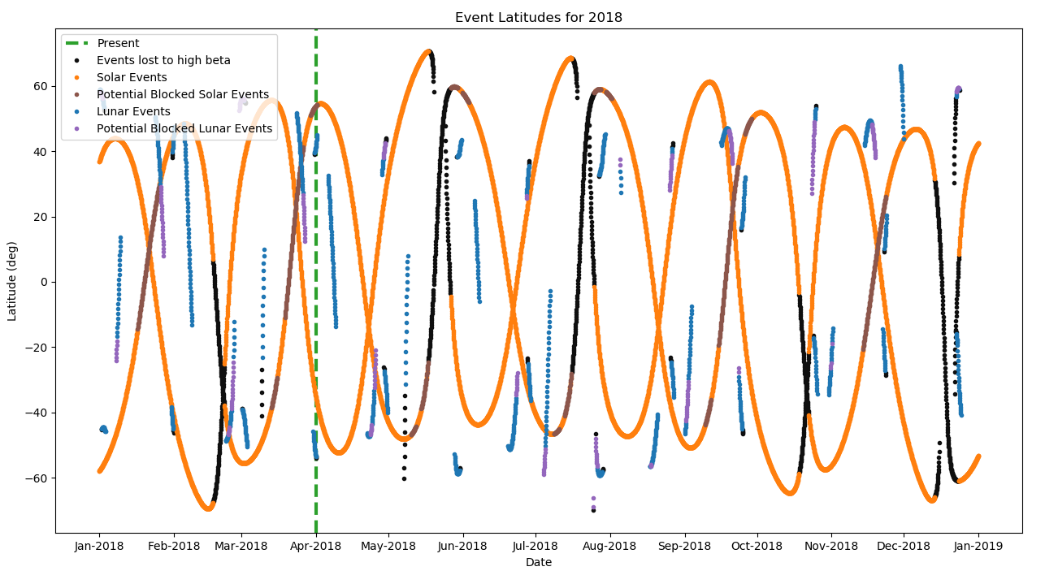
SAGE III/ISS Spatial/Temporal Sampling
No significant sampling issues arise from ISS blockages

Slide 17
Extended Mission Review Schedule
March 2020: Senior Review Cycle FY21 – FY23
  Senior Review for Earth Science Projects
  Held every three years
  Mission Extension Review
  Will provide extension funding to bridge to EPMR
July/August 2020: End of Prime Mission Review
  3 year Phase E Prime Mission ends June 30, 2020
  Review cycle has this occurring 30 – 60 days after Senior Review
  Present that Mission met our Level 1 requirements to closeout the primary mission

Slide 18
Next Product Release
Expect the next product version to be 5.2
Goal is to release an improved dataset that will be available for use in the 2022 International Ozone Assessment
To that end, targeting a public release in late 2020
Expected V5.2 contents discussed in a section later today

Slide 19
Summary
SAGE III/ISS is a climate continuity mission addressing critical international science needs: sage.nasa.gov
SAGE III/ISS is operating nominally with additional data released at monthly intervals: eosweb.larc.nasa.gov/project/sageiii-iss/sageiii-iss_table
Experience on ISS has grown rapidly, consistently collect 90% of solar opportunities, 85% solar+lunar.
Provisional Ozone/Aerosol Data w/ V5.1
Comparisons of mid-stratosphere ozone within ±10% of validated sources
Beta version of water vapor product w/ V5.1
Baseline mission is July 2017 – June 2020; continuation renewed in 3-yr cycles
Next dataset version targeted for late 2020

