Slide 1
Mission Operations
Jamie Nehrir
Mission Operations Manager

Slide 2
Ops Overview
Mission Operations Goals
  Commanding and downloading data on a weekly/daily basis
  Maintaining the health and safety of the SAGE III payload
    Daily engineering checks
    Trending of engineering data and science metrics
  Process and distribute SAGE III data
    Process Ground Support Equipment (GSE) and Solid State Memory Card (SSMC) in near real-time (8-5 ET)
    Processes 24 hours of SSMC data daily
    Generates daily SCF files
      Level 0 and ancillary data
    Generates daily ESA/TASI data files

Slide 3
Outline
Mission Operation Overview
  Meet the team
What Has Change in the Last Year
  Maintenance Activities
  Calibration Activities
ISS Challenges
  Space-X Dragon 2
  Breaker Anomaly

Slide 4
Ops Team
SAGE III Payload Operations Center
Jamie Nehrir | Mission Operations Manager
Greg Paxton | Ground Systems Lead
Andrew Peterson | Deputy Mission Operations Manager
Robert Borchardt | Lead Technical Payload Engineer
Jonathan Hicks | Ground Systems Engineer
James Farmer | Ground Systems Engineer
Samuel Porter | Payload Engineer
Joshua McDonald | Payload Engineer
Caitlyn Stone | Payload Engineer
Tyler Dawson | Payload Engineer
Daniel Larrowe | Payload Engineer
Donald Cleckner | Payload Engineer

Slide 5
Science Team Meeting
NASA Langley Research Center
10/29/2019

Slide 6
Changes to Operations
A more rigorous maintenance and calibration schedule has been generated
  The operations team along with the Science team reviewed the optimization and maintenance activities and determined the proper time scale for each activity
  Some activities changed in frequency and can be seen in the following charts

Slide 7
Optimization Activity Schedule
Optimization Activities | Constraints/Frequency
Atmospheric Spectral Survey (Sunrise and Sunset) | By request: At most once per year
Boresight Alignment | By request: At most once per year
CCD Characterization and Dark Current | Weekly
CTE Calibration | Twice per year
Extended Sunrise Events (Spectral Survey and Mirror Calibration) | Once per year at each of the following Beta ranges: High Beta >50, Low Beta <30, and 0 Beta
Extended Sunset Events (Spectral Survey and Mirror Calibration) | Measurements of opportunity based on ISS orientation
Off-Nadir Angle | Science Intern Automated Process to be used on a routine trending basis
Green indicates change in activity schedule

Slide 8
Payload Maintenance Activity Schedule
Optimization Activities | Constraints/Frequency
Azimuth Range of motion | Quarterly
CCD Annealing | During High Negative Beta
Hexapod Zero Procedure | Twice a year
Attenuator | Quartely
Green indicates change in activity schedule

Slide 9
IAM Flight Software
IAM Code Build 7.3 was uploaded to the instrument in Dec. 14th 2018.
  Improvements that aid the operations team:
    Updating how an empty file transfer buffer is handled
    The addition of a command to delete all science events
    An additional software message when science events are added to the event manager
    An increased time-tag buffer size
  An identified software bug that caused science event mispredictions
  Closure of items tracked in the JIRA software during IAM builds:
    Time marker strobe timestamp update
    Synchronization of the IAM and CMP serial interface
    Cleanup of unused inputs to the command handler task

Slide 10
Additional IAM Code Builds
Two IAM code builds were conducted this year to help diagnose and fix a problem where tasks within the IAM would unexpectedly stop working
  This has occurred twice on orbit, once with the time controller and then once with the 1553 BC bus task. Each time a reset of the IAM fixed the problem
  IAM code load 7.4 was loaded on September 9, 2019, this code change added in additional monitoring capability to help diagnose what was causing tasks to unexpectedly stop working
  IAM code load 7.5 will be loaded in December 2019, this code change implements a heartbeat monitor into the OS and monitors the health of all tasks. If a task unexpectedly stops working the IAM will take action to safe the payload

Slide 11
ISS Activities
Robo Survey
  On February 5th, 2019 a robotic survey of the SAGE III payload was conducted to view all surfaces and components
  The priority sensitive surfaces included
    All Silver Teflon and Thermal radiator surfaces
    All CMP Sensors
    Contamination Window
    MLI Surfaces
  The survey was very successful and all available surfaces were viewed and analyzed for any changes since instillation

Slide 12
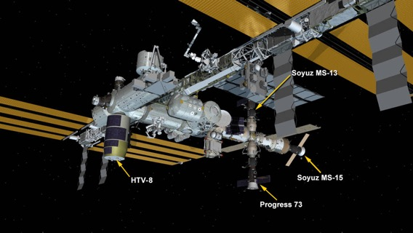
ISS Activities Continued
Arrival of Space-X Dragon-2
  March 3-8th 2019
  Docked on PMA2
  Caused the ISS to pitch from +0.1 degrees to +0.8 degrees
  Because of the 7 degree wedge that the Hexapod sits on (which was implemented to combat the eventual installation of MLM) the additional pitch put the Hexapod at its positioning limitations
In total 144 events have a Hexapod error code 27 with optional word of 5 which indicates that the Hexapod was unable to prepoint to a nadir position:
  46 Sunrises
  51 Sunsets
  47 Limbs
  5 Events were unable to acquire their target as a result
  of not being able to prepoint (all 5 were sunrises)
  13 events violated the 1°requirement for off nadir
  pointing
Space-X Dragon-2 slated to arrive 1/1/2020-1/8/2020
The Boeing module is slated to arrive on station in 12/18/2019 as well and will dock on the PMA2 node. The SAGE III Operations team will closely monitor the payload during this time to determine if the Boeing module will also affect the nadir pointing of SAGE. A crewed version of this vehicle is slated to doc in 01/2020

Slide 13
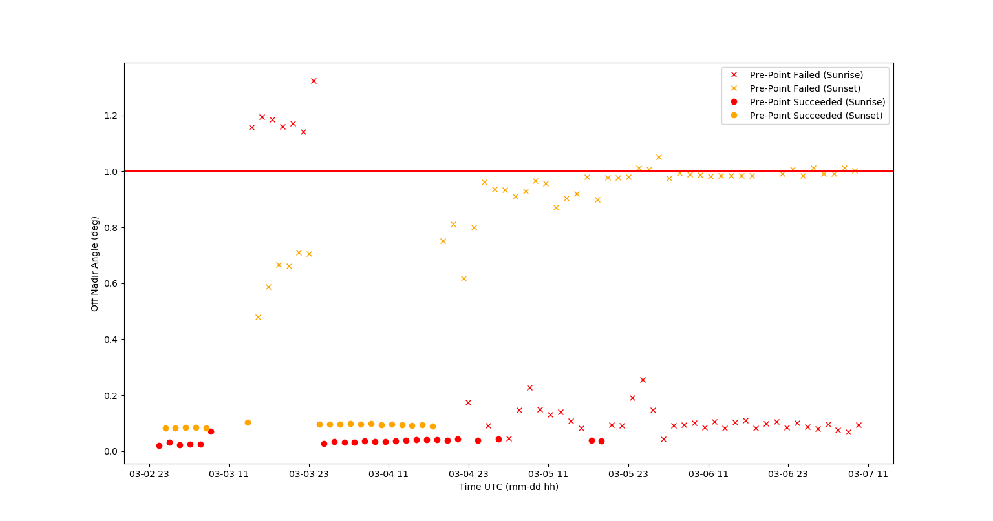
Off Nadir Angle during Space X 2 Docking

Slide 14
ISS Activities Continued: Breaker Anomaly
RPC Failure On ELC-4
  At 00:36 UTC (09:36pm ET) on September 23rd the ISS again lost main power on ELC-4 causing a hard power off of the SAGE III payload. The unexpected power down occurred while the payload was in non-science mode with the scan head stowed and the contamination door closed. The main power on ELC-4 powers the SAGE III 28V and 120V operational line meaning that the payload was powered off with the loss of main power. The AUX power remained operational during this down time which maintained the survival heater power.
  The breaker was successfully replace on 10/13/2019 and SAGE III was able to power up on 10/21/2019
    Because of some battery maintenance activities that were going on during the month of October it was requested to leave the SAGE III Payload powered off until 10/21/2019, following the replacement of a BCDU (Battery Charge Discharge Unit) the SAGE III team was given the go ahead to power on.

Slide 15
Questions

