Slide 1
Instrument Assembly
Samuel Porter

Slide 2
Instrument Assembly
Science events
Azimuth motor health
Elevation motor health
Scan-plane alignment (off-nadir angle)
Dark current signal
Instrument response
CCD temperature stability

Slide 3
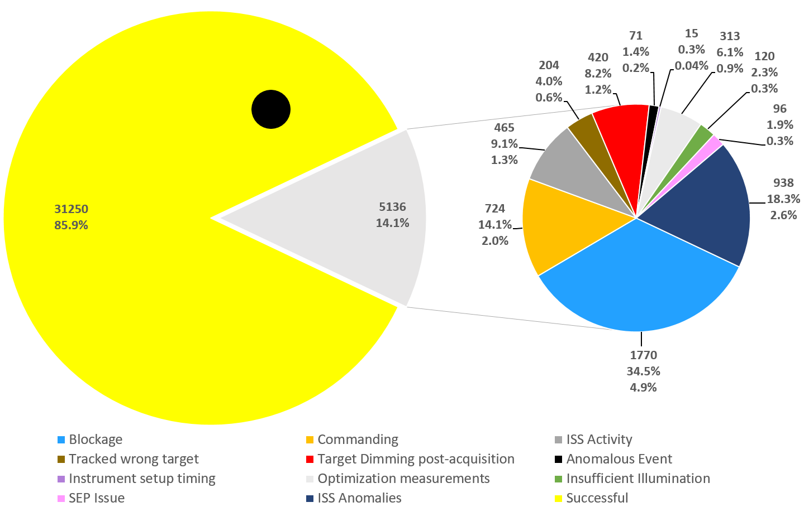
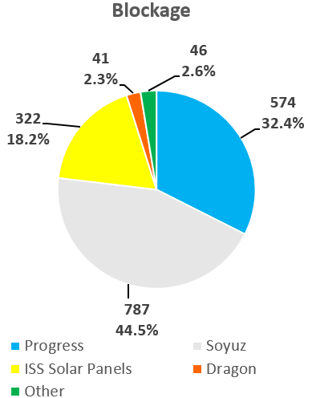
Events (7/1/2017 - 10/23/2019)

Slide 4
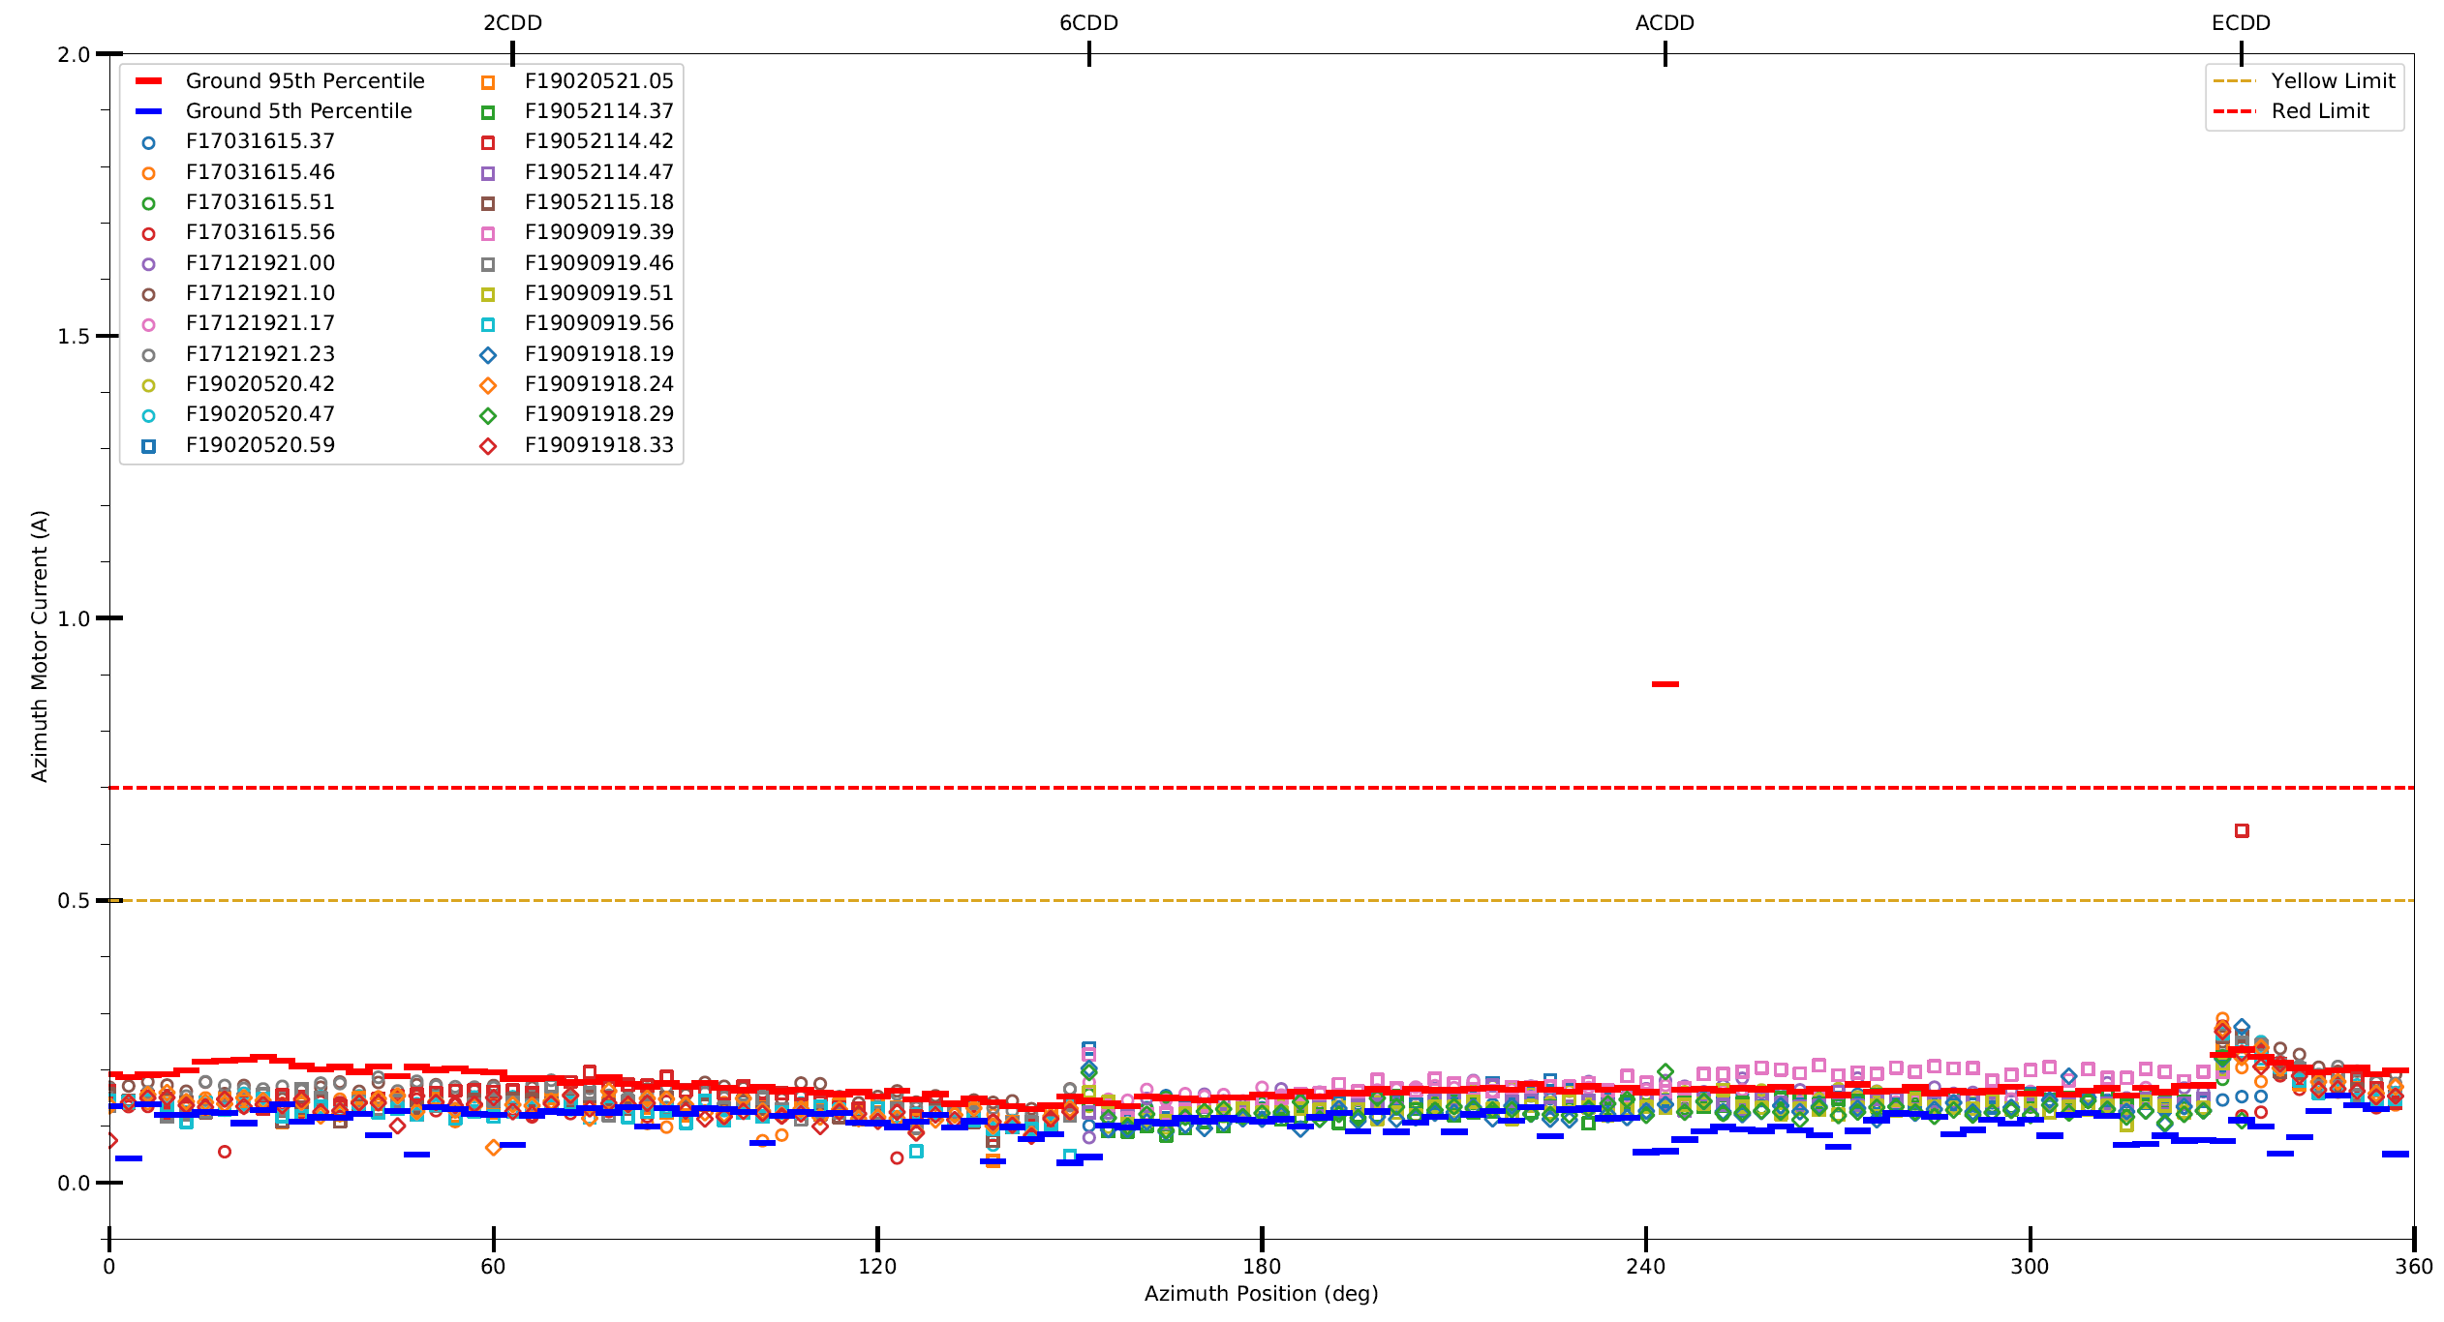
Azimuth Motor Current

Slide 5
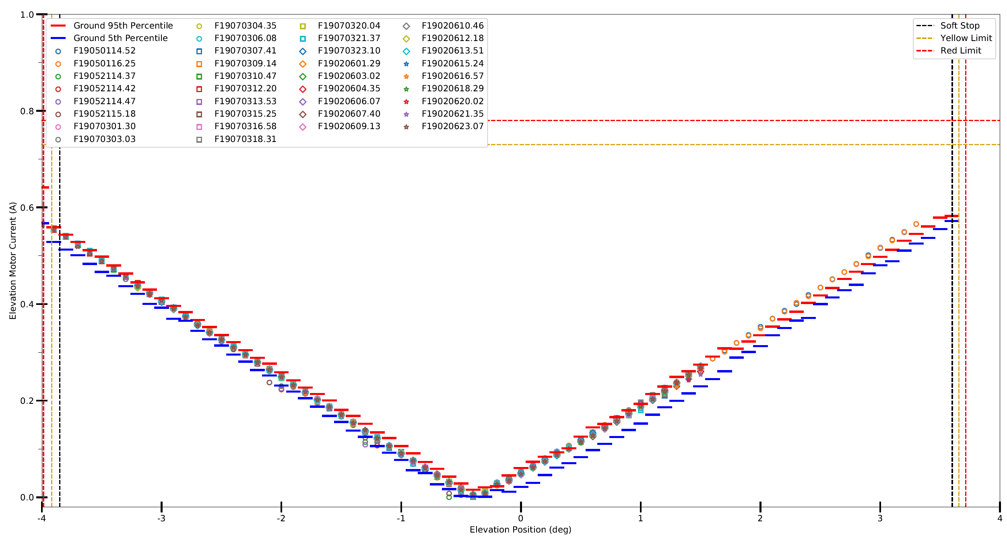
Elevation Motor Current

Slide 6
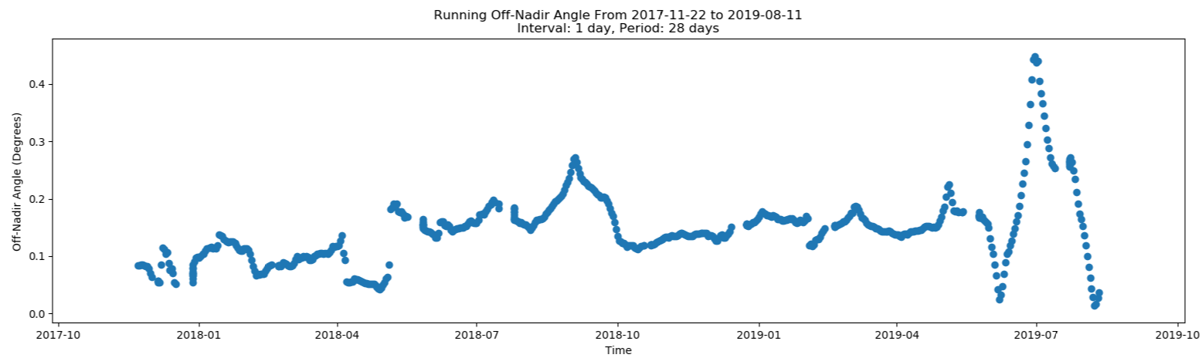
Off Nadir Angle
Off nadir angle is the angle between the scan head and the nadir direction.
Level 1 science requires the scan head to be oriented within 1° of nadir during science events to ensure that the center of the Sun is being scanned tangentially to Earth’s limb.

Slide 7
SAGE-III CCD

Slide 8
SAGE-III CCD
Custom CCD with 8 segments which can be commanded individually to use different integration times as necessary.
CCD temperature is controlled with a thermal electric cooler (TEC) to reduce thermal agitation which decreases ambient charge or dark current.
  TEC nominally set to 12.5°C.
A photodiode is attached to measure 1550nm wavelengths (channel-9).

Slide 9
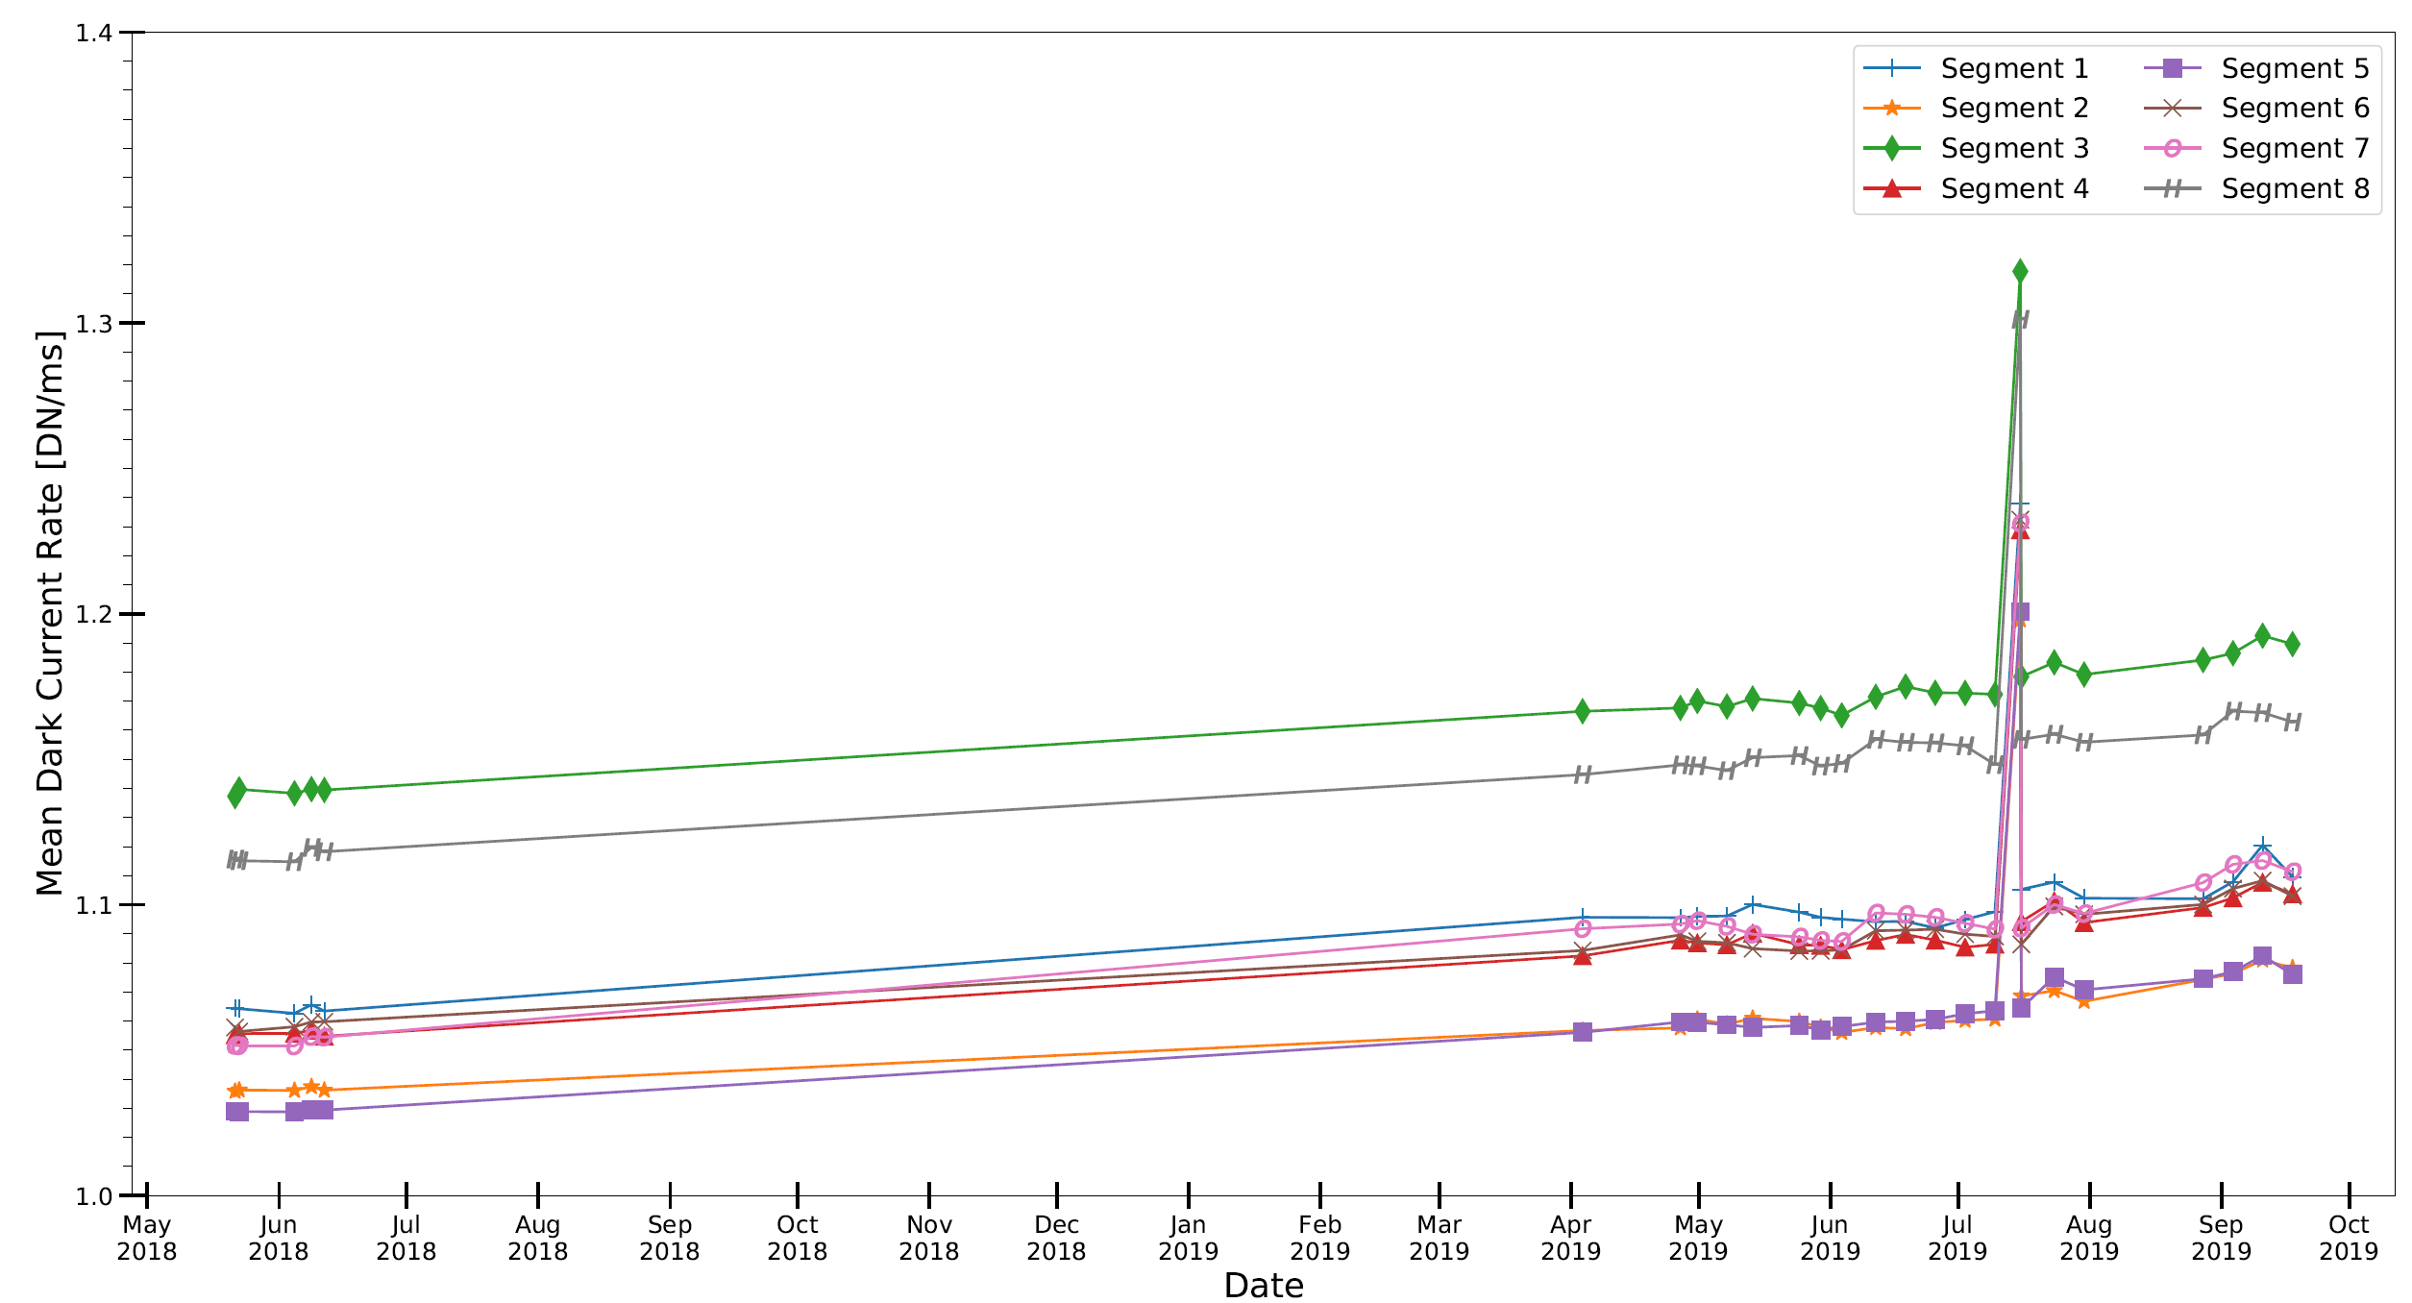
Dark Current
TEC set to 13.5°C

Slide 10
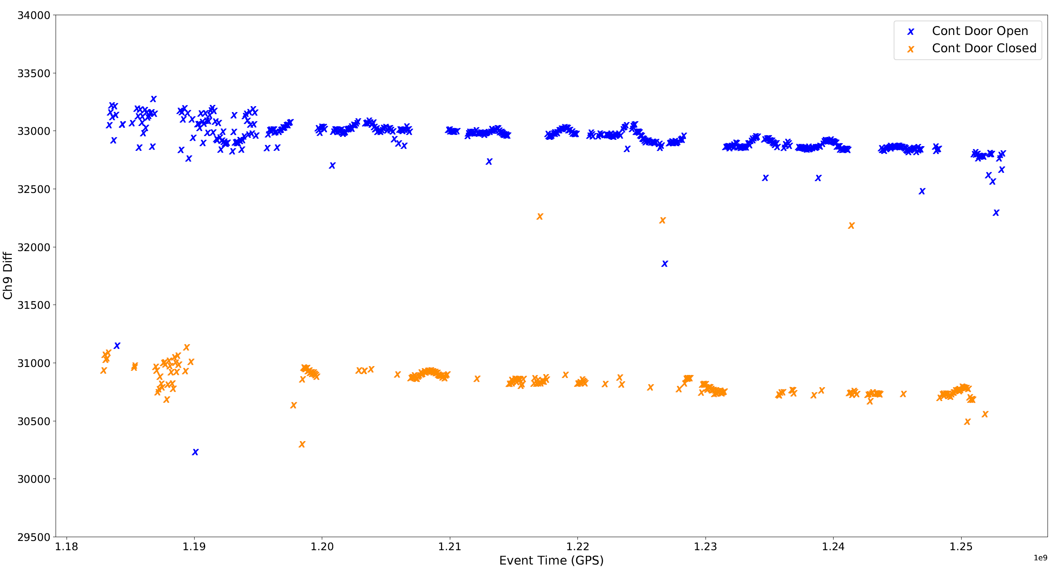
Channel-9 Response
Channel-9 response values are corrected to remove background noise.
Response values have decreased approximately 200 counts over 2 years.

Slide 11
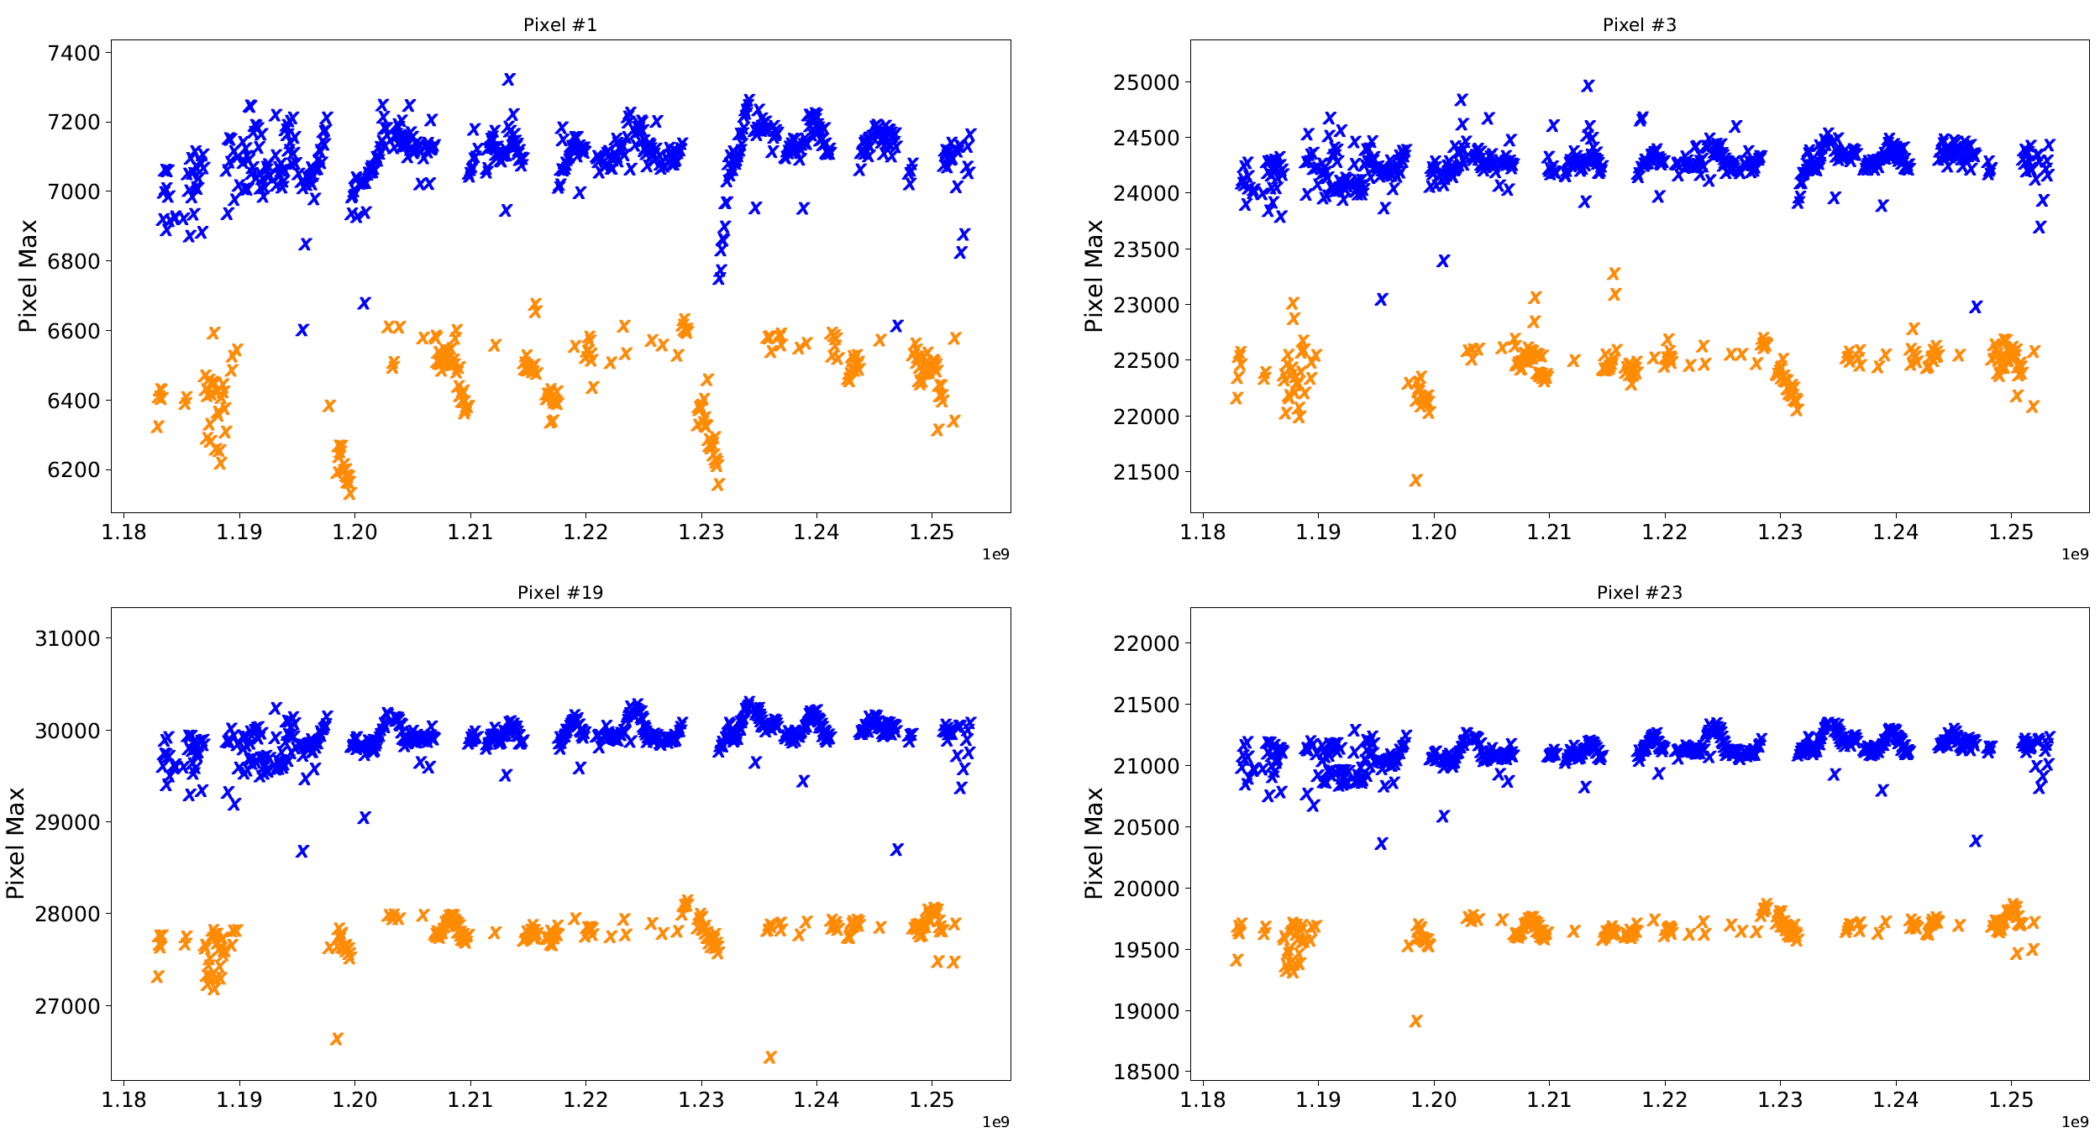
Blue Pixel Response

Slide 12
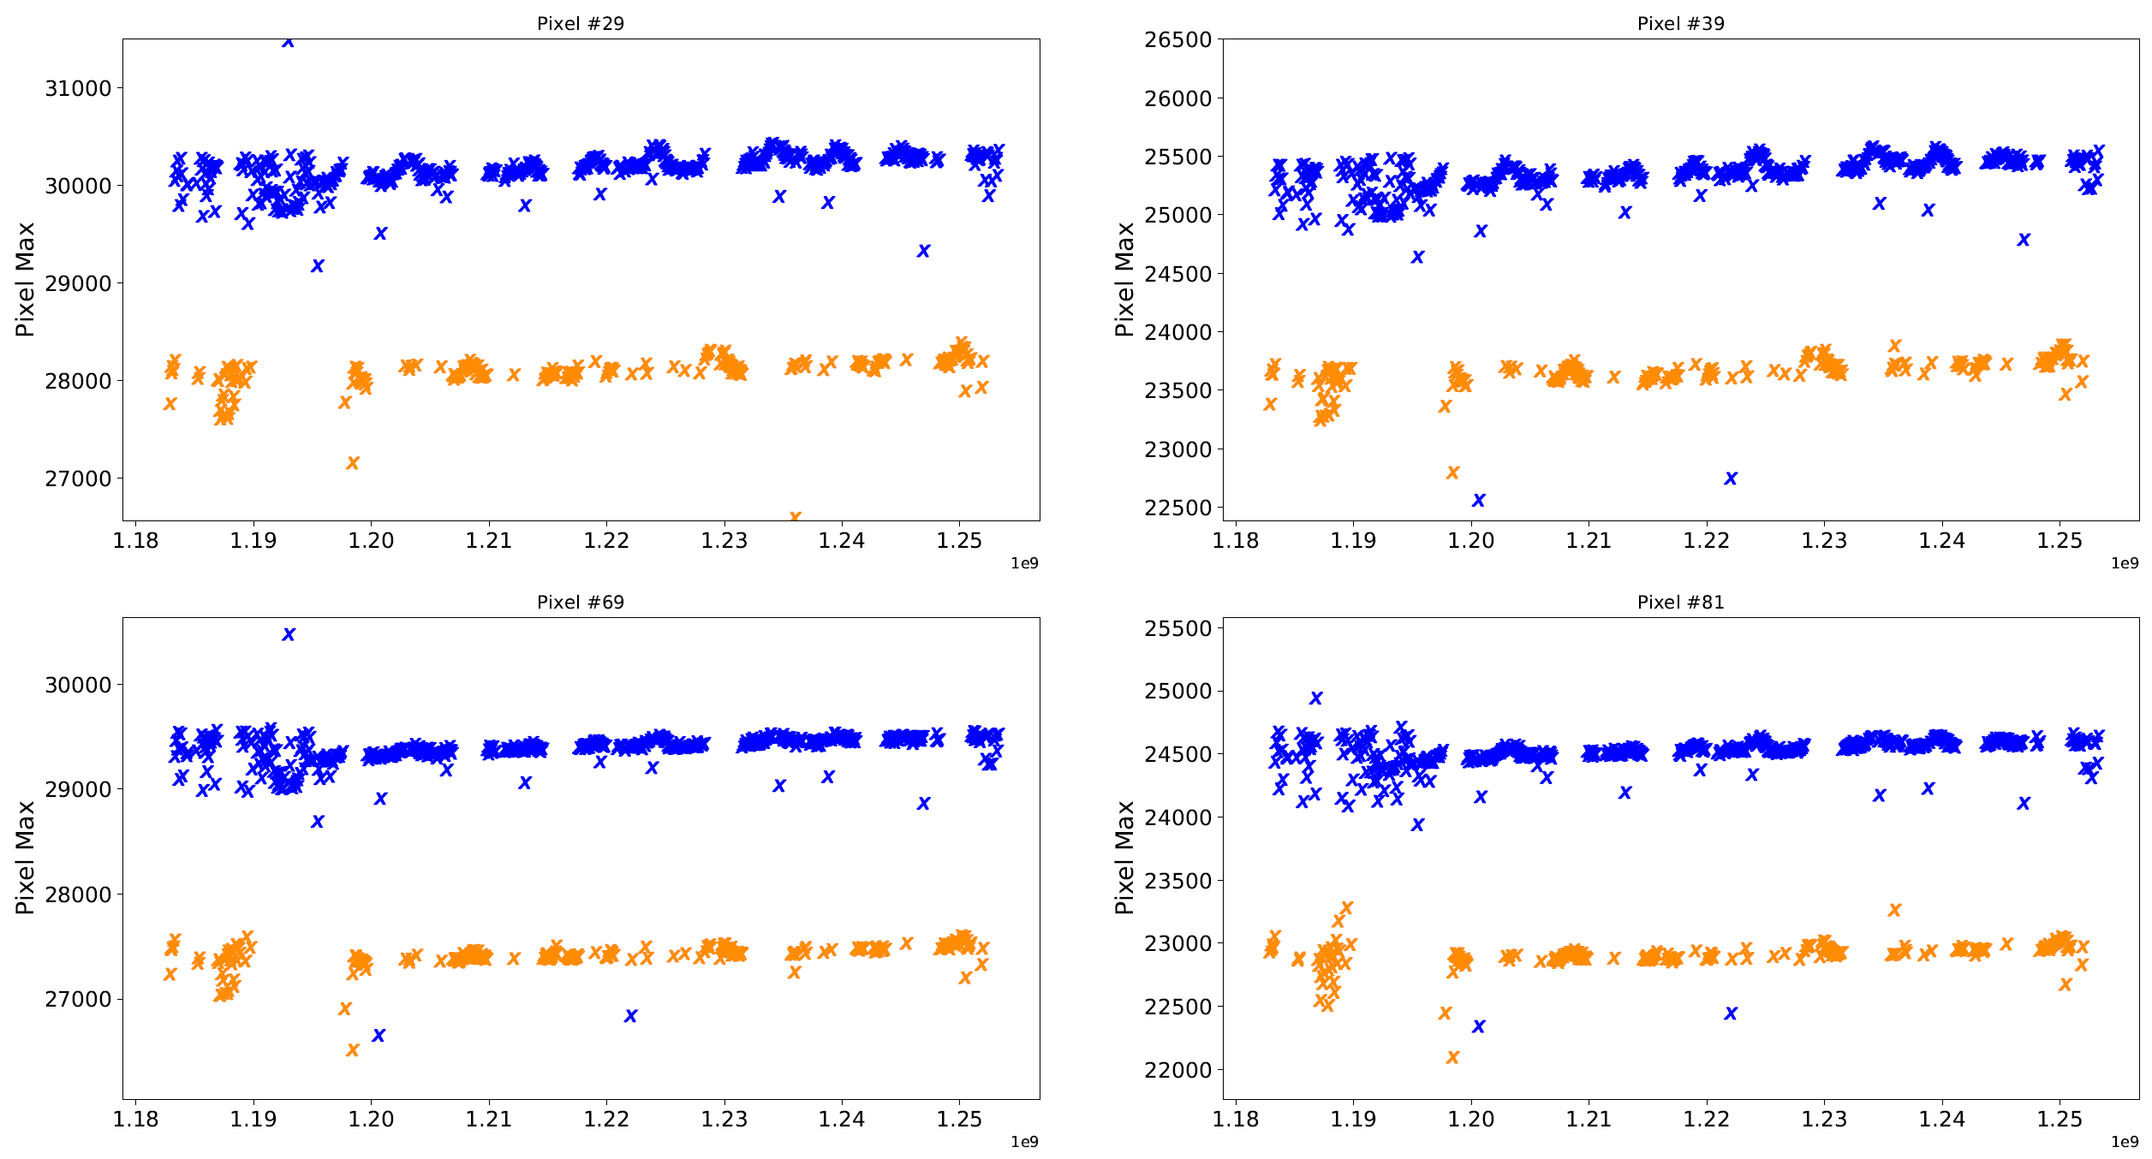
Red Pixel Response

Slide 13
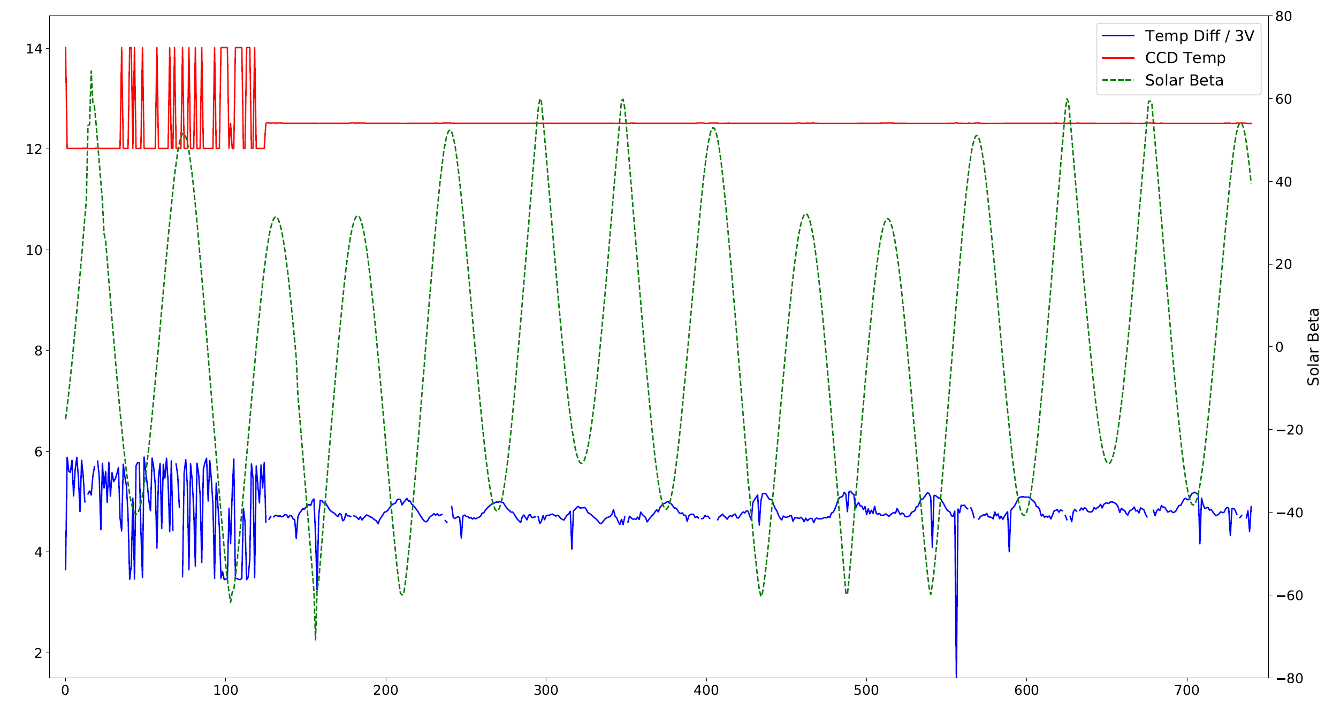
TEC Efficiency
CCD Temp stabilized Nov. 2017

Slide 14
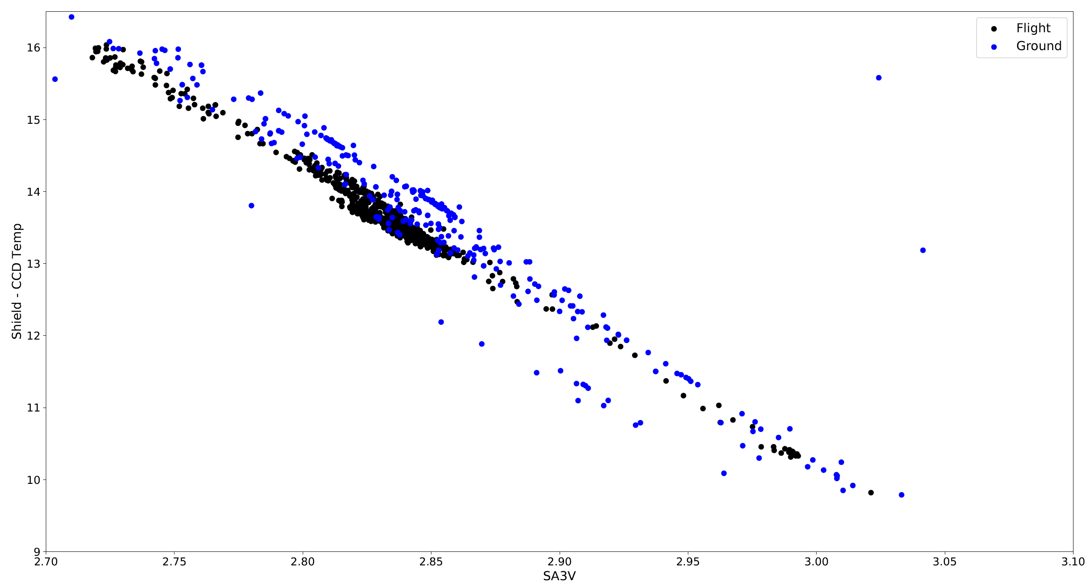
TEC Efficiency

Slide 15
Conclusion
Instrument Assembly is healthy and experiencing no major problems.
CCD pixel responses and TEC efficiency are showing no signs of degradation.
Some slight aging in the channel-9 photodiode response and dark current.
Improvements are being made to increase the amount of science data collected, and mitigate some causes of science event failures.

