Slide 1
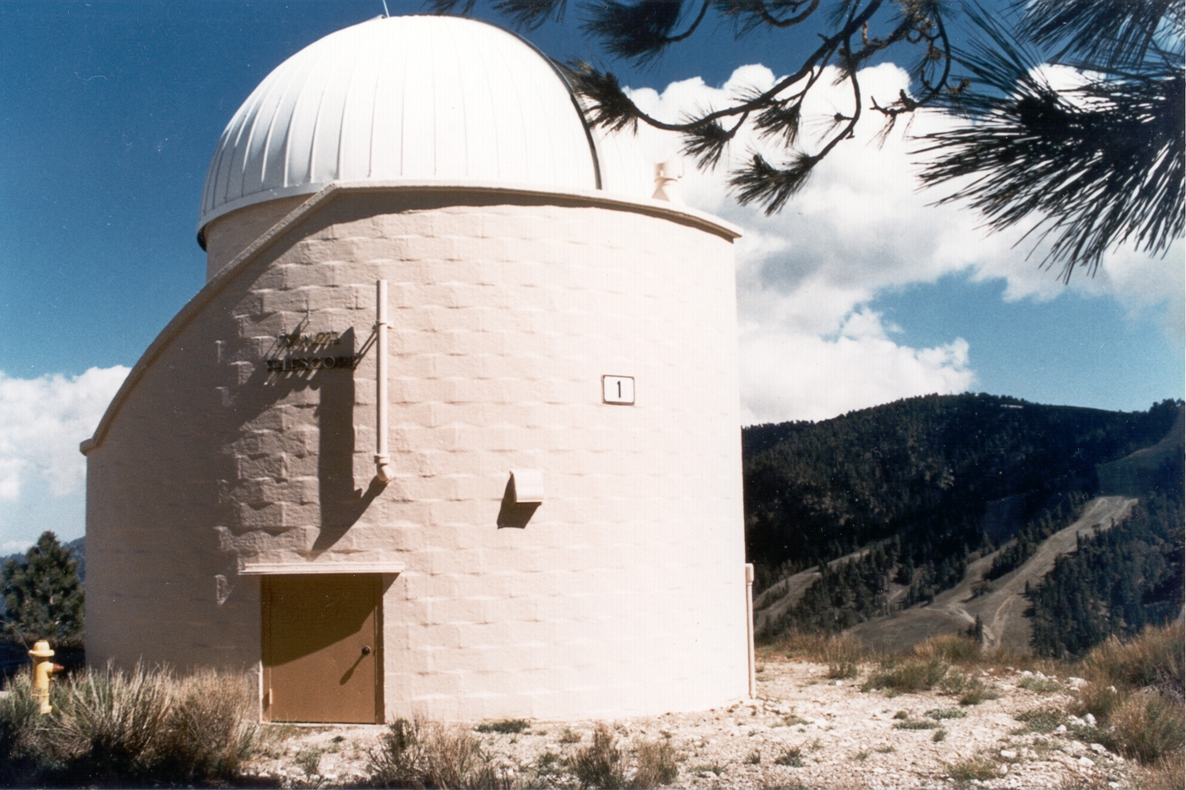

Ground-Based Diurnal Measurements of NO₂ and NO₃ in Support of SAGE-III/ISS Validation
Thomas J. Pongetti¹, King-Fai Li², Yuk L. Yung³ and Stanley P. Sander¹
¹Jet Propulsion Laboratory, California Institute of Technology
²University of California, Riverside, ³Caltech
© 2019, California Institute of Technology. Government sponsorship acknowledged.

Slide 2
Task Objectives
Objective 1: Obtain lunar occultation measurements of nighttime NO₃ and NO₂ from Table Mountain Facility in support of SAGE III/ISS validation.
Objective 2: Utilize in-situ measurements of NO₃ and NO₂ and chemical modeling to separate stratospheric and tropospheric partial columns.
Objective 3: Analyze comparisons with coincident SAGE III/ISS measurements and work with the Science Team to interpret the comparisons and incorporate improvements into retrieval algorithms.
Co-Investigators
Thomas J. Pongetti, JPL | Data Acquisition/Analysis
King-Fai Li, UCR | 1-D Modeling
Yuk L. Yung, Caltech | 1-D Modeling
Steven S. Brown, NOAA | In-situ measurements

Slide 3
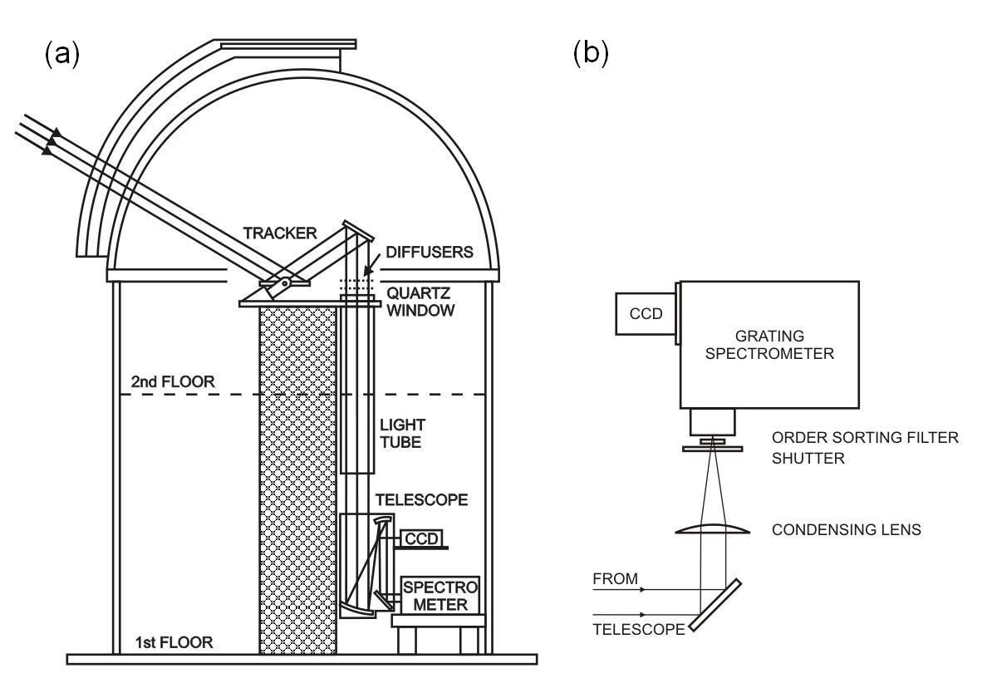
UV-Visible Grating Spectrometer at JPL/Table Mountain
Schematic of the instrument light path. (a) Light is collected by the primary of the heliostat (tracker) then through an off-axis telescope which also serves as a fine guider for the pointing system. (b) The light is directed through a condensing lens, shutter, order-sorting filter, and then into the spectrometer where it is dispersed and recorded by a CCD camera.
Notes:
Setup works for both solar and lunar occultation

Slide 4
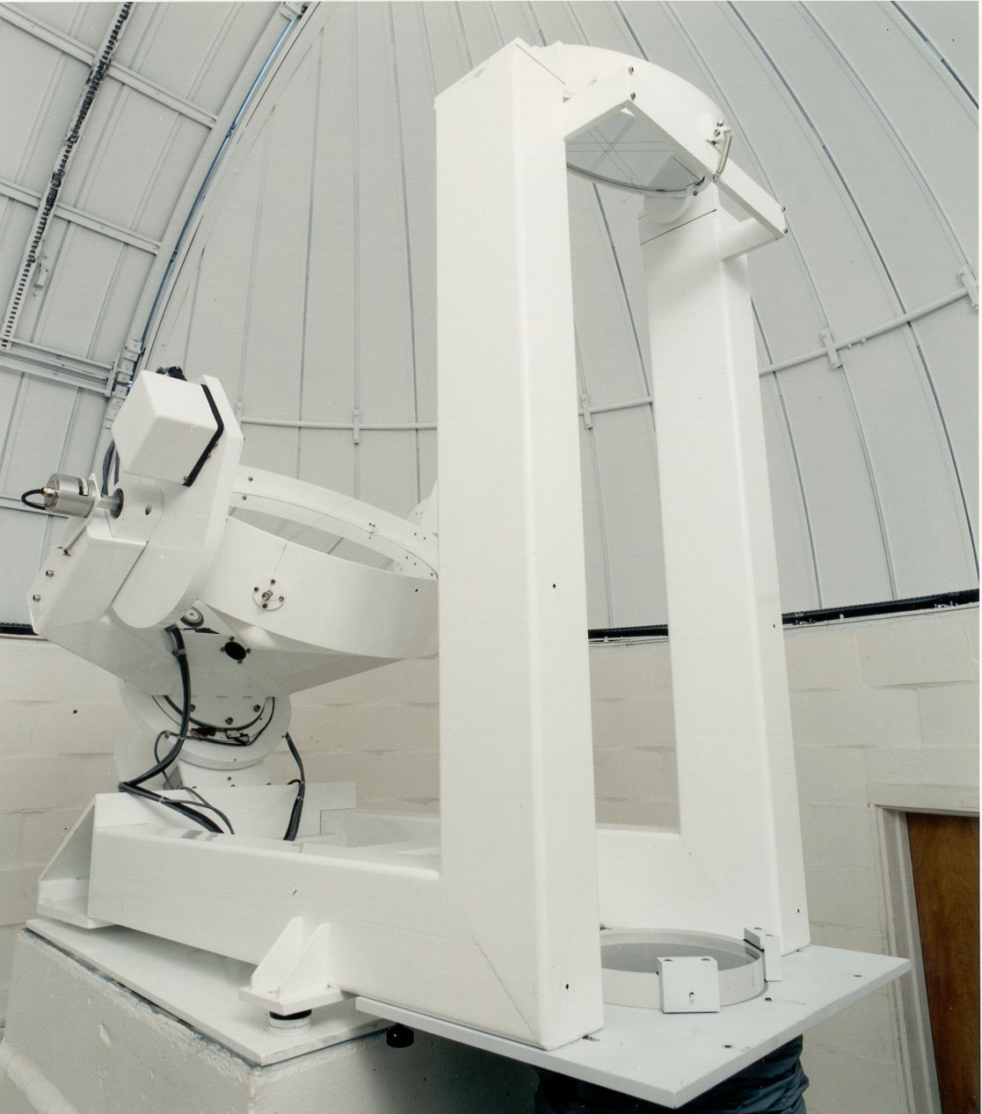
Heliostat for Solar and Lunar Occultation Spectroscopy
10″ Secondary Mirror
Fixed Mount
16″ Primary Mirror
Equatorial Mount
Fused Silica Isolation
Window
Notes:
Large size driven because the heliostat is also feeding light to an interferometer with a large aperture.

Slide 5
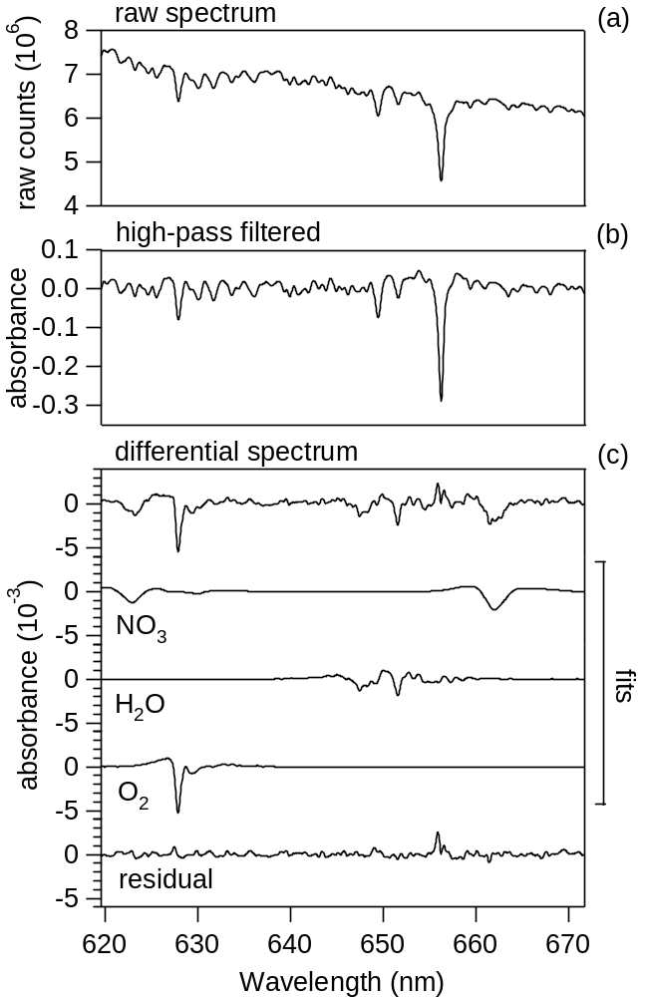
NO₃ Spectral Fitting using the DOAS Approach
Raw spectrum with sloping baseline
High-pass filtered raw spectrum derived by
dividing the raw spectrum by a smoothed version
Differential spectrum after fitting solar, NO₃, water vapor and O₂ reference spectra
Residuals
Notes:
Raw spectrum does not have obvious trace gas absorption features – dominated by Fraunhofer features

Slide 6
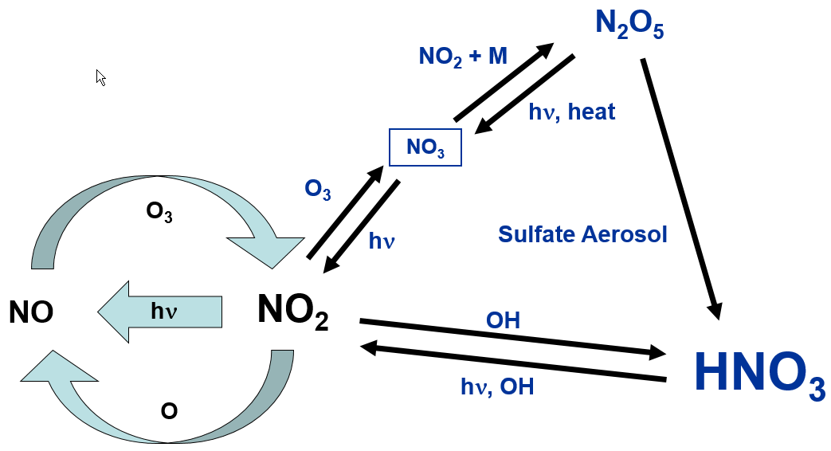
Key Processes in Stratospheric NO_{x}-NO_{y} Photochemistry
Sensitive to Pressure
Sensitive to Temperature
Two pathways to HNO₃ formation:
  Daytime (through OH + NO₂ + M reaction)
  Nighttime (through N₂O₅ + sulfate aerosol reaction, NO₃-mediated
Notes:
Coupling of Nox cycle with HNO3 explains the diurnal variability of NO2 and NO3
NO3 is zero during the day due to rapid photolysis

Slide 7
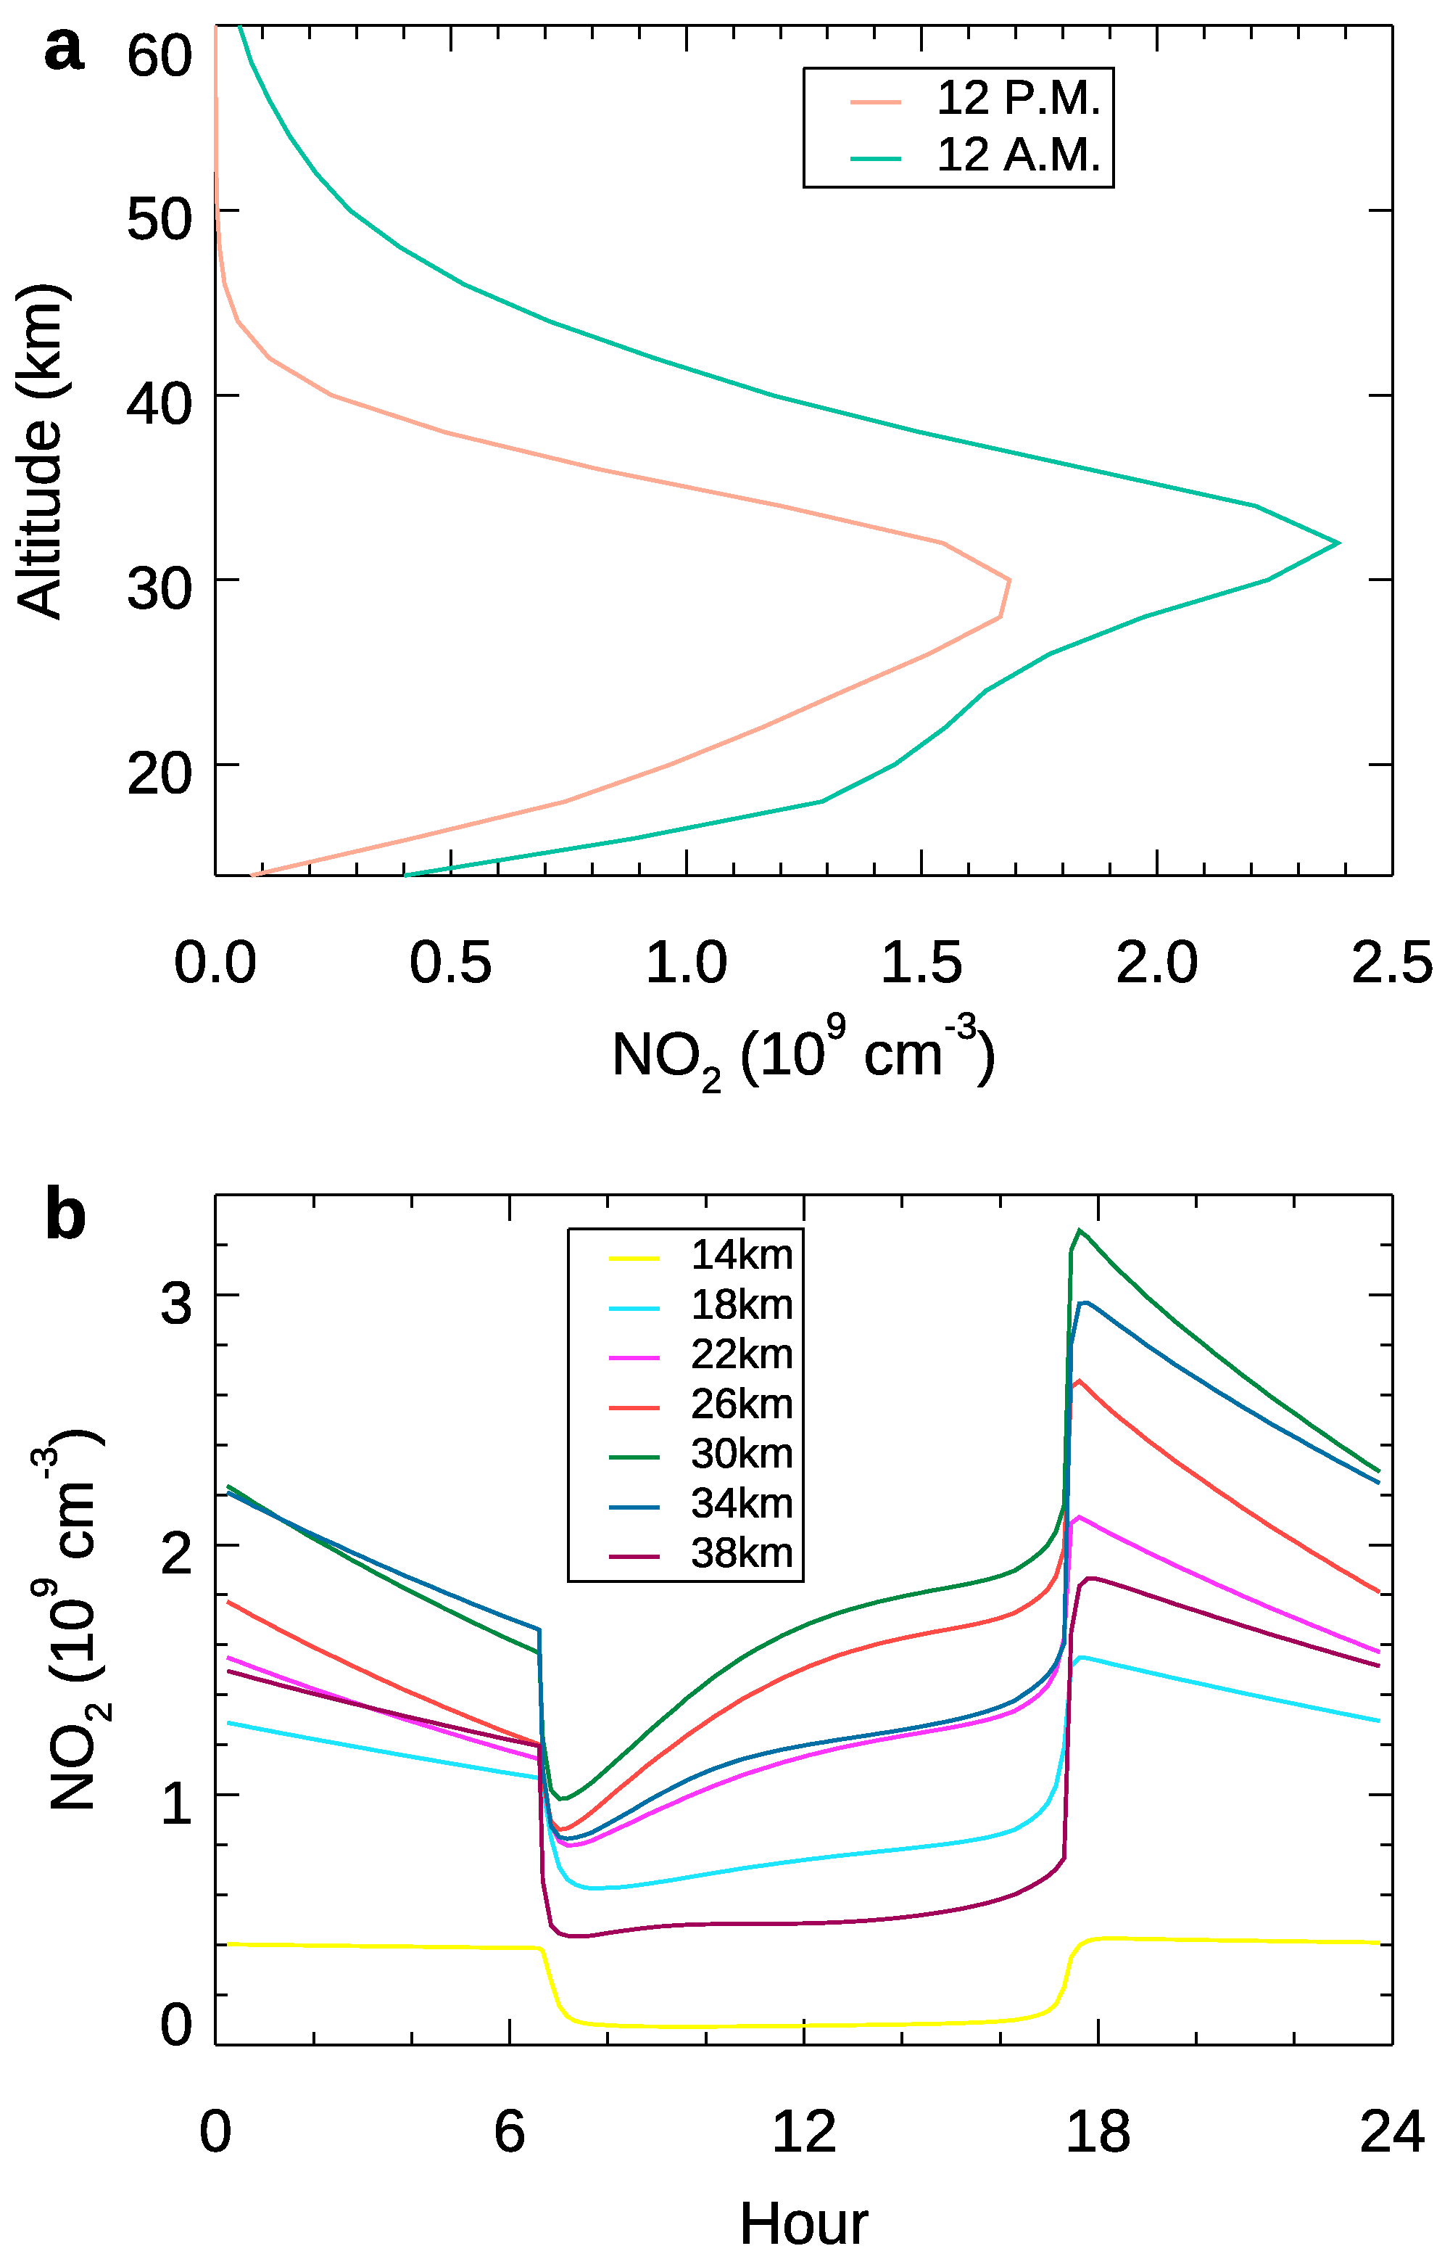
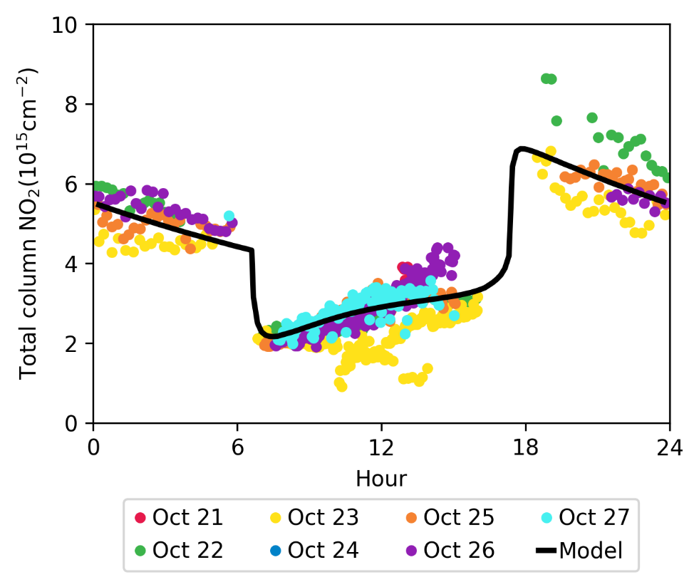
NO₂ Diurnal Variation from Caltech 1-D Model
Vertical Profile and Total Column
Daytime increase driven by HNO₃ + hν
Nighttime decrease driven by NO₂ + O₃

Slide 8
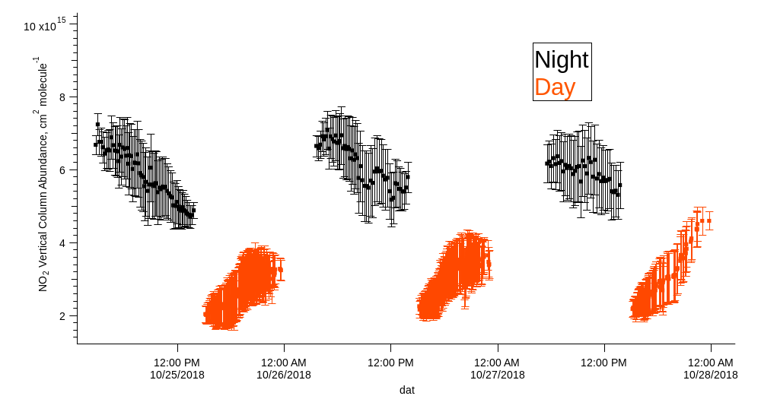
NO₂ Vertical Column Data from Table Mtn.:
Diurnal View
Notes:
First day+night measurements of NO2 and NO3, as far as I know.

Slide 9
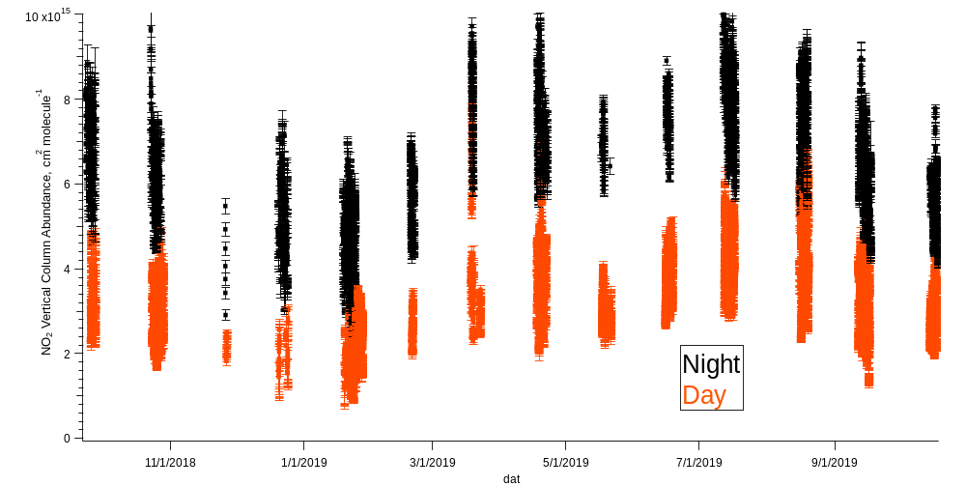
NO₂ Seasonal Variability: Day/Night
Notes:
Data reproduces the well-known stratospheric NO2 seasonal cycle

Slide 10
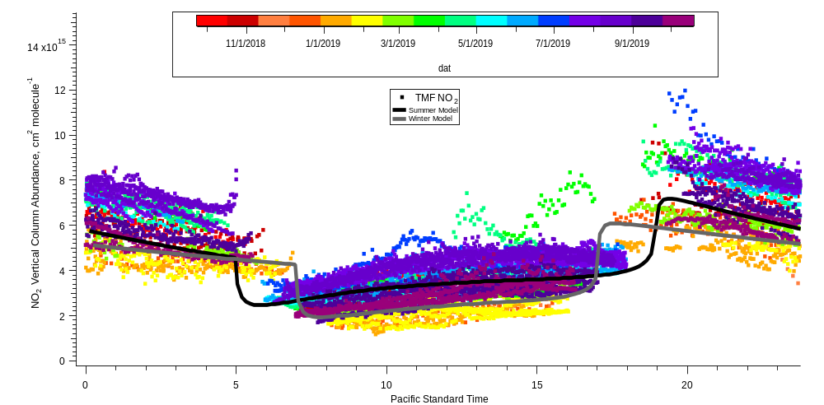
NO₂ Diurnal Variability: Model Comparison

Slide 11
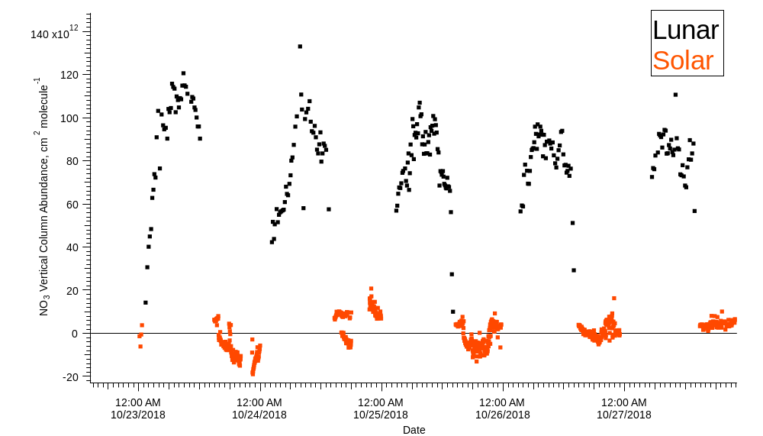
NO₃ Vertical Column Data from Table Mtn.:
Diurnal View

Slide 12
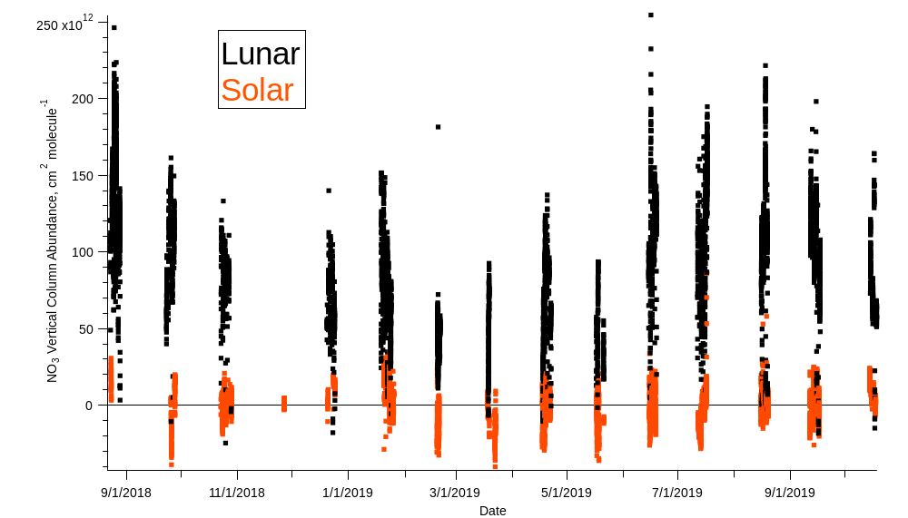
NO₃ Seasonal Variability: Day/Night

Slide 13
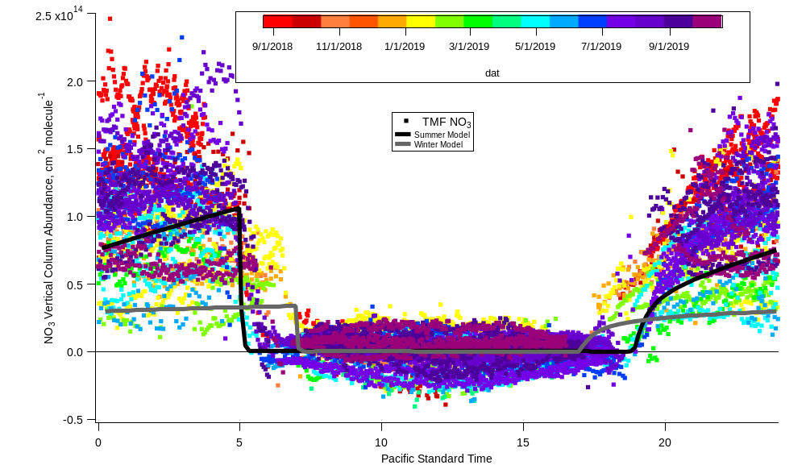
NO₃ Diurnal Variability: Model Comparison

Slide 14
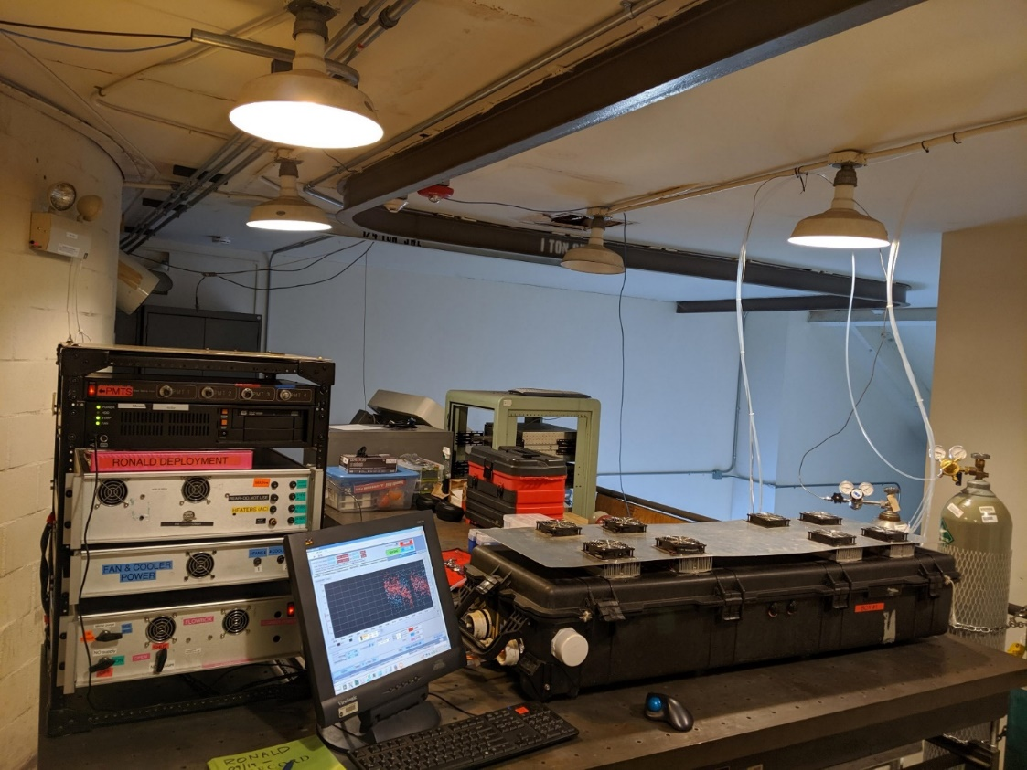
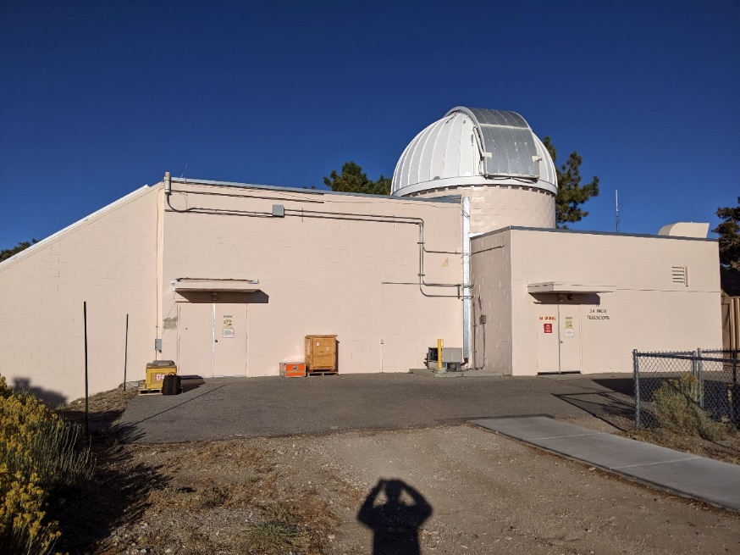
NOAA NO₃/N₂O₅ Instrument Installed at TMF on 16 October
2 Channel CRDS instrument was installed on the second floor of TM12, inlet was strung through the wall on the southwest side of the building
Notes:
Instrument on loan from the Brown group at NOAA.

Slide 15
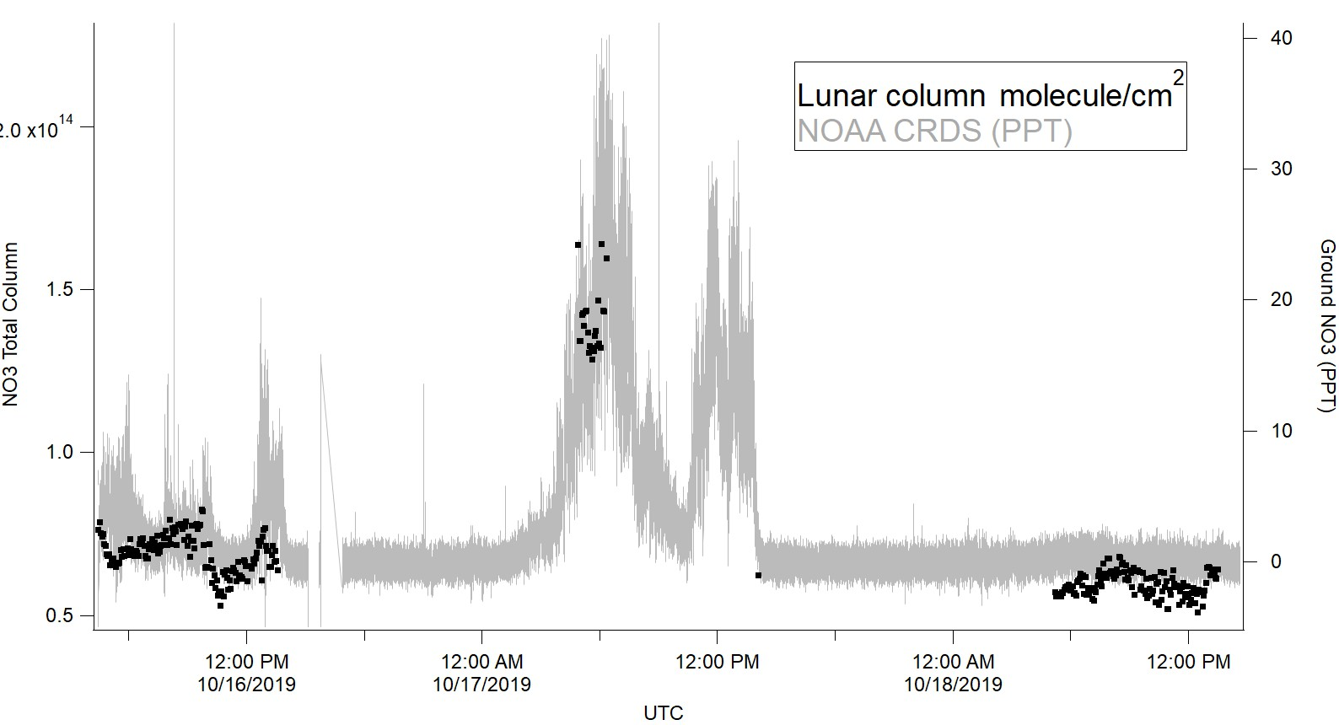
NO₃: Column (JPL)/Surface (NOAA)
First Results

Slide 16
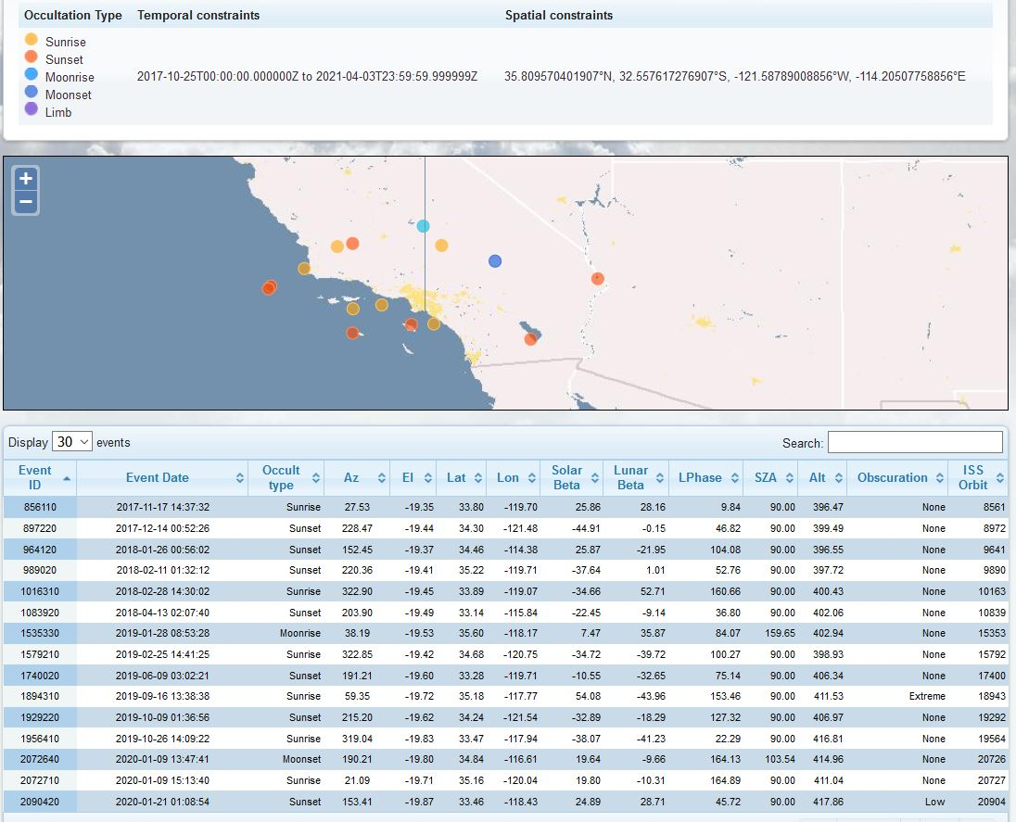
Occultation Events Near TMF
± 3° longitude, ± 1.5° latitude

Slide 17
Summary
One year of data on NO₂ and NO₃ day and night column abundance data has been acquired.
Observed diurnal column data qualitatively agree with the Caltech 1-D model
Further analysis underway to quantify the effect of tropospheric NO_{x} pollution on total columns
NOAA NO₃/N₂O₅ instrument installed and running
A number of coincident measurements (mainly solar) with SAGE III/ISS have been identified and will be compared in the next year.

