Slide 1
SAGE III/ISS Future Algorithm Development
Rob Damadeo & Dave Flittner

Slide 2
Priorities for Version Beyond 5.2
General algorithm scrub to flush out remaining “surprises” in the inherited code
Make it “Version 7” (i.e., standardize across platforms to extent possible and reasonable)
Single ozone profile from visible channels
Incorporate DMP data for better pointing knowledge and to mitigate anomalous influences … Pointing Knowledge is Critical!
Advancements realized from this set could be folded into V5.2, if it makes sense

Slide 3
Beyond 5.2: Known Deficiencies
Known/Suspected Deficiencies / Problems
  Is transmission binned properly?
  DMP rate data isn’t utilized
  Definition of Sun size
  I0 (aka I-zero) uncertainties are not incorporated
  Is refraction done correctly? Optimize?
  NO₂ appears biased high

Slide 4
Beyond 5.2: Improvements
Improvements
  Consistent solution for O₃, NO₂ and aerosol in visible spectrum
    OZONE_MLR does this but not the way it was originally envisioned
    Exploring several different solution approaches
  Pressure-broadening correction for NO₂ cross-sections?
  H₂O (right combination of channels)
  Mesospheric O₃ (stray light correction, channel usage)
  Optical Depth (OD) thresholds for stopping retrieval
  Temperature/Pressure (T/P) implementation
  Incorporate ancillary aerosol products (e.g., SAD or R_{eff})
  ‘Cloud’ flagging

Slide 5
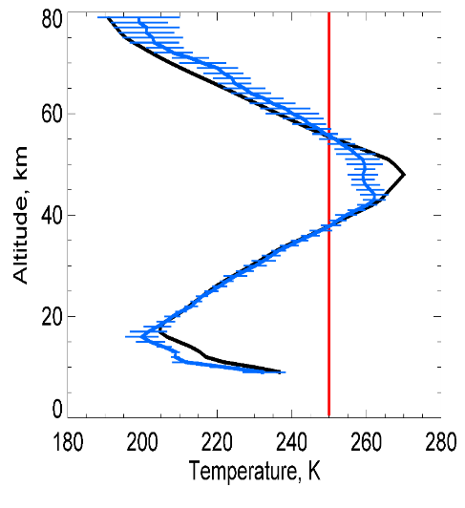
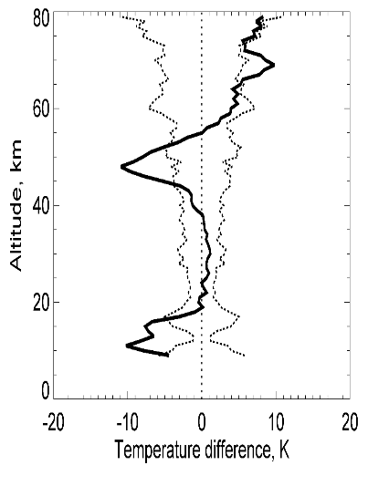
SAGE III/ISS Temperature and Pressure Research Products
Composite of 15 Sunset Events on 2017-11-14 (~27.5º S)
Strategy
  SAGE III/ISS retrieves profiles of T/p from multi-spectral measurements of the O₂ A-band absorption feature near 762 nm
  T/p products from the METEOR/3M mission were of limited science value due to instrument issues
Preliminary assessment:
  SAGE III/ISS O₂ A-band measurements are of higher fidelity than SAGE III/Meteor 3-M’s with no apparent instrument issues
  Sensitivity tests indicate an apparent small wavelength shift in A-band channels relative to nominal registration (approximately 0.03-0.04 nm for sunset and 0.04-0.05 nm for sunrise)
  Preliminary retrievals look encouraging with near science quality products, but some issues remain
Past year spent addressing computer hardware issues affecting S/W
ΔT MERRA-2 – SAGE III/ISS, K
Future work:
  Refine wavelength registration
  Examine sensitivity to forward model parameters
    Bandpass (width, wings, etc.)
    Spectroscopy (line intensities, line shape)
    Solar spectrum
  Exclude weaker channels and/or solar feature

Slide 6
Lunar and Limb
Focus so far has been on solar
Lunar
  Similar algorithm scrub to look for areas to improve
  Are we fundamentally limited by SNR or algorithm?
Limb:
  Looking to implement Level 1B product
  Community supported effort to develop L2 products

Slide 7
Questions?

Slide 8
Solar Algorithm Breakdown
Ephemeris
  Mostly SDP Toolkit routines
Meteorological Processing
  MERRA-2 Reanalysis
Refraction
  Fairly straightforward but slightly different from SAGE II
Transmission
  The “meat” of the algorithm; also the trickiest
Inversion
  Fairly straightforward with good transmission profiles

