Slide 1
Expected changes in version 5.2
Rob Damadeo, Dave Huber & Dave Flittner

Slide 2
Overview
v5.1 Recap
Minor Changes
Completed Changes
Changes in Development

Slide 3
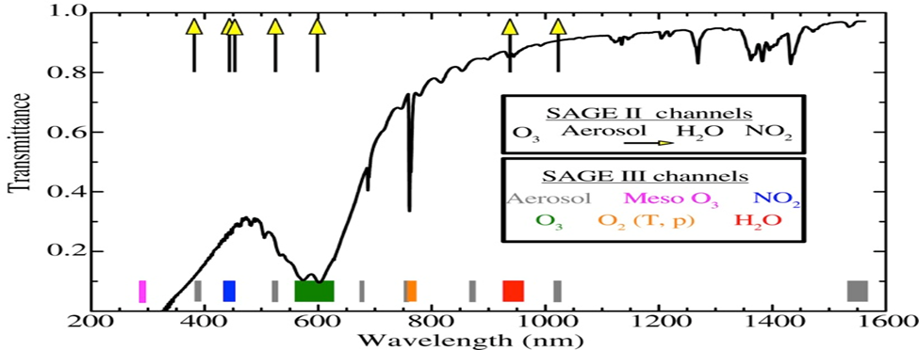
v5.1 Recap: Spectral Coverage
Si CCD (~280-1035nm)
Photodiode (1542±15nm)
O3, NO2, H2O, aerosol, T/p
Solar:
  87 “pixel groups”
  12 spectral “channels”
CCD is reprogrammed for lunar and limb

Slide 4
v5.1 Recap: Current Products
Solar
  Ozone
    MLR – Channels 3 & 5 to solve for O3 & NO2, aerosol has assumed shape in channels
    AO3 – Channels 3, 4, 5, 6, 7, 9, & 11 to solve for O3 and aerosol simultaneously
    Mes – Channel 1 to solve for O3 only, affected by spectral stray light (reentrance spectra)
  NO2 – comes from MLR retrieval (Channel 3)
  Aerosol – 9 wavelengths derived as residuals using MLR products
  H2O – Channel 10 (~940nm) to solve for H2O, O3, and aerosol independently
Lunar
  Ozone and NO3 – very similar to Meteor algorithm
Limb
  No released L1 or L2 products yet

Slide 5
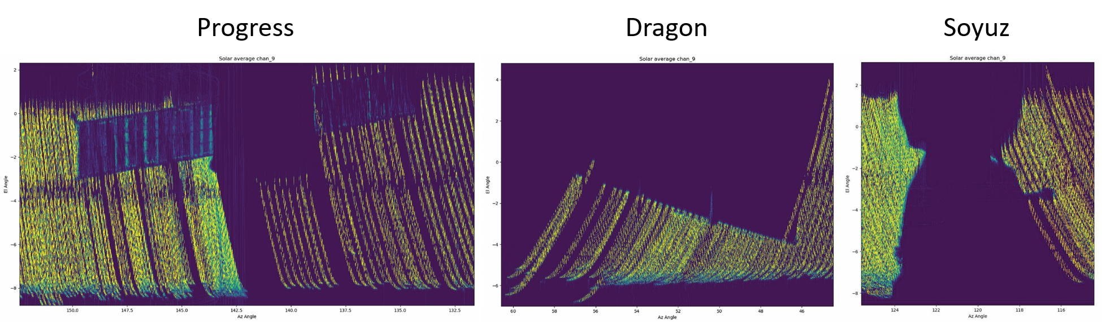
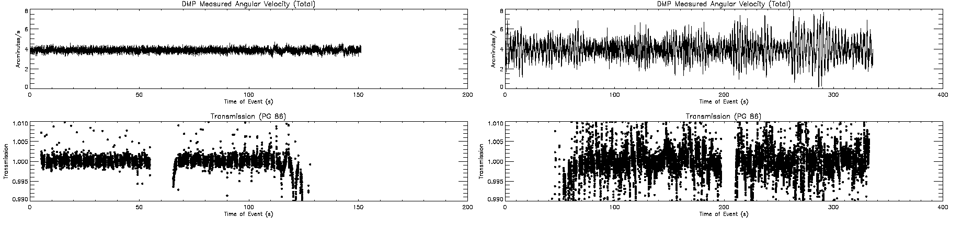
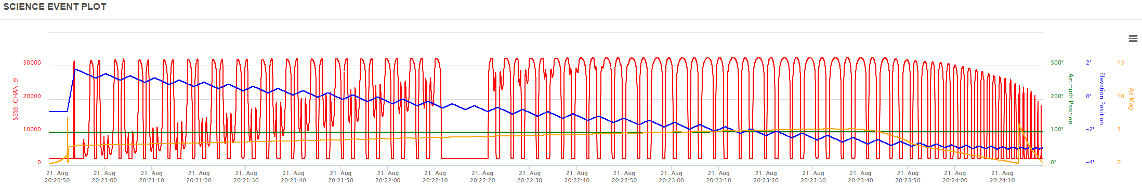
v5.1 Recap: Observational Anomalies
Visiting vehicles
  Off during maneuvers, contamination door closed
Solar Eclipse
Blockages
Disturbances

Slide 6
Minor Changes
Environment Migration
  Keeping up with NASA IT security
  Removing pay-to-use math libraries
Fixed some ephemeris and timing problems
  Sometimes causes algorithm to crash and events to drop
Fixed a bug in NO2 clearing
  NO2 contribution to LOS OD wasn’t removed from altitudes below NO2 profile
Slight adjustment to methodology for computation of effective absorption cross-sections

Slide 7
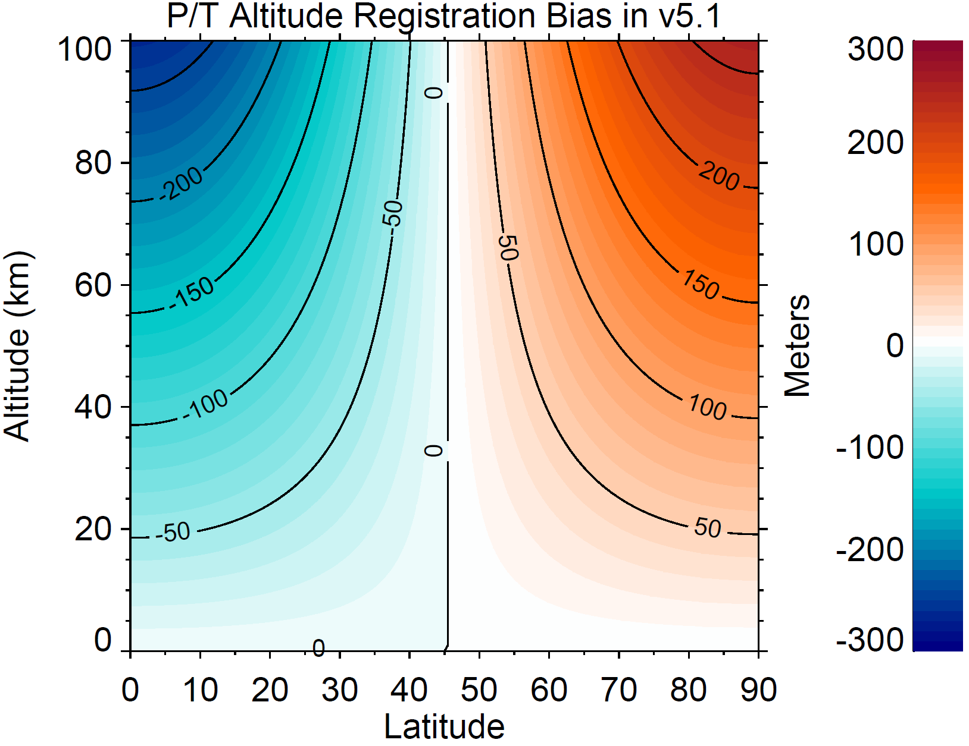
Completed: T/p Altitude Registration
Utilize MERRA2 T/p on Z_{Φ}
Geopotential height is converted to geometric altitude to put T/p on the retrieval grid
Conversion was a simplified approximation copied from SAGE II
Updated surface gravity to WGS84
L2 products are generally unaffected in native representation
Care should be taken when converting unit representations
To apply correction to v5.1, ask us for details

Slide 8
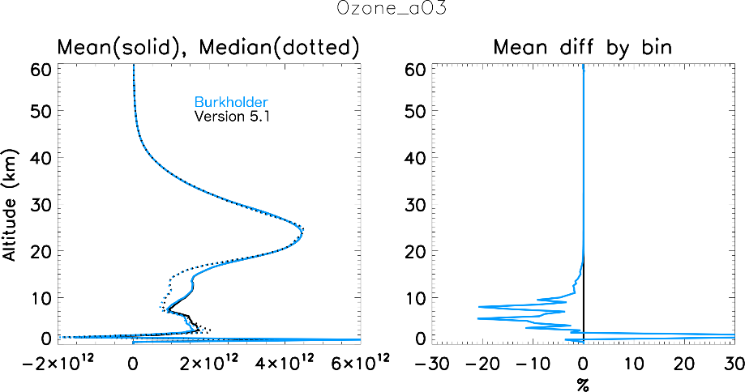
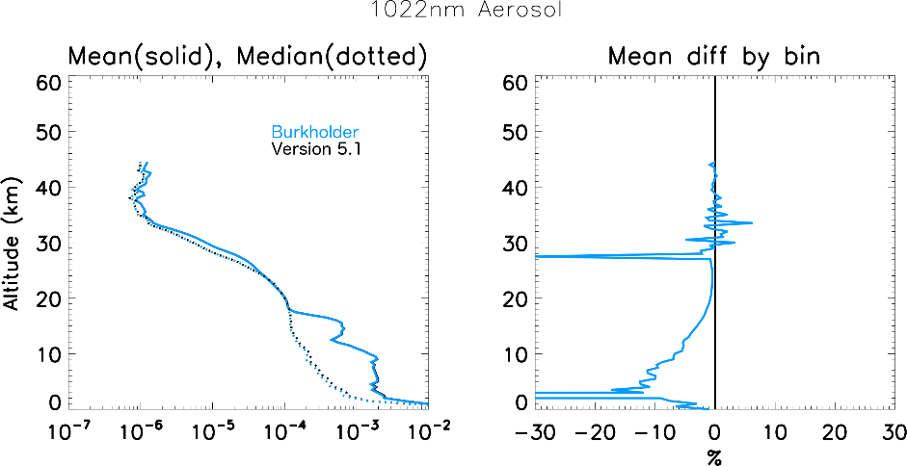
Completed: O4 Spectroscopy
v5.1 uses improper O4 spectroscopic model
O4 contributions are removed from Chappuis (and 1um) prior to species retrievals
Improper clearing resulted in systematically large O3 in troposphere and lowermost stratosphere

Slide 9
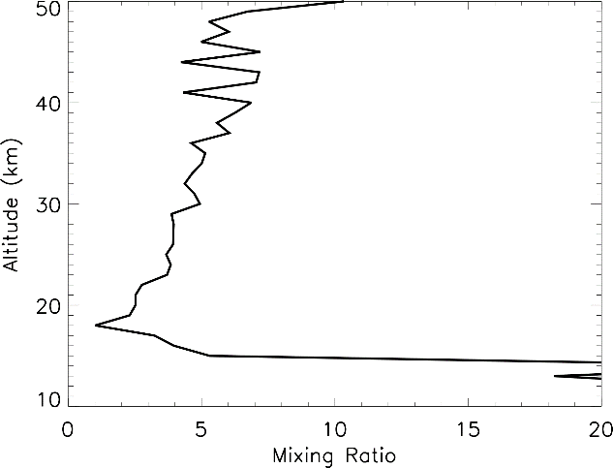
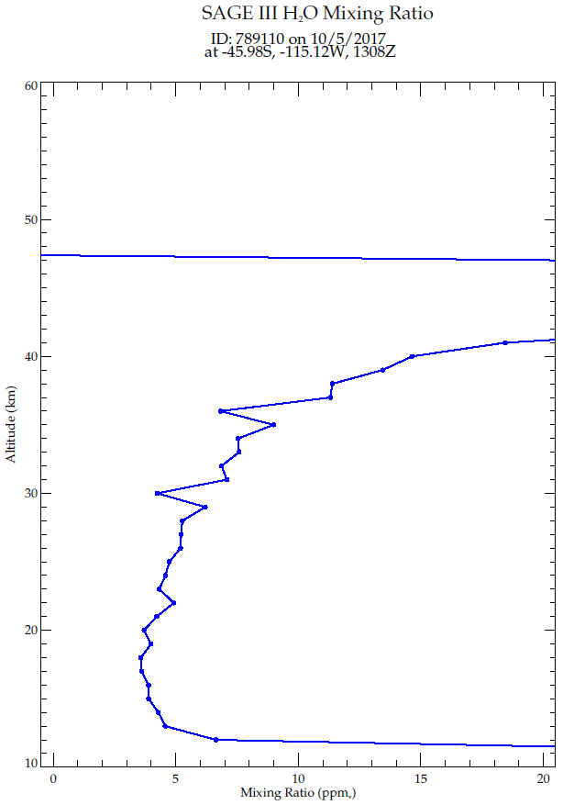
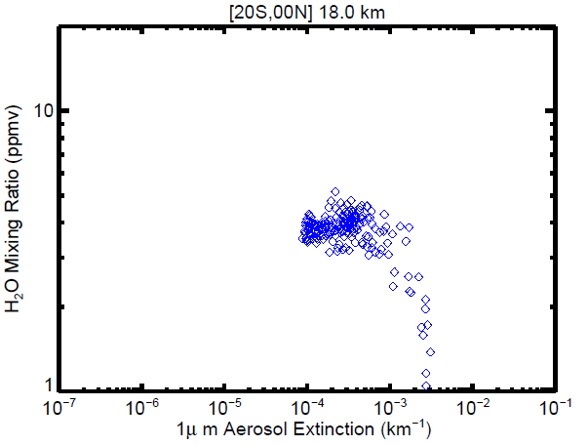
Development: H2O Retrieval
Algorithm very similar to Meteor (CGA + onion peeling)
Indexing bug in v5.1 included Channel 9 (868nm)
  Endpoint anomaly aliases into retrieval and yields anomalously lower H2O in presence of volcanic aerosol
Bug in CGA routine resulted in frequent and persistent negative mixing ratios that crashed the retrieval or caused excessive number of “keel-over” profiles

Slide 10
H2O Retrieval cont.
Revisit H2O retrieval
Go back to basics
  Current algorithm retrieves at 1km grid and smooths
Investigate optimum channel combinations
  Channel 10 has 28 PGs between 930 & 950nm as well as 920nm and 970nm
  Retrieves O3, H2O, and aerosol separately without using other solutions
  Can look at adding or subtracting spectral information, coadding spectral channels for increased SNR, incorporating external solutions (e.g., MLR/AO3) in certain regimes (e.g., increased aerosol loading)

Slide 11
Development: Inversion Step
Inversion is simple global fit using Beer’s Law
  LOS Optical Depth = Path-Length Matrix * Extinction
  Mathematically assumes extinction is uniform in layer (i.e., entire contribution to OD in shell layer comes from extinction at bottom of layer)
Can rework the math to assume linear gradient in extinction
Primary contribution to OD comes from bottom of tangent layer (~2/3) at tangent height but weighting shifts in higher shells
Should result in an upward shift in resulting profiles
Also influences clearing of molecular scattering in retrieval

Slide 12
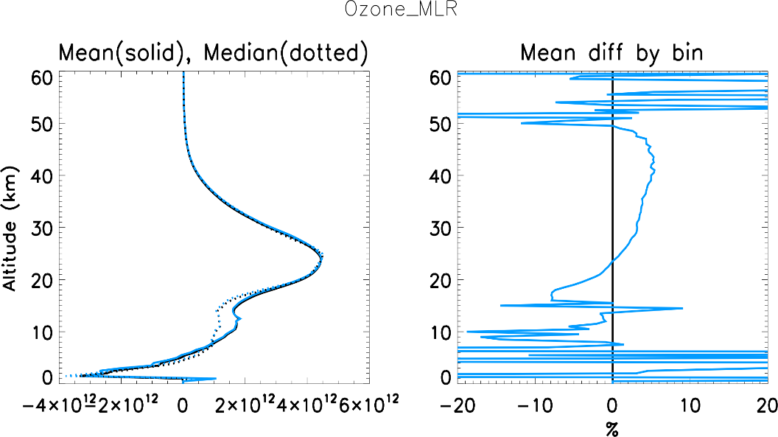
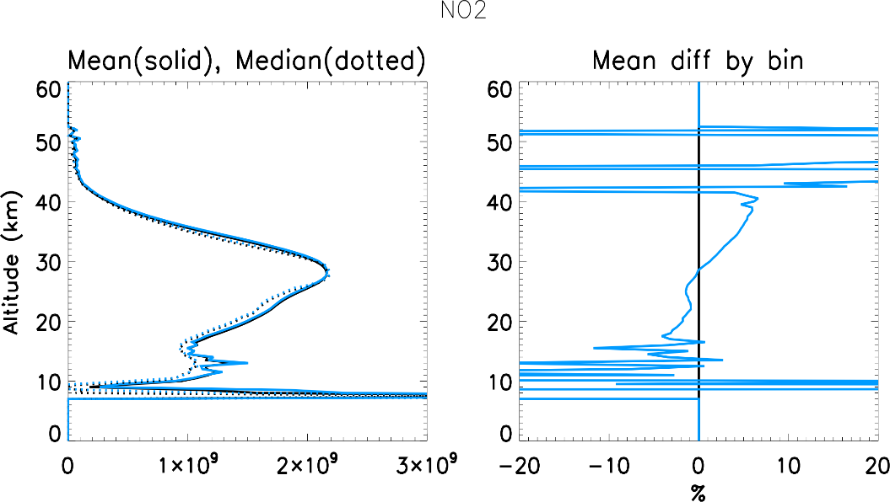
Inversion Step cont.
Differences in O3 and NO2 are consistent with a shift in altitude (~200-250m)

Slide 13
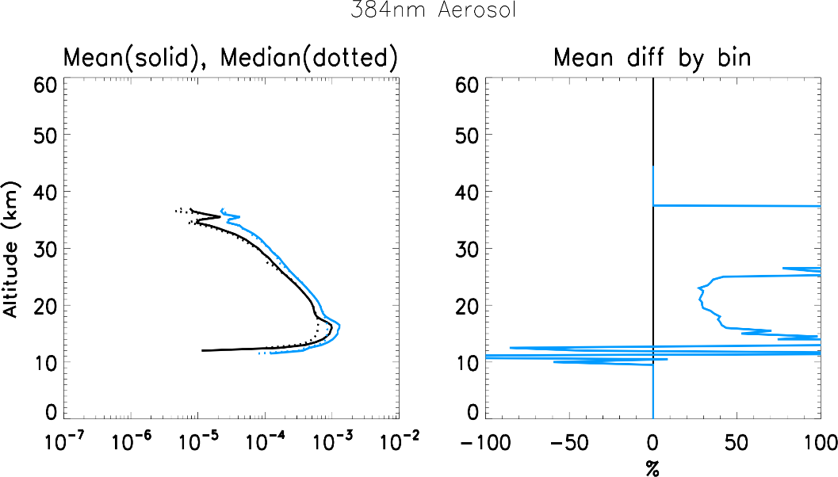
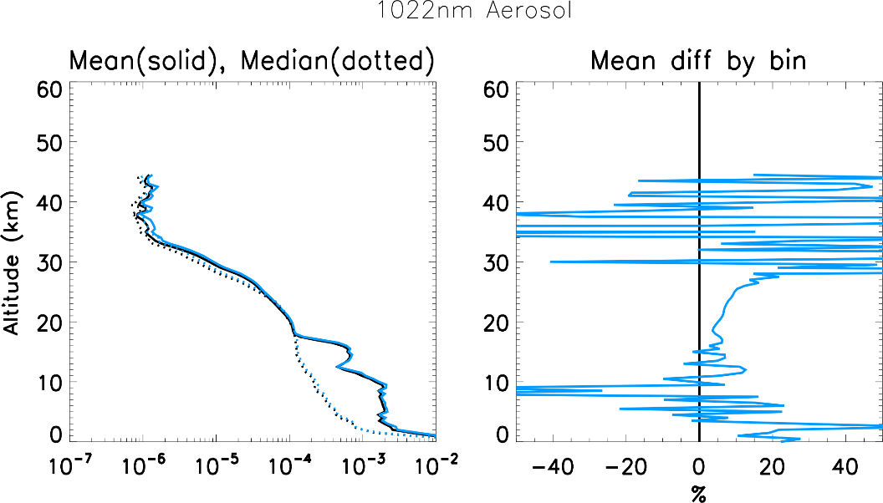
Inversion step cont.
Changes in Rayleigh clearing have a systematic impact on aerosol

Slide 14
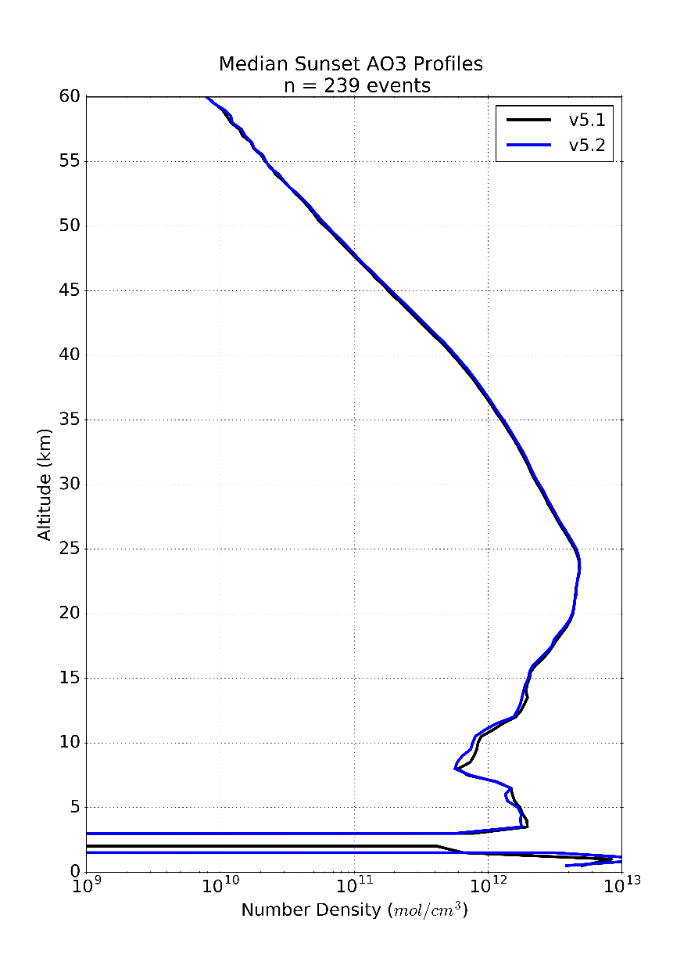
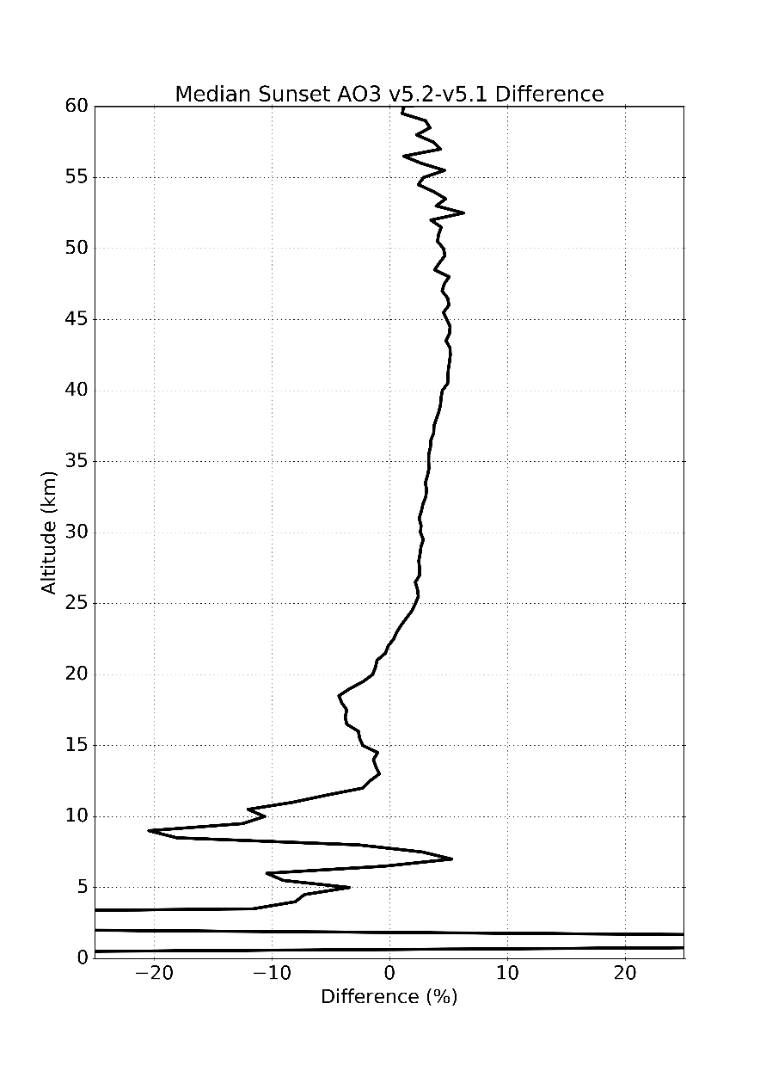
Quantitative Changes So Far: Ozone
2nd Order T/p Altitude Registration
Updated O₄
Path-length
NO2 Clearing
Results:
5% increase above concentration peak
Decrease below the peak

Slide 15
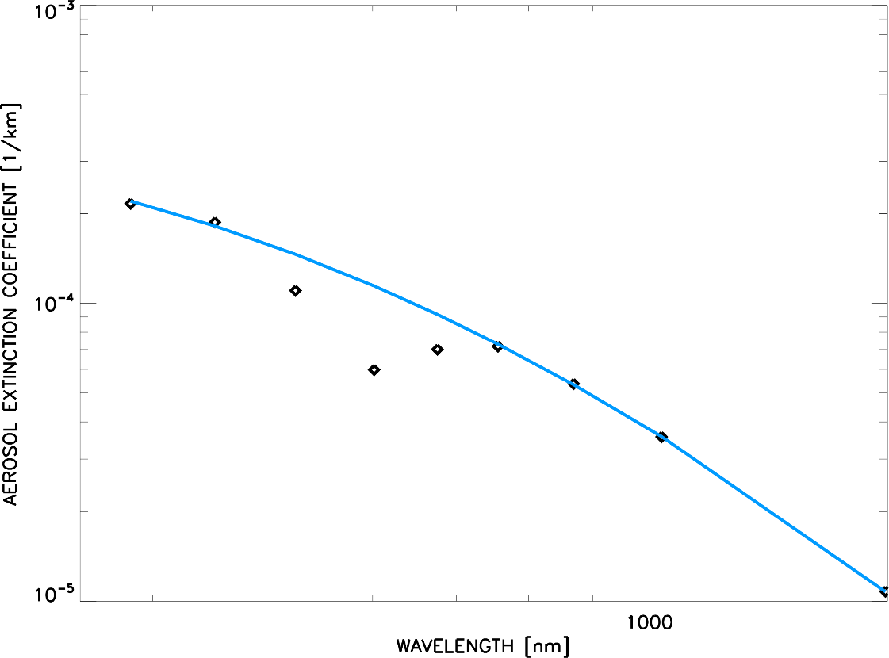
Development: Aerosol Spectrum
Aerosol spectrum k_{ext}(λ) should be smoothly varying
“Dip” near Chappuis that scales with O3 cross-sections
Fit k_{ext}(λ) with 2nd order polynomial in log-log space using other aerosol channels and compute residuals
Residual

Slide 16
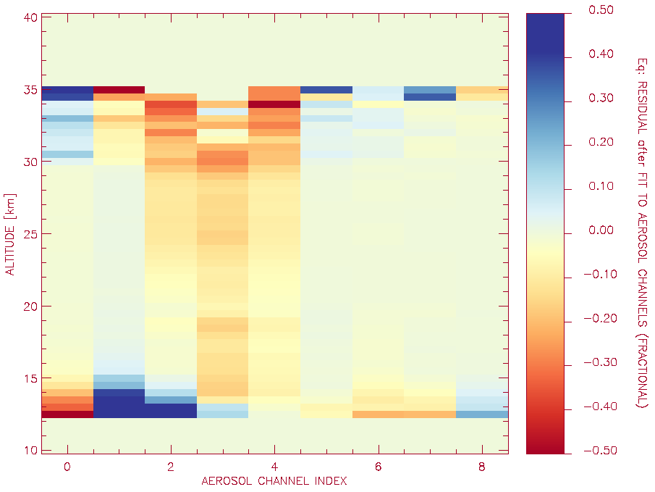
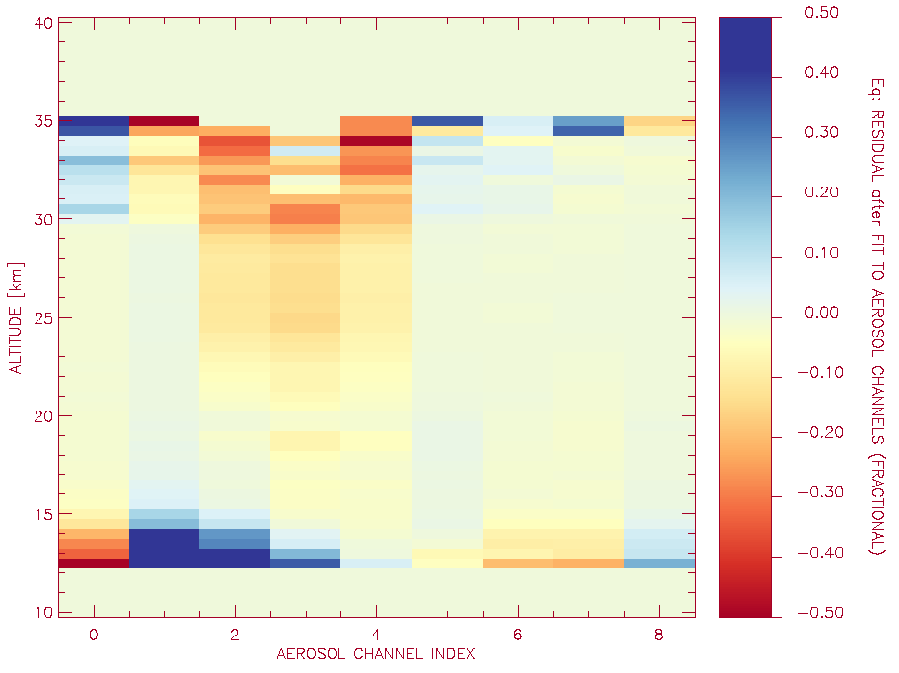
Aerosol Spectrum cont.
“Dip” in stratosphere scales with O3 spectroscopy and profile
Primary contribution at low altitudes results from O4
v5.1 w/ O4 change

Slide 17

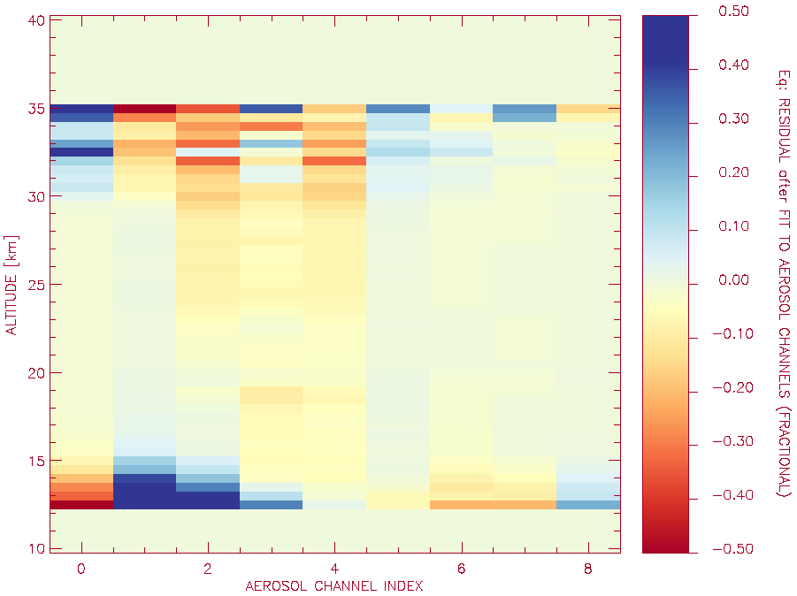
Aerosol Spectrum cont.
Aerosol is solved for in AO3 retrieval but not reported
AO3 aerosol appears more robust
MLR aerosol AO3 aerosol

Slide 18
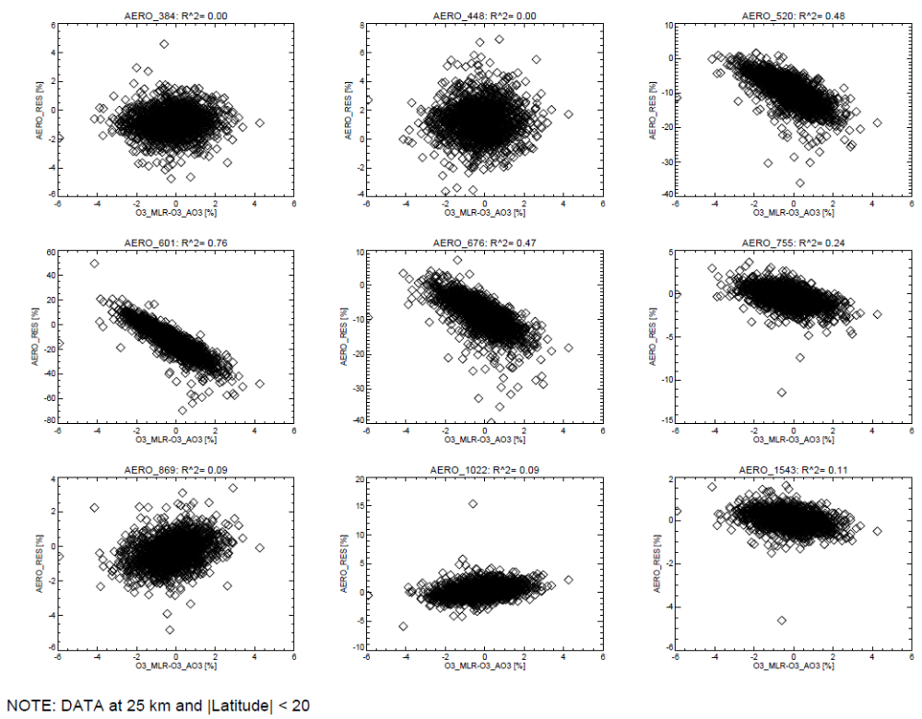
Aerosol spectrum cont.
446nm
Residual from fit appears correlated with difference between MLR and AO3 ozone solutions.
384nm
520nm
601nm
675nm
AEROSOL RESIDUAL (%)
755nm
1022nm
1043nm
869nm
O3_MLR – O3_AO3 (%)

Slide 19
Aerosol spectrum cont.
Summary:
  Aerosol data near Chappuis biased low
  Aerosol data at other channels generally unaffected in stratosphere
  Aerosol spectrum dip possibly related to O3 spectroscopy (needs investigation)
  Determine if AO3 aerosol product should be reported instead

Slide 20
Development: Improved QA
Quality assurance process continues from SAGE III/M3M
Exclude blatantly broken events (e.g., missing data, obstruction)
Exclude blatantly broken H2O profiles (i.e., retrieval failures)
Problems:
  Subjective process – we don’t always agree about what looks “broken”
  Prone to human error – sometimes we miss some (particularly H2O)
Working on automating the process
  Requires strict criteria for “brokenness”
  Repeatable and documentable
  No need to stare at tens of thousands of profiles for next version release

Slide 21
Development: New File Format
Current file formats are holdovers from SAGE III/M3M
  We don’t like them all that much either
Data binning:
  Single event files (kernel the algorithm runs on) with useful naming convention
  Monthly files for ease of distribution and use (both binary and NetCDF)
Will try to include additional useful information within the data files
  Still working on existing flags as well as new ones
  We’re open to suggestions by the community

Slide 22

Timeline
Goal is an improved dataset available for use in the 2022 International Ozone Assessment
Anticipate all items mentioned here will be included.
Will work with the Science Team to assess the dataset before public release
Public release targeted for later 2020.

