Slide 1
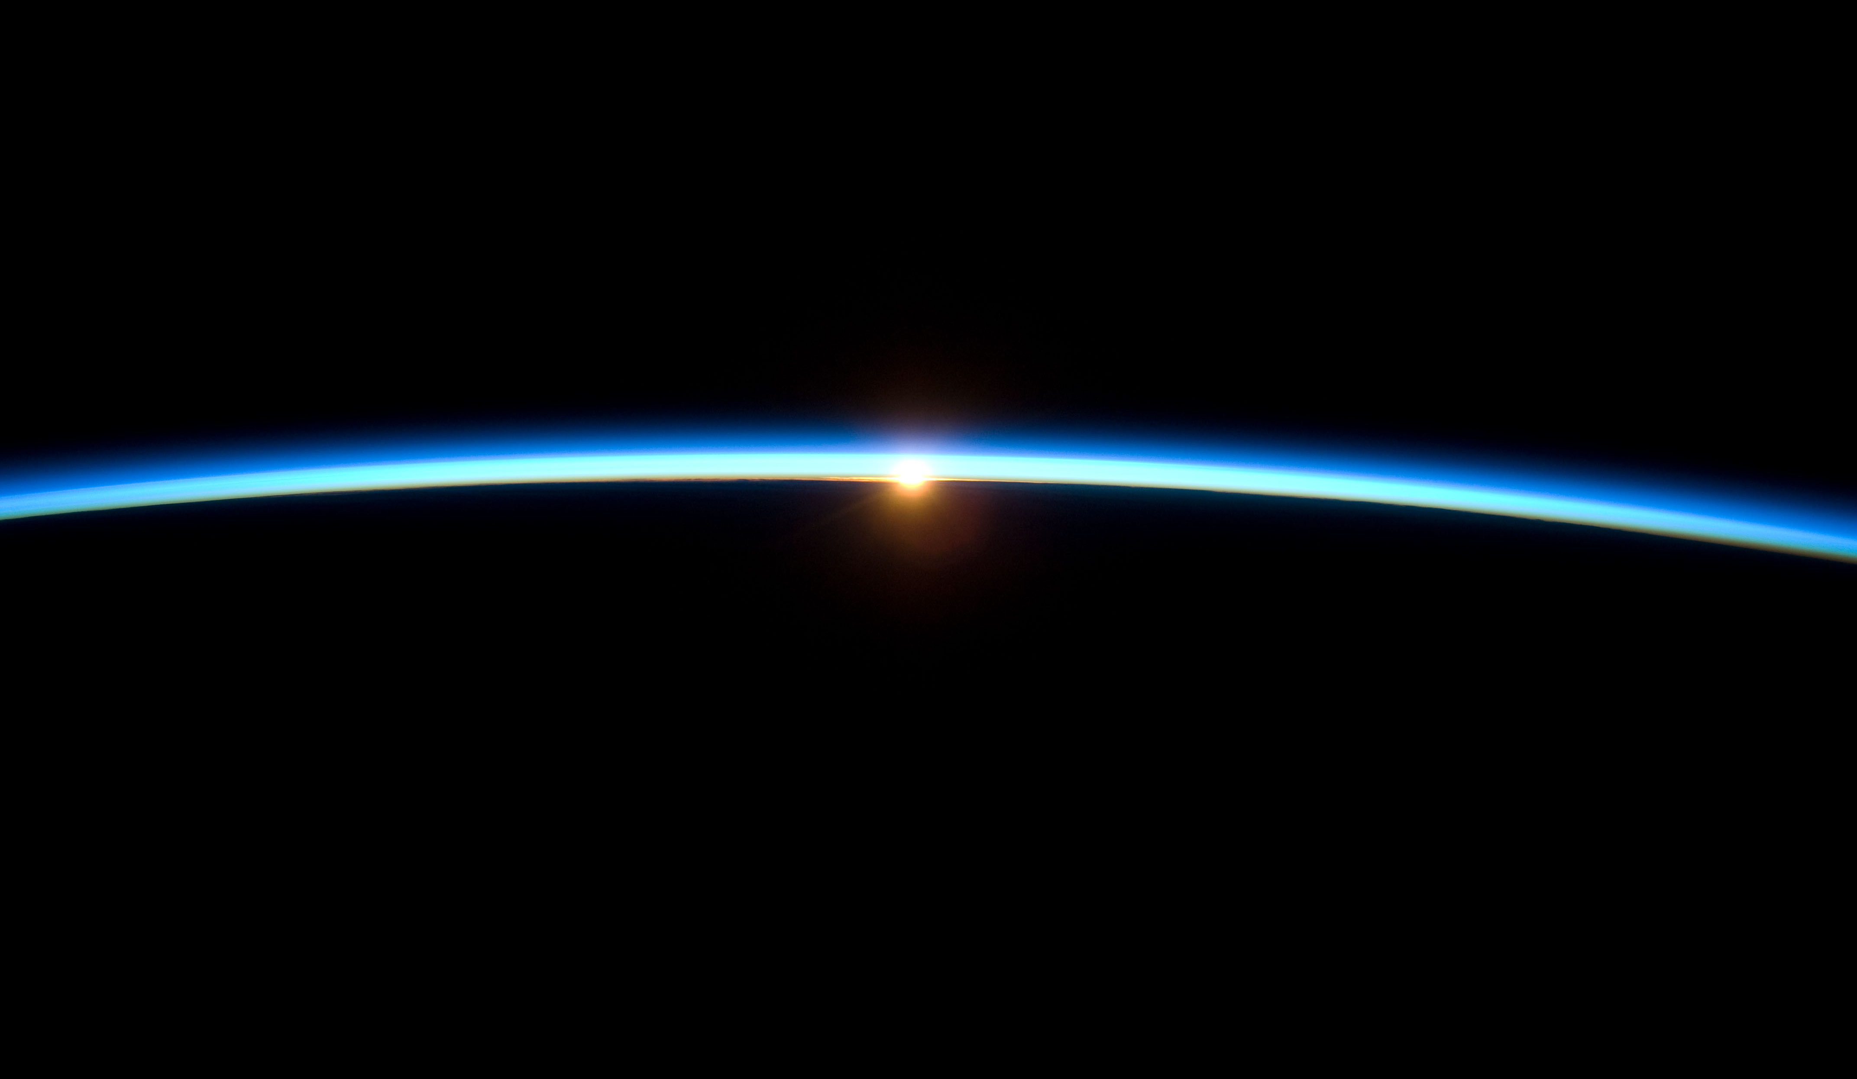

Diurnal Cycle Modeling Related to SAGE III/ISS Products
Luke Oman¹, Sarah Strode^{1,2},
Ghassan Taha^{1,2}, and Mark Schoeberl³
¹NASA/GSFC, Greenbelt, MD, USA
²University Space Research Association, Columbia, MD, USA
³Science and Technology Corporation, Columbia, MD, USA
Luke Oman
luke.d.oman@nasa.gov
SAGE III/ISS STM – Oct. 30, 2019

Slide 2
General Overview on the GEOS GMI simulation
GEOS-5 Replay simulation for the SAGE III/ISS period (2017 – 2018 completed will run additional years as emissions become available)
Replay is a constrained dynamics run using 3-hrly ASM (U, V, T, P, and Q (trop. only)) fields from MERRA-2
The simulation is run at C90 (cubed sphere) and output on 1° lon. x lat. grid with 72 vertical levels
Including full Stratospheric and Tropospheric chemistry from the Global Modeling Initiative (GMI) chemical mechanism
Including the GOCART aerosol module with SU, DU, SS, OC, BC, and NI
A full suite (over 20) of transport diagnostic tracers
The output from this simulation is available from Luke Oman (luke.d.oman@nasa.gov) or Sarah Strode (sarah.a.strode@nasa.gov)

Slide 3
GMI Chemical Mechanism
Global Modeling Initiative (GMI) chemical mechanism
With over 120 species, and over 400 reactions (322 Kinetic and 81 photolysis) - JPL 15 photokinetic rates
Uses SMVGEAR II algorithm (Jacobson, 1995) to integrate the chemical mass balance equations and FAST-JX (v6.5) for photolysis (Bian and Prather, 2002)
Greenhouse gases (CO₂, N₂O, and CH₄) are based on observations and ODSs are from A1 2018
Includes observed ~11 year solar cycle variability and Galactic Cosmic Ray NO_{x} production
Aerosols are connected to optical depth used in photolysis rates and heterogeneous chemistry
One way connection of the oxidant fields used in GOCART (coming from GMI but not altered)

Slide 4
Some Relevant GOCART Details
Goddard Chemistry Aerosol Radiation and Transport (GOCART) module (Chin et al., 2002; Colarco et al., 2010)
Prognostic Sulfate, Dust, Sea Salt, Organic Carbon, Black Carbon, and Nitrates
Dust and Sea salt emissions are tied to the simulated meteorology
Volcanic SO₂ – daily degassing and episodic eruptions from Carn et al., 2017 (updated through 2018)
This simulation includes OCS as a source for the background stratospheric aerosol layer

Slide 5
Specialized High Time Frequency Output
The simulation includes 30 minute frequency output for a number of meteorological variables and chemical constituents - high frequency output necessary because of fast change near the terminator
Met: PS, T, PL, ZL, Q, TH, FCLD, SZA, TROPPB, NUMDENS, AIRDENS
S3 Chemistry: O₃, NO₂, NO₃, OClO
Other constituents: NO, HNO₃, N₂O₅, OH, HO₂, CH₄, BrO, O³(P), O¹(D), Condensed HNO₃ and Ice, and Surface Area Density for Sulfate, Ice, and NAT
Many other fields available as 6-hrly or daily average
Post-processed files are available indexed by SZA to apply scalers for validation with instruments measuring at a variety of SZA
Special scalers for SAGE III/ISS solar occultation O₃ and NO₂ referenced to sunrise and sunset
Files use a signed SZA which is negative in the PM (sunset)

Slide 6


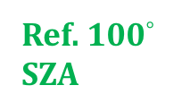
Modeled Ozone Diurnal Cycle – By Altitude
Ref. 100$°$ SZA
Eq.
40$°$N
Examples for Jan. and July at the Equator and 40$°$N
Ozone scaler referenced to 100$°$ SZA just before sunrise
Using negative signed SZA for PM
(90$°$ SZA for sunrise and
-90$°$ SZA for sunset)
Diurnal cycle gets larger with altitude with significant differences between 40 and 50 km
Jan.
SUNRISE
SUNSET
Jul.

Slide 7

Modeled Ozone Diurnal Cycle – Seasonal Cycle
Examples for the Seasonal Cycle at the Equator for 40 and 50 km
Ozone scaler referenced to 100$°$ SZA just before sunrise
At 40 km peak ozone occurs just before sunset
At 50 km the peak ozone is generally just after sunset
Large decrease in ozone in the daylight hours at 50 km
Some variability over the seasonal cycle
Dec.
Jan.

Slide 8
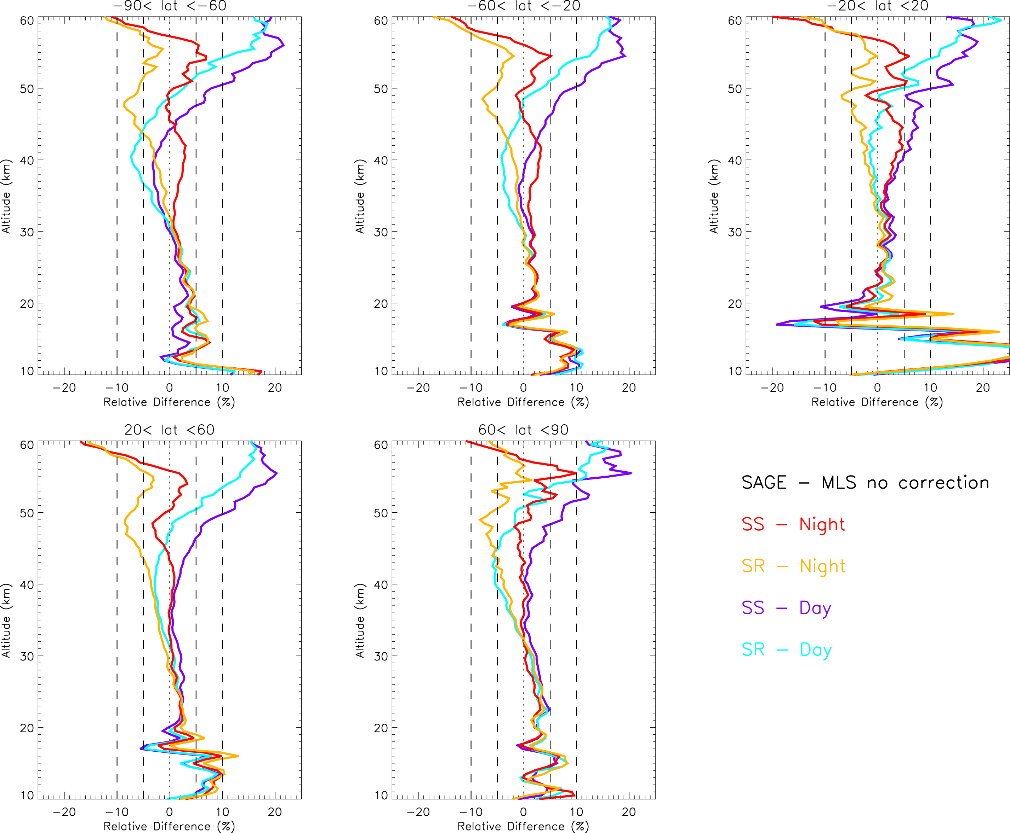
SAGE III/ISS – MLS Ozone Comparison
SAGE III/ISS – MLS ozone comparisons for 4 different pairings with no diurnal correction
Below 30 km where diurnal cycle variability is relatively small all the pairings show a more similar difference
Above 35 km the differences grow larger with altitude.
At the highest altitudes more difference is seen from MLS Day vs Night than SAGE III/ISS SS vs SR

Slide 9
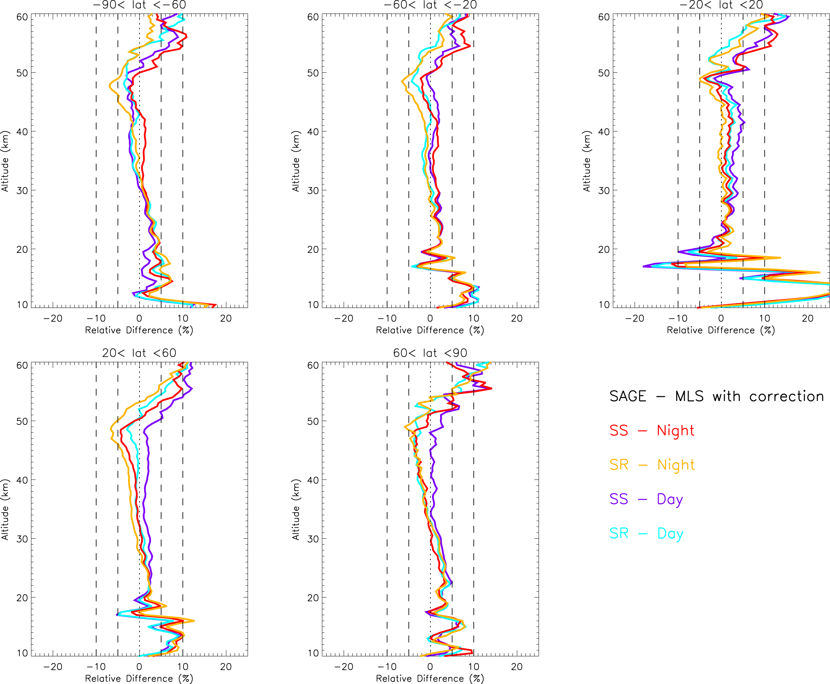
SAGE III/ISS – MLS Ozone Comparison with Diurnal Correction
SAGE III/ISS – MLS ozone comparisons for 4 different pairings with a diurnal correction from the GEOS modeling
Significant convergence of the differences for all the pairings
Generally very good agreement especially between 20-50 km and in many cases just a few percent
Above 50 km the difference grows larger

Slide 10

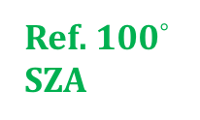

Modeled NO₂ Diurnal Cycle – By Altitude
Ref. 100$°$ SZA
Eq.
40$°$N
Examples for Jan. and July at the Equator and 40$°$ N
NO₂ scaler referenced to 100$°$ SZA just before sunrise
Using negative signed SZA for PM
(90$°$ SZA for sunrise and
-90$°$ SZA for sunset)
Very sharp gradient at the terminator and the longer lit upper stratosphere can be seen
Higher NO₂ at night with largest relative values just after sunset between 25-35 km at the Eq. and 20-30 km at 40$°$N
Jan.
SUNRISE
SUNSET
Jul.

Slide 11

Modeled NO₂ Diurnal Cycle – Seasonal Cycle
Examples for the Seasonal Cycle at the Equator for 25 and 35 km
NO₂ scaler referenced to 100$°$ SZA just before sunrise
At 25 and 35 km peak NO₂ occurs just after sunset
Relatively fast conversion of NO to NO₂ then slower conversion of NO₂ to NO₃ and together to form N₂O₅
Again some variability is modeled over the seasonal cycle
Dec.
Jan.

Slide 12
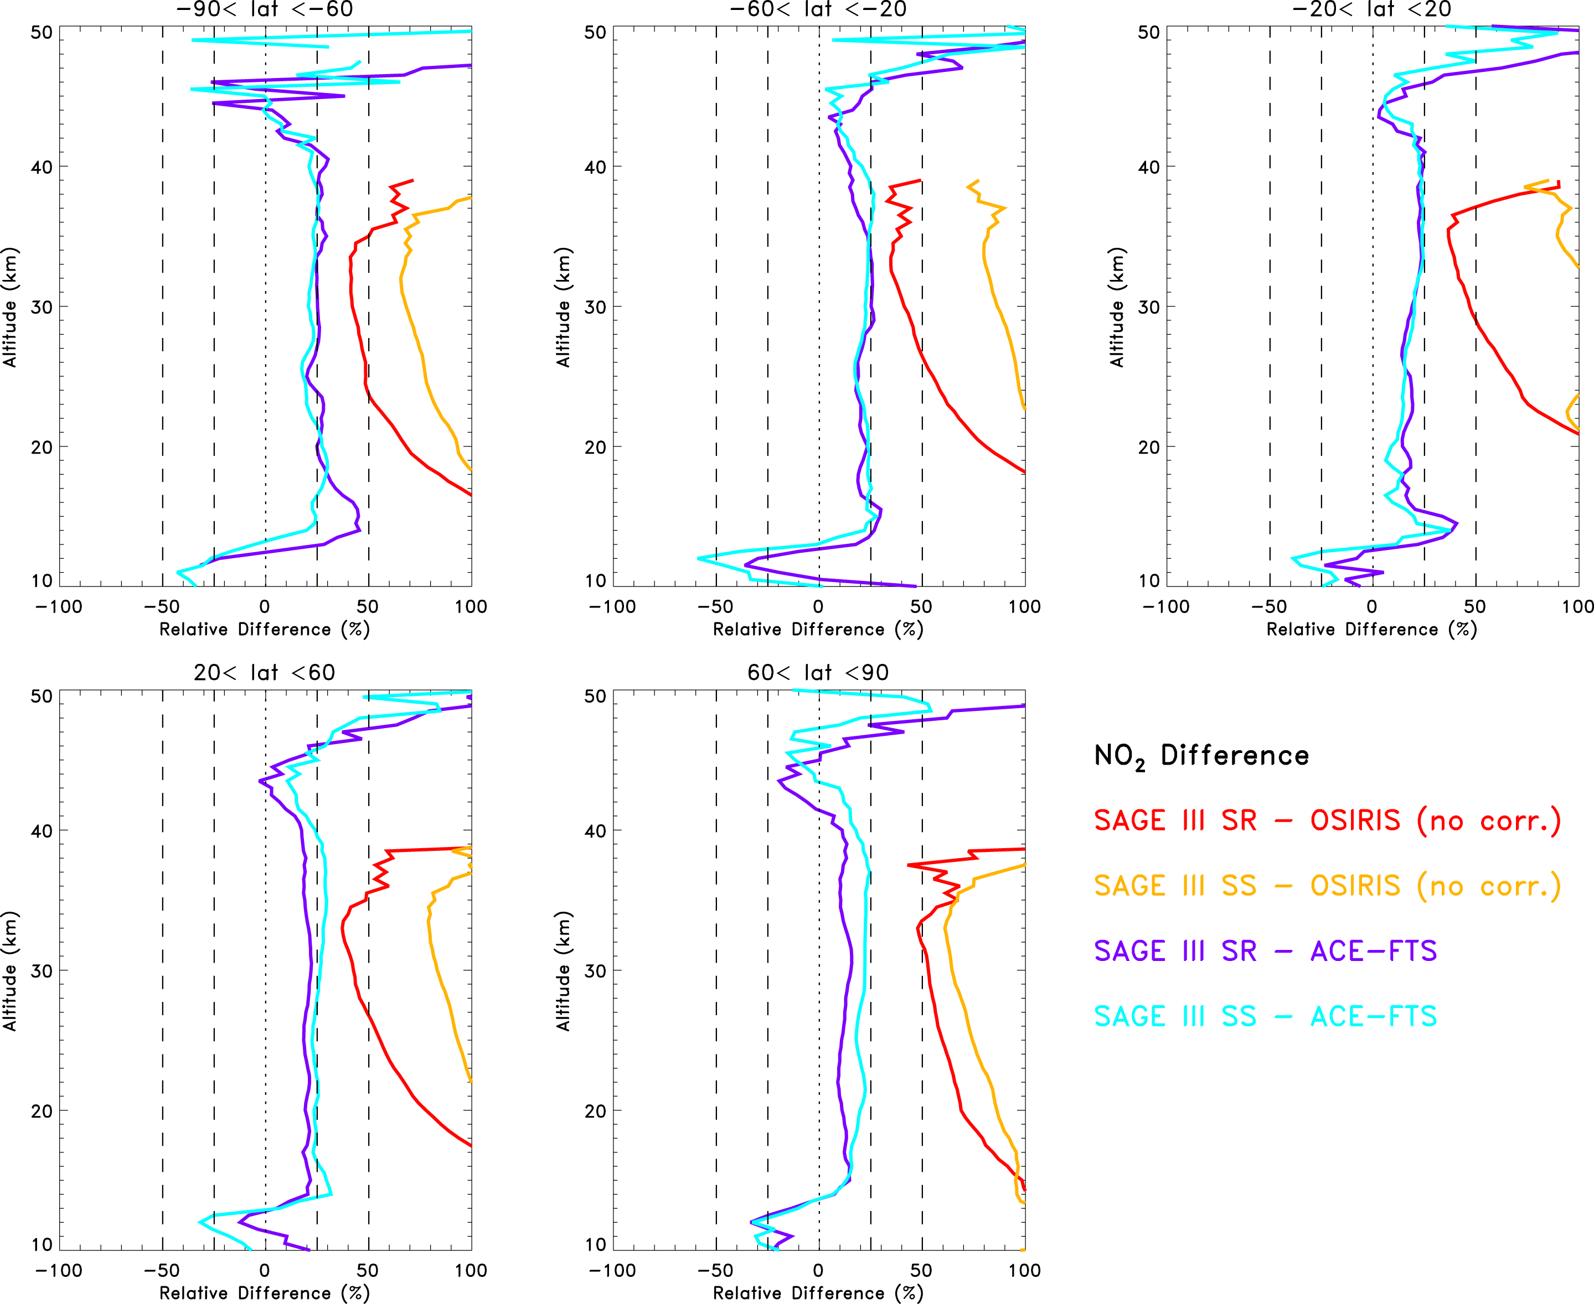
SAGE III/ISS – ACE and OSIRIS NO₂ Comparisons
SAGE III/ISS – ACE and OSIRIS NO₂ comparisons with no diurnal correction for OSIRIS
ACE measurement are also solar occultation so just looking at coincidences
Comparisons with ACE show generally 25% higher values over most altitudes (15-40 km) and much larger differences are seen with OSIRIS also a significant spread between SR and SS comparisons

Slide 13
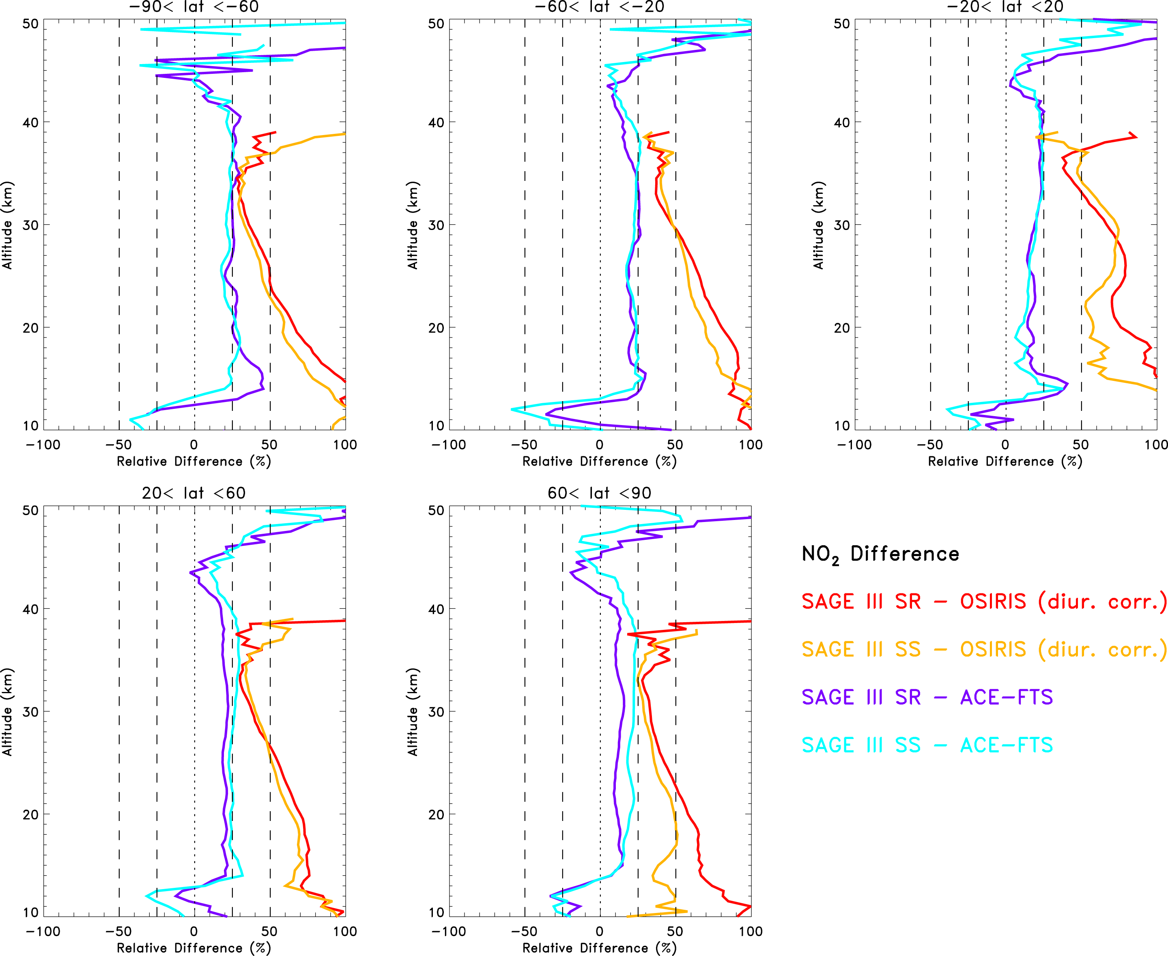
SAGE III/ISS – ACE and OSIRIS with diurnal corr. NO₂ Comparisons
SAGE III/ISS – ACE and OSIRIS NO₂ comparisons with a diurnal correction for OSIRIS from GEOS
Comparisons with OSIRIS and ACE have more similar difference at 30-35 km but OSIRIS comparisons are still significantly high biased growing larger with lower altitudes
The diurnal cycle correction applied to OSIRIS significantly reduces the spread between SR and SS comparisons
The largest change from the diurnal correction is seen in the SS observations

Slide 14
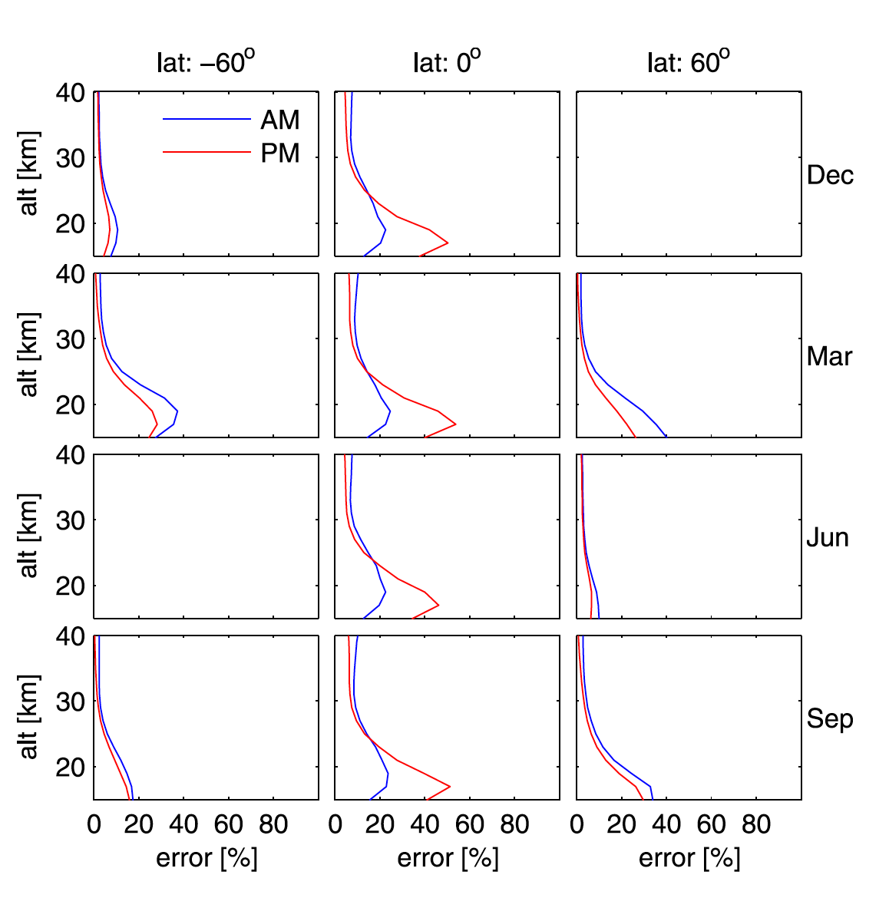
SAGE III/ISS – ACE and OSIRIS with diurnal corr. NO₂ Comparisons
Figure 9 from Brohede et al. [2006] showing NO₂ errors from solar occultation instruments from inhomogeneous NO₂ conc. along the LOS in conjuction with increasing optical depth at low tangent altitudes.
Also see McLinden et al. [2006]

Slide 15
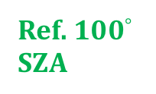
Modeled NO₃ Diurnal Cycle – By Altitude
Ref. 100$°$ SZA
Eq.
40$°$N
NO₃ is a SAGE III/ISS Lunar Occultation product with close to zero concentrations during the day.
Over the tropics the concentrations peak just after sunset between 25-35 km and begin to decrease as N₂O₅ forms
Below 25 km the modeled peak concentration is just before sunrise – slower conversion low O₃ and low temperature
Jan.
Jul.
15

Slide 16
We have modeled the diurnal variations of species related to SAGE III/ISS measurements using GEOS GMI
This output is available to the SAGE III/ISS ST and others interested in accounting for or understanding diurnal cycles for validation, evaluation, and for providing context.
Things we are thinking about for future refinements:
Line of Sight (LOS) averaging across the terminator, impact on different species
Increasing SZA resolution across the terminator
Any systematic variation in surface referenced SZA with altitude
The output from this simulation is available from Luke Oman (luke.d.oman@nasa.gov) or Sarah Strode (sarah.a.strode@nasa.gov)

