Slide 1
Disturbance Monitoring Package Status Report
Andrew Peterson
Deputy Mission Operations Manager
Amy Rowell, Marsha Larosee, David Huber, Charles Hill

Slide 2
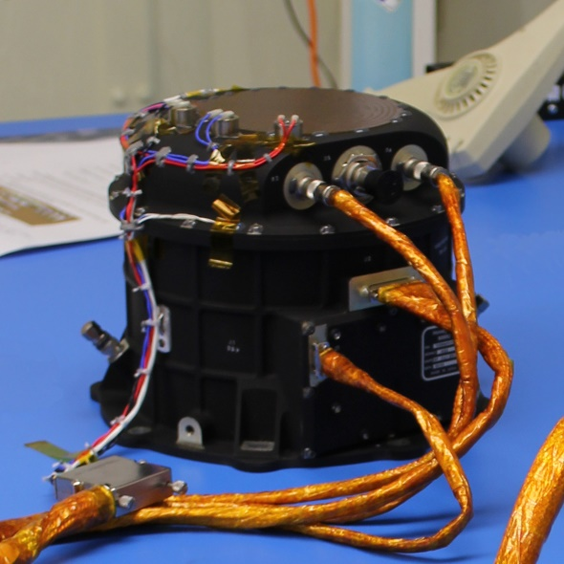
DMP Overview
The Disturbance Monitoring Package (DMP) is a Honeywell Miniature Inertial Measurement Unit comprised of three orthogonal ring laser gyros to measure angular rates in three orthogonal axes.
The DMP's primary requirement is to flag periods when vibration conditions can negatively impact the science data product.
Notes:
Slides 2-7 are a overview and refresher from last years science team meeting

Slide 3
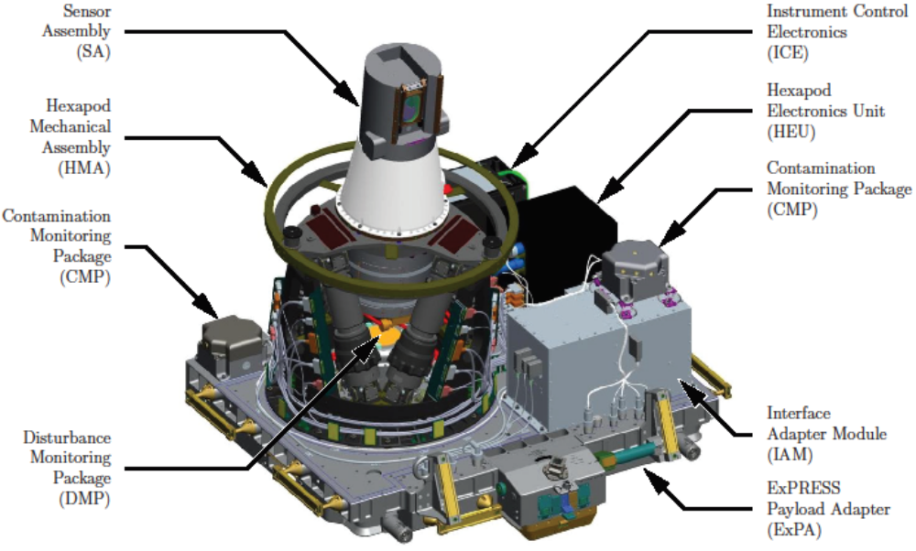
DMP Location

Slide 4
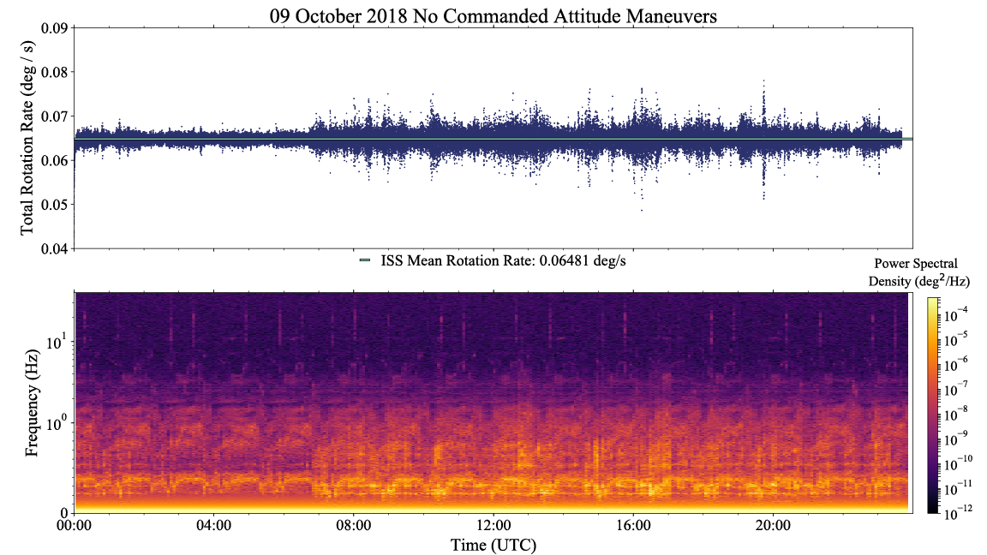
Quiescent Day as Observed from ELC-4

Slide 5
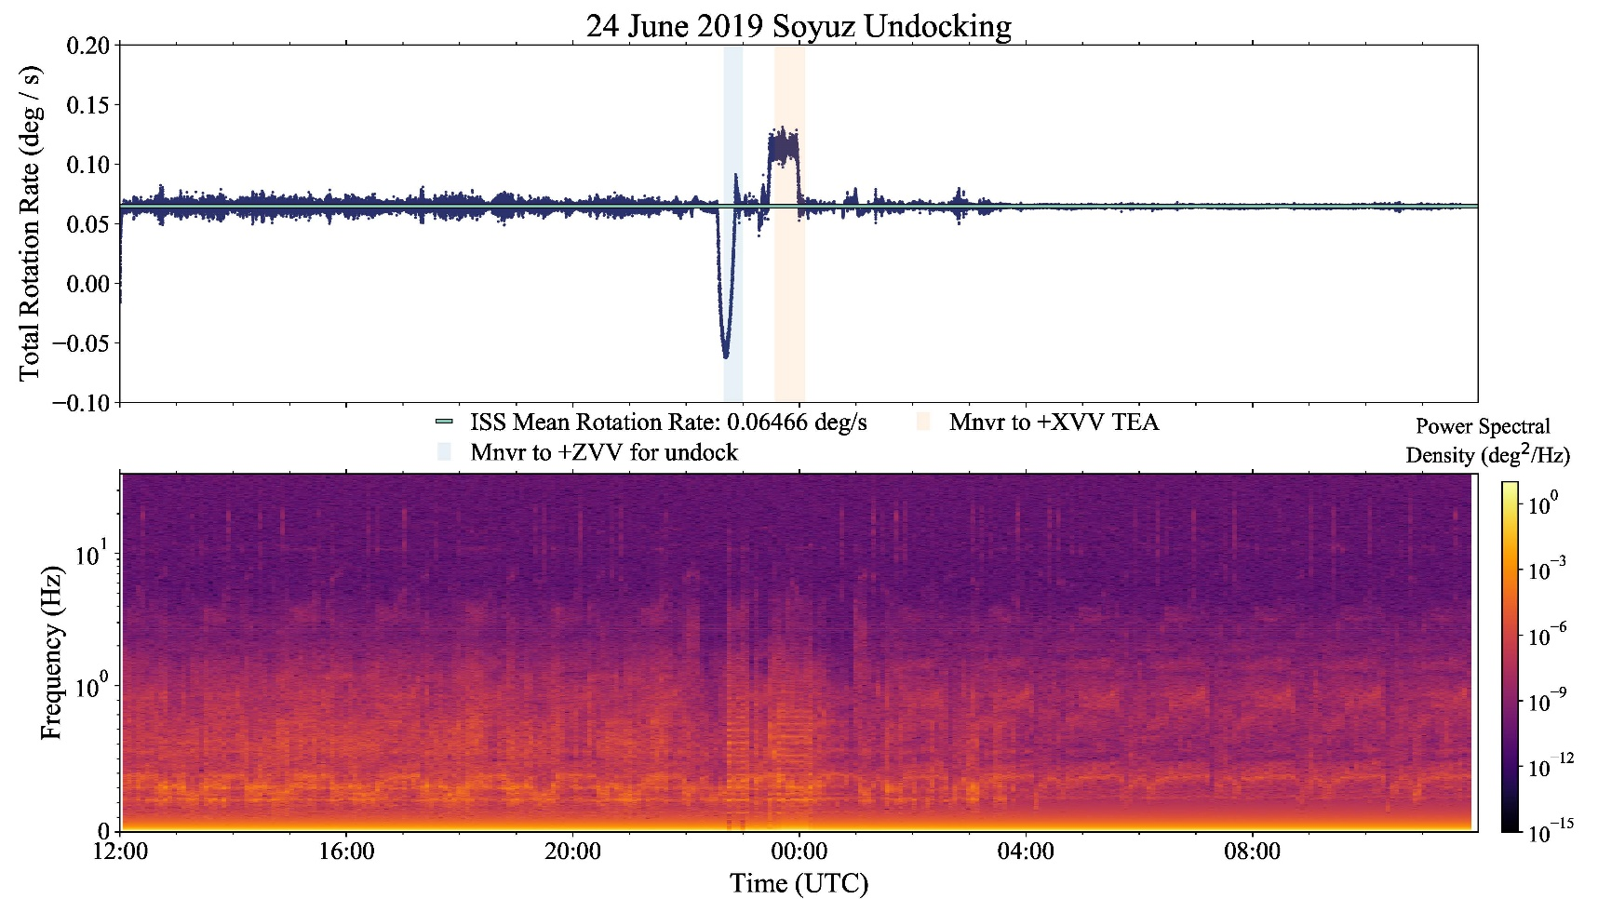
Small Shock from Soyuz Undocking as Observed from ELC-4

Slide 6
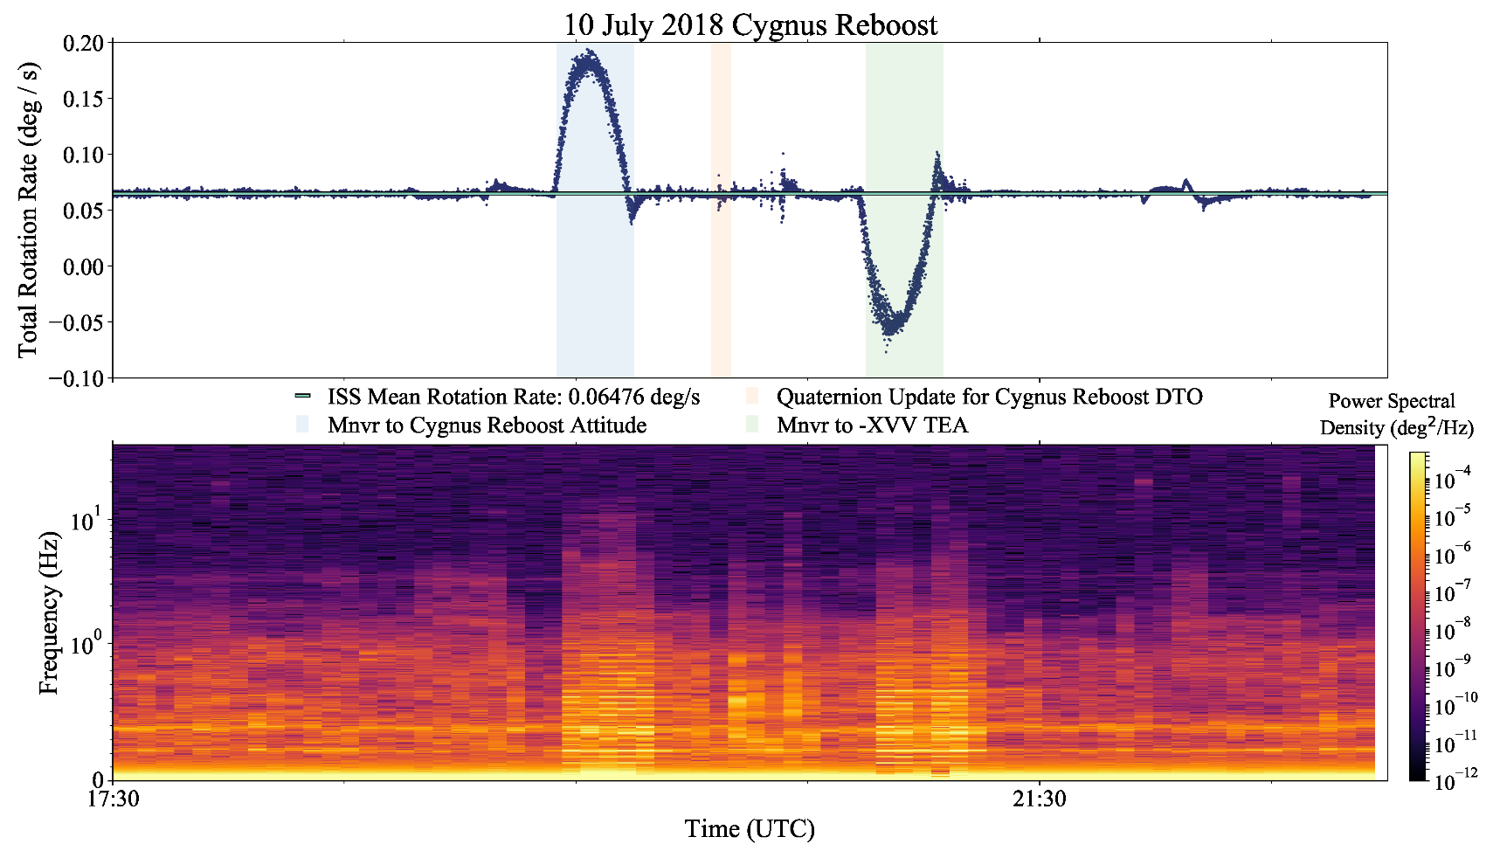
Large Shock from Reboost as Observed from ELC-4

Slide 7
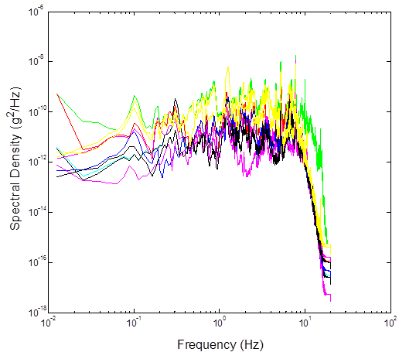
Expected Disturbance Environment
Pre-launch data are from a three axis accelerometer (S3B1N) located on the nadir side of the ISS S3 truss segment, which is where ELC-4 attaches to ISS.
Predicted Acceleration Spectral Density (ASD) comes from SER SAGE III-STR-001 V2 (shown right).

Slide 8
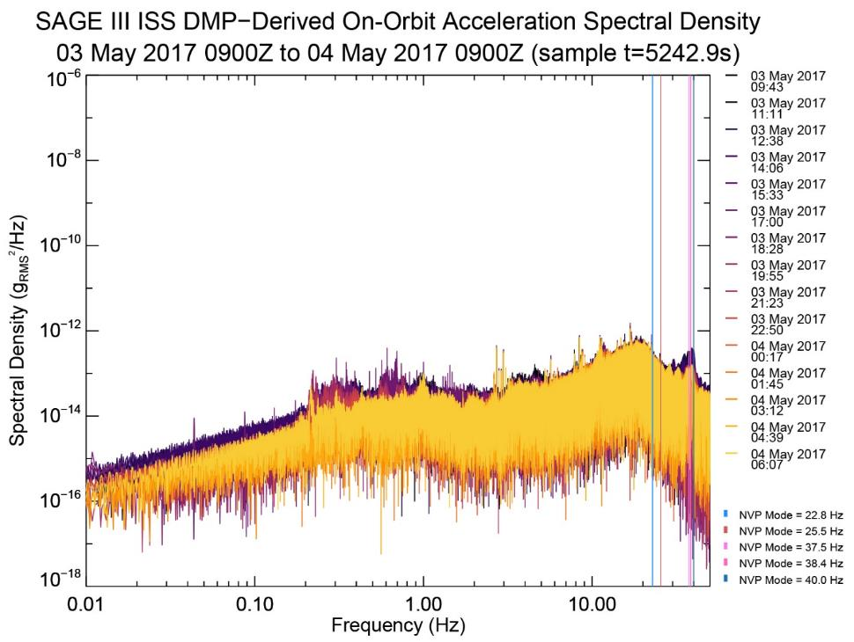
Observed Disturbance Environment
Similar to what was expected, and Nadir Viewing Platform (NVP) mode resonances are observed
DMP can successfully measure the ASD environment
NVP modes come from SER SAGE III STR-057

Slide 9
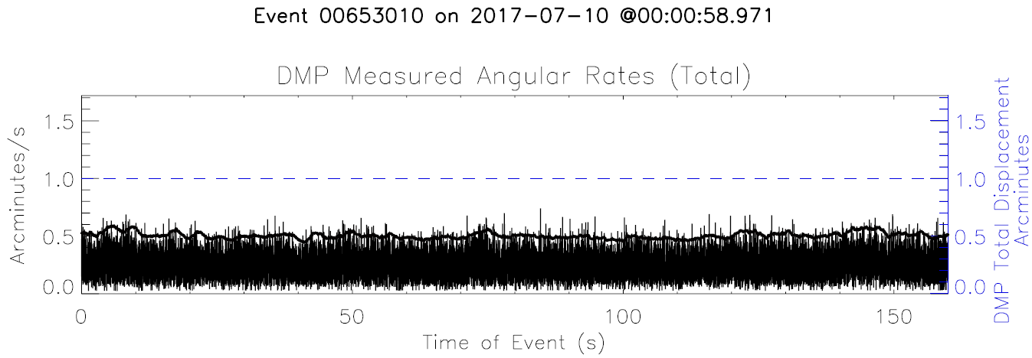
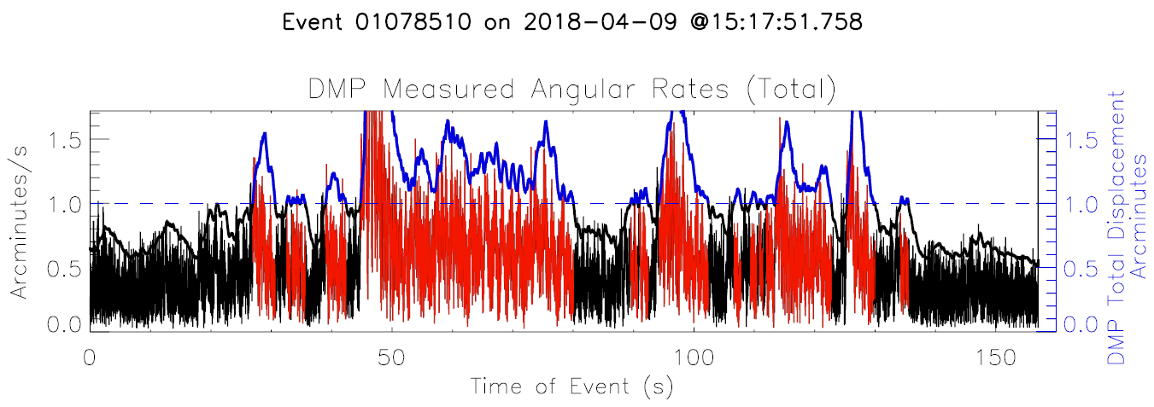
Current Use of DMP
Event packets are flagged during processing when the total angular deviation exceeds a threshold.

Slide 10
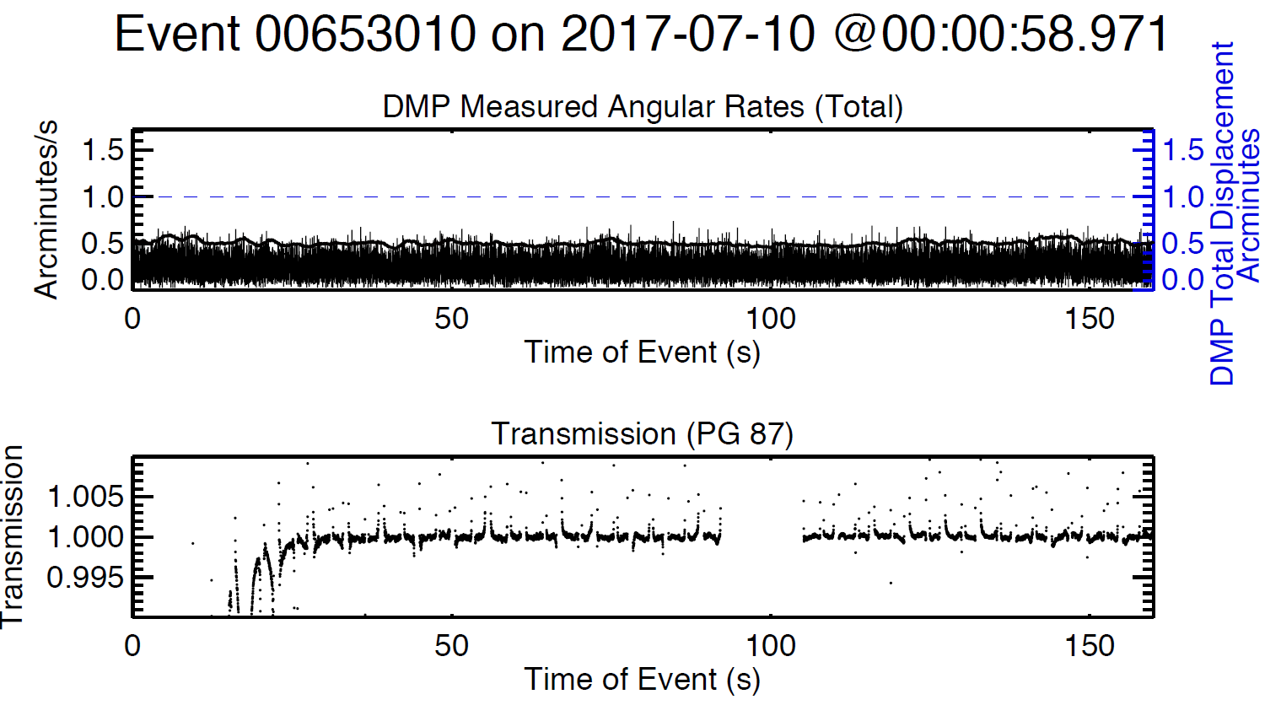
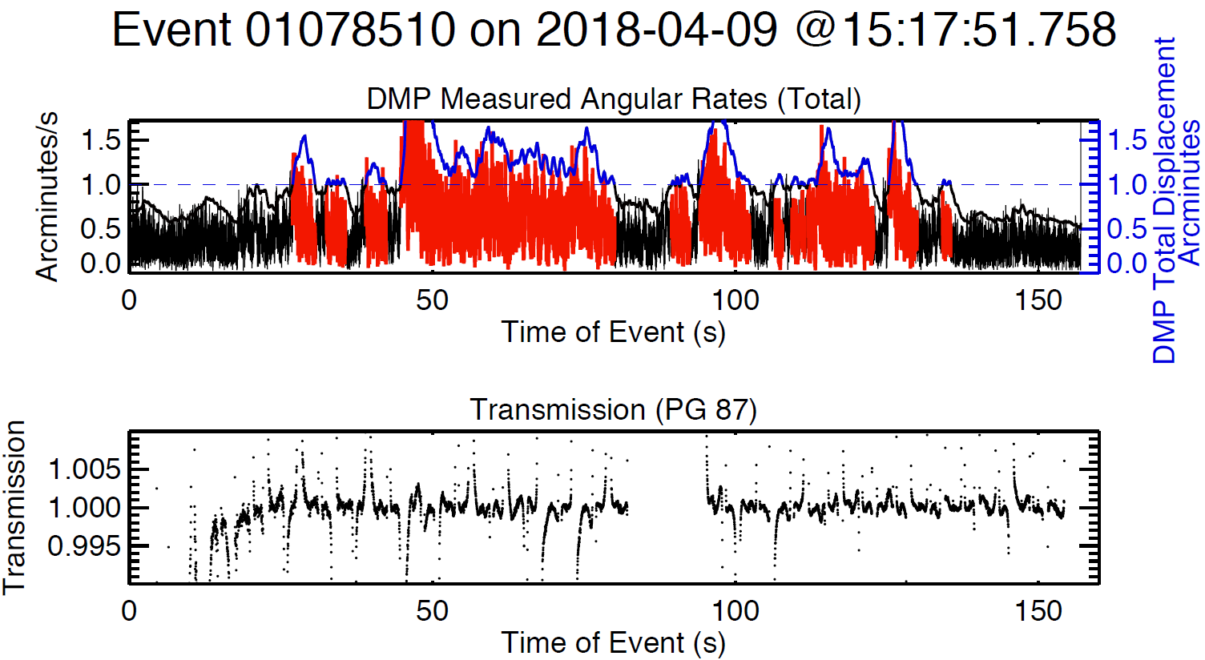
Current Use of DMP
The DMP flag appears to correlate with the transmission noise and additional quantitative analyses are in work.

Slide 11
Future Improvements to DMP Flag
Transform and separate DMP total rates into boresight elevation, azimuth, and roll axes
Correlate DMP disturbances to transmission noise
Create flags for each boresight axes

Slide 12
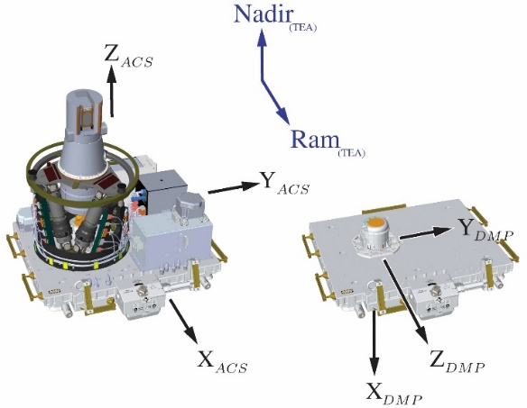
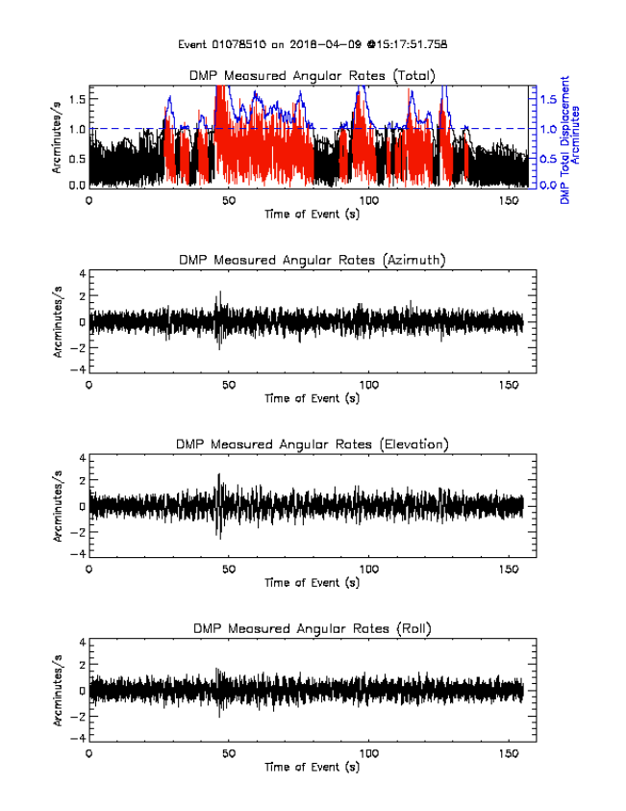
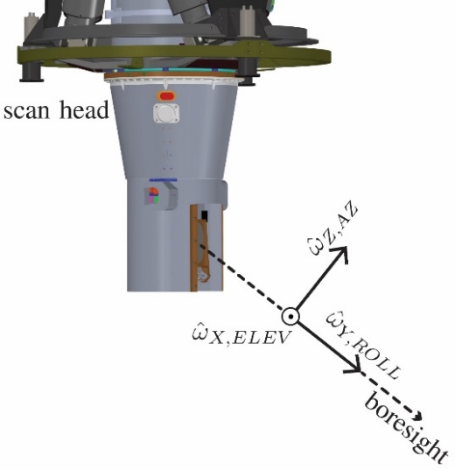
Projection of DMP Rates into Boresight Coordinates

Slide 13
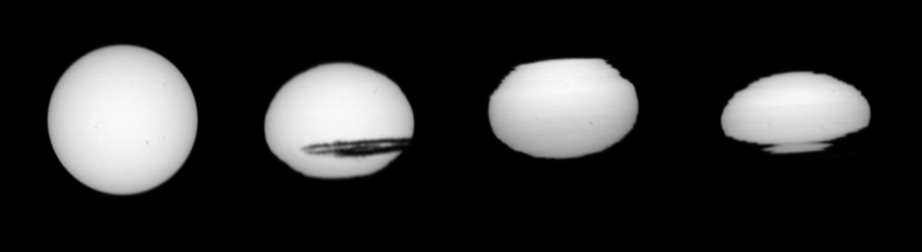
Improving Low Altitude Retrievals
Lower into Earth’s atmosphere the bottom of the Sun is often obscured by clouds and the horizon.
The science inversion algorithm currently uses a method that extrapolates the effective scan rate to estimate pointing lower into the troposphere.
Because the DMP precisely measures attitude rates, improvements can be made to retrievals in the troposphere by incorporating these rates into the current algorithm, accounting for spacecraft motion during science events.

Slide 14
Absolute Attitude Product
A Multiplicative Extended Kalman Filter (MEKF) is in development to produce a high-fidelity estimate of the SAGE III absolute attitude.
  Filter inputs: DMP (dead reckoning), IA solar measurements (absolute Sun position), BAD attitude
Absolute attitude will aid in registering limb measurement latitude, longitude, and altitude.
It would also provide an opportunity for data set comparisons with BAD and other external payload attitude sources.
Measurements can be used to characterize ISS bending as a function of attitude on ELC-4.

Slide 15
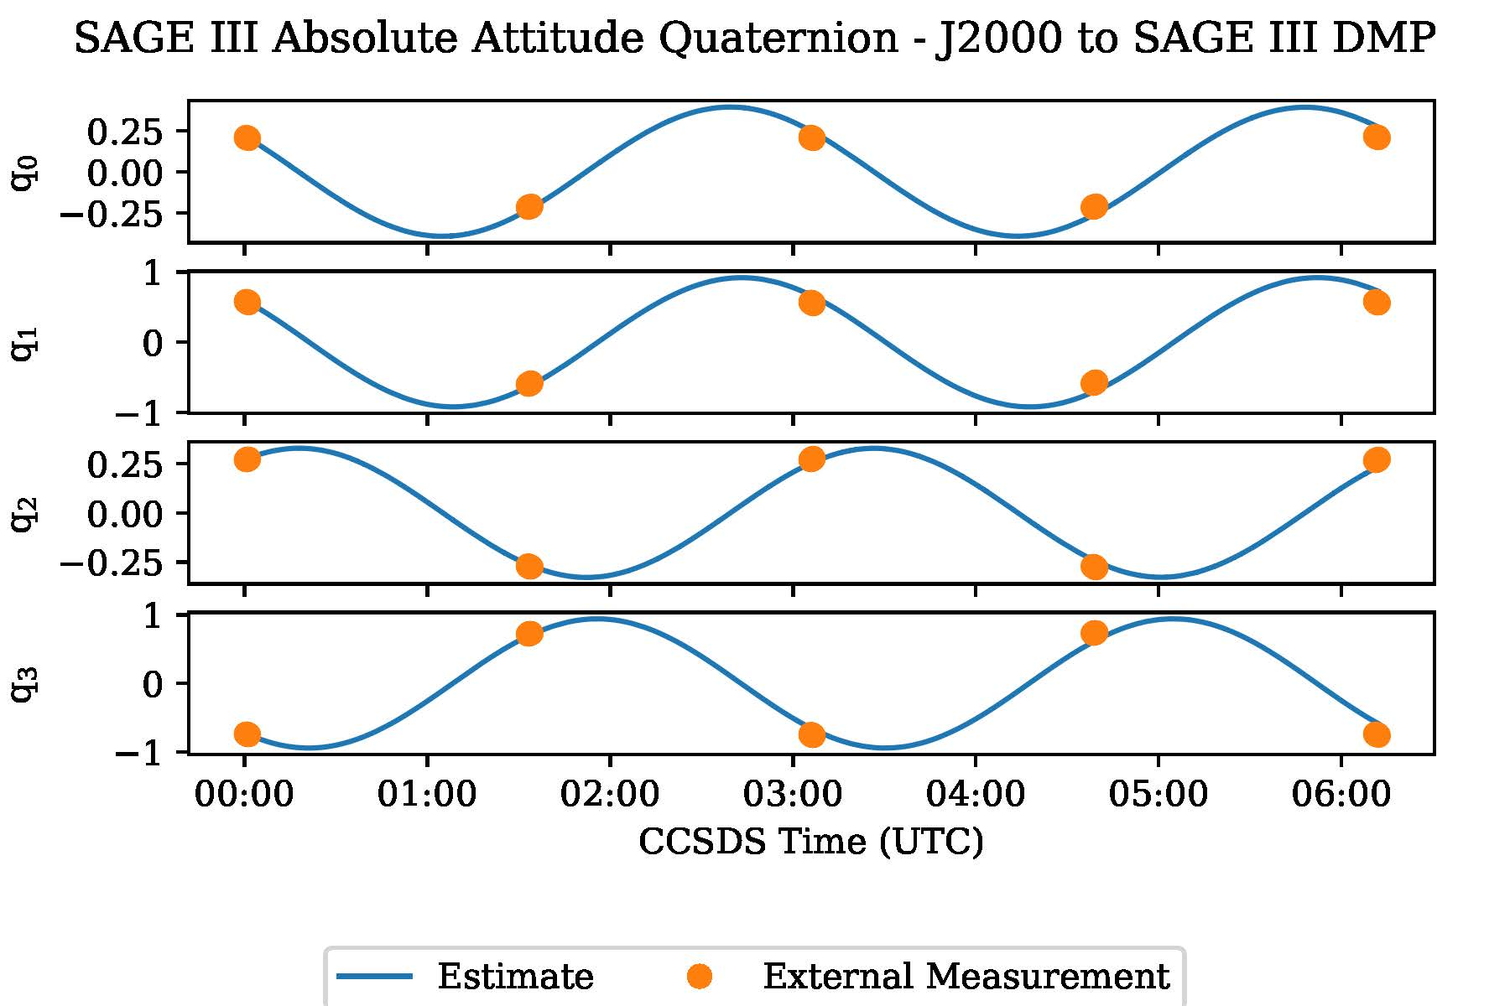
Absolute Attitude Product
Notes:
This plot shows the components of SAGE’s attitude quaternion as determined by the MEKF.
The dots are not IA events just BAD at the event time. It was not produced by a final implementation of the MEKF.
Most of the code and processing pipeline is in place.

Slide 16
Summary
We are improving our understanding of how disturbance impacts the measurements and working on an improved disturbance flag.
The absolute attitude product is in work and making progress.
The next goal is to correct IA scan rates with the DMP data by implementing a relative attitude correction in the science algorithm.

