Slide 1
Contamination Window Trending
Science Team Meeting 2019
Tyler Dawson and Carter Hulsey
tyler.t.dawson@nasa.gov
carter.b.hulsey@nasa.gov
NASA Langley Research Center
29 October 2019

Slide 2
Overview
Contamination Monitoring Package Update
  CMP High Frequency Limits
  Subverting Automatic Burn Off
Protecting the Science Data Product
  Contamination Window Trending
    Transmission Percentage vs. Wavelength
Effect on Science Data Product
  Comparisons with the Microwave Limb Sounder (MLS)

Slide 3
Contamination Monitoring Package Update

Slide 4
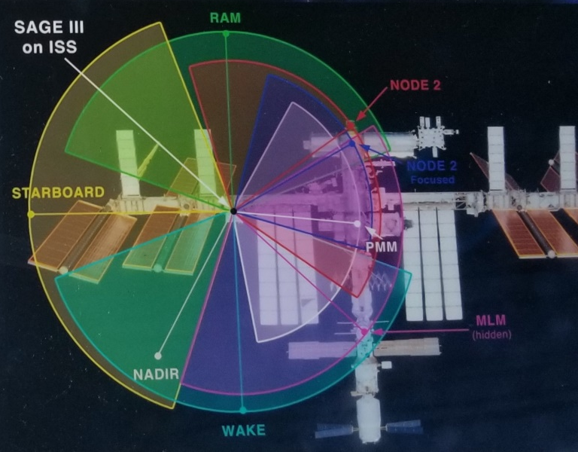
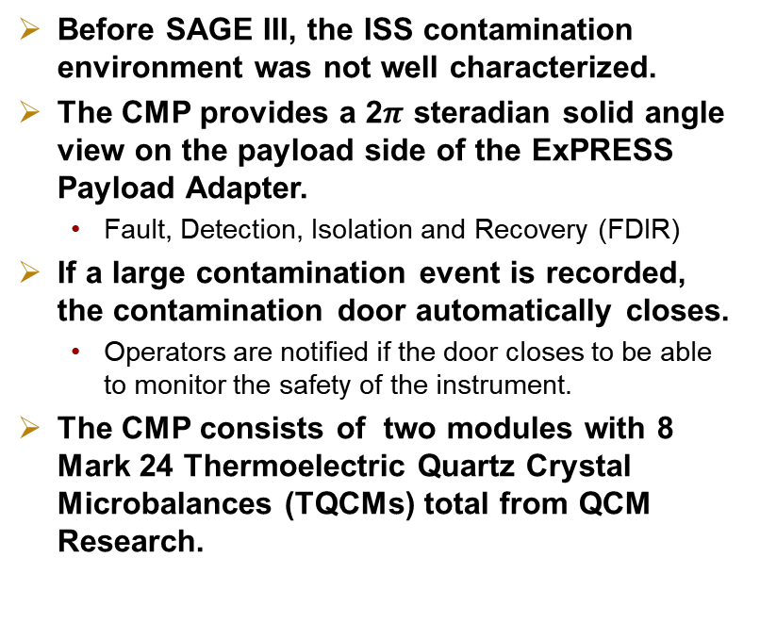
Contamination Monitoring Package (CMP)
Before SAGE III, the ISS contamination environment was not well characterized.
The CMP provides a 2$π$ steradian solid angle view on the payload side of the ExPRESS Payload Adapter.
  Fault, Detection, Isolation and Recovery (FDIR)
If a large contamination event is recorded, the contamination door automatically closes.
  Operators are notified if the door closes to be able to monitor the safety of the instrument.
The CMP consists of two modules with 8 Mark 24 Thermoelectric Quartz Crystal Microbalances (TQCMs) total from QCM Research.

Slide 5
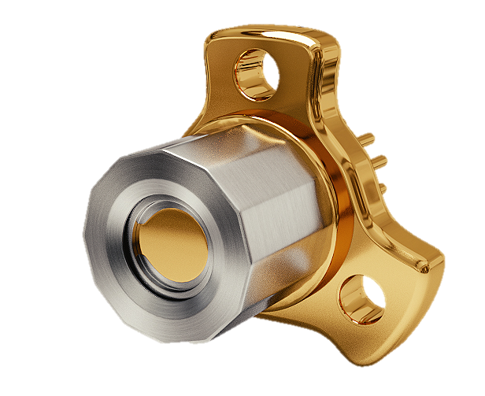
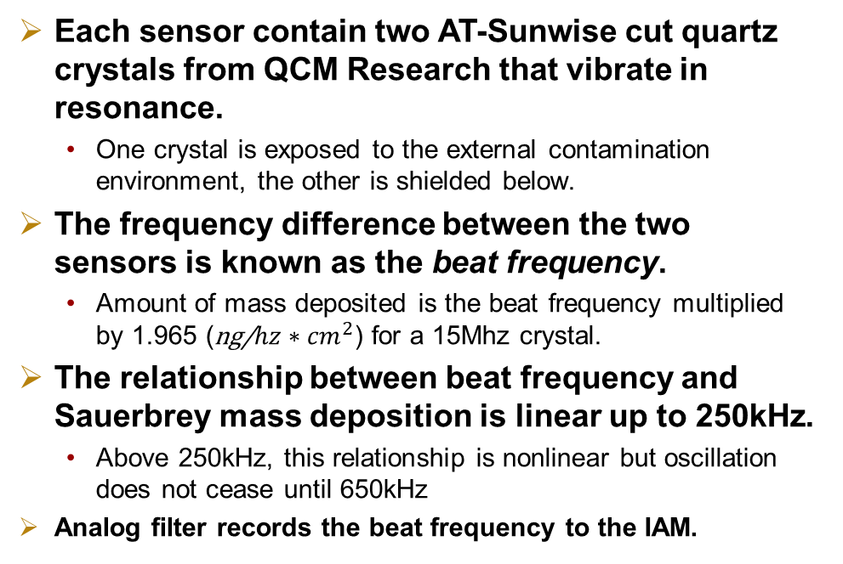
Mark 24 TQCM
Each sensor contain two AT-Sunwise cut quartz crystals from QCM Research that vibrate in resonance.
  One crystal is exposed to the external contamination environment, the other is shielded below.
The frequency difference between the two sensors is known as the beat frequency.
  Amount of mass deposited is the beat frequency multiplied by 1.965 (ng/${hz∗cm}^{2}$) for a 15Mhz crystal.
The relationship between beat frequency and Sauerbrey mass deposition is linear up to 250kHz.
  Above 250kHz, this relationship is nonlinear but oscillation does not cease until 650kHz
Analog filter records the beat frequency to the IAM.

Slide 6
CMP Frequency Limits
Testing done at different peak-to-peak voltage using CMP simulator to determine the analog filter response at high frequencies.
  Frequency counter rolls over at 65,535Hz.
CMP Module | 5vpp Max Frequency | 7vpp Max Frequency
CMP 1 | 320kHz | 385kHz
CMP 2 | 300kHz | 320kHz

Slide 7
Subverting Automatic Burn Off
Contaminants have chemisorbed to three of our sensors, rendering burn offs ineffective at cleaning the sensor.
  Only the sensors facing Node 2 docking port:
    Node 2 Focused, Node 2 Broad, PMM
Testing showed that if the internal automatic burn off value was set to 32,767Hz a burn off would never trigger.
  16-bit unsigned integer

Slide 8
Contamination Window Trending

Slide 9
Protecting the Science Data Product
Dynamic ISS environment means various contamination sources.
  Vehicle visitations
  Extra Vehicular Activities
  Venting
Quartz crystal contamination window can be closed over the telescope during periods of enhanced contamination.
This window permits continued science event acquisitions with an acceptable signal-to-noise ratio.

Slide 10
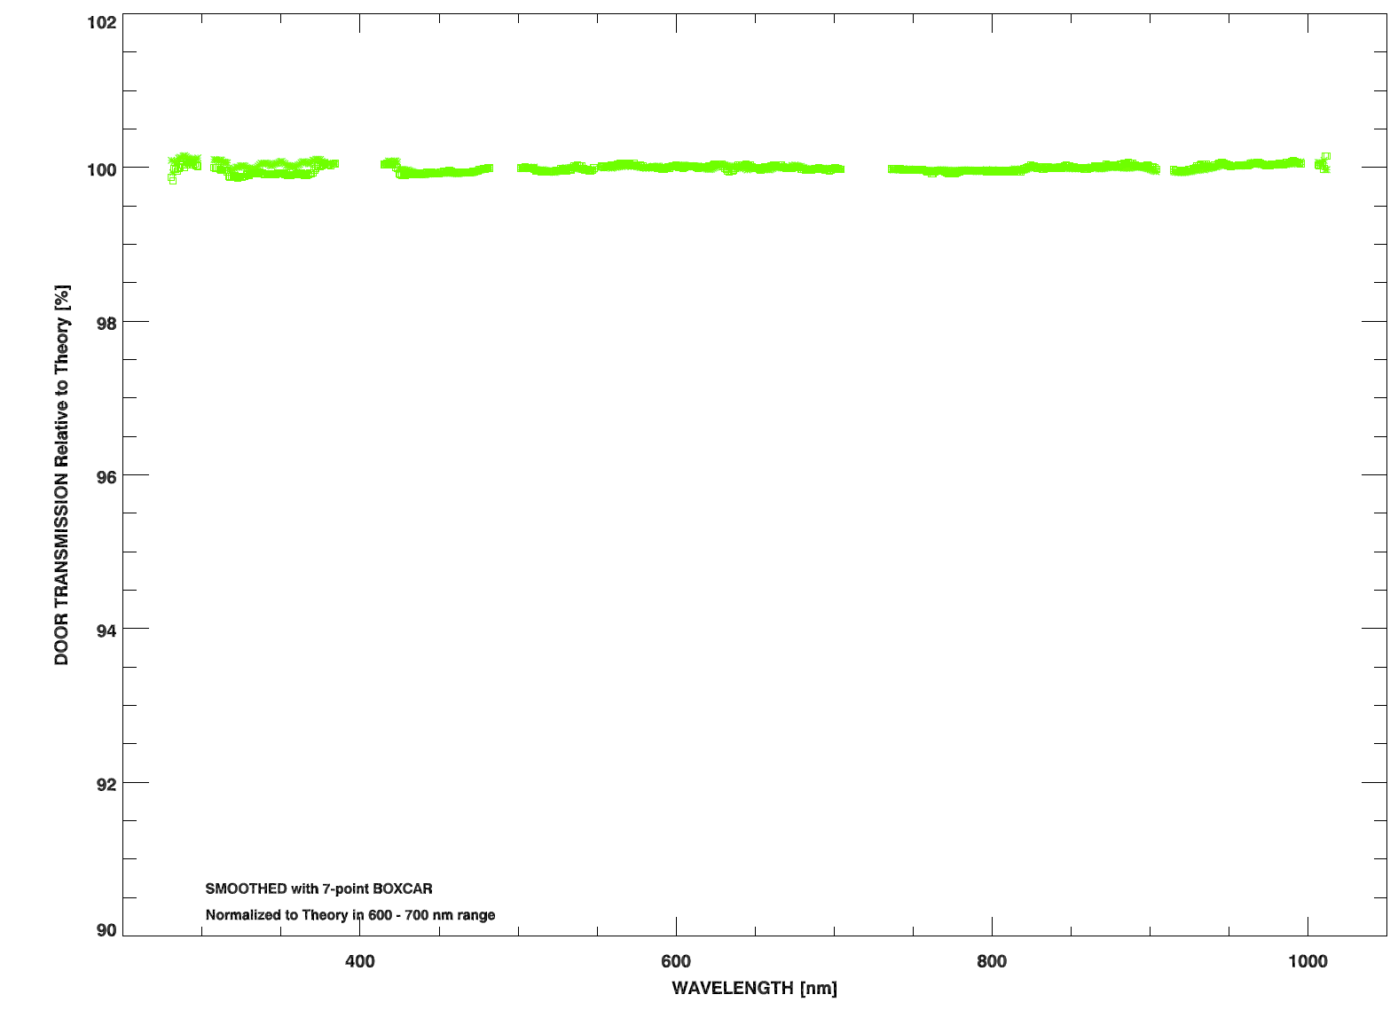
Transmission vs. Wavelength
Pre-CRS 13: December 2017

Slide 11
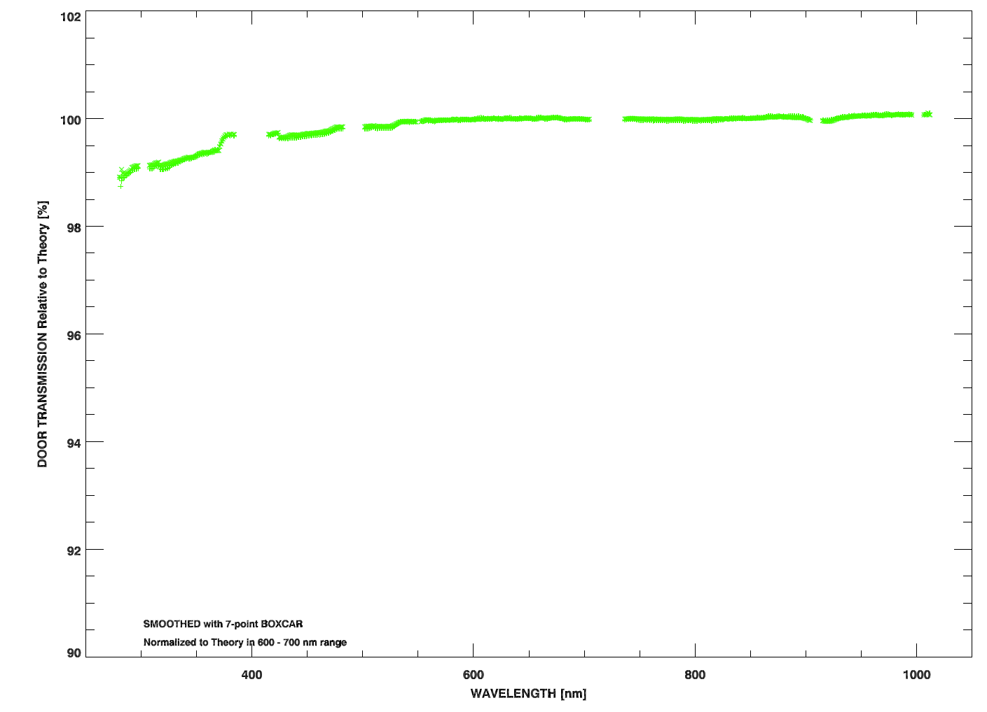
Transmission vs. Wavelength
Immediately Post CRS-13: January 2018

Slide 12
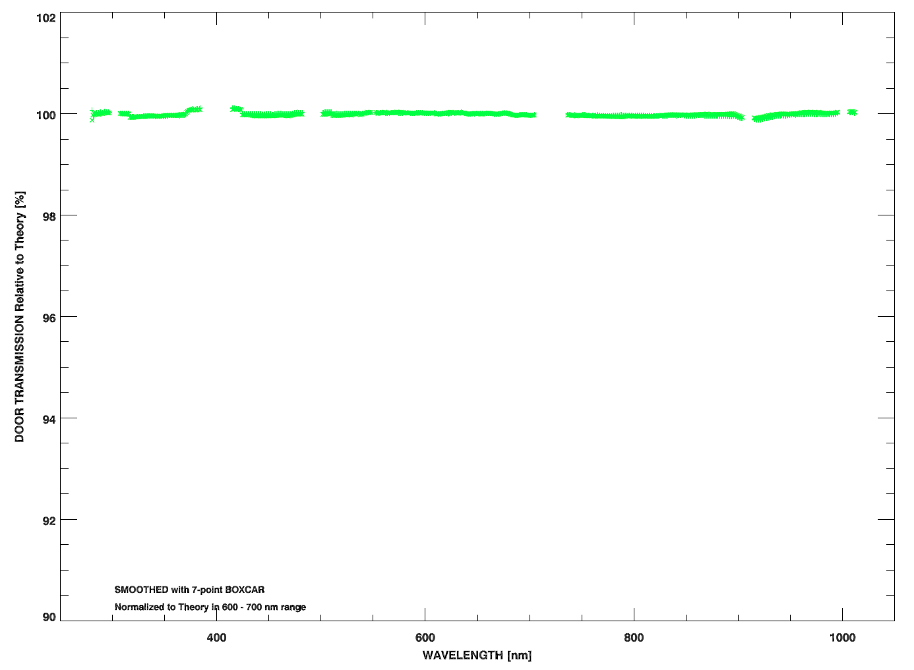
Transmission vs. Wavelength
4 Weeks Post-CRS 13: February 2018

Slide 13
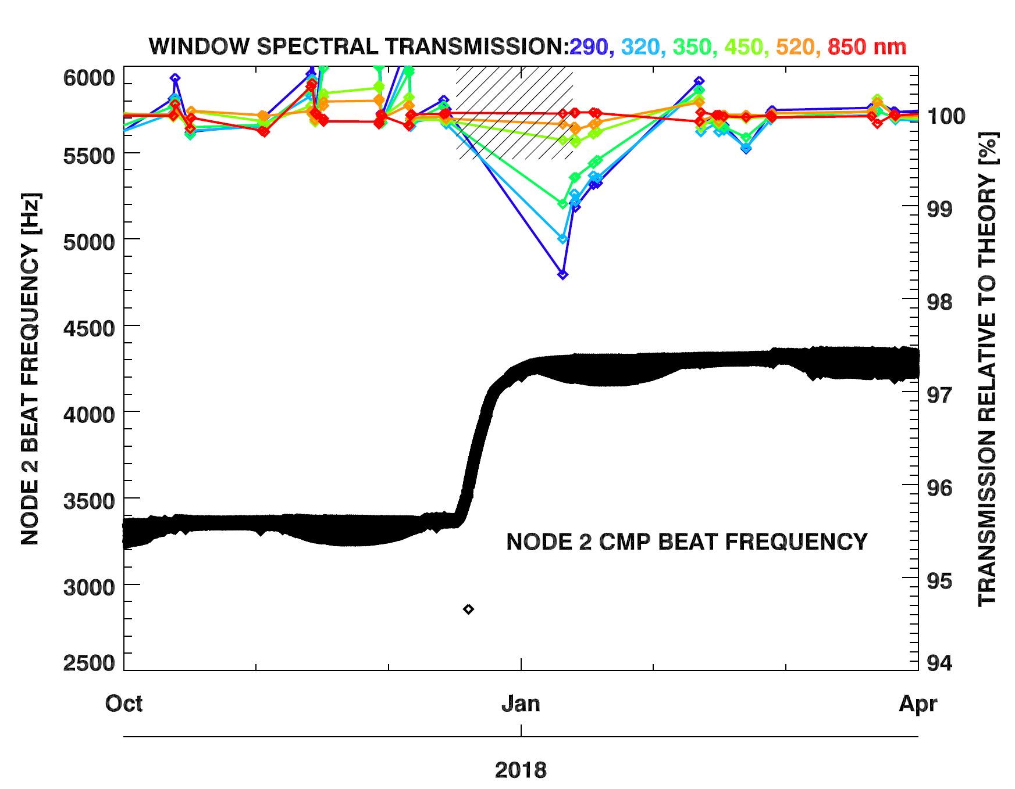
CRS-13 Visit
17 December 2017 to 13 January 2018

Slide 14
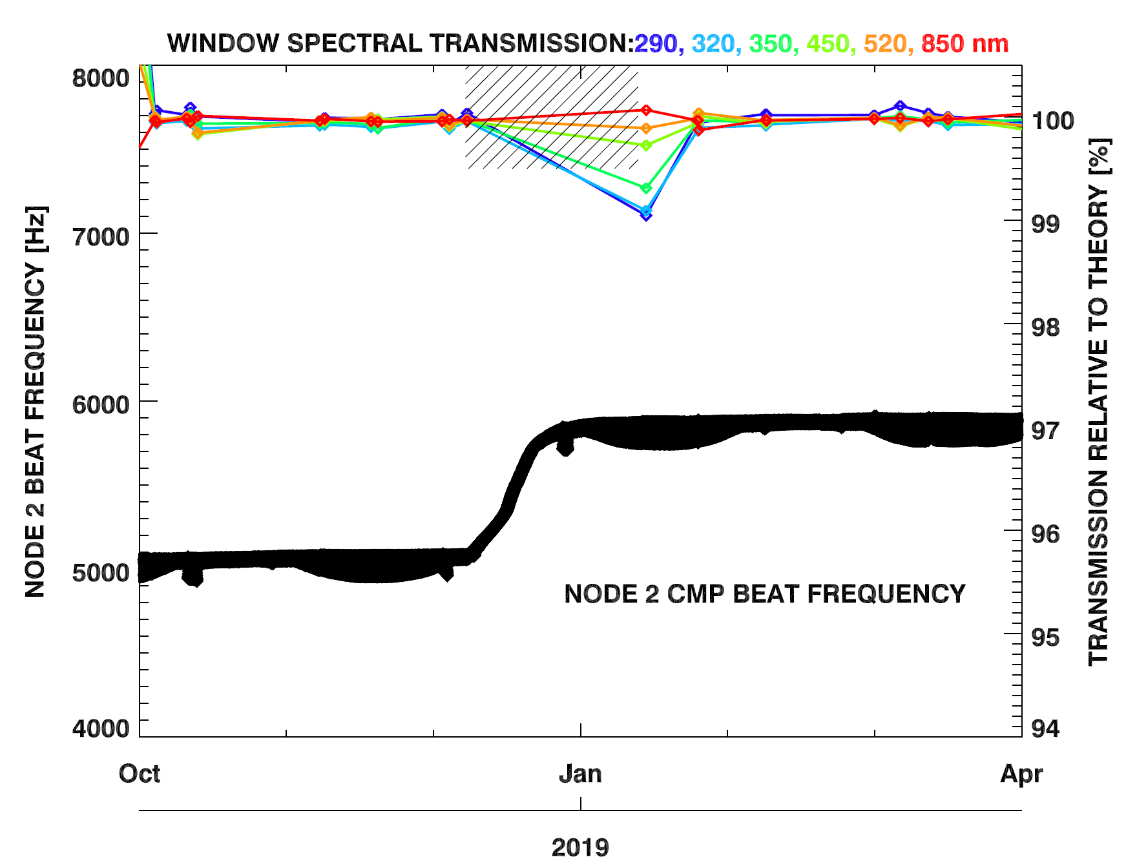
CRS-16 Visit*
8 December 2018 to 13 January 2019
*Window closed Dec. 8, 2018-Jan 13, 2019 for
CRS-16 visit.
Window transmission measured Jan 13, 2019 after CRS-16 departure.
Subsequently closed Jan. 25, 2019 to monitor rate of relaxation to baseline
Window transmission
measured Jan. 25, 2019

Slide 15
CMP Conclusion
Changed the CMP frequency limits to better reflect the analog filter’s physical limitations on the sensors.
  Rollover will be tracked when it happens.
  Automatic burn off subverted by changing it’s set-point frequency.
Closing the contamination door leads to signal-to-noise ratio within the acceptable limits.
  Returns to baseline after vehicle leaves.

Slide 16
Effects on Science Data Products

Slide 17
SAGE III Comparison with MLS
Separated events into 3 different states
  Closed contamination window with CRS Visit (Closed CRS)
  Closed contamination window without CRS visit (Closed)
  Open contamination window (Open)
Compared SAGE III AO3 Product with the Microwave Limb Sounder (MLS) O3 to determine any possible effects on the data product caused by contamination
  Found MLS data coincident to SAGE III events (± 24 hrs, ± 5° Lat, ± 20° Lon)
  Interpolated MLS data to SAGE pressure grid and converted SAGE AO3 product to units of ppmv
  Calculated difference and standard deviation between SAGE and MLS for each event

Slide 18
SAGE III Sunrise Events Comparison with MLS
a.
b.
c.

Slide 19
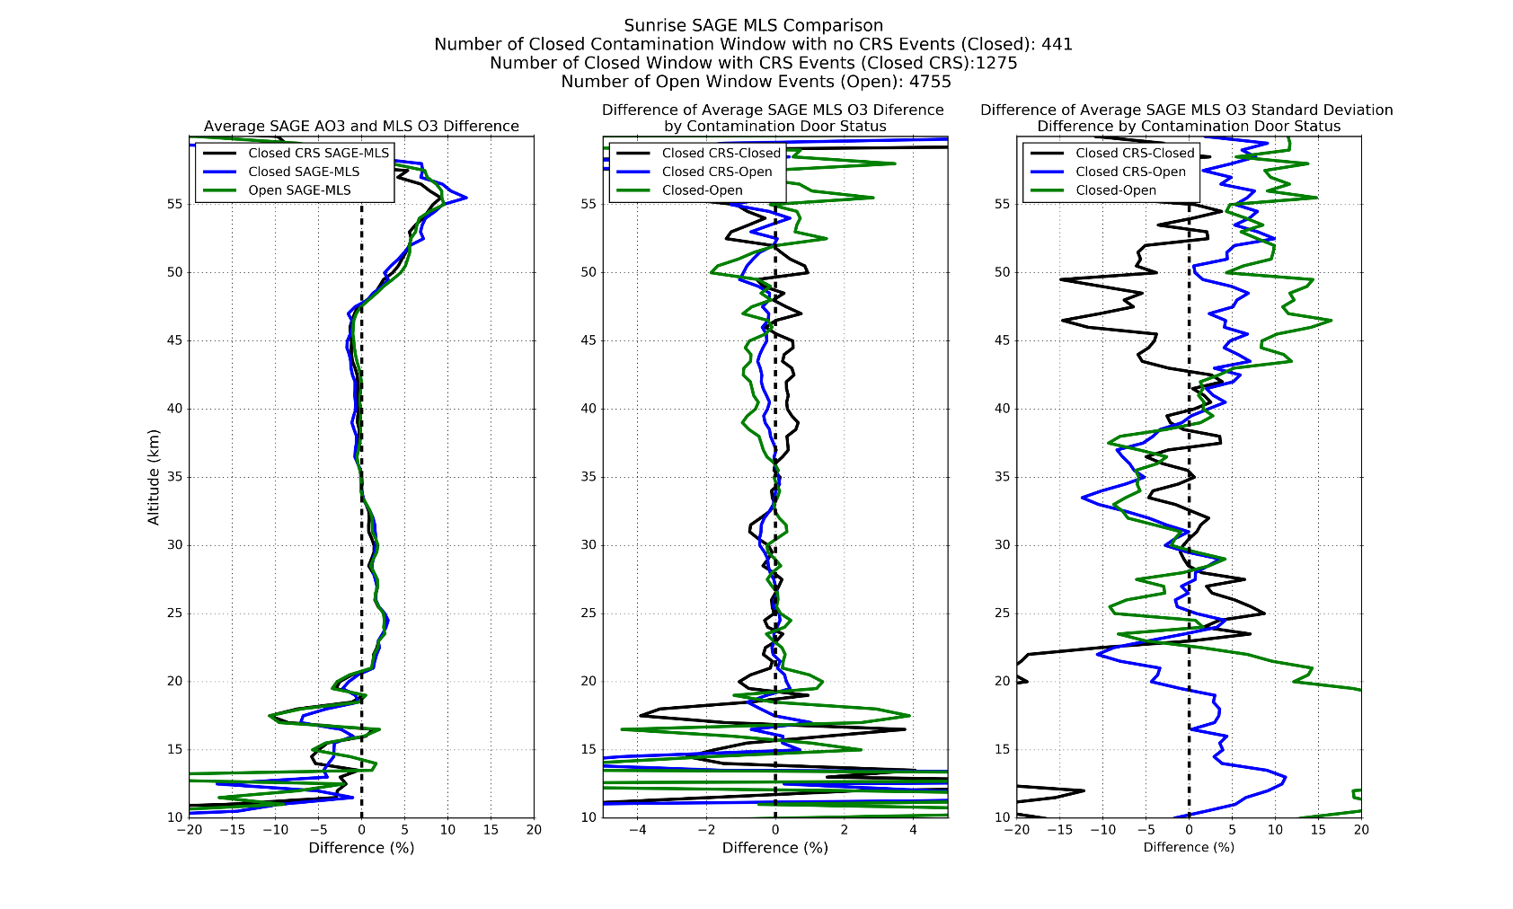
SAGE III Sunrise Events Comparison with MLS
a.
b.
c.

Slide 20
SAGE III Sunset Events Comparison with MLS
a.
b.
c.

Slide 21
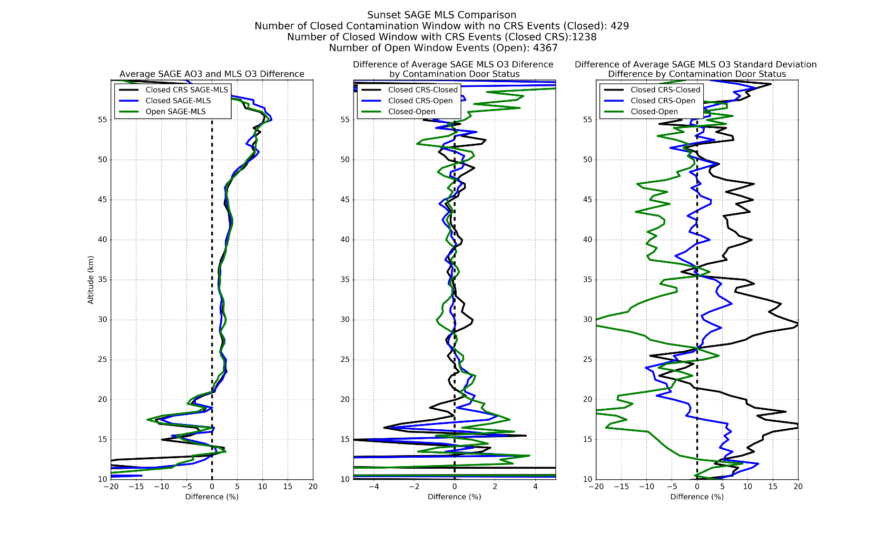
SAGE III Sunset Events Comparison with MLS
a.
b.
c.

Slide 22
Conclusion
The comparison with MLS displayed no apparent contamination effects on the SAGE III O3 products when a CRS visit occurred.
The comparison also showed no apparent effects on the SAGE III O3 products when the contamination window was closed.

Slide 23
