Slide 1
Communications and Public Engagement
Allison Leybold
SAGE III/ISS Communications Lead

Slide 2
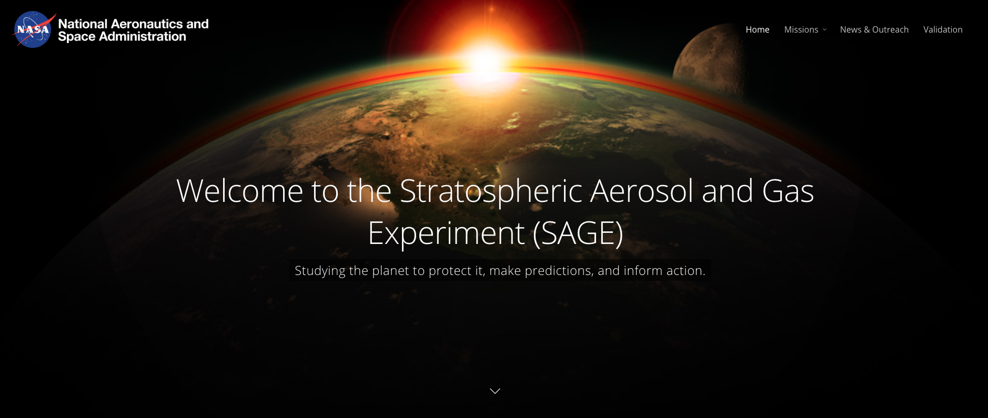
SAGE Website
sage.nasa.gov

Slide 3
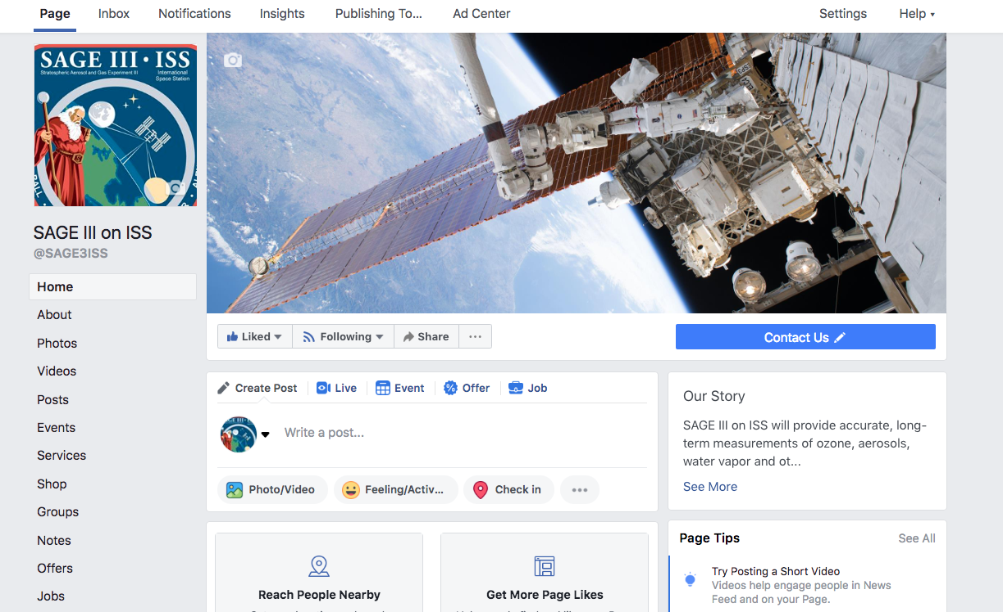
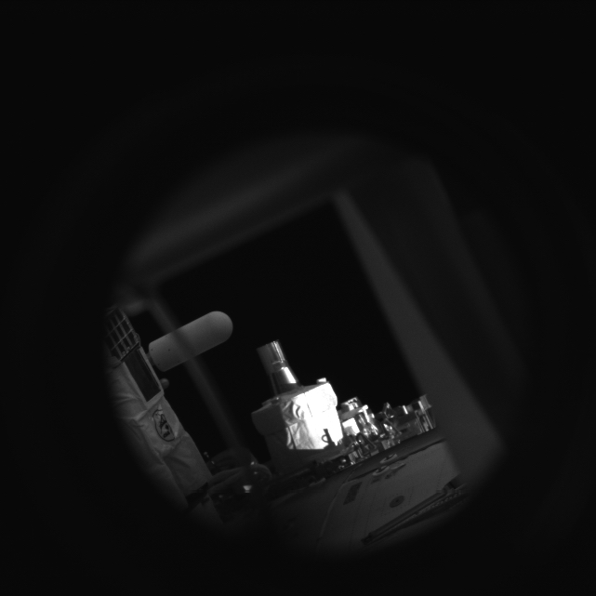
SAGE III/ISS Social Media
Follow SAGE III on Facebook!

Slide 4
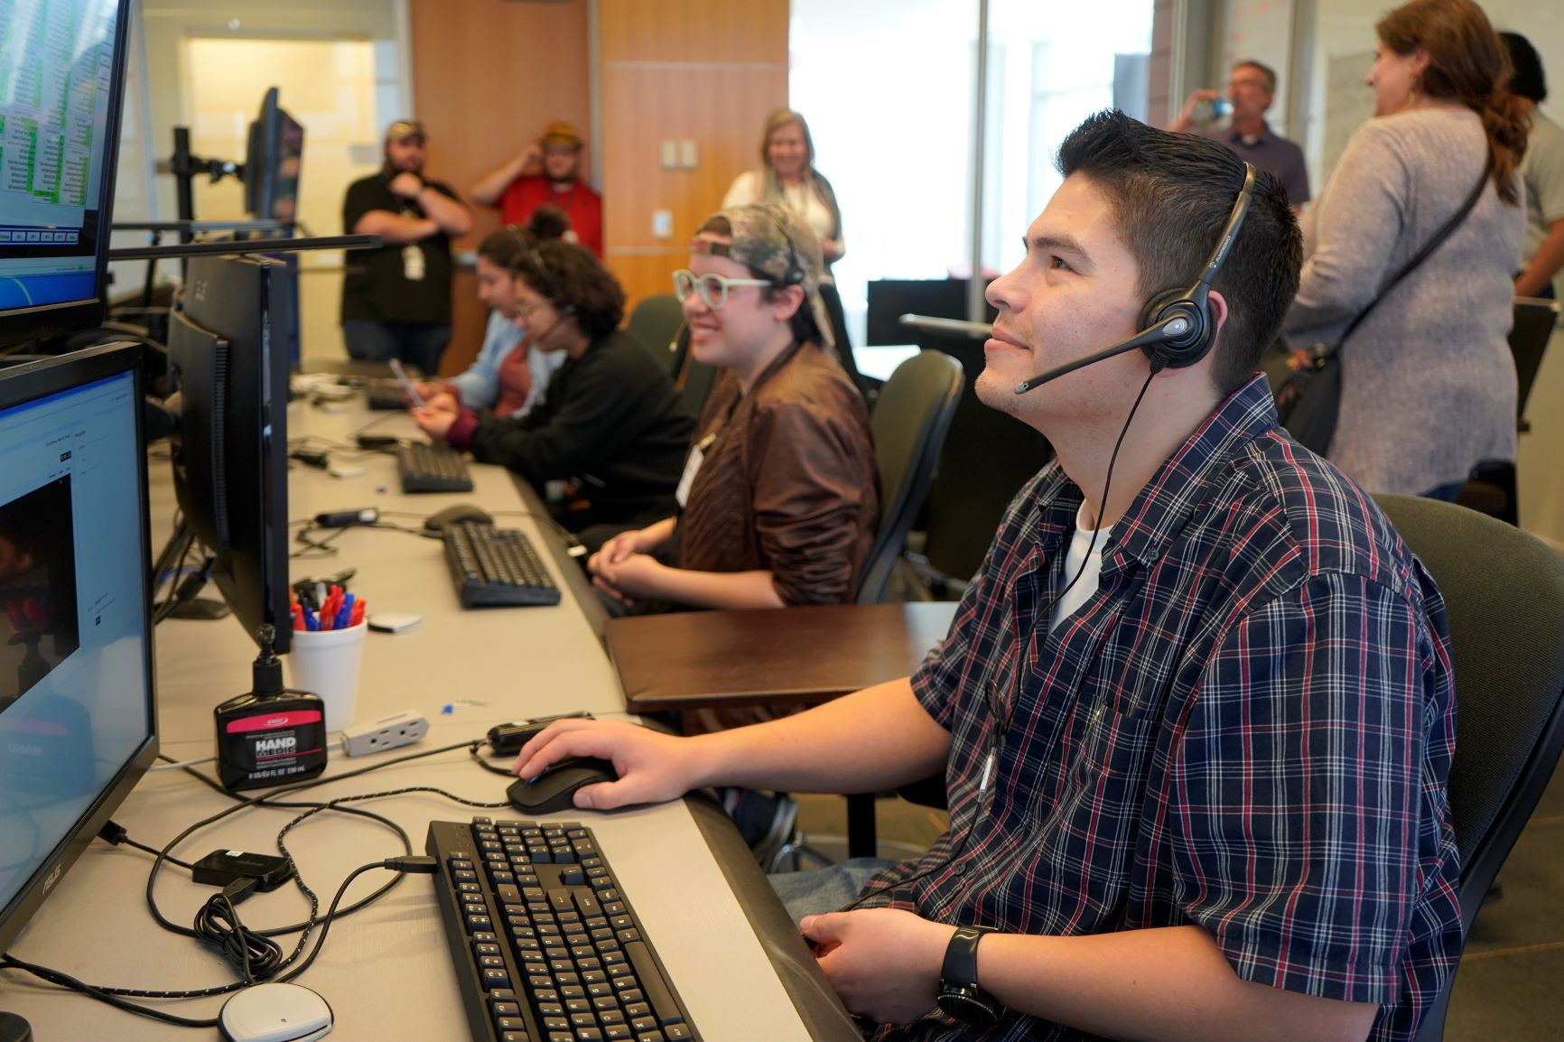
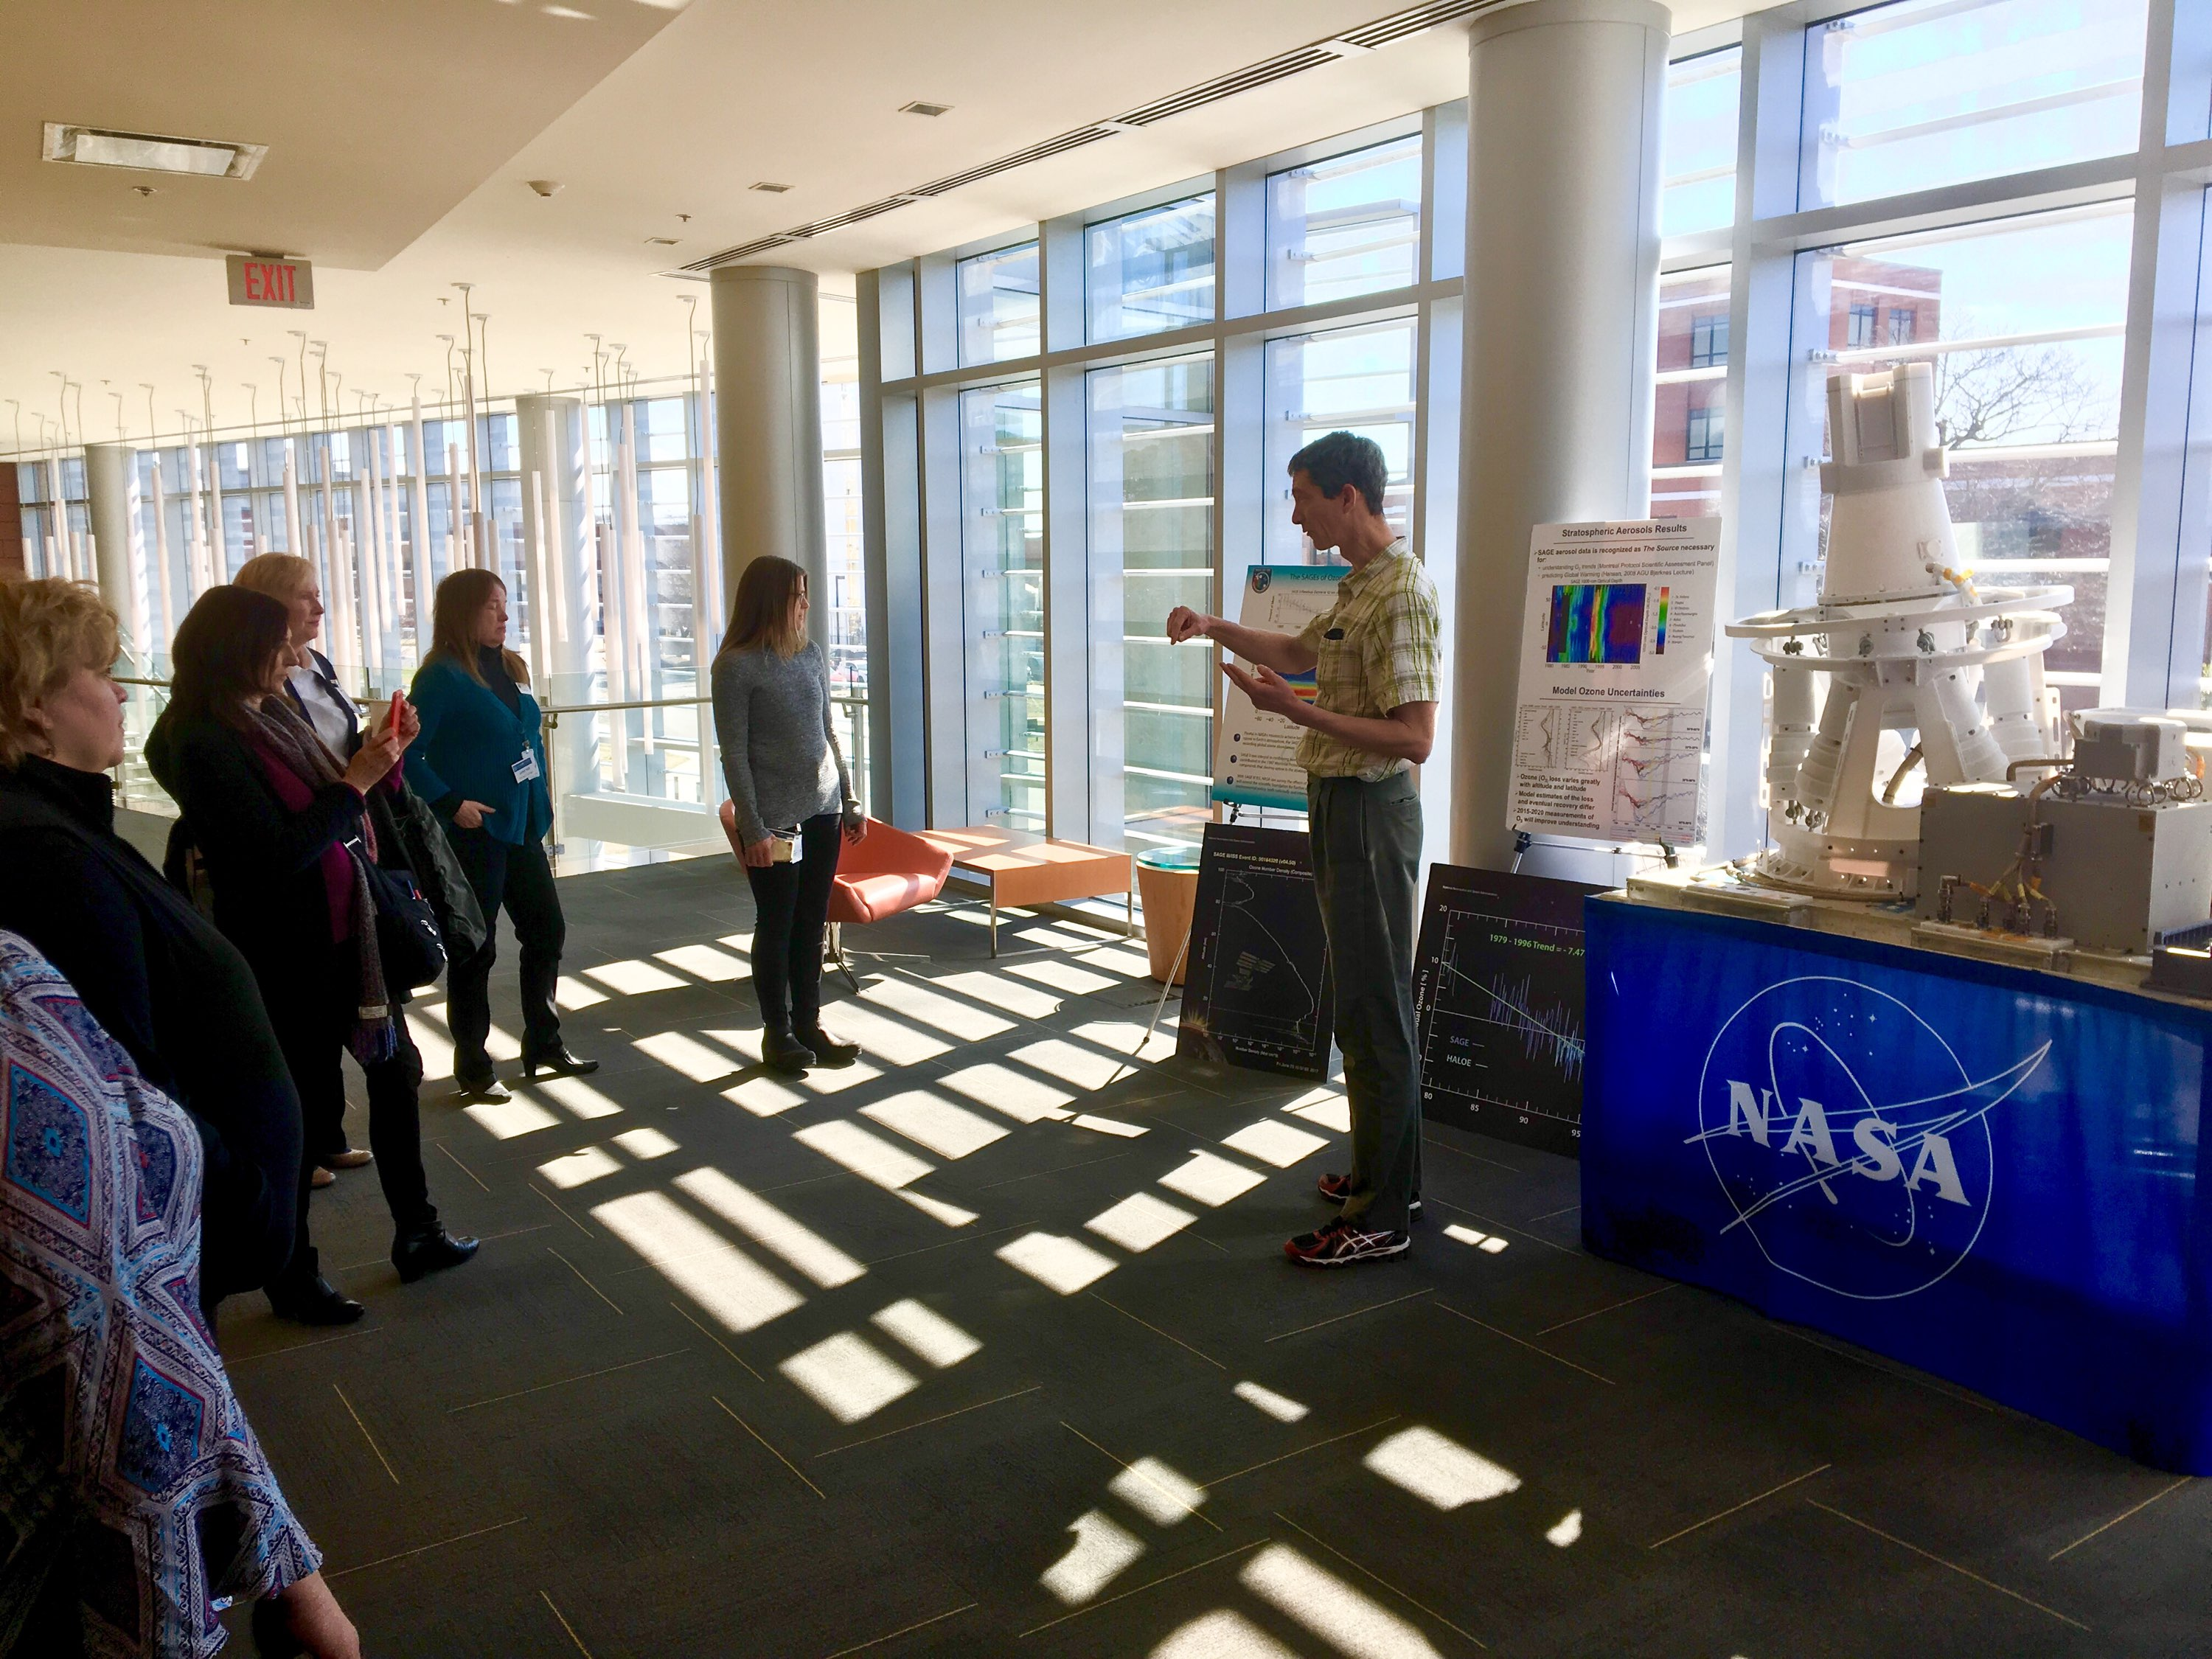
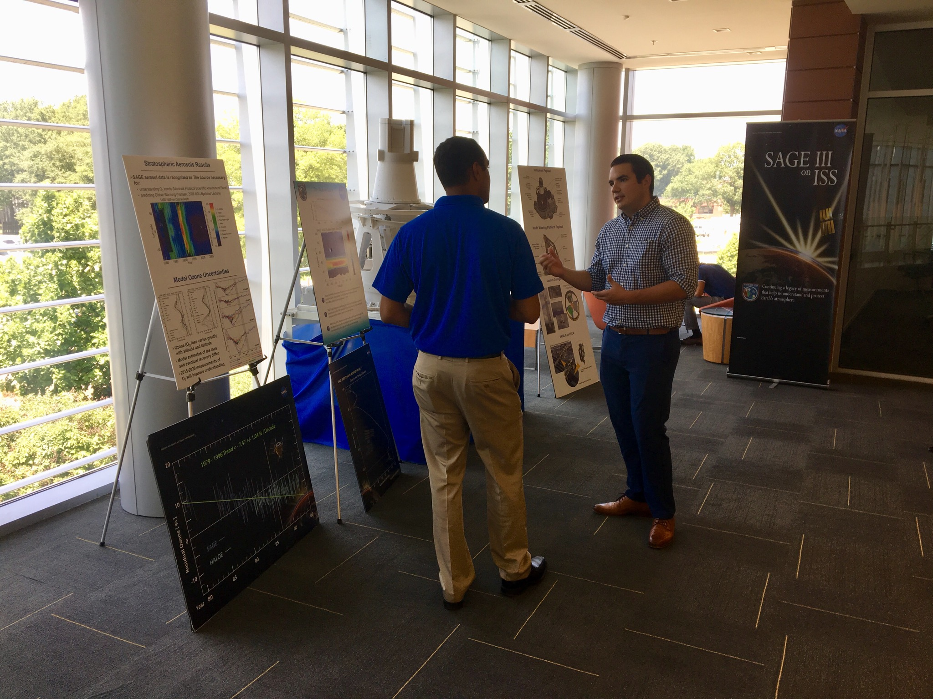
SAGE III / Flight Mission Support Center Tours
Hosted tours for:
WAVY TV10 Meteorologist Jeff Edmondson
The Global Learning and Observations to Benefit the Environment (GLOBE) Program
Peninsula Chamber of Commerce
Fond du Lac Tribal and Community College
LaRC Historical Landmarks Center tour
LaRC Safety and Health Awareness + Mission Success Week
LaRC interns

Slide 5
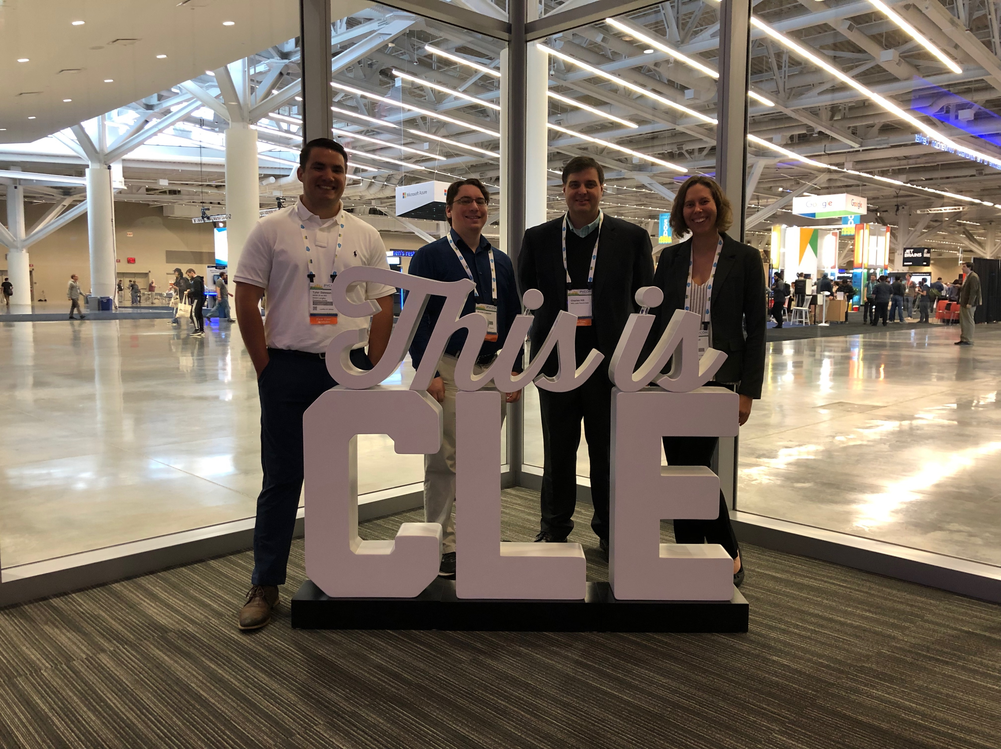
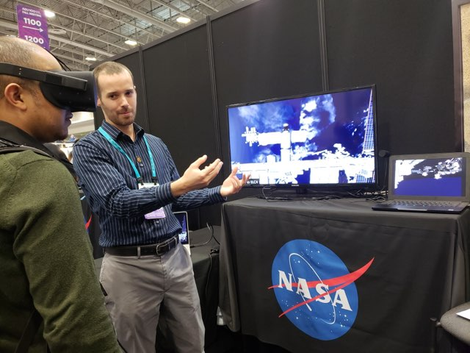
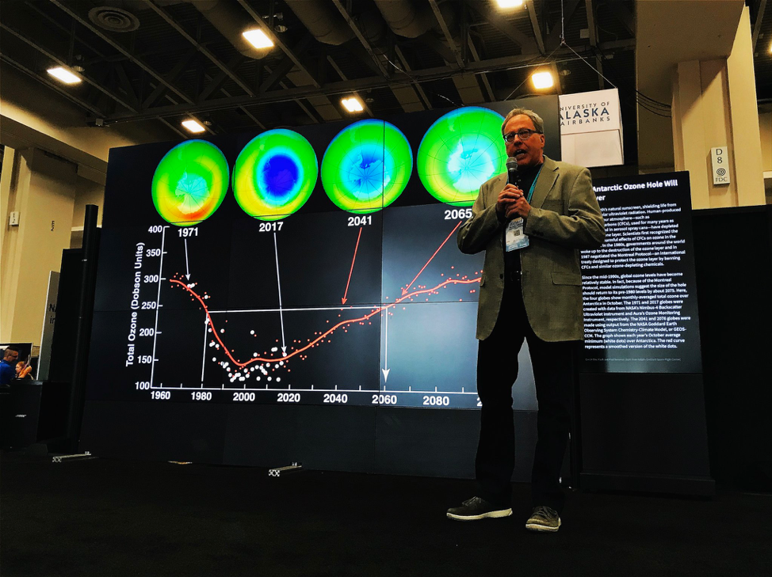
Events
December 2018
American Geophysical Union Fall Meeting- Washington, D.C.
February 2019
Aerospace Days- Richmond, VA
May 2019:
PyCon Conference- Cleveland, OH

Slide 6
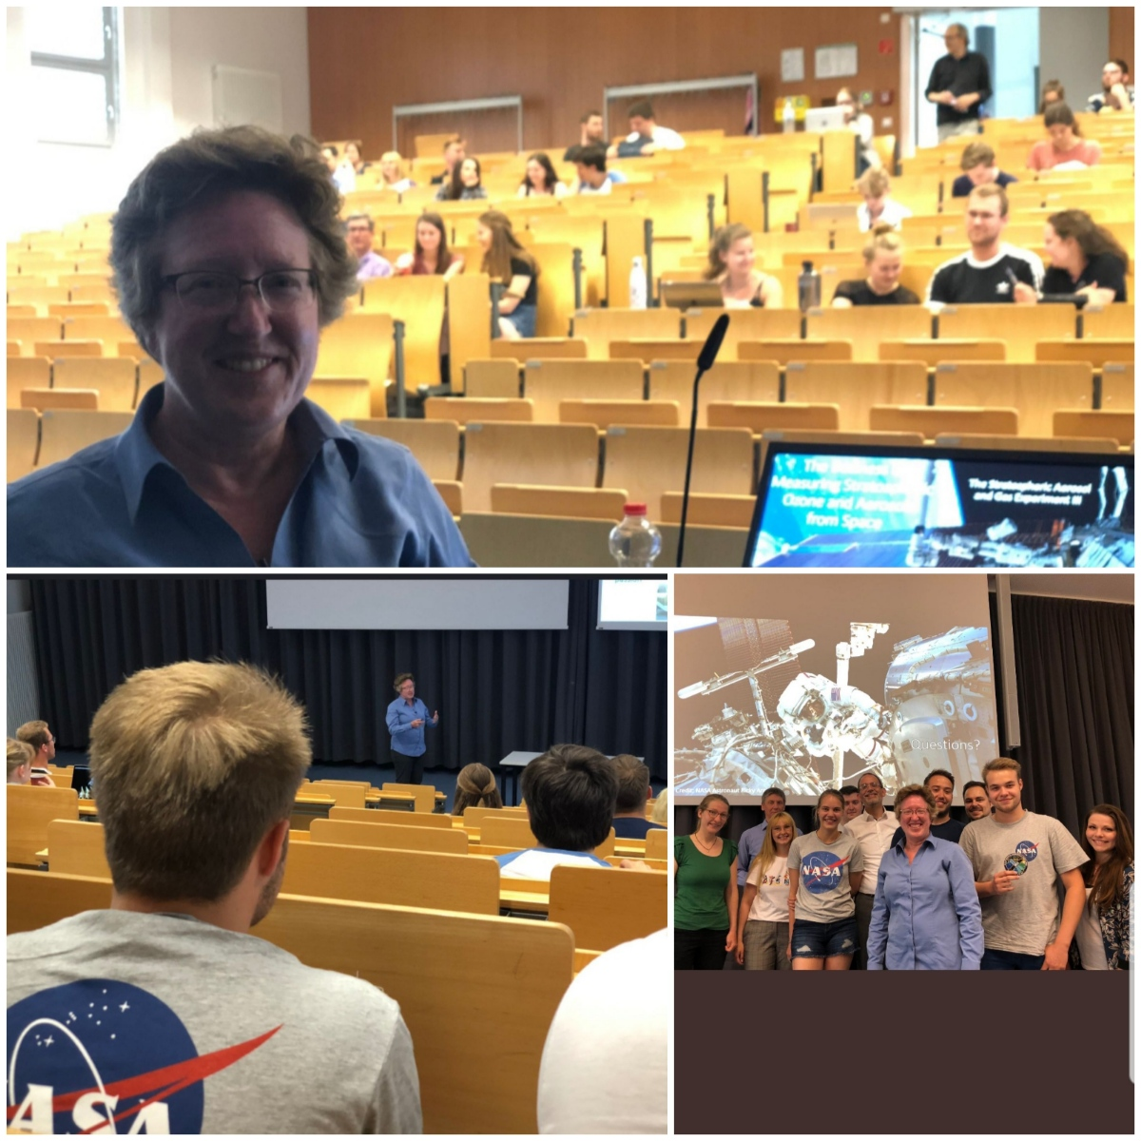
Events Continued
June 2019
Annual Limb Workshop- Greifswald, Germany
H2 Hochschule Stendal University in Stendal, Germany Invited Talk
July 2019
International Space Station Research and Development Conference- Atlanta, GA
SciPy Conference- Austin, TX
The International Union of Geodesy and Geophysics (IUGG) Conference- Montreal, Canada
October 2019
Skype session with 6th grade earth science class in Barrow County, GA
POIWG (Payload Operations Integration Working Group)- Huntsville, AL

Slide 7
Contact Information
Please contact me if you are interested in featuring your work on our website or Facebook page, or if you are in need of SAGE III/ISS outreach materials for your organization.
Allison Leybold
SAGE III/ISS Communications Lead
757.864.4563
allison.b.leybold@nasa.gov

Slide 8
Questions?

