Slide 1
Cloud Top Heights from SAGE III/ISS
J. Kummer, M. Schoeberl
STC
E. Jensen, R. Ueyama
ARC

Slide 2
Outline
Review of our SAGE III cloud algorithm
Comparison to other observations
Future work

Slide 3
How do we identify clouds within the SAGE III profiles?
2λ algorithm, Thomason and Vernier (2013)
  Uses extinction ratio and extinction magnitude
  Can also be used with SAGE II
3λ algorithm, Kent et al. (2007)
  Uses two extinction ratios
  Cannot be used with SAGE II

Slide 4
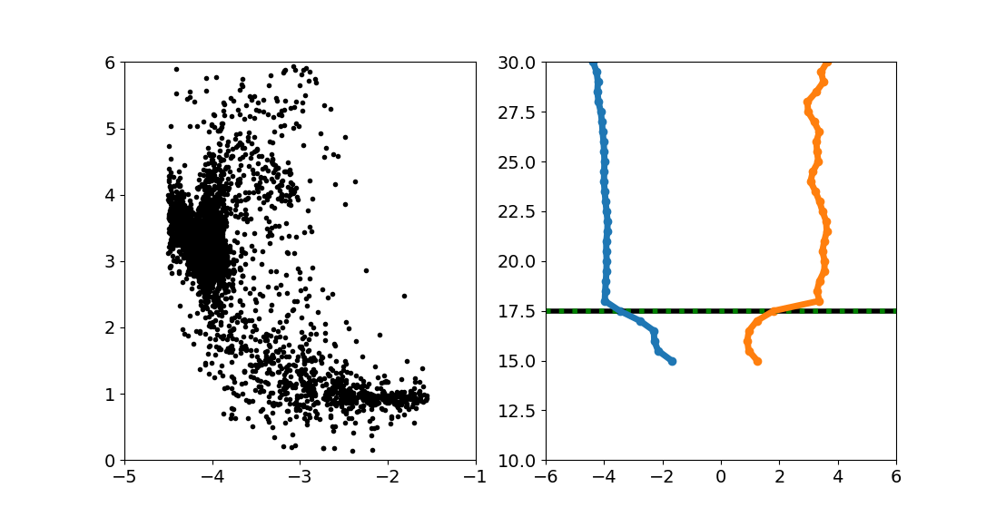
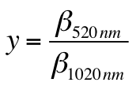

Example of the 2λ Algorithm
All TWP Points (2-λ)
z [km]
Cloud
< 2
> -3.7
x(z)=log₁₀(β(z)₁₀₂₀)
y(z)=β₅₂₀ / β₁₀₂₀
Lat/Lon: -21.45, 30.01
9/16/2017

Slide 5
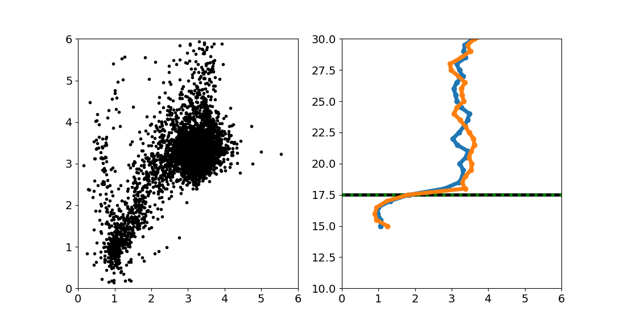
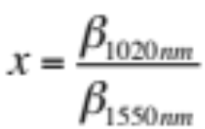
Same case for the 3λ algorithm
All TWP Points (3-λ)
Example of x~1 y~1 observation
z [km]
x(z)
y(z)
Cloud
Extinction Ratio [unitless]
Lat/Lon: -21.45, 30.01
9/16/2017

Slide 6
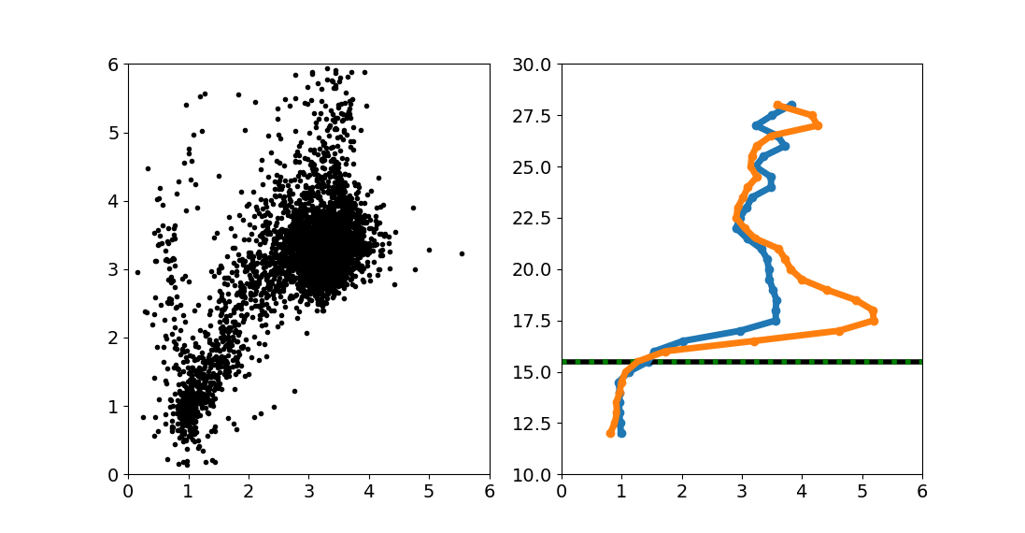
Case with an Aerosol Layer
All TWP Points (3-λ)
Profiles of two color ratios
z [km]
x(z)
y(z)
Aerosols
Stratospheric Aerosols
Cloud
Extinction Ratio [unitless]
Lat/Lon: 2.0, 150.55
4/24/2018

Slide 7
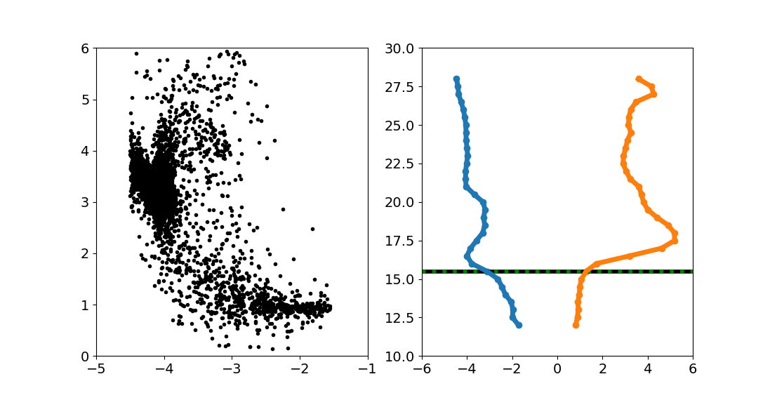
Case with an Aerosol Layer
All TWP Points (2-λ)
Profiles of extinction and color ratio
z [km]
Aerosols
Extinction increases while color ratio approaches 1
Cloud
x(z)=log₁₀(β(z)₁₀₂₀)
y(z)=β₅₂₀ / β₁₀₂₀
Lat/Lon: 2.0, 150.55
4/24/2018

Slide 8
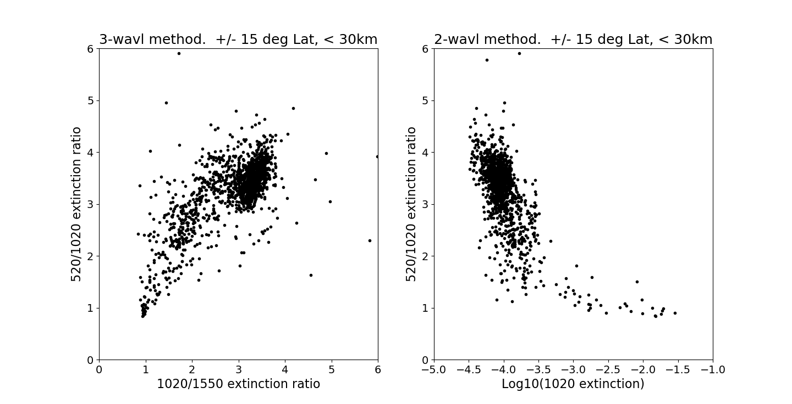
Summary of the Two Techniques
(June 2017 – March 2018 data)
  3-λ (Kent)
  2-λ (Thomason)
Aerosols
Ratio 520/1020 threshold = 2
Clouds
Clouds
Log(1020 extinction) = -3.7

Slide 9
Final Cloud Algorithm
The two algorithms disagree where extinctions at 1020 and 1550 are small (basically dividing by a small number). To correct this we modify the Kent algorithm to include the Thomason extinction cutoff.
New Kent algorithm: A Cloud is detected if
  3-λ (Color Ratio (520/1020 and 1020/1550 ext.) is 0.75< CR < 2.0 for both ratios
  And Log₁₀(1020 ext.) > -3.7 constraint from the 2-λ method.
The two algorithms now agree for 93% of the observations.

Slide 10
Validating the SAGE III cloud algorithm with OMPS and CALIOP observations
Using all of the SAGE III, OMPS-LP, and CALIOP data available we compare
Zonal mean Cloud Top Heights (CTH)
Zonal Mean Difference of Cloud Top Heights Relative to OMPS-LP
Cloud Top Height Maps

Slide 11
OMPS, SAGE and CALIOP Cloud Detection
Extinction
Back scattering
CALIOP
SAGE III
Limb Scattering
OMPS LP
Each system uses a different technique to identify cloud height.

Slide 12
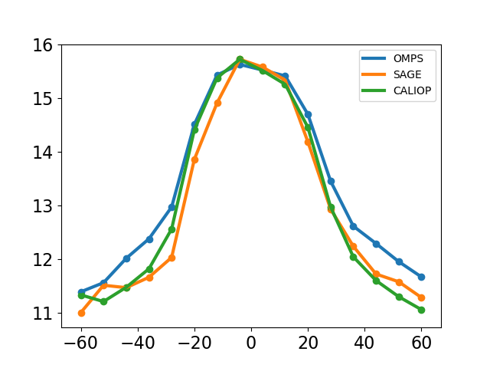
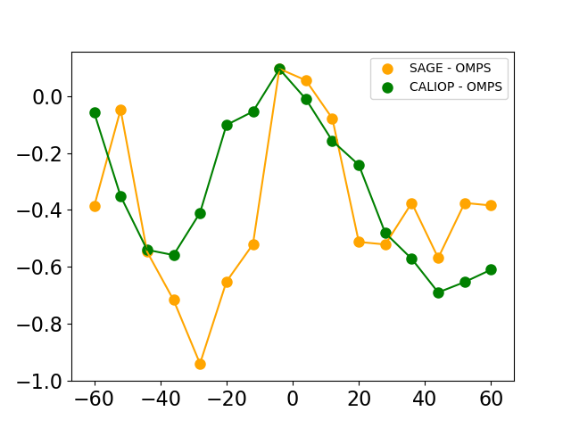
Zonal Mean CTH from SAGE III, OMPS-LP, CALIOP
km
km
CALIOP – OMPS
SAGE – OMPS
Latitude

Slide 13
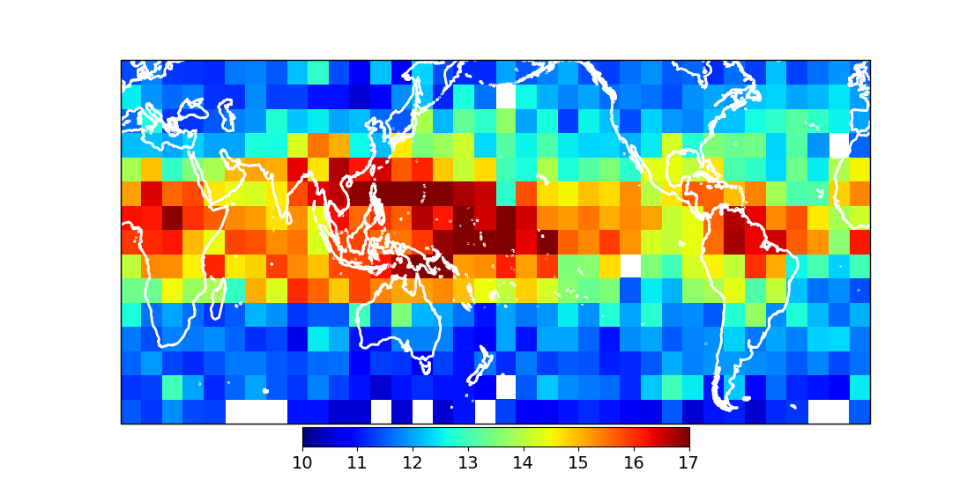
SAGE III Cloud Top Height
(annual average)
TWP Clouds are higher than OMPS.
TEP Clouds are more consistent with OMPS
km

Slide 14
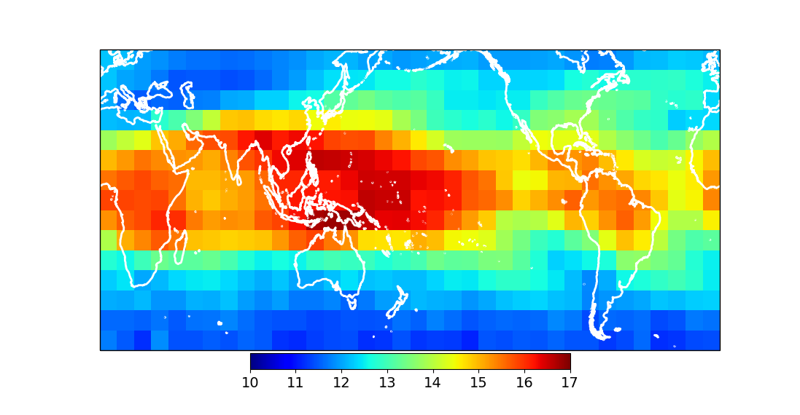
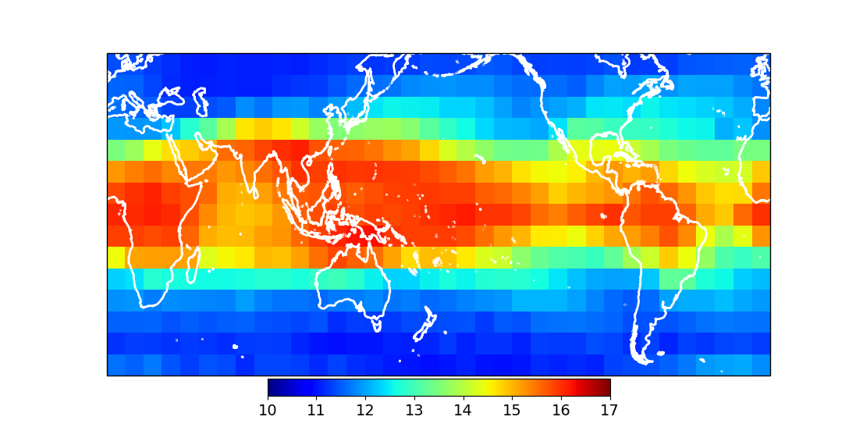
Comparison to CALIOP and OMPS
SAGE III
(1 year of data)
Overall, the three data sets are consistent
OMPS is ~1 km higher than CALIOP in TWP
SAGE III is slightly higher than OMPS in TWP
OMPS
(7 years of data)
CALIOP
(5 years of data)

Slide 15
Now look at JJA and DJF

Slide 16
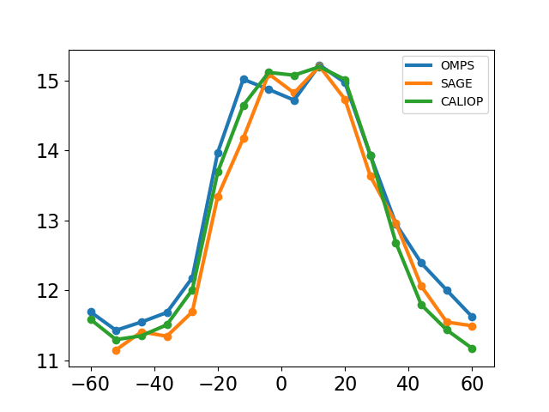
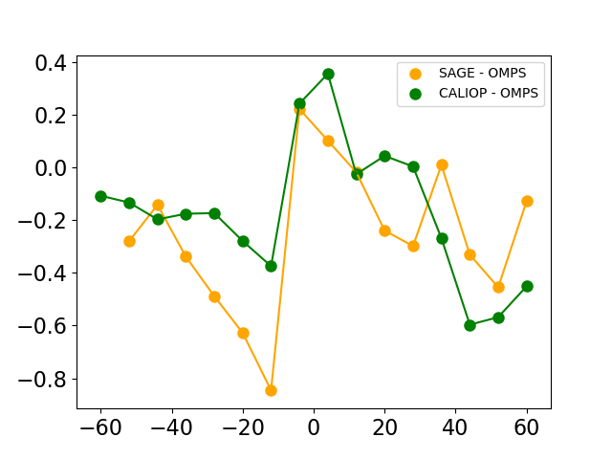
JJA 2017/18
Zonal Mean CTH from SAGE III, OMPS, CALIOP
km
OMPS and SAGE III are very similar in the tropics
Differences
km
Latitude

Slide 17
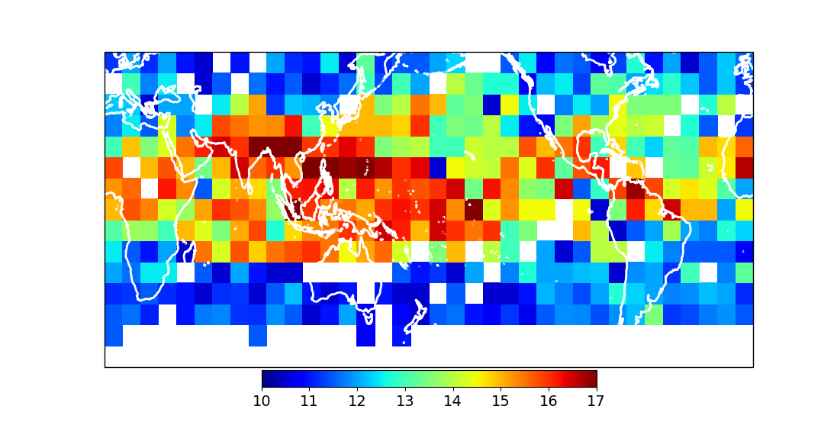
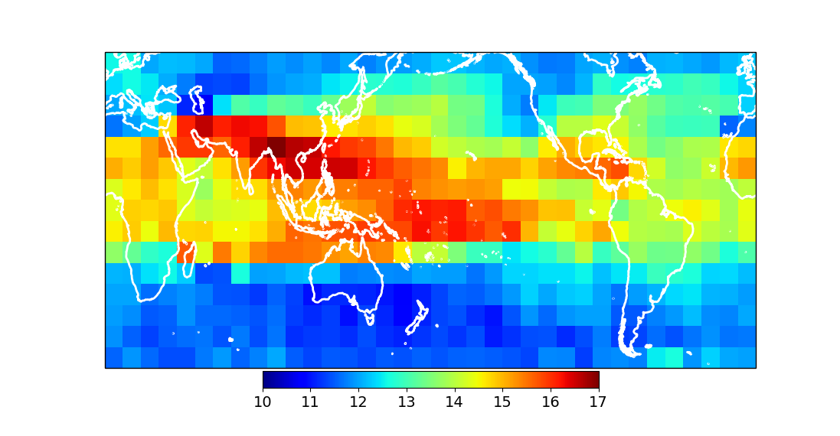
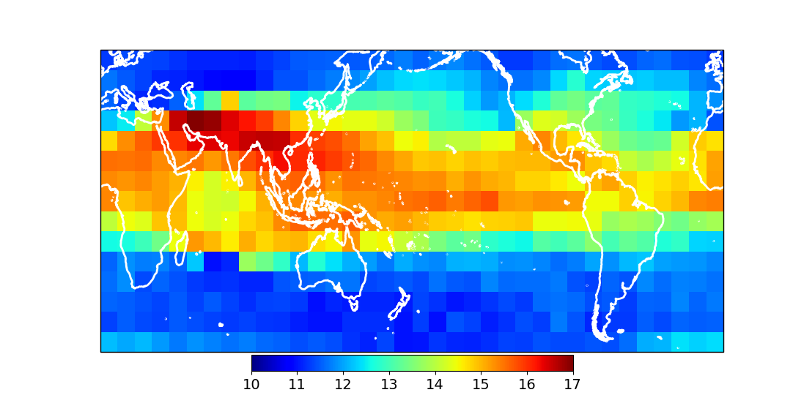
SAGE III CTH JJA
SAGE III
(2017/18)
Overall, the three data sets are consistent
SAGE III and OMPS are closer
Some interesting differences
OMPS
(2017/18)
CALIOP
(2017/18)

Slide 18
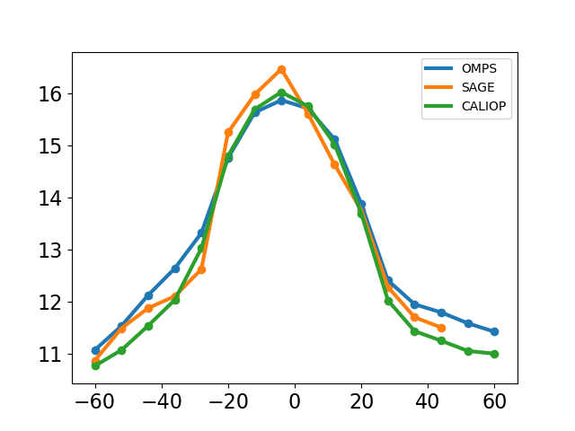
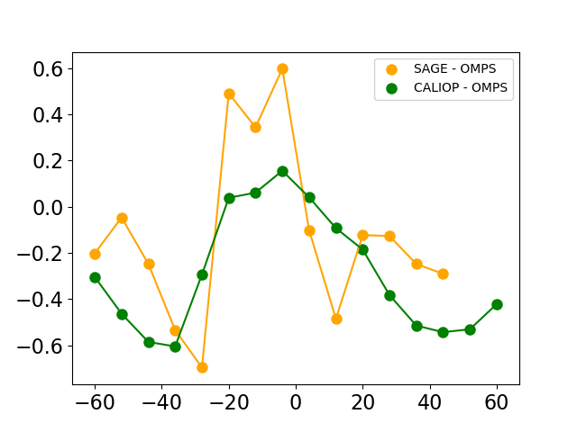
DJF 2017
Zonal Mean CTH from SAGE III, OMPS, CALIOP
km
SAGE III is highest
Latitude

Slide 19
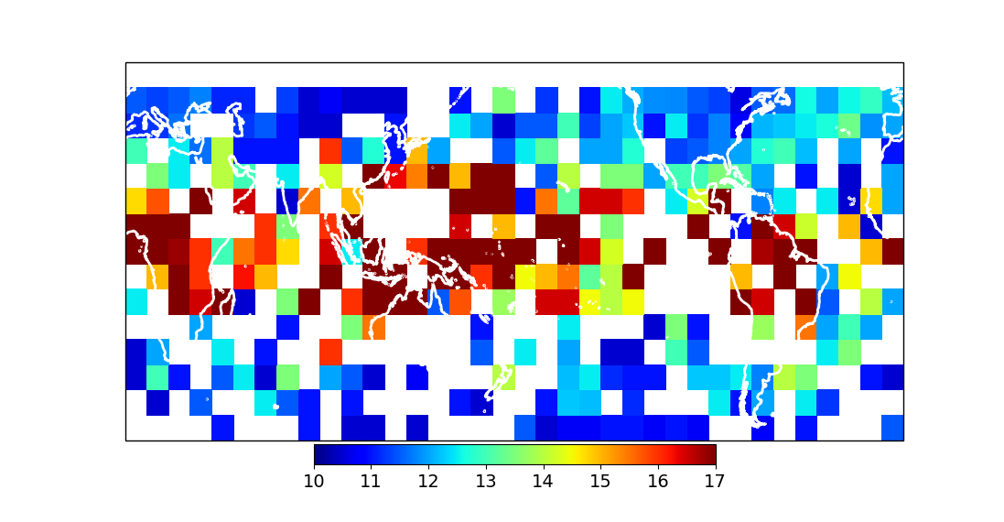
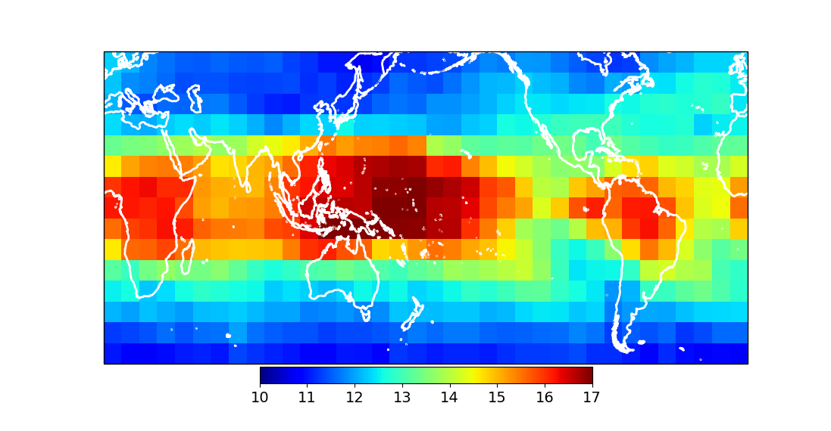
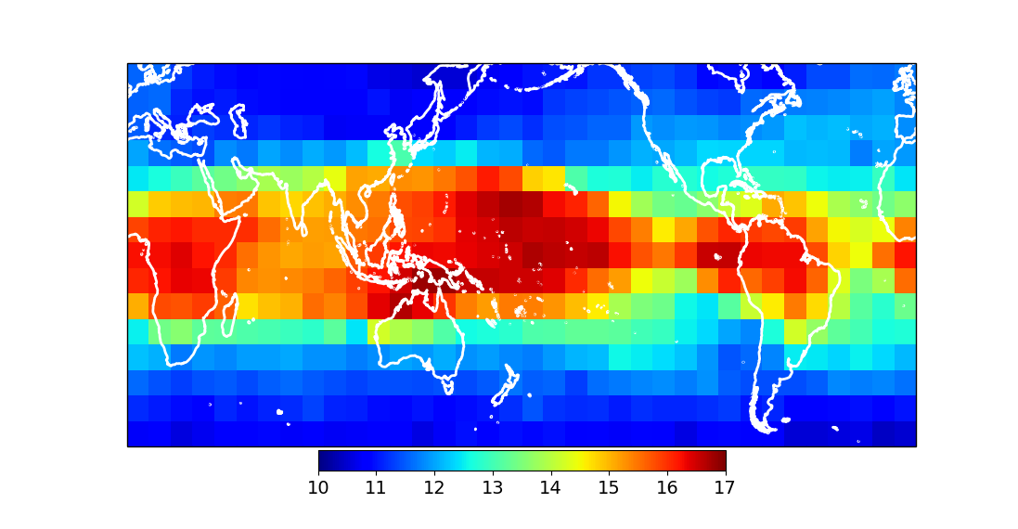
SAGE III CTH DJF
SAGE III
(2017)
Overall, three data sets are consistent
SAGE III is highest
Some interesting differences but more data is required
(white means no data)
OMPS
(2017)
CALIOP
(2017)

Slide 20
Conclusions
Both algorithms 2λ and 3λ produce reasonable SAGE III Cloud Top Height. We use a modified 3λ algorithm here (3λm).
Comparison with CALIOP and OMPS shows overall good agreement.
More SAGE data is required to solidify the comparisons and explore some of the differences.

Slide 21
Future Work
Implement a cloud top height detection algorithm operationally.
The OMPS ‘radiance gradient’ cloud identification scheme could also be used with in SAGE III data – especially for SAGE III in limb scatter mode.
Computation of cloud fraction is an ongoing project
  Estimating cloud fraction is important for climate studies
  Converting the CALIOP viewing geometry to SAGE III/OMPS viewing geometry is a challenge since it re quires an assumption about the horizontal extent of clouds (e.g. Liao et al. 1995)

