Slide 1
SAGE-III/ISS Science Team Meeting
Travis N. Knepp
Backscatter Coefficient Profiles from SAGE
Aerosol Products: Comparison
with NDACC Lidar Products
Notes:
1

Slide 2
Aerosol Evaluation?
– Traditional options
– Balloon-borne OPC
– Space-based observations: OSIRIS (750 nm), OMPS LP (675 nm)
– Ground-based lidar (old method)
– assume constant lidar ratio
– may not represent current atmosphere
– lidar ratio is not static
– Ground-based lidar (current focus)
– NDACC lidar working group
– long-term observations
– high quality observations (suitable for climatological studies)
– standardized observations
– data publicly available within one year
10/28/19

Slide 3
Requirements for Ground Site Selection
Ideal requirements:
– long-term record
– part of NDACC network
– provide backscatter coefficient
– frequent operation schedule (10+ nights per month)
– overlap with SAGE-II and SAGE-III/ISS
10/28/19

Slide 4
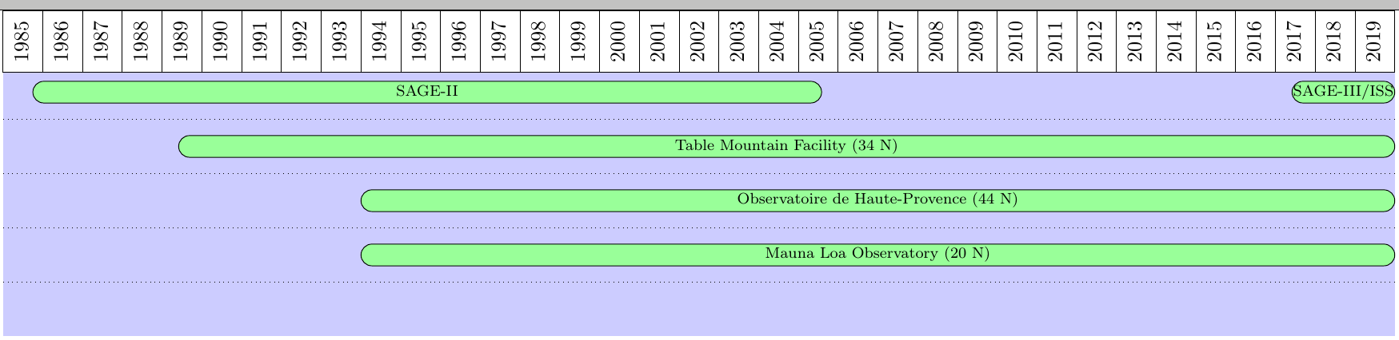
Requirements for Ground Site Selection
Ideal requirements:
– long-term record
– part of NDACC network
– provide backscatter coefficient
– frequent operation schedule (10+ nights per month)
– overlap with SAGE-II and SAGE-III/ISS
10/28/19

Slide 5
Apples and Eggplants
Backscatter (lidar) ≠ Extinction (SAGE)
Need a workaround for comparison
10/28/19

Slide 6
Mie Theory Conversion
Mie assumptions
– spherical particles
– predominantly sulfate (75% sulfate, 25% water)
– particles are log-normally distributed
10/28/19

Slide 7
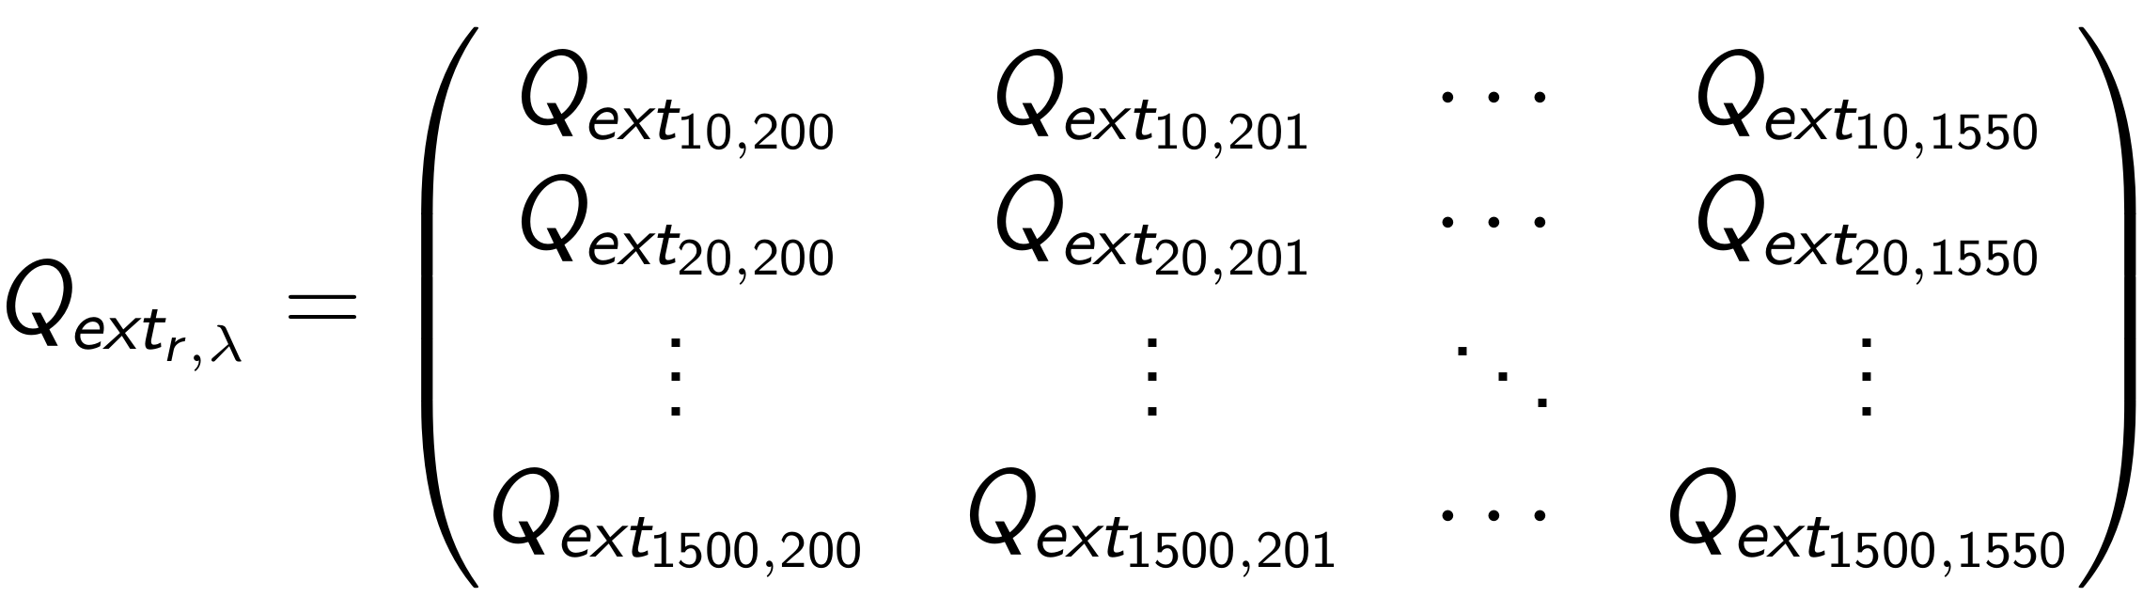
Mie Theory Conversion
10/28/19

Slide 8
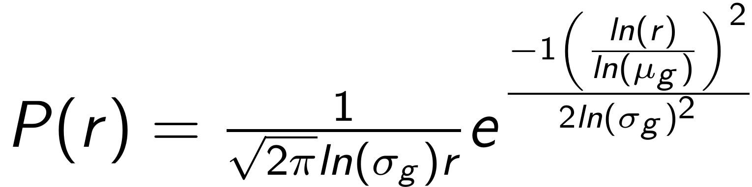
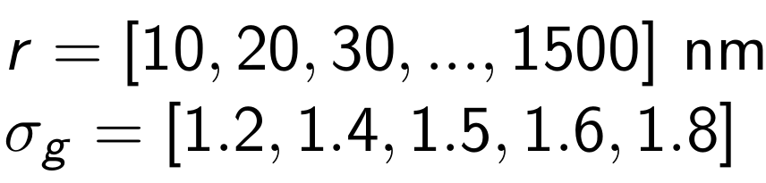
Mie Theory Conversion
10/28/19

Slide 9
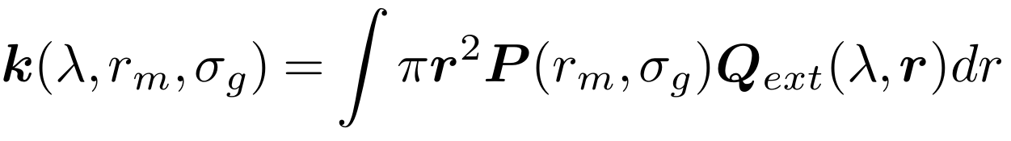
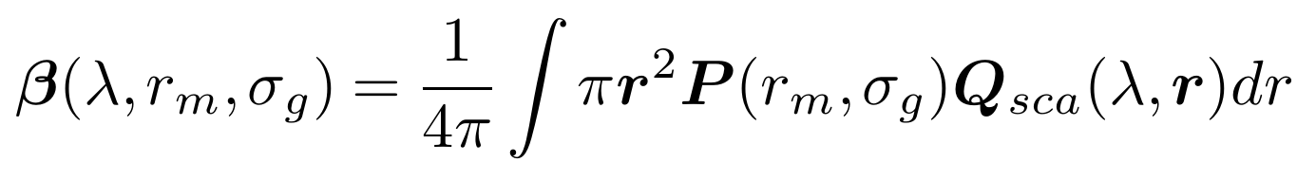
Mie Theory Conversion
Tables of backscatter/extinction coefficients based on wavelength, mode radius, and distribution width
10/28/19

Slide 10
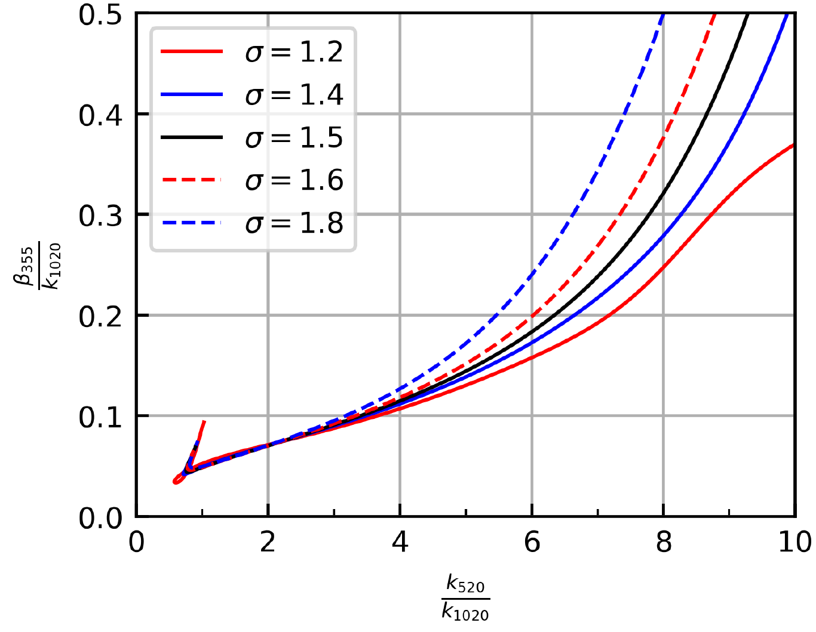
Nexus of Reality and Theory
10/28/19

Slide 11
Nexus of Reality and Theory
use 355 nm to match lidar
10/28/19

Slide 12
Nexus of Reality and Theory
Target
Wavelength should not matter
10/28/19

Slide 13



Evaluation of Method’s Robustness
Calculate backscatter using three wavelength combinations
?
=
?
=
10/28/19

Slide 14
Evaluation of Method’s Robustness
Calculate backscatter using three wavelength combinations
?
=
?
=
vs
520 acts as reference
vs
10/28/19

Slide 15
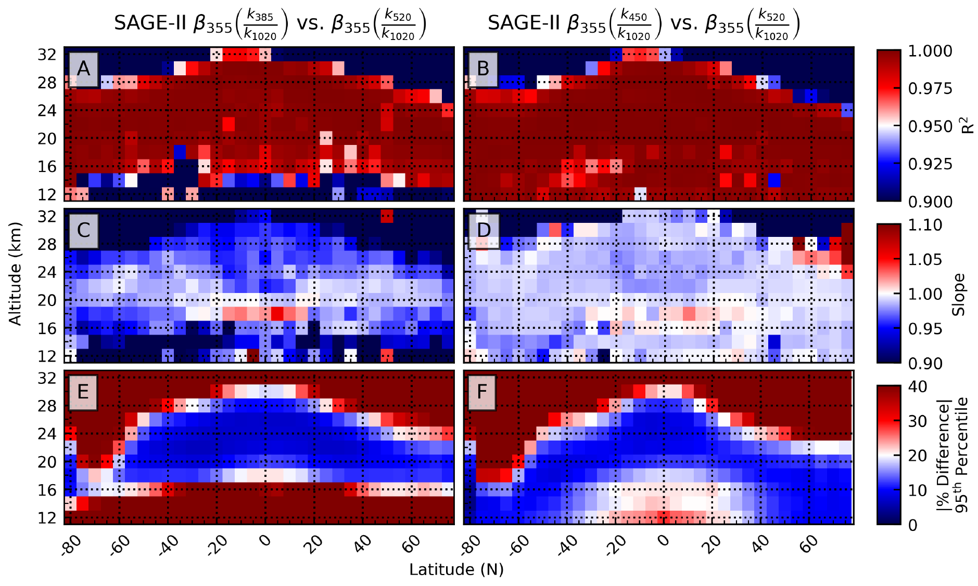
Evaluation of Method’s Robustness
SAGE-II
Coefficient of correlation
10/28/19

Slide 16
Evaluation of Method’s Robustness
SAGE-II
Coefficient of correlation
Slope
10/28/19

Slide 17
Evaluation of Method’s Robustness
SAGE-II
Coefficient of correlation
Slope
Percent Difference
10/28/19

Slide 18
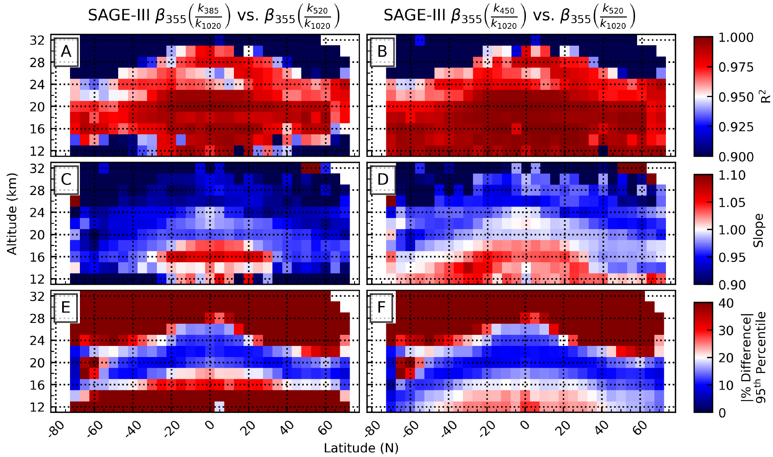
Evaluation of Method’s Robustness
SAGE-III
Coefficient of correlation
10/28/19

Slide 19
Evaluation of Method’s Robustness
SAGE-III
Coefficient of correlation
Slope
10/28/19

Slide 20
Evaluation of Method’s Robustness
SAGE-III
Coefficient of correlation
Slope
Percent Difference
10/28/19

Slide 21
Evaluation of Method’s Robustness
Overall Impression
– method is robust
– SAGE-II slightly different (better?) than SAGE-III
– SAGE-II had Pinatubo
– removing Pinatubo makes SAGE-II similar to SAGE-III
– consistent between 16–30 km
– how about some statistics?
10/28/19

Slide 22
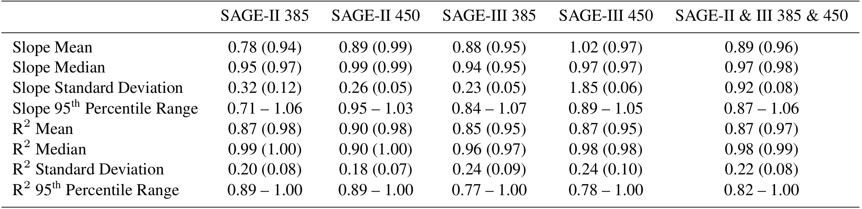
Evaluation of Method’s Robustness
Summary Statistics
Compared to backscatter using 520/1020 ratio
X
vs.
All data
Altitude filtered
10/28/19

Slide 23
Evaluation of Method’s Robustness
Summary Statistics
Compared to backscatter using 520/1020 ratio
X
vs.
All data
Altitude filtered
10/28/19

Slide 24
Stepping further into reality...
Method compared well with itself, how does it compare to another data set (lidar)?
Remainder of analysis using:
10/28/19

Slide 25
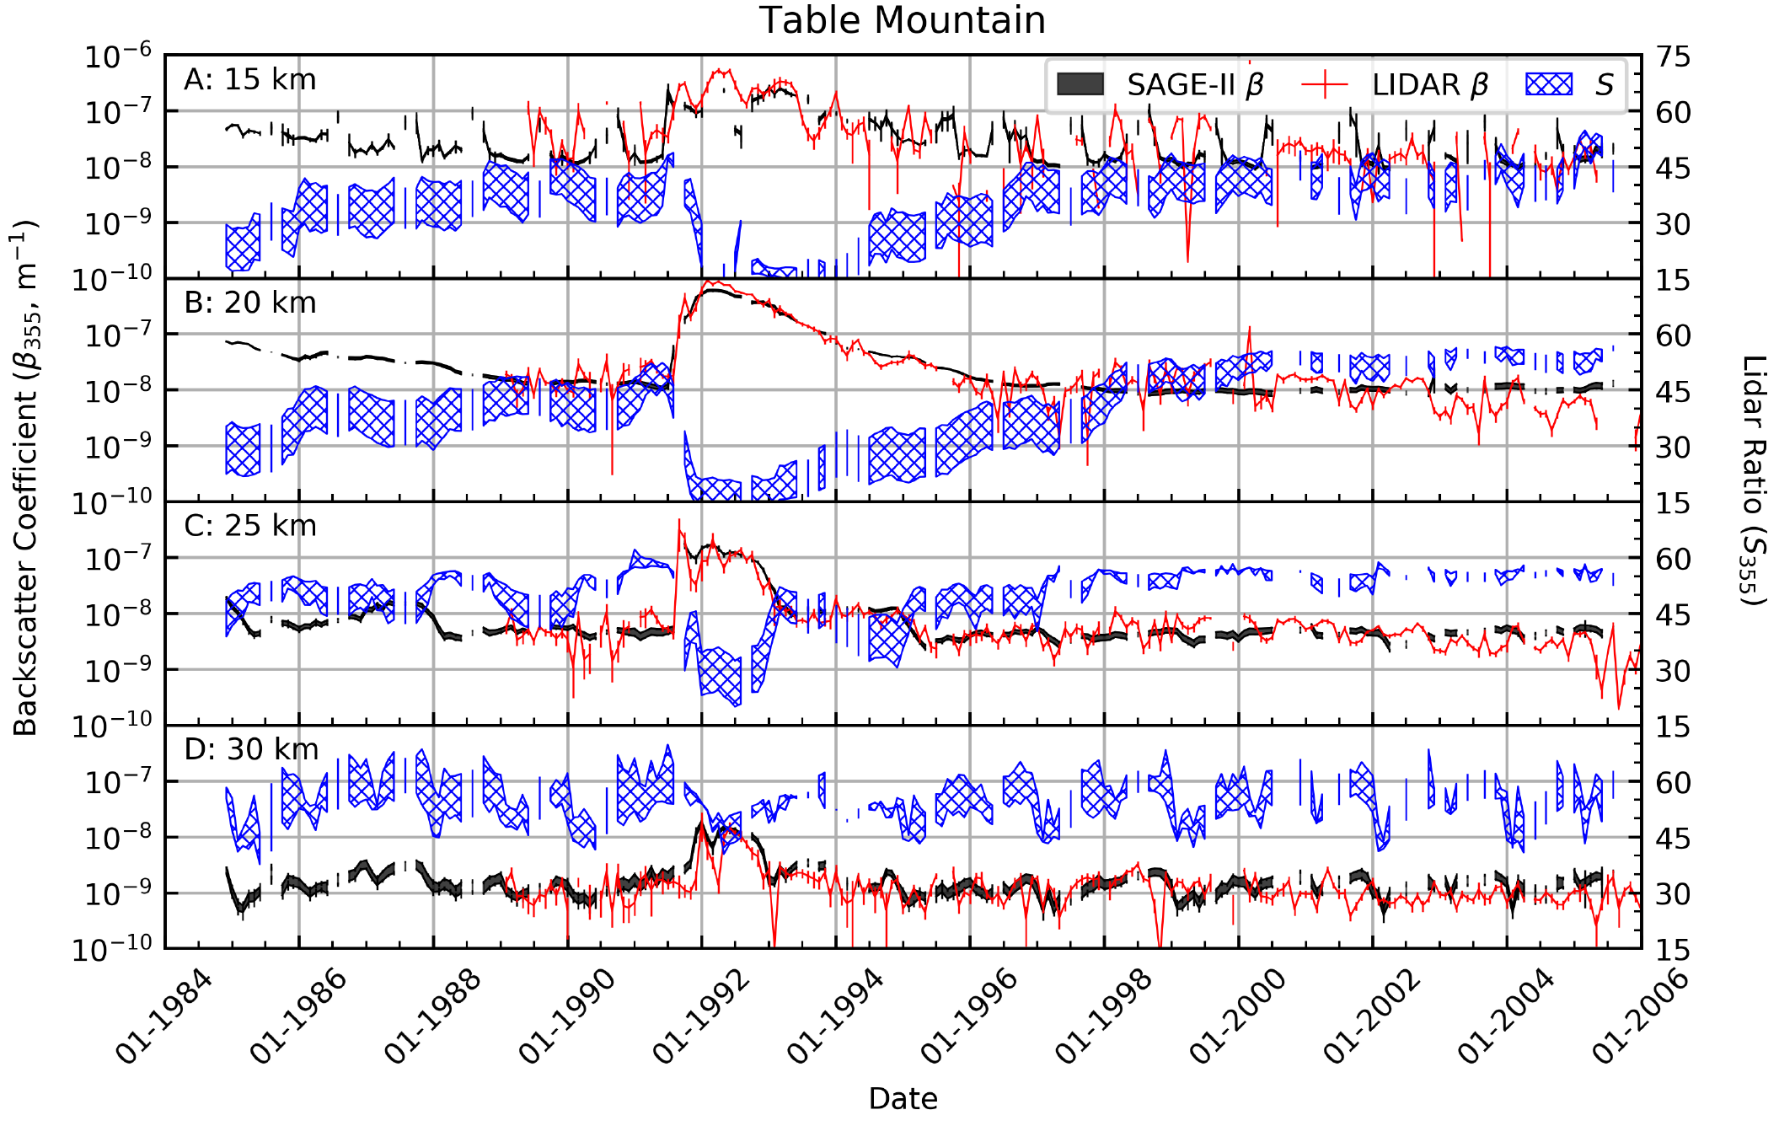
Comparison to Lidar
10/28/19

Slide 26
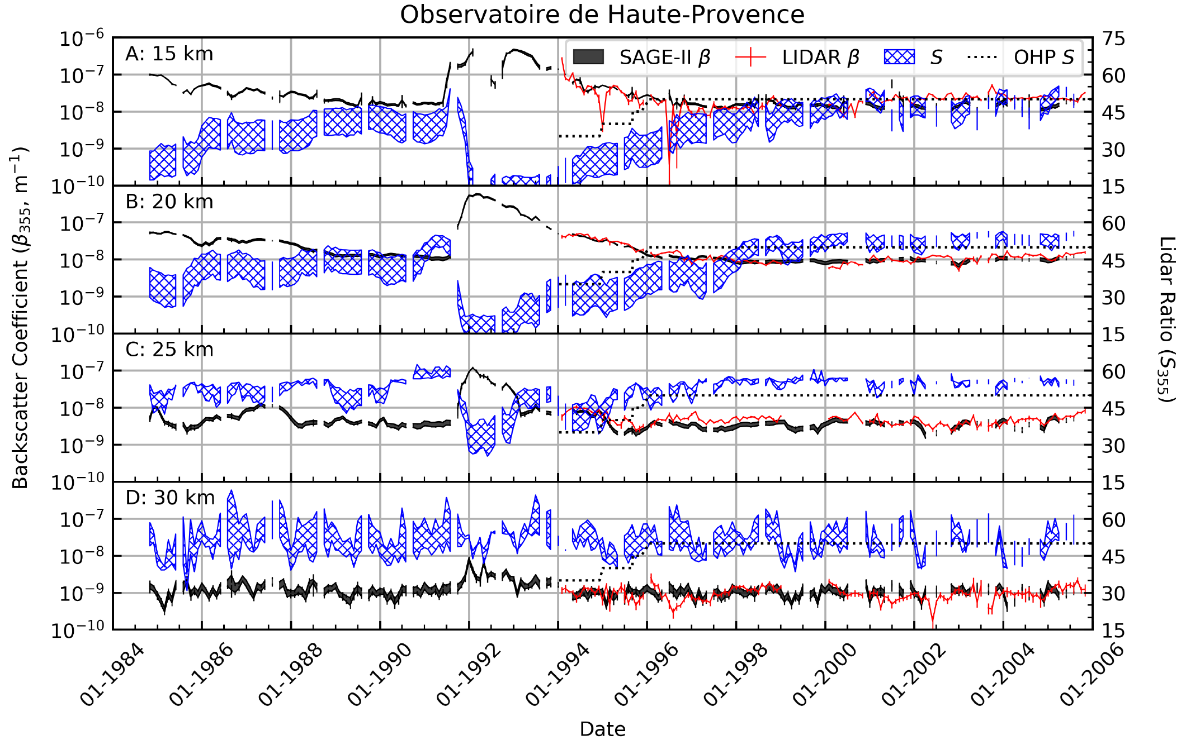
Comparison to Lidar
10/28/19

Slide 27
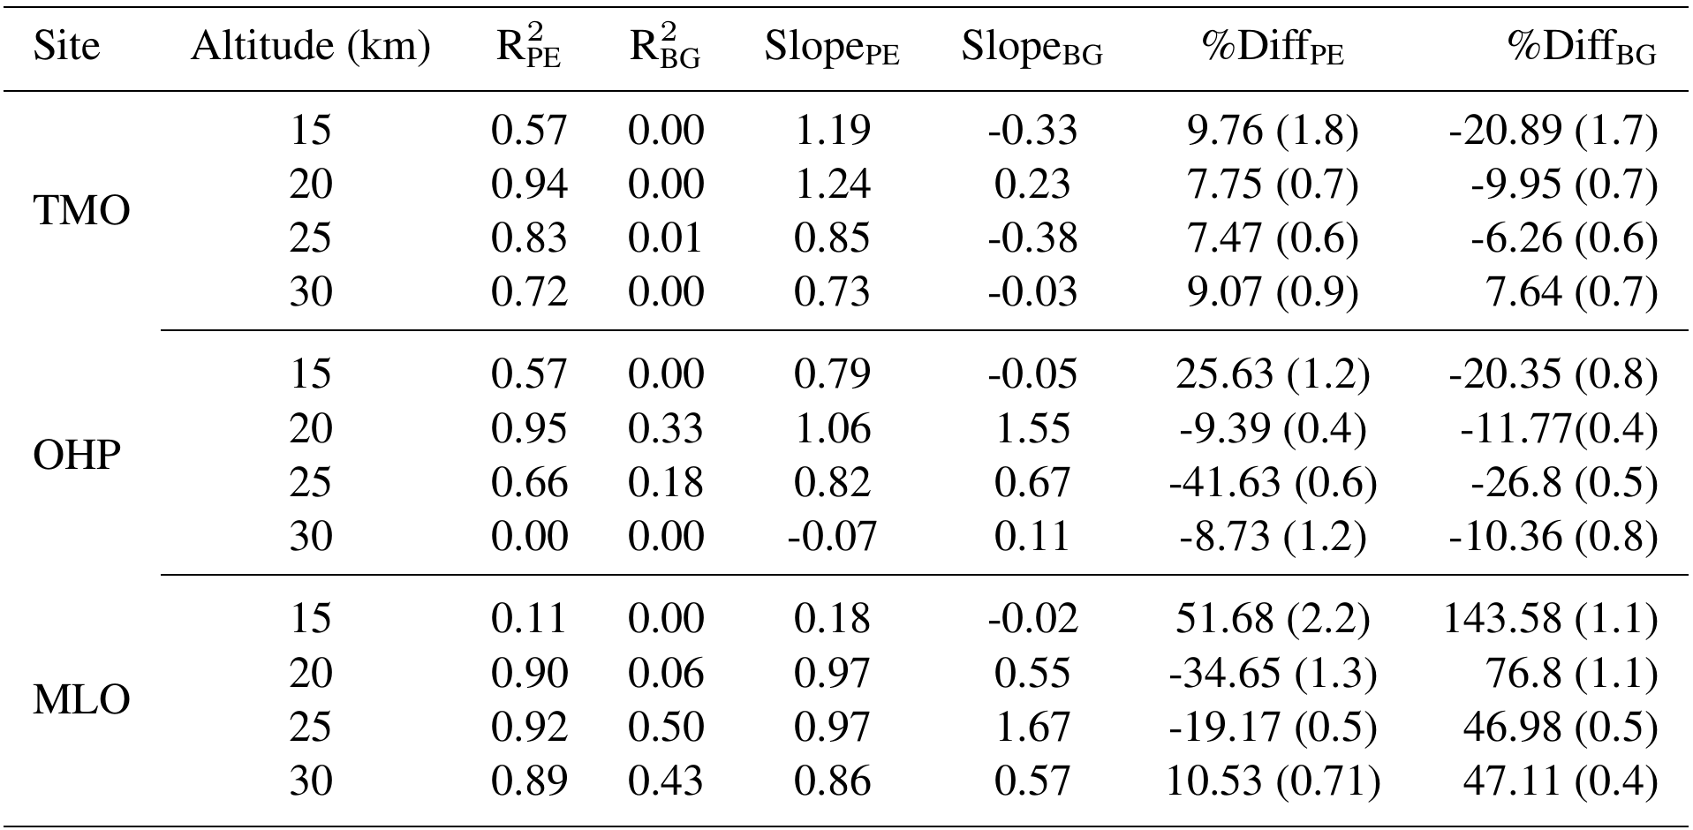
Comparison to Lidar
Summary Statistics
Pinatubo Eruption
Background
10/28/19

Slide 28

Comparison to Lidar
Summary Statistics
Pinatubo Eruption
Background
10/28/19

Slide 29
Recap
– New method of evaluating SAGE aerosol extinction products
– based on Mie theory
– robust (wavelength independent)
– reproduced ground lidar time series
– showed high correlation/low percent difference with ground lidar
10/28/19

Slide 30
Questions
10/28/19

