Slide 1
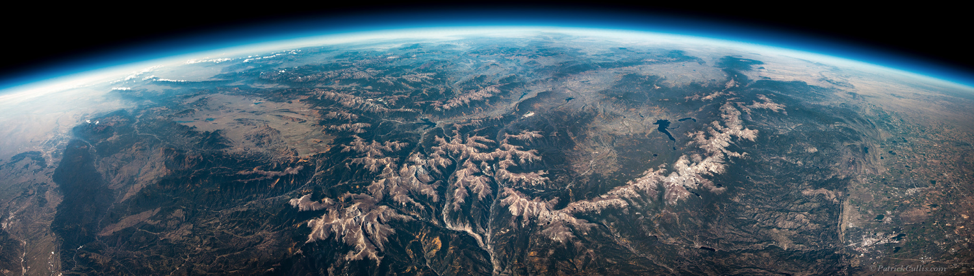

Assessment of SAGE III/ISS water vapor
Sean Davis, Rob Damadeo, Karen Rosenlof
Dale Hurst, Rennie Selkirk
NOAA Earth System Research Laboratory Chemical Sciences Division, Boulder, CO

Slide 2
Overview
Develop basic QC screening for SAGE III/ISS WV data
  Based on previous experience with filtering SAGE II data
  Tested with MLS coincident profile comparisons
Update on frostpoint hygrometer balloon intercomparisons
Using SAGE III/ISS in SWOOSH merged data record

Slide 3
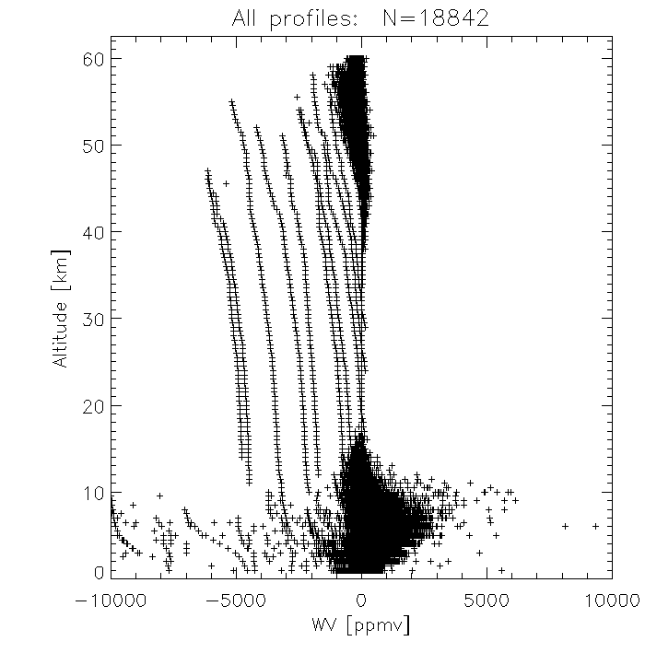
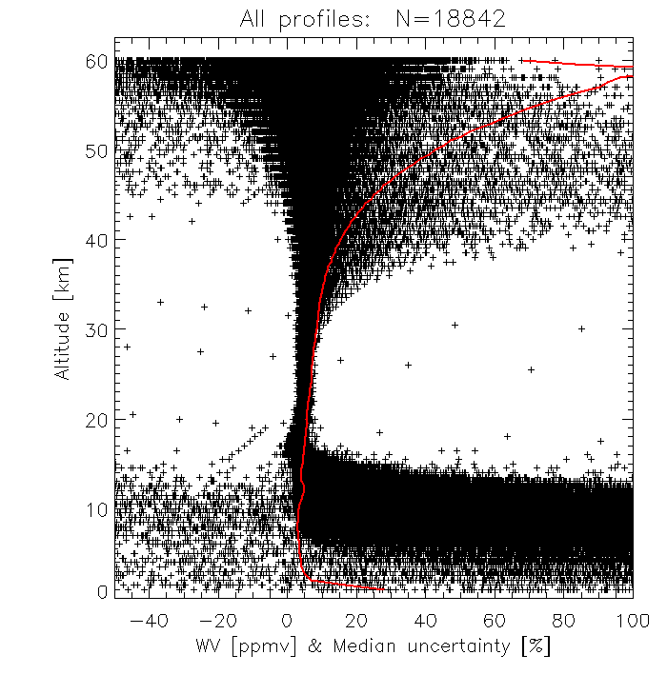
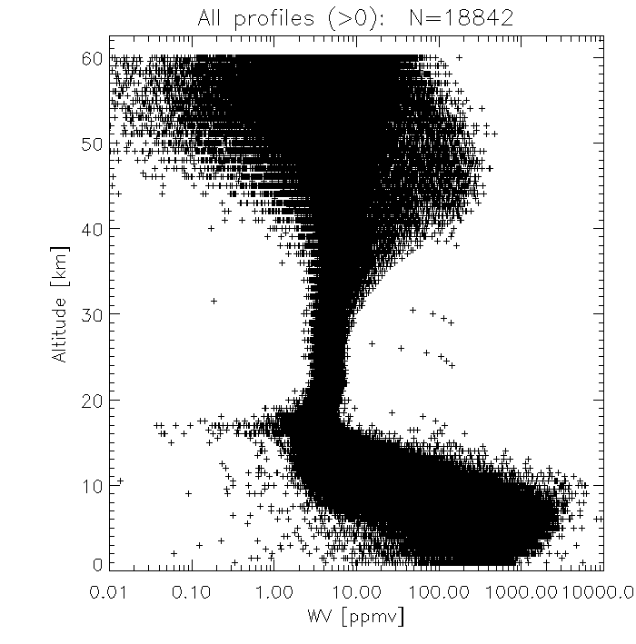
SAGE III/ISS v5.1 raw WV profiles
There are numerous outliers in the SAGE WV data
Simply removing negative values would help some, but that can throw off statistics in high noise regions (e.g., above 40 km)
We want to try and understand bad data

Slide 4
SAGE II-inspired screening
SAGE II WV screening from Taha et al. (2004)
  Remove points with uncertainty > 50%
  Remove points with β_{1020 nm} > 2 x 10⁻⁴ km⁻¹ (Rind et al. 2005 used 4 x 10⁻⁴ km⁻¹)
Questions:
  Are those thresholds appropriate for SAGE III/ISS?
  What about color ratio filtering (as done for O₃ in Wang et al., 2002)?
    E.g., Remove points in profile below level where β_{1020 nm} / β_{520 nm} > 0.7
  For extinction filtering, should we remove just points in the profile at which the threshold is exceeded, or should we remove all points below the level at which the threshold is exceeded?

Slide 5
SAGE III/ISS – MLS coincident profile comparison
MLS WV mixing ratio interpolated to SAGE altitude grid using MERRA2
For each SAGE III profile, look for MLS within
± 24 h
± 10° longitude at equator ( 1110 km)
± 2° latitude
→ Take closest profile in space if > 1 profile match
Data
  SAGE III/ISS v5.10 (6/2017 – 8/2019)
  Aura MLS v4.2

Slide 6
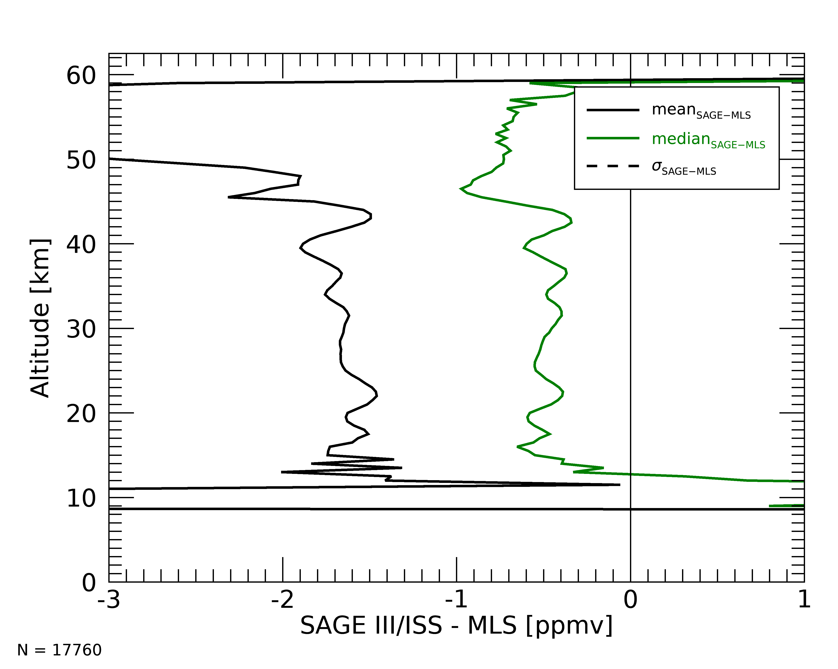
SAGE – MLS WV comparison: unfiltered
Mean strongly affected by negative outliers
Median fairly robust even with no filtering

Slide 7
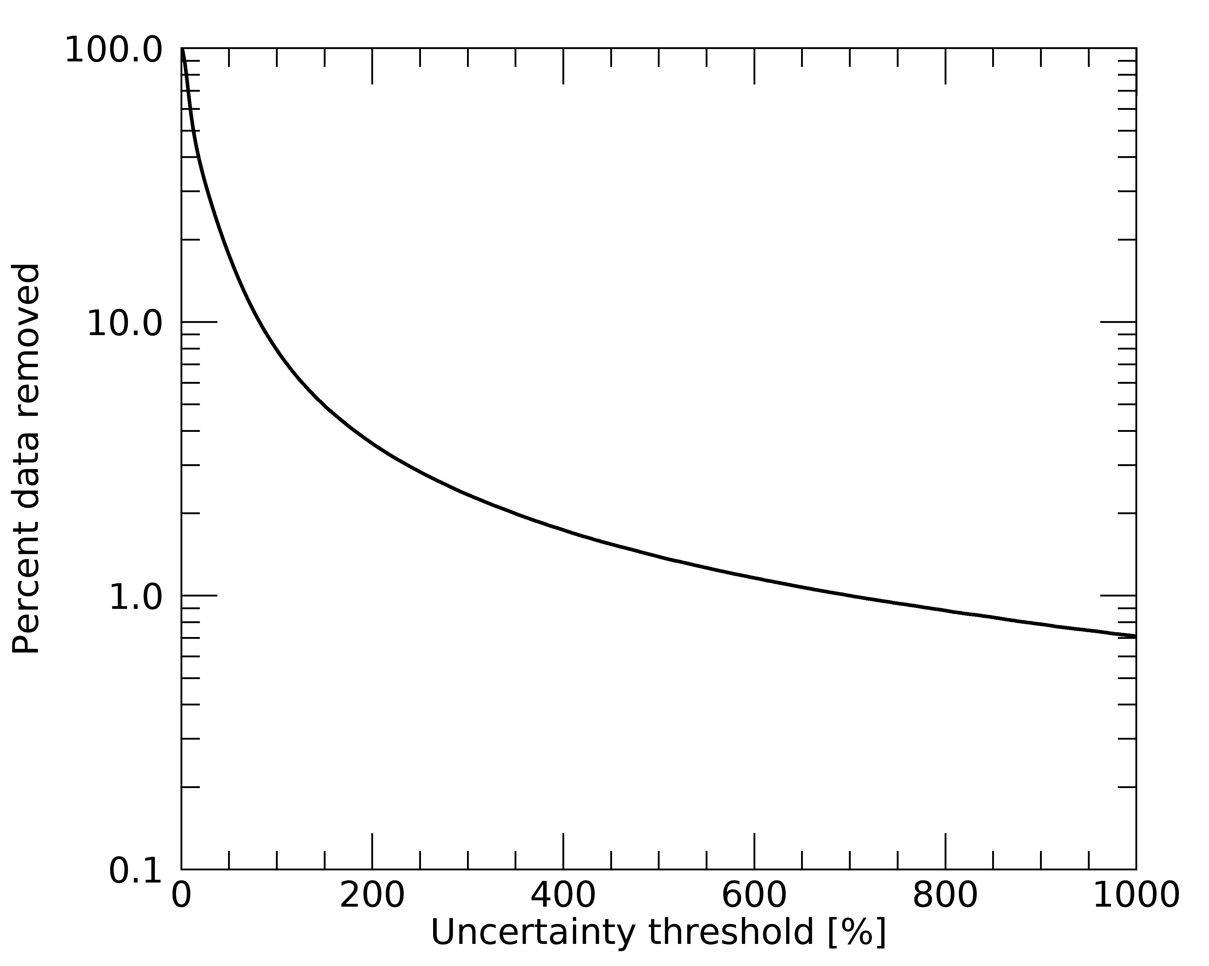
SAGE – MLS WV comparison: uncertainty threshold
Tradeoff where larger threshold -> more data filtered out
No bimodality to uncertainty -> no obvious ‘objective’ threshold

Slide 8
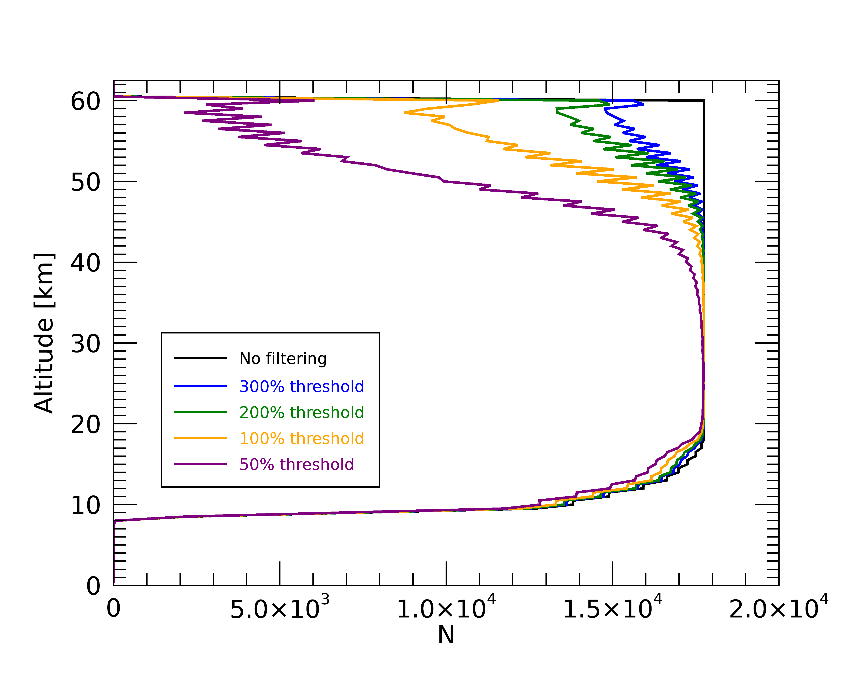
SAGE – MLS WV comparison: uncertainty threshold
Negligible impact at 20 – 40 km
Smaller threshold → more data filtered above 40 km
Doesn’t remove negative outliers
Raw
300 %
200 %
100 %
50 %

Slide 9
Extinction threshold filtering
No obvious bi-modality in extinction
Try out different extinction thresholds in the range 2 x 10⁻⁴ – 10⁻³ km⁻¹

Slide 10
Extinction threshold filtering
Some differences between profile (solid) and point (dashed) filtering
Data loss with threshold of 10⁻³ km⁻¹ below ~17 km

Slide 11
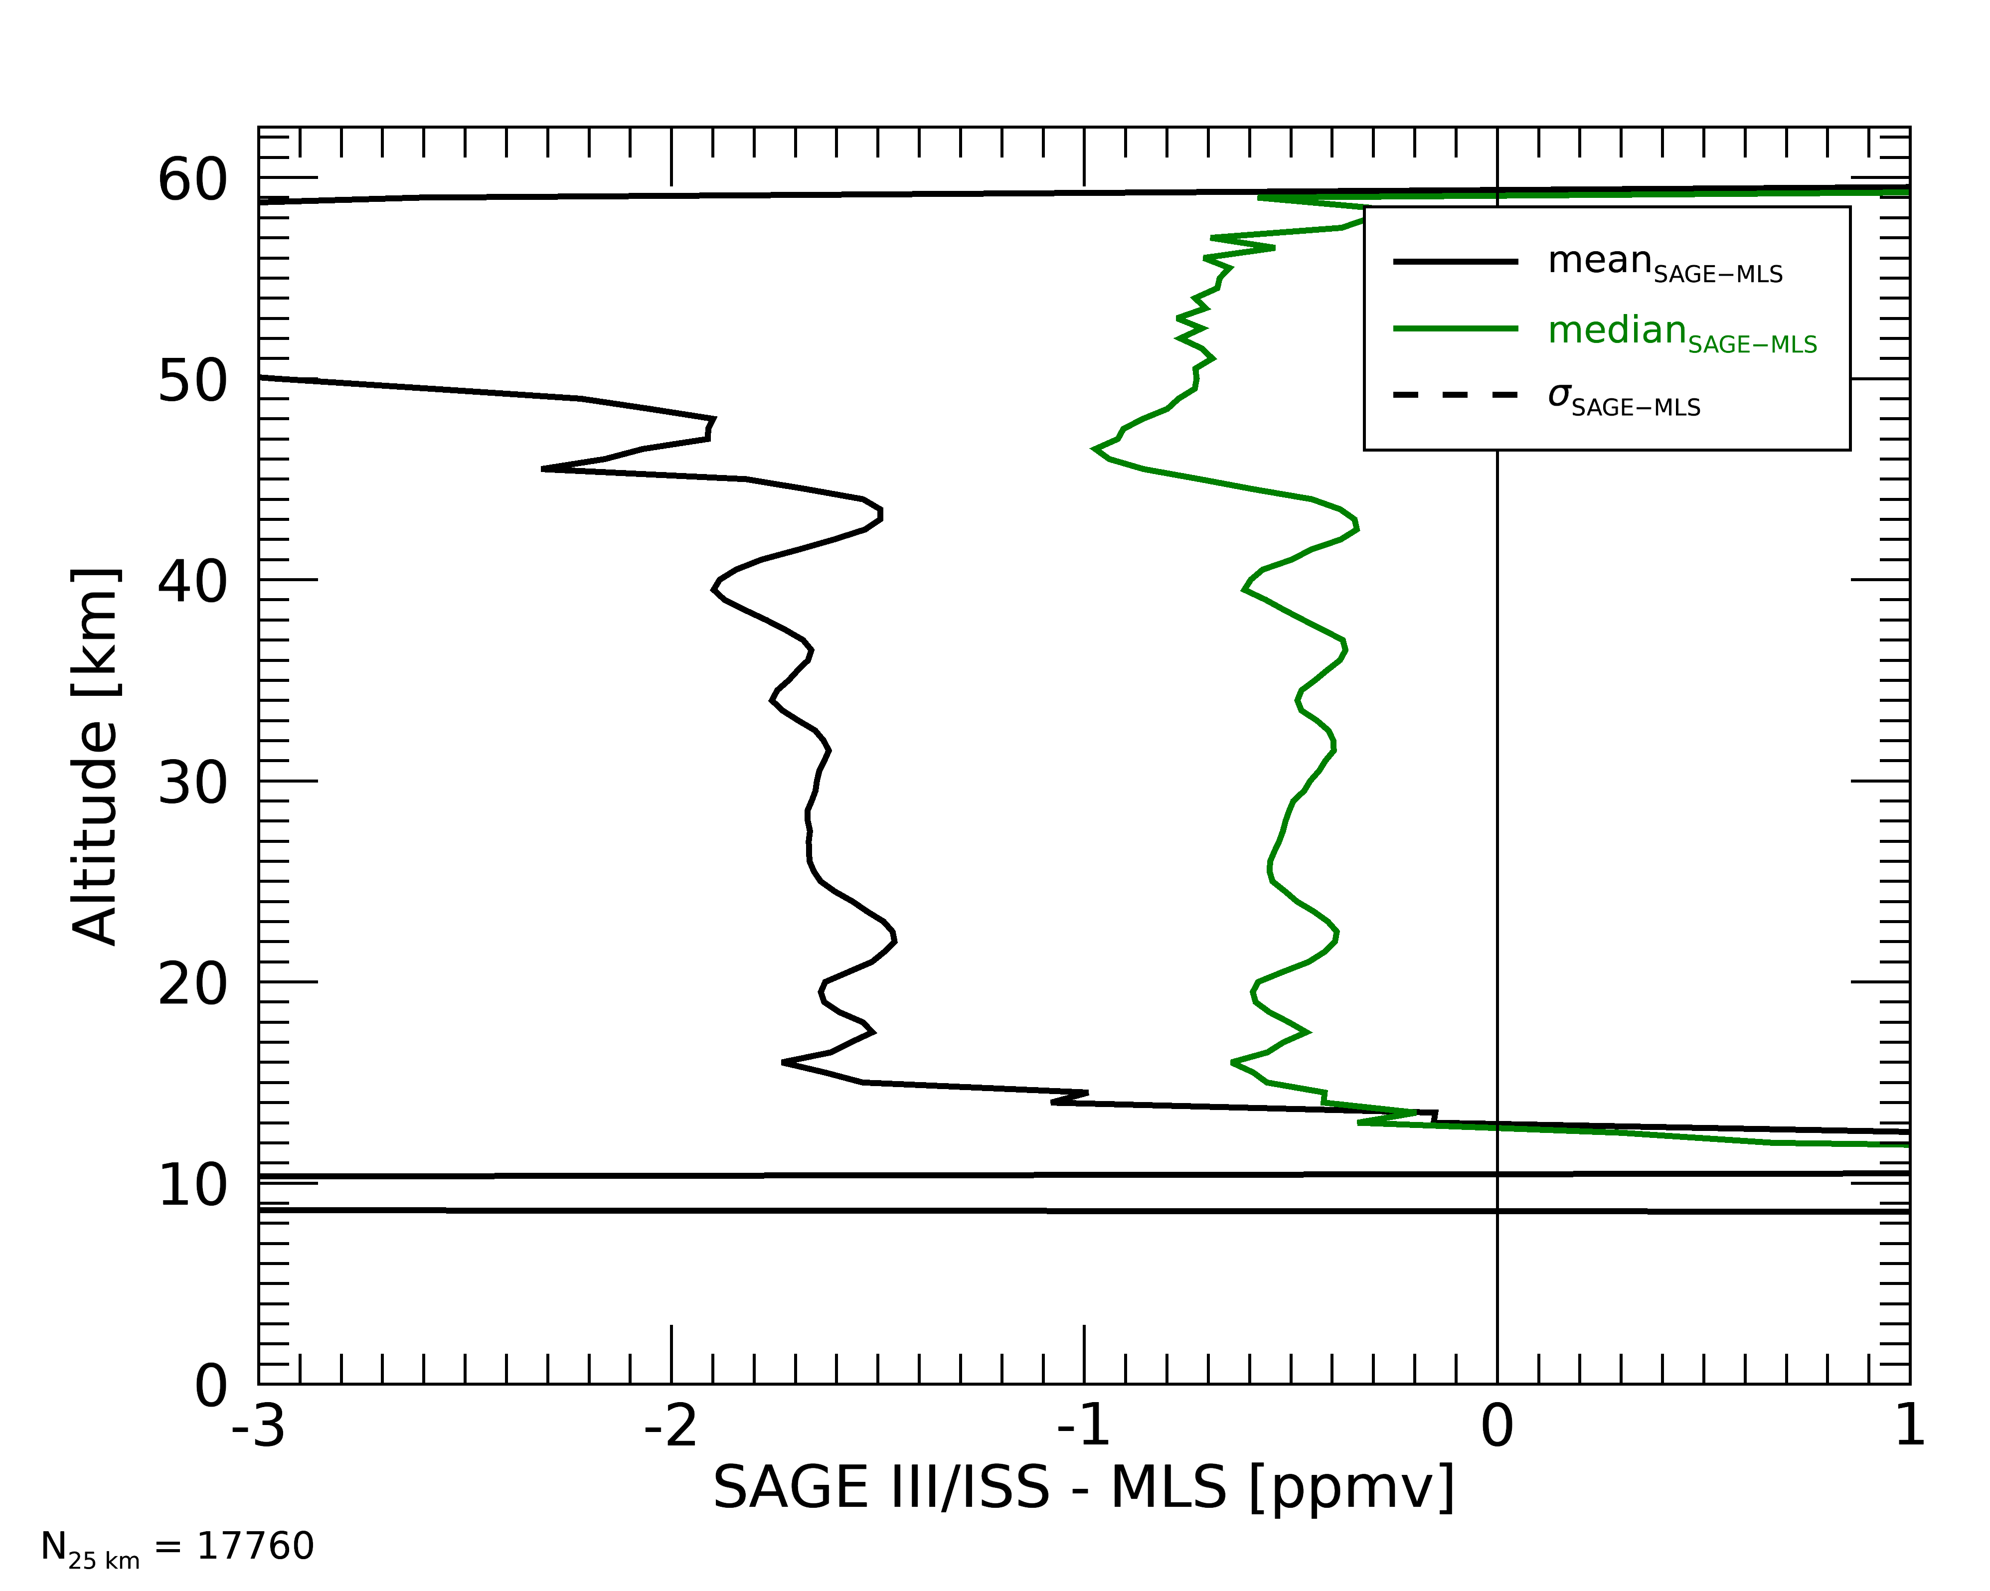
SAGE – MLS WV comparison: extinction threshold
Big difference between 2 x 10⁻⁴ km⁻¹ and others at ~15 – 19 km
Doesn’t remove negative outliers
2 x 10⁻⁴ km⁻¹
4 x 10⁻⁴ km⁻¹
1 x 10⁻³ km⁻¹

Slide 12
Color ratio filtering
There is a ‘minimum’ in data around 20 km, little data above 0.7

Slide 13
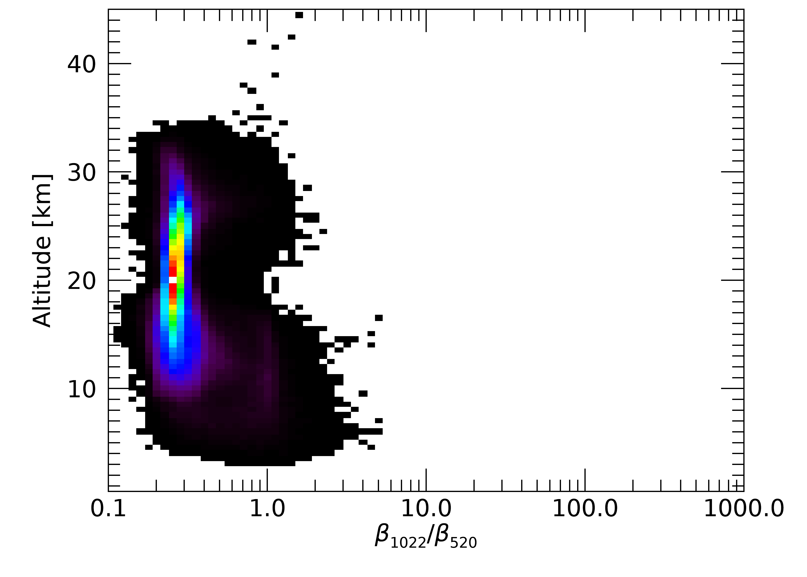
Color ratio filtering
There is a ‘minimum’ in data around 20 km, little data above 0.7
Removing cases where extinction uncertainty > 100% filters most outliers
Separate mode near ~1 in upper troposphere

Slide 14
SAGE – MLS WV comparison: color ratio threshold
Color ratios > 0.7 associated with outliers

Slide 15
SAGE – MLS WV comparison: color ratio threshold
Discarding points where color ratios > 0.7 does not remove many outliers

Slide 16
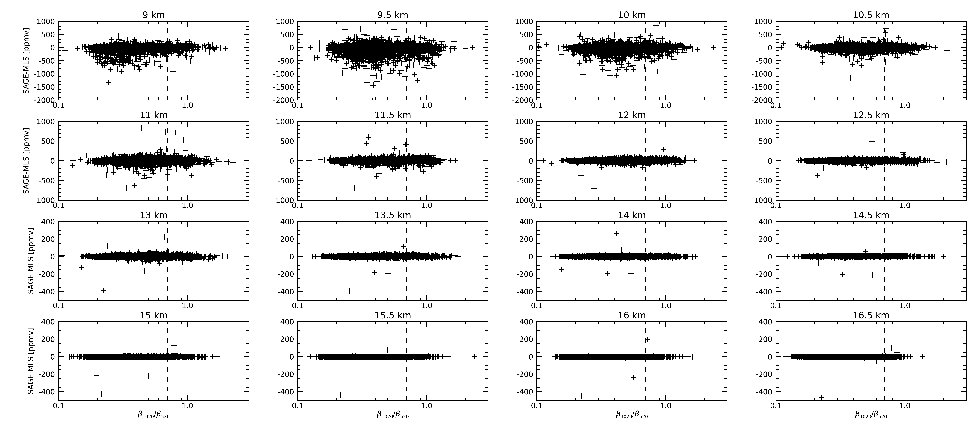
SAGE – MLS WV comparison: color ratio threshold
Discarding profile below where color ratios > 0.7 removes many outliers

Slide 17
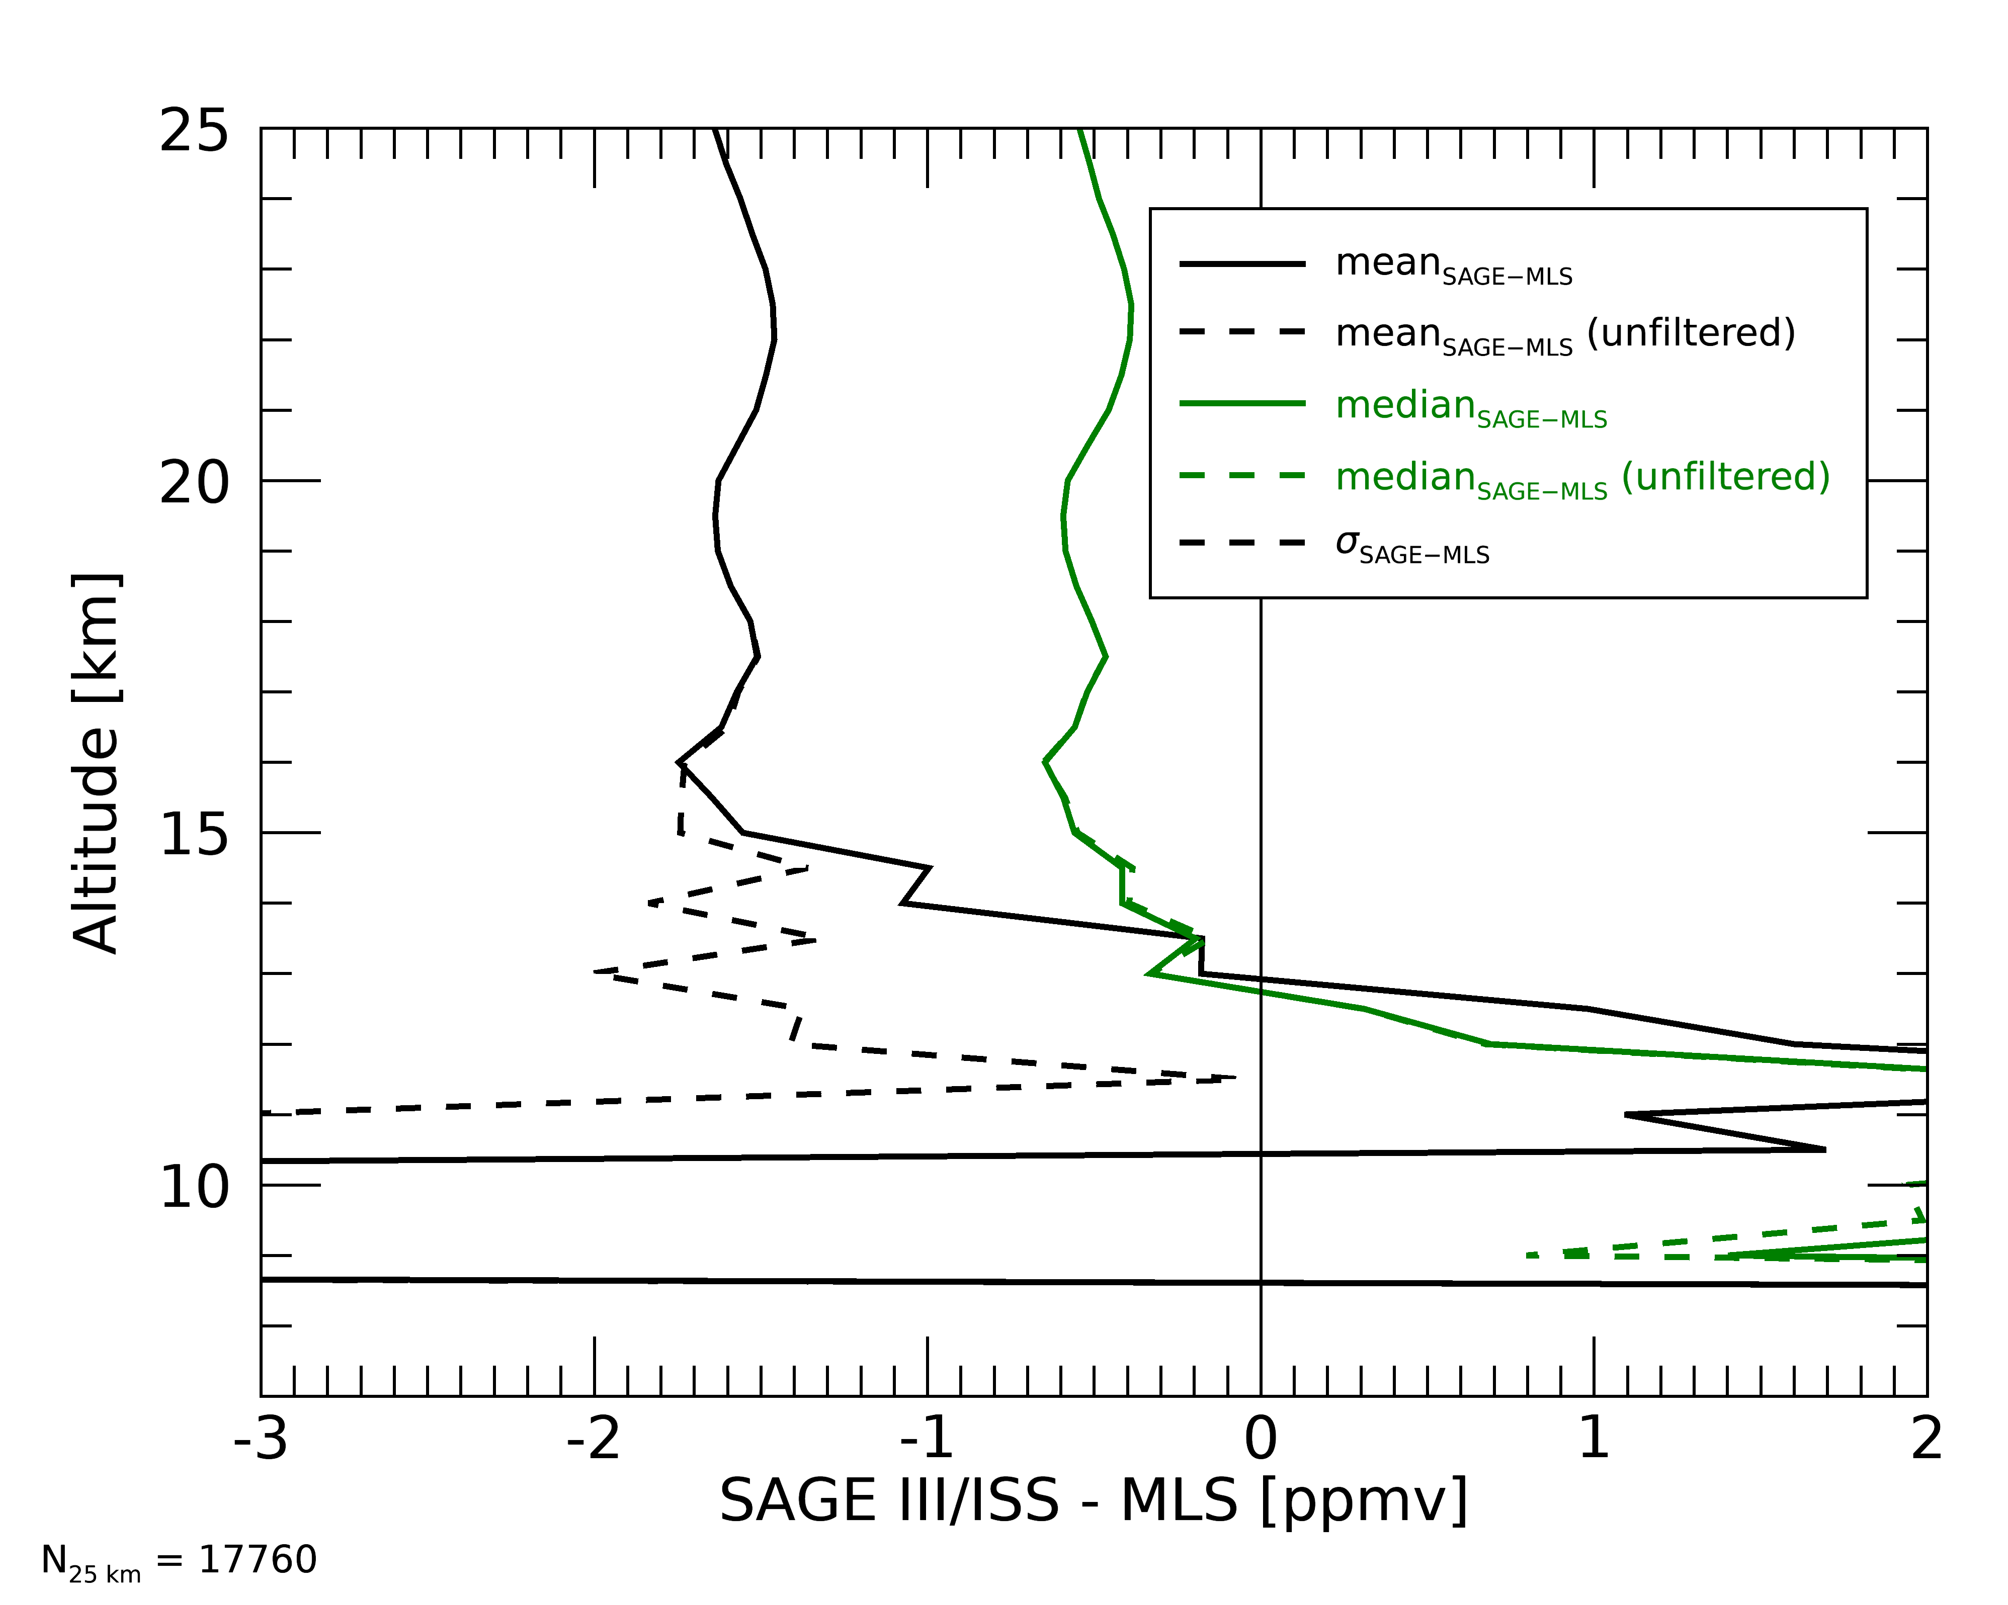
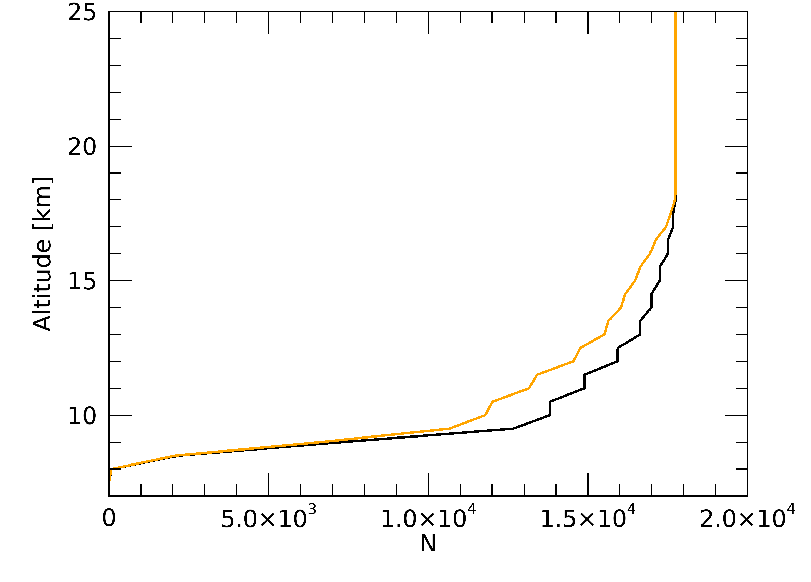
SAGE – MLS WV comparison: color ratio threshold
9% of data between 8 – 18 km removed
More consistent offset with MLS down to ~12 km

Slide 18
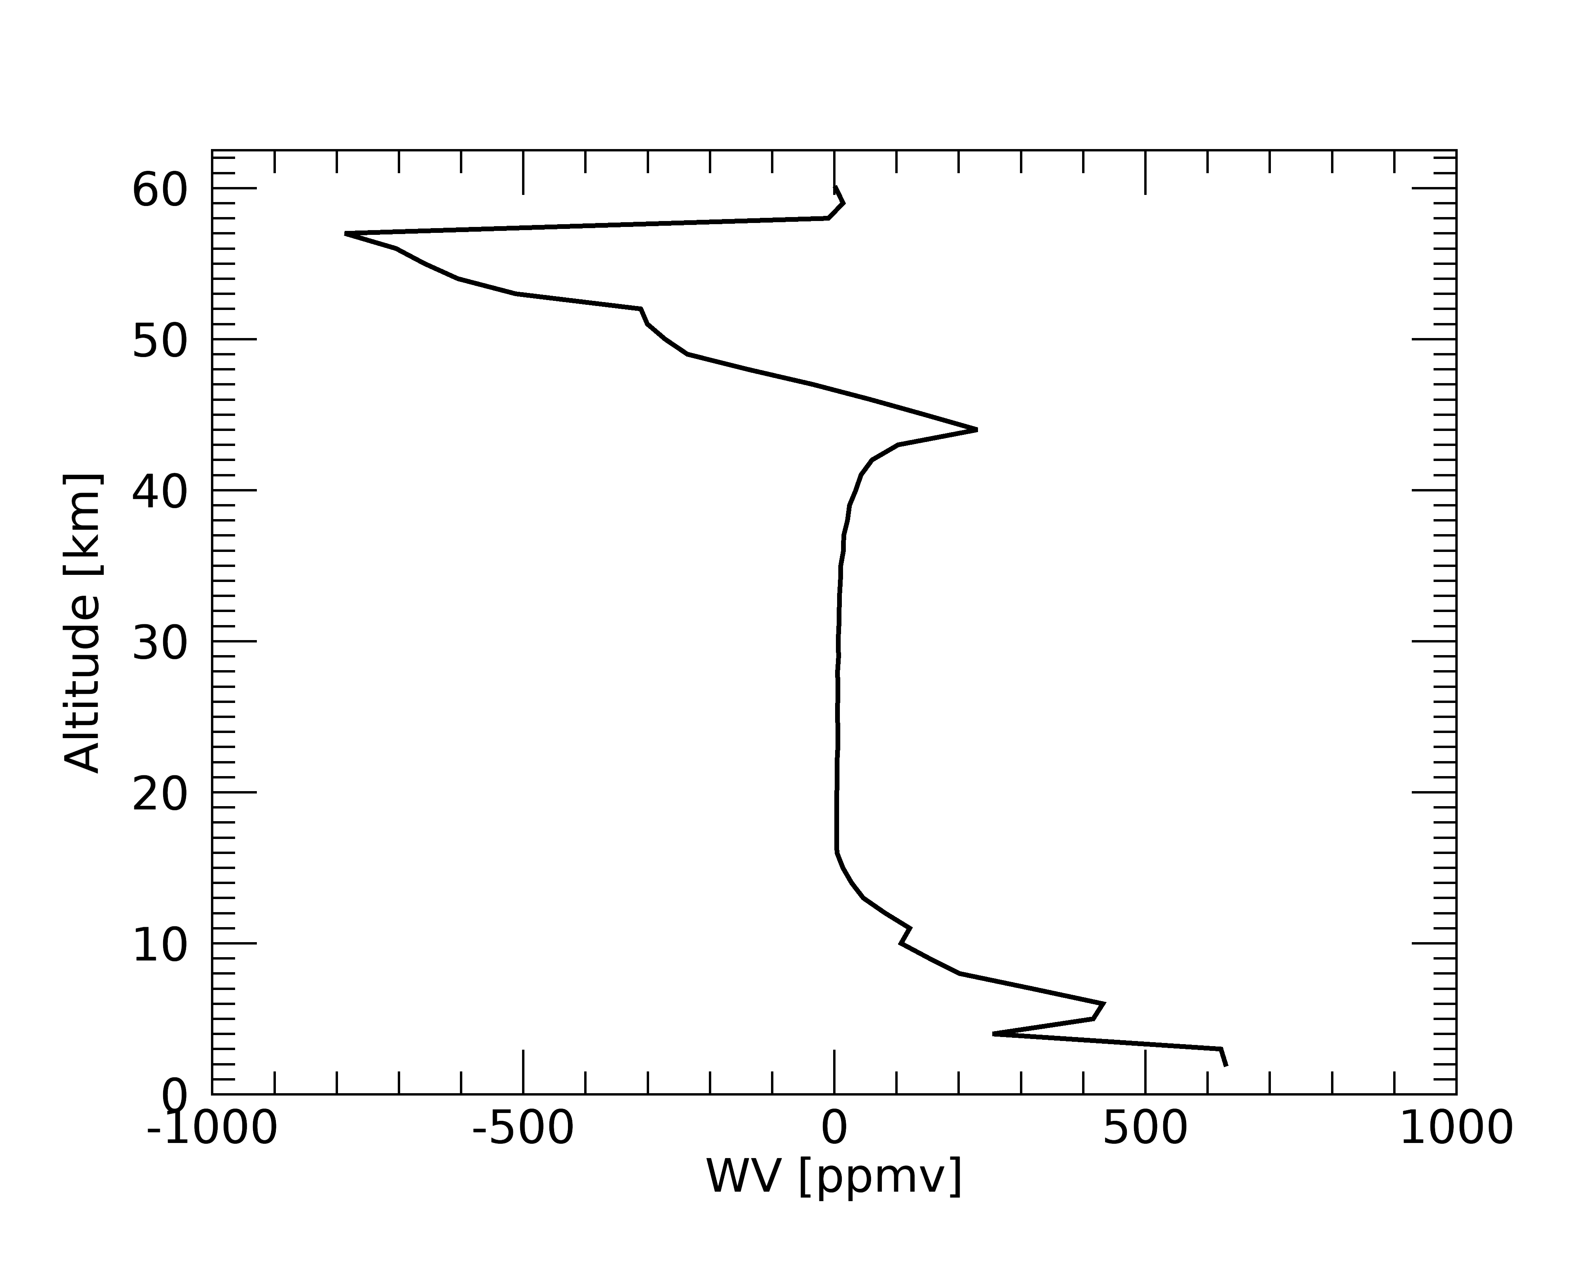
Keel over profiles
Profiles with abrupt jumps

Slide 19
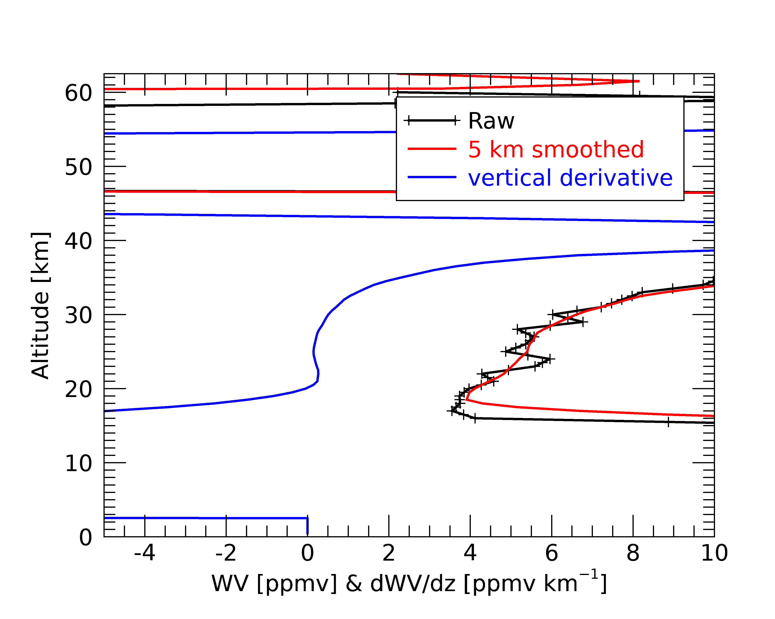
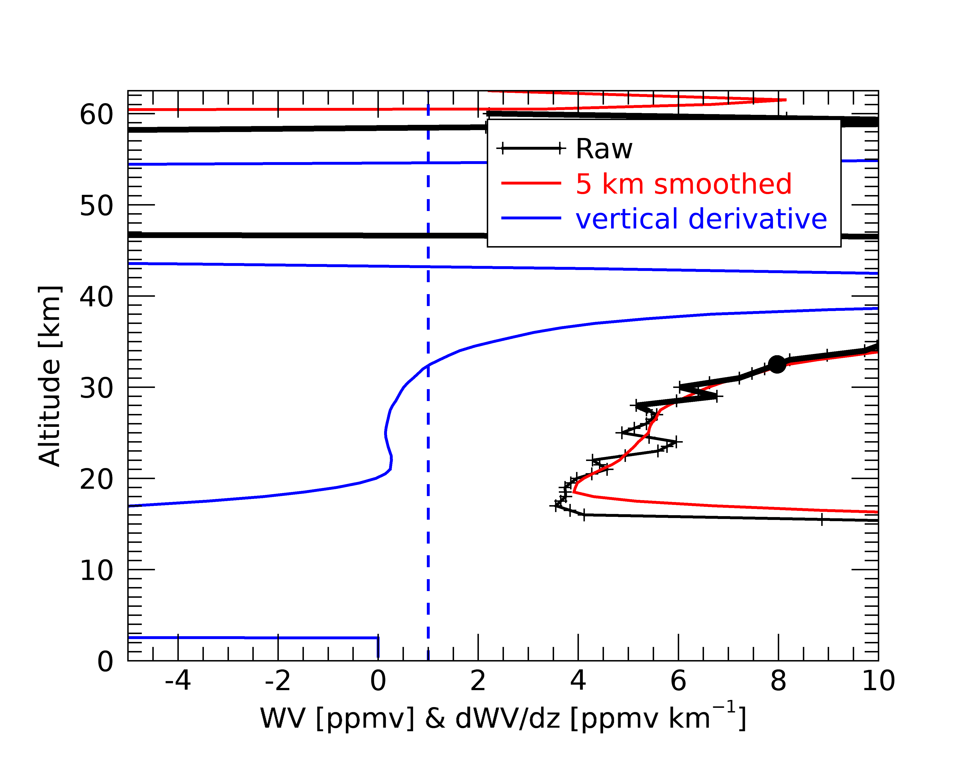
Keel over profiles
Profiles with abrupt jumps
Filtering based on vertical derivative
  Remove points from 5 km below where derivative exceeds 1 ppmv km⁻¹

Slide 20
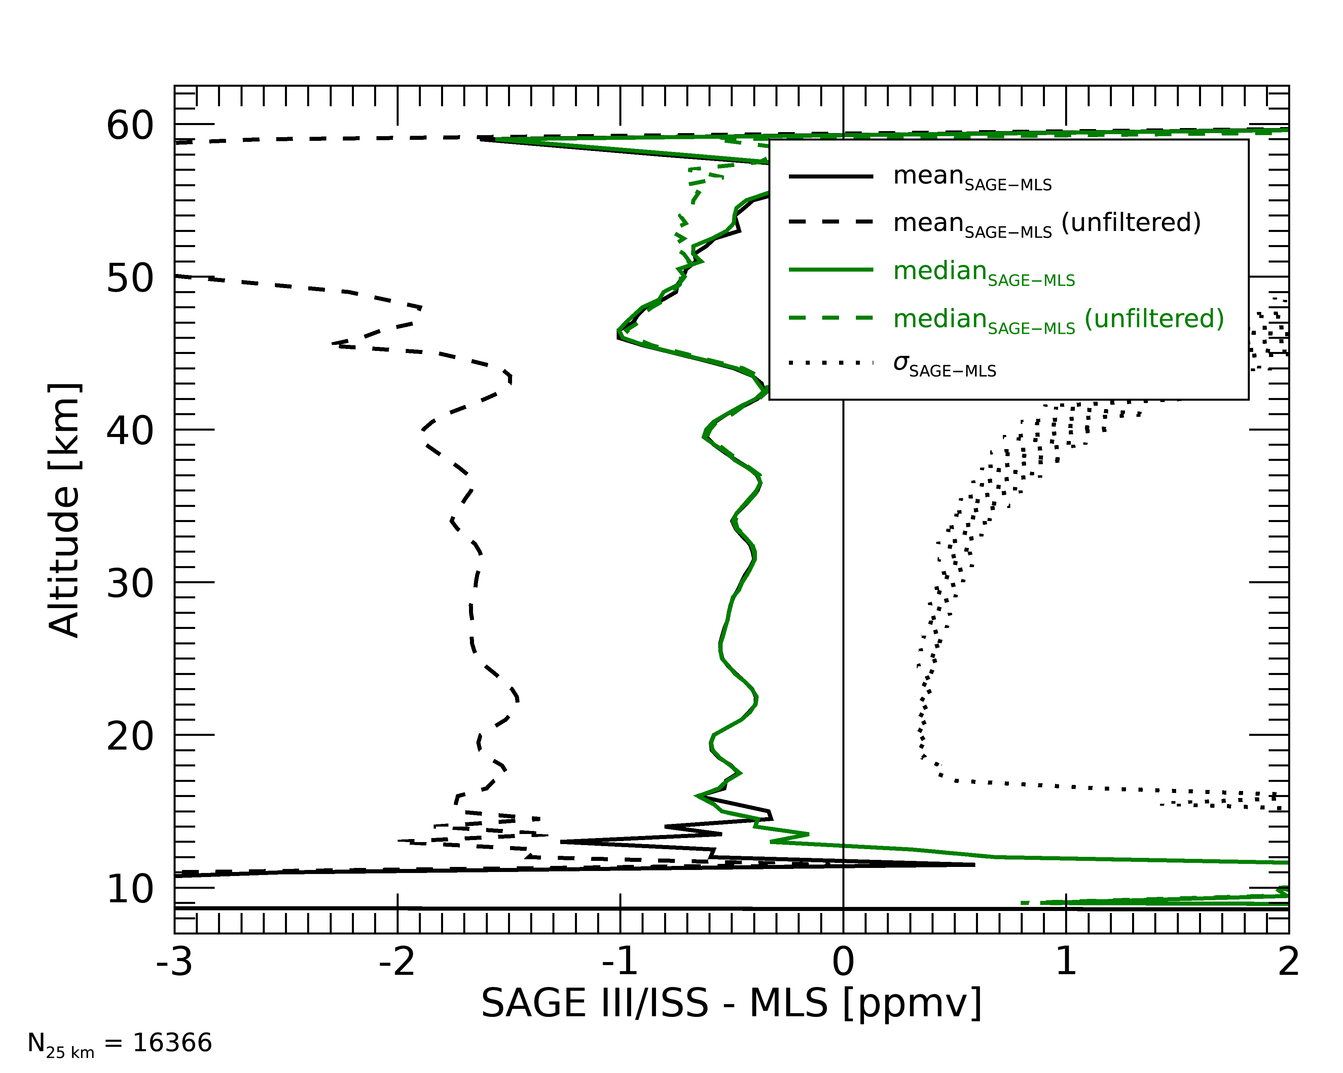
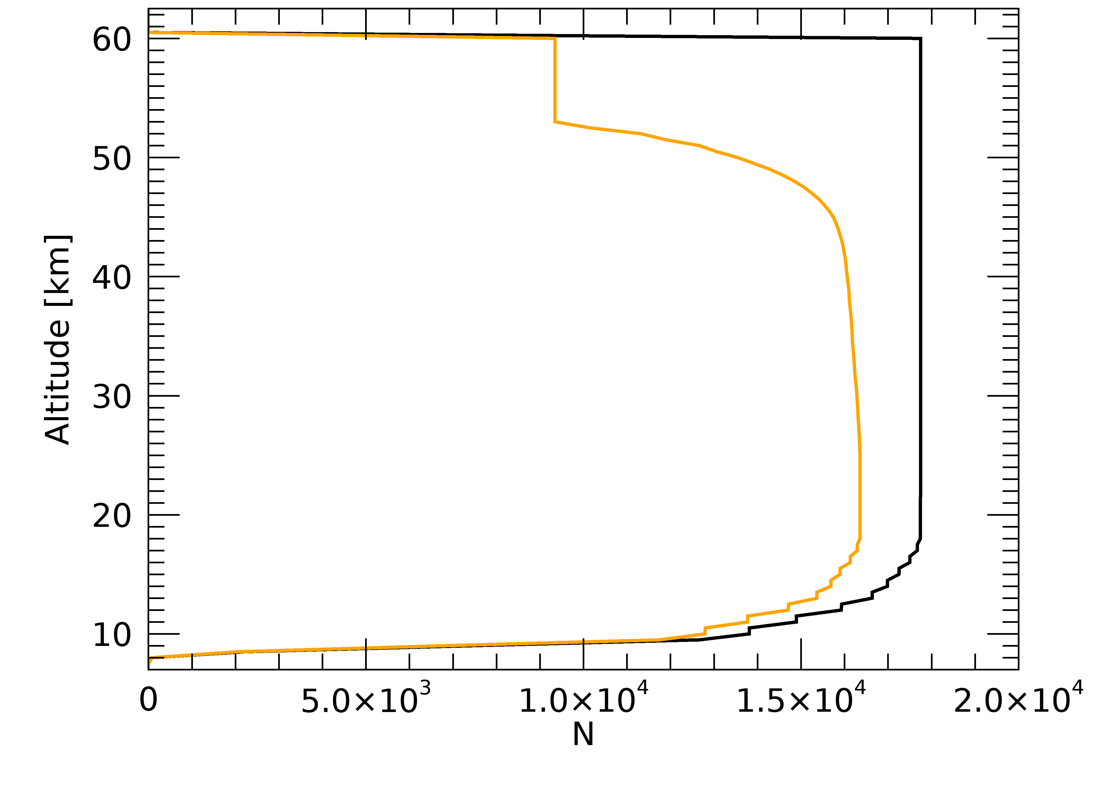
SAGE – MLS WV comparison: keel over filtering
11% of data between 20 – 50 km removed
Mean and median now agree. Std. deviation now “reasonable”

Slide 21
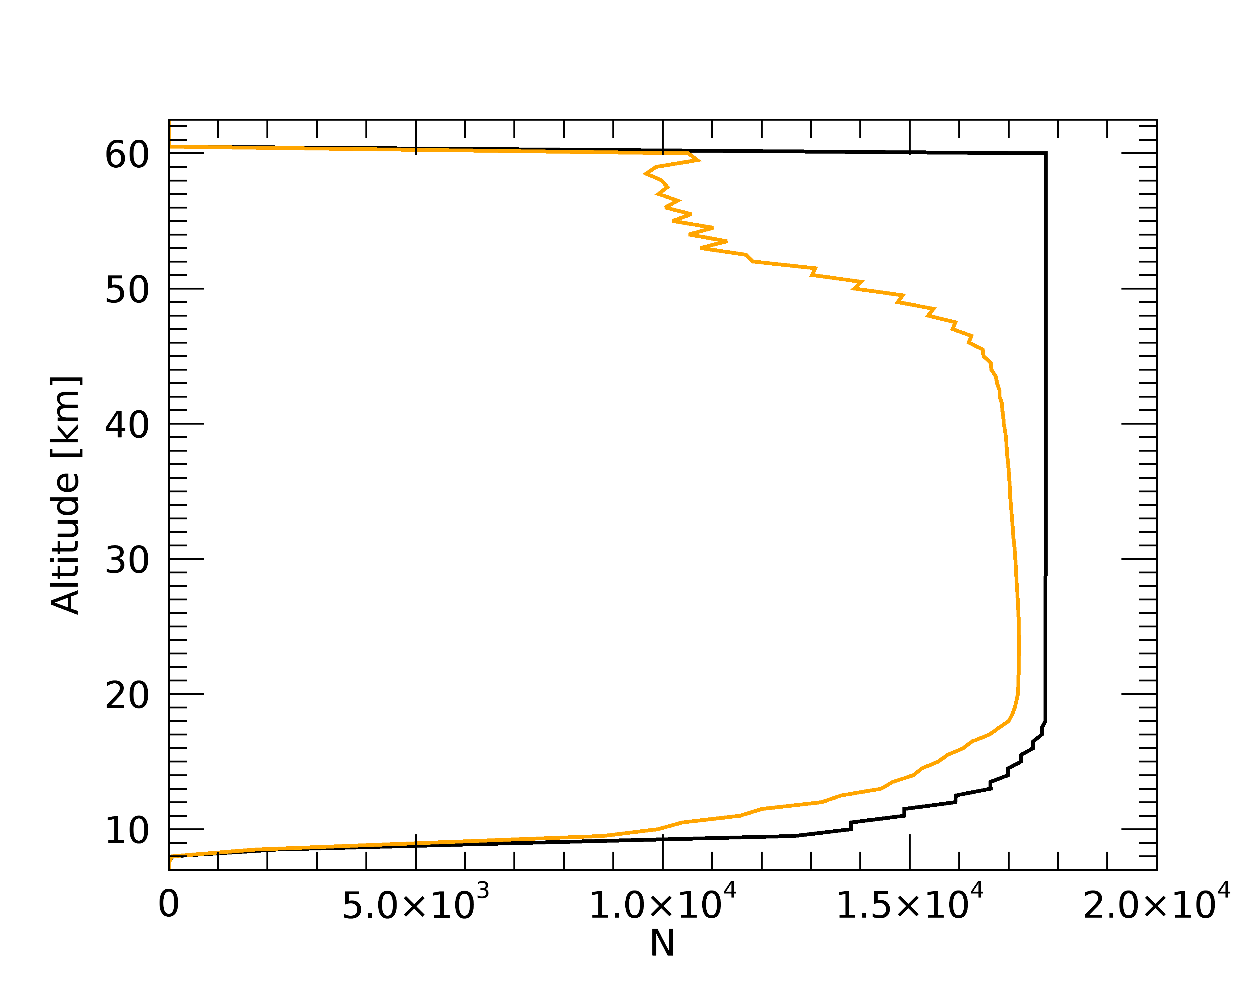
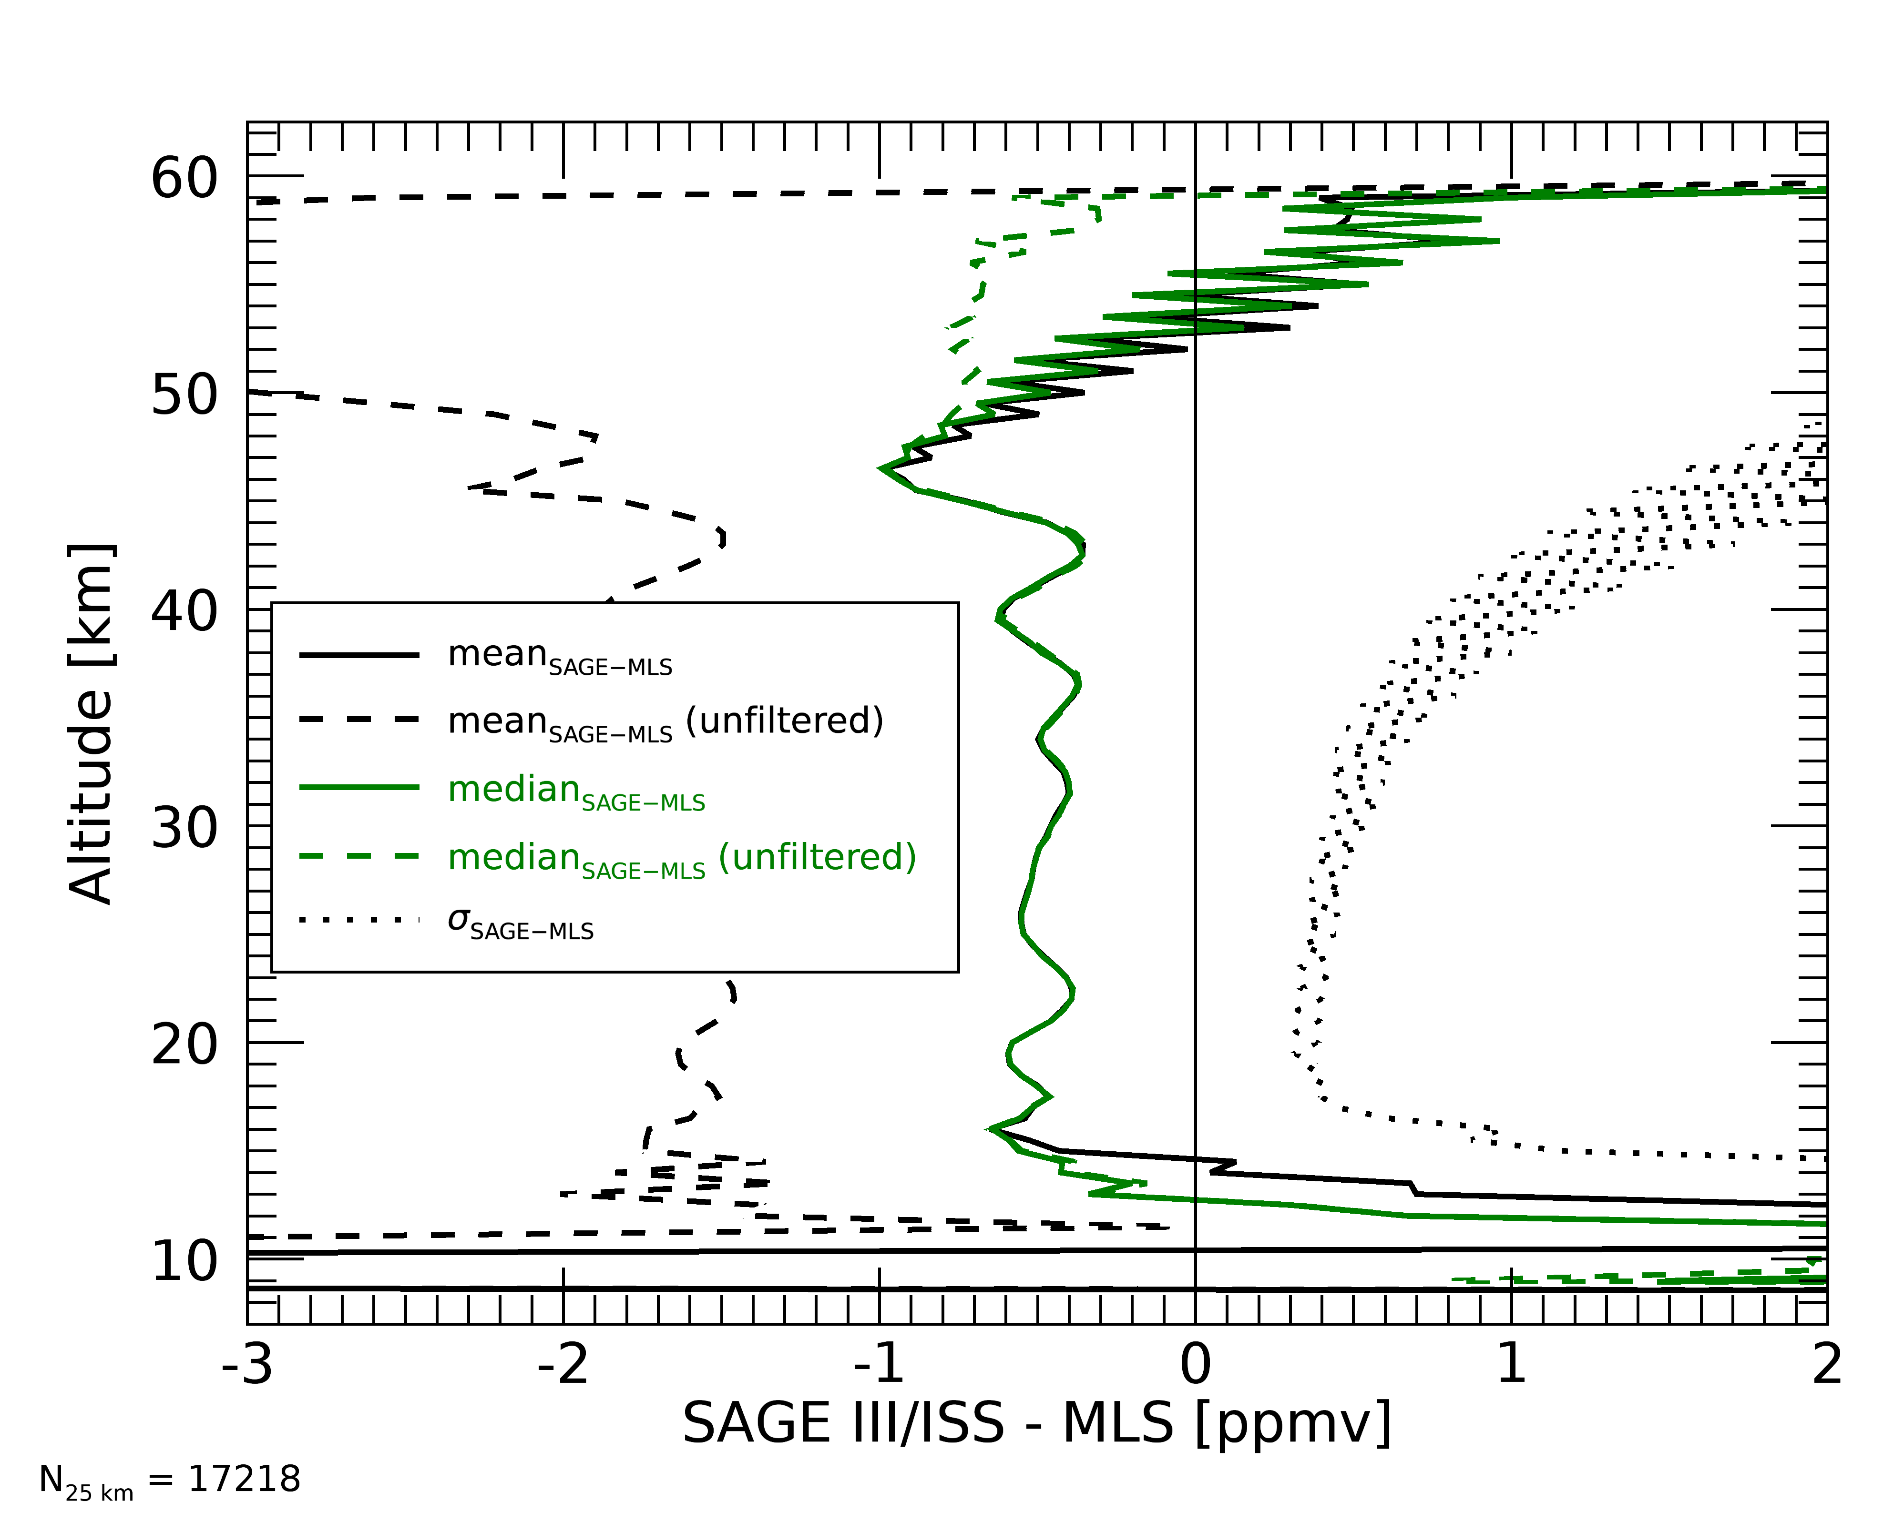
SAGE – MLS WV comparison: all filtering
300% uncertainty, 10⁻³ km⁻¹ aerosol, 0.7 color ratio, and keel-over removal
7% of data between 10 – 50 km removed

Slide 22
SAGE III/ISS v5.1 raw WV profiles

Slide 23
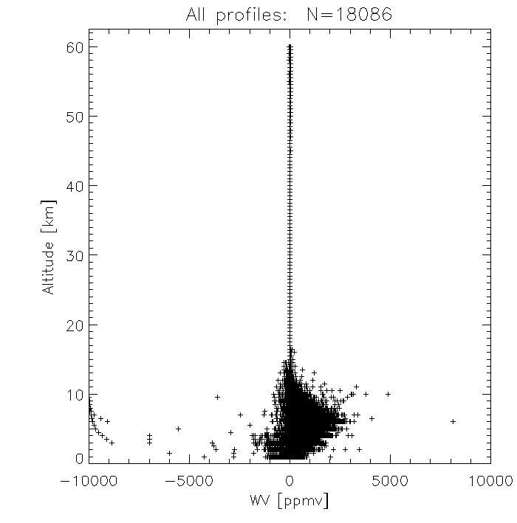
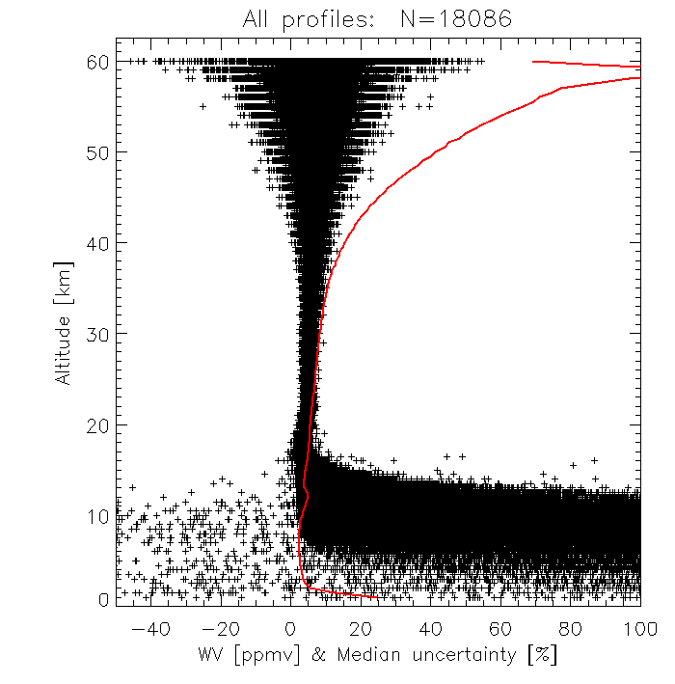
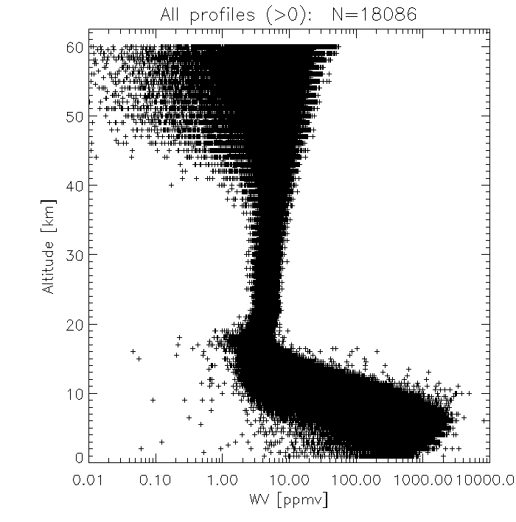
SAGE III/ISS v5.1 filtered WV profiles

Slide 24
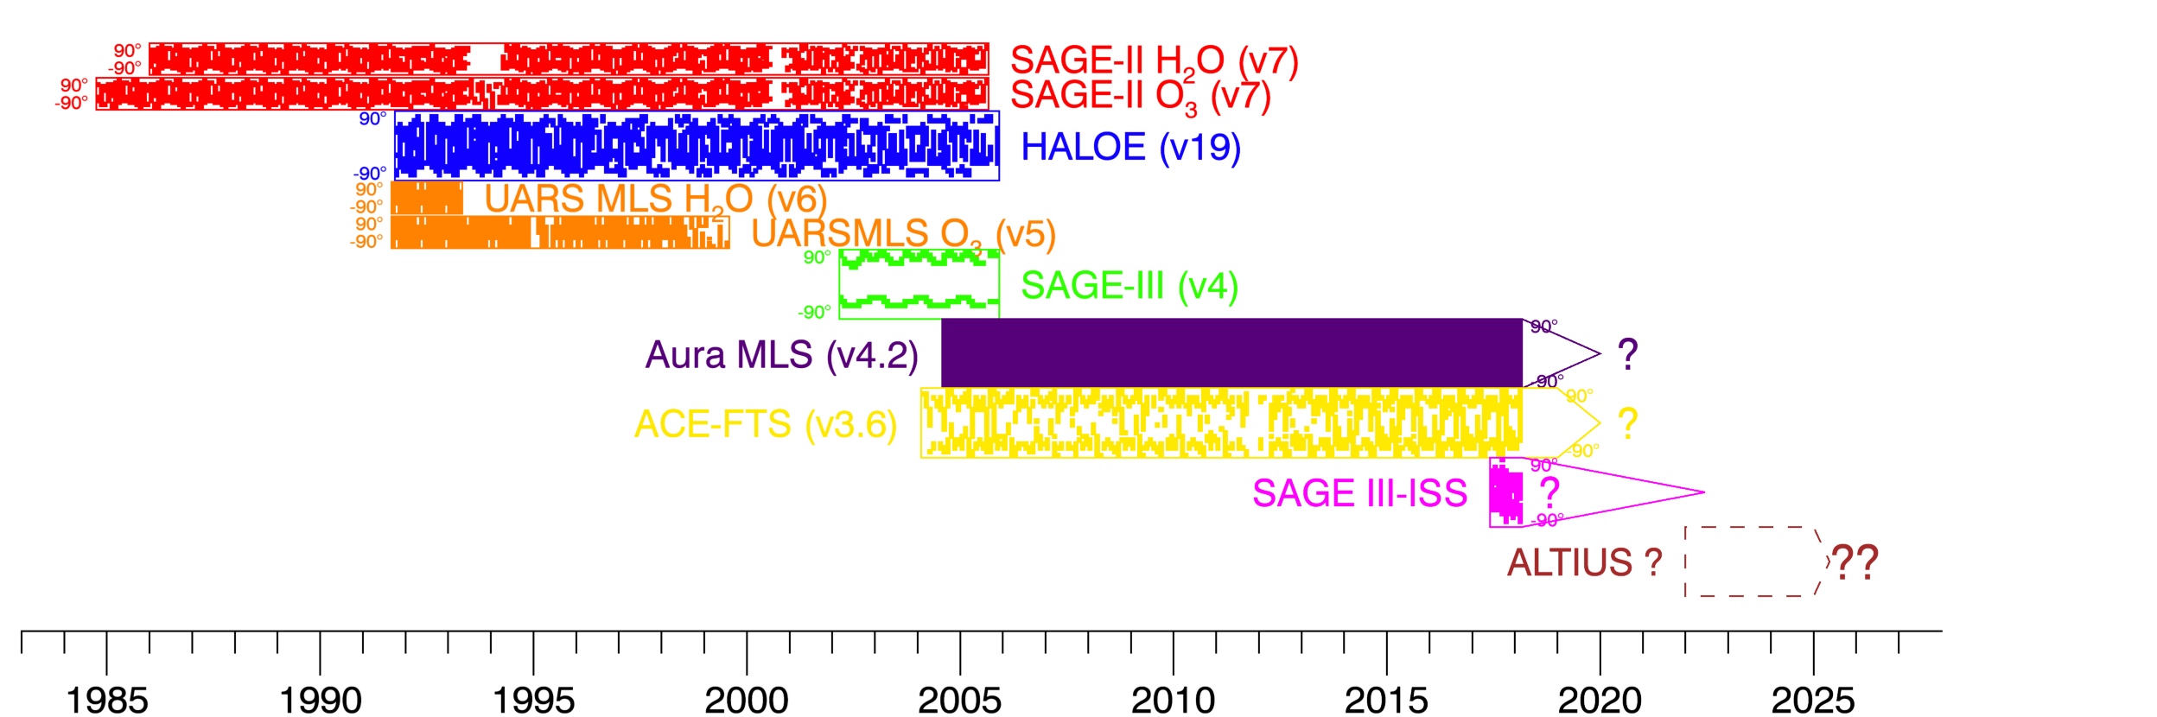
SWOOSH: The Stratospheric Water and Ozone Satellite Homogenized database
SWOOSH is …
  … vertically resolved
  … horizontally gridded
  … monthly-mean H₂O and O₃
  ... from satellite limb profilers
SWOOSH contains …
  … a merged data record
  … individual instrument records
  … multiple horizontal and vertical grids
    Zonal mean, equivalent latitude, pressure, isentropic
Current release is v2.6 https://www.esrl.noaa.gov/csd/swoosh/
SAGE III/ISS included in v2.7 beta release via FTP
  ftpshare.al.noaa.gov
  User: swoosh
  Password: Hal0$age
Adapted from Davis et al., Earth Syst. Sci. Data, 2016

Slide 25
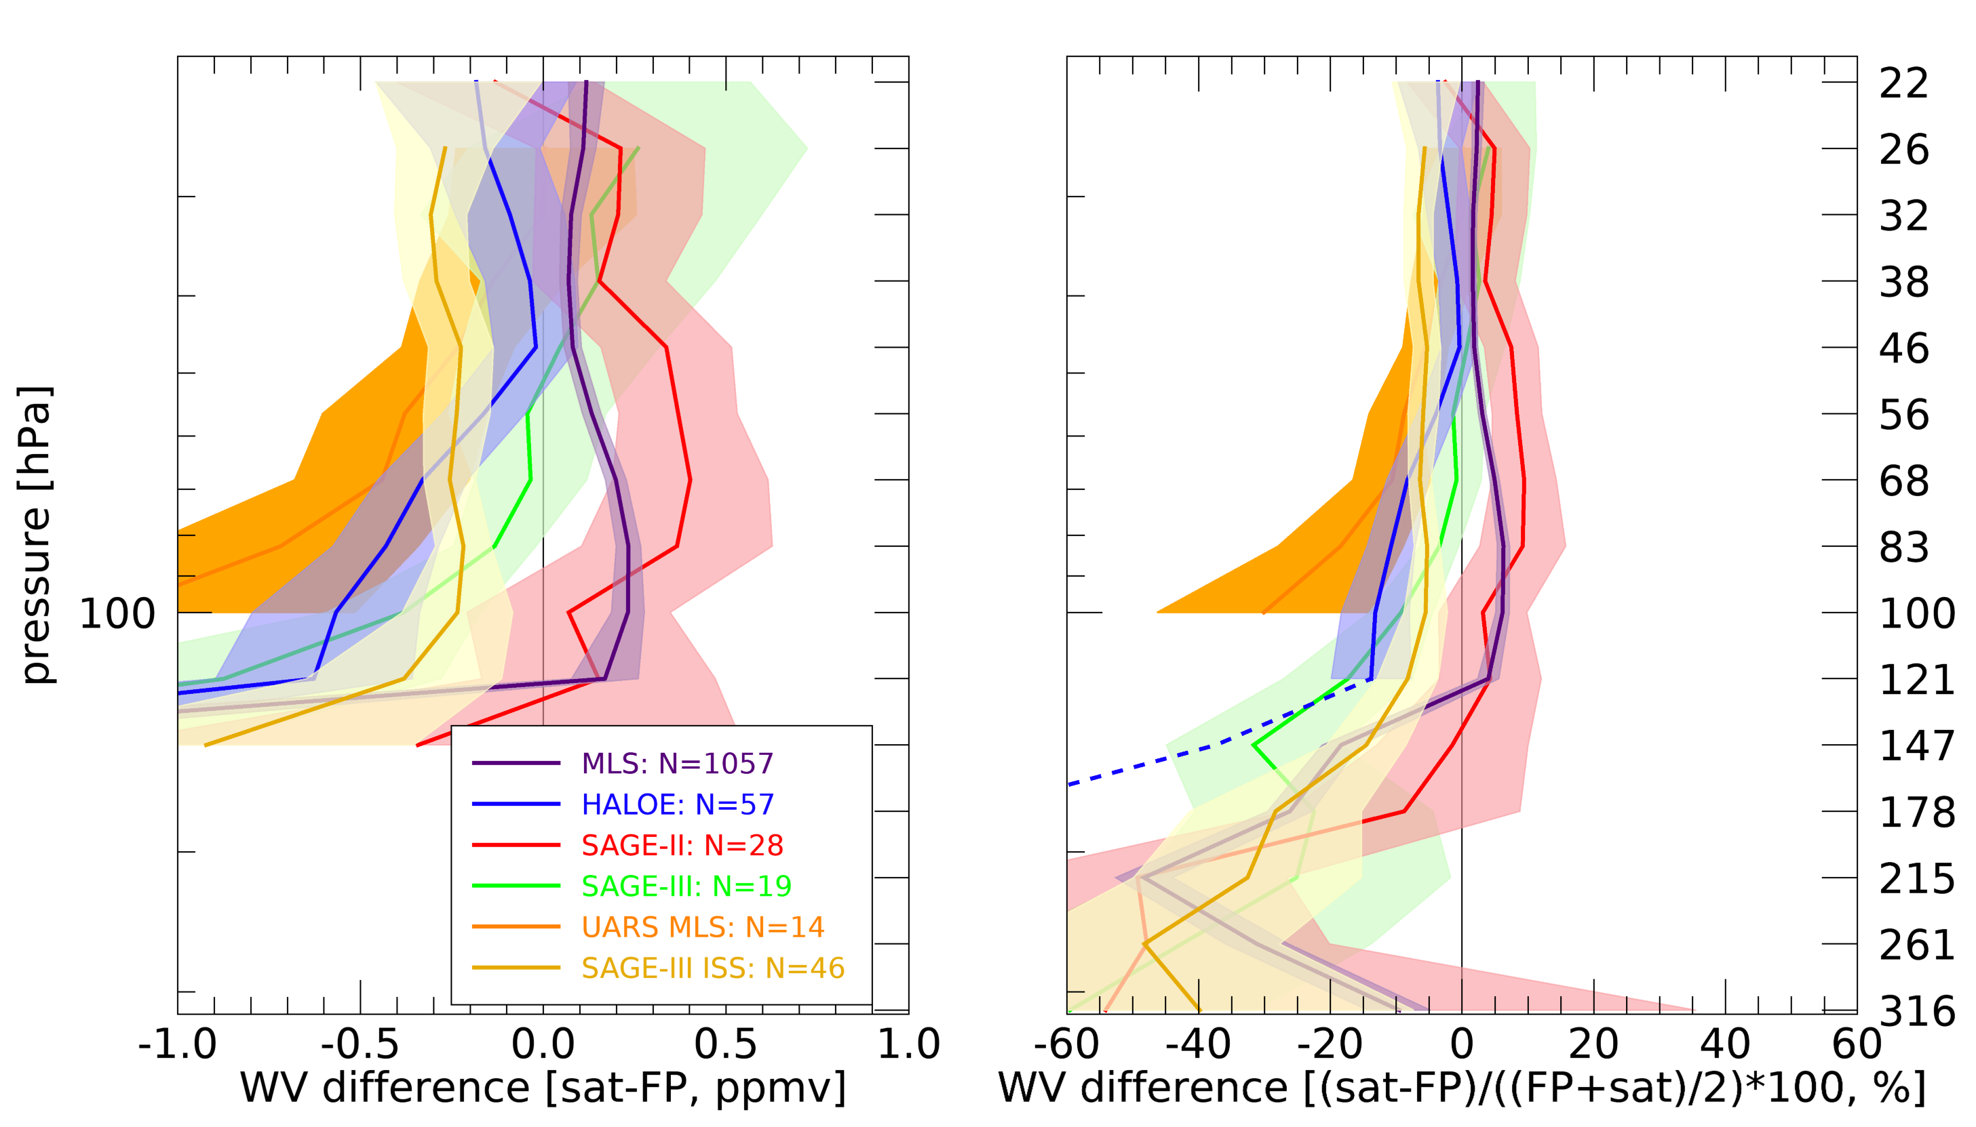
SAGE III/ISS – frostpoint coincident profile comparison

Slide 26
Conclusions
SAGE III / ISS WV data require significant filtering, but we have a decent set of criteria to QC the data
  Color ratio filtering to remove clouds
  Keel-over profile filtering removes most large outliers
SAGE III / ISS WV shows a ~ 10% (0.3 - 0.5 ppmv) dry bias relative to MLS and FP balloon measurements

