Slide 1
A Multi-instrument View of Upper Atmospheric Aerosol
Kevin Leavor
SAGE III/ISS Validation Scientist

Slide 2
Overview
Instrument Datasets Used
Analysis Methodology
Zonal Analysis of Aerosol Extinction Coefficient
Recent Stratospheric Heterogeneity
Viability of Dataset Fusion
Notes:
Slides 2-7 are a overview and refresher from last years science team meeting

Slide 3
Instrument Datasets Used
SAGE III/ISS
  Stratospheric Aerosol and Gas Experiment III
  9 Aerosol Extinction Coefficient Wavelengths covering from 384nm to 1544nm
  Solar Occultation with 0.5km reported vertical resolution
  Platform: International Space Station (ISS)
OMPS-LP
  Ozone Mapping and Profiler Suite Limb Profiler
  675nm Aerosol Extinction Coefficient with supplied cloud filtering algorithm
  Limb scattering with 1km reported vertical resolution
  Platform: Suomi National Polar-orbiting Partnership (Suomi-NPP)

Slide 4
Instrument Datasets Used
OMPS-NM
  Ozone Mapping and Profiler Suite Nadir Mapper
  UV Aerosol Index (UVAI) generated from 340nm and 378.5nm ratio
  Nadir-viewing Spectrometer
  Platform: Suomi National Polar-orbiting Partnership (Suomi-NPP)
CALIOP
  Cloud-Aerosol Lidar with Orthogonal Polarization
  532nm, 1064nm, and 532nm ⊥ polarization attenuated backscatter
  Elastic backscatter lidar with reporting at variable vertical resolution
  Platform: Cloud-Aerosol Lidar and Infrared Pathfinding Satellite Observation (CALIPSO)

Slide 5
Analysis Methodology
Binning
  SAGE III/ISS is binned to 4° Latitude bins with a temporal frequency of 1 month
  OMPS-LP is binned to 1° Latitude bins with a temporal frequency of 1 week
  OMPS-NM is binned to 2°×2° with a temporal frequency of 1 day
Averaging
  Weighted averages have been used for vertical profile data.
  Weights are calculated using inverse variance (1/σ²)
  OMPS-NM UVAI values are averaged into bins with no additional weighting
Dataset Considerations
  Unfiltered Aerosol Extinction Coefficient is used for OMPS-LP for direct comparison with SAGE III/ISS and in consideration of significant aerosol loading events from both volcanic and pyrocumulus sources

Slide 6
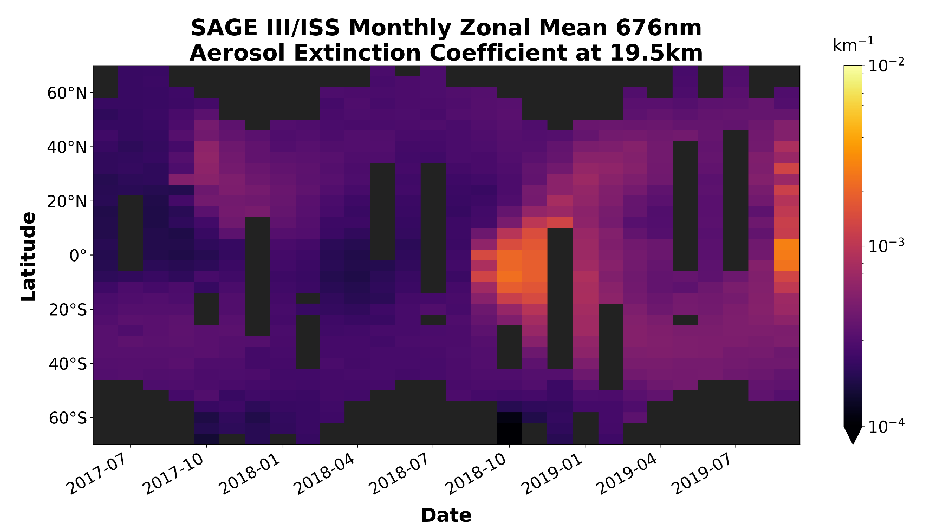
Zonal Analysis –
Latitude Distribution Time Series

Slide 7
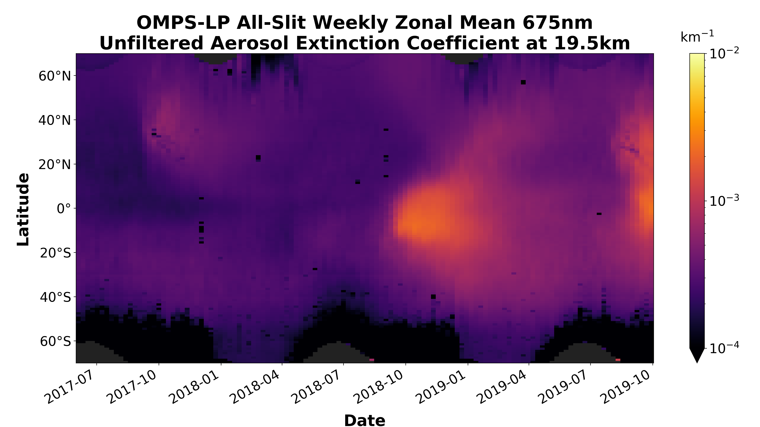
Zonal Analysis –
Latitude Distribution Time Series

Slide 8
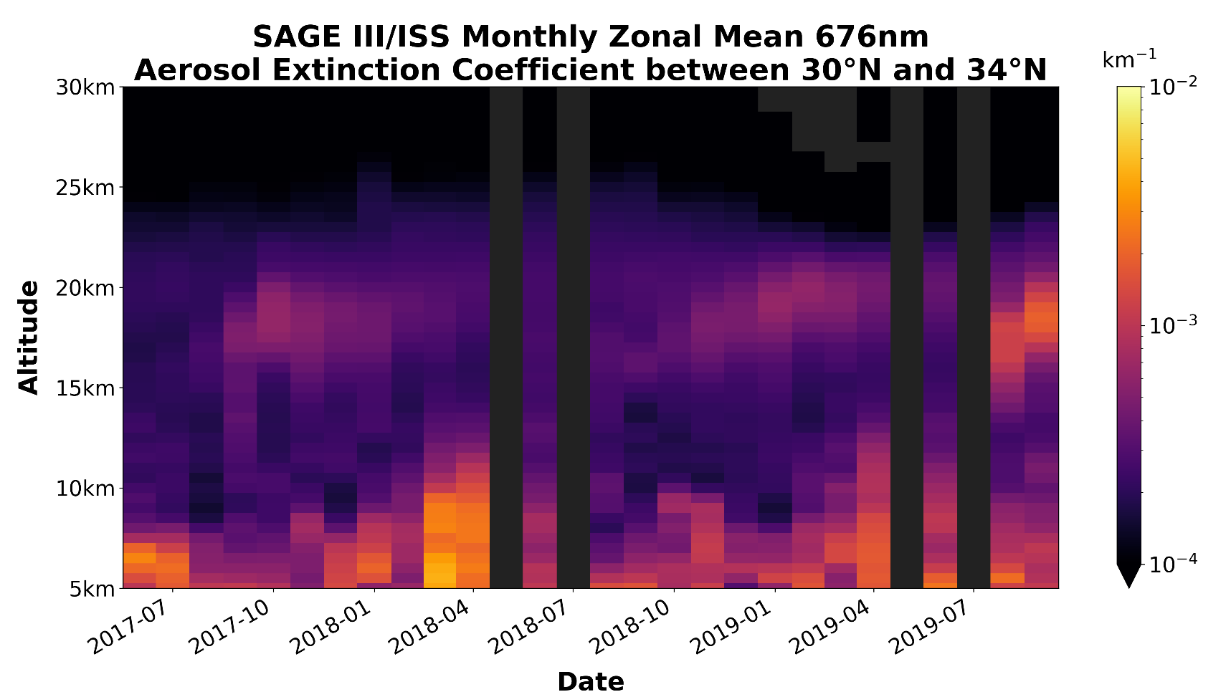
Zonal Analysis –
Altitude Distribution Time Series

Slide 9
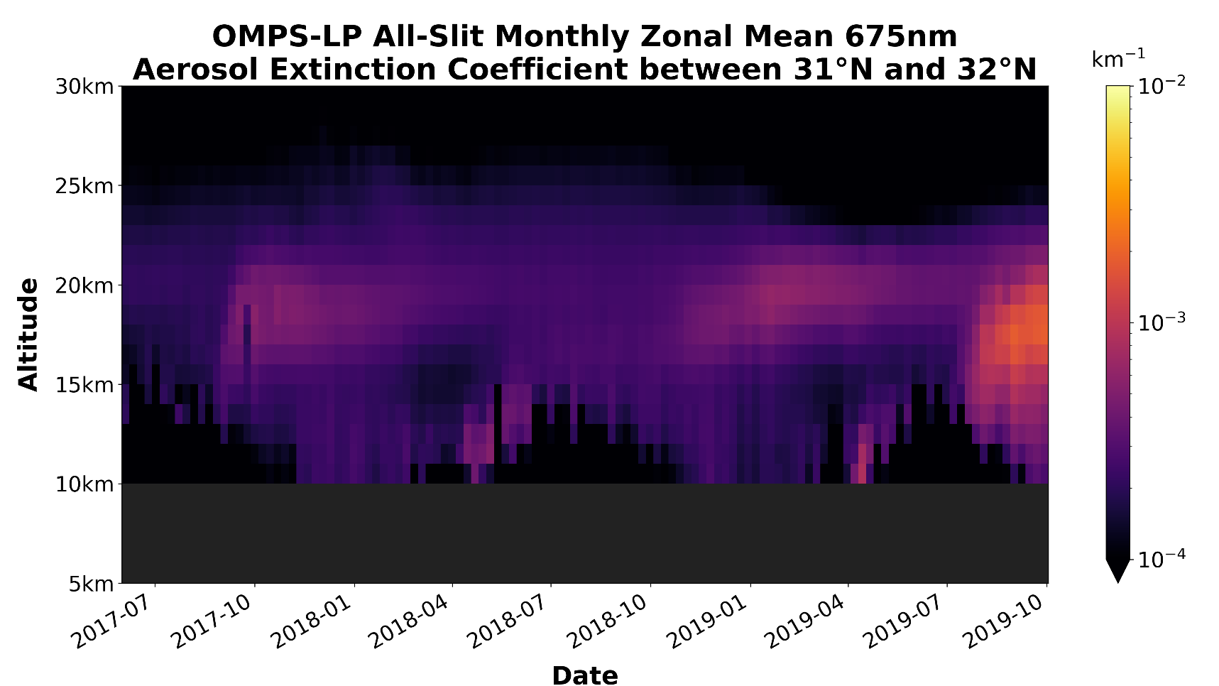
Zonal Analysis –
Altitude Distribution Time Series

Slide 10
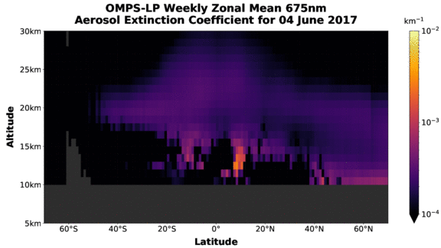
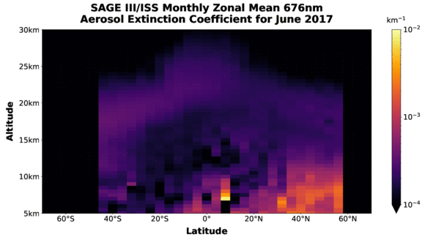
Zonal Analysis –
Spatial Distribution Time Series

Slide 11
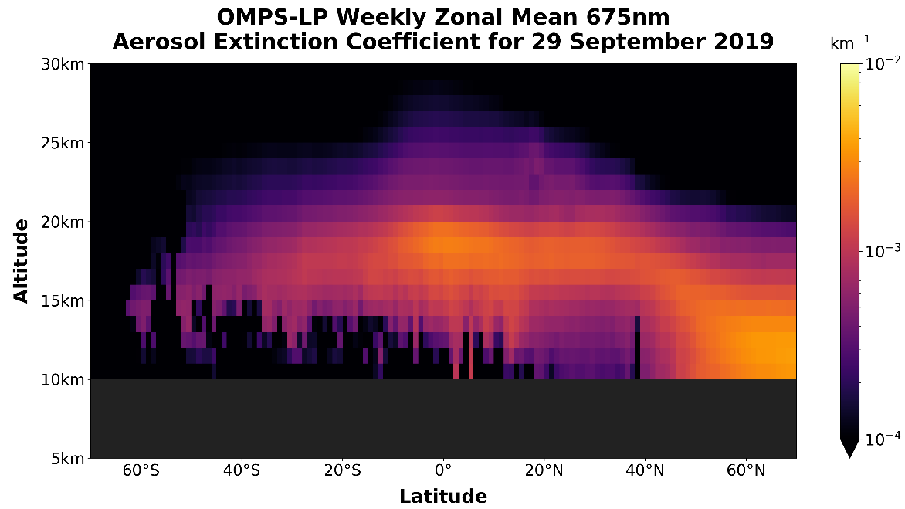
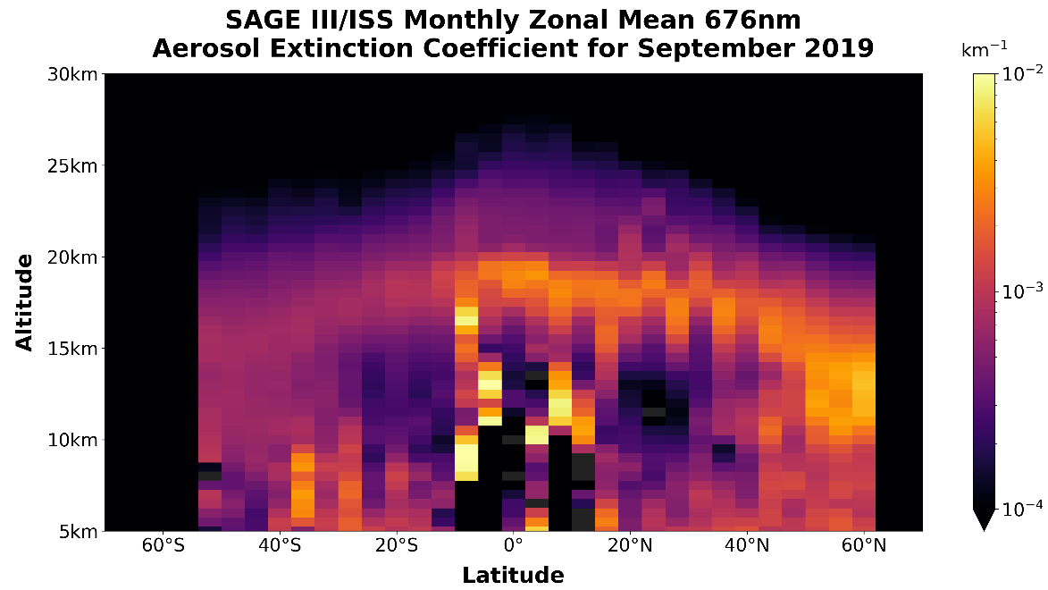
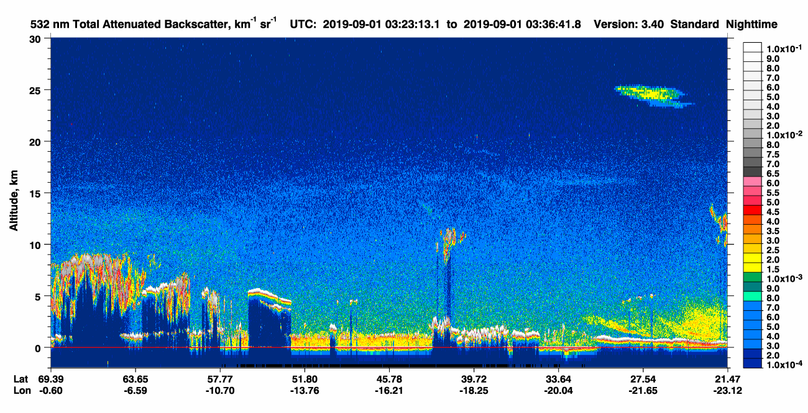
Composition, Heterogeneity, and 2019

Slide 12
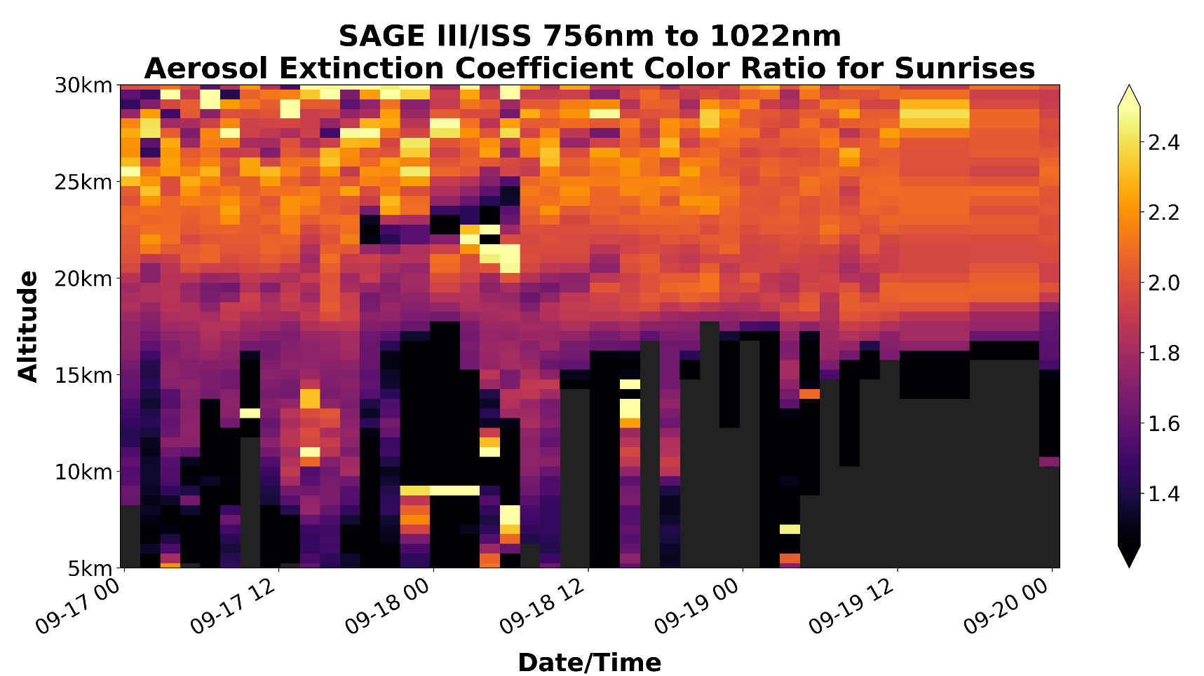
Composition, Heterogeneity, and 2019

Slide 13
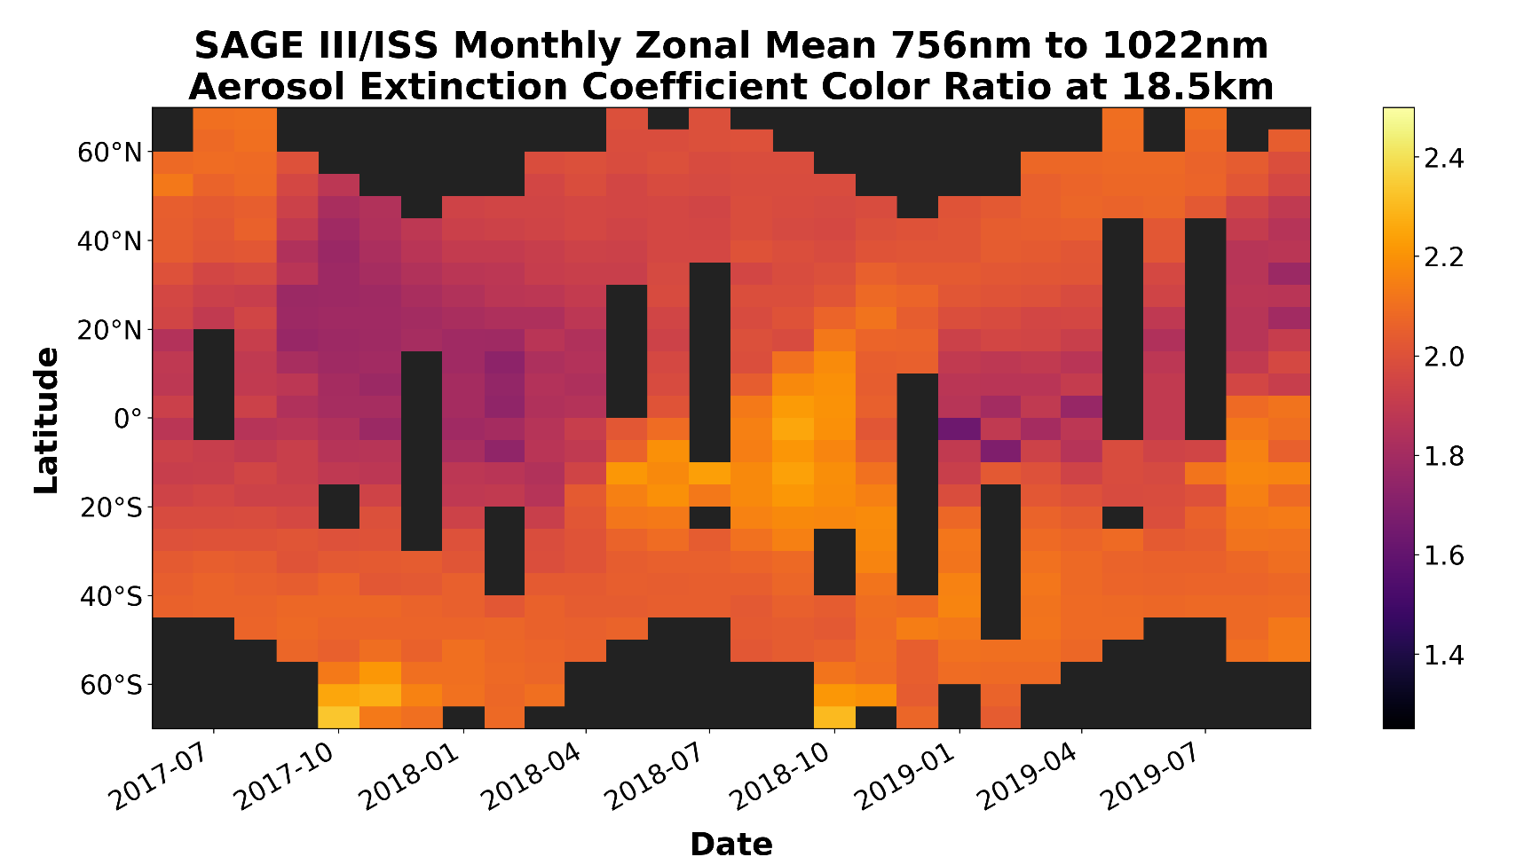
Composition, Heterogeneity, and 2019
Larger
Particles
Smaller
Particles

Slide 14
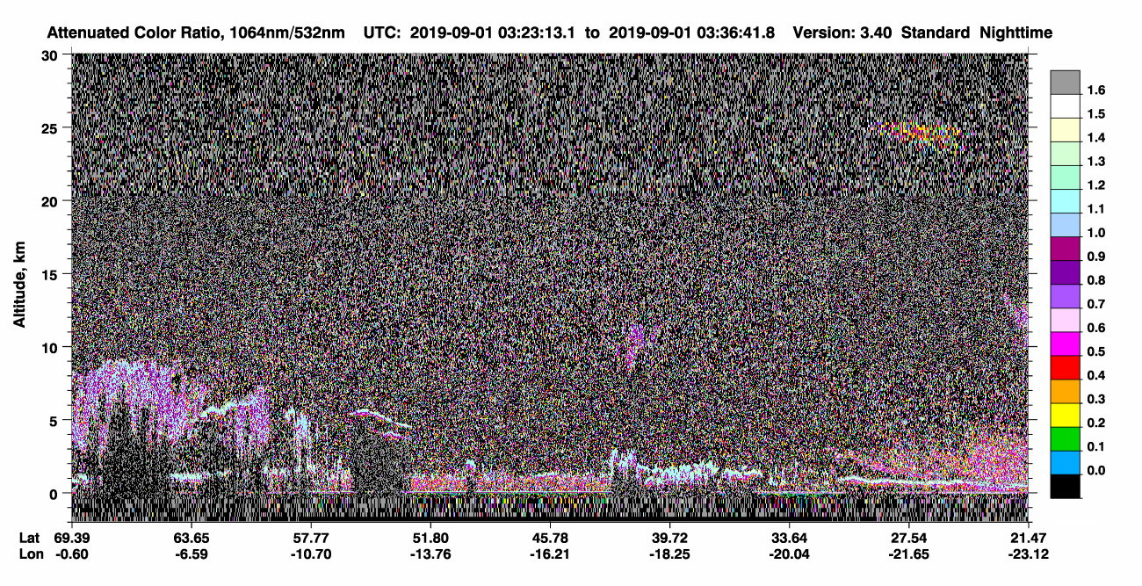
Composition, Heterogeneity, and 2019

Slide 15
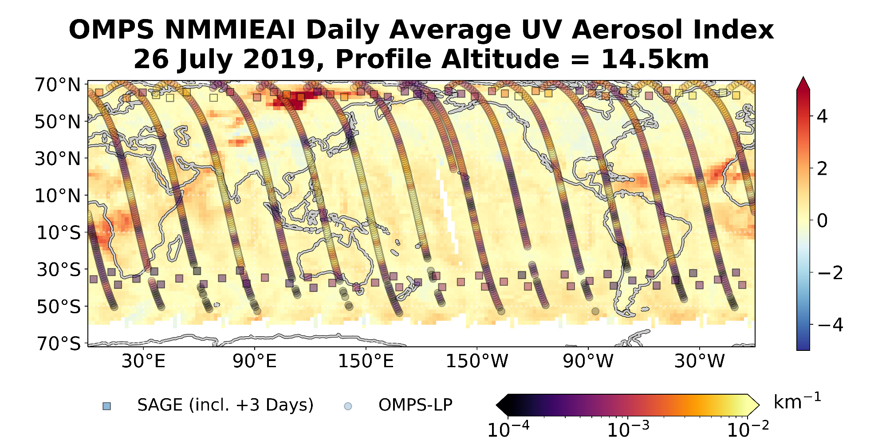
Data Fusion – Future Work

Slide 16
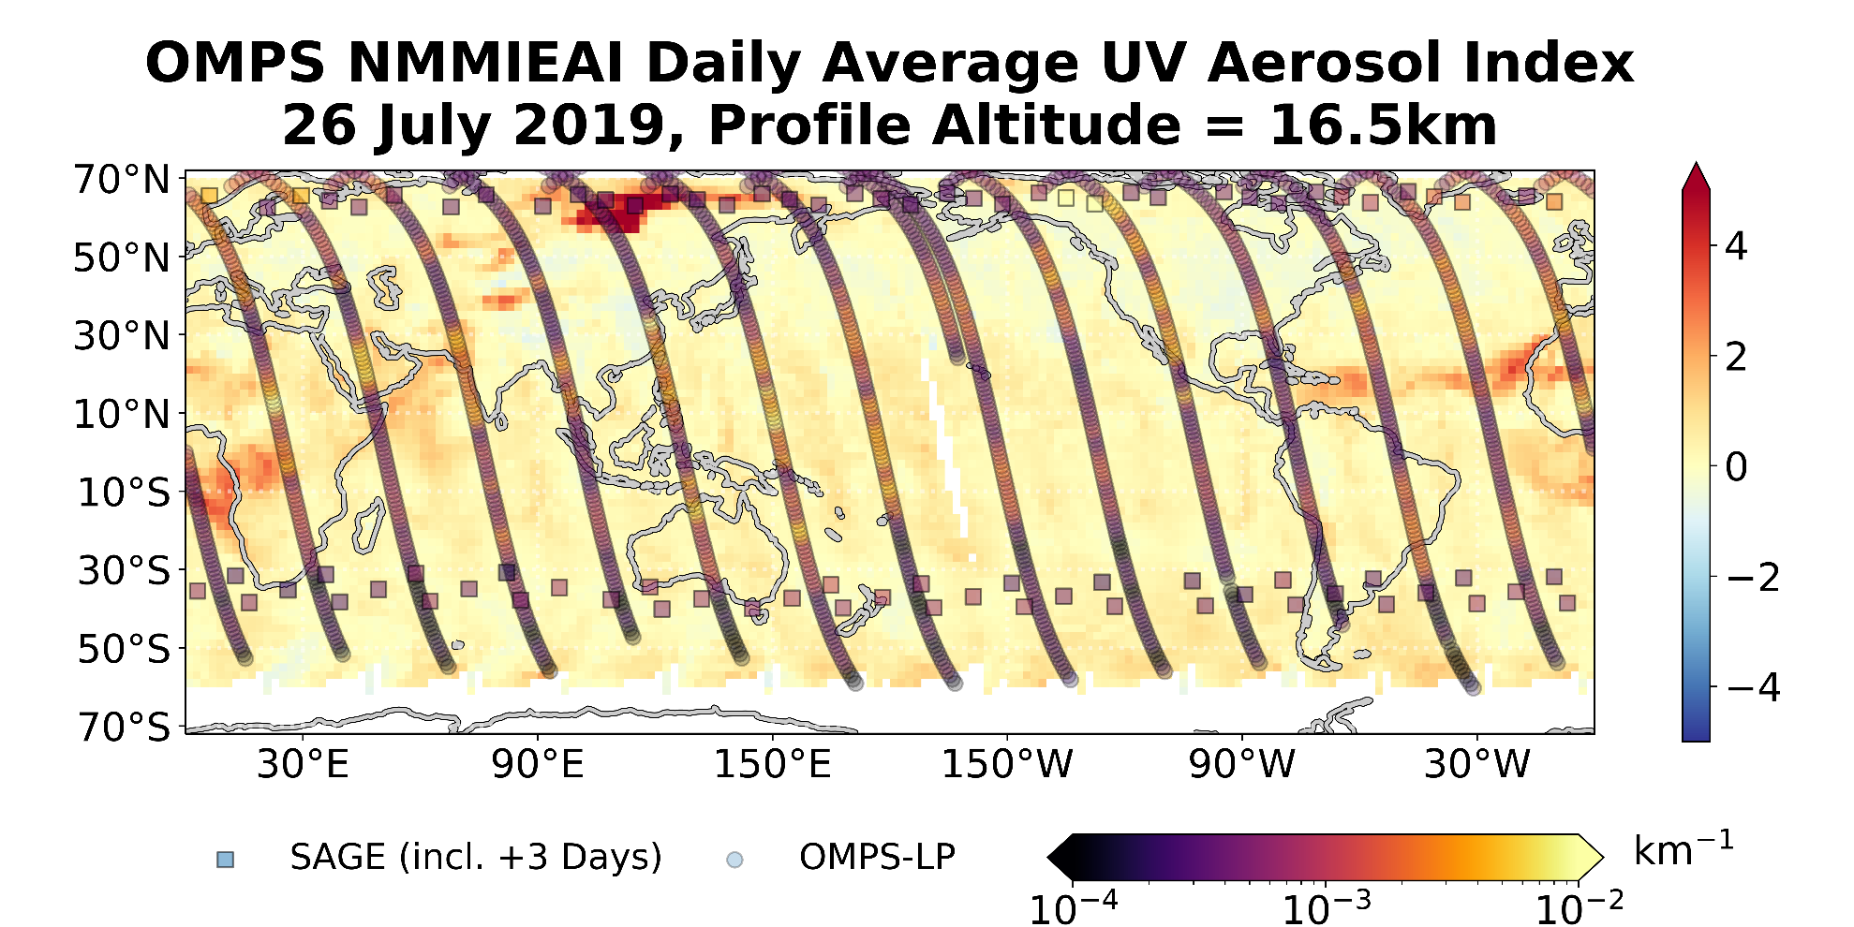
Data Fusion – Future Work

Slide 17
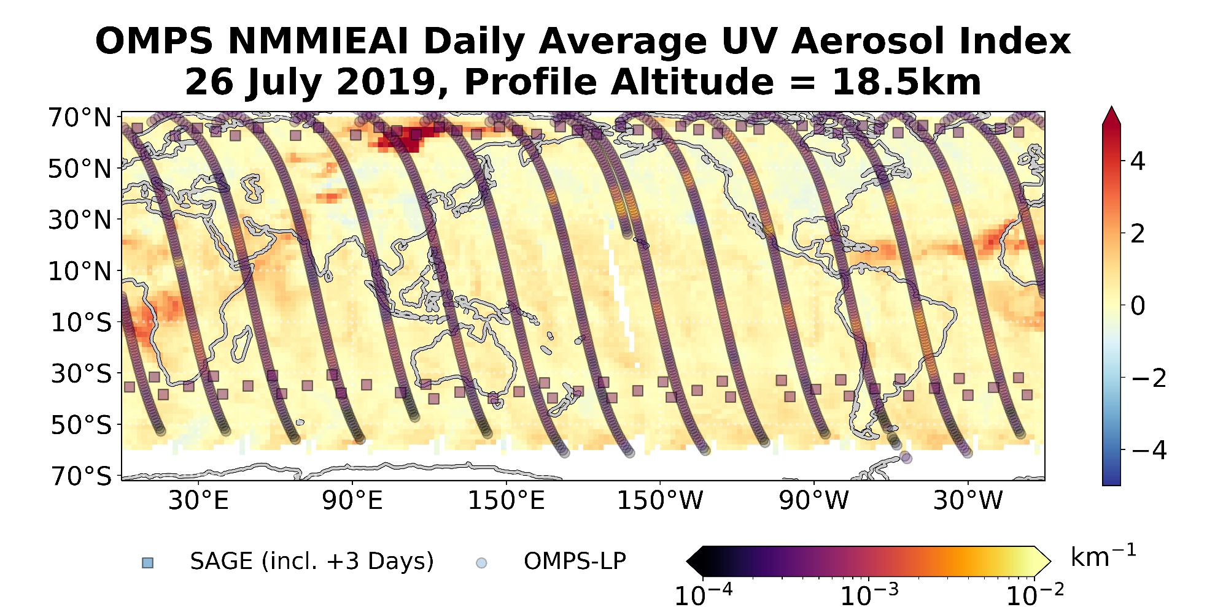
Data Fusion – Future Work

Slide 18
Conclusions
SAGE III/ISS continues to compare well against contemporary instruments with regards to stratospheric aerosol.
Stratospheric aerosol composition has changed significantly and repeatedly since first light for SAGE III/ISS.
Significant heterogeneity is observable in the stratosphere since late June/July 2019.
  Months-old injected aerosol has still not mixed to a significant degree.
  Northern hemisphere is dominated by burned biomass with sporadic volcanic aerosol (Raikoke).
  Southern hemisphere is dominated by volcanic aerosol (Ulawun).
Potential benefits exist for fusing mapping and profiling instruments for complete 3D representations of air masses.

