Slide 1
Validation and Mission Planning
Carrie Roller
SAGE III Scientist/Engineer

Slide 2
Validation Partners - Overview
During the validation campaign, the SAGE science team reached out to all currently participating NDACC lidar and sonde sites in an attempt to facilitate the coordination of SAGE III predicted events with in-situ data gathered at each site.
Currently, 14 stations have agreed to participate in the SAGE III validation campaign.
Each week, participating stations receive emails detailing all upcoming SAGE III events that will coincide with their locations and meet the validation criteria.
New stations are still being added to the distribution list .

Slide 3
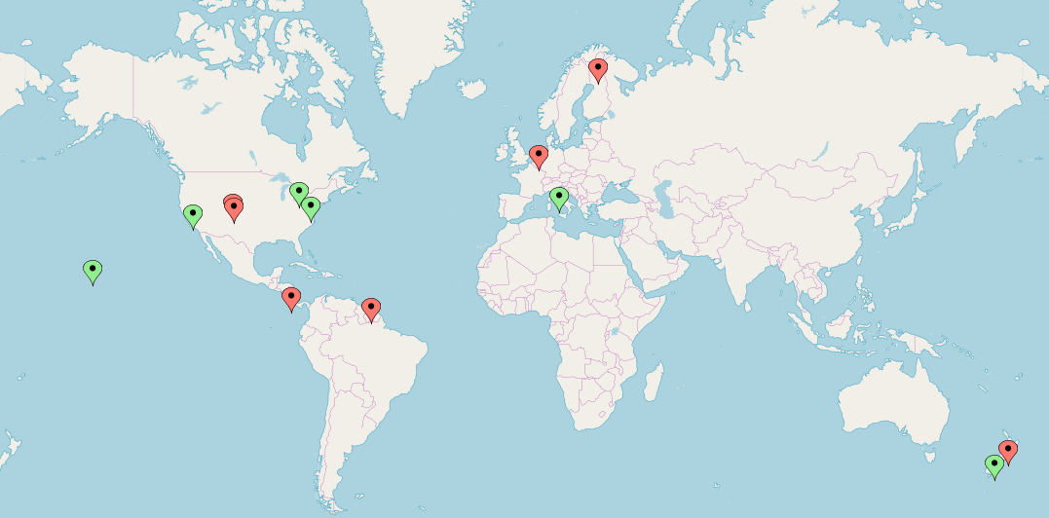


Validation Partners cont.
Boulder, Colorado
University of Colorado Boulder
Mauna Loa, Hawaii
Table Mountain, California
London, Ontario, Canada
Goddard Space Flight Center
San Jose, Costa Rica
Paramaribo, Surinam
De Bilt, The Netherlands
Sodankyla, Finland
Rome, Italy
Lauder, New Zealand (lidar)
Lauder, New Zealand (sonde)
Lidar
Sonde

Slide 4
Validation Criteria
In order to be used for validation, in-situ data must be collected within +/- 24 hours of a coincident SAGE III event.
Species of interest: stratospheric ozone, aerosol, water vapor
The latitude and longitude constraints for event matching are: +/- 5 deg latitude, +/- 10 deg longitude
The types of SAGE III science events that are used for validation are solar occultation events (Sunrise and Sunset), and lunar occultation events (Moonrise and Moonset). Limb events are not currently used for validation.

Slide 5
SAGE III Validation Website
The SAGE III validation website is:
  https://sage.nasa.gov/validation/
The validation site is available to internal and external users and provides an easy way to input desired event type(s), date(s), and a geospatial range.
Any SAGE III predicted events that meet the user entered criteria will be shown on the results page.
Results can also be downloaded and saved as a text file.
The website can be used to locate SAGE III events that occurred in the past.
Danny Mangosing is the curator of the validation website.

Slide 6
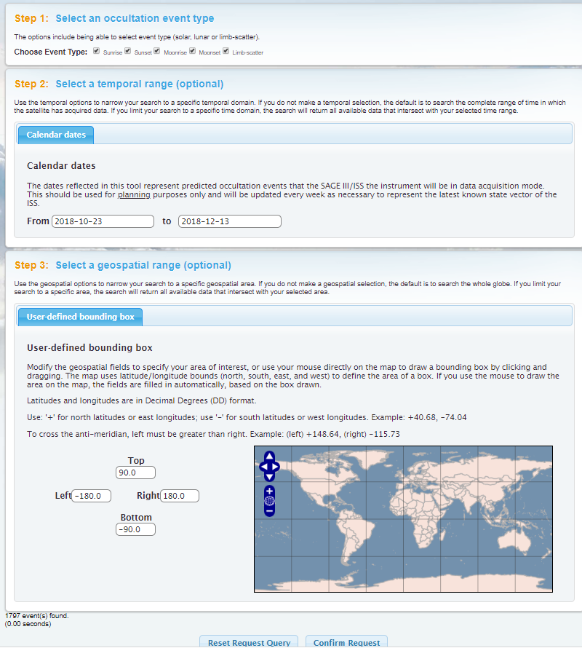
SAGE III Validation Website cont.

Slide 7
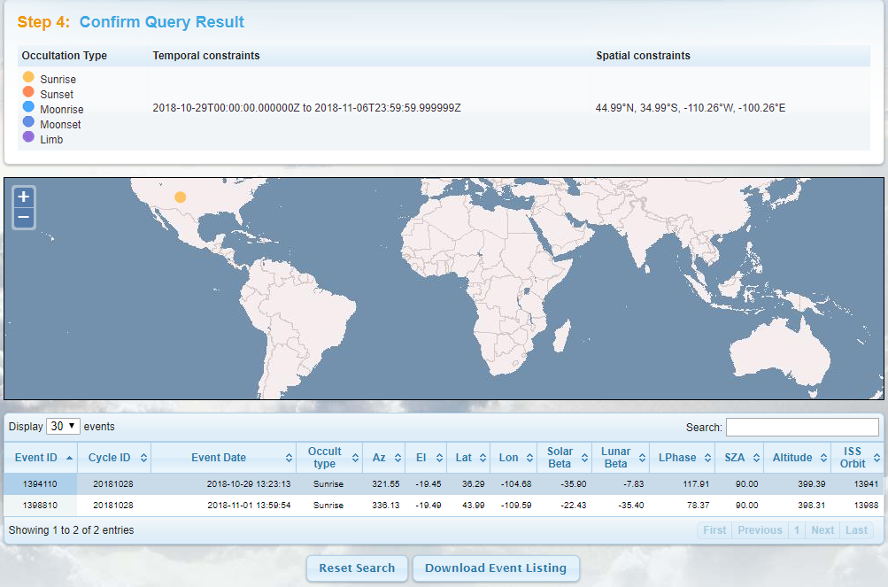
SAGE III Validation Website cont.

Slide 8
Weekly Process
Each week, participating stations are sent emails detailing any coincident SAGE III events that will occur in approximately three weeks.
This time frame is used to ensure the accuracy of the SAGE III event predictions and allows stations to have advance planning for possible coincident measurements.
Coincident events for each specific station are determined using the SAGE III validation website.
Each event is then checked against the SAGE III operations calendar as well as the ISS schedule for any activities that may alter the planned event schedule.
Events are also checked for potential station-related blockage.

Slide 9
SAGE III Operations
Though SAGE III aims to collect as much science data as possible, there are times when the instrument has an altered event schedule or is not collecting science data. This includes:
  High solar or lunar beta (no occultation events predicted)
  Anomalies and the associated recovery time
  Instrument calibration activities
  Subsystem specific commands and activities

Slide 10
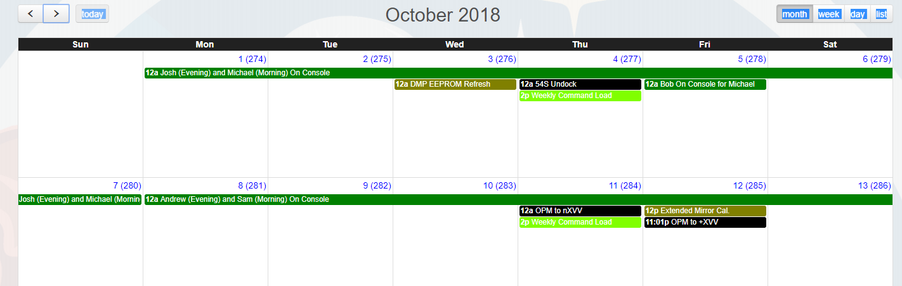
SAGE Ops cont.
SAGE activities that are planned in advance are found on the Operations Calendar. This calendar is on the SAGE III OPS website and is available to approved users. ISS activities are also synced to this calendar.

Slide 11
SAGE Ops cont.
Any event that falls within the time period of a planned SAGE activity or calibration that will affect science data collection is removed from the weekly email list with an explanation to validation partners.
Anomalies are rare, though they do occur occasionally. These unplanned occurrences can cause additional disruptions to the event schedule.

Slide 12
ISS Operations
The ISS is an extremely dynamic environment.
ISS activities can also impact SAGE data collection. These types of activities include (but are not limited to):
  Vehicle dockings and undockings
  Attitude maneuvers
  Station reboosts
  EVAs (Extravehicular Activities)
  PDAMs (Pre-determined Debris Avoidance Maneuvers)
  Thruster testing
  Robotics activities

Slide 13
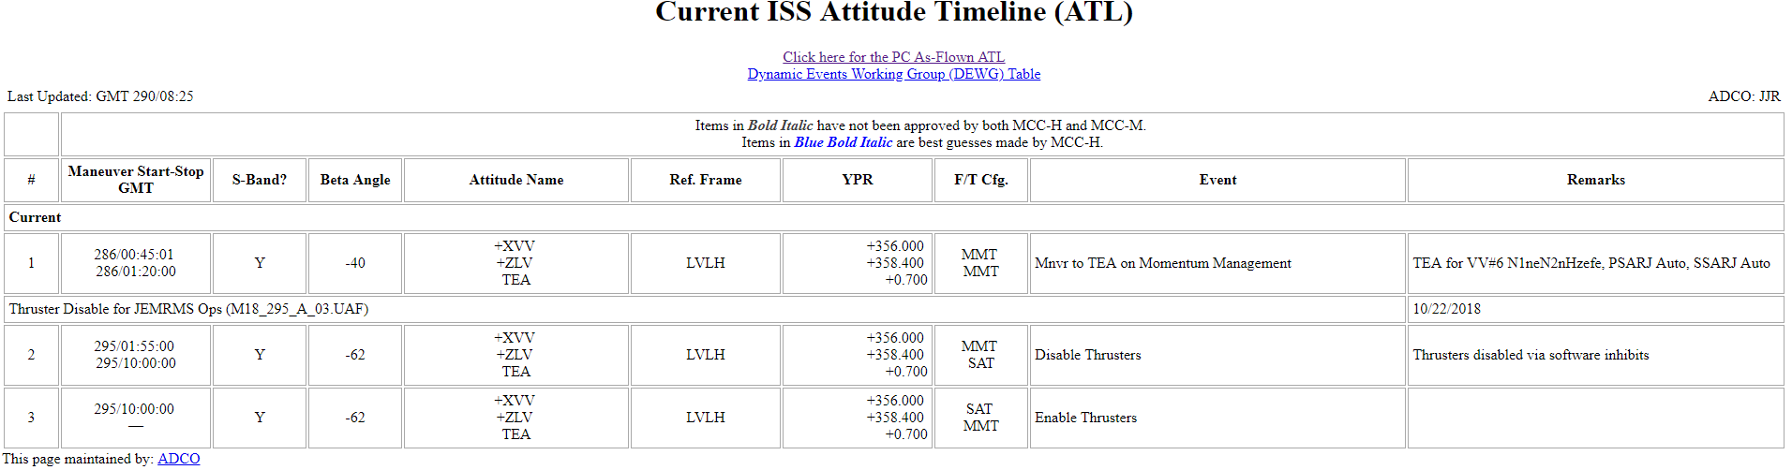
ISS Ops cont.
Upcoming planned ISS maneuvers, scheduled times, and additional activity notes are found on the ATL (Attitude Timeline). This site is also accessible for internal, approved users. Critical changes to this timeline are usually communicated with payloads via email as well.

Slide 14
ISS Ops cont.
According to SAGE Flight Rules and Constraints, there are certain ISS activities that require SAGE to refrain from taking science data for the duration of the activity.
Any event that falls within the time period of a planned ISS activity that requires SAGE action is removed from the weekly email list with an explanation to validation partners.
Due to the highly variable ISS environment, late changes to the ISS timeline do occur.
The timeline is monitored closely for changes that might potentially impact SAGE III events. Any major changes are relayed to validation partners as soon as they become available.

Slide 15
ISS Reboost
Periodically, the ISS needs to complete a reboost for altitude maintenance.
Following an ISS reboost, it takes approximately 2-4 days for the ISS orbit parameters (Two-line elements, TLEs) to fully settle into the new changes in the ISS orbit.
During this time, predictions may be slightly skewed in time and longitude.
Reboost details are included in weekly emails, as applicable.
Once the orbit changes have settled out, all events are re-checked for accuracy to ensure that they still meet the constraints for validation.

Slide 16
Blockage
There are times when visiting vehicles, solar panels, or modules can obstruct the view of SAGE.
Expected blockage information can be found on the SAGE Validation website
  Select “Download Event Listing”. In the output file, the “Obscuration” column will list the level of blockage expected.
  Levels are: none, low, medium, high, and extreme
Depending on the severity of the blockage, events may still acquire successfully.
Events sent to validation partners have blockage levels of medium or lower to ensure event success.
High and extreme levels of blockage may still acquire but are not guaranteed. These events are not sent to validation partners.

Slide 17
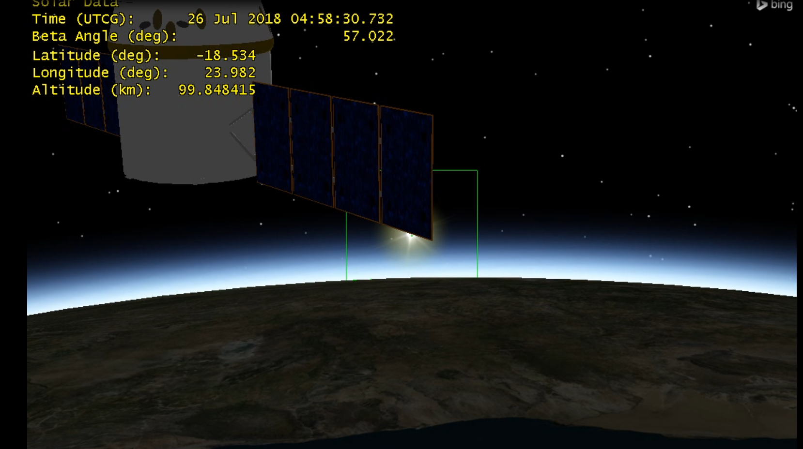
Blockage - Sunrise

Slide 18
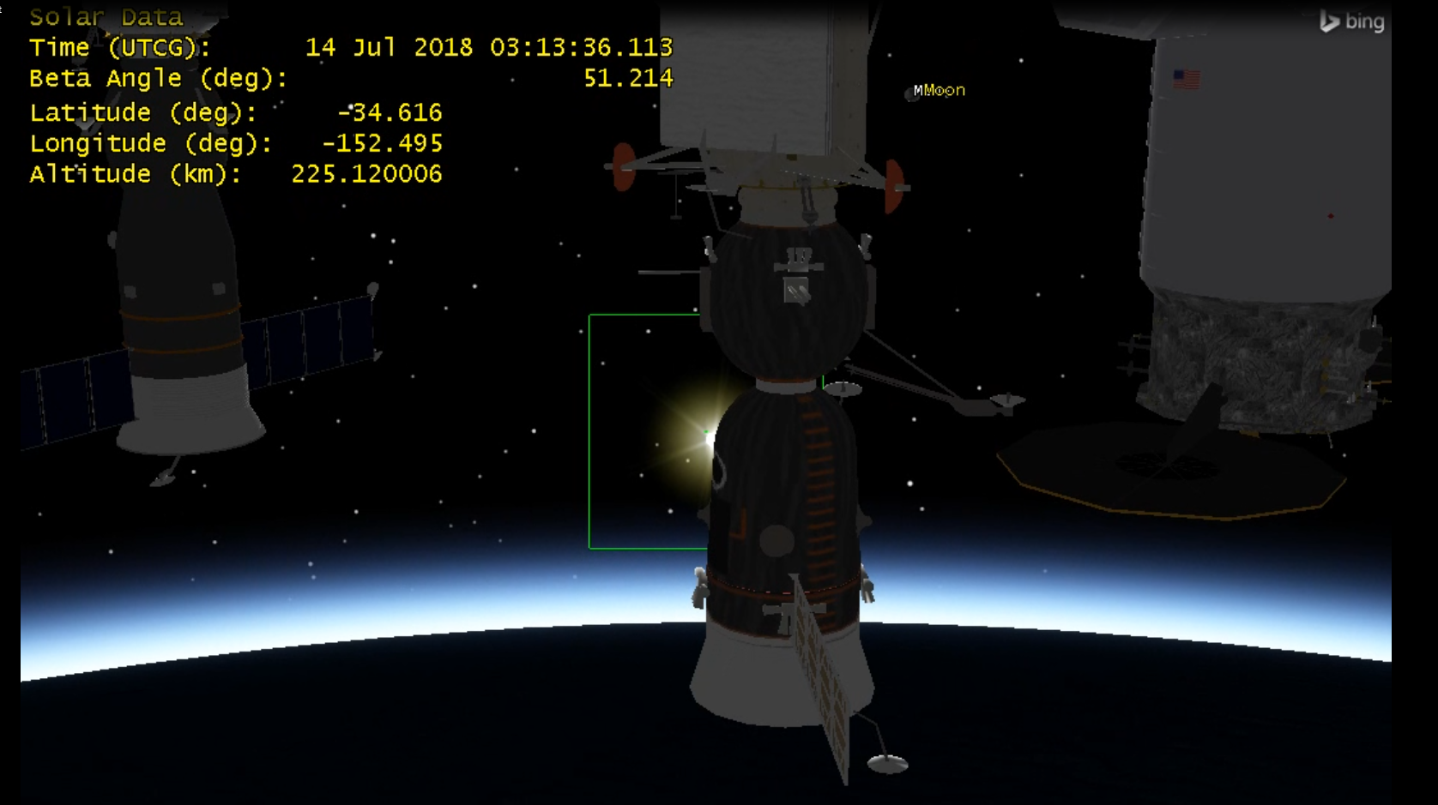
Blockage - Sunset

Slide 19
Contact Information
SAGE III is looking for additional validation partners to collaborate with! Please forward my contact information to anyone that may be interested in coordinating sonde launches or lidar operations with SAGE III events.
    Carrie Roller
    SAGE III Science, Engineer
    carrie.roller@nasa.gov
    757-864-9520

Slide 20
Questions?

