Slide 1
Science Team Meeting 2018
NASA Langley Research Center
Oct 30, 2018

Slide 2
Science Data Product Algorithm Validation
Marilee Roell
Science Manager

Slide 3
Internal Algorithm Validation
Actively cooperate with NOAA and NIWA to collect coincidence measurements of Ozone, Water vapor (v5.1), and Aerosol (future goal) between balloon borne sondes and SAGE III overpasses
Comparisons provide confidence in the algorithm (currently version 5.1)
Aerosol sondes are in development at NOAA (expected to fly on balloons after the first of the year 2019)
Current aerosol validation utilizes a conversion from extension values to backscatter values for comparison with NDACC aerosol LIDAR measurements.
Additional comparisons using NDACC sonde measurements provide confidence that our measurements are within 20% above 20km

Slide 4
SAGE III ISS v5.1 Validation
Water Vapor Comparison: SAGE v5.1, MLS and NOAA Boulder FPH
  Individual NOAA Events showing mixing ratio and % difference
    Oct. 2017 – Feb. 2018
    MLS data showing no matches for March and June 2018.
    Difference Ranges: Latitude 5º, Longitude 10º, Time 24 hours
    Use SAGE event numbers to note the Sunrise and Sunset events
Ozone Comparison: SAGE v5.1 ozone aerosol product vs NIWA Lauder ozonesonde
  All events with a SAGE overpass
    June 2017 – May 2018
    Difference Ranges: Latitude 5º, Longitude 10º, Time 24 hours
    NIWA data retrieved from AVDC
    Aerosol Extinction conversion to Backscatter measurements

Slide 5
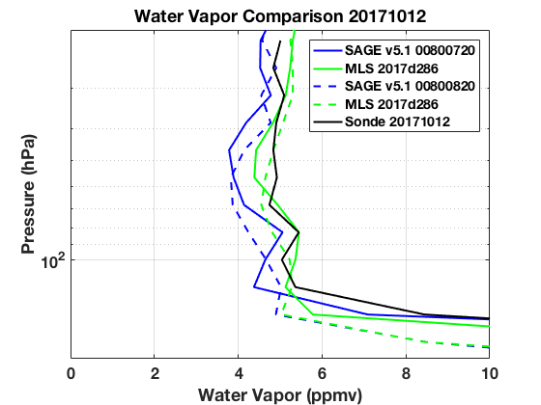
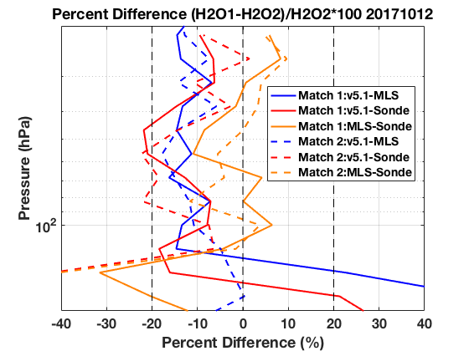
SAGE III/ISS v5.1 Water vapor Oct 12, 2017

Slide 6
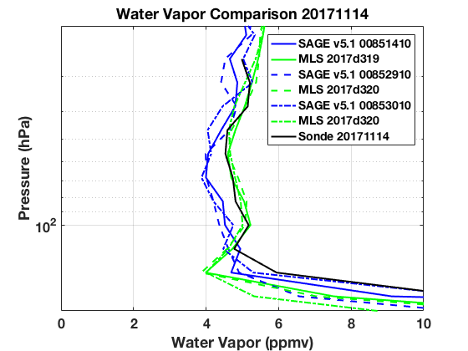
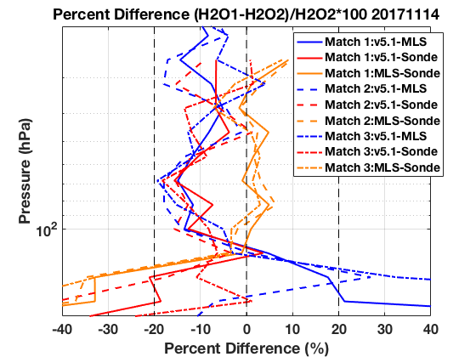
SAGE III/ISS v5.1 Water vapor Nov 14, 2017

Slide 7
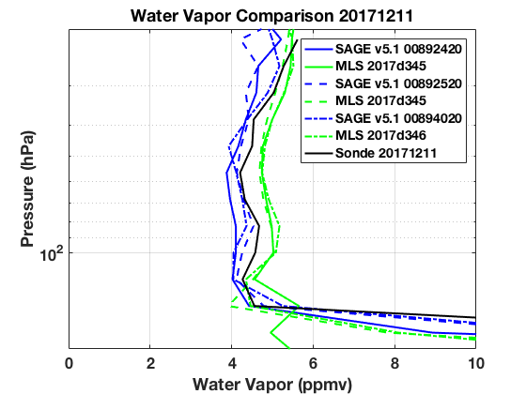
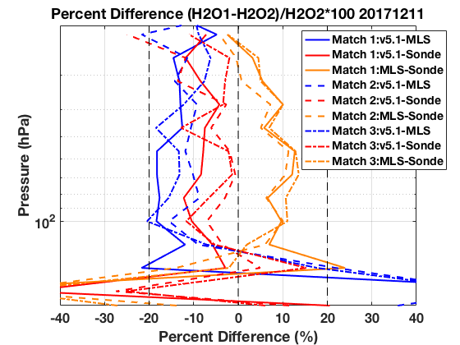
SAGE III/ISS v5.1 Water vapor Dec 11, 2017

Slide 8
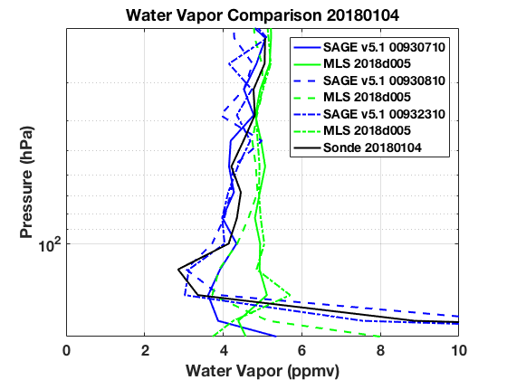
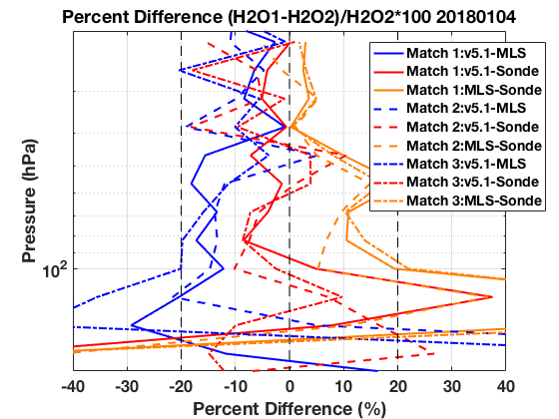
SAGE III/ISS v5.1 Water vapor Jan 4, 2018

Slide 9
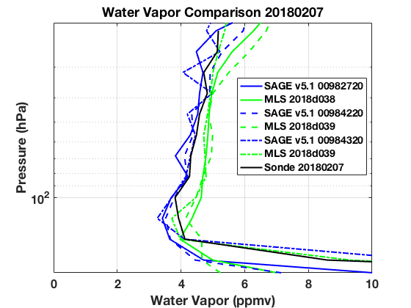
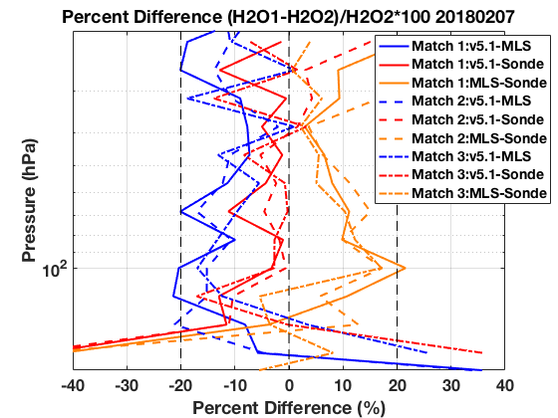
SAGE III/ISS v5.1 Water vapor Feb 7, 2018

Slide 10
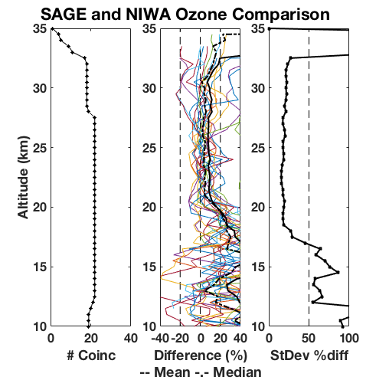
SAGE III/ISS v5.1 Ozone Aerosol
SAGE v5.1 Ozone Aerosol Product
Data Range June 2017 – May 2018
NIWA data retrieved from AVDC

Slide 11
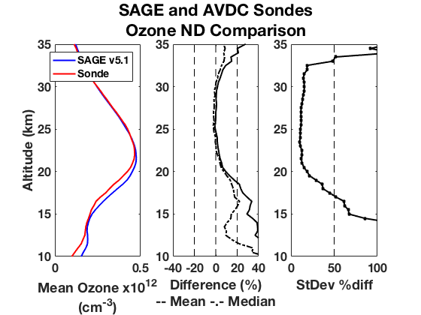
SAGE v5.1 Ozone Aerosol Product
Data Range June 2017 – May 2018 (255 coincidence)
  Broadwell
  Macquerie Island
  Neumayer
  Praha
  Dumont d’Uville
  OHP
  Scoresbysund
  Hohenpeissenberg
  Marambio
  Legionowo
  Naha
  Syowa
  Tsukuba
  De Bilt
  Parambio
  Payerne
  Lauder
  Boulder
  Hilo
  Huntsville
  Pago Pago
  Suva
  Trinidad Head CA
  Ushu
ABM
JMA
KNMI
NOAA

Slide 12
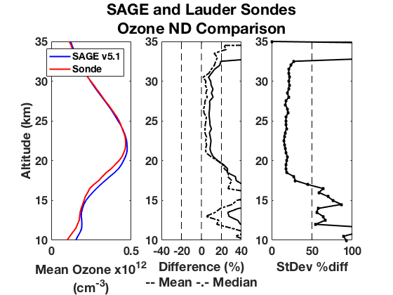
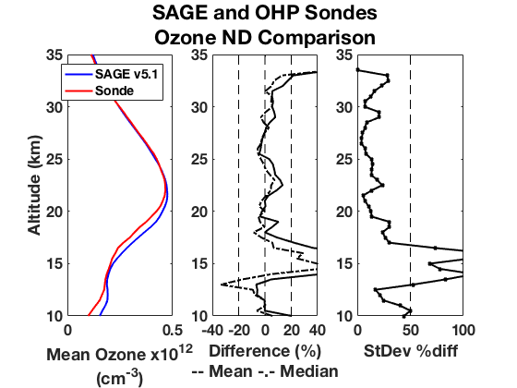
SAGE v5.1 Ozone Aerosol Product
22
7

Slide 13
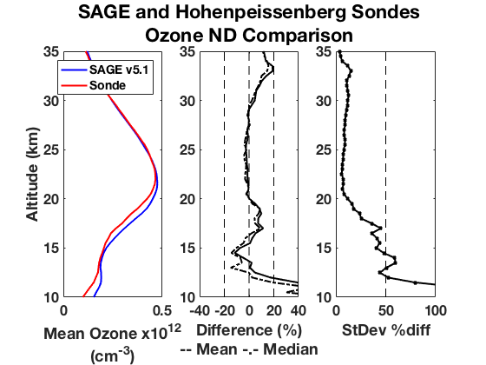
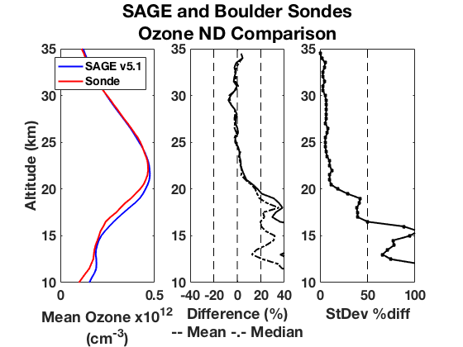
SAGE v5.1 Ozone Aerosol Product
57
19

Slide 14
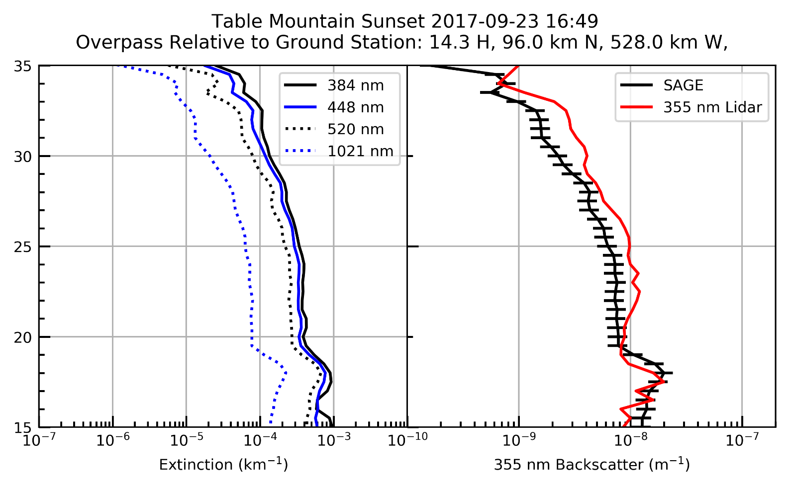
Aerosol Extinction conversion to Backscatter Sept 23, 2017

Slide 15
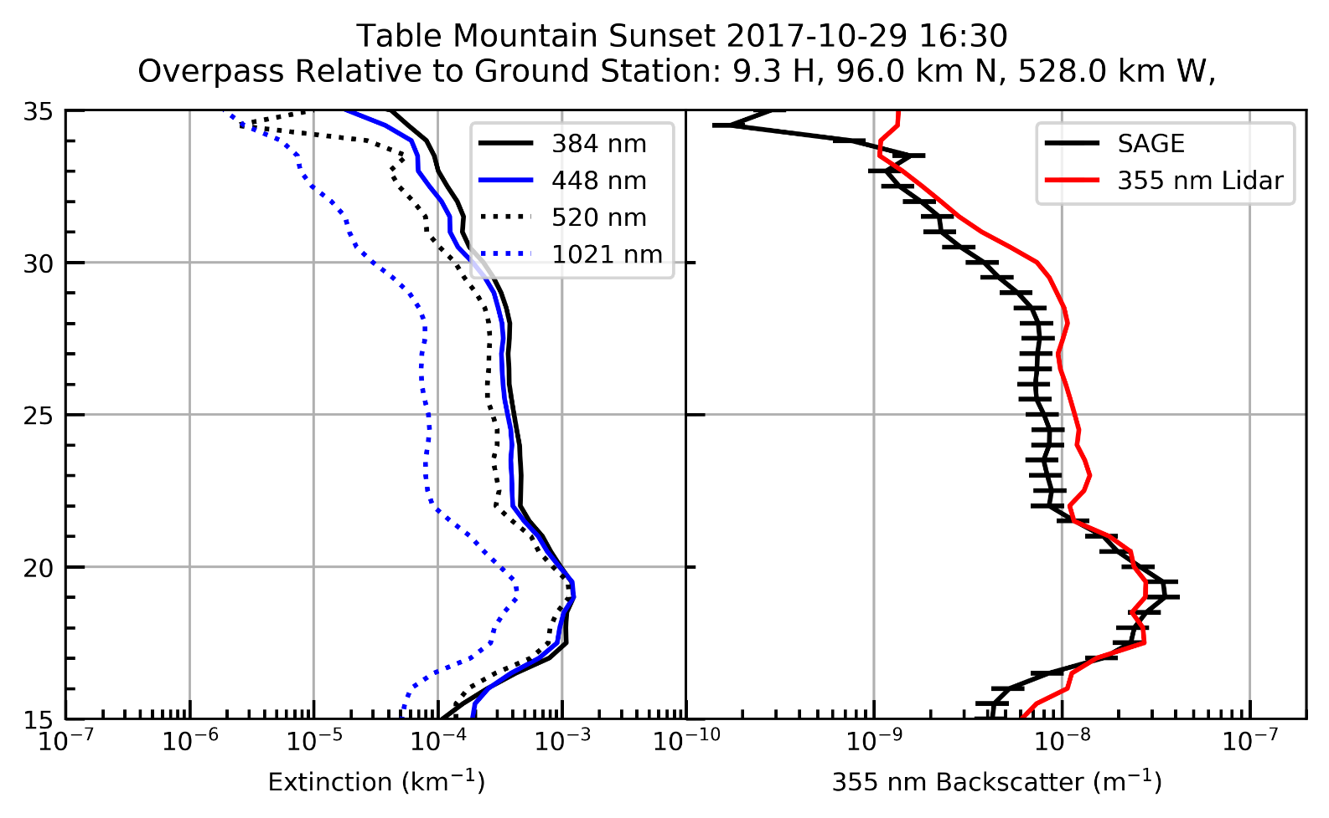
Aerosol Extinction conversion to Backscatter Oct 29, 2017

Slide 16
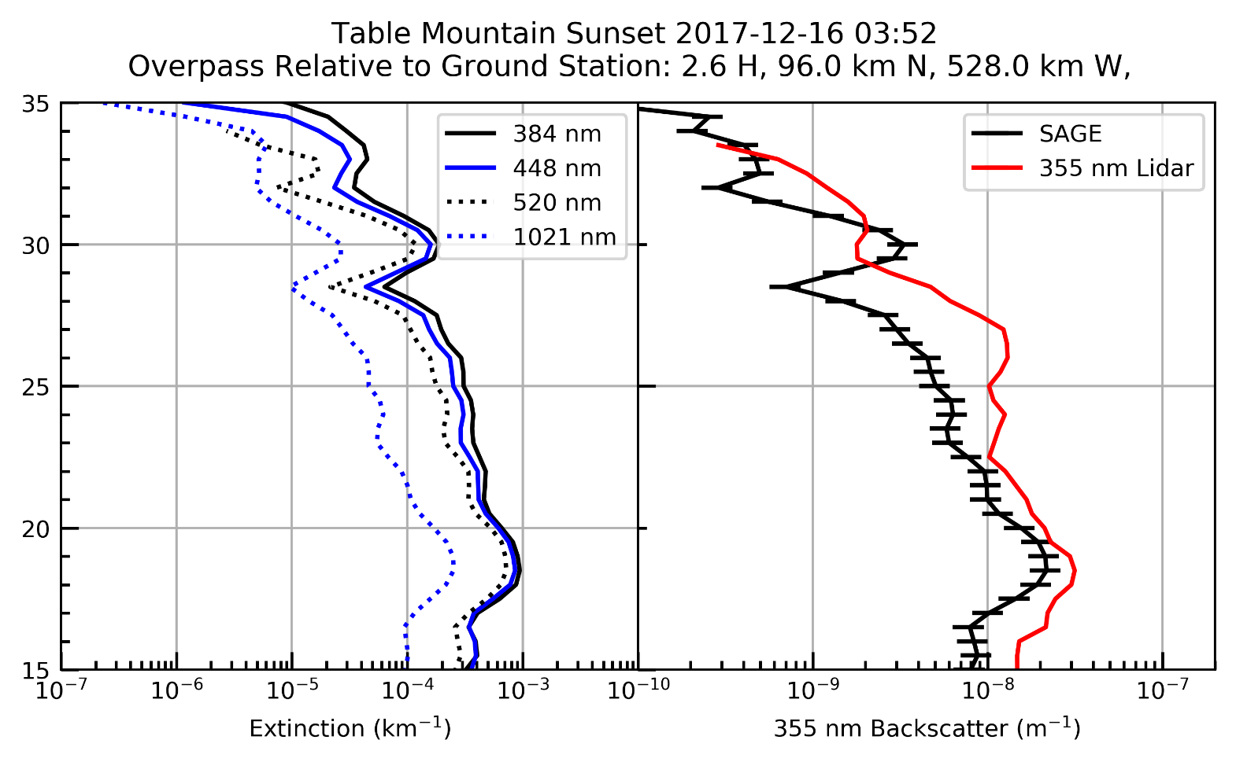
Aerosol Extinction conversion to Backscatter Dec 16, 2017

Slide 17
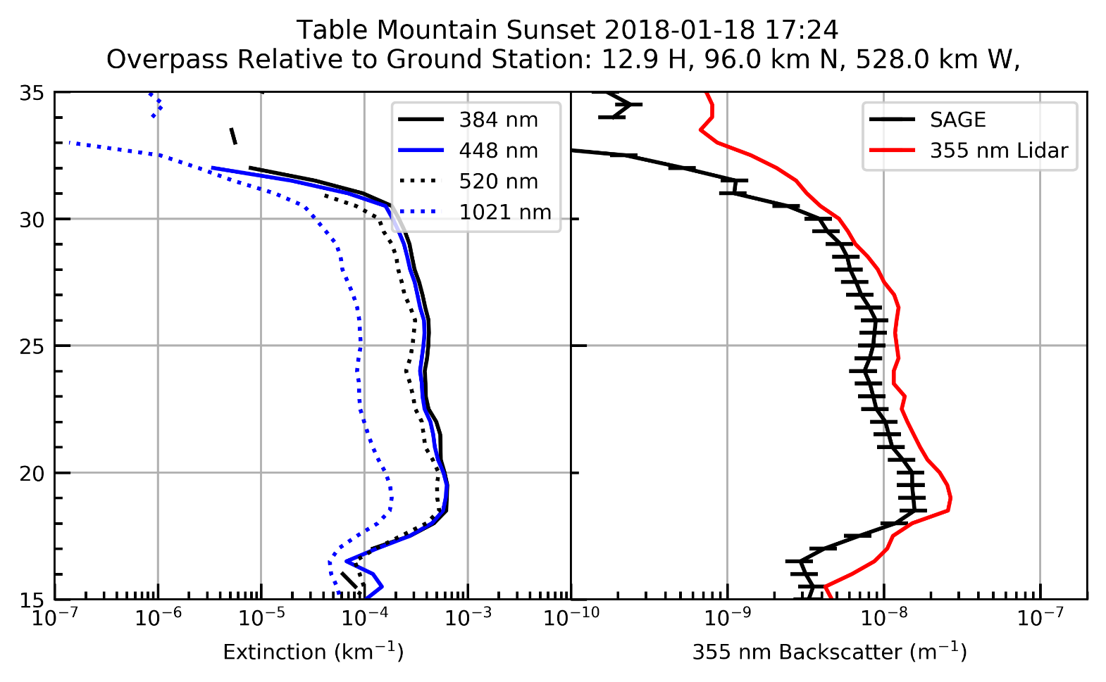
Aerosol Extinction conversion to Backscatter Jan 18, 2018

Slide 18
Conclusions
Algorithm version 5.1 shows good agreement with coincident sonde measurements (<20% above 20km)
Future aerosol validation will require validated aerosol sondes (POPS) currently in development
Conversion of aerosol extinction to backscatter measurements allows comparisons with CALIPSO CALIOP aerosol measurements as well as NDACC LIDAR measurements
Continued refinements in this comparison process and 16 total coincident balloon borne launches scheduled in FY19 along with available NDACC comparisons will continue to provide validation of the algorithm versions.

