Slide 1
SAGE III Limb Scatter Retrievals
Glen Jaross, P.K. Bhartia, Natalya Kramarova | NASA Goddard Space Flight Center
Ghassan Taha | Universities Space Research Association
Philippe Xu | Science Applications International Corp.
SAGE 3 STM, 31-Oct., 2018

Slide 2
Proposed effort
Provide LaRC operational retrieval codes that will work for SAGE LS data
  Ozone and aerosol extinction
  Based on existing OMPS retrievals
Correct Level 1 radiances for problems affecting product accuracy
  Stray Light: out-of-band and out-of-field
  Tangent Height registration errors
  We assume the Level 1 SAGE LS product will have only basic TH registration and no SL correction
Recommend LS operations scenarios

Slide 3
OMPS LS retrieval algorithms
Aerosol v1.5 algorithm
Ozone v2.5 algorithm
Computes extinction profile at 675 nm;
Radiances are normalized at 45 km;
Gamma size distribution in Mie calculation;
Chahine’s non-linear relaxation algorithm;
Cut off at cloud top;
Residuals calculated at 8 wavelengths.
3 UV pairs and 1 VIS triplet;
Radiances are normalized at 55 km for UV and 40 km for VIS ranges (no retrievals above);
Include the explicit aerosol correction by using LP-derived aerosols;
Algorithm uses realistic a priori covariance matrices instead of Tikhanov regularization;
Limited wavelengths allow us to better isolate instrumental issues

Slide 4
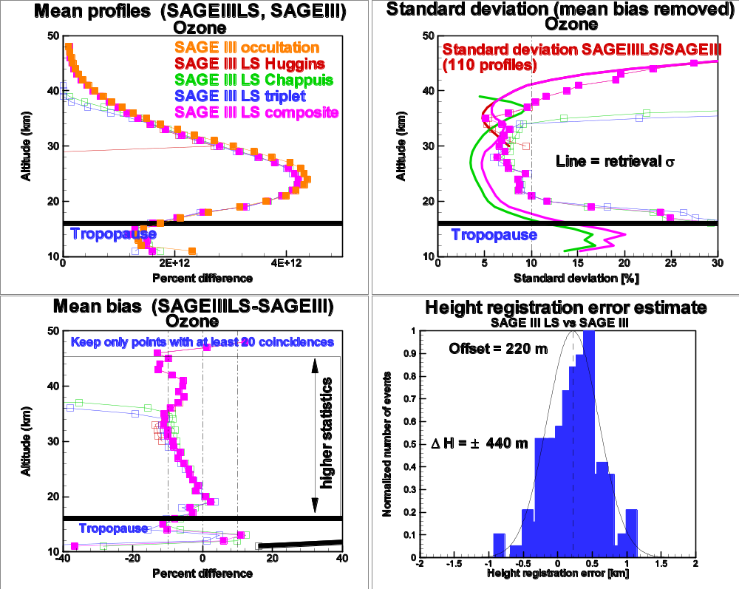
SAGE/M3 LS retrievals
Ozone retrieval approach is mostly unchanged from previous SAGE III LS retrievals

Slide 5
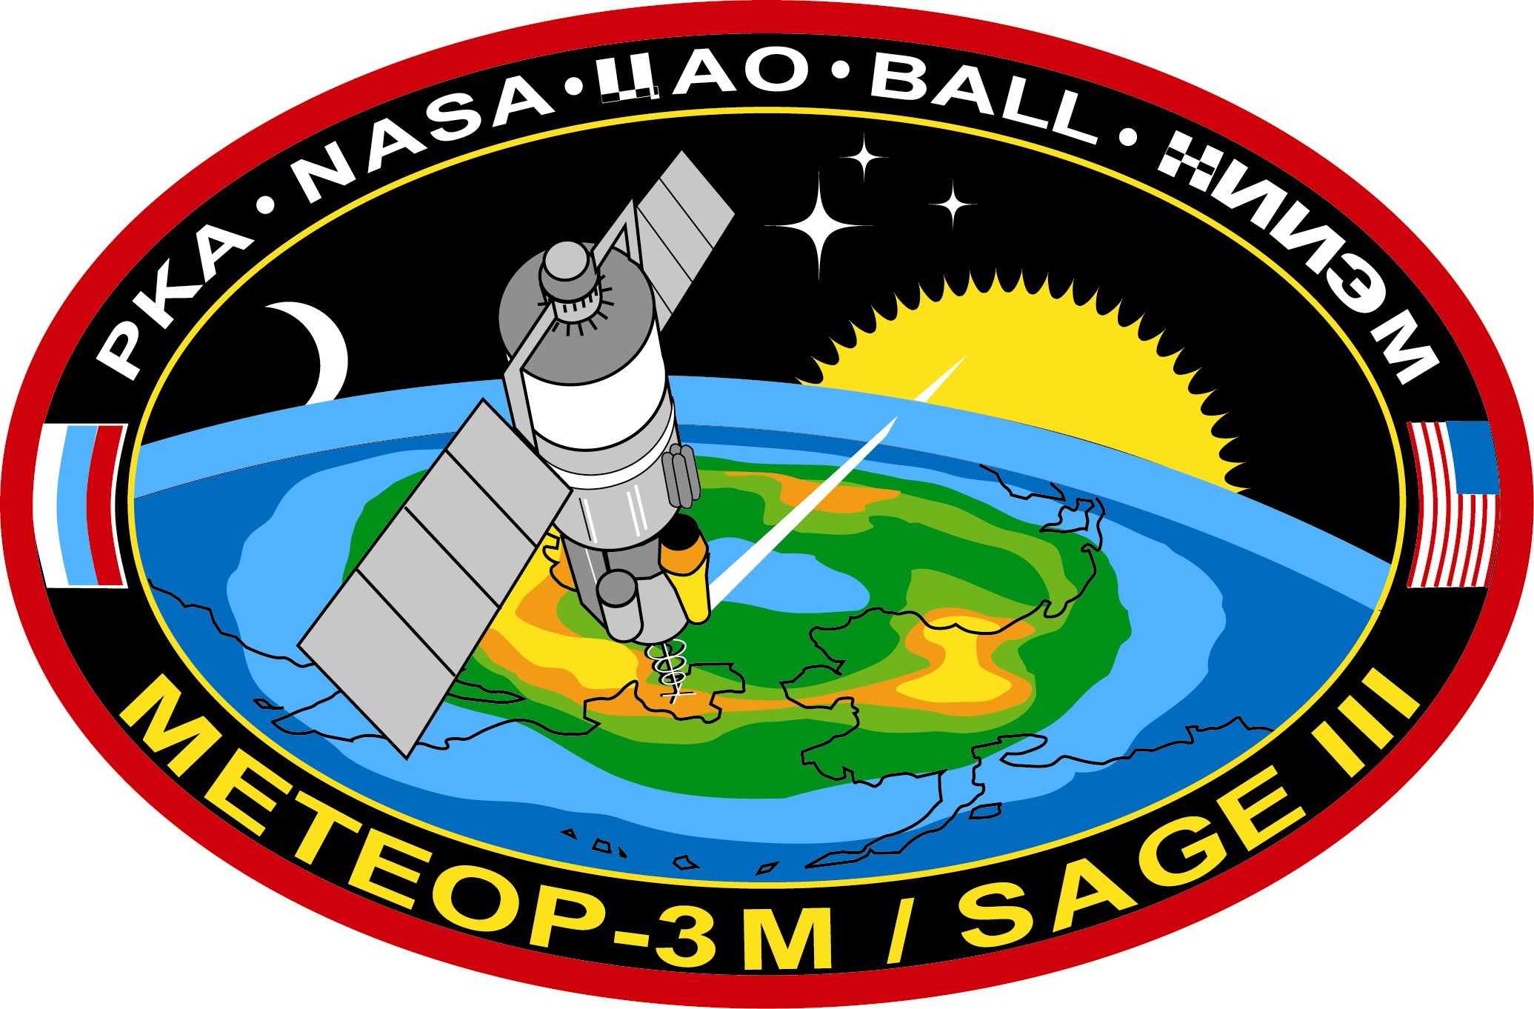
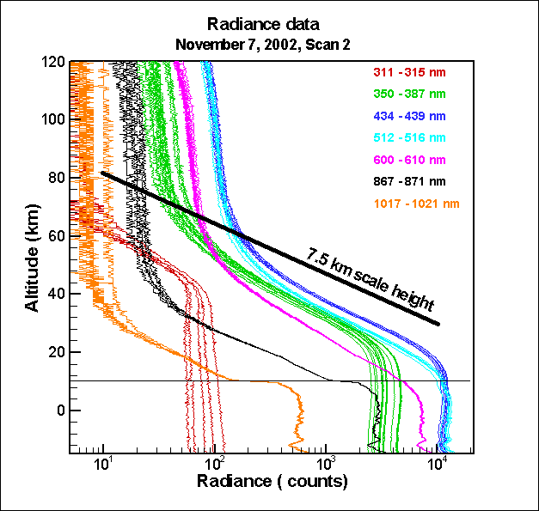
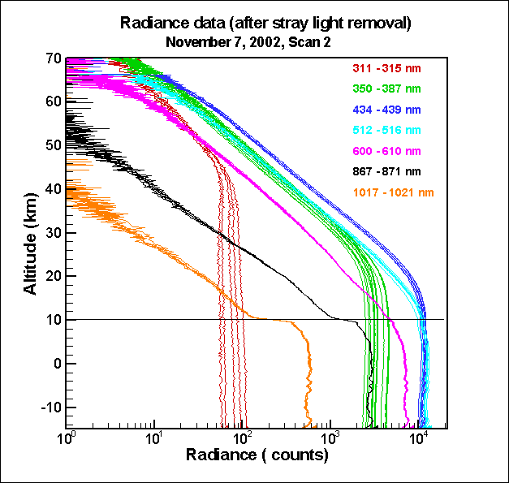
Out-of-Field stray light
M3-SAGE LS Signal
M3-SAGE LS Signal
Telescope scatters bright Earth signal into higher altitude angles (in-band)
Excess signal at retrieval normalization altitude
Primarily a VIS/NIR problem
We will apply the same SL removal technique as used on M3 SAGE LS and GOMOS LS

Slide 6
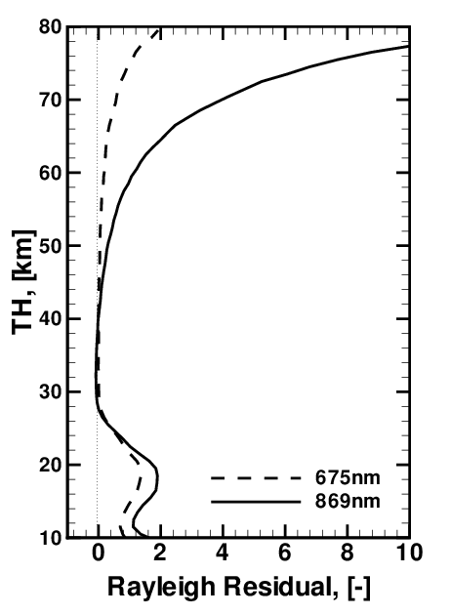
Diagnostics from RTM radiance residuals
OMPS residuals – Stray Light
Rayleigh residual=(I_{m}-I₀)/I₀
where I_{m} is the measured radiances and I₀ is the calculated radiance for a Rayleigh atmosphere only. All radiances are normalized at 40.5km to reduce effects of surface/cloud reflectance and sensor absolute calibration.
OOF stray light is inherently worse at longer wavelengths due to signal reduction with altitude

Slide 7
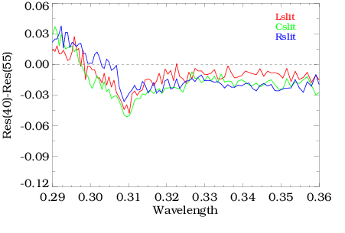
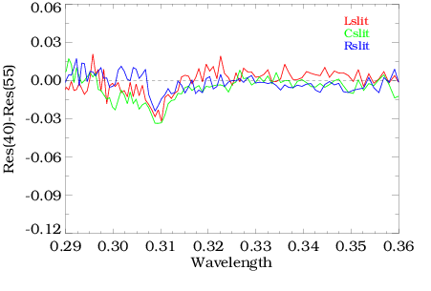
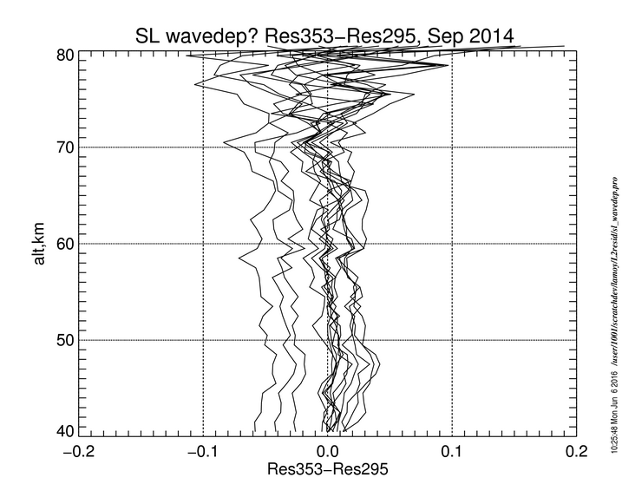
Out-of-Band stray light
OMPS Res40km – Res55km
Without Correction
With Correction
Primarily a UV problem
SAGE has more out-of-band SL than OMPS (grating vs. prism)
SL error need not be zero, just spectrally flat
Pair Wavelength
Retrieval Wavelengths

Slide 8
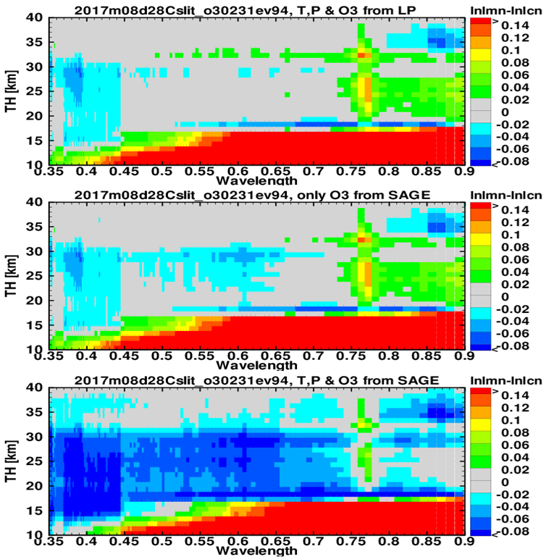
Instrumental and RTM issues
OMPS radiance residuals from LS RTM
(aerosol extinction from OMPS)
UV to VIS retrieval transition
Aerosol extinction and/or stray light
OMPS O3
Calibration ?
Cloud
SAGE O3
SAGE-OMPS O₃ difference

Slide 9
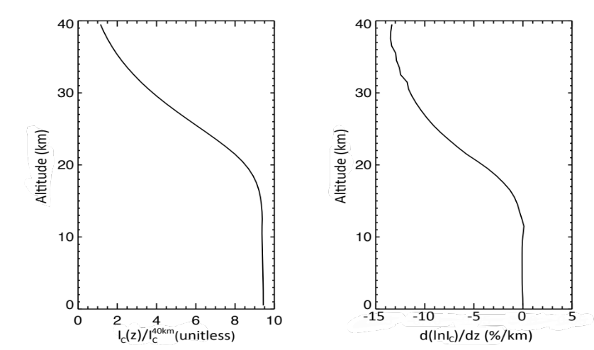
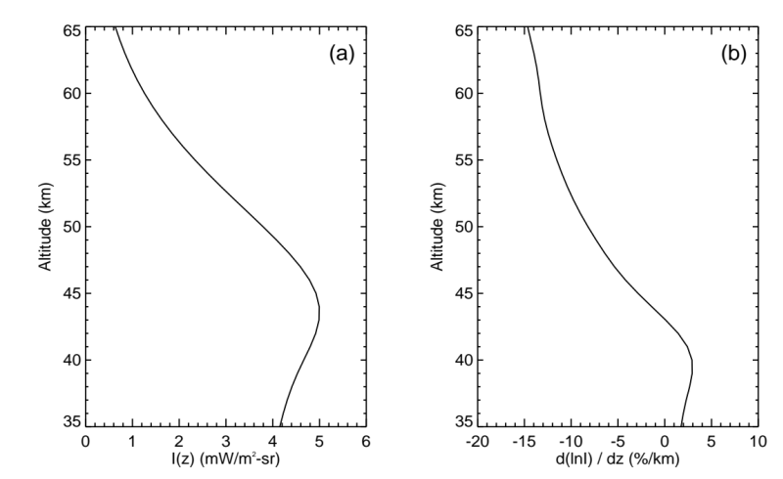
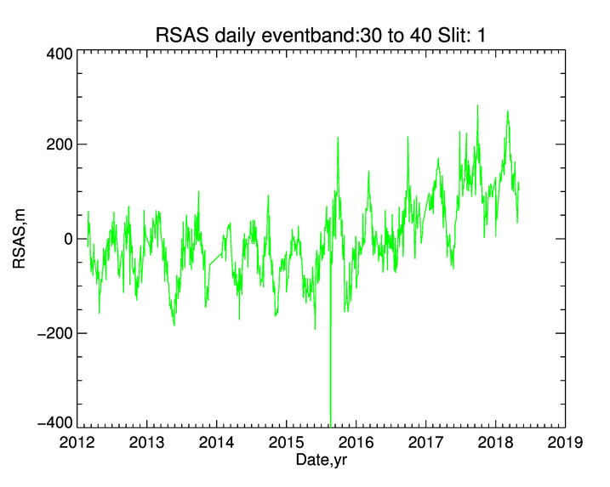
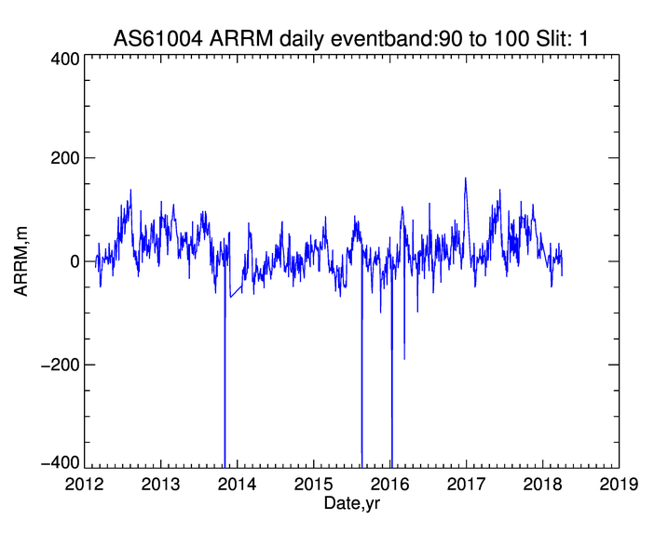
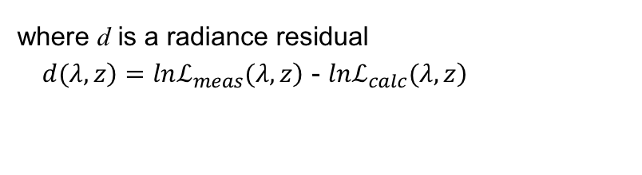

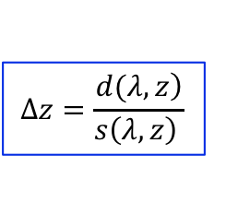

Two tangent height verification methods
$$∆z=\frac{\left.d(λ,z\right)}{\left.s\left(λ,z\right) \right.}$$
where d is a radiance residual
$\left. d(λ,z\right)=lnℒ_{meas}\left.(λ,z\right)$ - $lnℒ_{calc}\left.(λ,z\right)$
Calculated sensitivity
Calculated sensitivity
ARRM
RSAS
$$s\left(350nm,z\right)$$
$$s\left(305nm,z\right)$$
Use of 𝜆 < 310 nm at z = 65 km minimizes DUR error
Susceptible to non-Rayleigh errors: aerosols
Also sensitive to stray light errors
OMPS

Slide 10
Convert SAGE Level 1B to OMPS-like L1
Radiances from each scan on a common time stamp
Solar angles calculated at 35 km
Radiances interpolated or smoothed to uniform 1 km grid and OMPS wavelengths/bandpass (initial version)
Additional stray light or tangent height corrections applied as necessary
OMPS Level 1B
(geolocated, calibrated, irregular spectral/spatial sampling)
OMPS Level 1G
(geolocated, calibrated, uniform spectral/spatial grid)
Level 2 Aerosol
675 nm extinction coefficients
Level 2 Ozone
Number density vertical profile
SAGE Level 1B
(geolocated, calibrated, irregular spatial sampling)
SAGE Level 1G
(geolocated, calibrated, uniform spectral/spatial grid)
Provided by LaRC
Existing Code
New Code

Slide 11
Timeline
Phase 1
  Convert SAGE L1B to OMPS L1G format (degrade SAGE bandwidth in VIS)
  Generate basic ”OMPS” O3 and AER675 products
  Initial software package to LaRC
  Begin RTM residuals evaluation using MLS, OMPS profiles
Phase 2
  Introduce empirical calibration corrections in L1G
  Modified retrievals working at SAGE resolution
  Continue residuals eval. with SAGE SO profiles
Phase 3
  Multi-wavelength aerosol extinctions
  Final software package to LaRC

Slide 12
Summary
LS Team will deliver LS retrieval software in 2 stages
Team will evaluate and attempt to correct stray light and other errors
Work started to make LS retrieval codes instrument agnostic
We need:
  L1B LS product definition / sample products
  SAGE LS measurement timeline

