Slide 1
SAGE III – ACE Comparisons
For SAGE III Science Team Meeting
29 October 2018

Slide 2
Comparison Parameters
Comparison periods used:
SAGE III-3M June 2004 – June 2005
SAGE III/ISS June 2017 – June 2018
Data versions used
SAGE III-3M v4
SAGE III/ISS v5.0 (for O₃ AER profiles used)
ACE-FTS v3.5/3.6 – for both O₃ and NO₂
MAESTRO v3.13 only goes to Sept 2017, processing continuing to bring data set up to present
  Not enough coincidences to do comparisons with ISS – 3M only
  Also does not have NO₂ yet (produced only for 2004-2010 due to degradation of the UV channel)

Slide 3
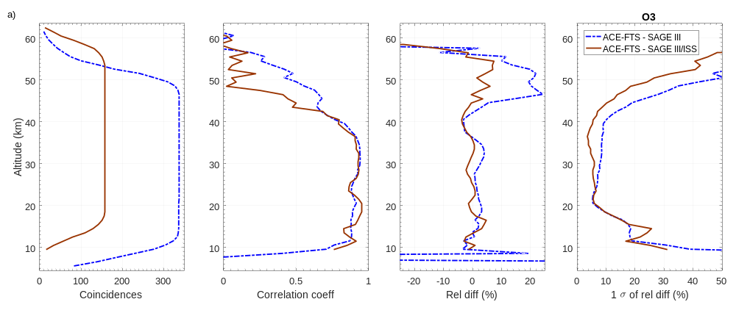
Ozone Comparisons
  Coincidence criteria: within 12h and 500 km. Mean of relative differences are calculated for each pair with respect to ACE, global averages.
  Agreement for SAGE III/ISS with ACE-FTS is better than for SAGE III 3M, reducing the high bias particularly above 45 km.

Slide 4
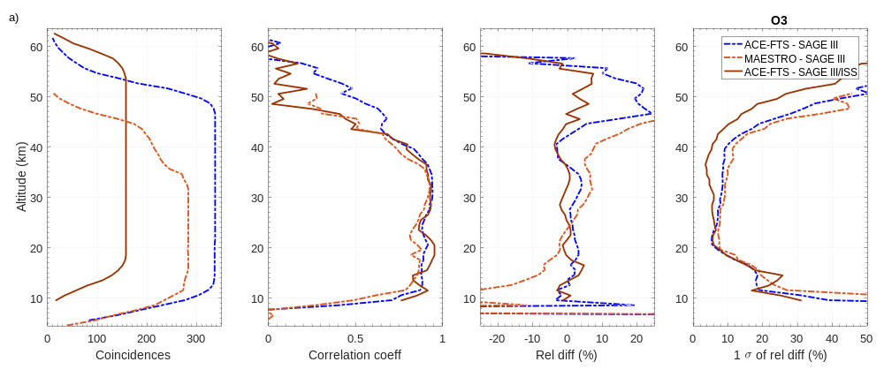
Ozone Comparisons
  Coincidence criteria: within 12h and 500 km. Mean of relative differences are calculated for each pair with respect to ACE, global averages.
  Agreement for SAGE III/ISS with ACE-FTS is better than for SAGE III 3M, reducing the high bias particularly above 45 km. MAESTRO may have vertical offset with respect to SAGE III-3M.

Slide 5
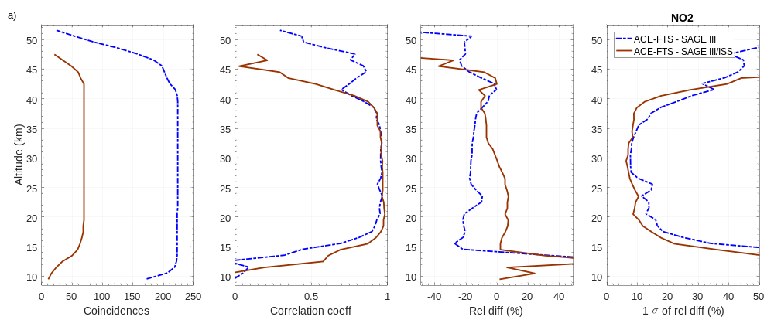
NO₂ Comparisons
  Coincidence criteria: within 4h and 350 km; ACE-FTS scaled to local solar time of SAGE III/ISS using chemical box model [Sheese et al., 2016].
  Agreement for SAGE III/ISS much better than for 3M. Below 30 km, differences of up to +8% and, from 30-45 km, diffs. up to -10 to -12%.

