Slide 1
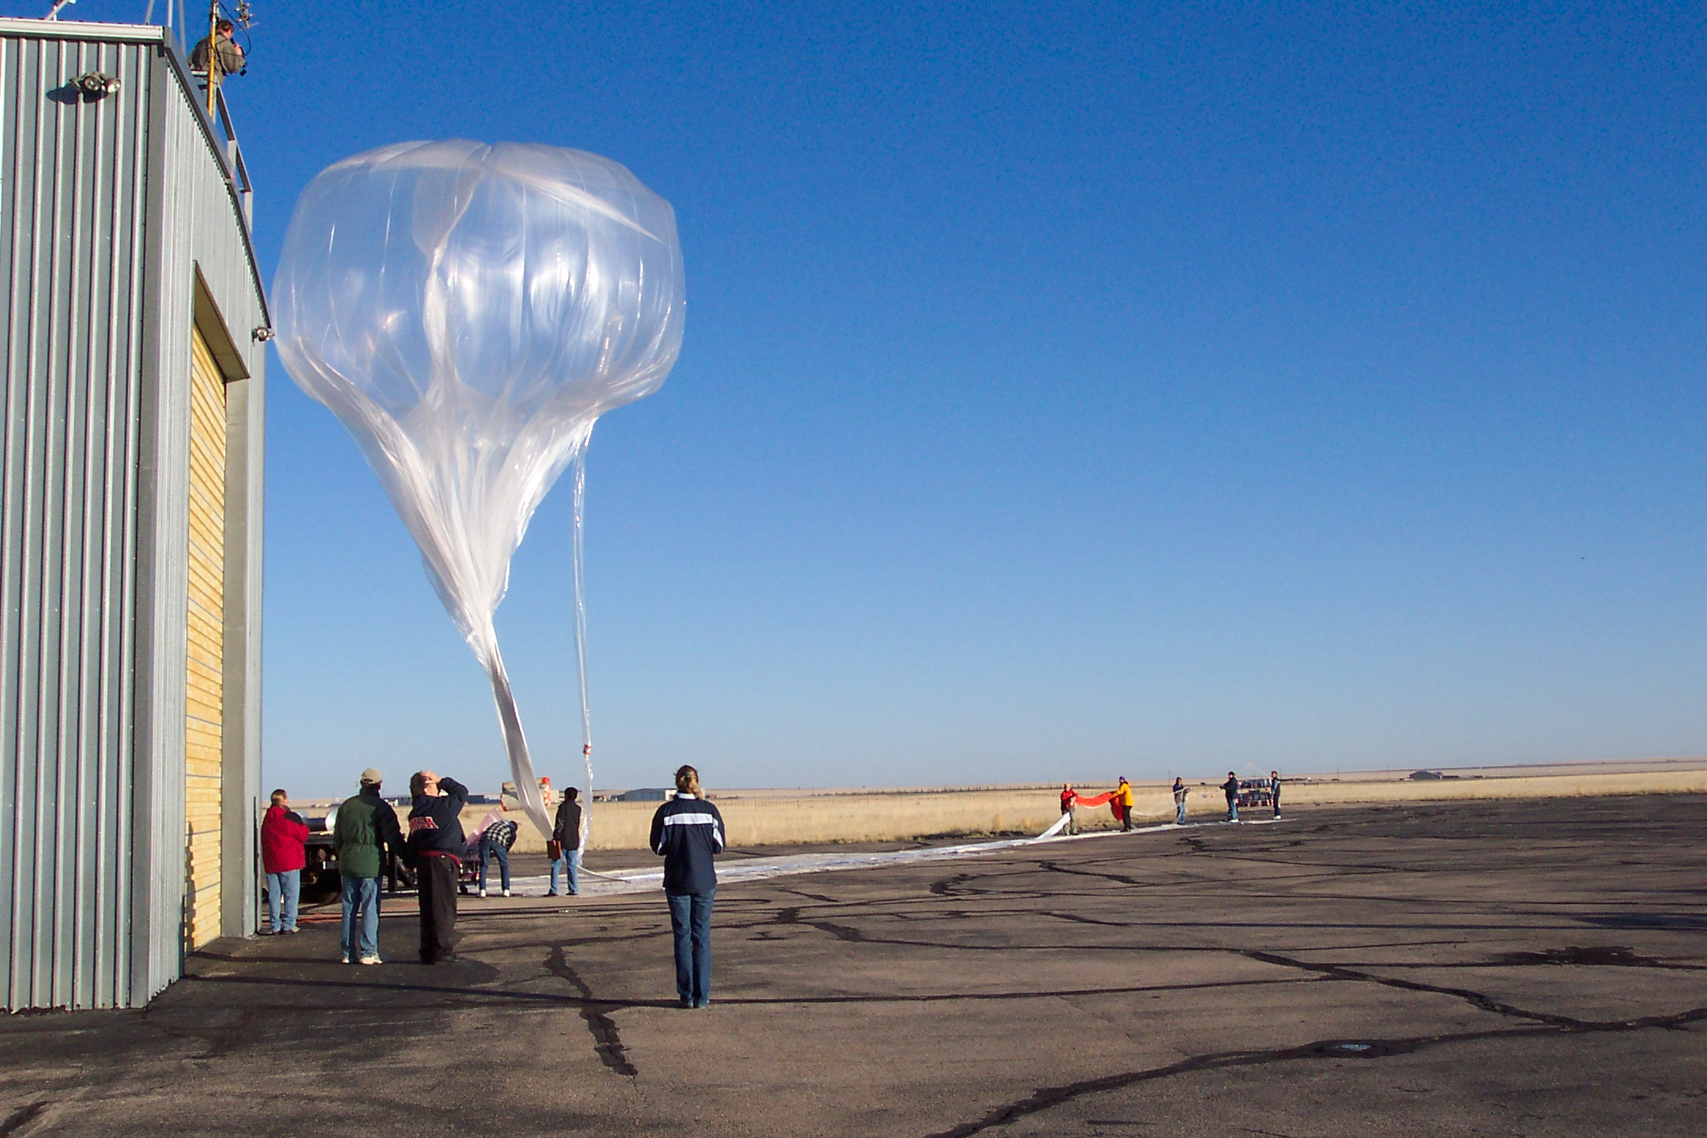




Retrieval of aerosol size distributions from in situ particle counter measurements: instrument counting efficiency and comparisons with satellite measurements.
Terry Deshler (LASP – Boulder, Univ of Wyoming – Laramie)
Lars Kalnajs (LASP – Boulder)

Slide 2
Objectives of this work
Continue regular in situ balloon borne measurements of stratospheric aerosol size resolved number concentrations to validate SAGE III-ISS
Augment an existing tropical balloon sounding site with aerosol instruments and performing regular tropical soundings
Retrieve aerosol extinction and surface area densities from in situ size distribution measurements for comparison with remote measurements
Provide a priori aerosol size distribution and microphysical parameters for aerosol retrievals from remote measurements by other optical instruments
Maintain and enhance an in situ measurement capability to provide measurement data from regions with high aerosol loadings that may be opaque to limb sounding measurements during future volcanic eruptions

Slide 3
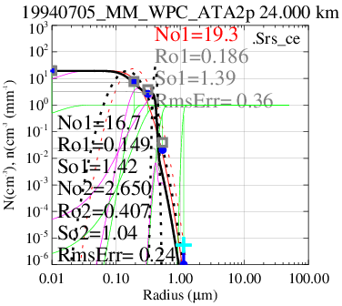
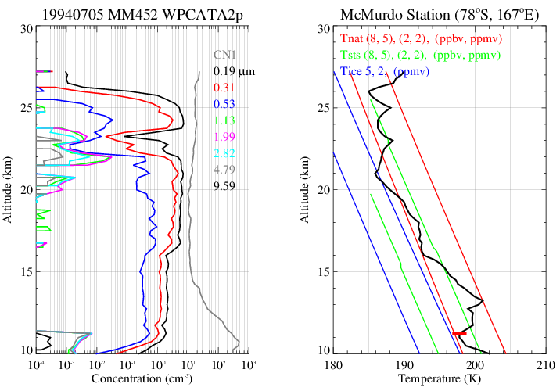
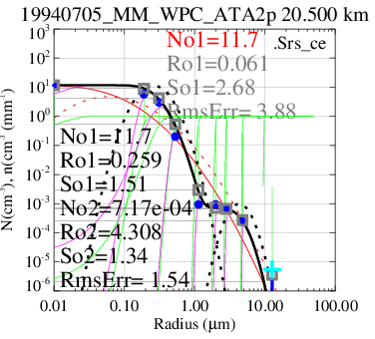
c)
a)

Slide 4
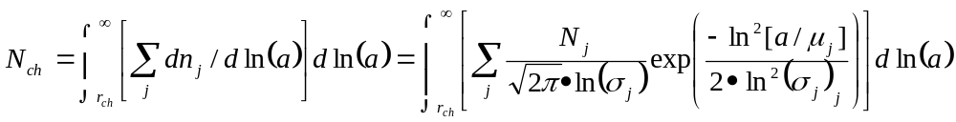
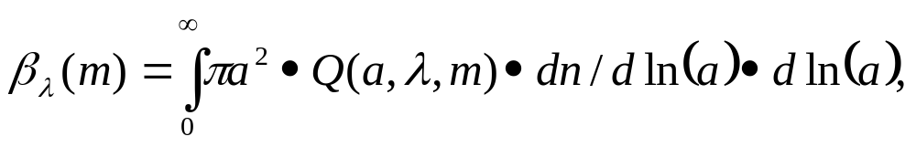

Slide 5
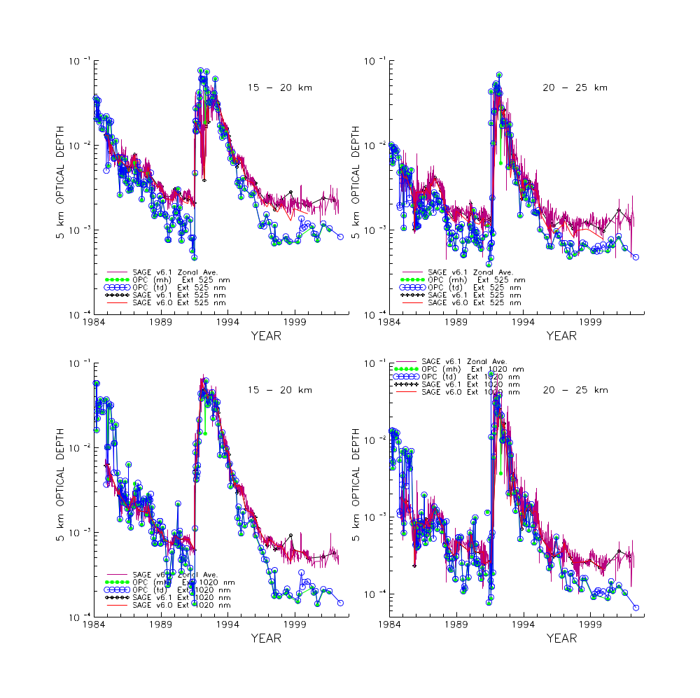
525 nm
Comparison of SAGE v6.0 and 6.1 with UWOPC optical depth
1020 nm

Slide 6
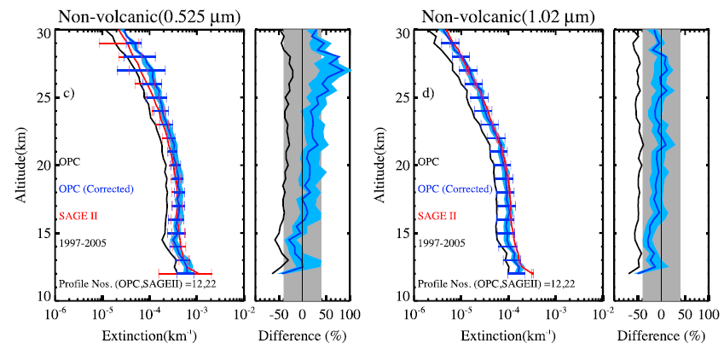
Kovilakam & Deshler, JGR, 2015

Slide 7
Possible source of problem
Inlet sampling problem
Particle evaporation in the inlet
Counting efficiency (calibration problem)
Arose from convergence of new investigator, new calibration system, and newly revised instrument.

Slide 8
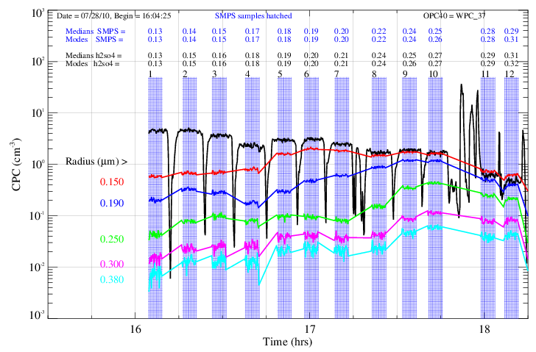
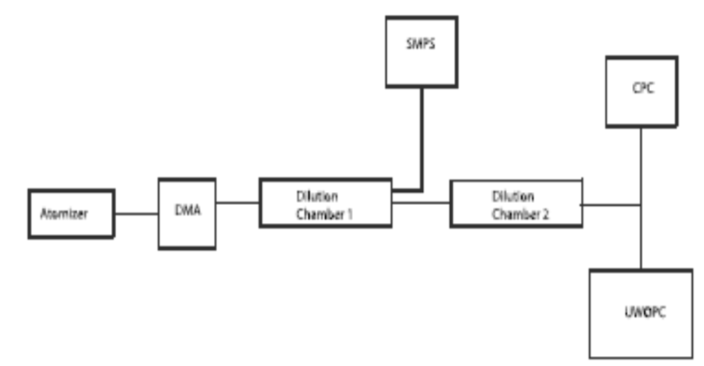
Atomizer
DMA
Dilution
Chamber 1
SMPS
Dilution
Chamber 2
CPC
UWOPC

Slide 9
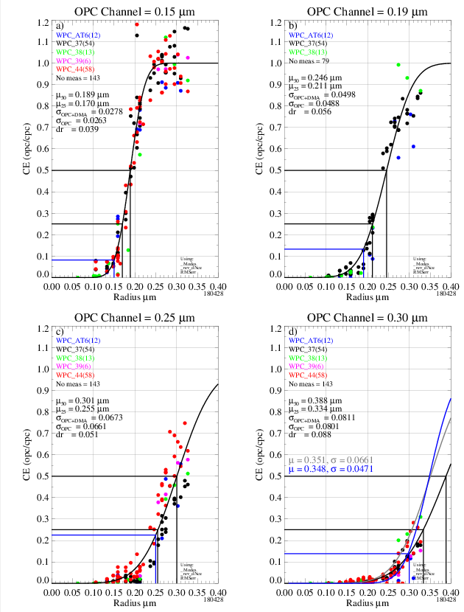
Ch 0.15
µ 0.189
σ 0.0263
Ch 0.19
µ 0.246
σ 0.0488
Ch 0.25
µ 0.301
σ 0.066

Slide 10


Slide 11
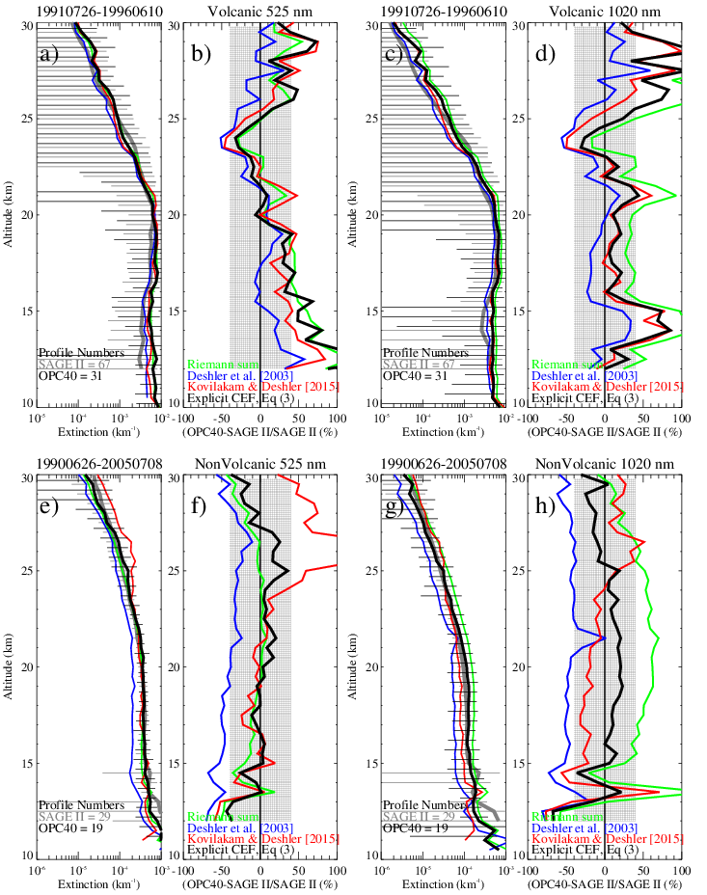
Before
After
Extinction 525 & 1020 nm
OPC vs SAGE II

Slide 12
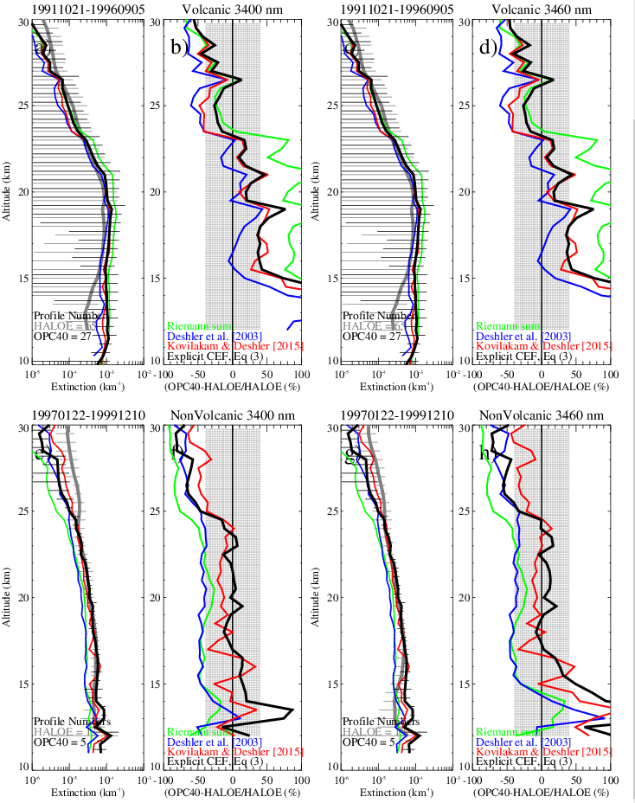
OPC Extinction at 3400 and 3460 nm compared to HALOE
Volcanic Period
Non-Volcanic Period

Slide 13
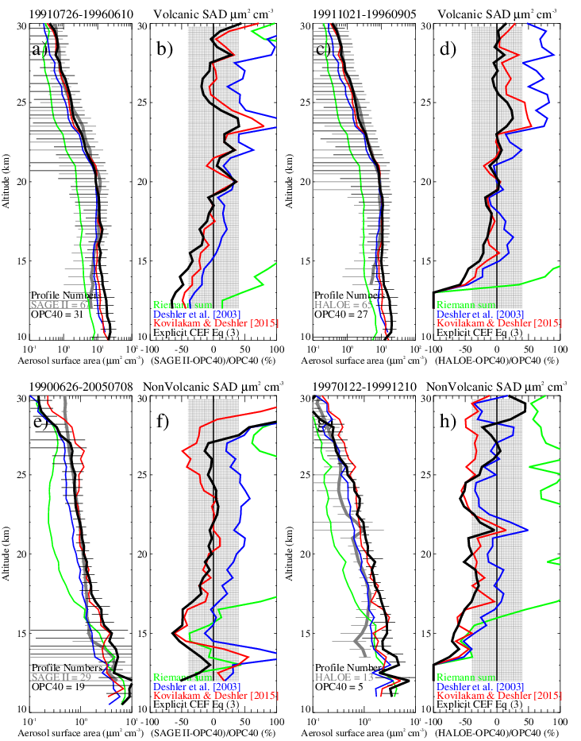
HALOE
SAGE II
Surface Area Density

Slide 14
HALOE
SAGE II
Surface Area Density
Deshler Terry, Beiping Luo, Mahesh Kovilakam, Thomas Peter, Lars Kalnajs, Retrieval of aerosol size distributions from in situ particle counter measurements: instrument counting efficiency and comparisons with satellite measurements. Submitted J. Geophys. Res., 8-26-18.

Slide 15
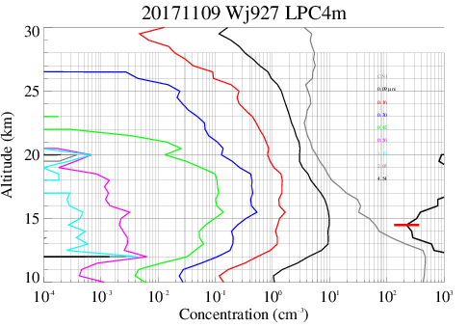
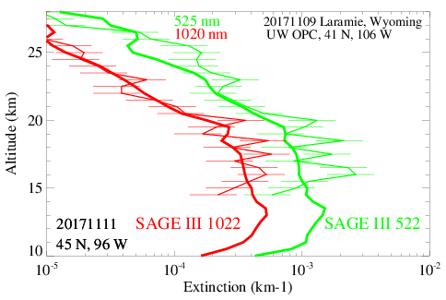

Slide 16
Objectives of this work
Continue regular in situ balloon borne measurements of stratospheric aerosol size resolved number concentrations to validate SAGE III-ISS
Augment an existing tropical balloon sounding site with aerosol instruments and performing regular tropical soundings
Retrieve aerosol extinction and surface area densities from in situ size distribution measurements for comparison with remote measurements
Provide a priori aerosol size distribution parameters for aerosol retrievals from remote measurements by other optical instruments
Maintain and enhance an in situ measurement capability to provide measurement data from regions with high aerosol loadings that may be opaque to limb sounding measurements during future volcanic eruptions

Slide 17
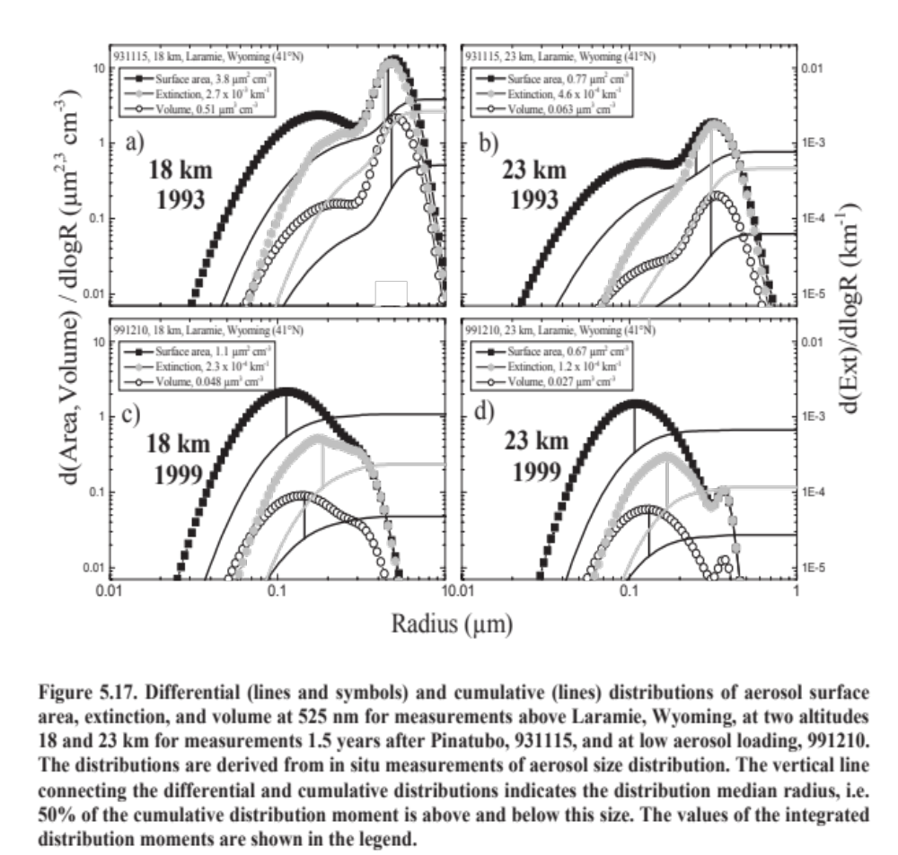
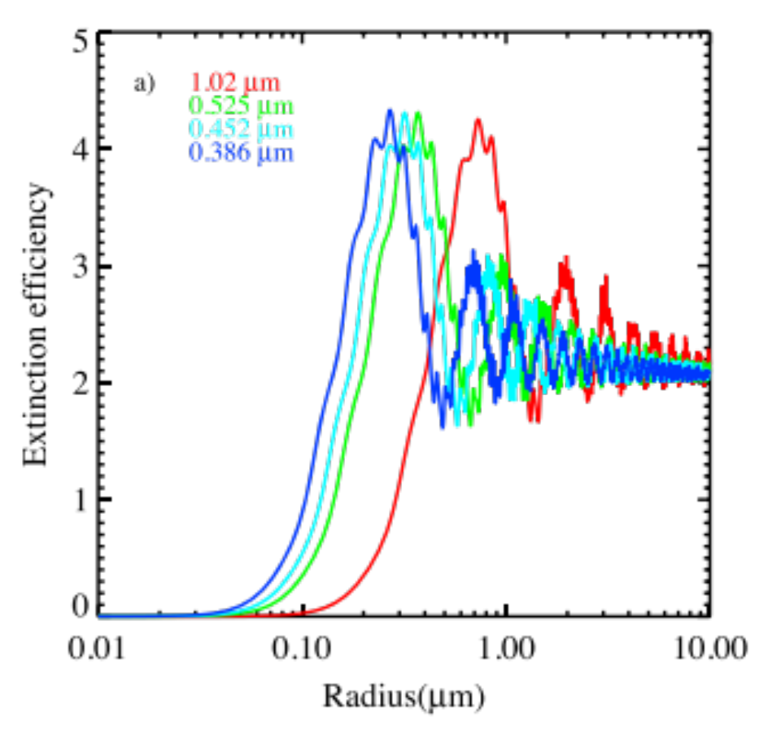
Challenges to measurements in volcanic and non volcanic regimes.
Volcanic
Non-Volcanic
Grey: Extinction at 525nm
SPARC ASAP Report 2006
Kovilakam, M., and T. Deshler (2015)
Notes:
The measurement challenges for continued SAGE validation are different during volcanic and non-volcanic periods. During the non-volcanic period, more than half the extinction at 525nm is due to particles of radius < 0.15um, which are hard for OPCs to capture. In this regeime the CNC is critical to capture the bulk of the particles, but only gives one channel. We are scheming on how to get better resolution for particles r < 0.1um. During a volcanic period it is the opposite – more than half the surface area is in particles with r > 4um, and even larger for the 1020 nm channel. While these particles drive the extinction, there are still not very many of them per volume, which is where the high flow counters become important.

Slide 18
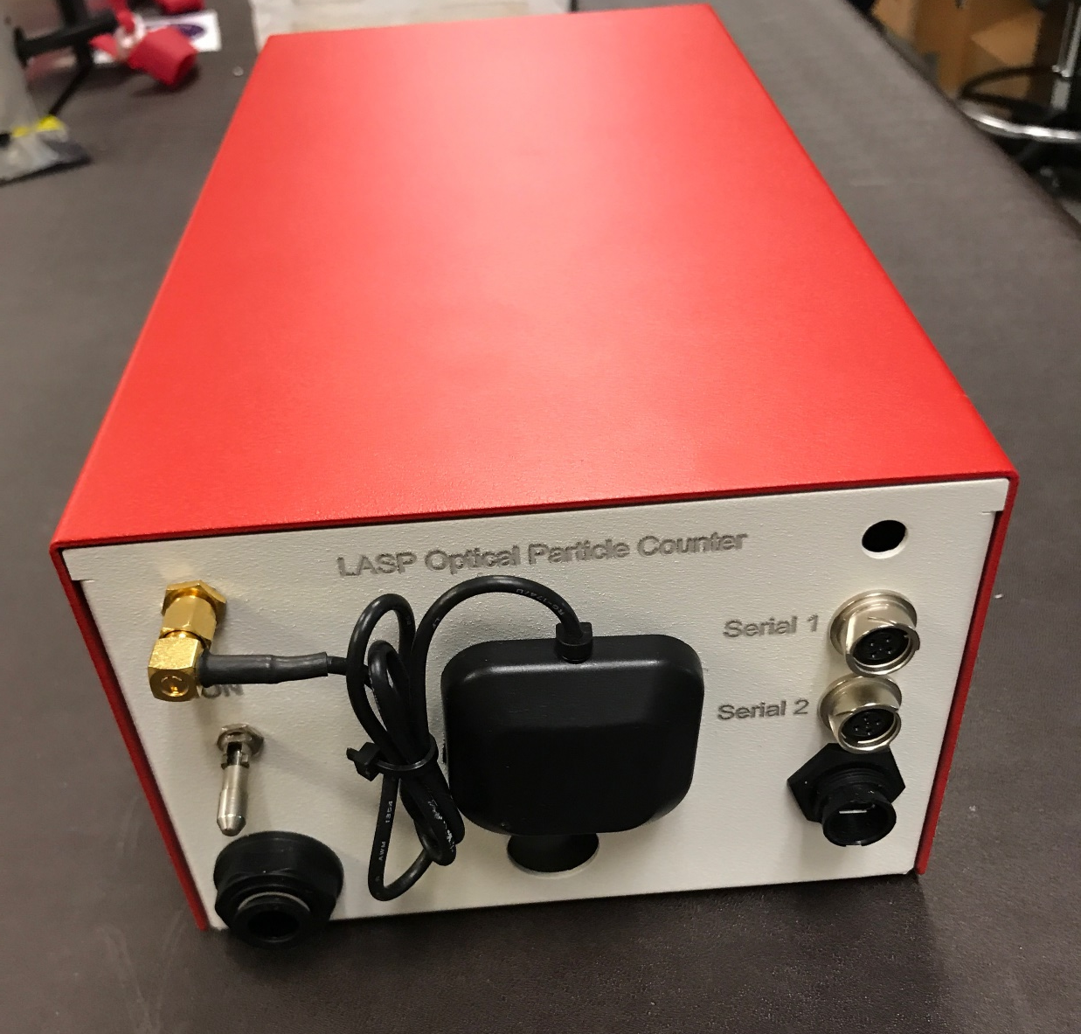
LASP Optical Particle Counter
Condensation Nuclei Counter
Size Range (radius) | 0.125 – 10μm
Size Bins | 2048 Raw, 1200 Effective, log spaced
Flow Rate | 20 LPM (660 cm³ per sample at 0.5Hz)
Concentration Range | 10⁻³ – 10³ cm⁻³ (at 0.5Hz)
Dimensions | 30cm x 10cm x 15cm
Mass | 2.4Kg (including battery)
Cost | ~$5K (component cost)
Light Source | 90mW 780nm Laser Diode
Detector geometry | 90º Scattering angle, 60º Acceptance
Detector | APD, non linear gain, 2 gain stages
Minimum Detectable Size (radius) | 0.007μm
Flow Rate | 1 LPM (33 cm³ per sample at 0.5Hz)
Sensitivity | 10⁻² – 10³ cm⁻³ (at 0.1Hz)
Dimensions | 30cm x 10cm x 18cm
Operation Time | 4 hours
Mass | 2.6Kg (including battery)
Cost | ~$4K (component cost)
Notes:
New instruments build on several lessons from prior instruments: Quick to build and light weight -> Lower cost of operations
Higher number of bins -> Much faster convergence

Slide 19
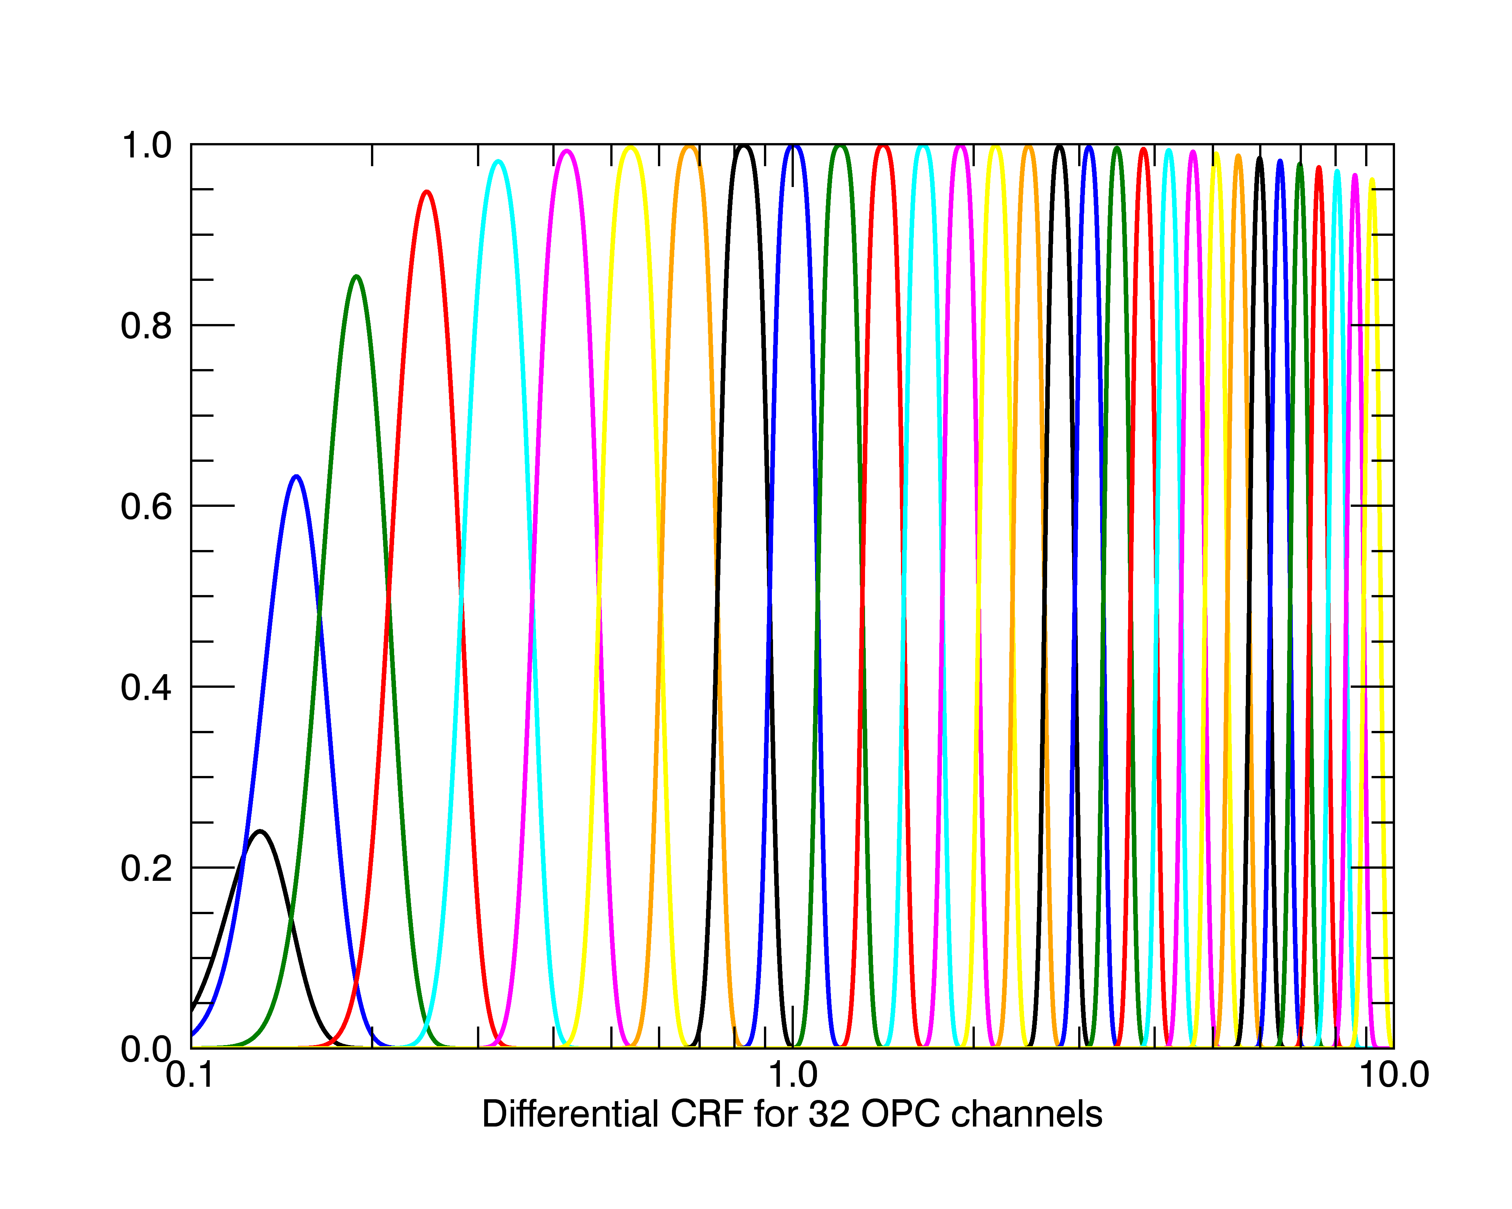
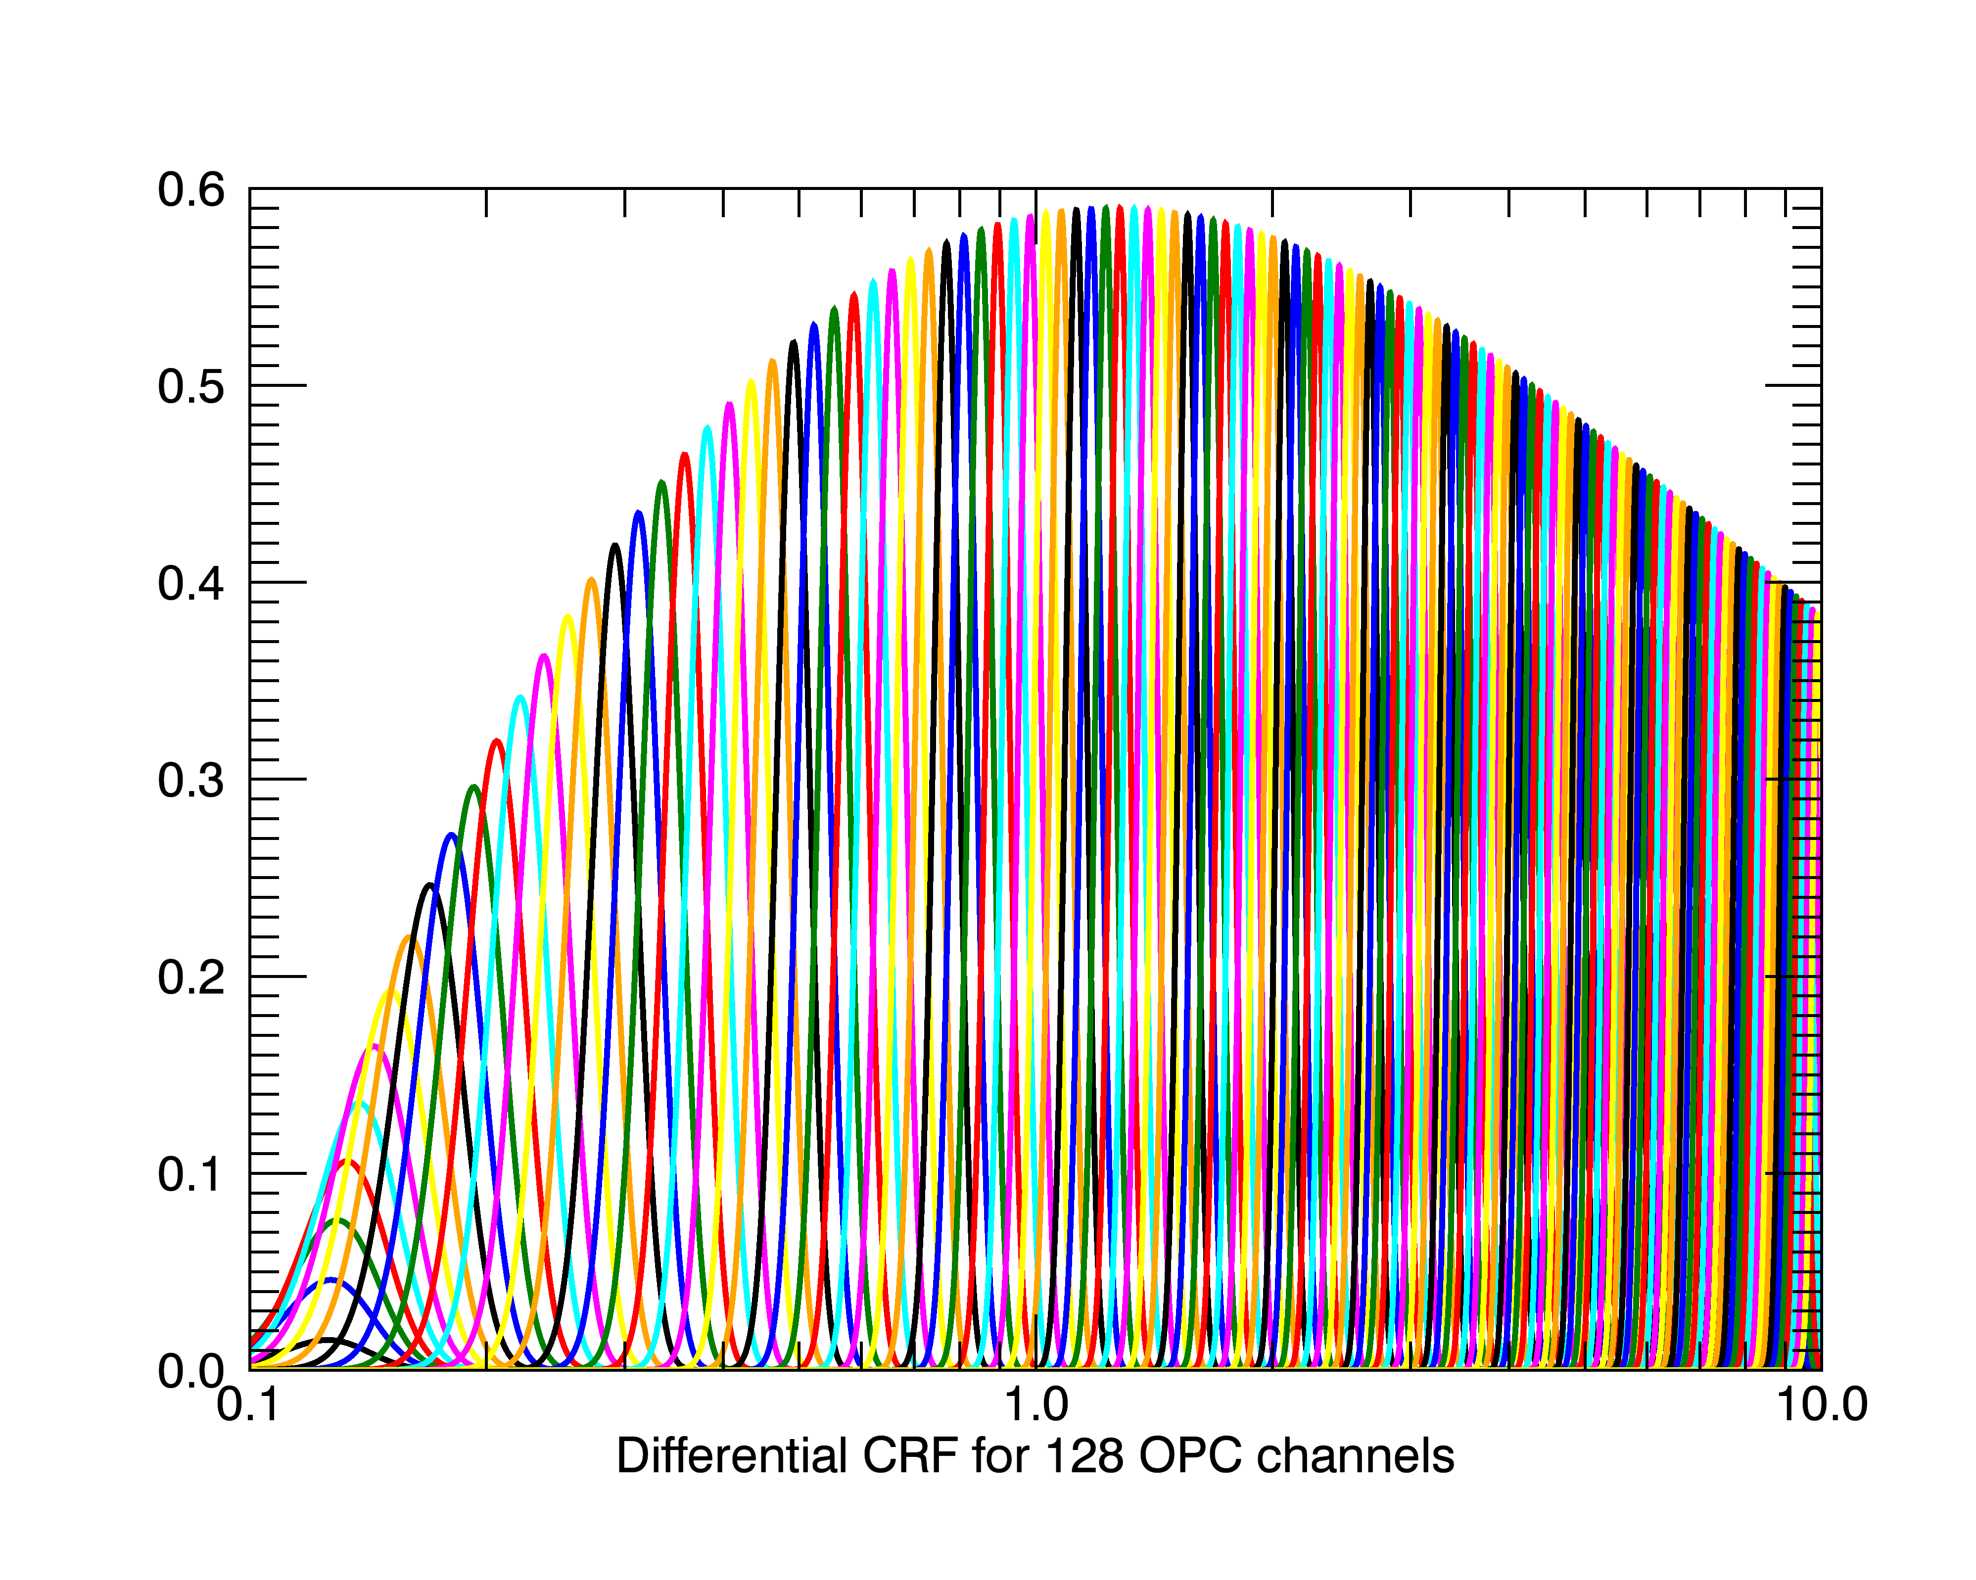
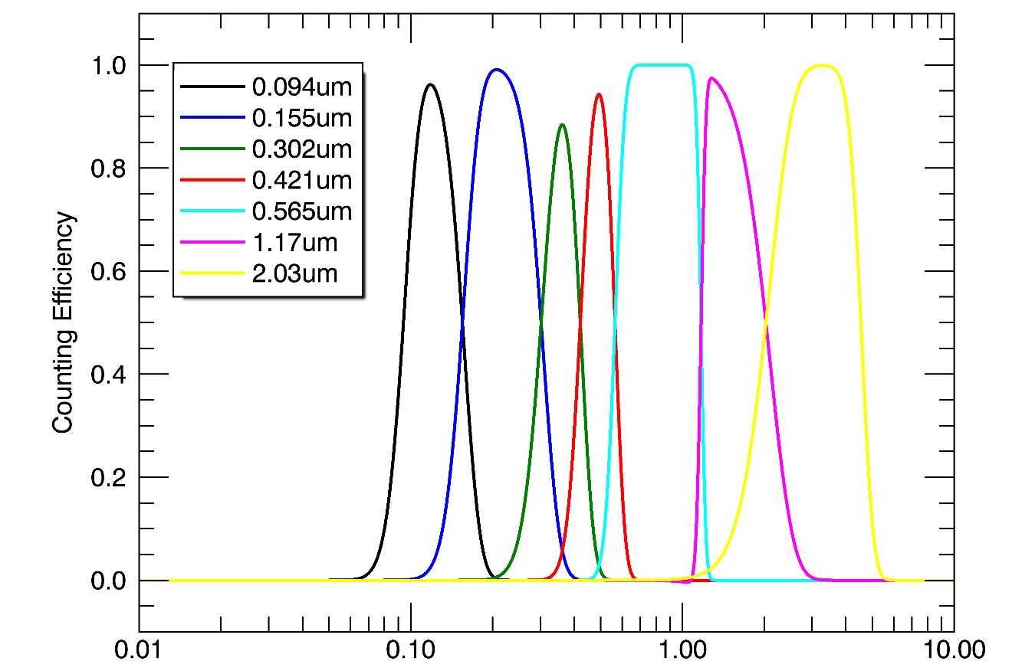
More Channels = Simplified Fitting Algorithm
Counter Response Function WOPC – 8 Channels
Counter Response Function LOPC – 128 Channels
Counter Response Function LOPC – 32 Channels
Particle Radius [µm]
Particle Radius [µm]
Notes:
Increasing the number of channels simplifies the size distribution retrieval. We no longer have to predetermine the shape of the distribution, we can see it in the data. However there is still fitting to be done! As the channels get narrower, the counting efficiency never makes it to 1 – need to scale each channel by the counting efficiency. This also sets an upper limit on the number of channels.

Slide 20
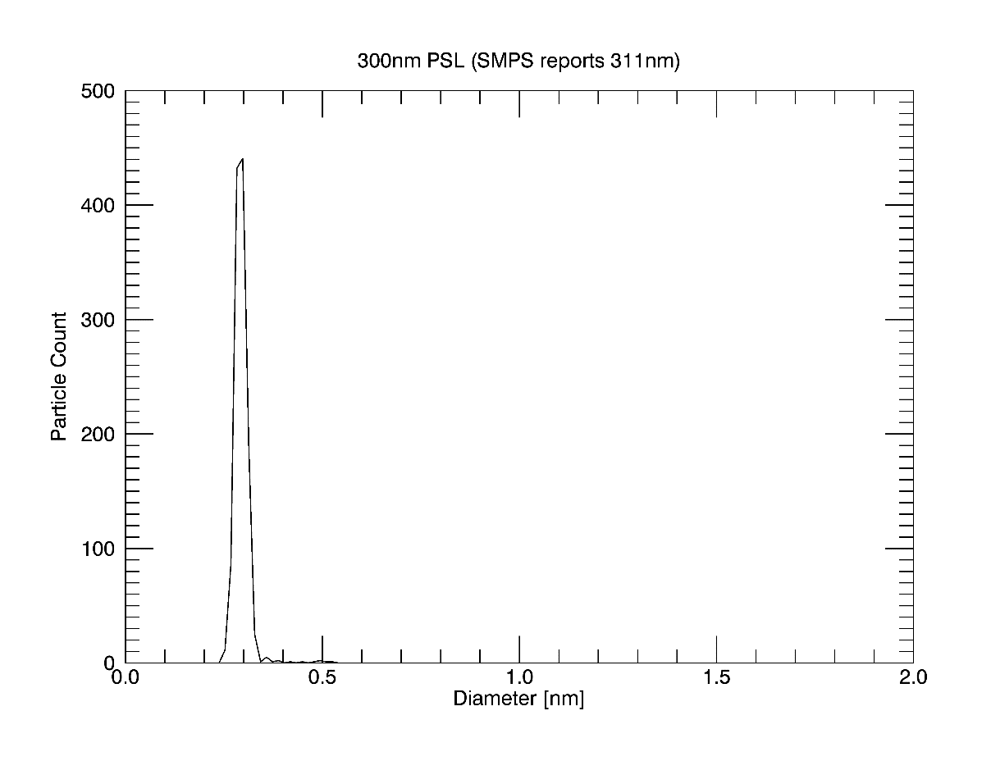
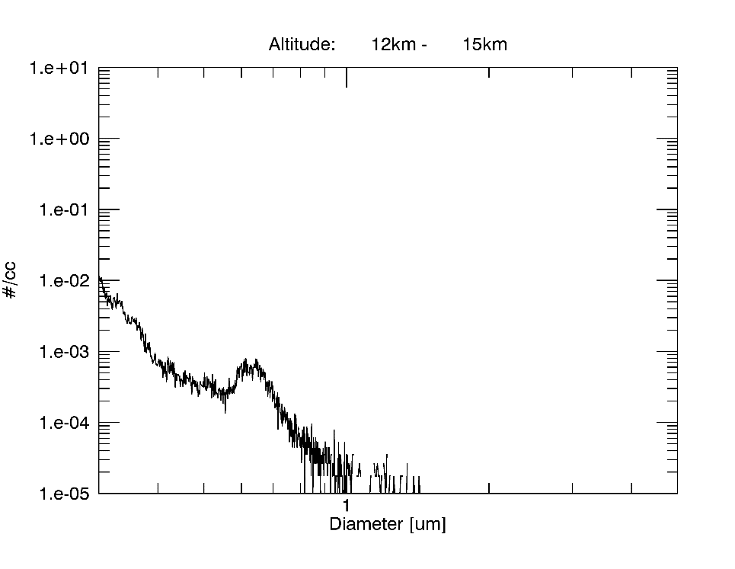
Example corrected number density distribution from lower stratosphere.
Laboratory response to 300nm calibration particles.
Figure Courtesy of Doug Goetz
Notes:
- New capabilities open new possibilities that we have not even thought about.

Slide 21
Completed:
Closed loop pump control
LOPC mechanical housing redesigned for production
Lower cost CNC condensation and growth chamber
Vacuum chamber comparisons with WOPC
Radiosonde and satellite telemetry system
Test flights of low cost OPC
Still to do:
In flight comparison with WOPC!
Repackage CNC for higher volume production
Validate low cost commercial OPC for non-recoverable flights
Commence regular flights

Slide 22
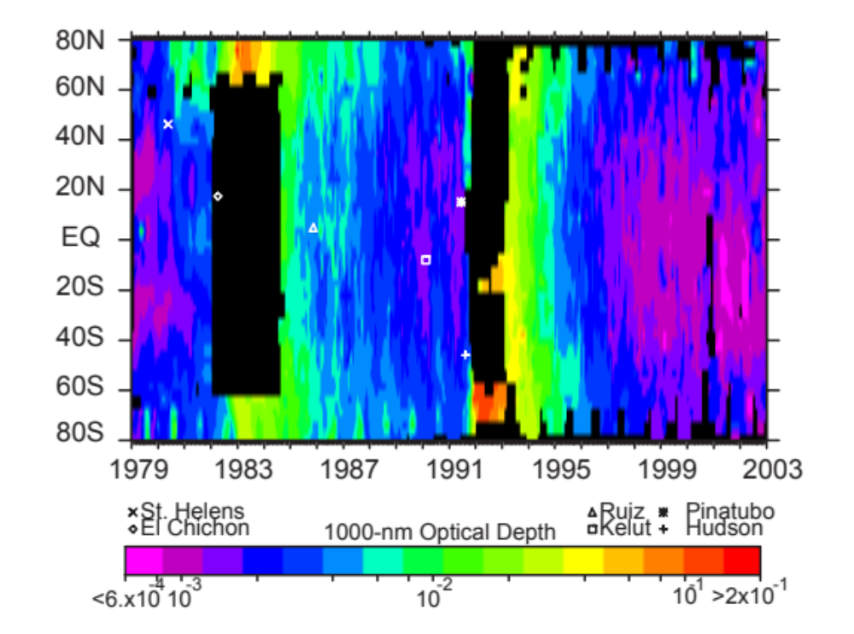
5. Maintain and enhance an in situ measurement capability to provide measurement data from regions with high aerosol loadings that may be opaque to limb sounding measurements during future volcanic eruptions
SPARC ASAP Report 2006
Notes:
During the Pinatubo eruption, SAGE II was blinded by the high AOD. The same thing could happen to SAGE III-ISS if we have a similarly sized or larger eruption. Larry spent much time filling in the SAGE II record for this period, and relied on in situ measurements among other things. One of the motivations for a volcanic response and an increased cadence and distribution of balloon measurements afterwards is to fill in these gaps again.

Slide 23
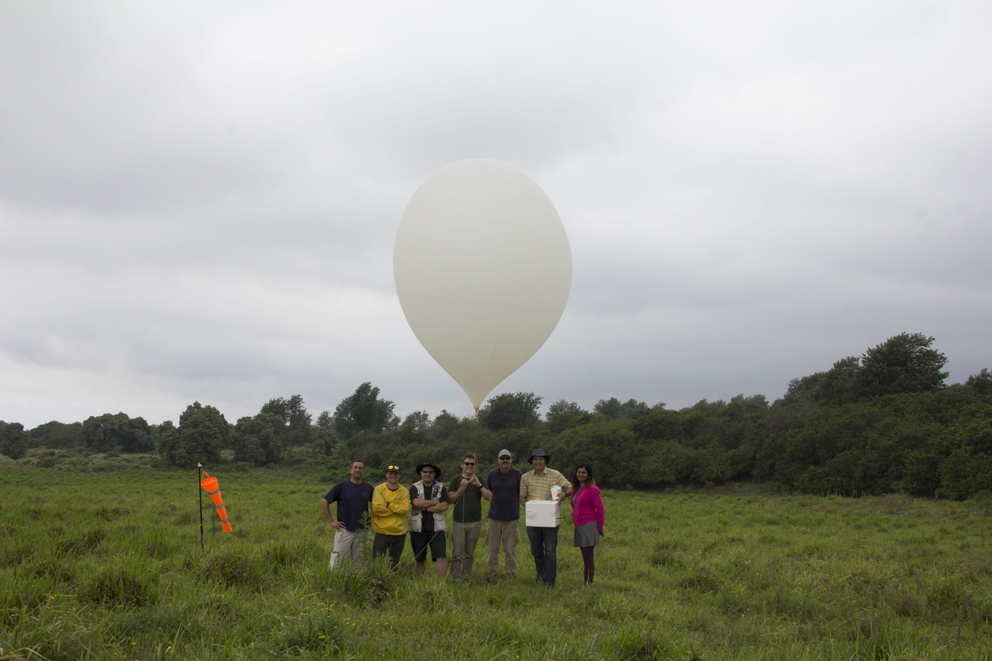
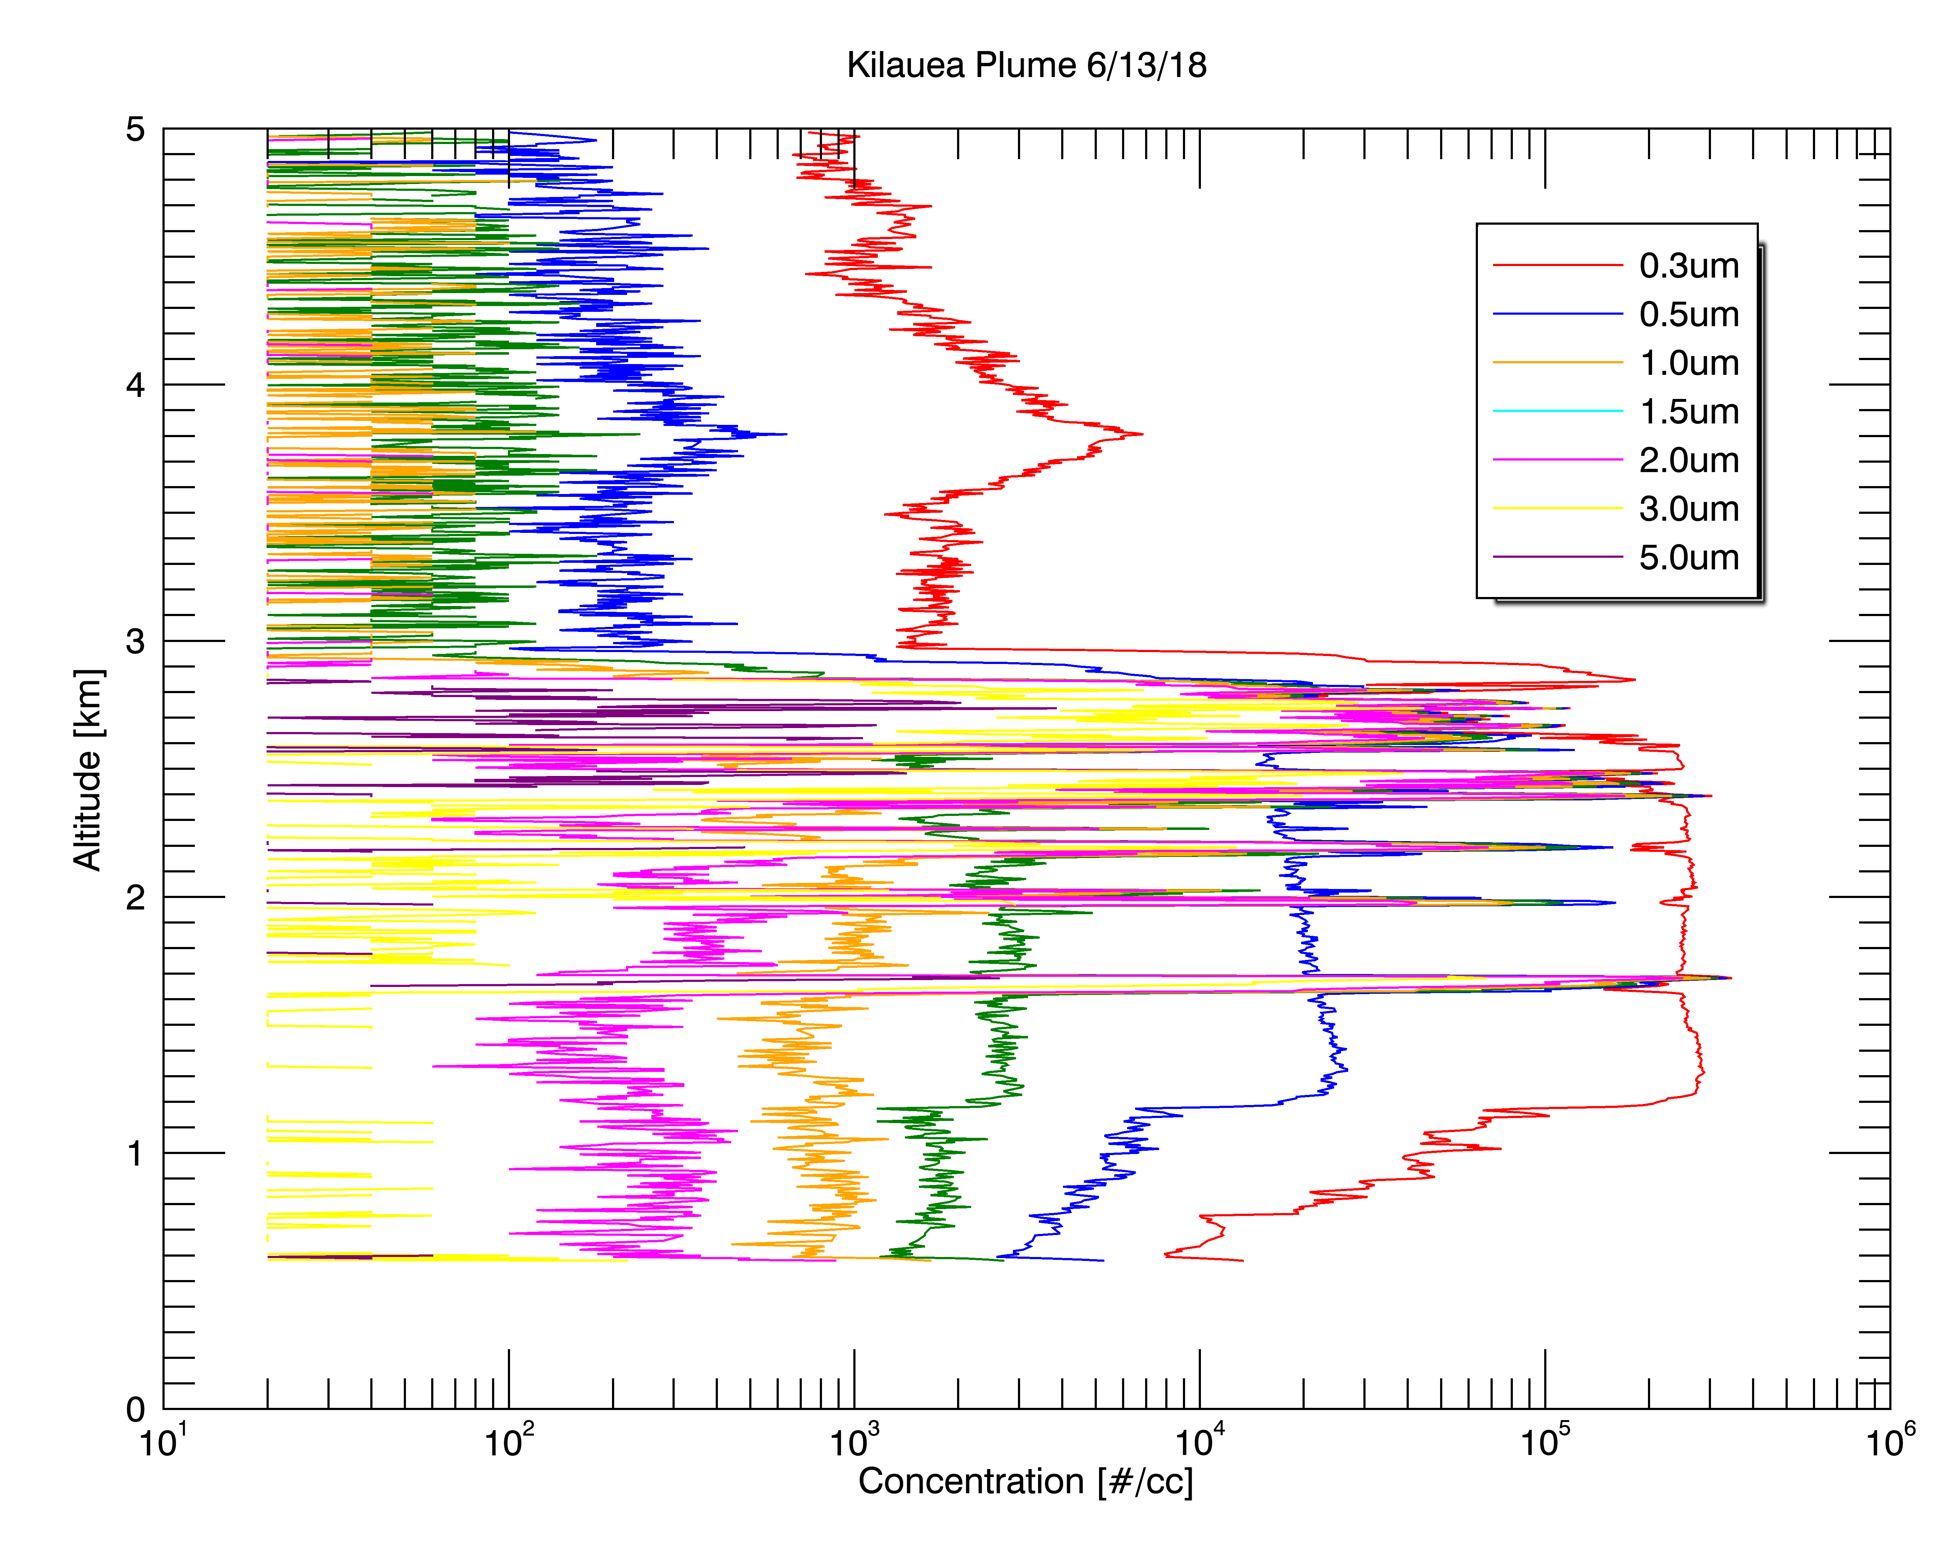
VolKilau Volcanic Response Mission
In dense volcanic plume, even simple OPCs have sufficient resolution.
Successfully demonstrated ability to rapidly respond to an eruption and collect the sort of data necessary to fill in satellite gaps
Quantify the aerosol and SO₂ emissions from the Kileauea eruption
Demonstrate and refine strategy for a rapid response to a volcanic event with stratospheric impacts

Slide 24
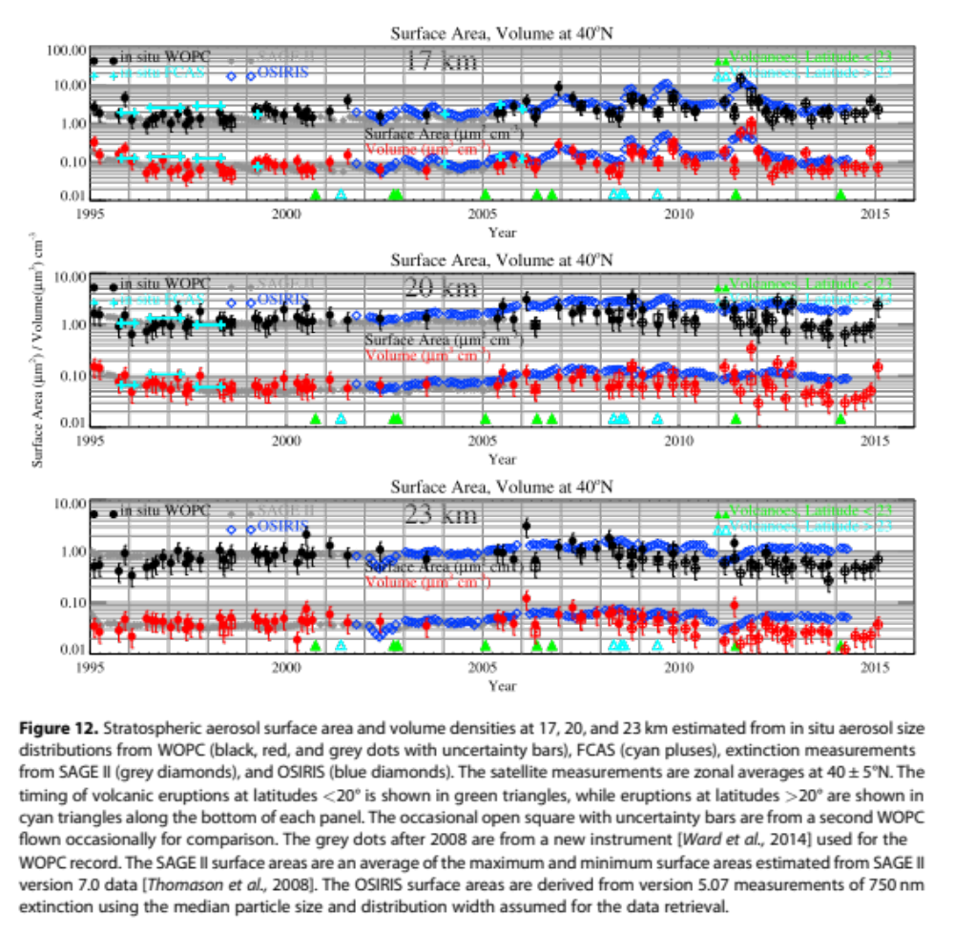
1. Continue regular in situ balloon borne measurements of stratospheric aerosol size resolved number concentrations to validate SAGE III-ISS
In situ measurements of stratospheric aerosol have been made from Laramie Wyoming, since 1971
There have been both personnel and instrument changes made over the past 45 years
The current instrumentation and PI are nearing retirement
Designing a new generation of smaller/lighter/cheaper instruments and moving operations to Boulder
Kremser, S., et al. (2016), Stratospheric aerosol—Observations, processes, and impact on climate, Rev. Geophys., 54, doi:10.1002/2015RG000511.

