Slide 1
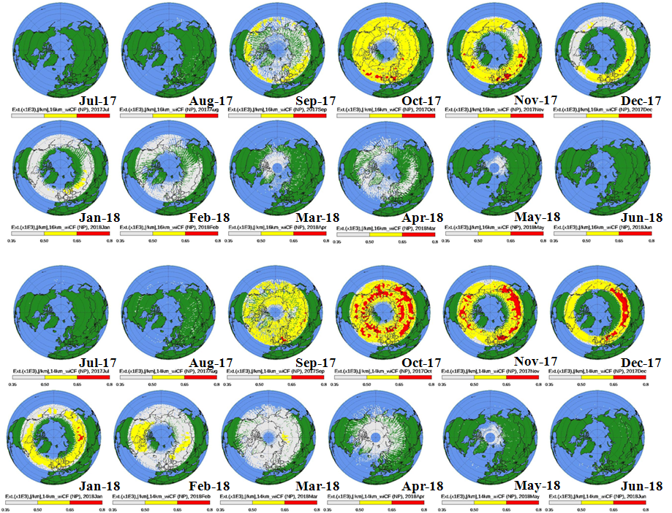
Retrieval of Aerosol Extinction Profiles from Limb Scattering Instruments: Experience with OMPS LP
Evolution of Strat Aerosols from Aug 13, 2017 PyroCb
16.5 km
14.5 km
P. K. Bhartia, Zhong Chen, Ghassan Taha
Notes:
Simple 7 circuit Labyrinth. It is not a maze..

Slide 2
Limb Scattering Instruments
SME: 1982-1988
SOLSE/LORE: 1997
SAGE III: 2002-2005, 2017-
SCIAMACHY: 2003-2011
GOMOS:2003-2011
OSIRIS: 2002-
OMPS: 2012-
Also flown on MARS missions

Slide 3
Limb Scattering Technique
Solar Radiation
Tangent point
Line of sight
Tangent height
Diffuse upwelling radiation

Slide 4
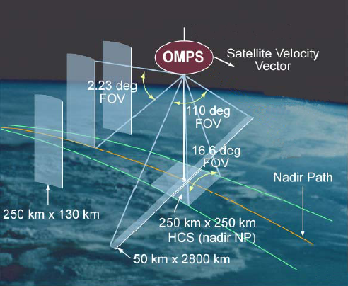
Suomi NPP O₃ Monitoring & Profiler Suite (OMPS)
LP
NP
NM
Notes:
OMPS consists of suite and ground processing algorithms
Two sensors, Limb and Nadir, provide Limb Profile, Nadir Total Column, and
Nadir Profile Raw Data Records
Main Electronics Boxes provide data processing, provide spacecraft electrical interfaces, and controls on-orbit operations
SDR and EDR algorithms process RDRs into SDR and EDR products
110° nadir cross-track field of view (FOV) and 3 limb FOVs provide required coverage
2.23° limb vertical FOV provides sampling from tropopause to 60 km

Slide 5
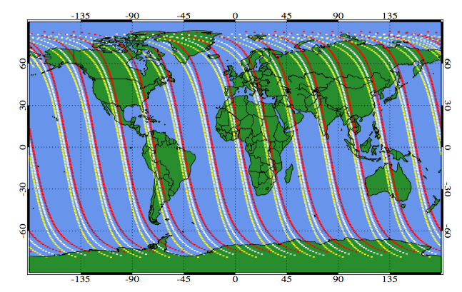
LP Daily Coverage
Left slit can go to 85S

Slide 6
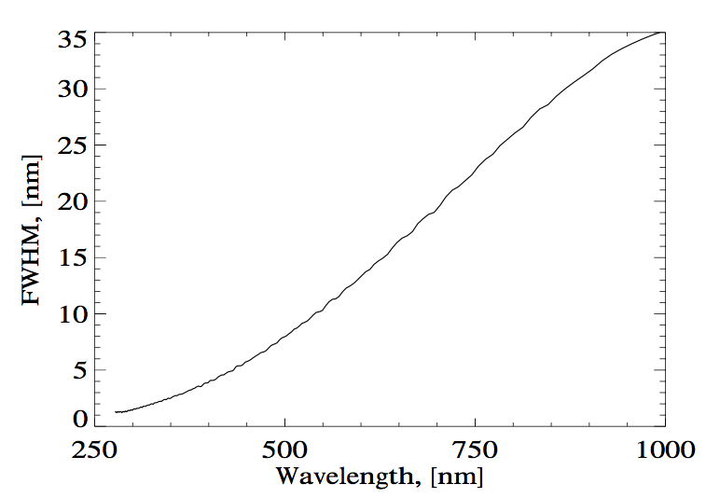
OMPS LP Spectral Coverage/Resolution
10-40 km aerosol extinction
10-30 km O₃
30-65 km O₃ and T

Slide 7
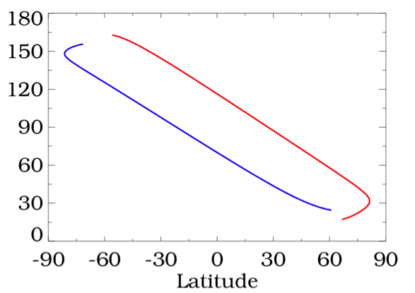
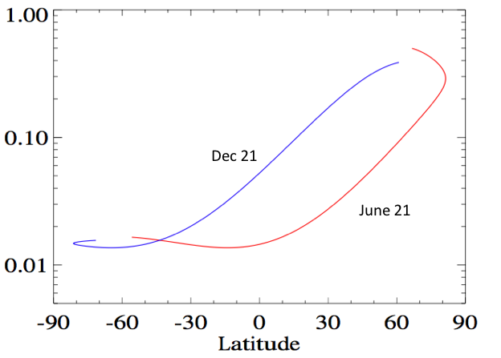
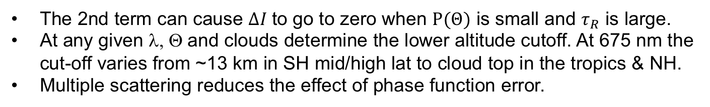
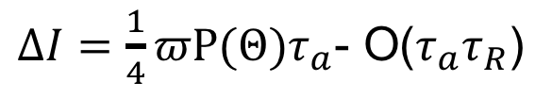

LS Aerosol Signal in SS Approx.
$ΔI=$ $\frac{1}{4}πΡ(Θ)τ_{a}$- O($τ_{a}τ_{R}$)
June 21
Θ
$$Ρ(Θ)$$
Dec 21
LP obs geometry
The 2nd term can cause $ΔI$to go to zero when $Ρ(Θ)$ is small and $τ_{R}$ is large.
At any given λ, Θ and clouds determine the lower altitude cutoff. At 675 nm the cut-off varies from ~13 km in SH mid/high lat to cloud top in the tropics & NH.
Multiple scattering reduces the effect of phase function error.

Slide 8
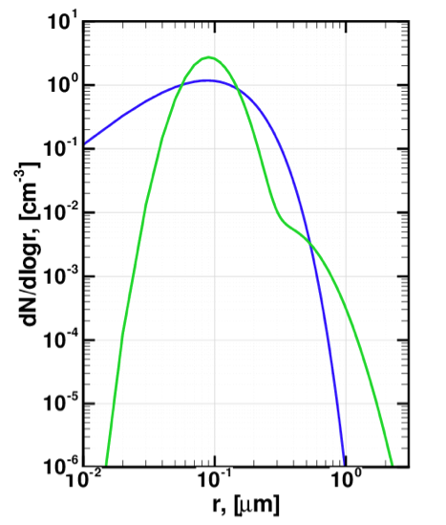
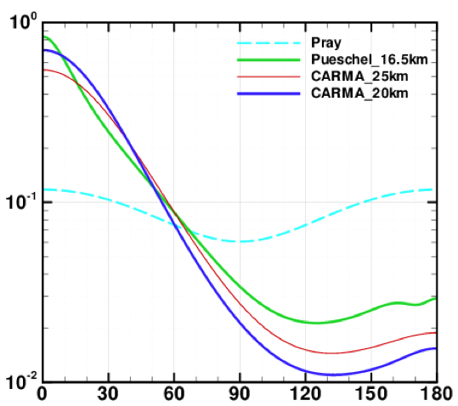
Gamma vs Bimodal lognormal Size Distribution
CARMA
P(Θ)
Pueschel
Pueschel et al.
CARMA
Θ
0.1μm particle density seem to matter most for determining the phase function. Bimodal lognormal distributions tend to overestimate it when there are no measurements below 0.15μm.
Gamma distribution seems to produce more reliable results.

Slide 9
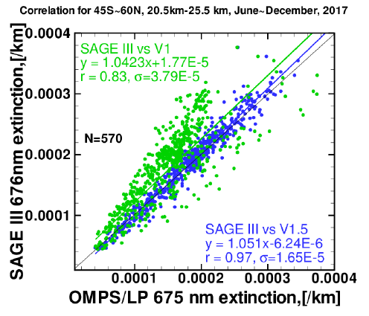
Comparison with ISS/SAGE III
Green points: Bimodal LN distribution, parameters from aircraft meas
Blue points: Gamma distribution, parameters derived from CARMA model
Improvement of stratospheric aerosol extinction retrieval from OMPS …….
Chen et al., submitted to AMT., amt-2018-221.

Slide 10
Key Conclusions
Based on a broad range of metrics the simple Gamma model does a better job for deriving aerosol scattering phase function than the bimodal lognormal model.
Unimodal lognormal works reasonably well, but it too over-predicts aerosol density below ~0.1 micron.
Gamma phase function and AE are well correlated, effectively making it a one parameter model for PF calculations.
The modified Gamma distribution may be needed if there are many coarse model particles.

Slide 11
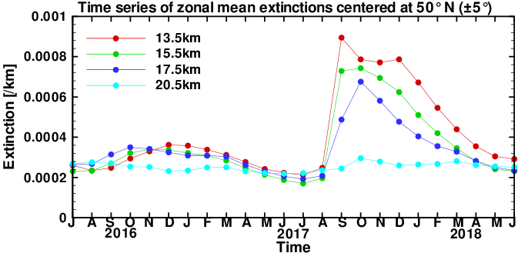
Time series (Jul 2016-Jun 2018) of aerosol extinction as seen by OMPS/LP at different altitudes

Slide 12
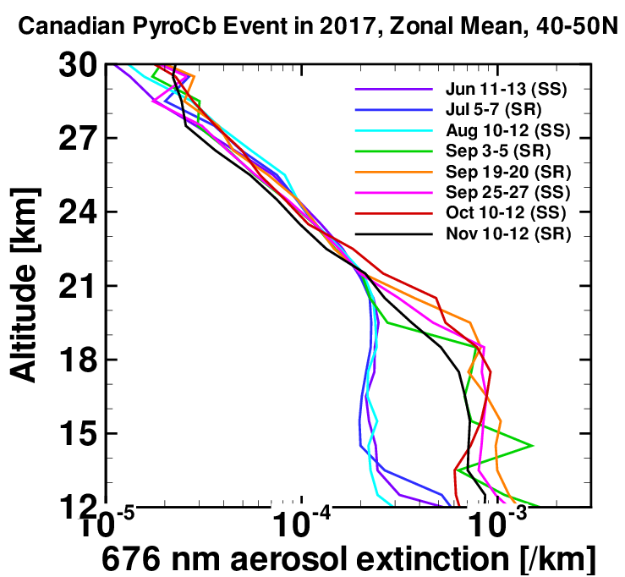
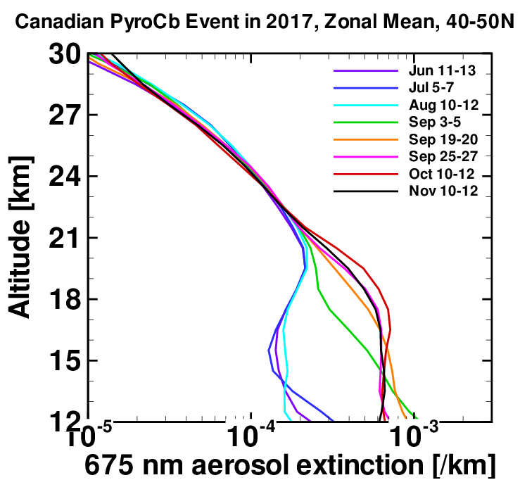
Canadian PyroCb event was observed by LP and SAGE III/ISS
SAGE III extinction profiles at 676 nm
OMPS/LP extinction profiles at 675 nm

Slide 13
Synergy with ISS/SAGE III
SAGE III measures aerosol extinction directly during solar/lunar occultation
  Comparison with LP can provide phase function information, which can then help tie down aerosol size distribution
SAGE III can also measure limb scattering between occultations at varying local times
  LS + occultation can better constrain aerosol size distribution, similar to AERONET DS + Almucantar data.
High spatial and temporal sampling from LP provides context to interpret SAGE data

Slide 14
Relevant References
OMPS Limb Profiler Version 1 Aerosol Extinction Retrieval Algorithm: Theoretical Basis
  Loughman, Bhartia, Chen, Xu, Nyaku, and Taha.
  Published in AMT
Impact of aerosol size distribution on extinction and spectral dependence of radiances measured by the OMPS Limb profiler instrument
  Chen, Bhartia, Loughman, and Colarco.
  AMT discussions (under review, publicly available)
The sensitivity of the stratospheric aerosol phase function to aerosol size distribution models
  Nyaku, Loughman, Bhartia, Deshler, Chen, and Colarco.
  Under Revision

