Slide 1
Wavelength Calibration
Robbie Manion
October 2018

Slide 2
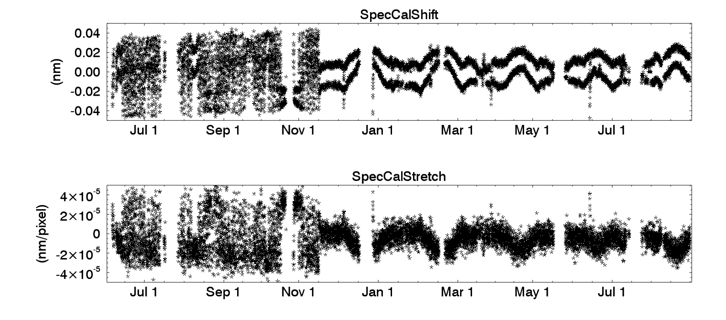
SpecCalShift and SpecCalStretch

Slide 3
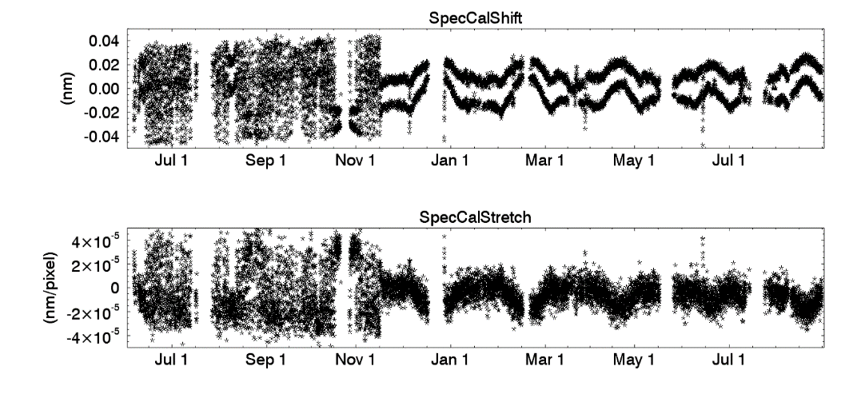
Wavelength Calibration
How do we determine the pixel-wavelength relationship for the SAGE III/ISS spectrometer?
Why do we need to shift and stretch the wavelength scale?
How different are the V5.1 wavelengths from V5.0?
What happened in November 2017?

Slide 4
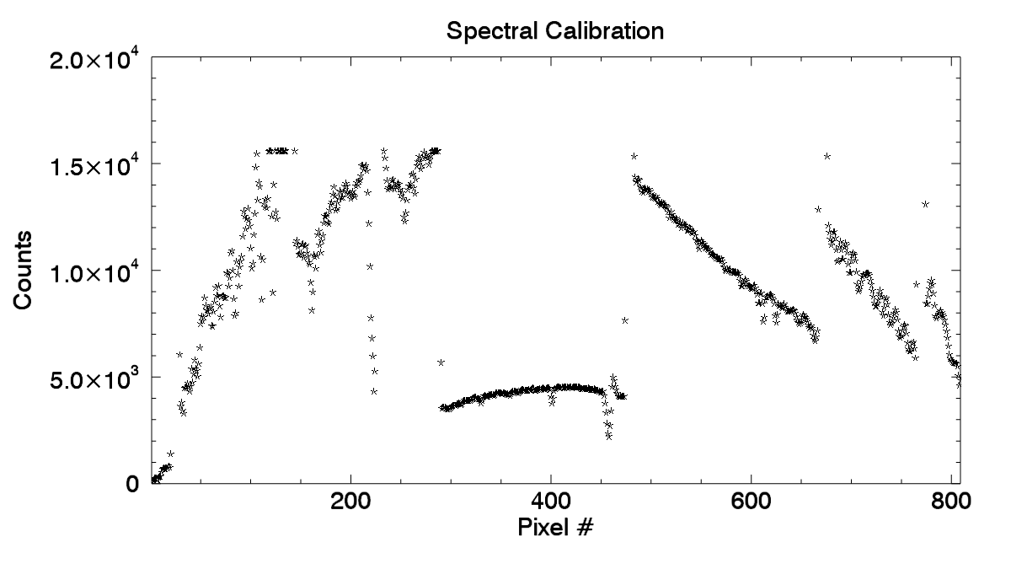
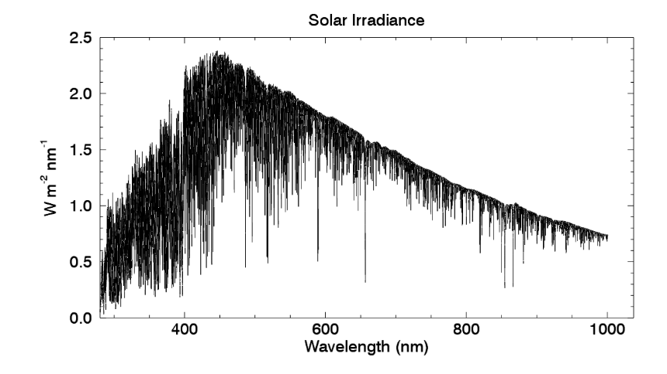
Spectral Calibration Data
Exoatmospheric scans of the solar disk
Center of Sun counts recorded for all 809 pixels of the CCD
Can be compared to reference solar spectrum (Chance & Kurucz 2010)
K. Chance and R.L. Kurucz, “An improved high-resolution solar reference spectrum for earth’s atmosphere measurements in the ultraviolet, visible, and near infrared”, Journal of Quantitative Spectroscopy & Radiative Transfer, vol. 111. pp 1289-1295, 2010.

Slide 5
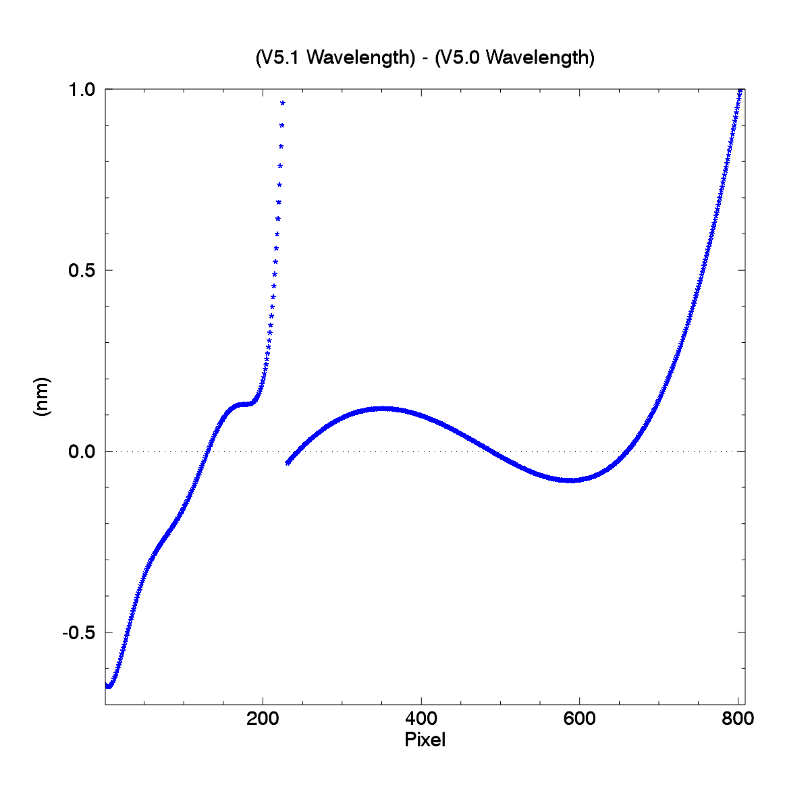
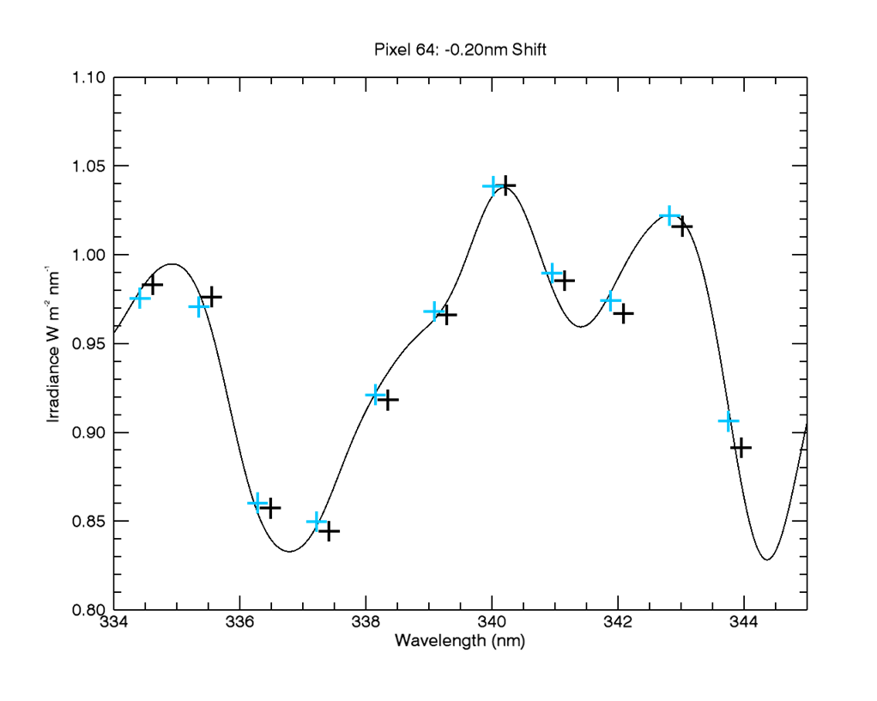
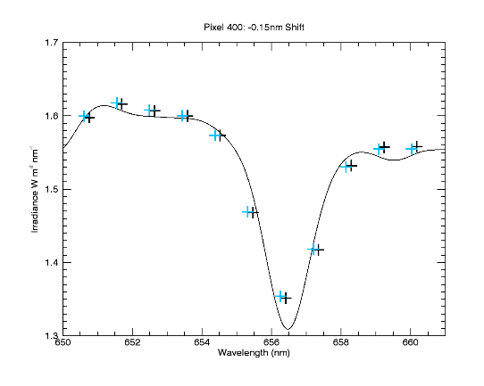
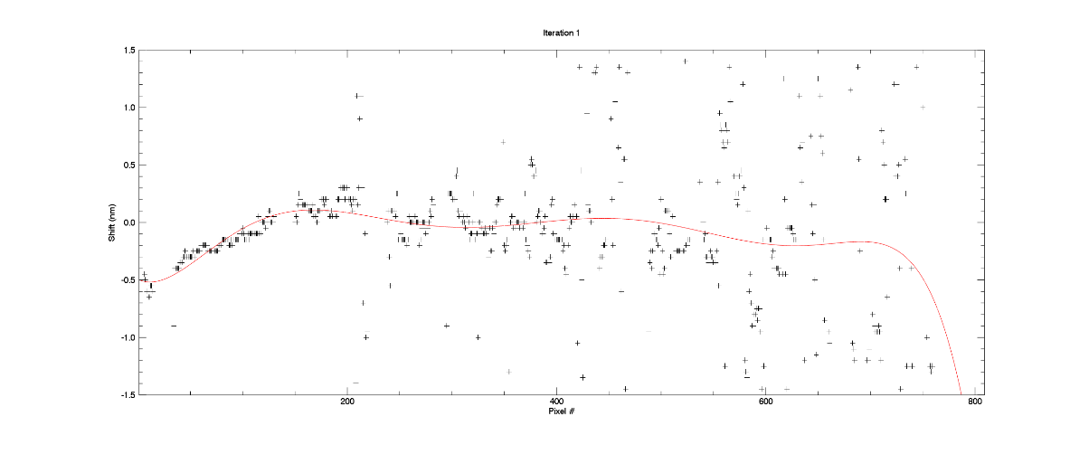
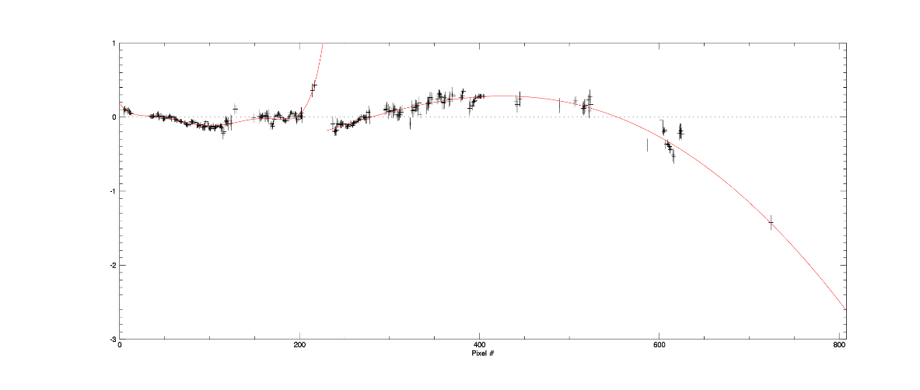
Pixel-to-Wavelength
The instrument manufacturer provided a pixel-to-wavelength map (the “Ball” map).
For V5.0, we compared this spectral calibration data to a solar spectrum and determined the shift necessary to line up with a few Fraunhofer lines. Wavelengths across the CCD were adjusted according to a straight-line fit of those shifts.
For V5.1 we took the Ball map and similarly fit our data to solar features, but did not limit the fitting to a few lines.
To get a better handle on the pixel vs wavelength relationship, we looked at its departure from linear and ultimately based our nominal pixel-to-wavelength map on the polynomials you see here.
V

Slide 6
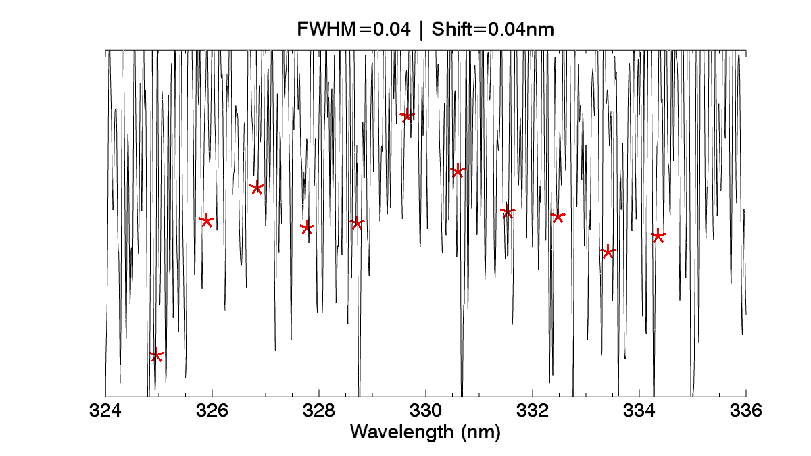
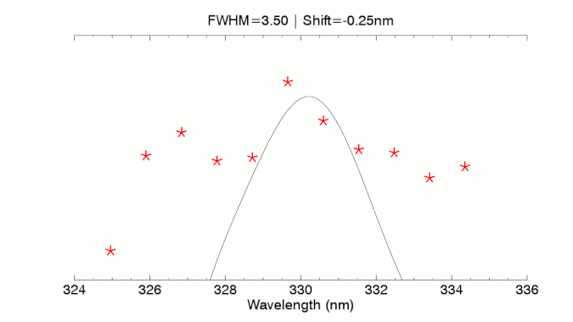
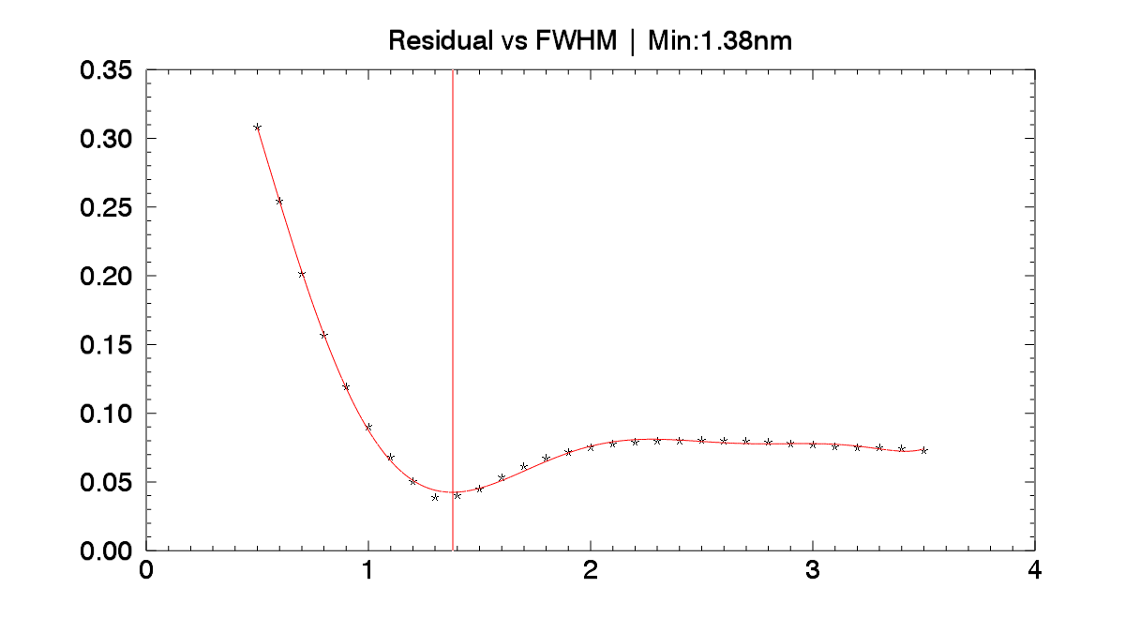
Bandpass Characterization
Scaling the solar spectrum to the counts spectrum suggests a difference in resolution.
Assuming a gaussian for the instrumental profile of the SAGE III/ISS spectrometer, we can solve for the FWHM.
We want to see what FWHM gaussian, when convolved with the solar spectrum, gives the best fit to counts.

Slide 7
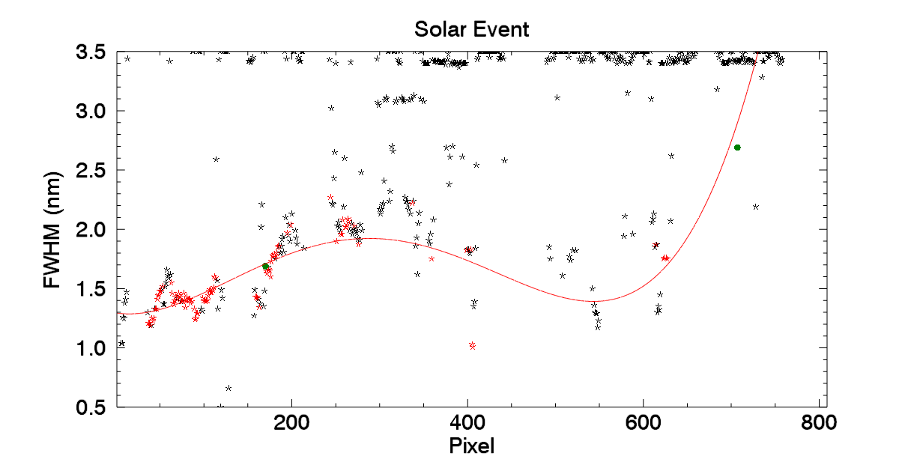
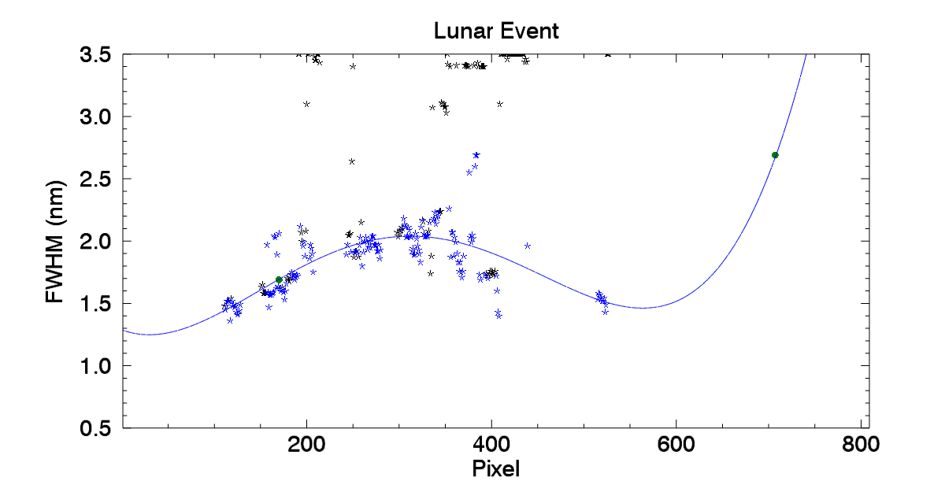
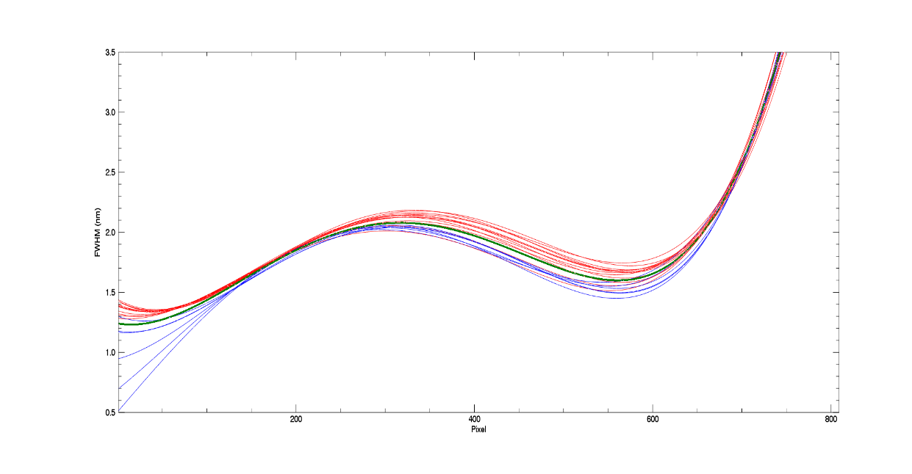
Bandpass Characterization
Repeating this process across all pixels, we can determine FWHM as a function of pixel.
Lunar exoatmospheric data may also be used.
These results are fairly consistent across time and event type.

Slide 8
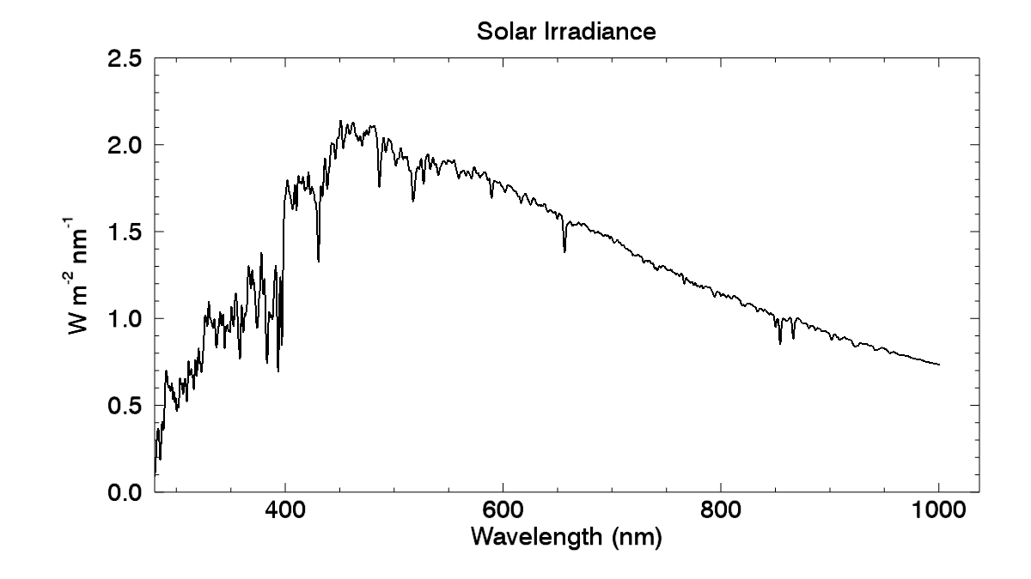
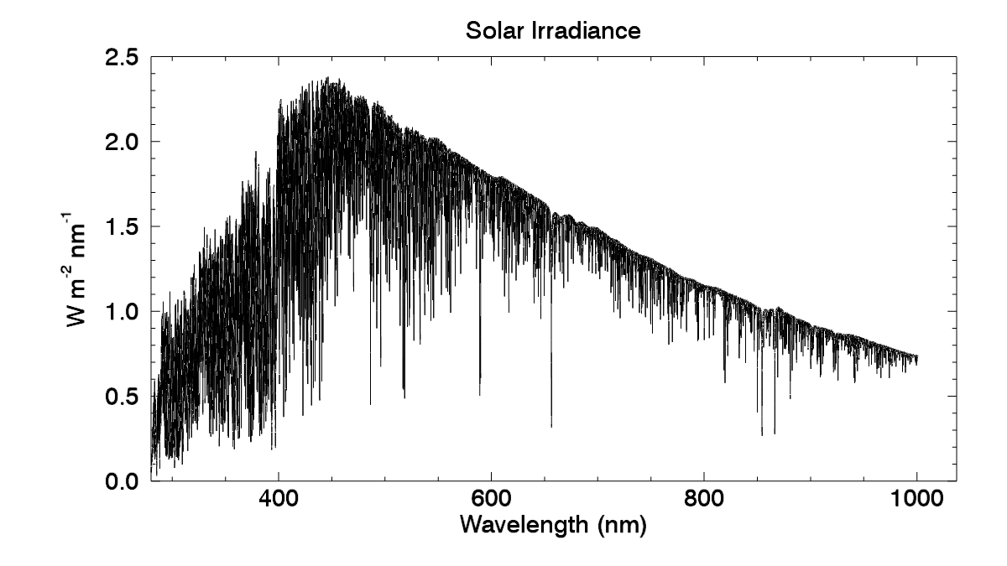
Bandpass Characterization
With this resolution information, we can create a solar spectrum that should compare well with our CCD.
Knowing the solar irradiance spectrum, as our instrument sees it, is also important when generating the absorption cross section databases for our retrievals.

Slide 9
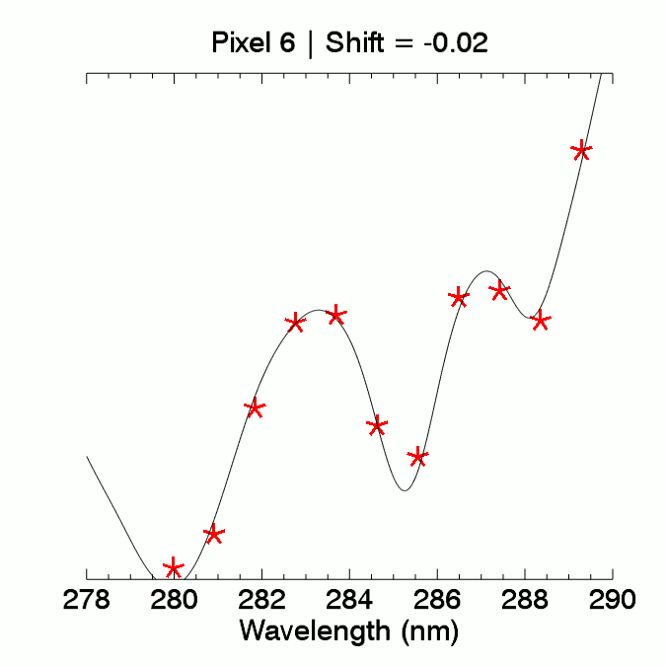
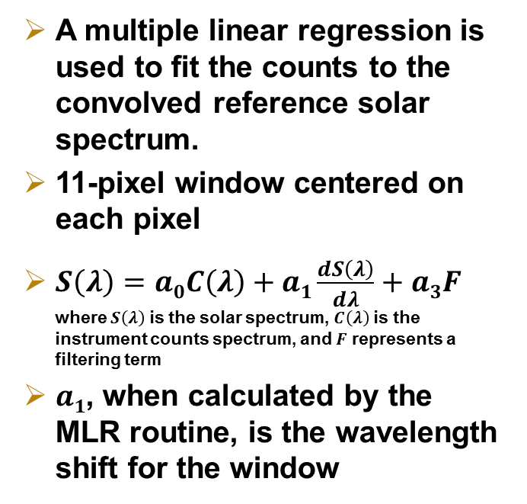
Event-By-Event Calibration
A multiple linear regression is used to fit the counts to the convolved reference solar spectrum.
11-pixel window centered on each pixel
$S\left(λ\right)=a0C\left(λ\right)+a1\frac{\begin{aligned} \\ dS\left(λ\right)\end{aligned}}{dλ}+a3F$
where $S\left(λ\right)$ is the solar spectrum, $C\left(λ\right)$ is the instrument counts spectrum, and $F$ represents a filtering term
$a1$, when calculated by the MLR routine, is the wavelength shift for the window

Slide 10
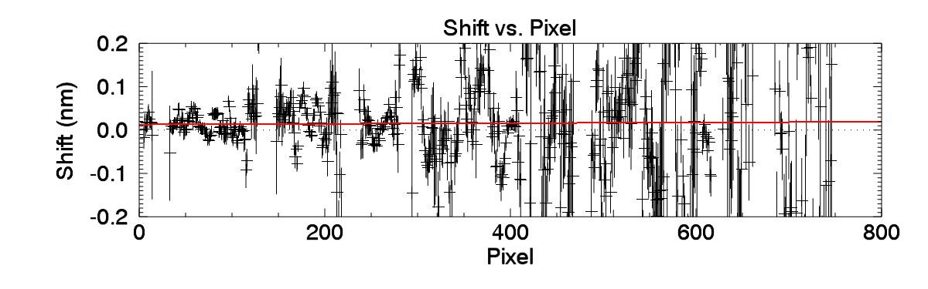
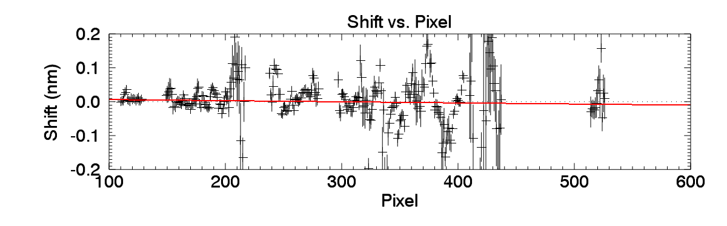
Event-By-Event Calibration
A linear fit in shift vs pixel space (weighted toward the shifts with better certainty) gives the shift and stretch value you see in the product file.
This is the wavelength shift/stretch that is applied to all the pixels of the CCD for that event.
Solar
Lunar

Slide 11
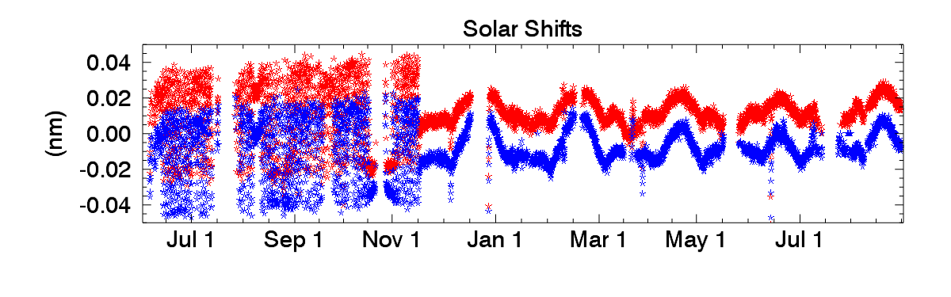
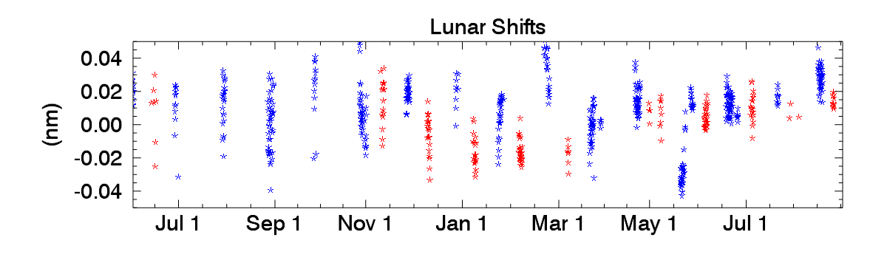
Wavelength Shift by Event Type
Sunrise Sunset
Moonrise Moonset

Slide 12
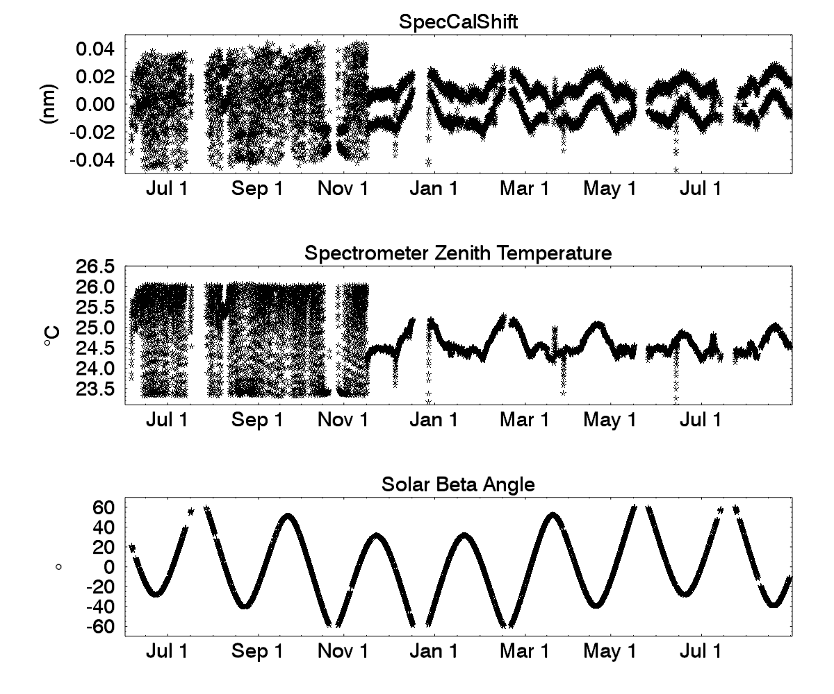
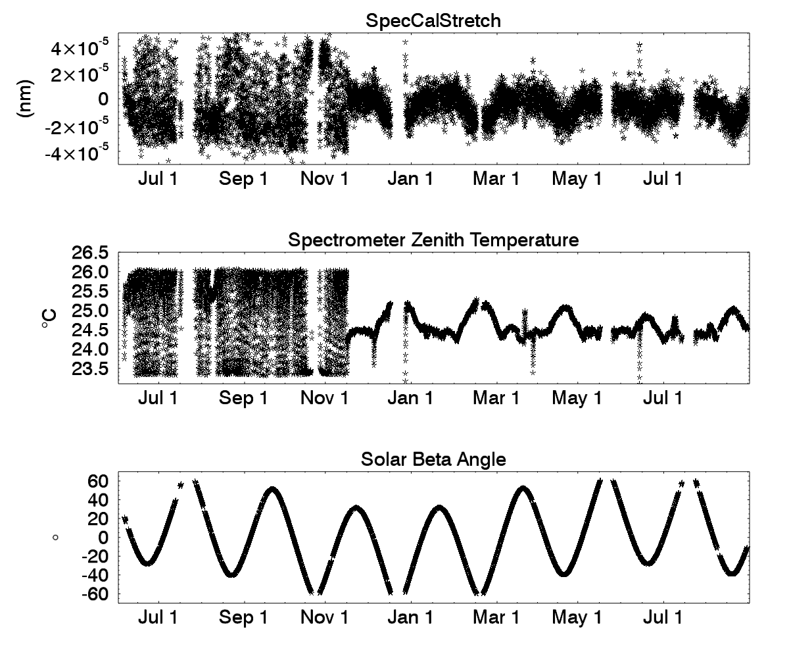
Thermal Dependence

Slide 13
Wavelength Calibration
Between V5.0 and V5.1, a more thorough wavelength calibration was performed to determine center wavelength for each of the 809 pixels of the SAGE III/ISS CCD spectrometer.
As part of this process, the instrument bandpass was independently characterized.
Shifts and stretches in the pixel vs wavelength relationship seem to be related to the thermal conditions/settings of the instrument. A routine is in place to adjust wavelengths on an event-by-event basis.
Calibration is necessarily an ongoing activity for this instrument and there is still room for improvement.

