Slide 1
Water Vapor Product
David Huber
Scientific Programmer

Slide 2
Introduction
Motivation
Retrieval method
Improvements
Results & comparisons
Future work

Slide 3
Why measure stratospheric water vapor?
Tracer for studying UTLS dynamics
  Pan et al. (2007)
Stratospheric radiative forcing
  Solomon et al. (2010)
PSCs and secondary role in ozone destruction
  Stenke and Grewe (2005), Khosrawi et al. (2016)
Tropical upwelling/trace gas indicator
  Randel et al. (2006)

Slide 4
Retrieval method
Smooth transmission using 1-2-1 kernel to 1km grid
  29 Pixels (869, 920 and 934-957nm)
Clear molecular scattering
Levenburg-Marquardt non-linear least sqaures fit
  Water vapor, ozone, aerosol
Curtis-Godwin approximation for water vapor
Iterate from 60km downward

Slide 5
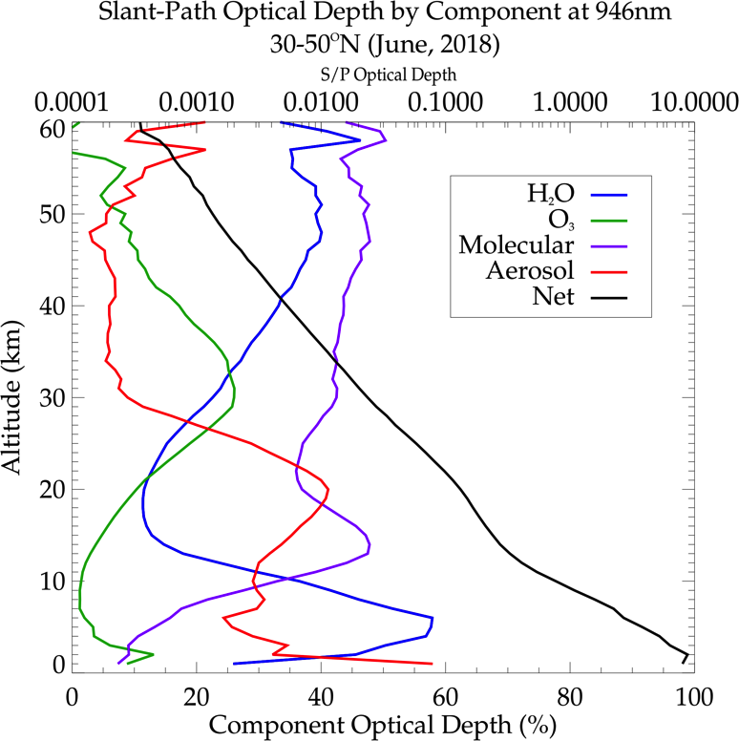
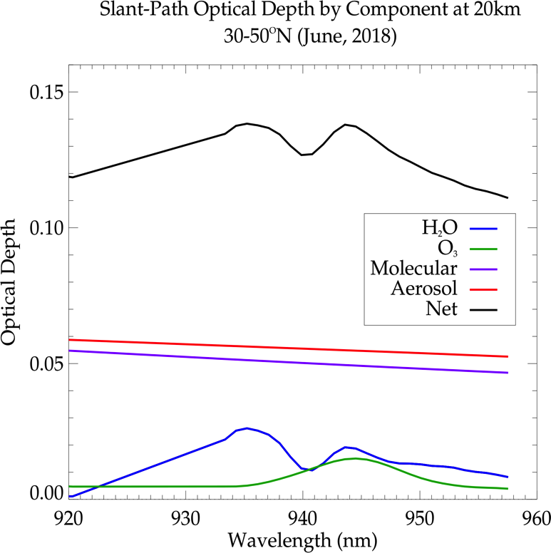
Retrieval
Challenging retrieval due to weak signal
Intractable solutions frequent above 50km

Slide 6
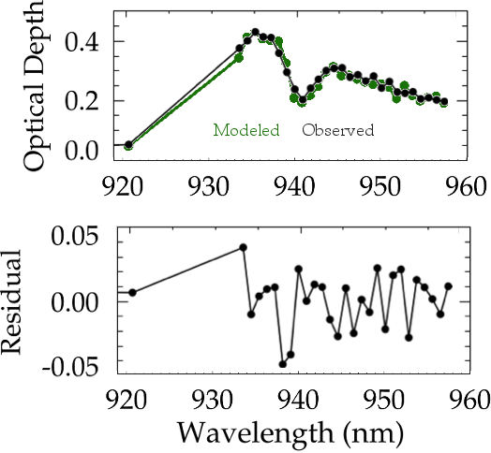
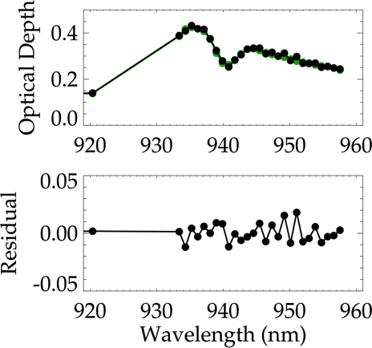
Improvements since M3M
Much improved approximation of bandpasses and wavelengths
Version 5.0
Version 5.1
N. Hemisphere, July, 2017
50ppm < χ < 100ppm
Optical depth less molecular

Slide 7
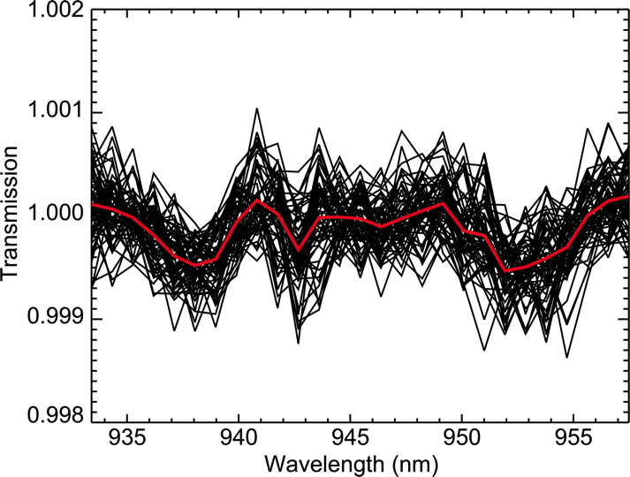
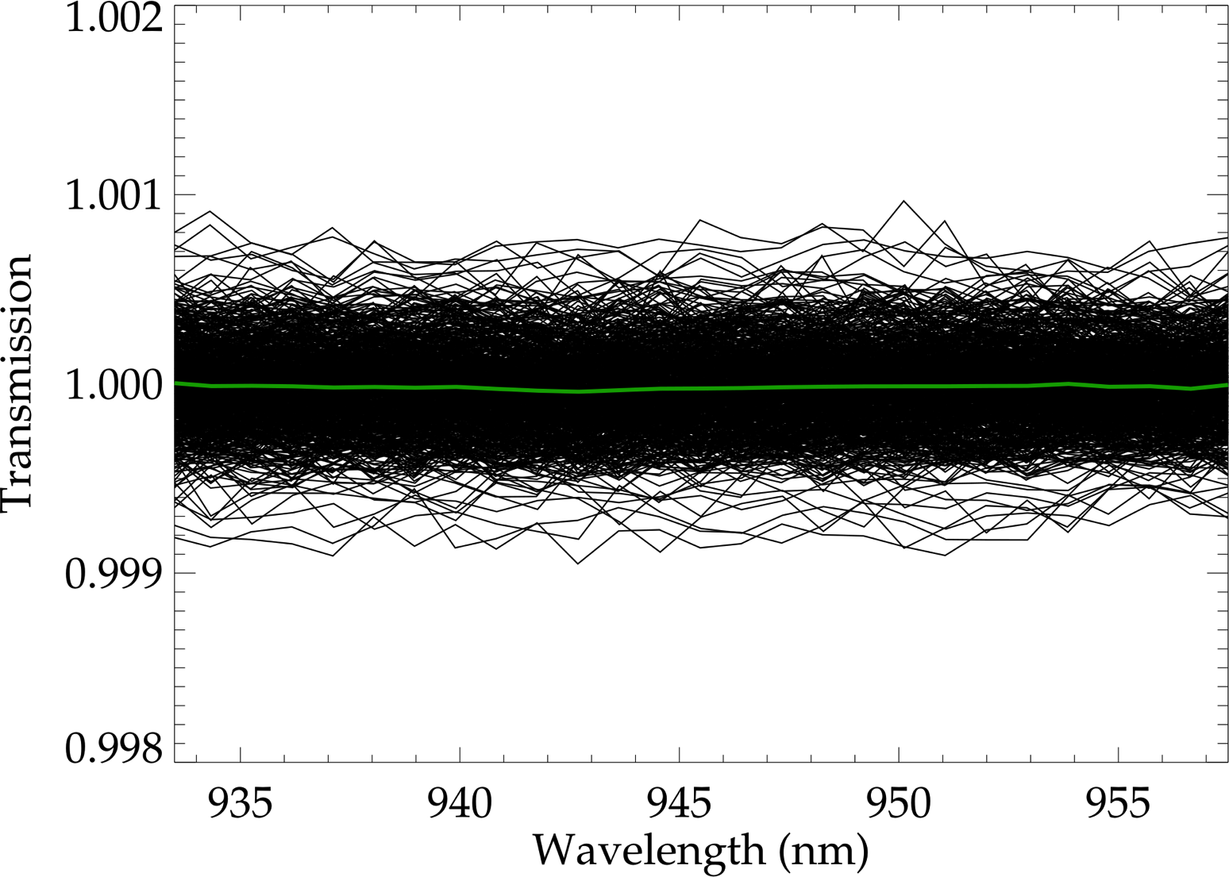
Improvements since M3M
New solar atenuator for ISS does not produce an etalon
90 – 100km Mean Transmission
M3M
ISS
Thomason et al. (2010)

Slide 8
Results
Median comparisons
July, 2017
Northern mid-latitudes (30-50°)
Aerosols/ozone compared with AO3
Water vapor with MLS-EOS

Slide 9
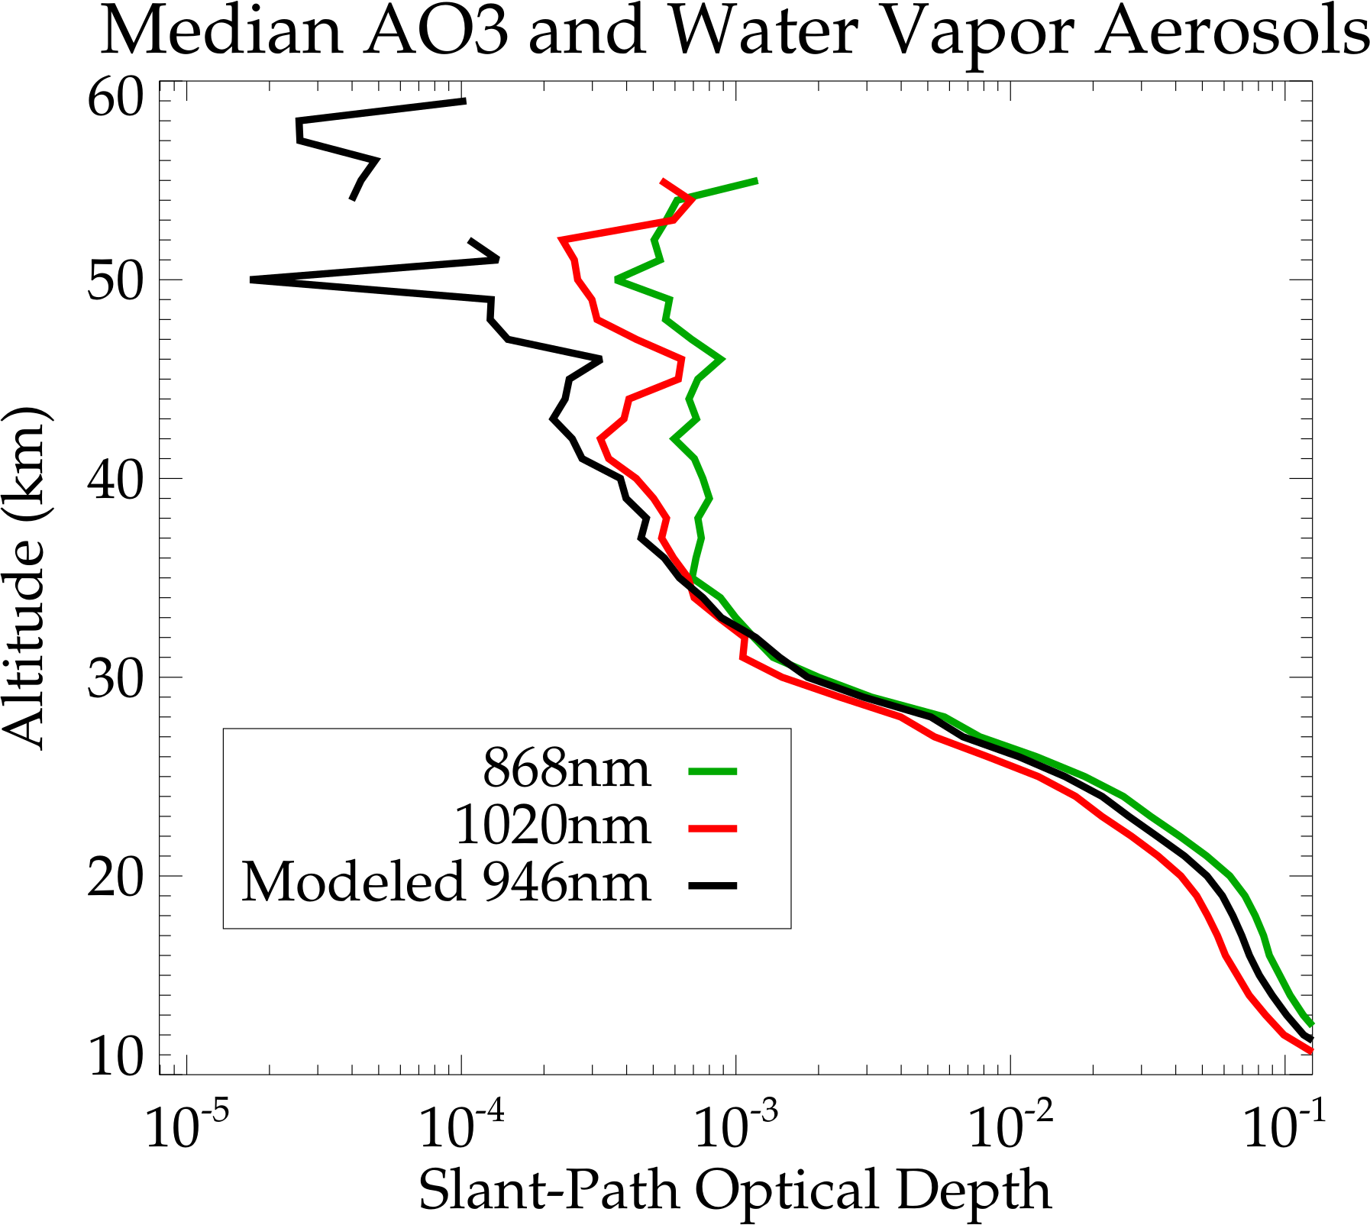
Results (Aerosols)
Modeled aerosols may be a little high from 25-35km
Noise floor lower than AO3

Slide 10
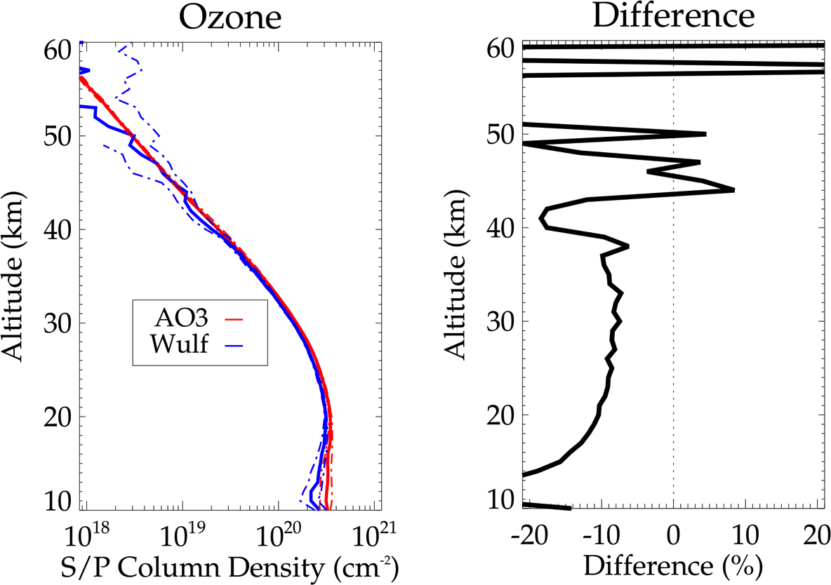
Results (Ozone)
Wulf band ozone ~10% less than AO3
Shape matches well to 40km
Relative Wulf and Chappuis spectroscopic differences roughly agree with SAGE II

Slide 11
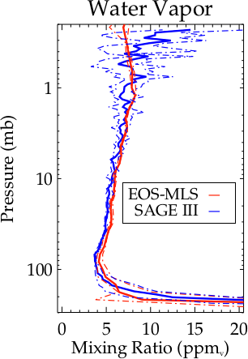
Results (Water Vapor)
Comparison with EOS-MLS
21 coincident events (±12h, 5° latitude, 20° longitude)
Persistently large above 50km (~0.7mb)
Negative bias against MLS

Slide 12
Future Work
Improvements to transmission product
Improve handling measurement noise
  Dependent on changes to transmission
  Consider co-adding pixels and other smoothing processes
  Global fit
Improve ozone/aerosol handling
Graceful handling of intractable retrieval at high altitudes

