Slide 1
An Internal Assessment of SAGE III/ISS Ozone Data Quality
Rob Damadeo

Slide 2
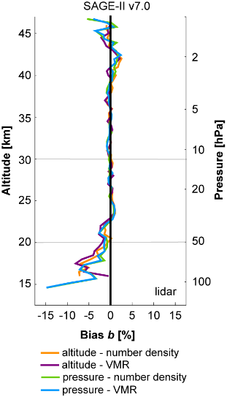
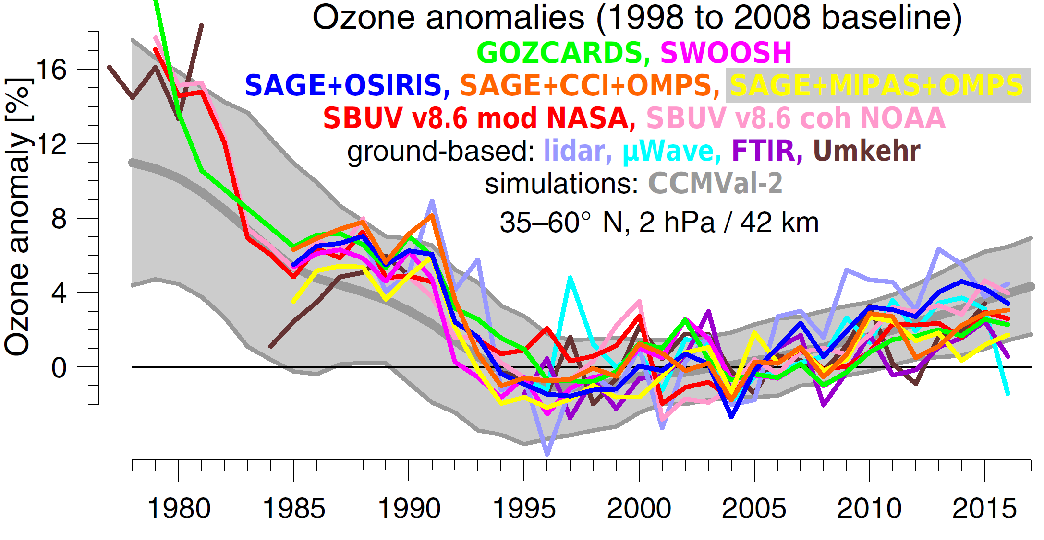
History of SAGE Ozone
SAGE I/II/III M3M/III ISS (1979–1981,1984–2005,2002–2006)
~1% precision in the stratosphere, ~1 km vertical resolution
Thoroughly validated, very stable, extensively utilized
Multi-instrument Ozone Data Sets
Steinbrecht et al., ACP, 2017.
Hubert et al., ACP, 2016
SAGE I/II/III

Slide 3
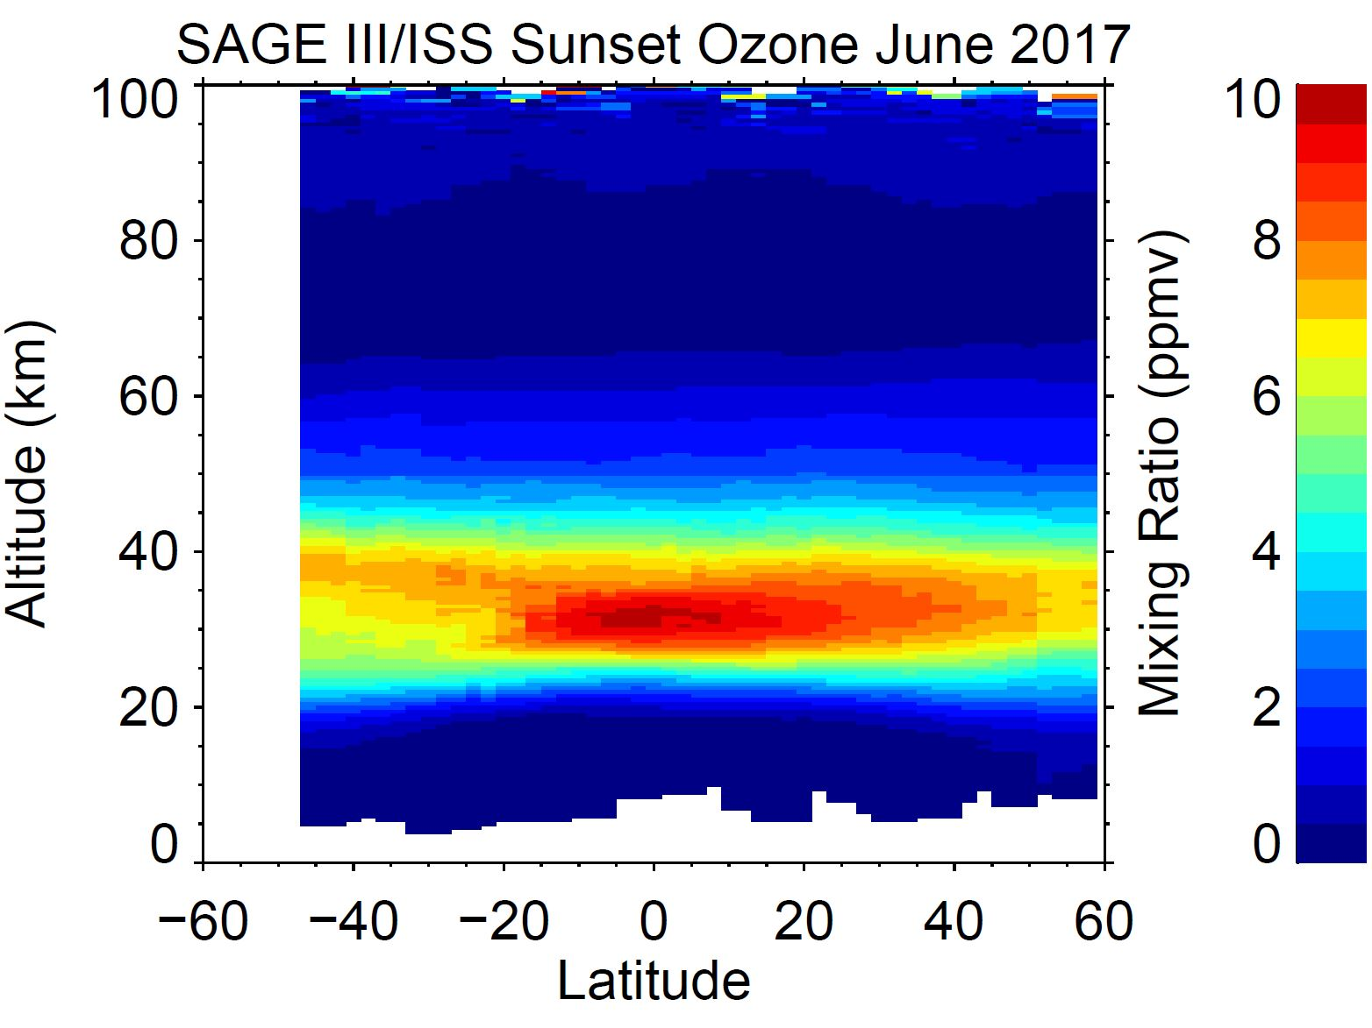
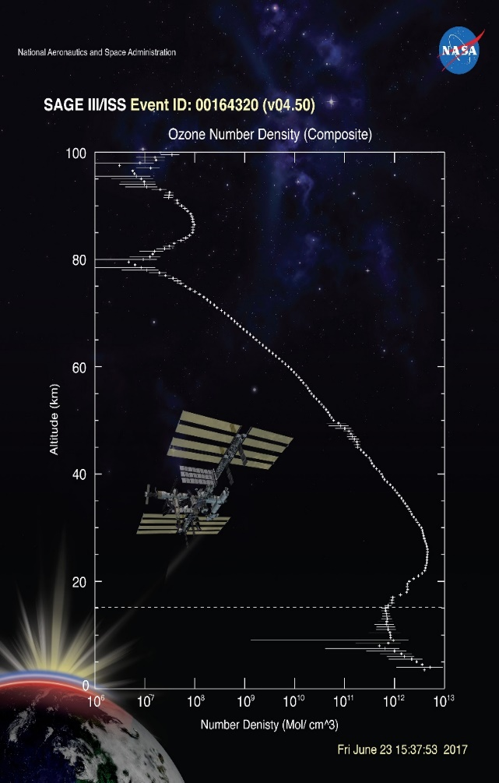
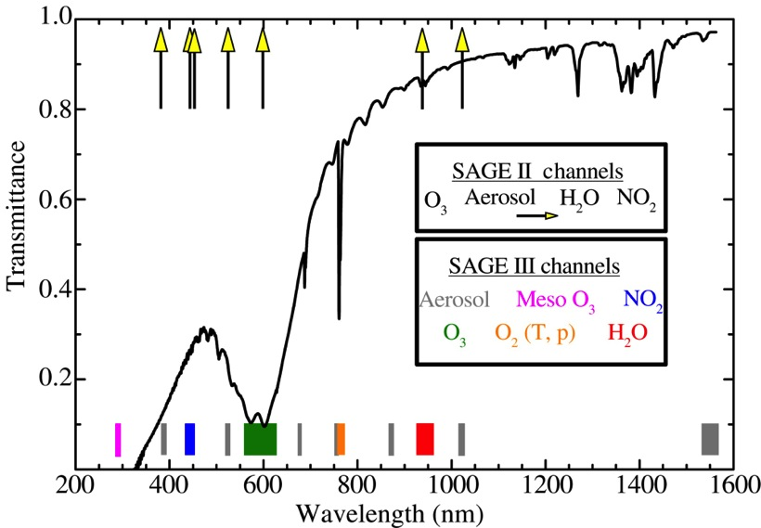
SAGE III/ISS Ozone Products
Derived from inversion of solar transmission profiles
Three main ozone products:
  “MLR” – DOAS-style retrieval in Chappius (0-70 km)
  “AO3” – Broadband SAGE II-style retrieval in Chappius (0-70 km)
  “MES” – UV (<300 nm) retrieval (45-100 km)
Limb
Lunar

Slide 4
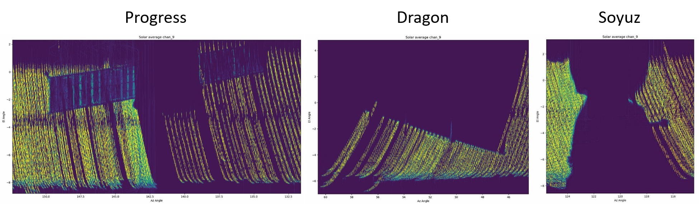
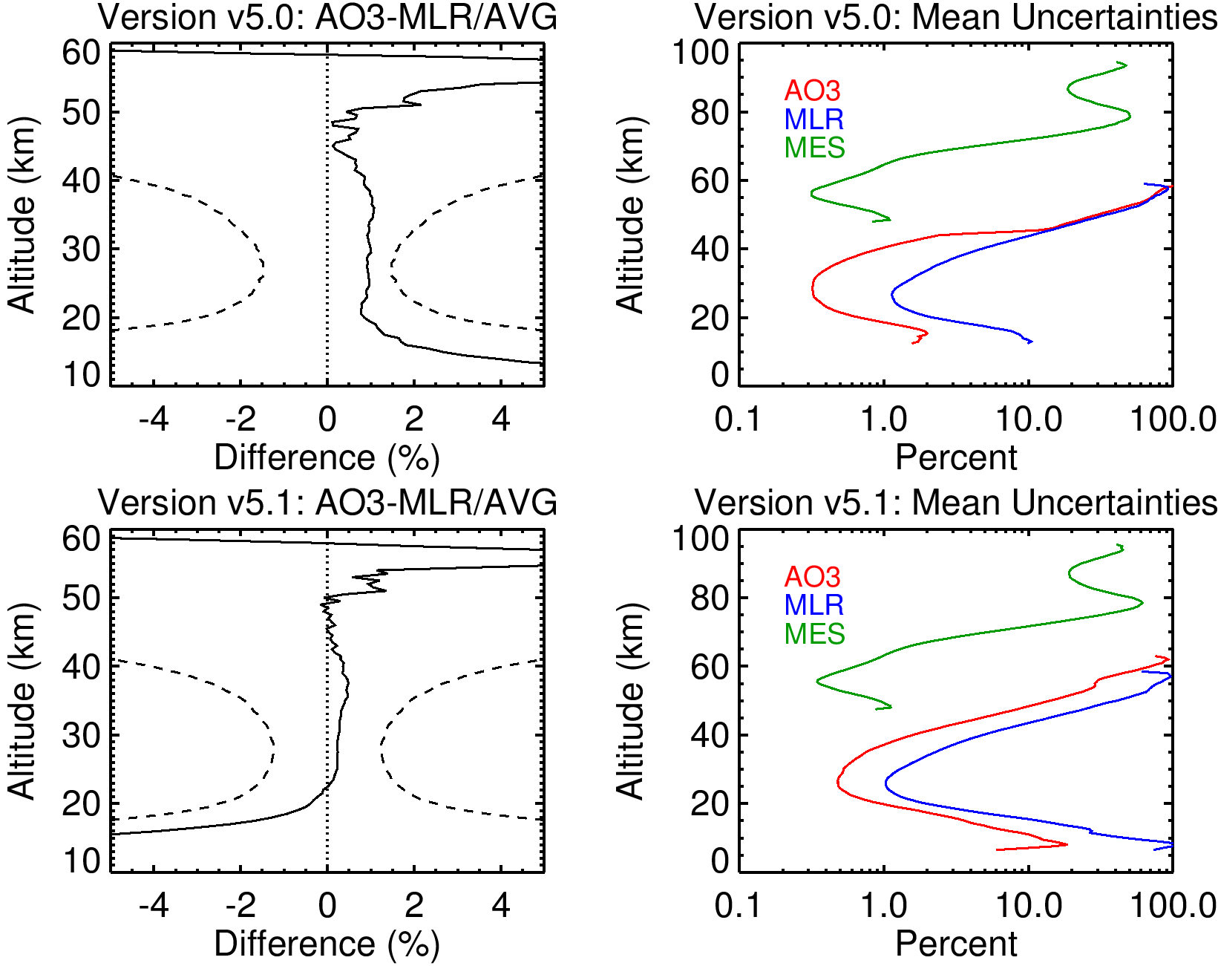
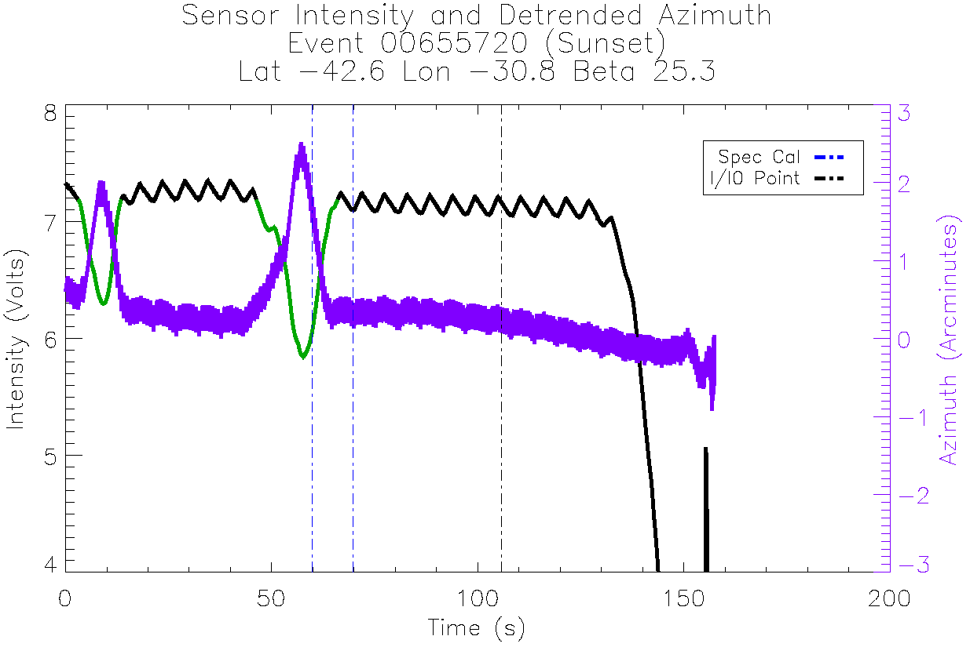
Improvements between v5.0 and v5.1
General algorithm improvements and bug fixes
Improved wavelength registration (MLR and AO3 agree better)
Exclude field-of-view blockages (happens more than we’d like)

Slide 5
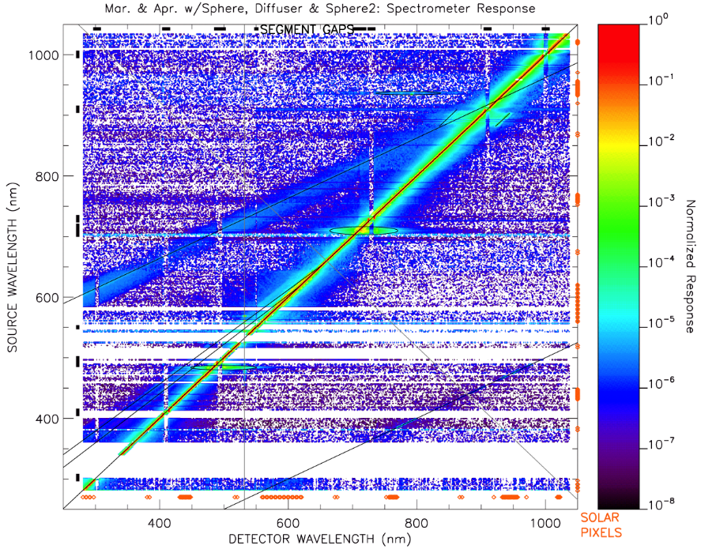
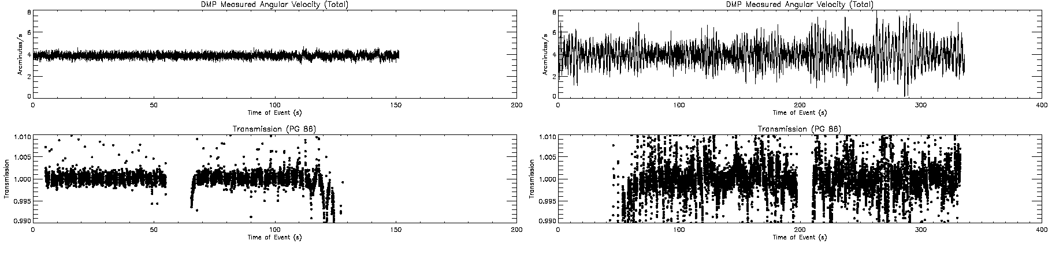
Known anomalies in v5.1
Algorithm is still not version 7 (we’re working on it)
Spectral stray light in mesospheric ozone (not recommended)
Pointing disturbances can impact data quality

Slide 6
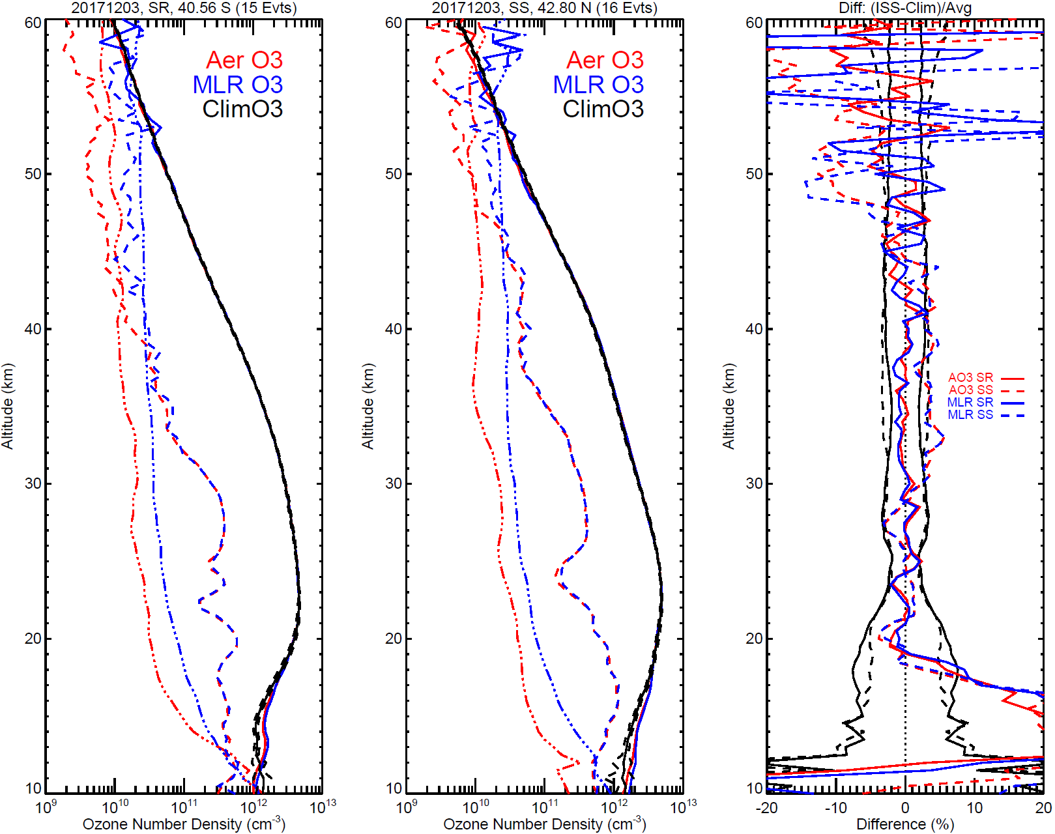
Consistency Check

Slide 7
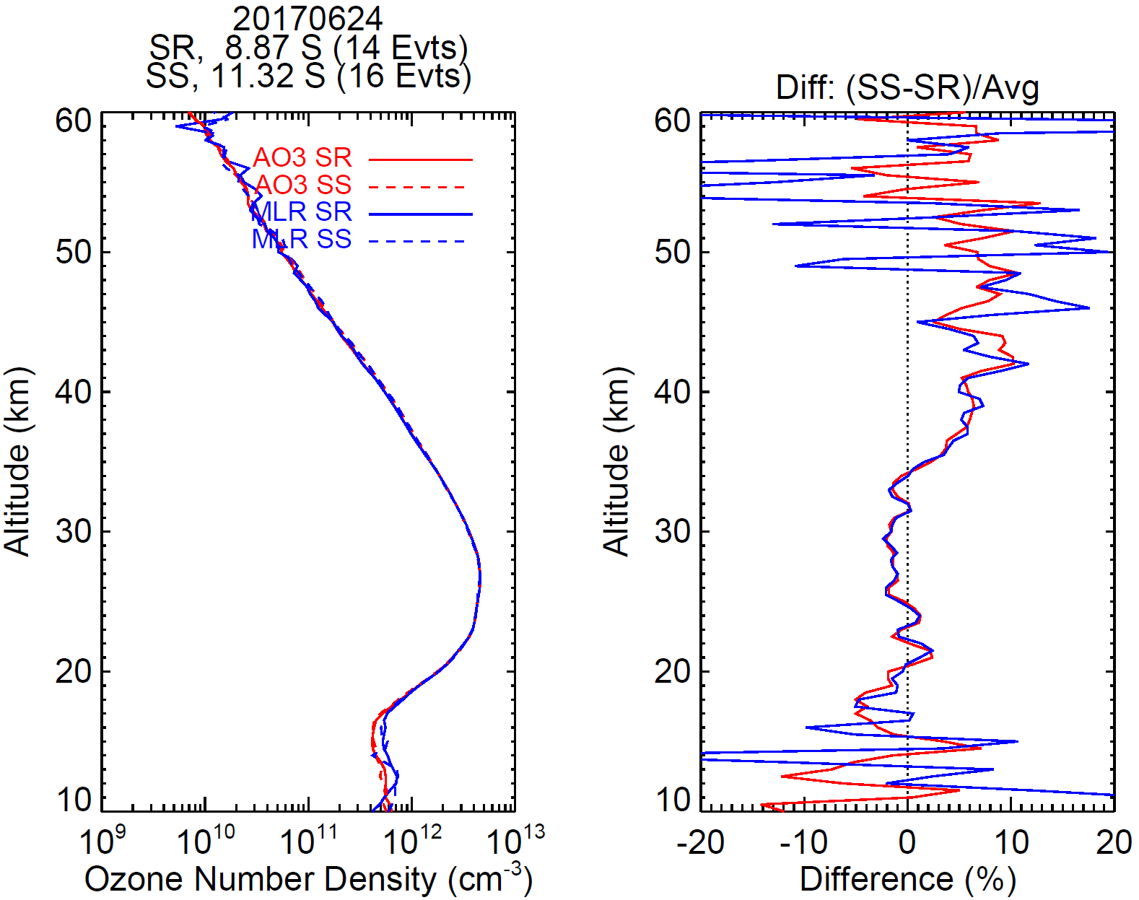
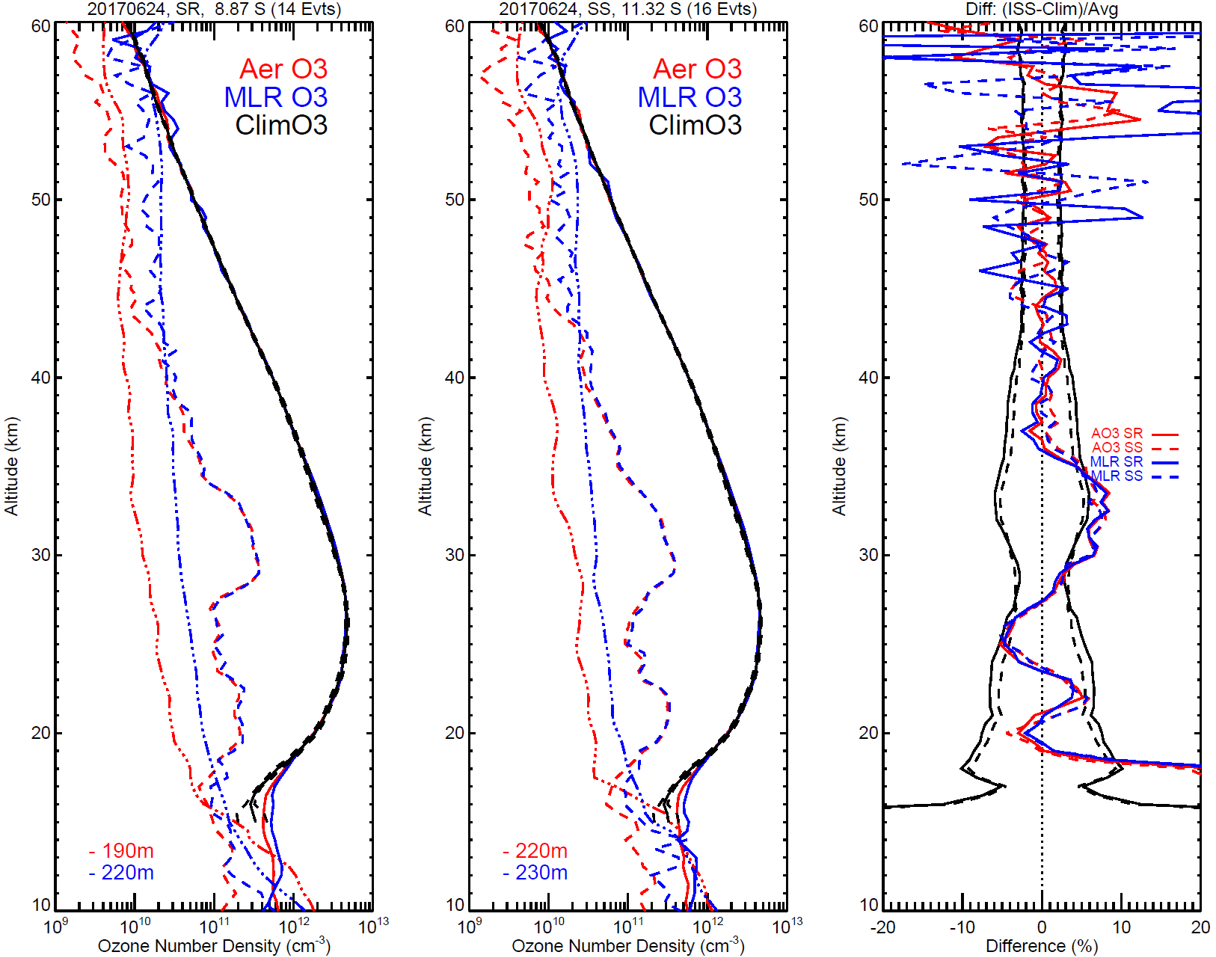
Self Consistency

Slide 8
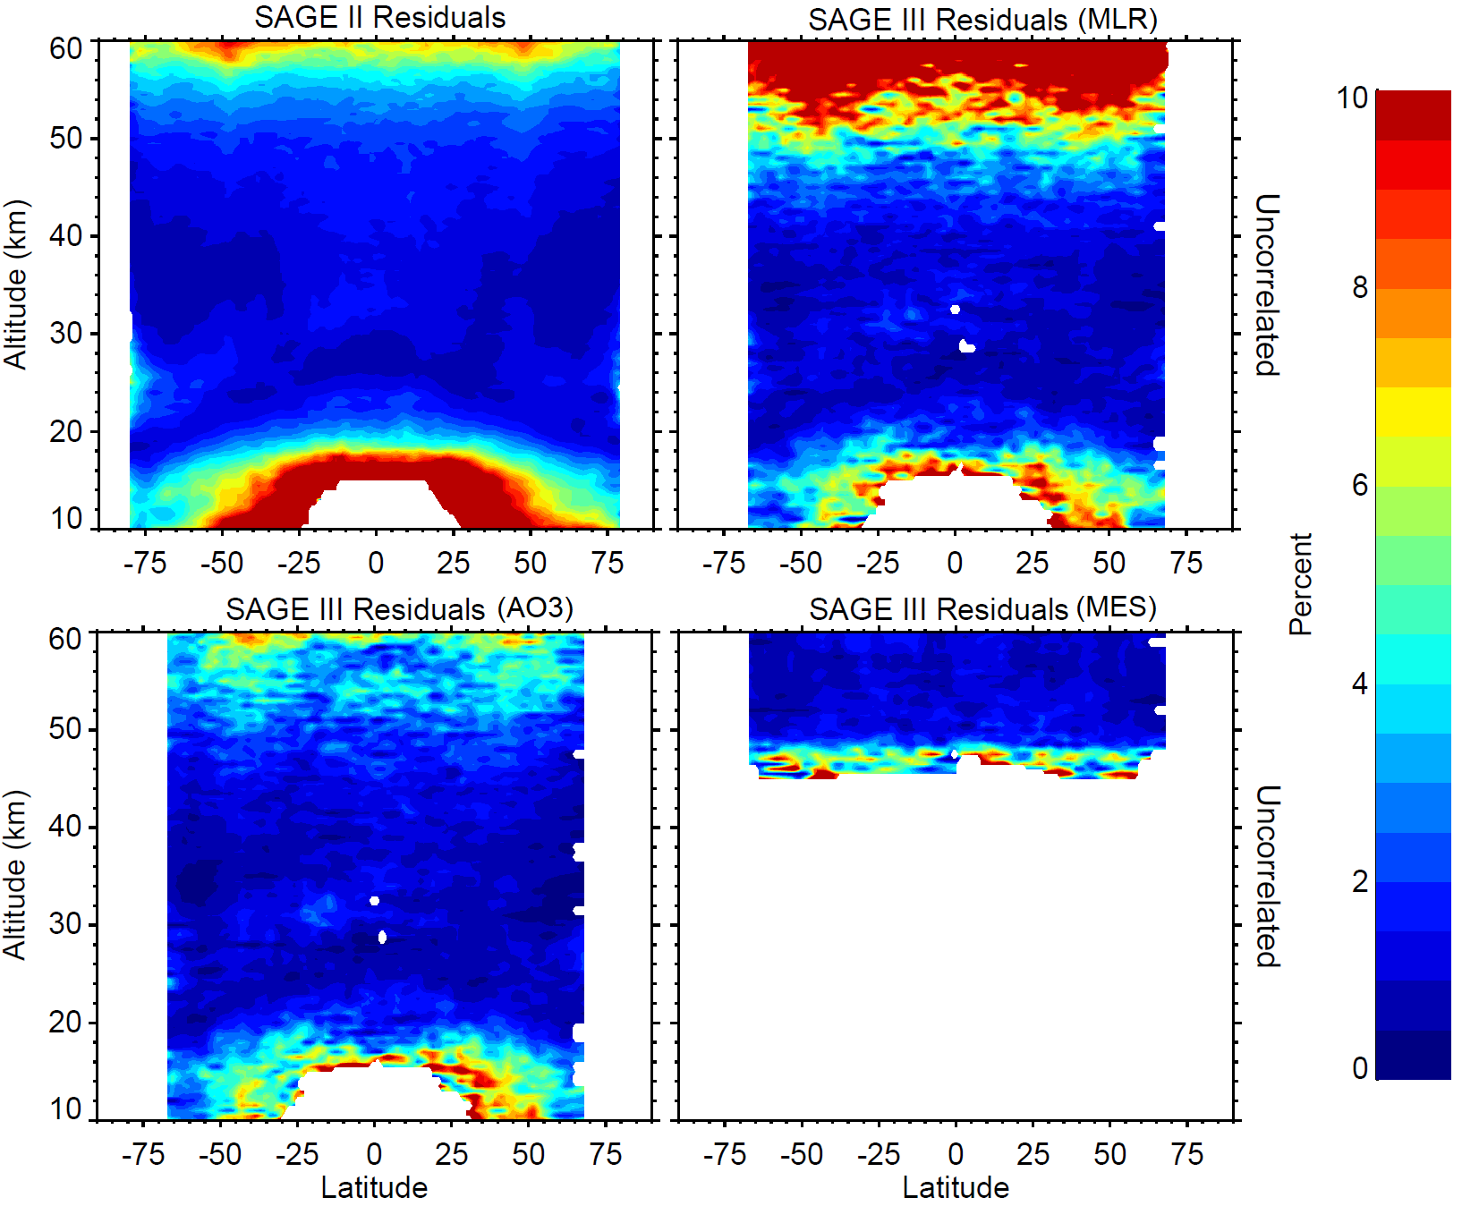
Comparison to SAGE II
Residual analysis from Damadeo et al. (ACP, 2014)
Assess data quality from uncorrelated residuals
  Similar data quality in middle to lower stratosphere
  AO3 data quality is better than MLR in upper stratosphere / lower mesosphere
Recommend AO3 for general research use
  MLR actually more resilient to instrument anomalies, useful as diagnostic (no large volcanos yet)

Slide 9
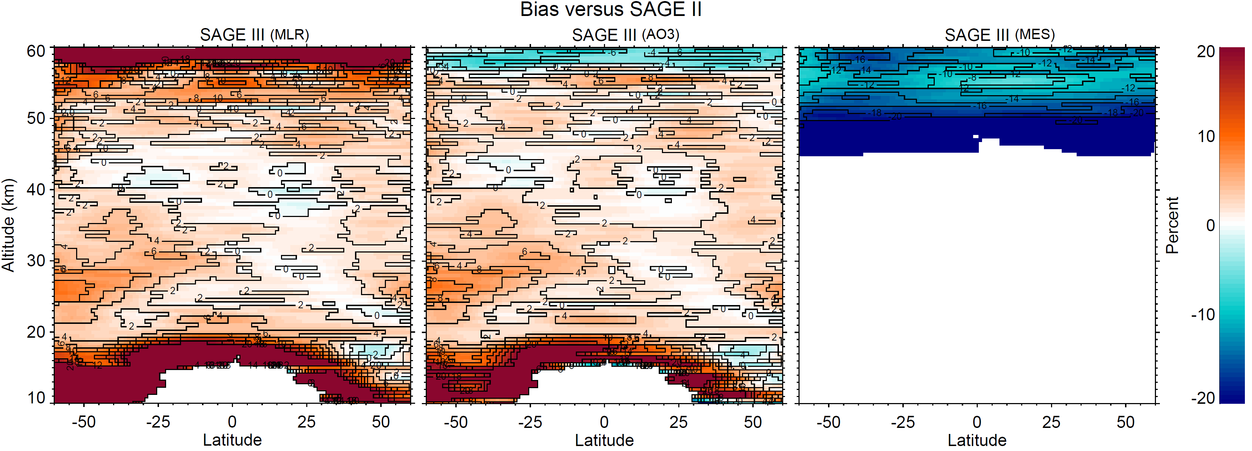
Comparison to SAGE II (cont.)

Slide 10
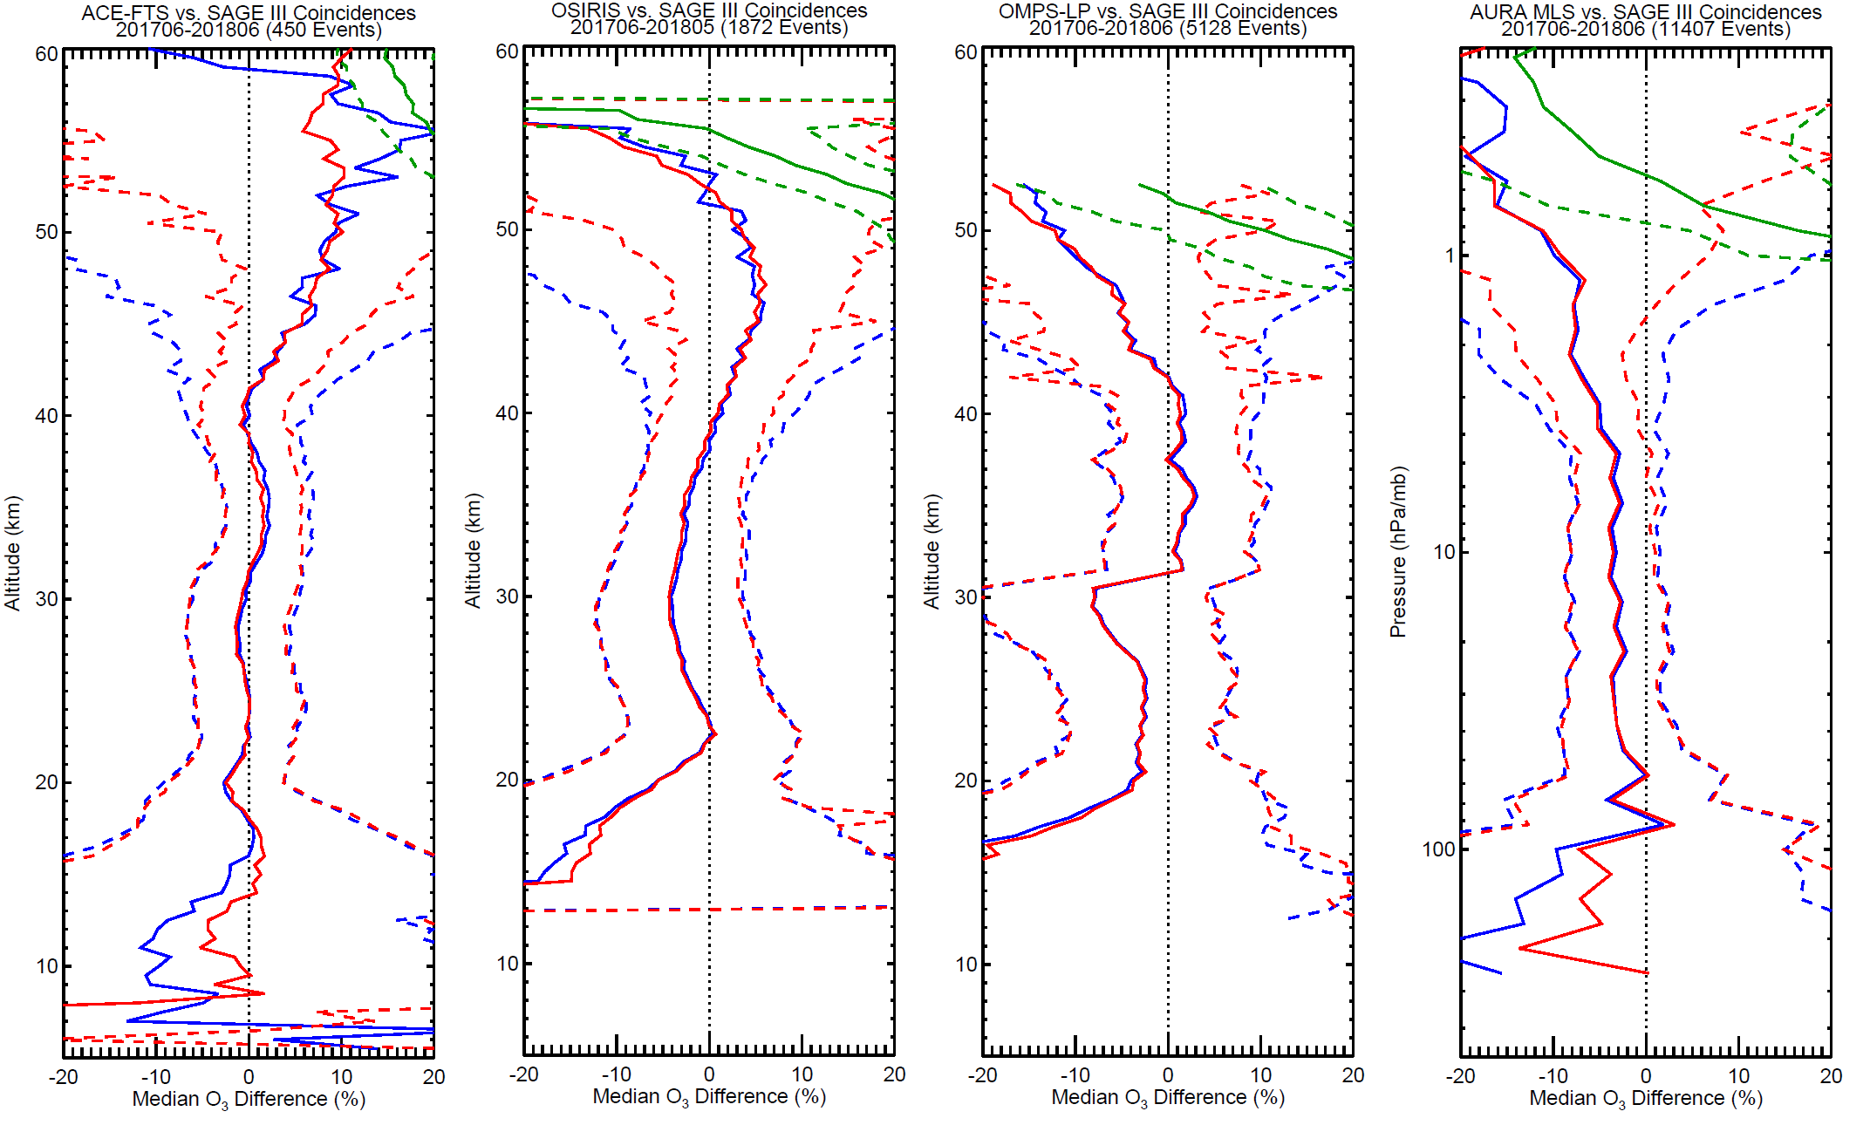
Comparison to satellite

Slide 11
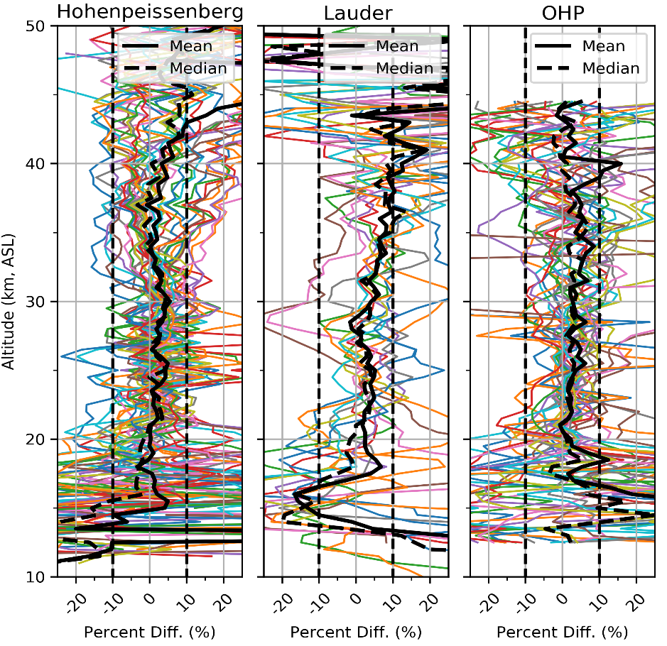
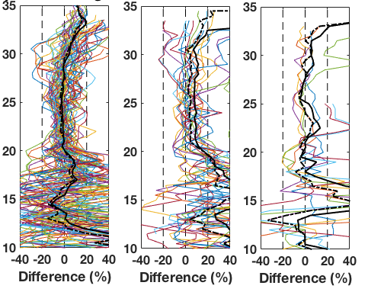
Comparison to ground
Lidar
Sondes

Slide 12
Conclusions
Instrument environment and anomalies can make life difficult but we’re working on it
Improvements in first validation release show good agreement between MLR and AO3 (<1%) in the stratosphere
MLR and AO3 agree well (<5%) with other instruments (satellite and ground) in the stratosphere
MES product still requires attention
SAGE III/ISS ozone data (AO3 recommended) is suitable for continuation of trend studies

