Slide 1
SAGE III/ISS Science Team Meeting
NASA Langley Research Center
October 30-31, 2018

Slide 2
Product Status: NO₂
D. Flittner
October 2018

Slide 3
NO₂
NO₂ is derived using Multiple Linear Regression (MLR) method in conjunction with O₃
No change from M3M
NO₂ absorption cross sections taken from Bogumil et al. to replace the Harder + compilation used with M3M
Wavelength scale and band pass were optimized to provide best fit in the spectral window in V5.1
V5.1 is about 20% greater than V5.0 because of the refined band pass (reduced effective cross-section)

Slide 4
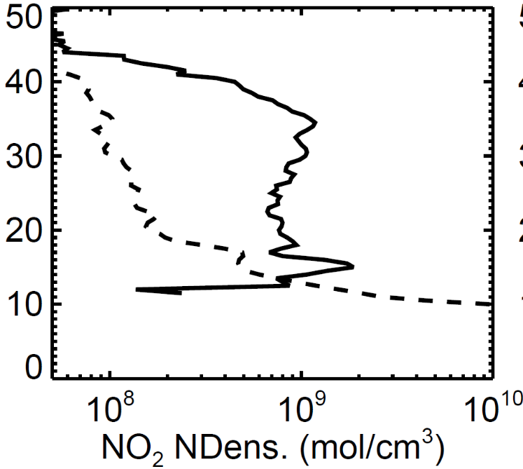
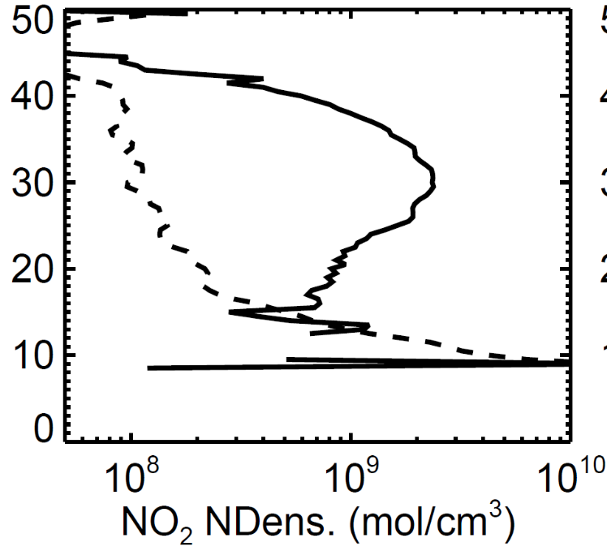
SAMPLE PROFILES
Sunrise
Sunset
ALTITUDE [km]
Event 01097710 on 20180421 at 23:54:19 UTC (16.1 S,94.6 E)
Event 01097720 on 20180421 at 23:21:18 UTC (17.7 S,84.6 W)

