Slide 1
The SAGE III/ISS Lunar Algorithm
Robbie Manion
October 2018

Slide 2
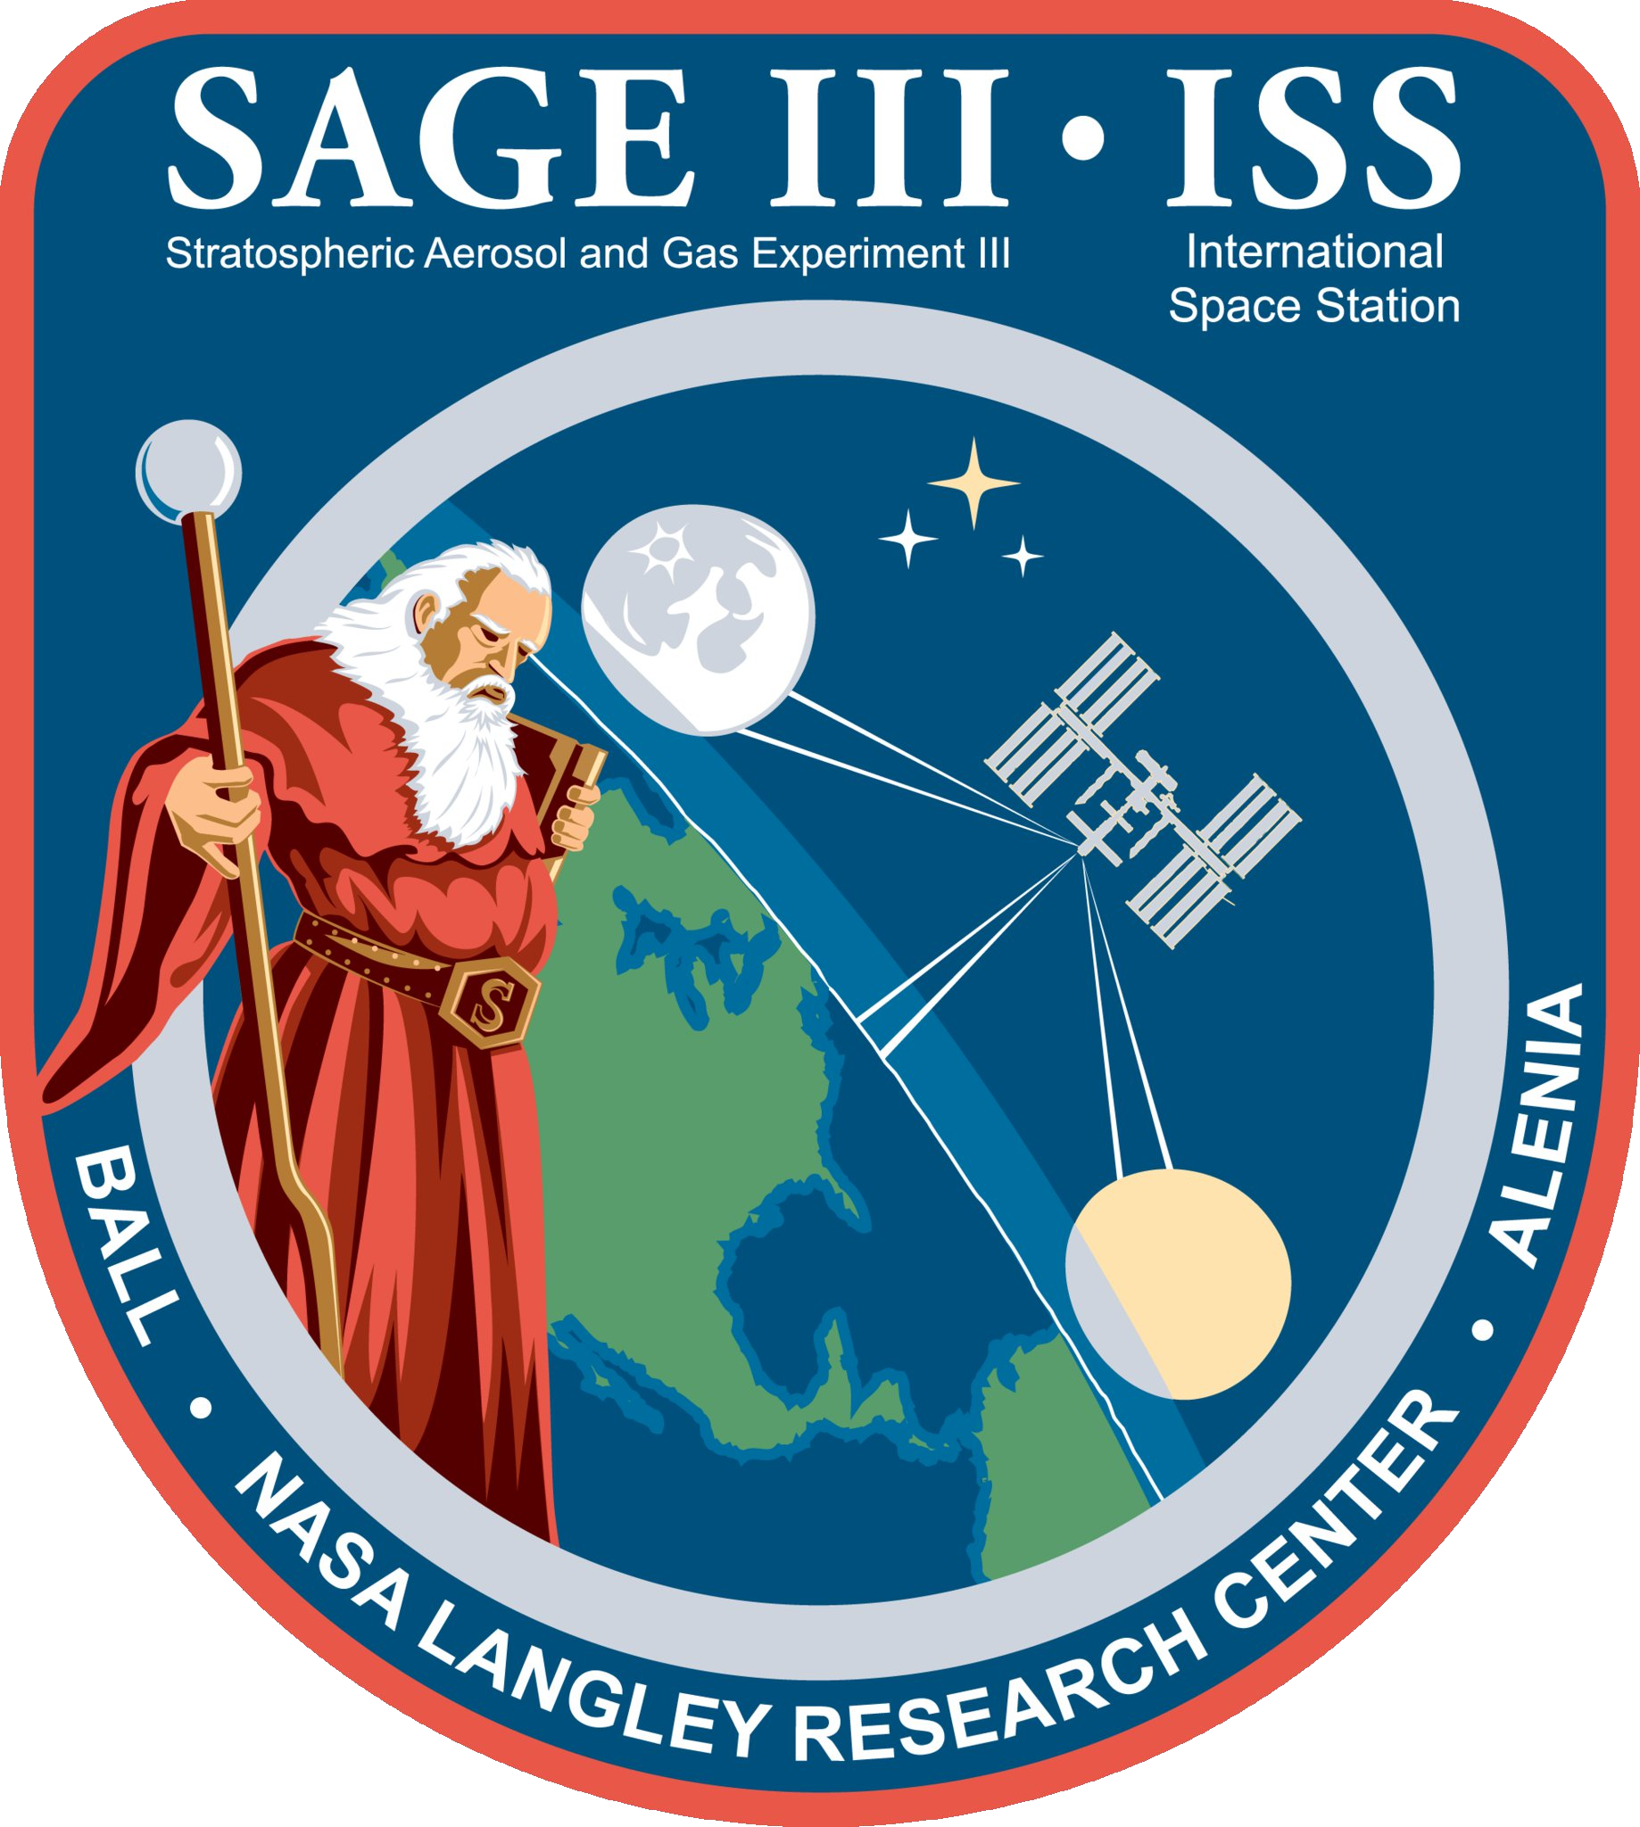


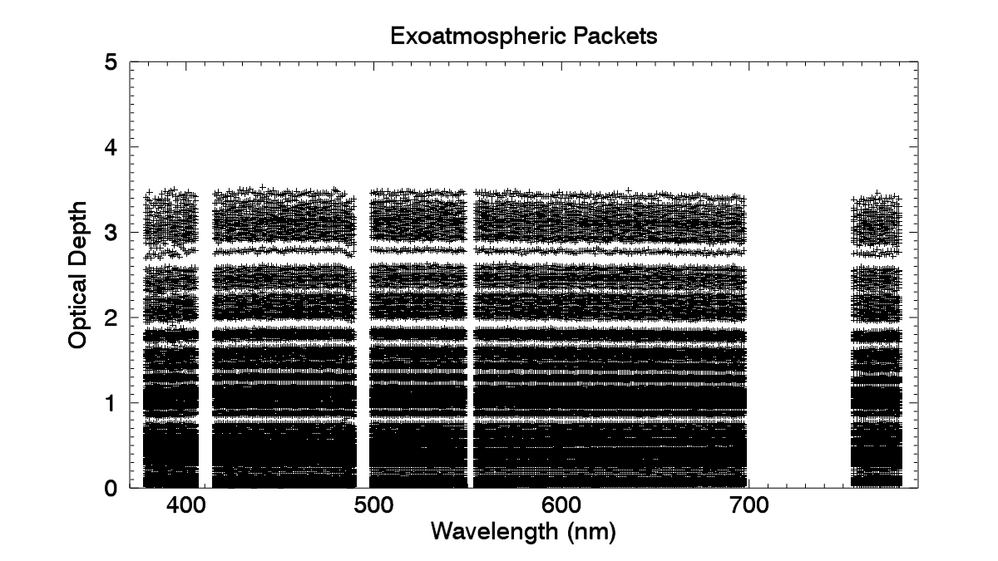
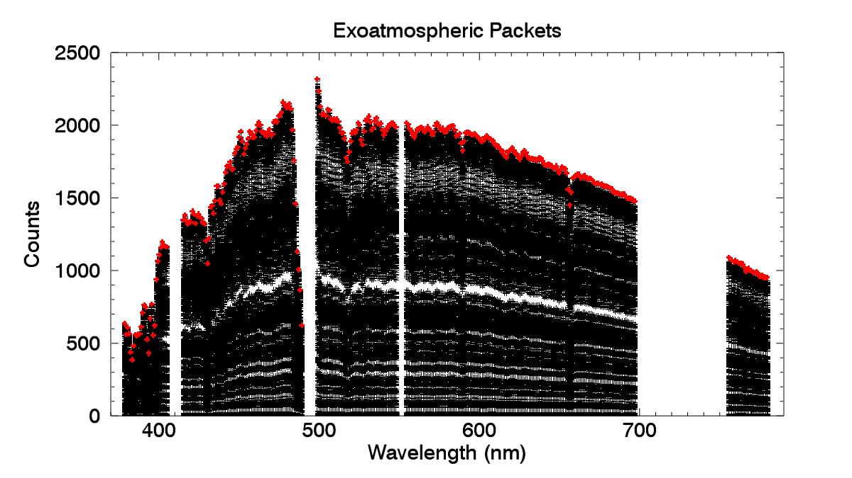
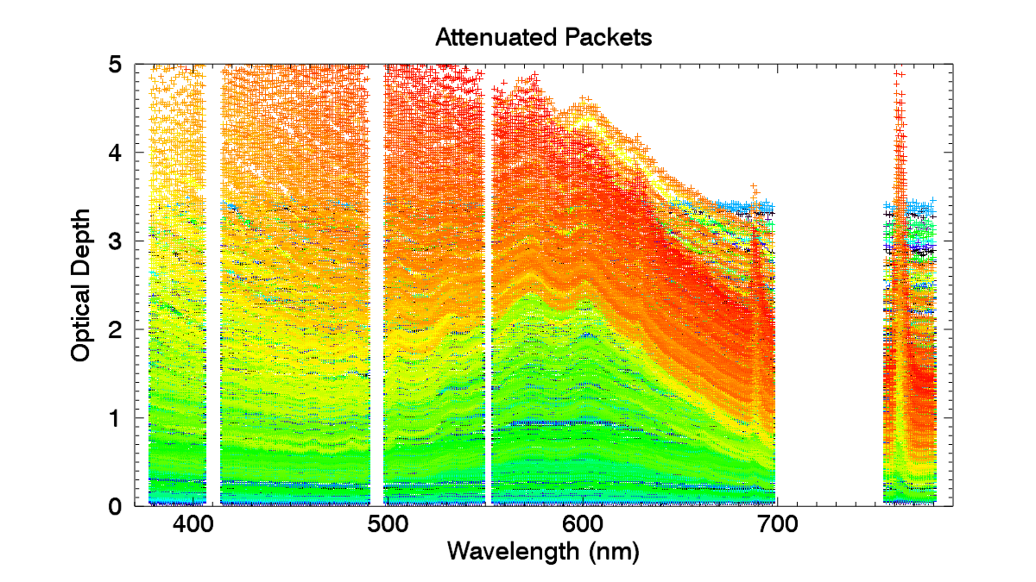
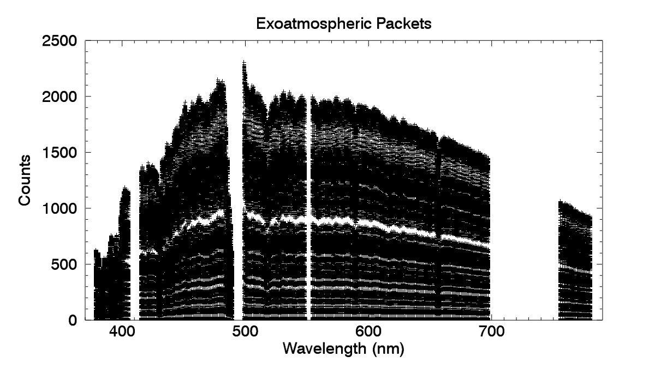
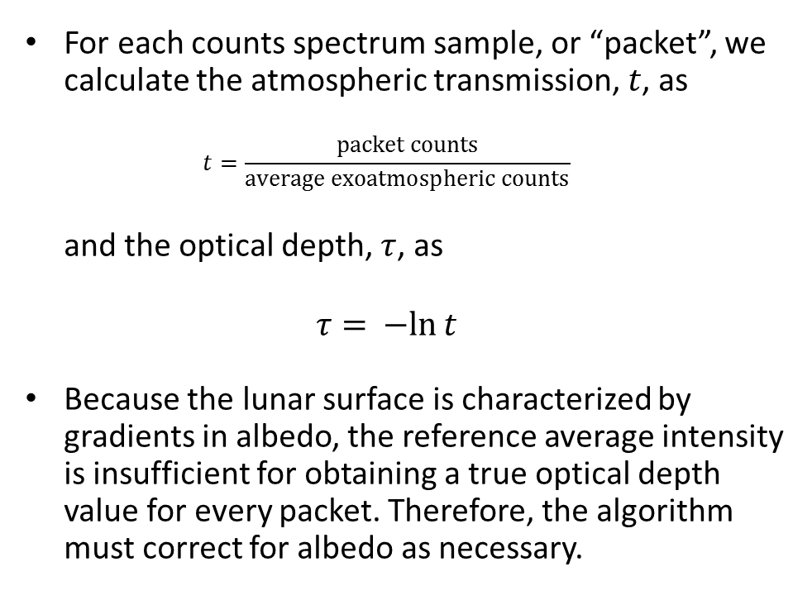
Slant Path Optical Depth
For each counts spectrum sample, or “packet”, we calculate the atmospheric transmission, $t$, as
$t=\frac{packet counts}{average exoatmospheric counts}$
and the optical depth, $τ$, as
$τ=­−ln{t}$
Because the lunar surface is characterized by gradients in albedo, the reference average intensity is insufficient for obtaining a true optical depth value for every packet. Therefore, the algorithm must correct for albedo as necessary.
Data
Dark Current Correction
Altitude Registration
Inversion
Altitude Adjustment
Filtering and Binning
Peeling
Products
Wavelength Calibration
The SAGE III/ISS Lunar Algorithm
2
Robbie Manion | October 2018

Slide 3
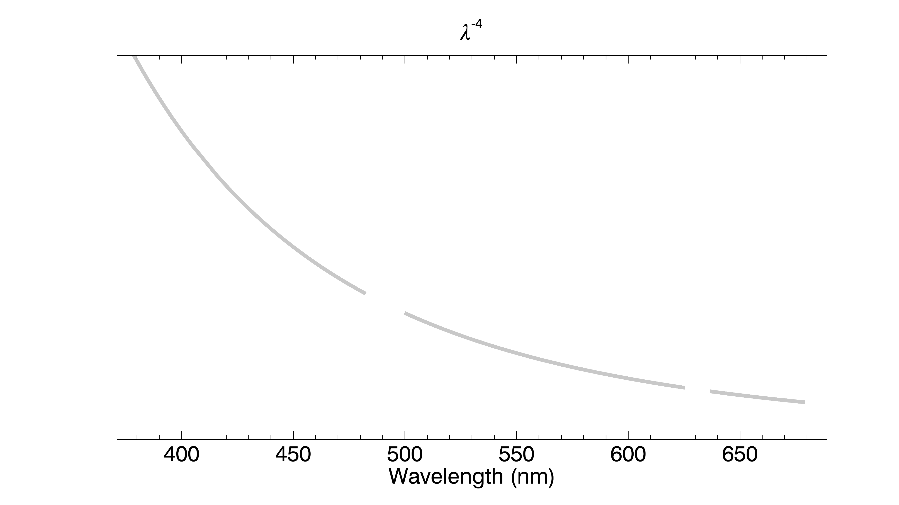
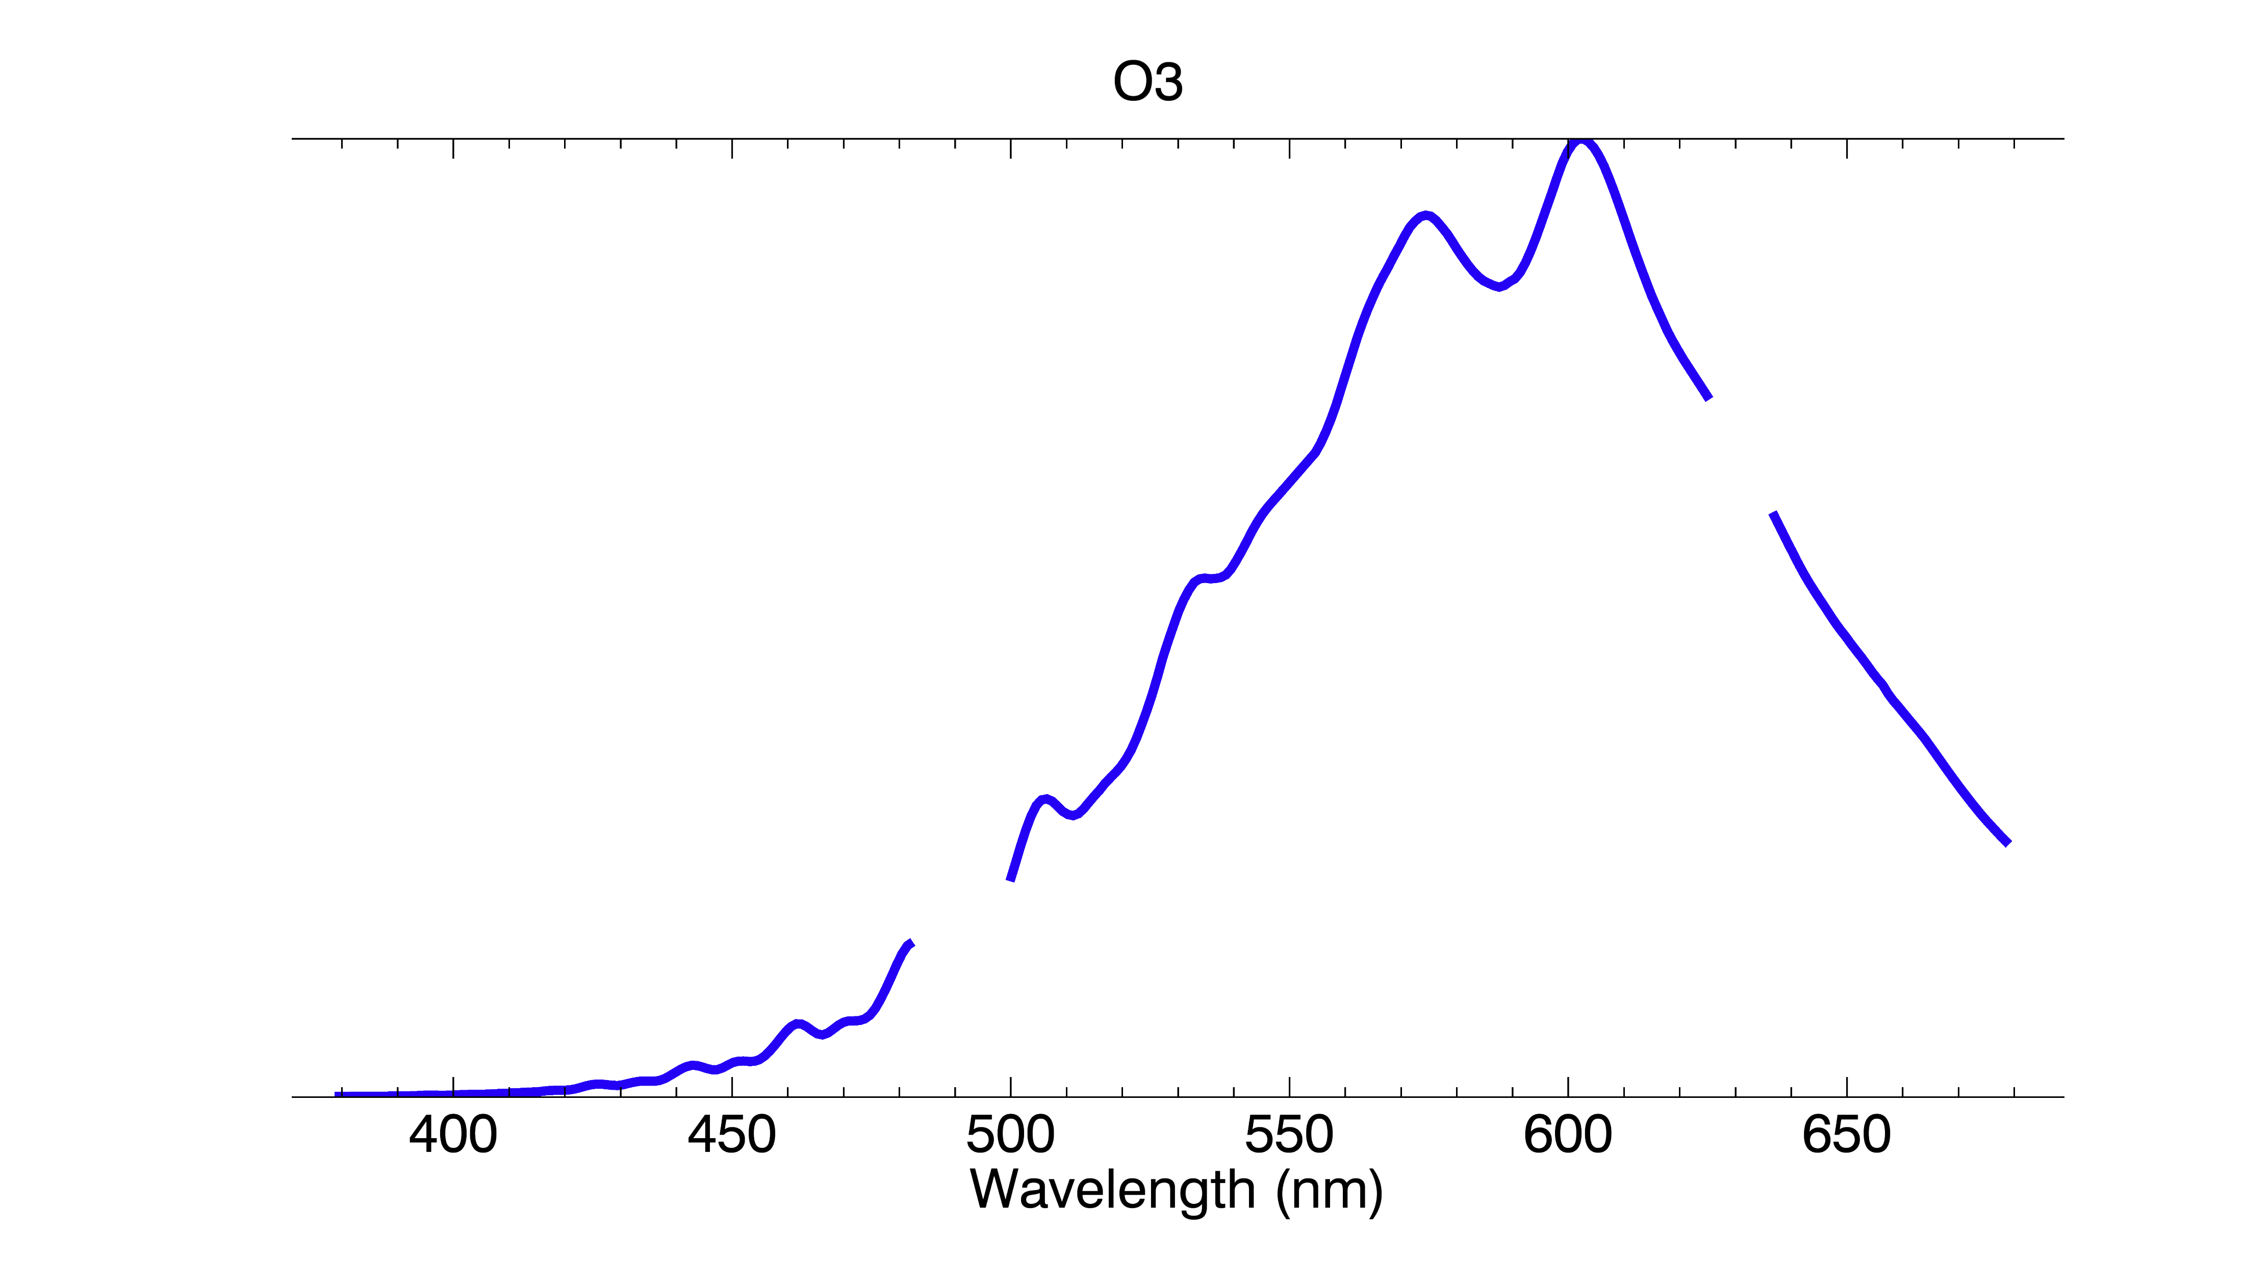
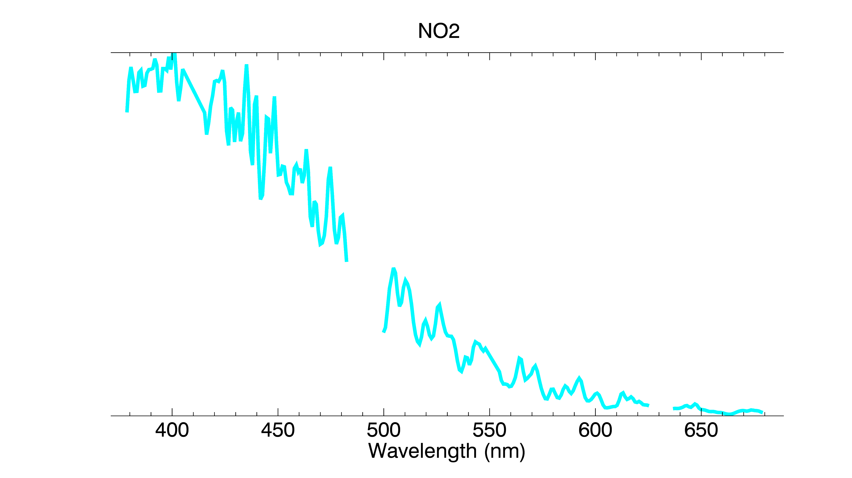
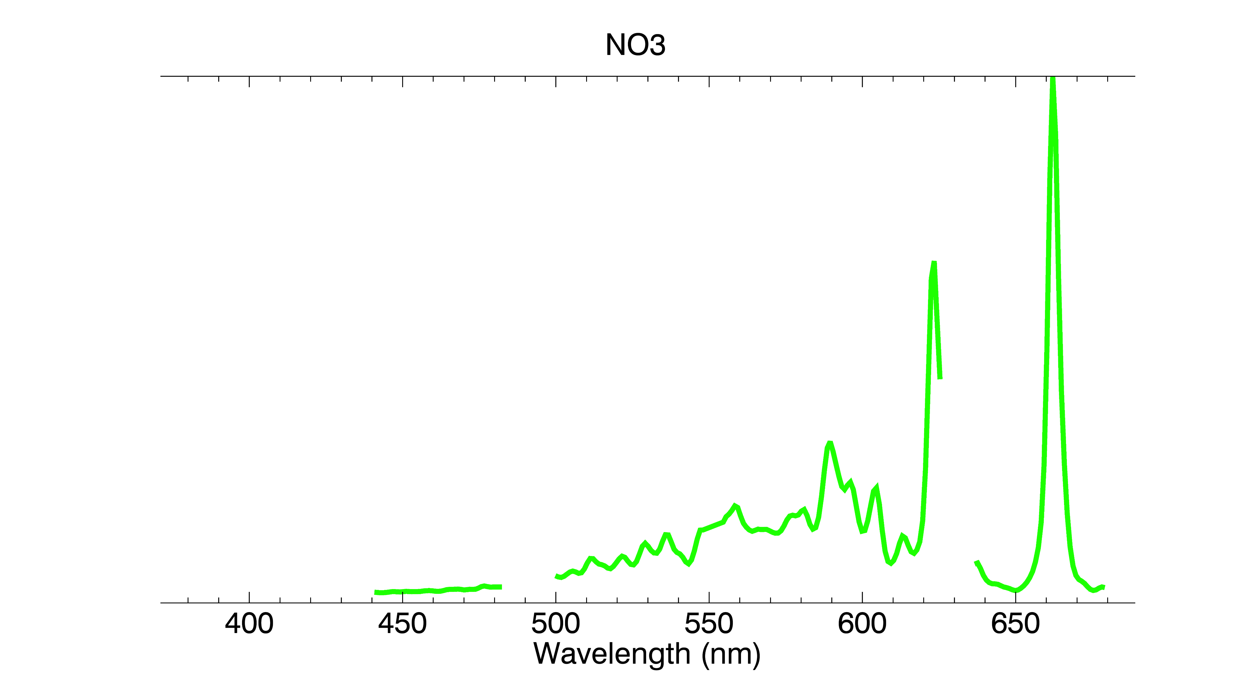
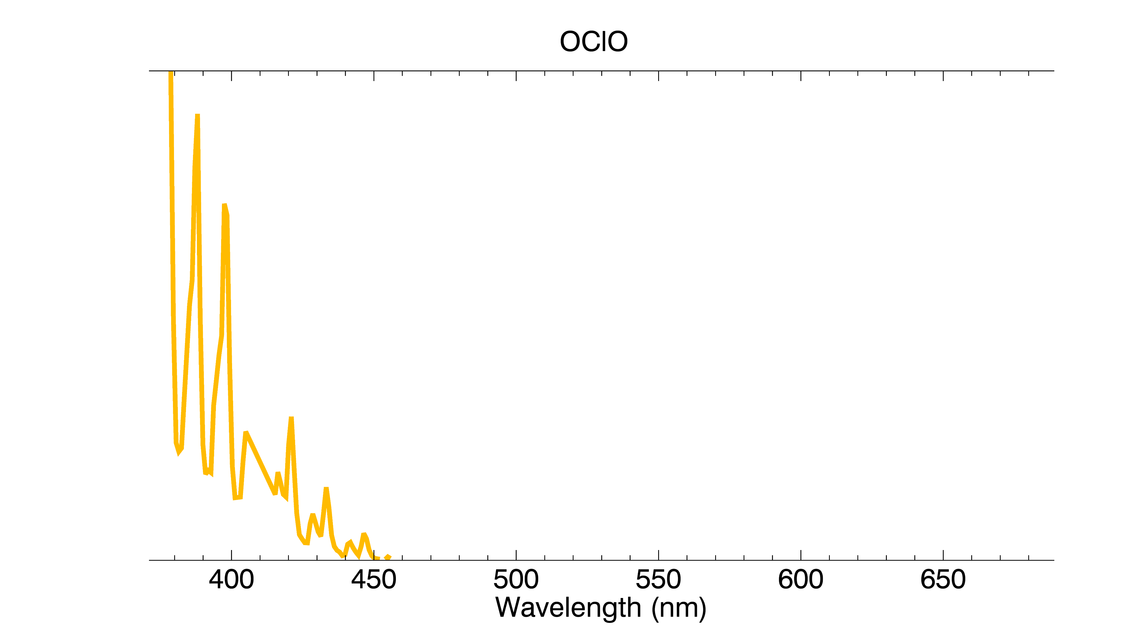
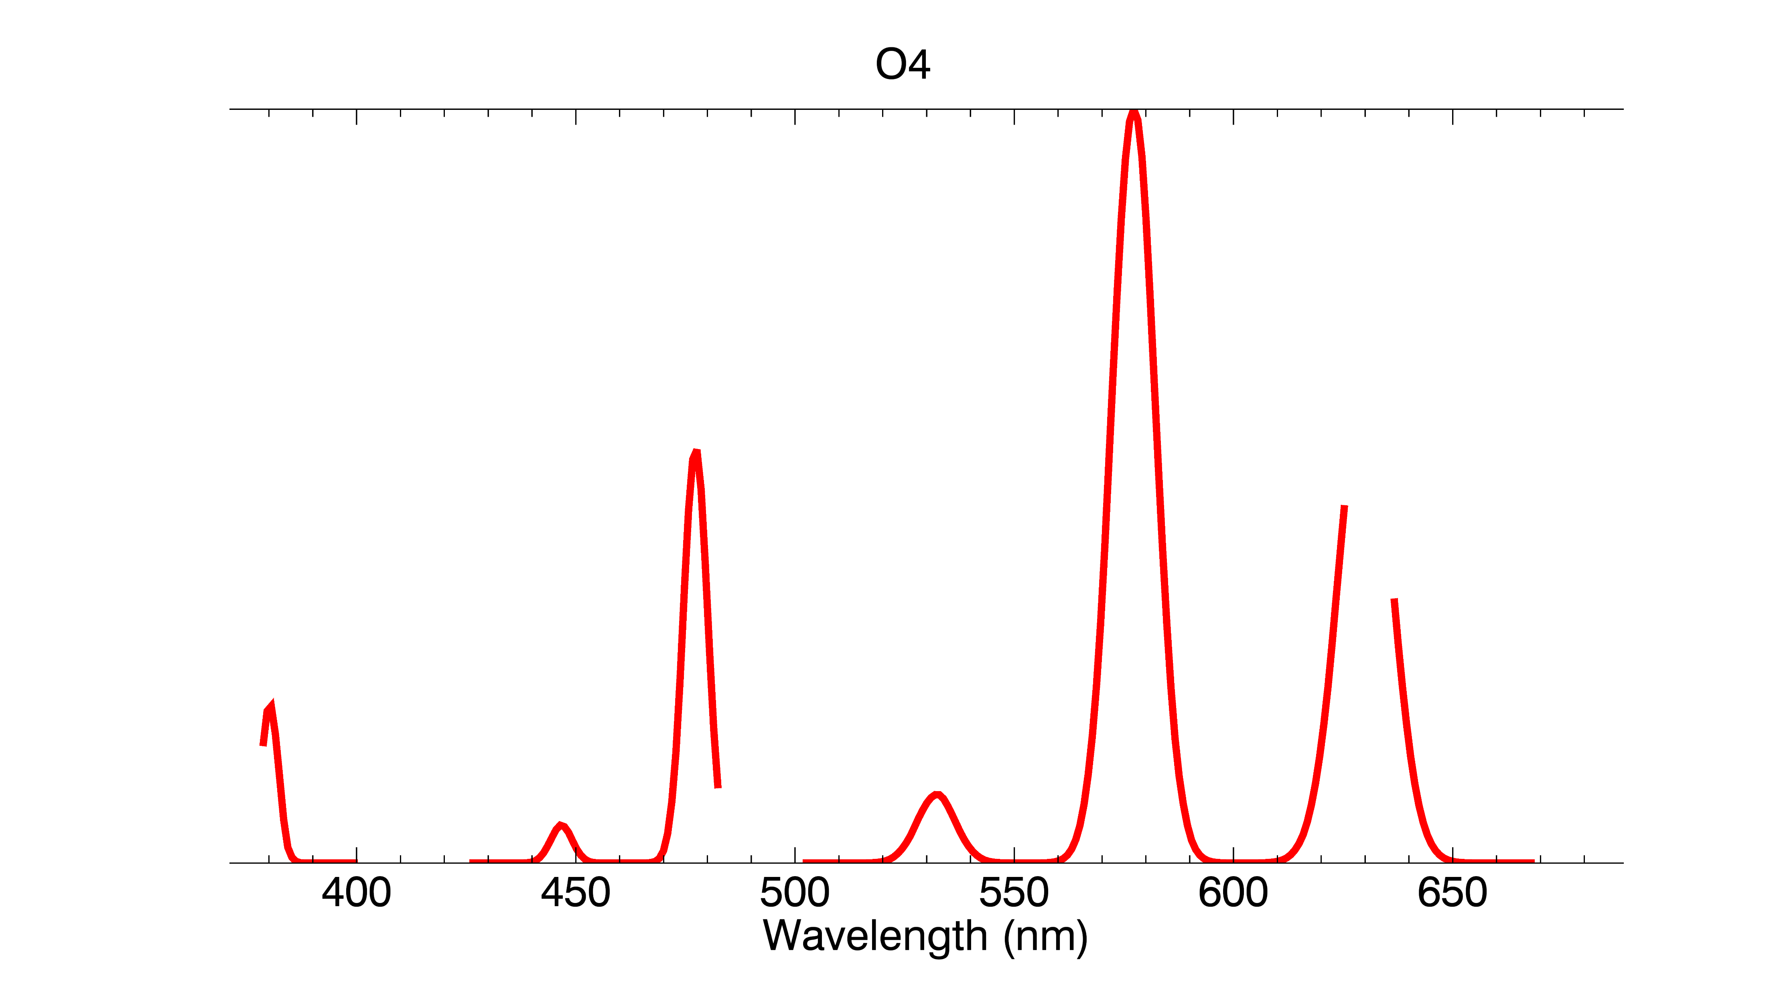
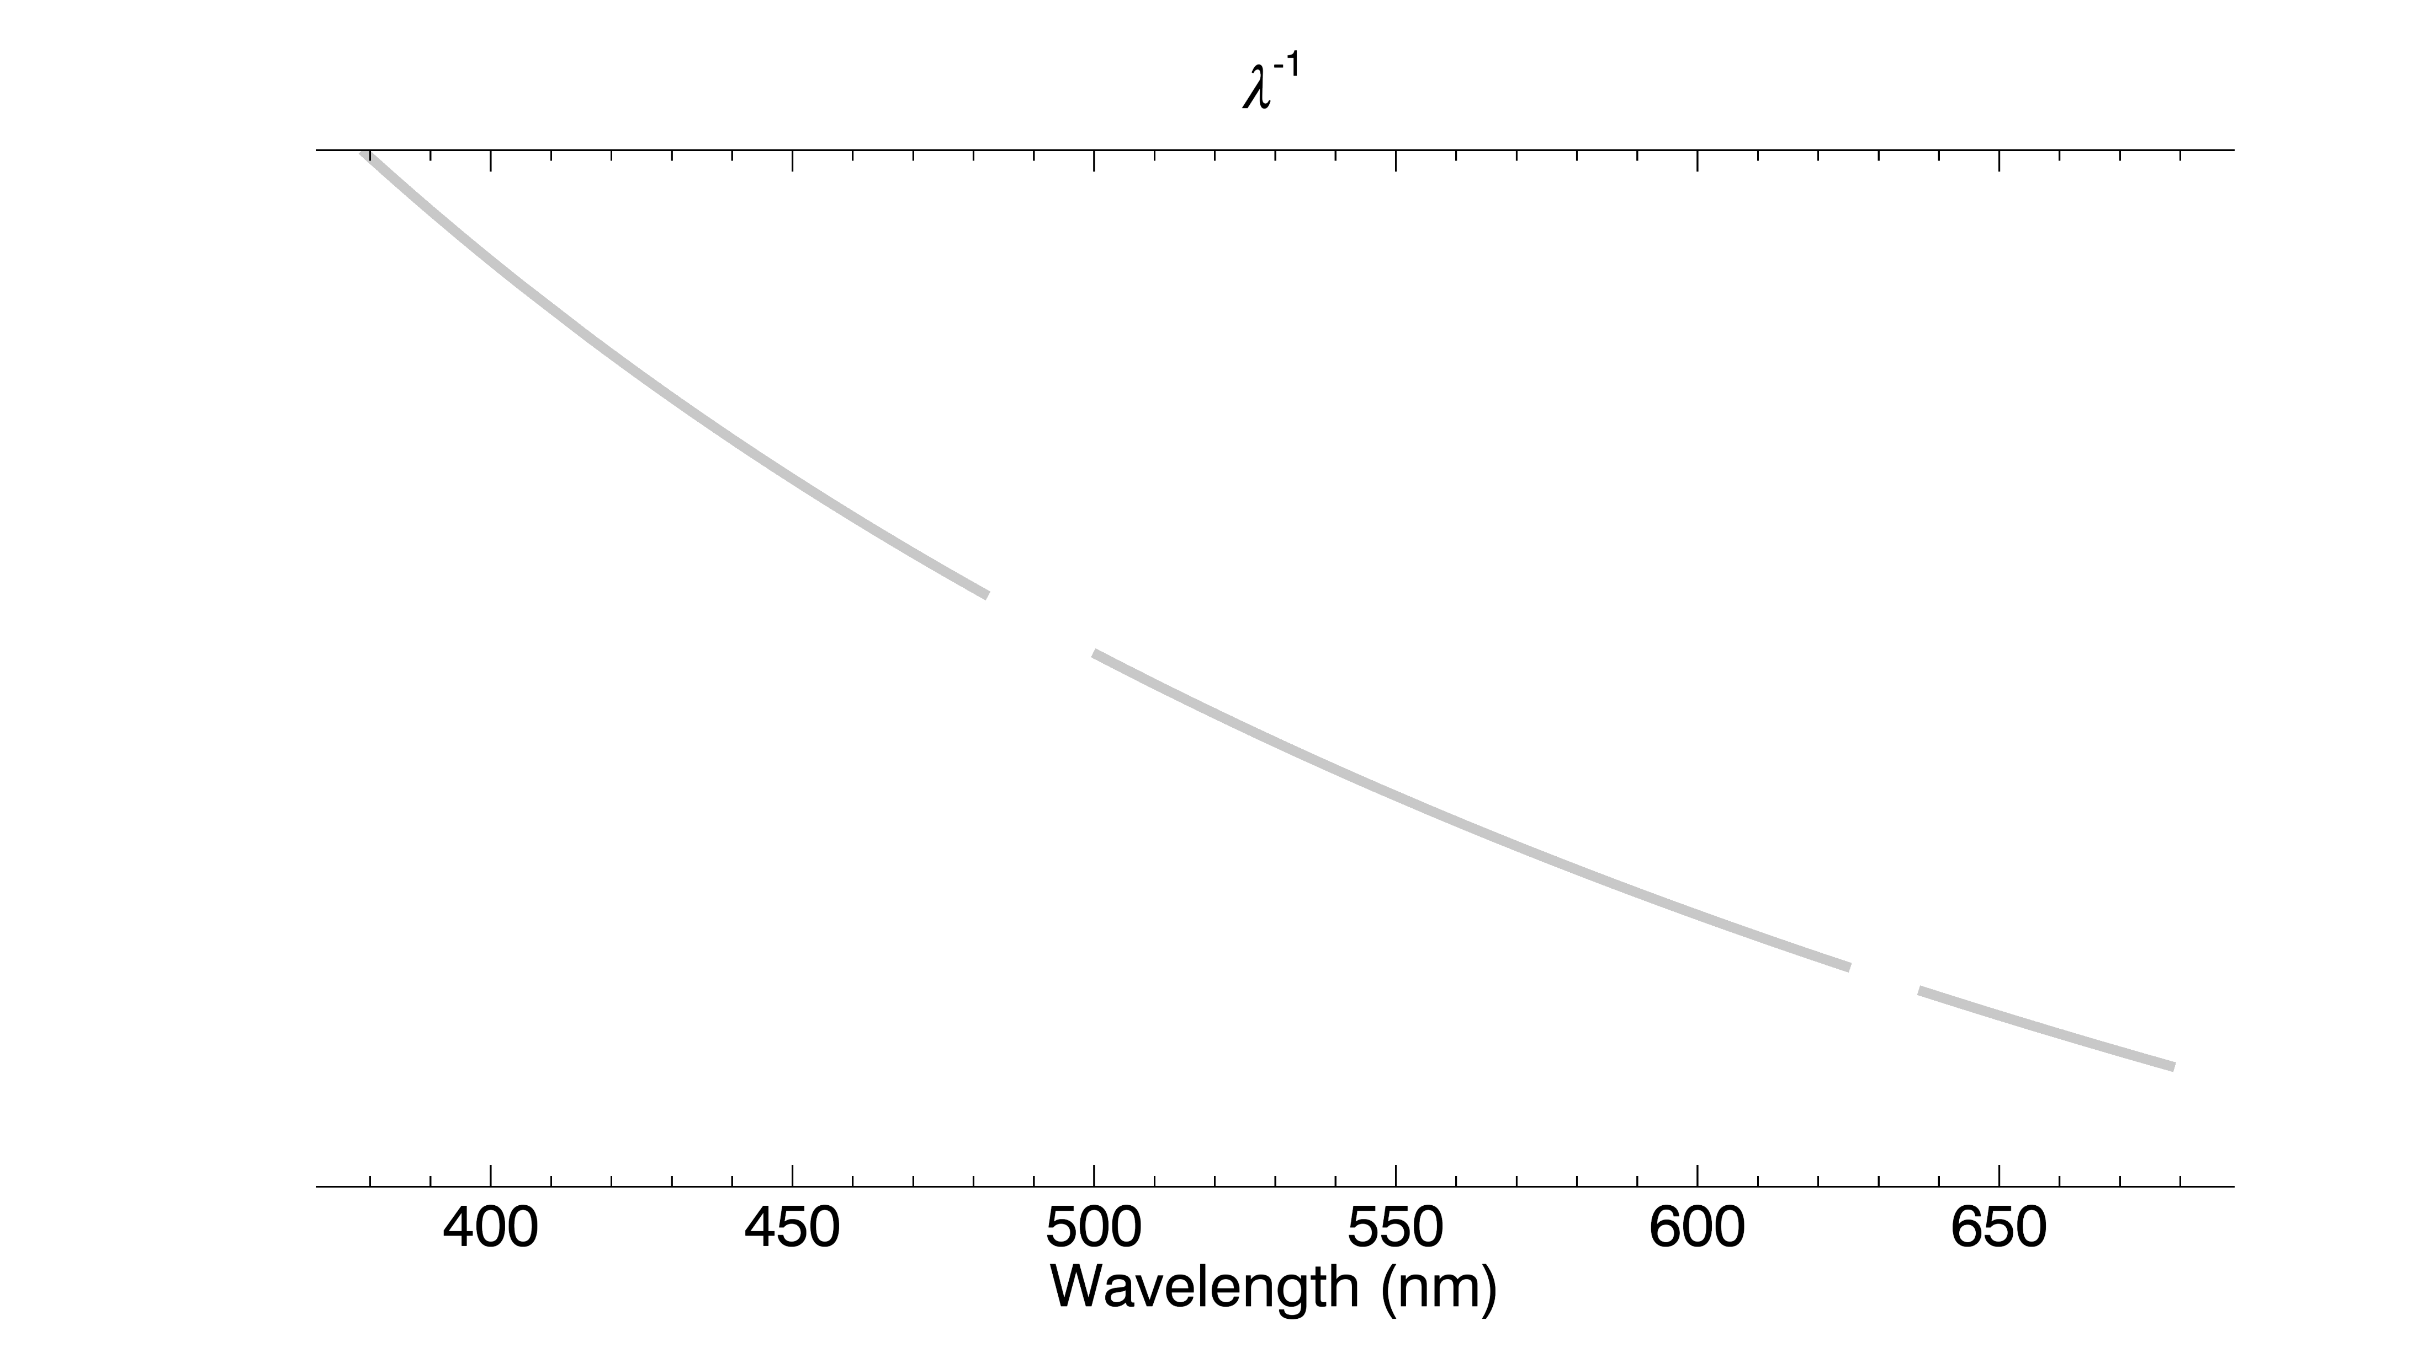
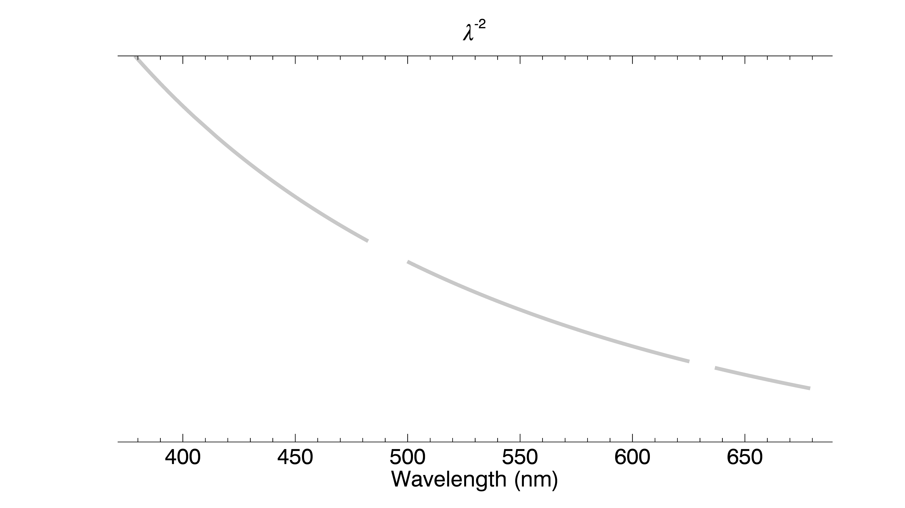
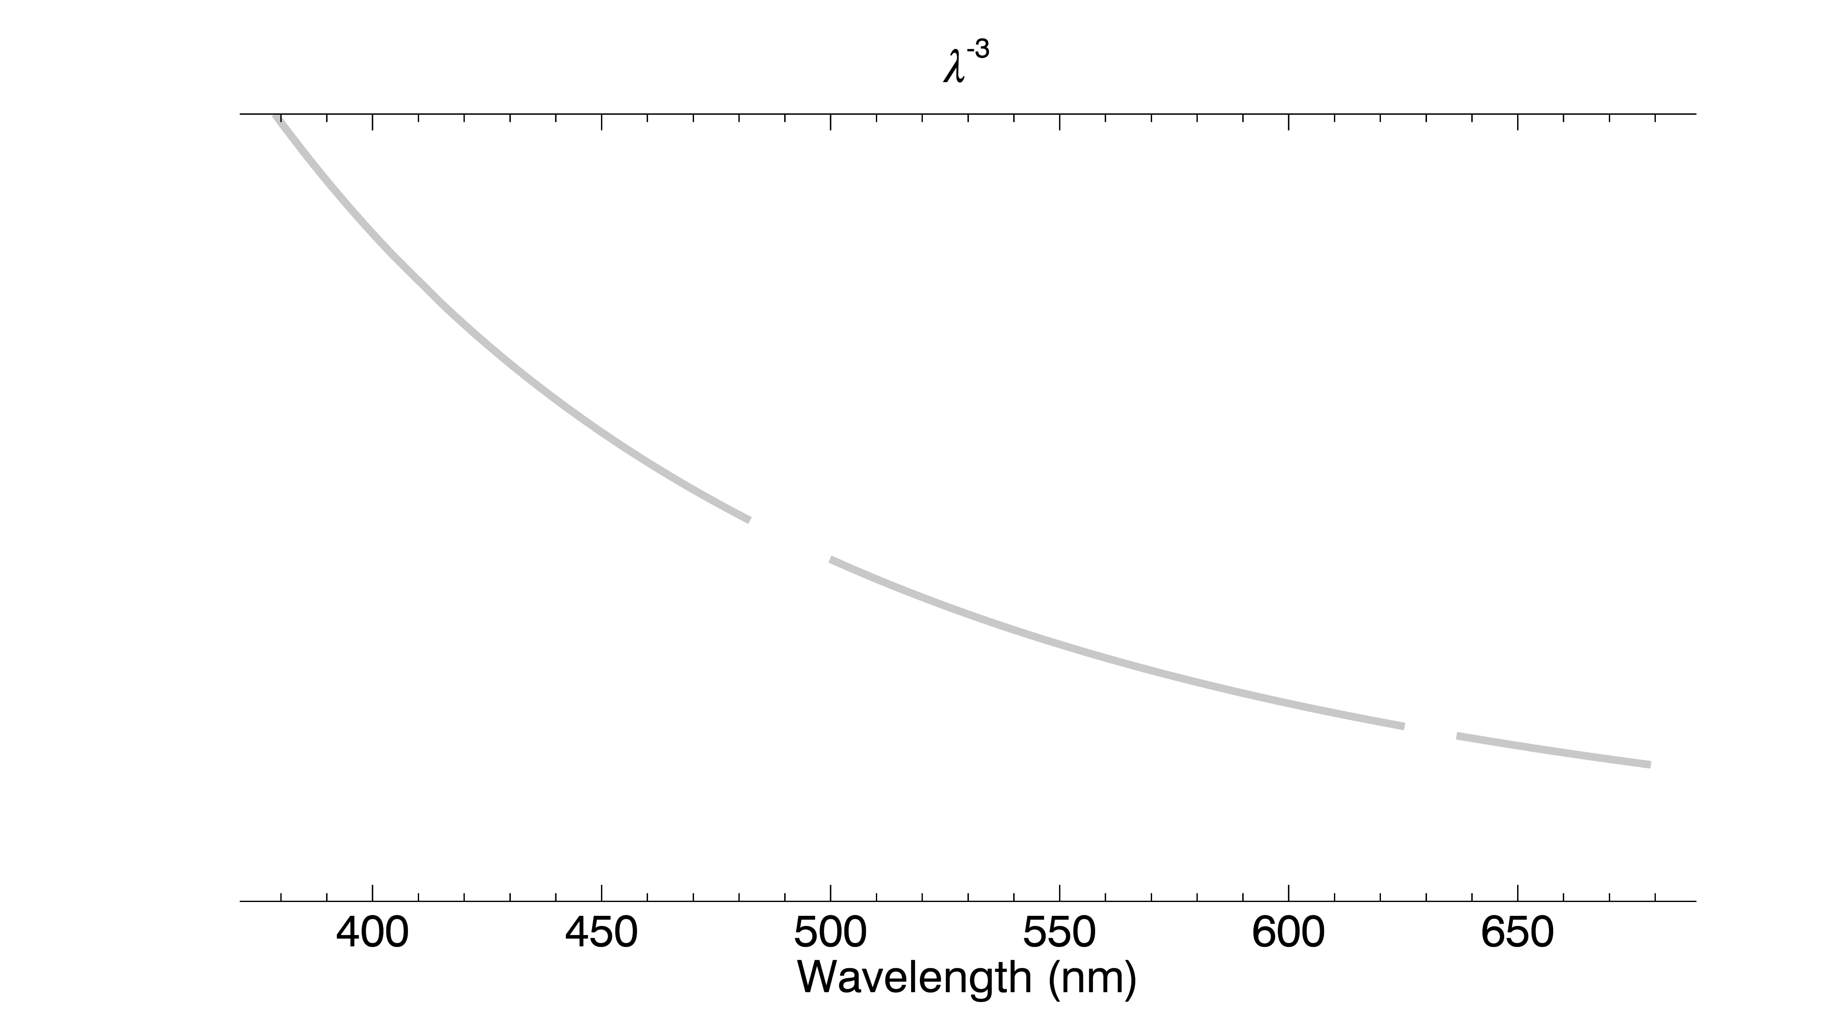
Cross Sections
Cross section spectra for O3, NO2, NO3, OClO, and O4.
Four filters (plus a constant) are added in with the cross sections to account for the optical depth contribution from Rayleigh scattering, aerosols, and differences in lunar albedo.
Data
Dark Current Correction
Altitude Registration
Inversion
Altitude Adjustment
Filtering and Binning
Peeling
Products
Wavelength Calibration
The SAGE III/ISS Lunar Algorithm
3
Robbie Manion | October 2018

Slide 4
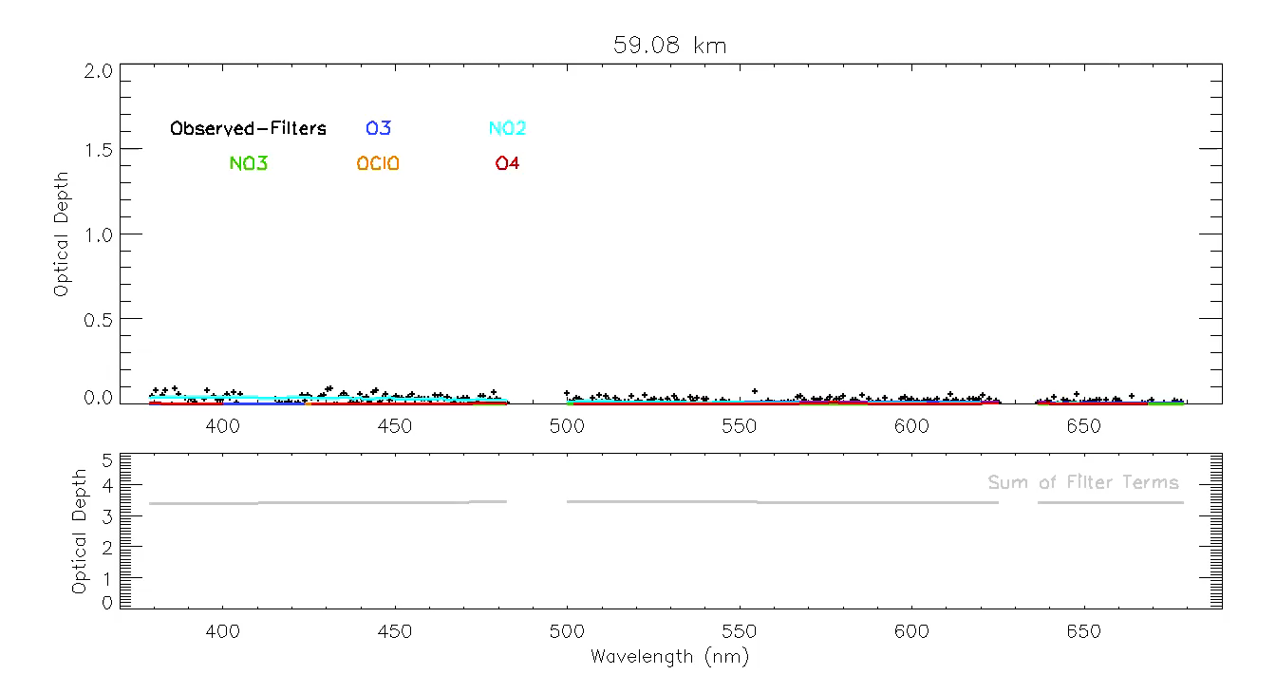
Inversion
+symbols+
-lines-
Data
Dark Current Correction
Altitude Registration
Inversion
Altitude Adjustment
Filtering and Binning
Peeling
Products
Wavelength Calibration
The SAGE III/ISS Lunar Algorithm
4
Robbie Manion | October 2018

Slide 5
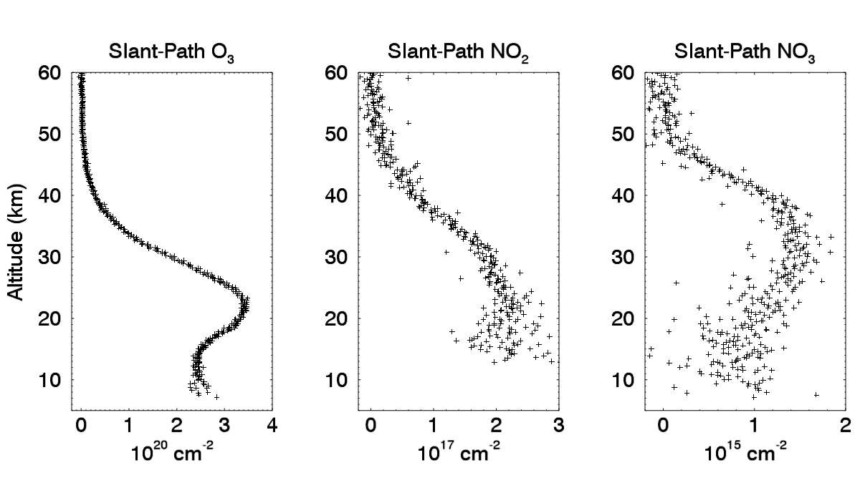
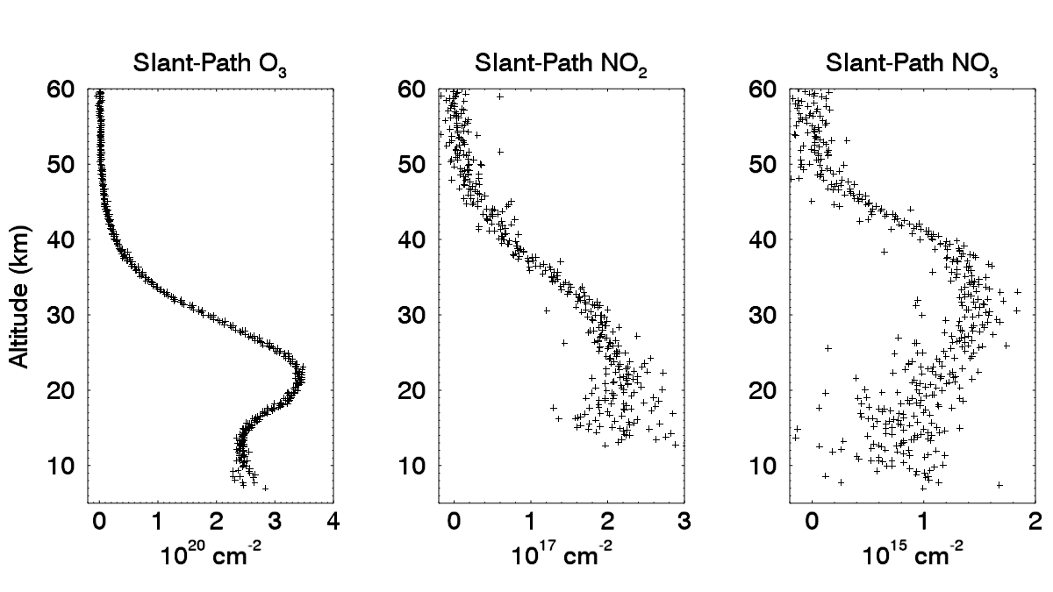
Altitude Adjustment
The retrieved Ozone in each scan is compared to overlapping scans to line up the scan altitudes. A-band O2 optical depth is also used in this comparison.
Additional adjustment is made on a packet-by-packet basis by comparing A-band O2 signal to a forward model.
Data
Dark Current Correction
Altitude Registration
Inversion
Altitude Adjustment
Filtering and Binning
Peeling
Products
Wavelength Calibration
The SAGE III/ISS Lunar Algorithm
5
Robbie Manion | October 2018

Slide 6
Filtering, Binning, and Peeling
Data
Dark Current Correction
Altitude Registration
Inversion
Altitude Adjustment
Filtering and Binning
Peeling
Products
Wavelength Calibration
The SAGE III/ISS Lunar Algorithm
6
Robbie Manion | October 2018

Slide 7
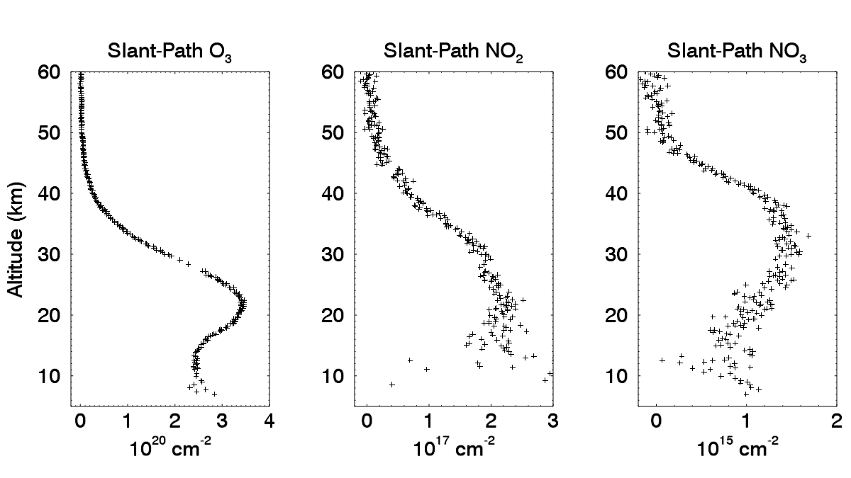
Filtering, Binning, and Peeling
Data
Dark Current Correction
Altitude Registration
Inversion
Altitude Adjustment
Filtering and Binning
Peeling
Products
Wavelength Calibration
The SAGE III/ISS Lunar Algorithm
7
Robbie Manion | October 2018

Slide 8
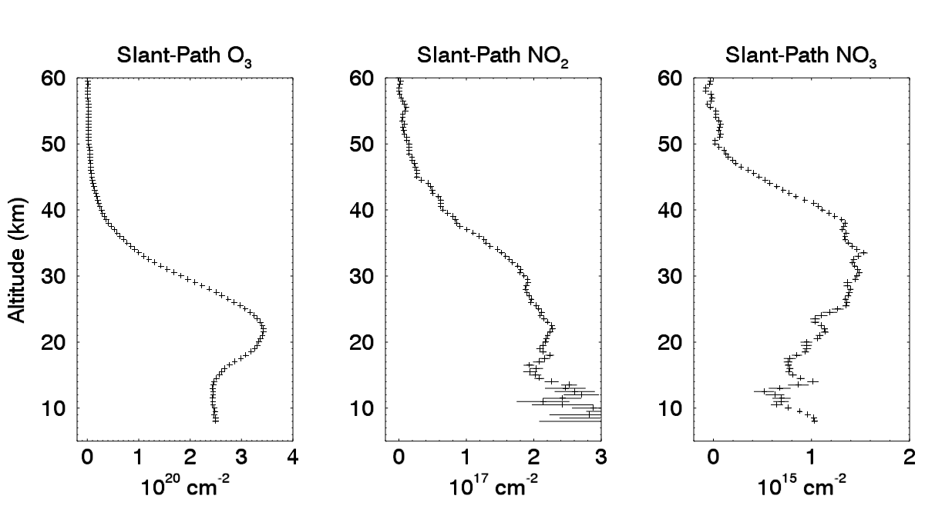
Filtering, Binning, and Peeling
Data
Dark Current Correction
Altitude Registration
Inversion
Altitude Adjustment
Filtering and Binning
Peeling
Products
Wavelength Calibration
The SAGE III/ISS Lunar Algorithm
8
Robbie Manion | October 2018

Slide 9
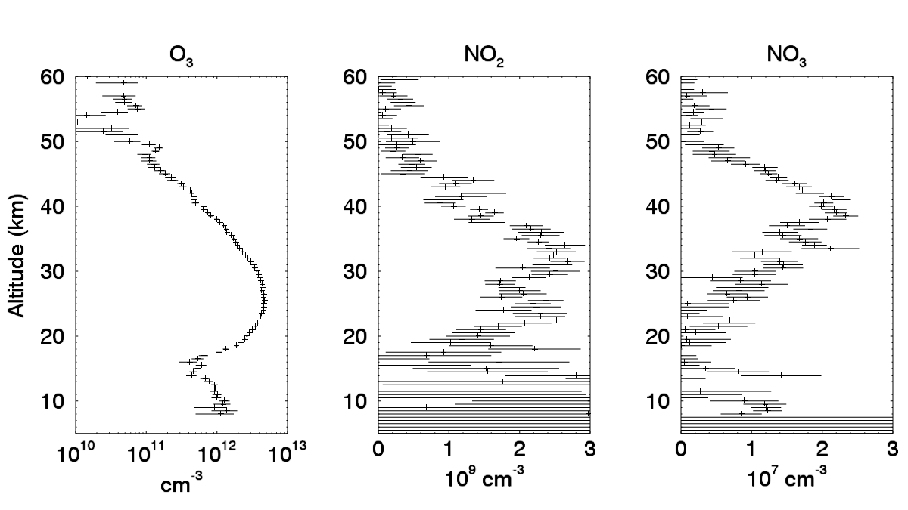
Filtering, Binning, and Peeling
Data
Dark Current Correction
Altitude Registration
Inversion
Altitude Adjustment
Filtering and Binning
Peeling
Products
Wavelength Calibration
The SAGE III/ISS Lunar Algorithm
9
Robbie Manion | October 2018

Slide 10
Products
In V5.1 we have released Ozone as a provisional product and NO₃ as a research product.
NO₂ is being worked on.
OClO retrieval is challenged by the lower counts on the ISS instrument compared to Meteor.
Data
Dark Current Correction
Altitude Registration
Inversion
Altitude Adjustment
Filtering and Binning
Peeling
Products
Wavelength Calibration
The SAGE III/ISS Lunar Algorithm
10
Robbie Manion | October 2018

