Slide 1
The SAGE III/ISS Lunar Algorithm
Robbie Manion
October 2018

Slide 2
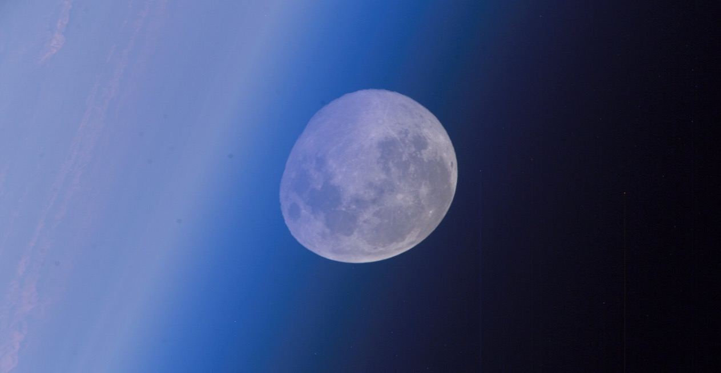


The SAGE III/ISS Lunar Algorithm
The SAGE III/ISS Lunar Algorithm
2
Robbie Manion | October 2018

Slide 3
Data
Using the moon as a target
  More geographical coverage
  Monitor nighttime species
  Illuminated portion of the moon varies in shape and brightness
  Moon is not very bright overall
Instrumental field of view is increased for lunar events
  More “counts” on the CCD, increased signal-to-noise
  Coarser resolution (altitude)
Packet rate for lunar science data is 1/16 s compared to 1/64 s for solar data
  Fewer temporal data points
  More spectral data points
This presentation will focus on the progression of data through a single moonset event.
Date: 2018.07.23 | Time: 0234 UTC
Lat: 28.0N | Lon: 12.7W
Data
Dark Current Correction
Altitude Registration
Inversion
Altitude Adjustment
Filtering and Binning
Peeling
Products
Wavelength Calibration
The SAGE III/ISS Lunar Algorithm
3
Robbie Manion | October 2018

Slide 4
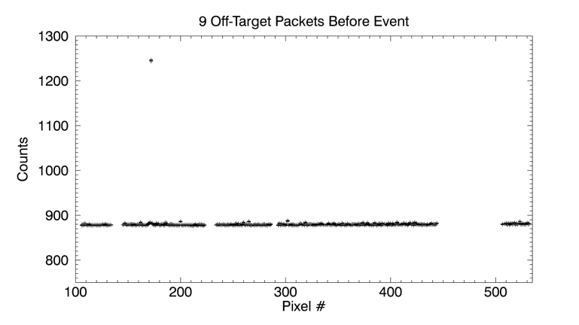
Dark Current Correction
The CCD begins collecting data packets prior to target acquisition.
The counts measured in these space-looking packets are used to correct all counts measured through the event.
Data
Dark Current Correction
Altitude Registration
Inversion
Altitude Adjustment
Filtering and Binning
Peeling
Products
Wavelength Calibration
The SAGE III/ISS Lunar Algorithm
4
Robbie Manion | October 2018

Slide 5
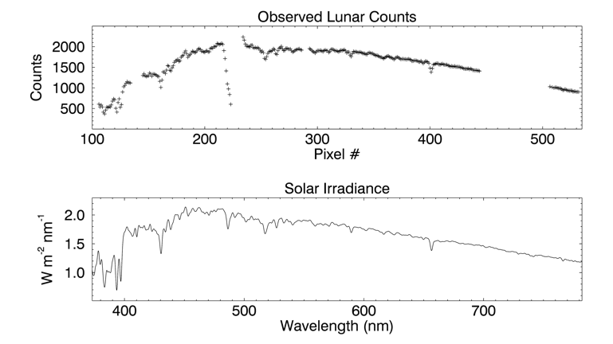
Wavelength Calibration
Start with a nominal pixel-to-wavelength map.
Consider the brightest exoatmospheric packet(s).
Shift the counts spectrum to best echo the features of a reference solar spectrum.
So far, we see shifting from nominal of less than +/- 0.05 nm.
Data
Dark Current Correction
Altitude Registration
Inversion
Altitude Adjustment
Filtering and Binning
Peeling
Products
Wavelength Calibration
The SAGE III/ISS Lunar Algorithm
5
Robbie Manion | October 2018

Slide 6
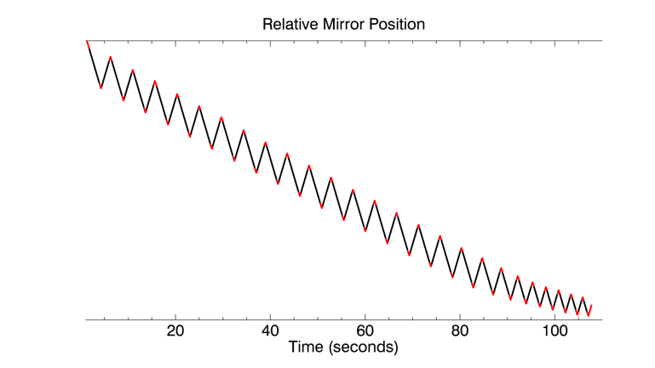
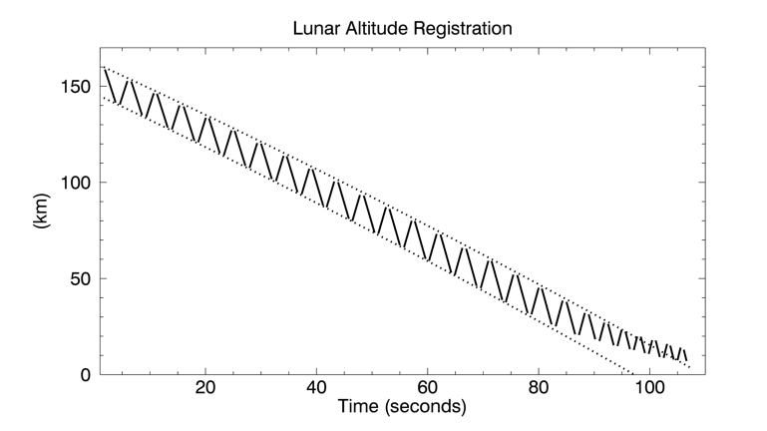
Altitude Registration
The instrument scans through the brightness centroid of the target.
Given the geometry of the occultation and the fullness of the moon, we can reference a lunar model to predict this centroid and the chord along which the instrument scans.
Comparing the observed edges of the target to the model edges helps register the relative location of each packet on the target.
Refraction is also considered when determining the tangent altitude of the optical path.
Data
Dark Current Correction
Altitude Registration
Inversion
Altitude Adjustment
Filtering and Binning
Peeling
Products
Wavelength Calibration
The SAGE III/ISS Lunar Algorithm
6
Robbie Manion | October 2018

Slide 7
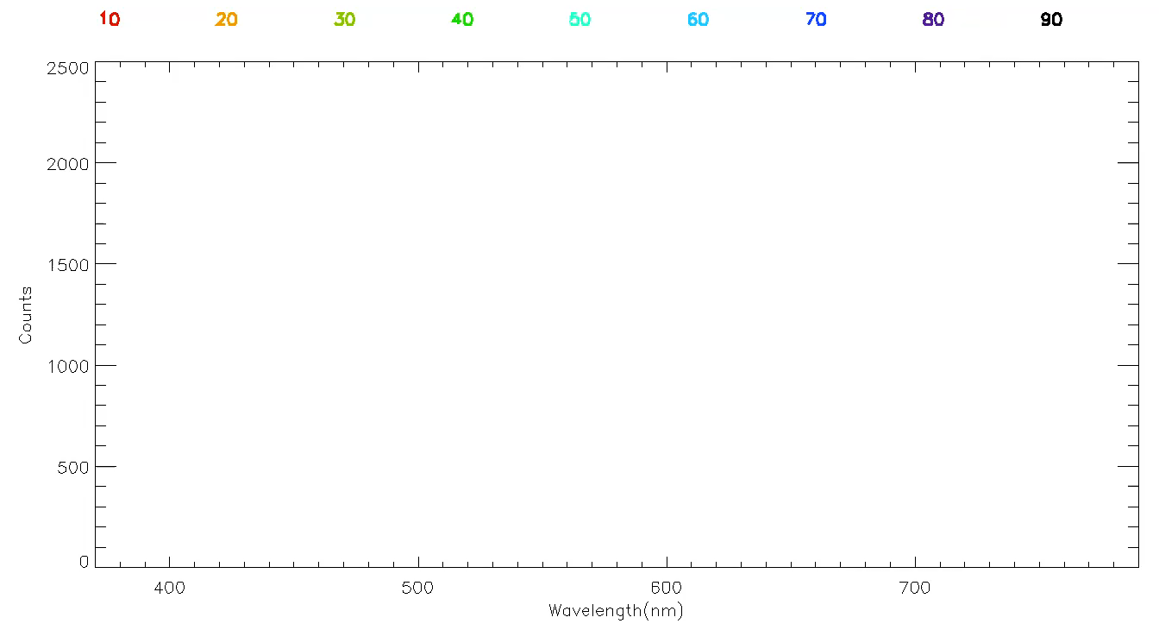
Exoatmospheric Scans
Data
Dark Current Correction
Altitude Registration
Inversion
Altitude Adjustment
Filtering and Binning
Peeling
Products
Wavelength Calibration
The SAGE III/ISS Lunar Algorithm
7
Robbie Manion | October 2018

Slide 8
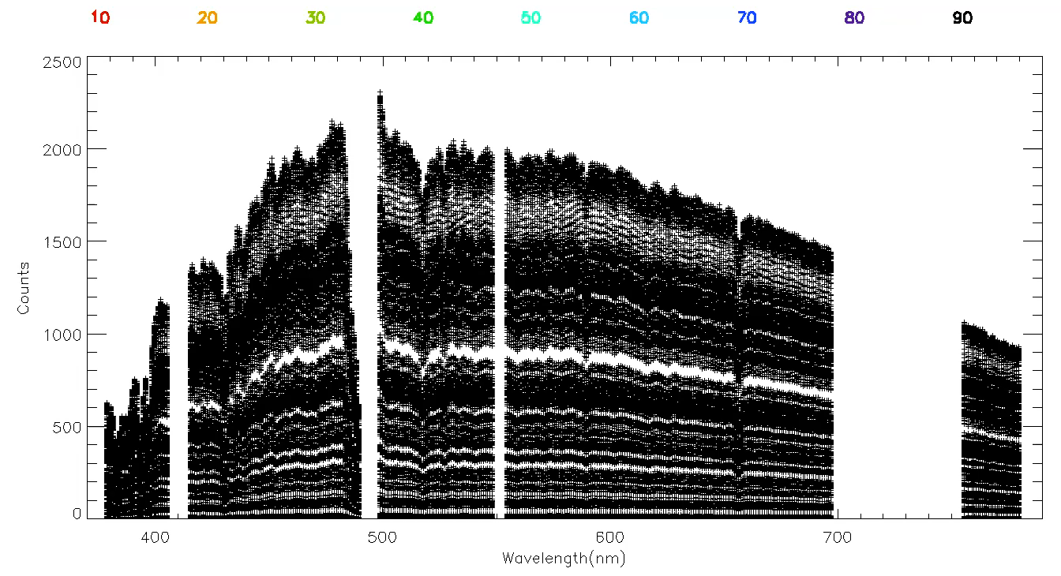
Attenuated Scans
Data
Dark Current Correction
Altitude Registration
Inversion
Altitude Adjustment
Filtering and Binning
Peeling
Products
Wavelength Calibration
The SAGE III/ISS Lunar Algorithm
8
Robbie Manion | October 2018

Slide 9
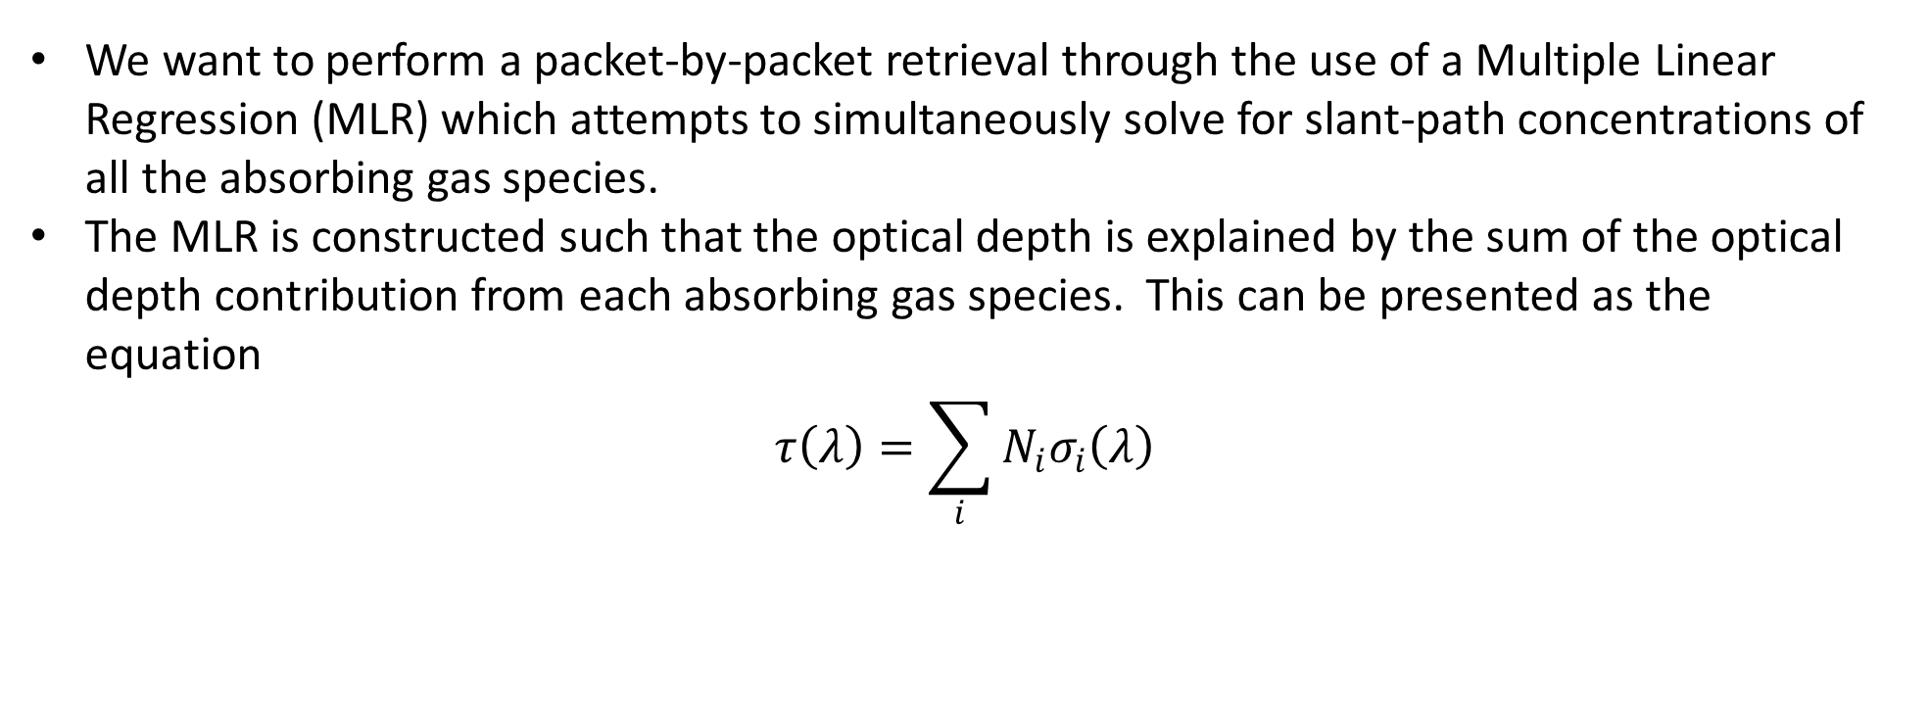
MLR Retrieval
We want to perform a packet-by-packet retrieval through the use of a Multiple Linear Regression (MLR) which attempts to simultaneously solve for slant-path concentrations of all the absorbing gas species.
The MLR is constructed such that the optical depth is explained by the sum of the optical depth contribution from each absorbing gas species. This can be presented as the equation
$$τ\left(λ\right)=\sum_{i}{N_{i}σ_{i}\left(λ\right)}$$
Slant-Path Optical Depth
Species Cross Section
Species Column Density
Data
Dark Current Correction
Altitude Registration
Inversion
Altitude Adjustment
Filtering and Binning
Peeling
Products
Wavelength Calibration
The SAGE III/ISS Lunar Algorithm
9
Robbie Manion | October 2018

