Slide 1
Title of Review
NASA Langley Research Center
Date

Slide 2
SAGE III stratospheric aerosol data quality and other particulate thoughts
L. Thomason
Peon

Slide 3
Unnamed Slide
Internal consistency
  Aerosol spectra
  Precision assessment
Comparisons with other space instruments: OSIRIS
Some interesting features of the first year of observations
Somethings to remember about SAGE III aerosol
  No spectral (wavelength) form is imposed; aerosol is reported as a residual based on the MLR retrieval of ozone and NO2
  As a residual, aerosol often reflects deficiencies in all the preceding parts of the algorithm from measurement to MLR

Slide 4
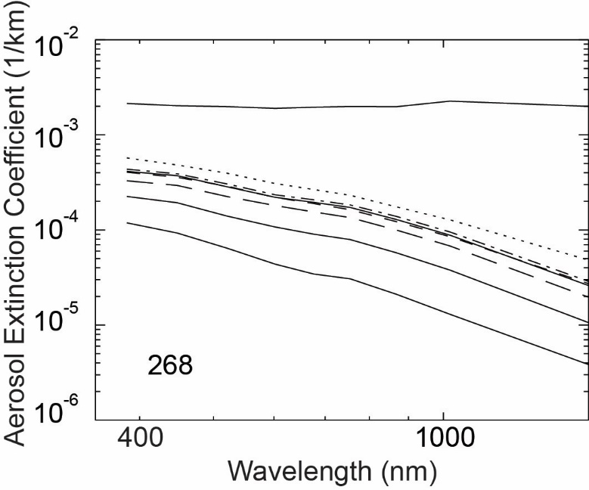
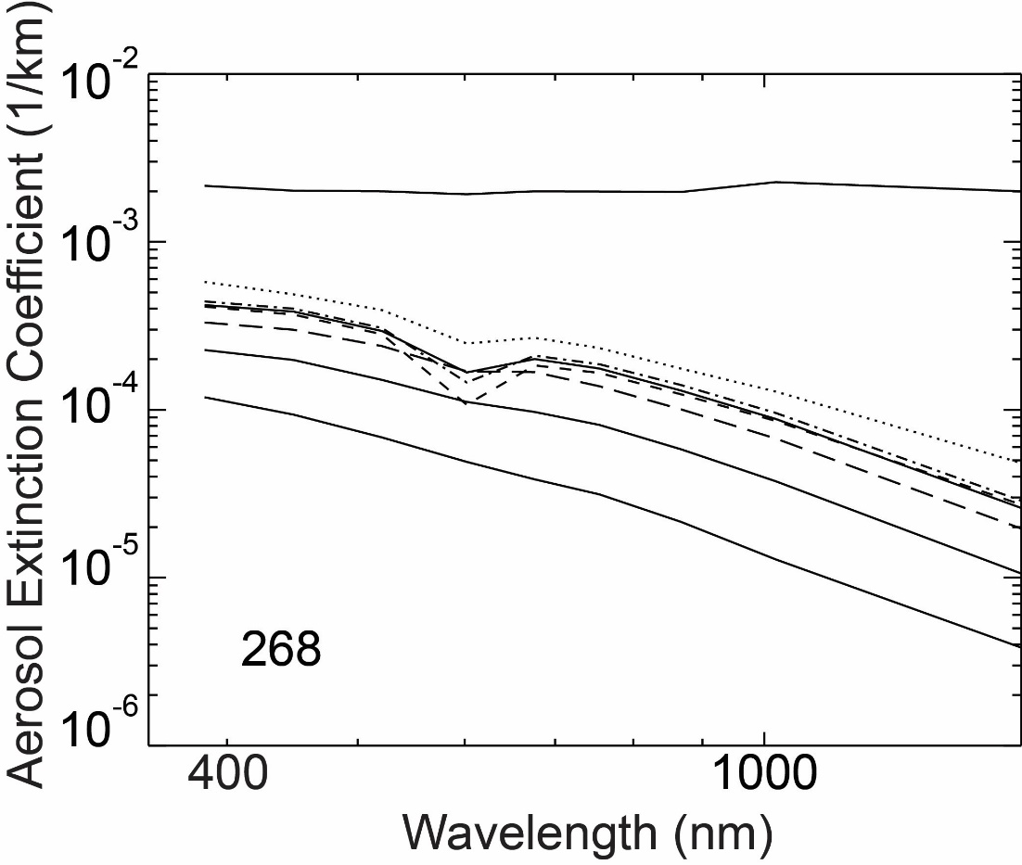
Internal Consistency: Aerosol Spectra
Expect, smooth ~monotonic aerosol extinction coefficient spectra. Departures are a good measure of how well we are doing with not just aerosol but also ozone and NO2
Aerosol loading is LOW only ~20-40% higher than the lowest levels observed since 1979 (2000).
Generally, see positive results except some tendency for aerosol channels with high ozone absorption (521, 602, 676) to be a bit low.
(See “when spectroscopy goes bad”)
15 to 32.5 km
Increasing altitude
clouds
aerosol

Slide 5
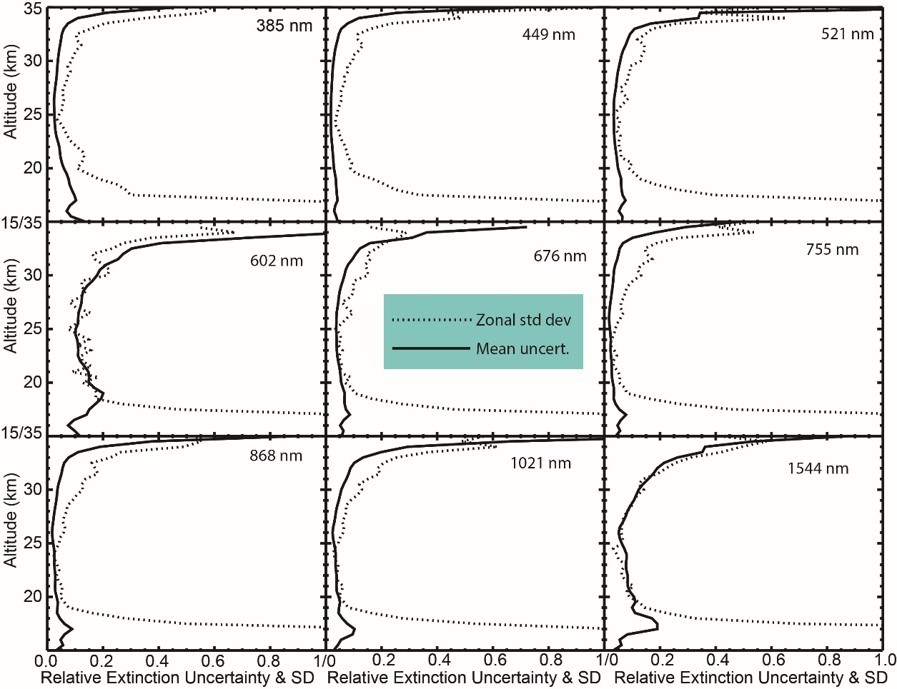
Internal Comparisons: Variance in the Tropics
Expect aerosol extinction coefficient zonal variability to be low at very low latitudes.
We expect zonal standard deviation (dashed) to be close to but greater than the reported uncertainty (solid)
Behaves as expected

Slide 6
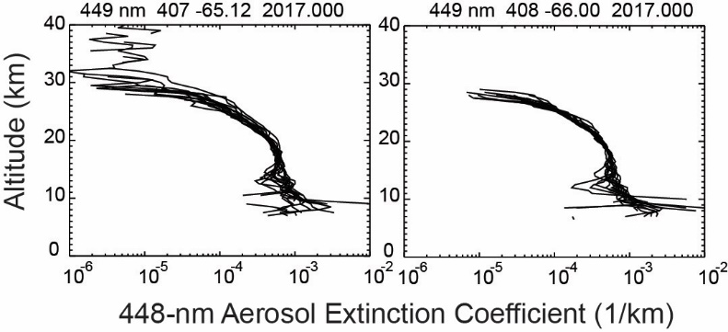
Variable Noise Levels
Some events are noisy than others mostly due to the ride. Hopefully, this will get to be less an issue once the DMP data is incorporated into the processing but ISS will always require a bit more care in usage than previous SAGE data sets.

Slide 7
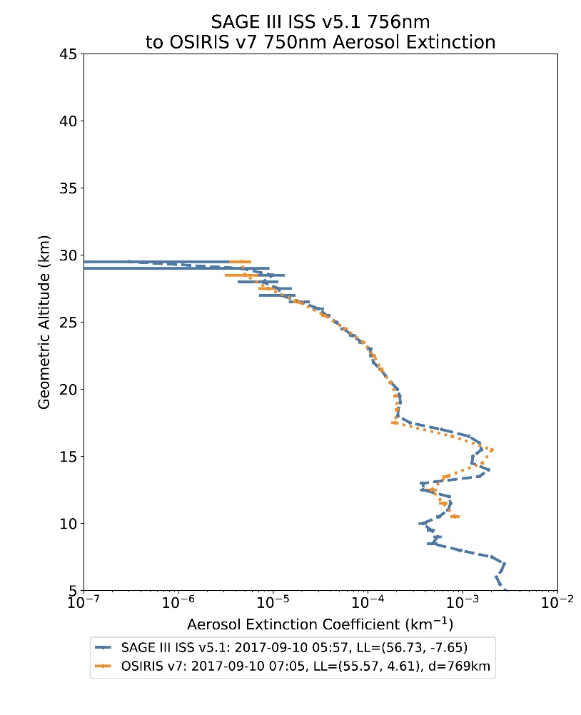
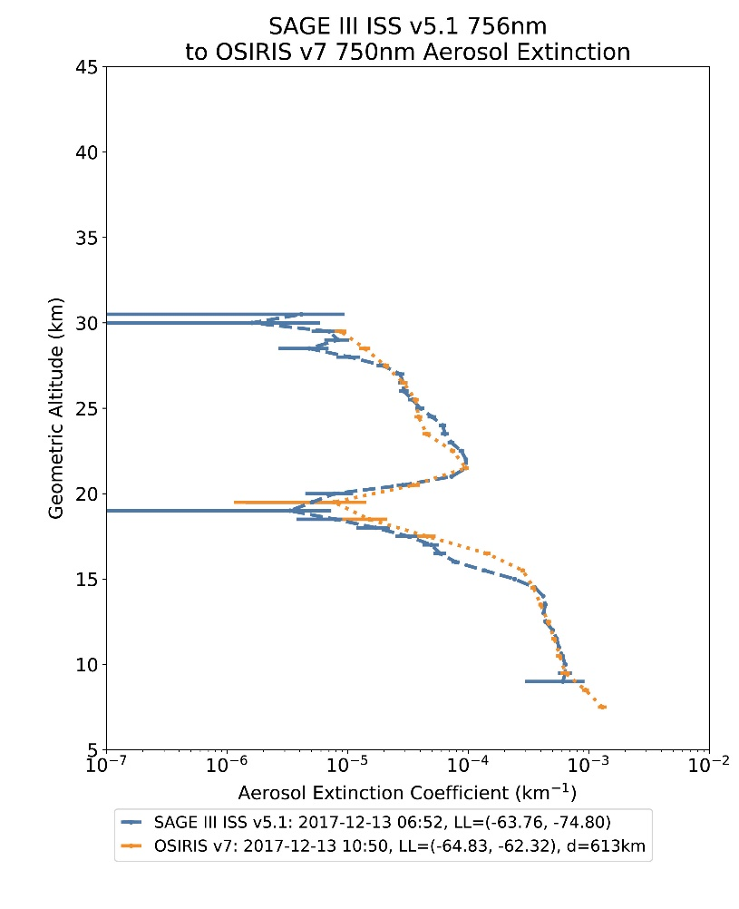
SAGE III Aerosol Comparisons With OSIRIS
SAGE III at 756 nm
OSIRIS at 750 nm
Many coincident events allow comparison subsets:
  Latitude
  Season
  Events (e.g., pyrocumulus)
  Sunrise vs Sunset (SAGE)
  Solar scattering angle (OSIRIS)
Similar studies possible with OMPS, CALIPSO, etc.

Slide 8
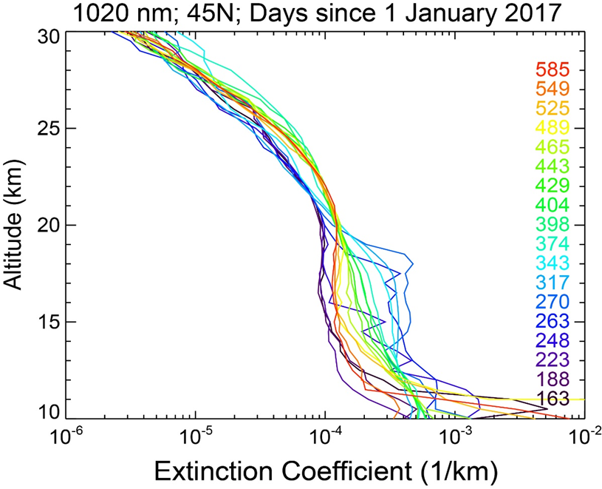
Observations of the Pyrocumulus Event
August 2017
SAGE III observed the large pyrocumulus event in Canada in August 2017
Extinction levels increased by as over a factor 10 in some profiles and by 5 in zonal means
Lower stratospheric levels have relaxed back near to pre-event levels by this summer

Slide 9
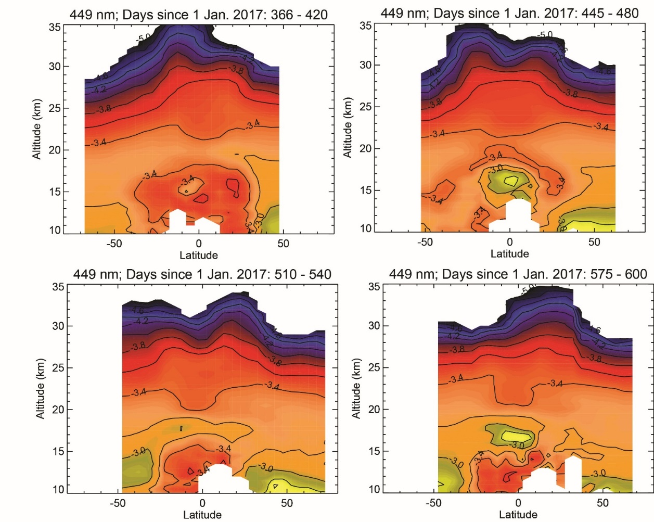
Spring/Summer Volcanic Event: Ambae (aka Aoba)
January
Some 449 nm aerosol extinction cross sections from 2018
Maxima in the tropical UTLS in ‘April’ (upper right) and in ‘August’ (lower right) are consistent with weak volcanic activity
The events are both likely associated with Ambae eruptions on 6 April and 26 July
Ambae is a part of Vanuatu (15.4S, 67.8E)

Slide 10
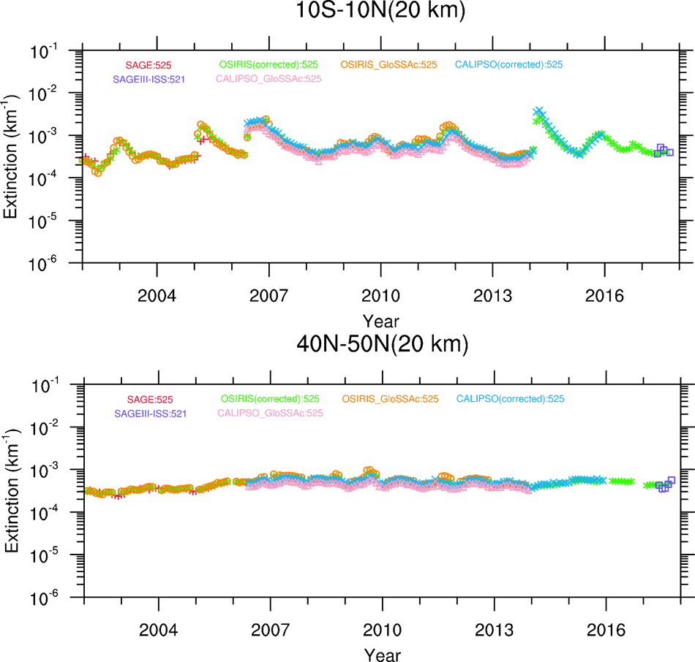
Role in the long-term stratospheric aerosol climatology (GloSSAC v2.0)
In the short term, SAGE III will provide corroboration of the aerosol record constructed using OSIRIS and CALIPSO data
Eventually (sooner than later), the record will be nearly solely dependent on SAGE III/ISS

Slide 11
Summary
SAGE III data quality status
  Wavelength consistency and reported precision are reasonable
  Variable noise between events makes careful usage important
Early comparisons with other space-based instruments are also promising
First year observations include the largest pyrocumulus event ever observed and at least two (very small) volcanic events
SAGE III will be very valuable to the long-term stratospheric aerosol climatology

