Slide 1


Ozone profile retrievals from OMPS Limb Profiler and comparisons with ISS SAGE III
N. Kramarova¹, P.K. Bhartia¹, and G. Jaross¹
1- Goddard Space Flight Center NASA
2018 ISS SAGE III Science Meeting, October 30-31

Slide 2
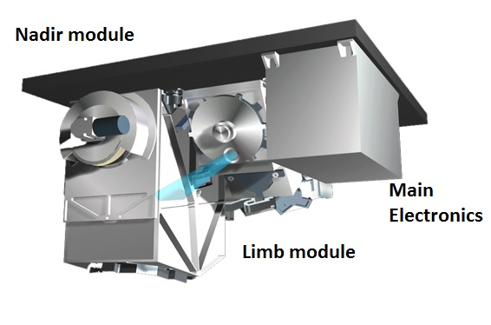
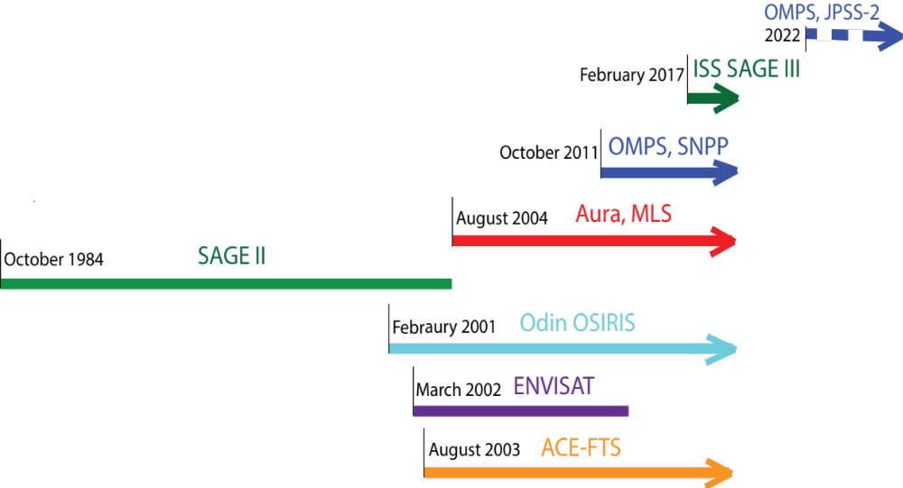
Suomi NPP OMPS Limb Profiler
2018 ISS SAGE III Science Meeting, October 30-31

Slide 3
Suomi NPP OMPS Limb Profiler: 6+ years
OMPS-LP v2.5 Ozone Profile product
Stray light correction for the VIS wavelengths;
Sensor pointing errors [Moy et al., AMT 2017];
New cloud height detection [Chen et al., AMT, 2016];
3 UV pairs and 1 VIS triplet;
Low down normalization altitude to 55 km for UV and 40 km for VIS wavelengths;
Explicit aerosol correction using LP aerosol v1;
Algorithm uses realistic a priori covariance matrices instead of Tikhanov’s regularization.
Internal analysis and comparison with correlative satellite observations (Aura MLS, OSIRIS and ACE-FTS)
Validate Ozone Profiles;
Verify altitude registration adjustments;
Estimate total error budget.
https://disc.gsfc.nasa.gov/datasets/OMPS_NPP_LP_L2_O3_DAILY_2/summary
2018 ISS SAGE III Science Meeting, October 30-31

Slide 4
Summary of OMPS LP ozone validation
LP ozone profiles agree within ±5-10% with correlative satellite ozone observations between 18 and 42 km;
Ozone comparisons validated the implemented altitude corrections (within ±200 m);
Most of the observed errors in the OMPS LP ozone retrievals are due to remaining errors in instrument calibration (e.g. thermal sensitivity in NH, radiometric errors);
The total systematic error budget is estimated for the OMPS LP ozone retrievals (~±5-10%);
A relative drift against MLS and OSIRIS was found that is consistent with a possible drift in the OMPS LP altitude registration detected by one of the methods (~100 m over 5.2 years);
Kramarova, N. A. et al., Atmos. Meas. Tech., 11, 2837-2861, https://doi.org/10.5194/amt-11-2837-2018, 2018.
2018 ISS SAGE III Science Meeting, October 30-31

Slide 5
Comparison of SAGE III ISS and OMPS LP ozone profile
Goals of comparing with SAGE III ISS:
Validate previous comparison results with Aura MLS, OSIRIS and ACE-FTS;
More accurately verify LP altitude registration.
SAGE III solar occultation retrievals version 5.0:
Time period: June 2017 –June 2018 (7897 SO events);
SAGE III interpolated on 1-km vertical grid;
Coincidence criteria: ±2º latitude and ±1000 km;
Total ~5000 co-located SAGEIII/LP profiles;
Typical difference in time of measurements ranges from 3 to 8 hours
GEOSCCM Model simulations:
Coupled stratospheric-tropospheric chemistry package and version 5 of the GEOS GCM (Duncan et al., 2007; Strahan et al., 2007; Oman et al., 2011; Rienicker et al., 2011)
The processes controlling ozone in the middle and upper stratosphere are complete, and the diurnal ozone cycle validated in the CCMVal-1/2 and with Mauna-Loa microwave instruments (Parrish et al., 2014);
2018 ISS SAGE III Science Meeting, October 30-31
Notes:
The model simulations use chemical and greenhouse gas conditions for 2005. The model results are from the Goddard Earth Observing System Chemistry Climate Model (GEOSCCM). It couples the comprehensive stratospheric/tropospheric chemistry package developed within the Global Modeling Initiative (GMI) (Duncan et al., 2007; Strahan et al., 2007; Oman et al., 2011) to version 5 of the GEOS GCM (Rienicker et al., 2011). It does not include a full representation of mesospheric processes but the processes controlling ozone in the middle to upper stratosphere are complete and the model diurnal cycle is thought to be realistic at altitudes < ∼ 52 km (0.5 hPa). The modeled diurnal variations are simulated using chemical and greenhouse gas conditions for 2005. Previous versions of the GEOSCCM have been thoroughly validated in the CCMVal-1 and CCMVal-2 model intercomparison campaigns.
> Comparisons with recent versions of the model are ongoing, but initial results indicate only small differences in the modeled diurnal cycle.

Slide 6
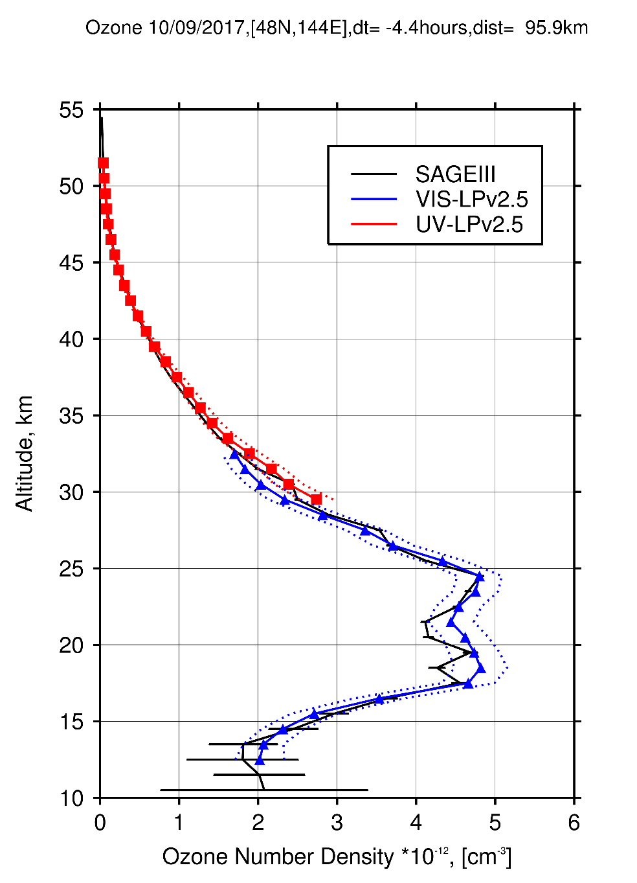
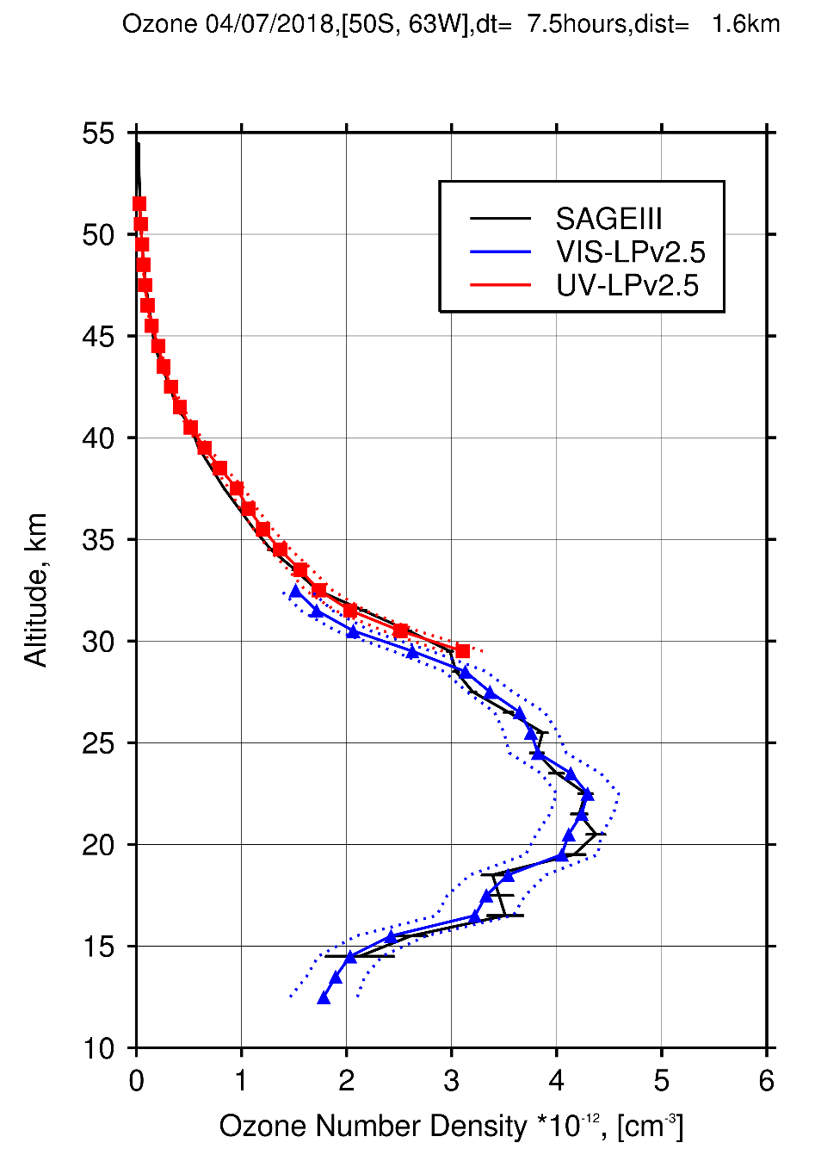

SAGE III ISS and OMPS LP individual ozone profiles
2018 ISS SAGE III Science Meeting, October 30-31

Slide 7
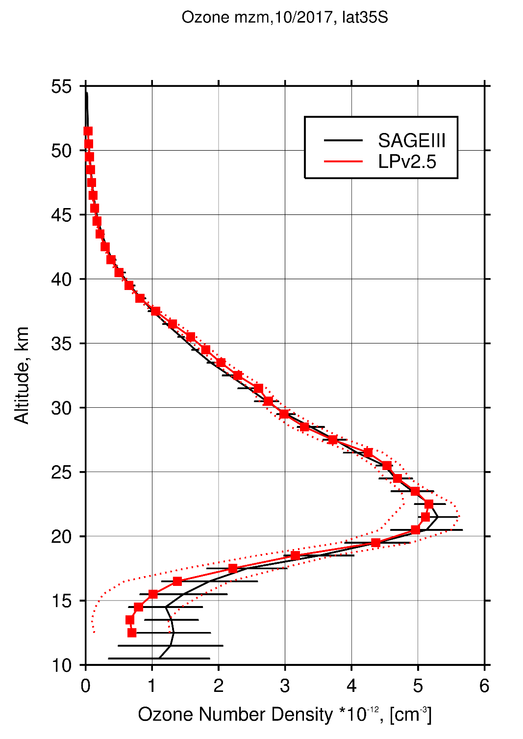
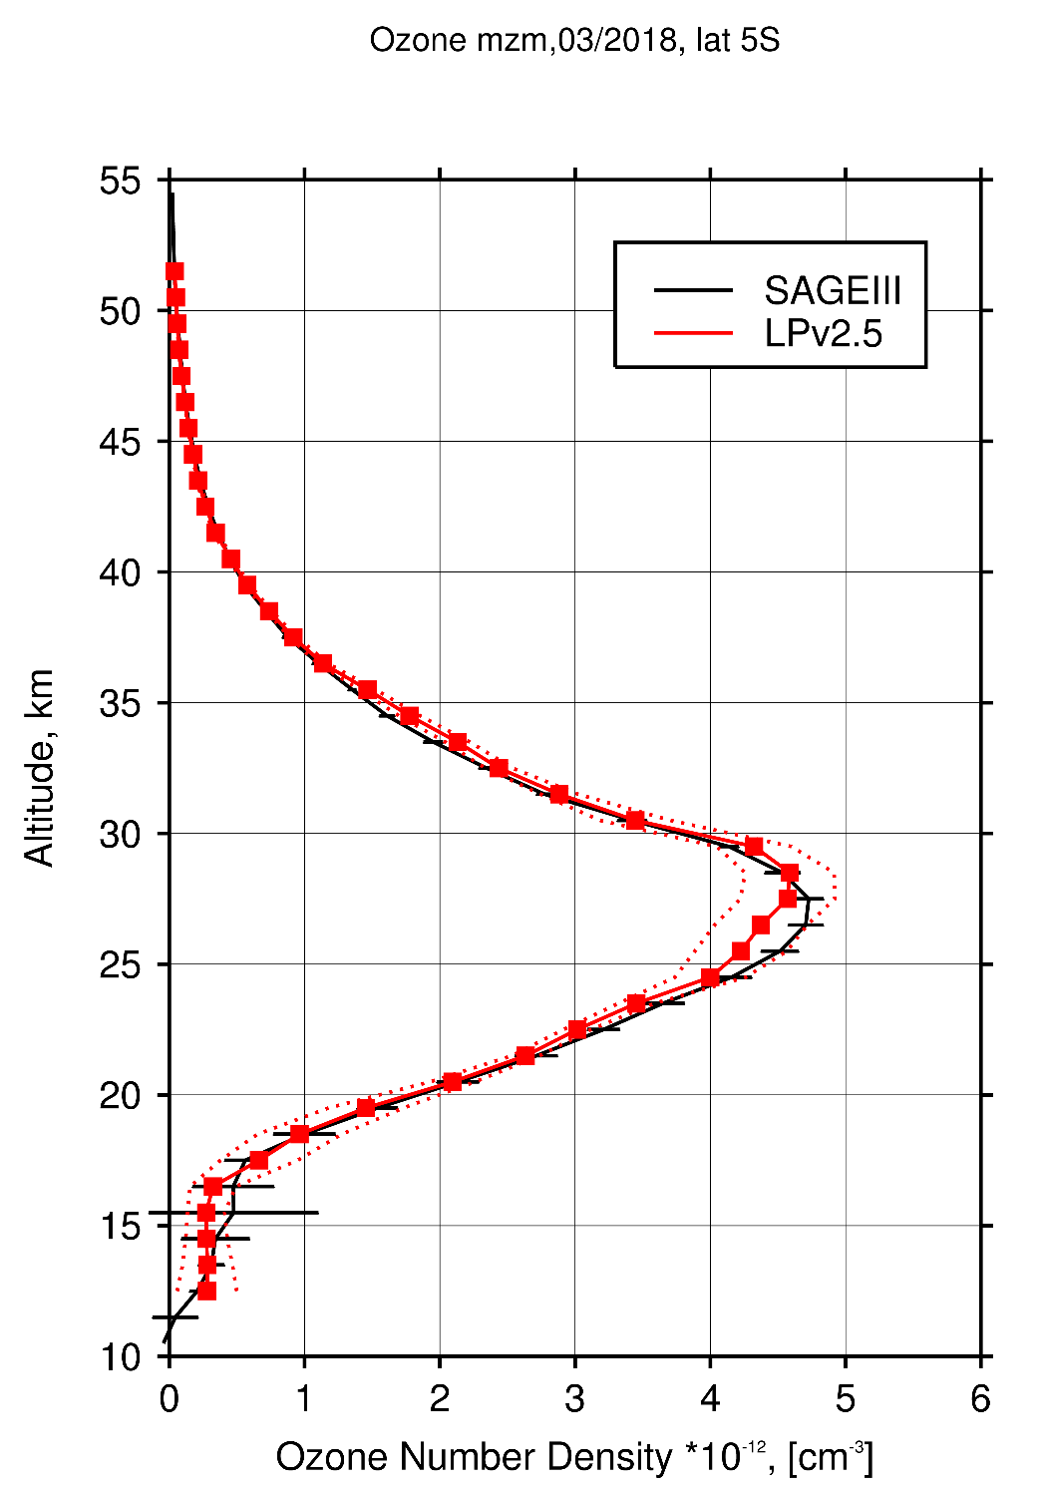

SAGE III ISS and OMPS LP monthly zonal mean ozone profile
30S-40S, Oct 2017
EQ-10S, Mar 2018
40N-50N, Jun 2018
Positive bias ~ 35 km
Low bias in SH
Low bias in NH
2018 ISS SAGE III Science Meeting, October 30-31

Slide 8
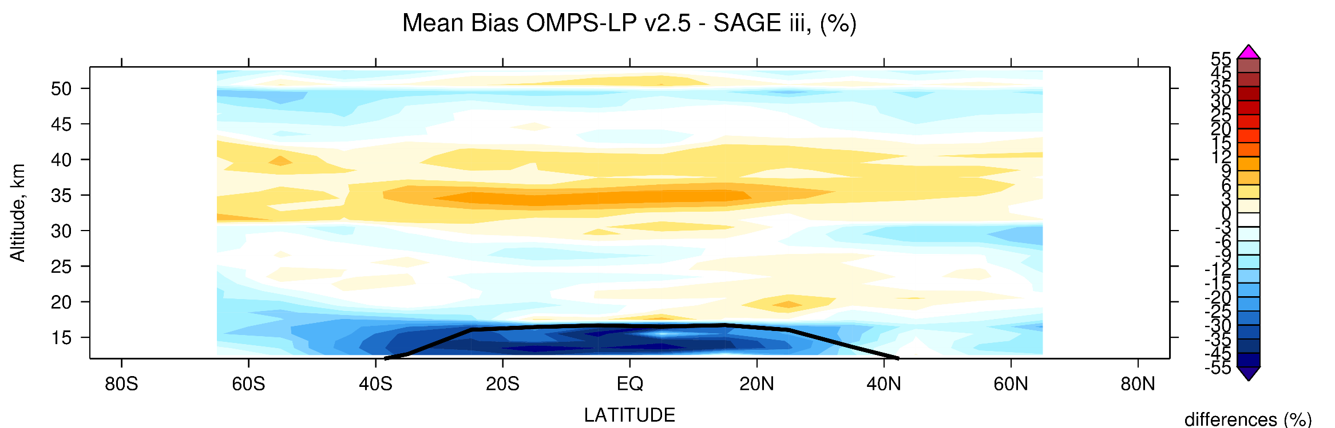
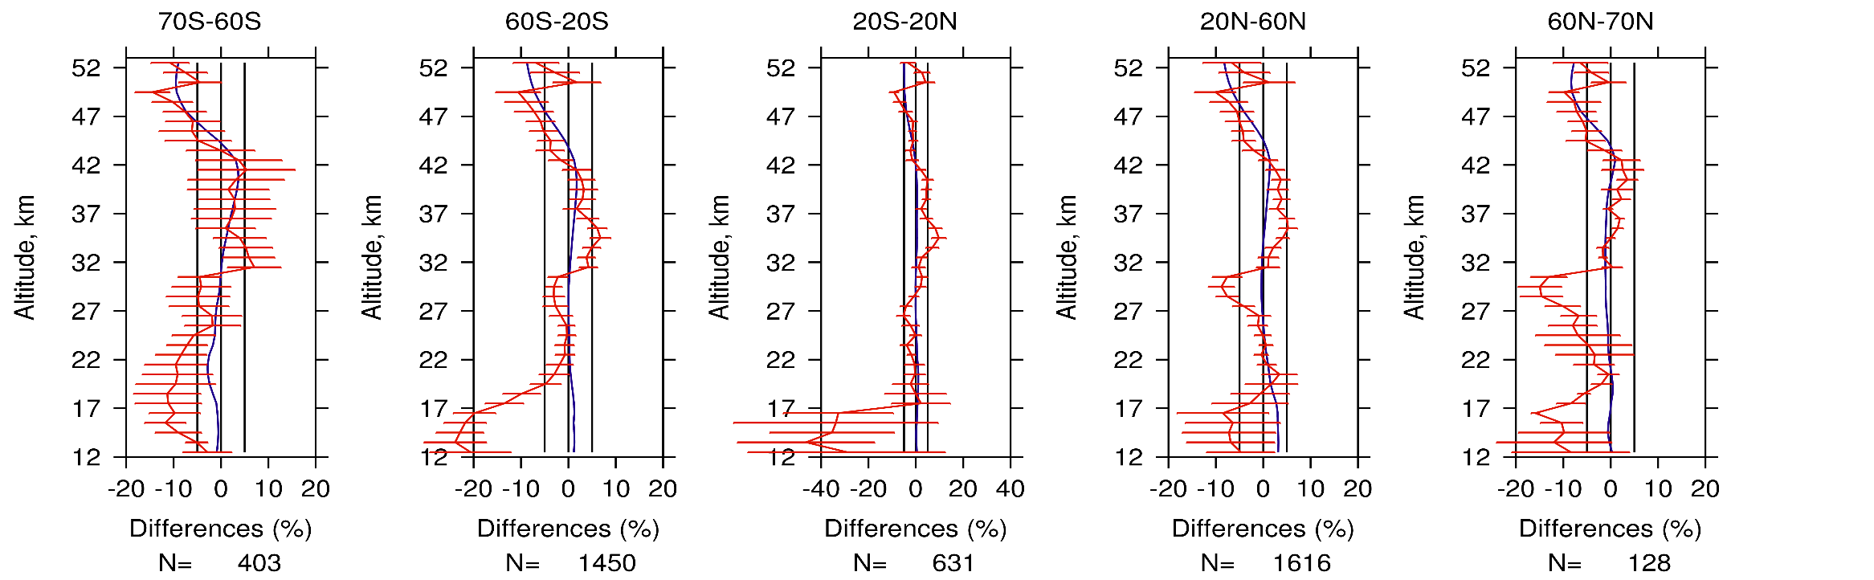
Comparison of SAGE III ISS and OMPS LP ozone profile
__model
__LP-SAGE
2018 ISS SAGE III Science Meeting, October 30-31

Slide 9
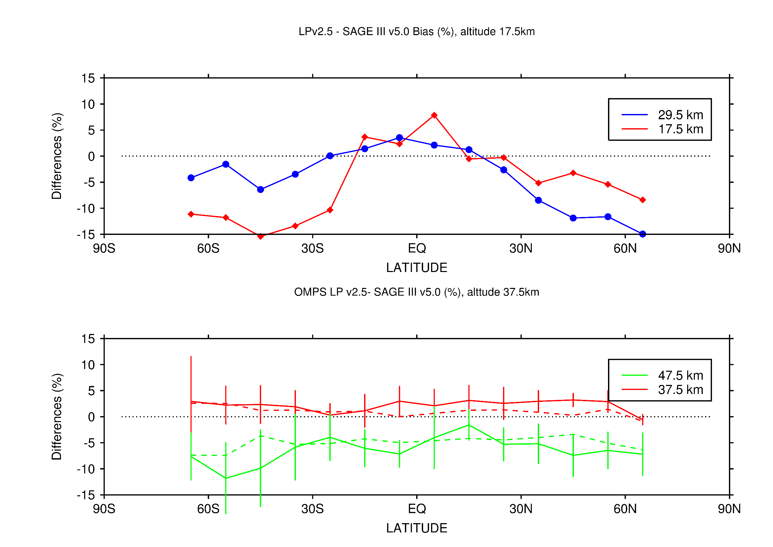
Comparison of SAGE III ISS and OMPS LP ozone profile
No indication of error in altitude registration;
There are no significant latitudinal patterns.
OMPS LP –SAGE III ISS, [%]
_ _ _ Model results
Biases between OMPS LP and SAGE III in the upper stratosphere and lower mesosphere are due to diurnal ozone cycle;
GEOSCCM confirms the pattern and magnitude of the diurnal differences.
2018 ISS SAGE III Science Meeting, October 30-31

Slide 10
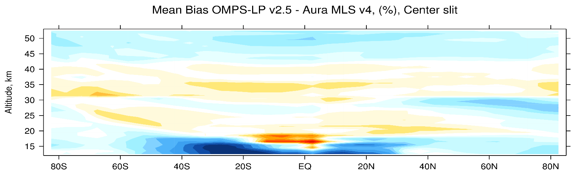
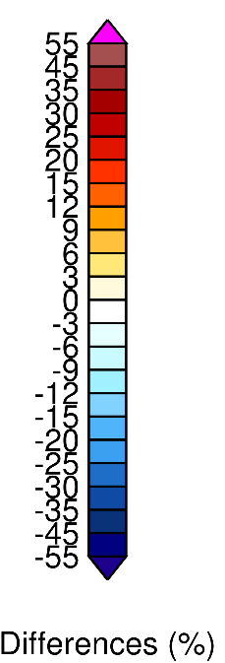

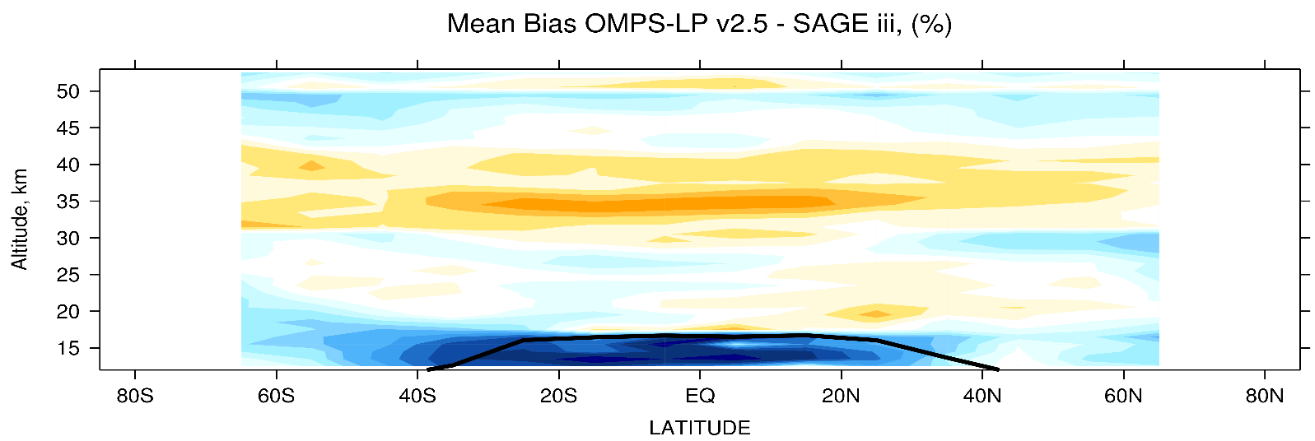
Comparison of SAGE III ISS and OMPS LP ozone profile
MLS v4
Negative bias in NH between 20-30 km
Low bias with MLS (no local time differences) ???
OSIRIS
SAGE III
Positive bias ~ 35 km (6-11%)
Notes:
Differences are less than 10% (and mostly less than 5%) between 20 and 45 km;
Higher negative biases above 45 km;
Negative biases in the lowermost stratosphere;
Larger negative biases in the NH high latitudes ~20-30km (thermal sensetivity effect )
Differences between vis and Uv retrievals

Slide 11
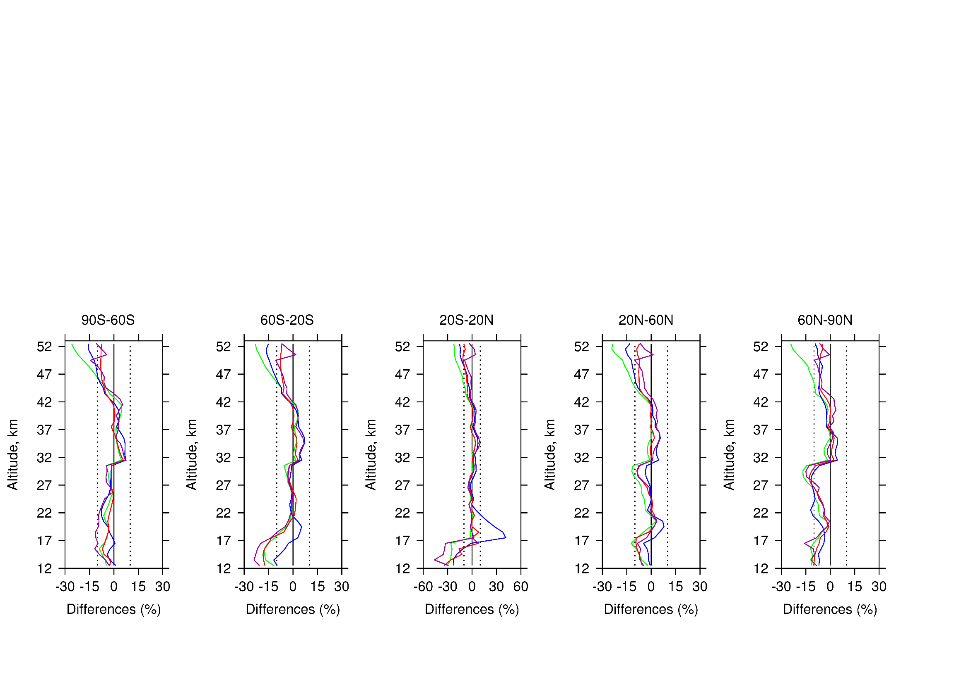
Comparison of SAGE III ISS and OMPS LP ozone profile
OSIRIS MLS ACE SAGE
2018 ISS SAGE III Science Meeting, October 30-31

Slide 12
Summary of SAGE III ISS and OMPS LP ozone comparisons
OMPS LP-SAGE III comparisons are consistent with the earlier published results based on validation with MLS, OSIRIS and ACE-FTS;
Our analysis did not reveal any signs of an error in the LP altitude registration;
Biases between OMPS LP and SAGE III in the upper stratosphere and mesosphere are consistent with the diurnal ozone model;
Longer overlap is needed to determine seasonal biases and relative drifts between the instruments.
2018 ISS SAGE III Science Meeting, October 30-31

Slide 13
Back up slides

Slide 14
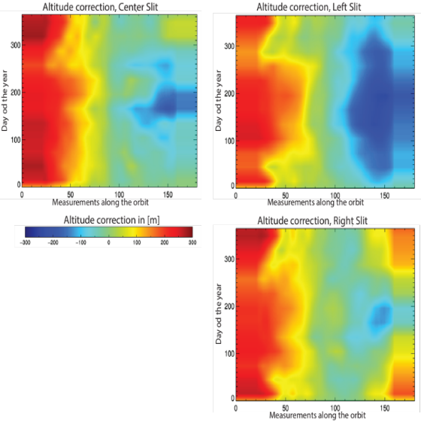
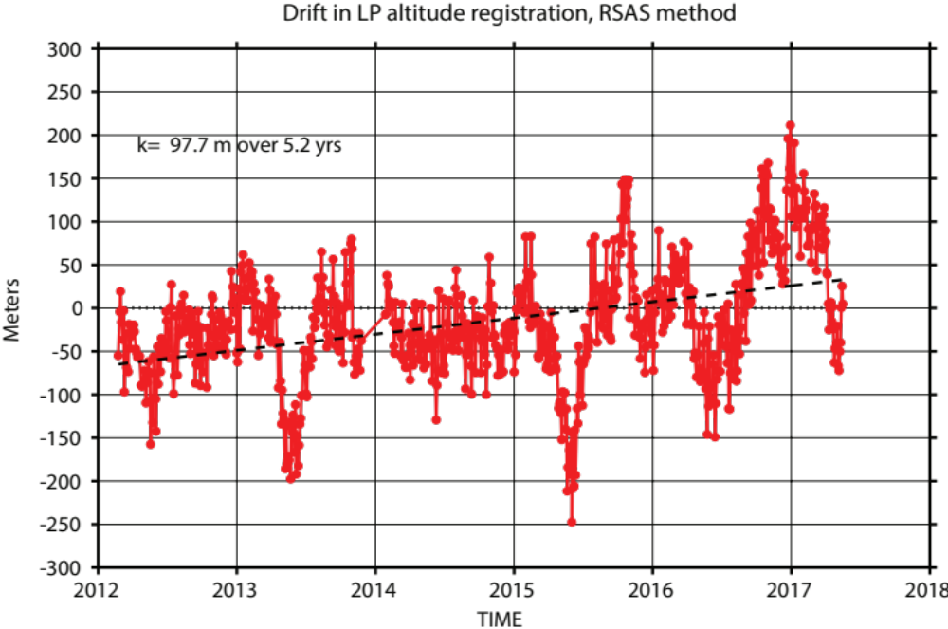
Estimation of Systematic Errors in OMPS LP v2.5 retrievals
I. Static corrections
1.12/1.37/1.52 km
left/center/right slits
Moy et al., AMT, doi:10.5194/amt-10-167-2017, 2017.
TH error, m | LEFT | CENTER | RIGHT
Version 2 | 0.58 | 1.18 | 1.75
Version 2.5 | 1.12 | 1.37 | 1.52
II. Slit based, intra-orbital, seasonally varying TH corrections of ~ 0.3 km
±200 m
±5%
III. Time-dependent +0.1 km adjustments:
-April 25, 2013
-September 5, 2014
2018 ISS SAGE III Science Meeting, October 30-31
Notes:
Static corrections ~ 190 m for the center slit;
Intra-orbital, seasonally dependent corrections ~300 m for the center slit from SP to NP;
Two 100 m steps in the altitude registration due to S/C pitch and inclanation maneuvers
Total, combined uncertinty of the two altitude registration methods is +/- 200m, which is about +/-5% for ozone in altitudes above 35 km
Drift of ~100 m over 5.2 years that started to build up in late 2016, detected by one of our methods;
Two methods are not consistent about the drift, further analysis is required

Slide 15
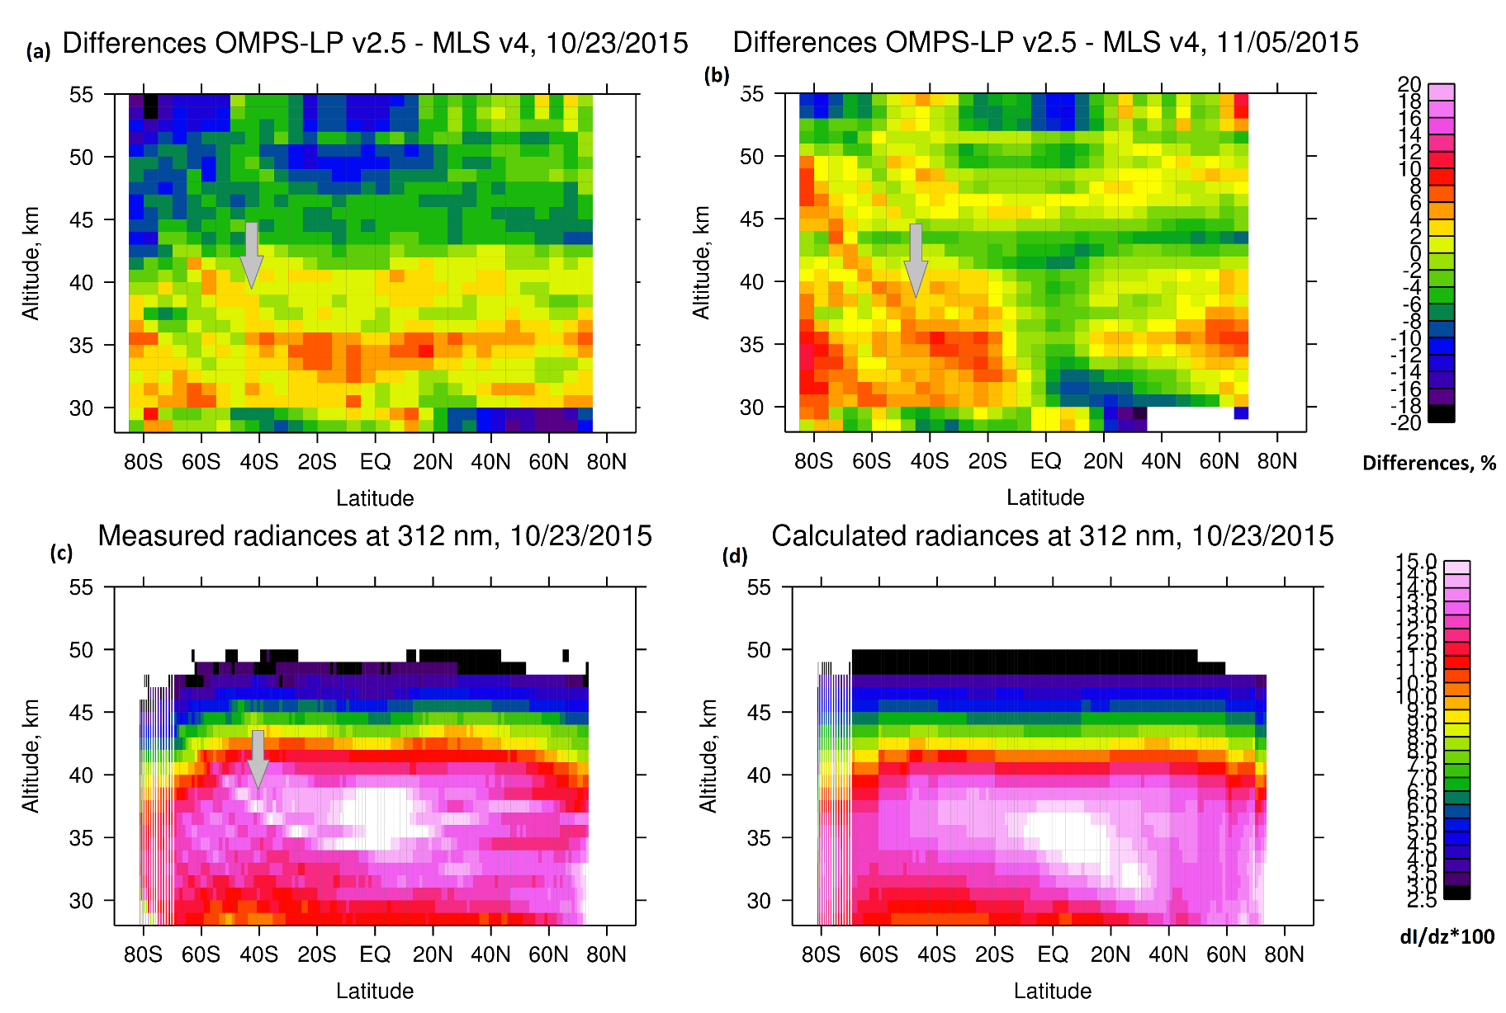
Estimation of Systematic Errors in OMPS LP v2.5 retrievals
Spectral structures that change with altitude, latitude and possibly season.
±1%
±3%
2018 ISS SAGE III Science Meeting, October 30-31
Notes:
Persistent patterns in ozone differences that repeat from orbit to orbit. Similar patterns are seen in measured radiances (but not in the calculated). The structures are seen in both dimensions: spectral and spatial.
Most likely these structures are due to differences in pixel to pixel responses of the CCD detector (Charge coupled device). Due to the geometry of the observations the same CCD pixel measures radiances at ~50 km at SP and ~ 35 km near the tropics, which leads to the observed latitudinal patterns in ozone.
We believe that these +/-1% subtle differences in measured radiances translate into +/-3% quasi-random differences in ozone
1. Overly simplified band shape assumed by L2 (Error in gridding process);
2. Band center mismatch between radiance and irradiance spectra;
3. Change in radiometric response associated with thermal-induced spectral shifts (seasonal and intra-orbital).

Slide 16
Comparison of SAGE III ISS and OMPS LP ozone profile
OMPS LP –SAGE III ISS, [%]
2018 ISS SAGE III Science Meeting, October 30-31

Slide 17
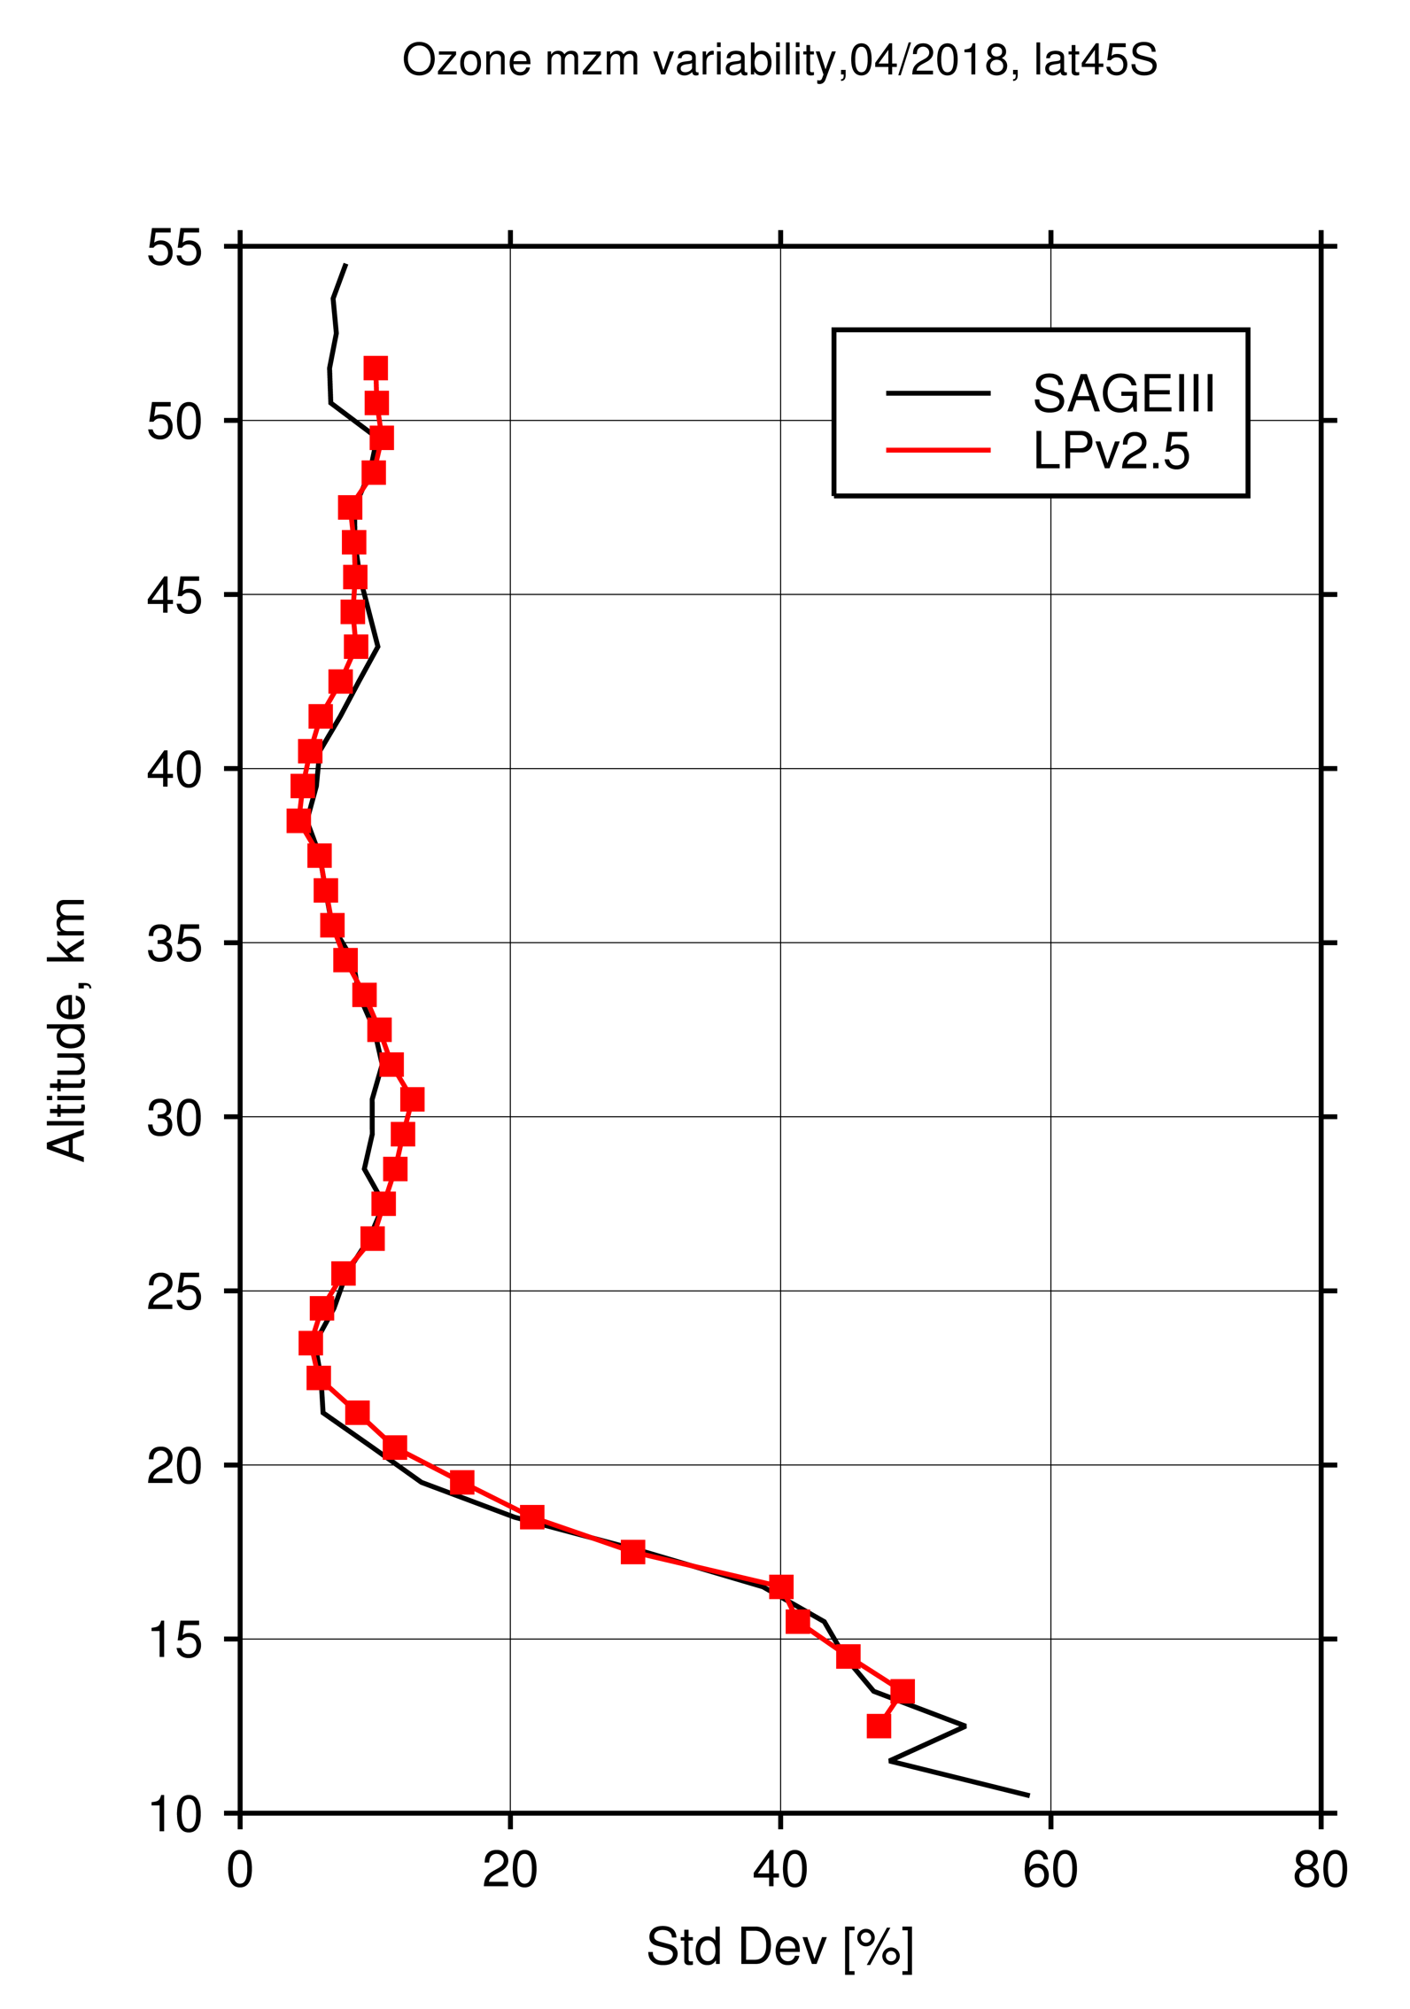
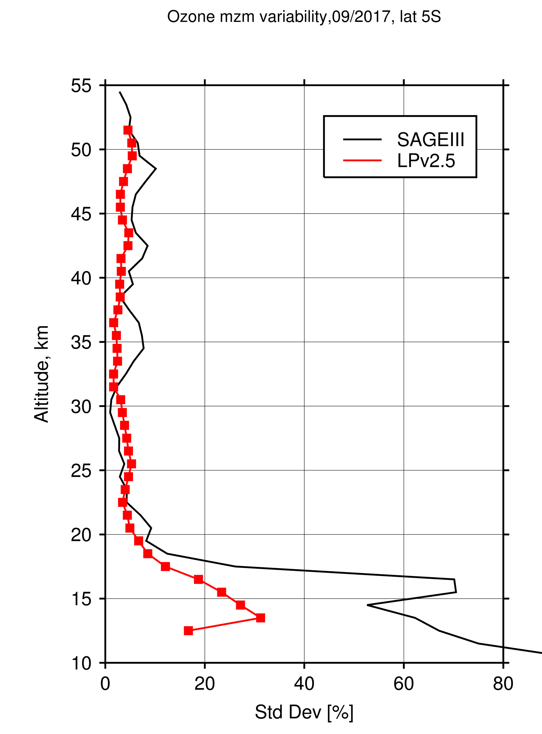

SAGE III ISS and OMPS LP monthly zonal mean ozone profile
40S-50S, Apr 2018
EQ-10S, Sep 2017
30N-40N, Feb 2018
2018 ISS SAGE III Science Meeting, October 30-31

Slide 18

2018 ISS SAGE III Science Meeting, October 30-31

