Slide 1





NDACC Data and Availability for SAGE III Validation Efforts
Jeannette Wild ESSIC/UMD, NOAA/NCEP/CPC
SAGE III Science Team Meeting: October 30, 2018, Langley, VA

Slide 2
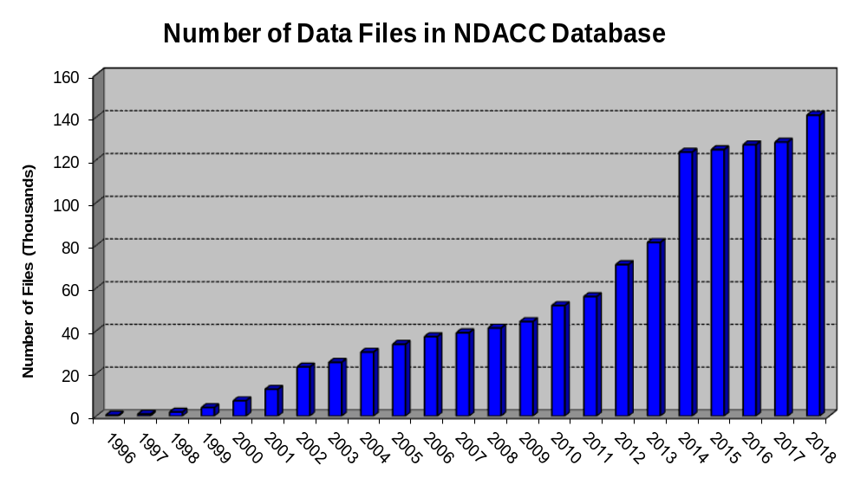
Fun Facts About NDACC:
Conceived initially in the 1980’s by NASA, NOAA and CMA (Chemical Manufacturers Association)
Operational in 1991.
Oldest data record in the NDACC archive: Sept, 1966: Boulder Dobson #091
Currently > 140,000 files in the NDACC data archive
Over 1 million file downloads so far in 2018
Files may be in NASA Ames or GEOMS HDF
IWGs working on harmonization of retrievals:
FTIR, Microwave, Lidar, UVVis, Sonde
Top 3 users in 2018 (so far) are
Belgian Institute for Space Aeronomie (BIRA)
NASA GSFC
Laboratoire Atmosphères, Milieux, Observations Spatiales (LATMOS)
SAGE III Science Team Meeting: October 30, 2018, Langley, VA

Slide 3
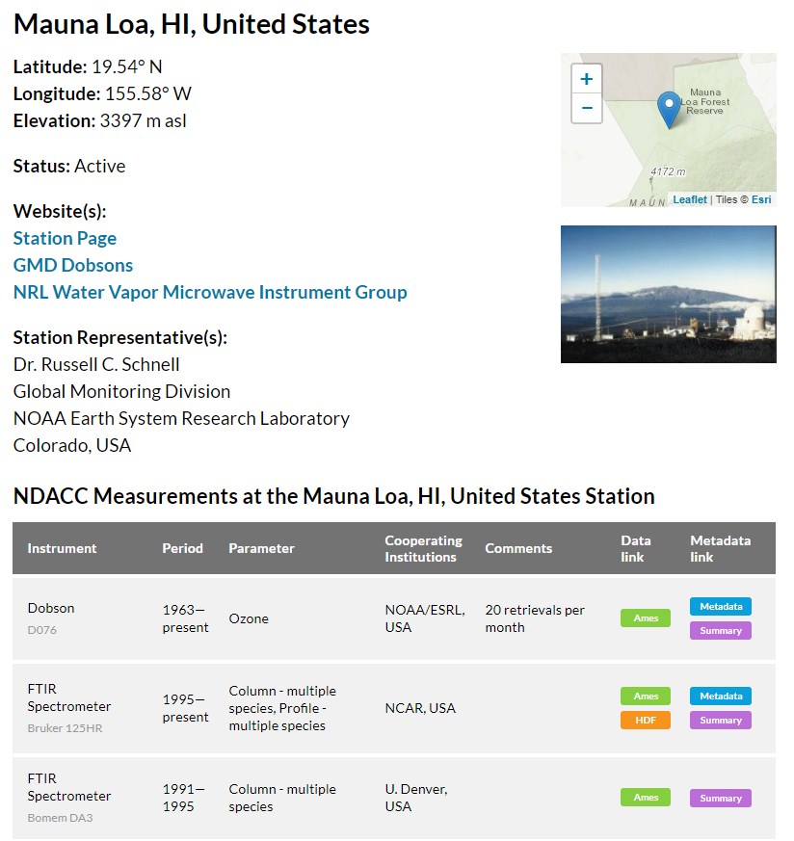
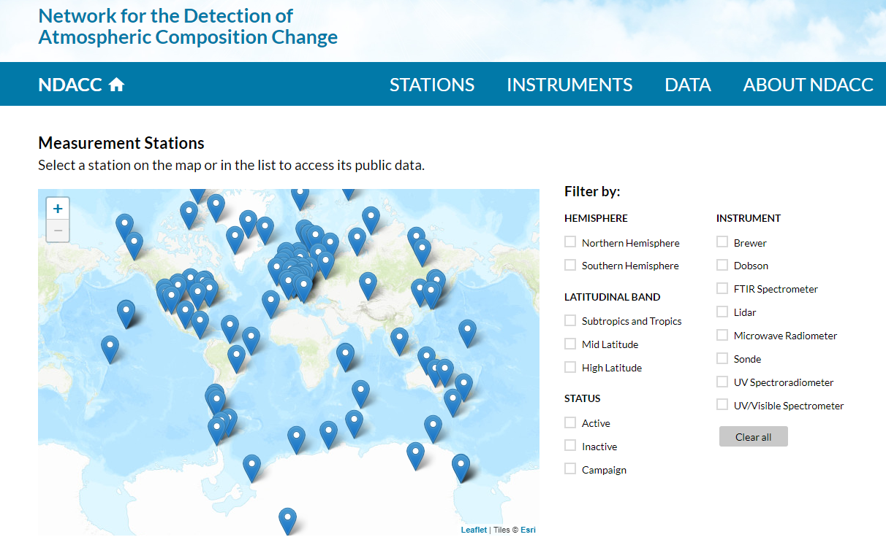
New NDACC website : www.ndacc.org
Anything that starts with www.ndsc.ncep.noaa.gov is the legacy site. This site was maintained until summer 2018, but is now increasingly out of date.
SAGE III Science Team Meeting: October 30, 2018, Langley, VA

Slide 4
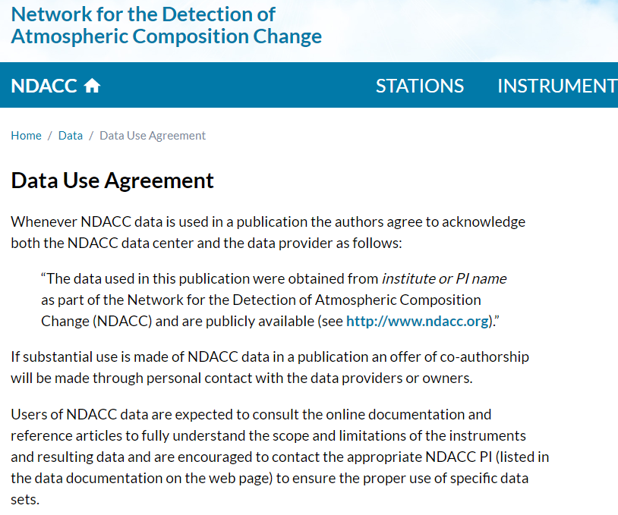
Data Use Agreement:
Please respect standard protocol on use of data in publications
Data Citation requirements:
Public data (supported by taxpayers in many cases) BUT:
Science is best supported if data users and originators work together
Continued funding is best supported if proper acknowledgement is given. For many PIs # publications count.
SAGE III Science Team Meeting: October 30, 2018, Langley, VA

Slide 5
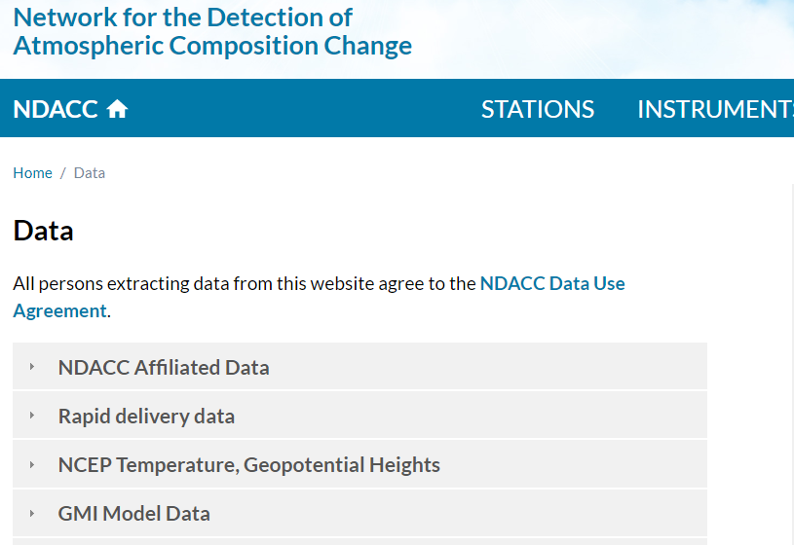
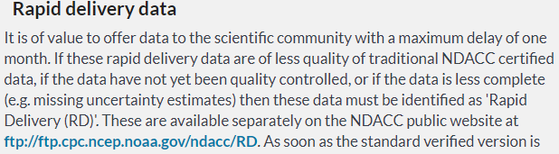
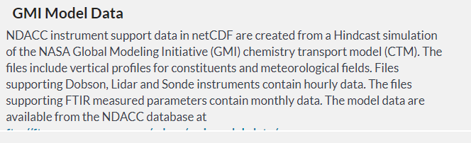
NDACC Affiliated Data
Contains data for official NDACC stations and measurements. Data is PI approved and validated and available at ftp://ftp.cpc.ncep.noaa.gov/ndacc/station/
SAGE III Science Team Meeting: October 30, 2018, Langley, VA

Slide 6
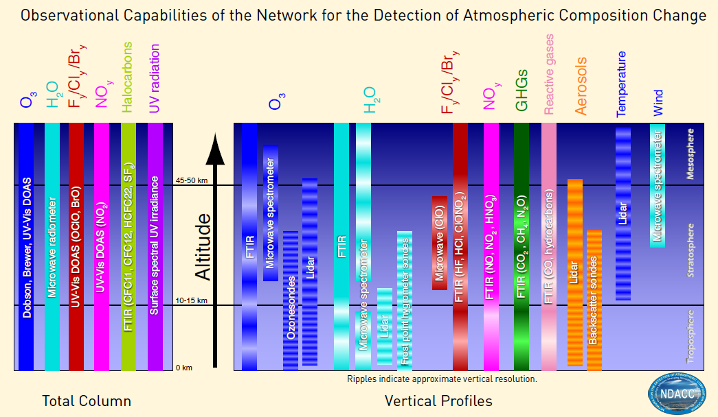
, UVVis
, UVVis
SAGE III Science Team Meeting: October 30, 2018, Langley, VA

Slide 7
NDACC Data – Geographical Distribution
    H₂O
    NO₂
    Aerosol
    O₃
SAGE III Science Team Meeting: October 30, 2018, Langley, VA

Slide 8
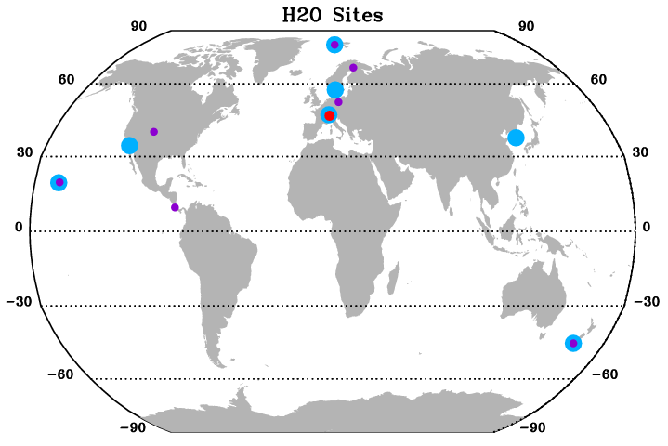
Map of ALL stations with H₂O data in 2017, 2018.
Notes:
The FTIR at Jungfraujoch has H₂O up to 2016, and other species after 2016, so this will likely come on line soon.
Lidar has finalized formatting and will report soon.
FTIR
Microwave
Sonde
SAGE III Science Team Meeting: October 30, 2018, Langley, VA

Slide 9
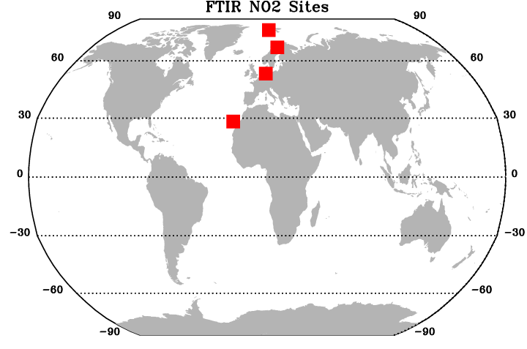
Map of FTIR stations with NO₂ data in 2017, 2018.
Notes:
FTIR NO₂ at NDACC Affiliated Stations, fully validated data only.
Affiliated
Rapid Delivery
SAGE III Science Team Meeting: October 30, 2018, Langley, VA

Slide 10
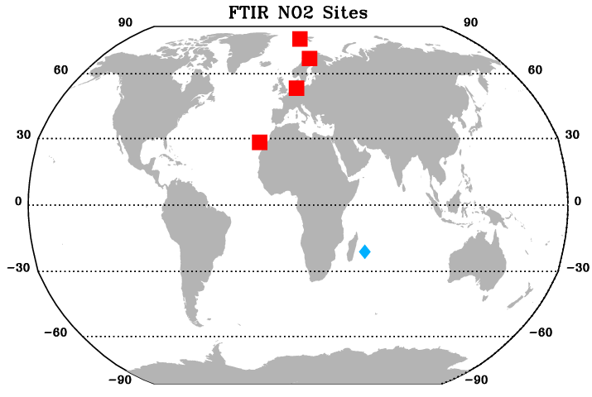
Map of FTIR stations with NO₂ data in 2017, 2018.
Notes:
Including Rapid Delivery Data adds one station. La Reunion, Maido
Affiliated
Rapid Delivery
SAGE III Science Team Meeting: October 30, 2018, Langley, VA

Slide 11
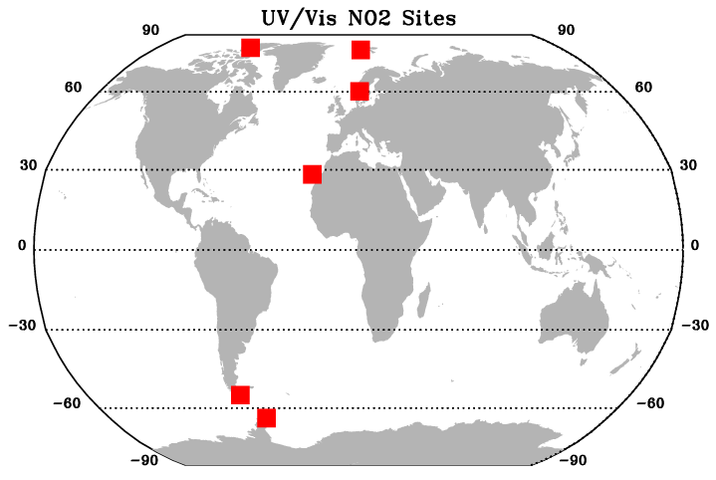
Map of UV/Vis stations with NO₂ data in 2017, 2018.
Notes:
UVVis NO₂ at NDACC Affiliated Stations, fully validated data only.
Affiliated
Rapid Delivery
SAGE III Science Team Meeting: October 30, 2018, Langley, VA

Slide 12
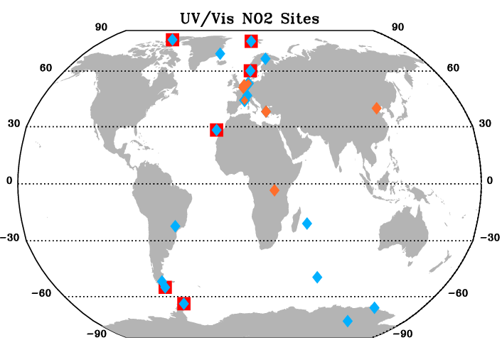
Map of UV/Vis stations with NO₂ data in 2017, 2018.
Notes:
Including Rapid Delivery Data adds eight stations, and increases the amount of data at a five others. RD data includes zenith and offaxis.
Affiliated
Rapid Delivery
SAGE III Science Team Meeting: October 30, 2018, Langley, VA

Slide 13
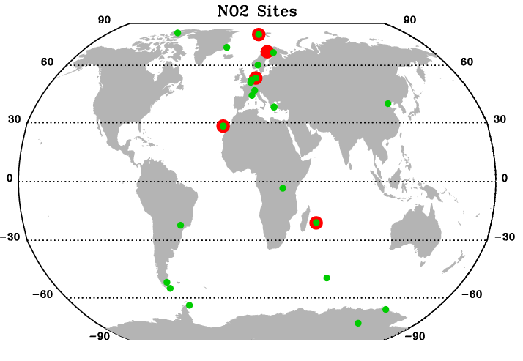
Map of ALL stations with NO₂ data in 2017, 2018.
FTIR
UV/Vis
SAGE III Science Team Meeting: October 30, 2018, Langley, VA

Slide 14
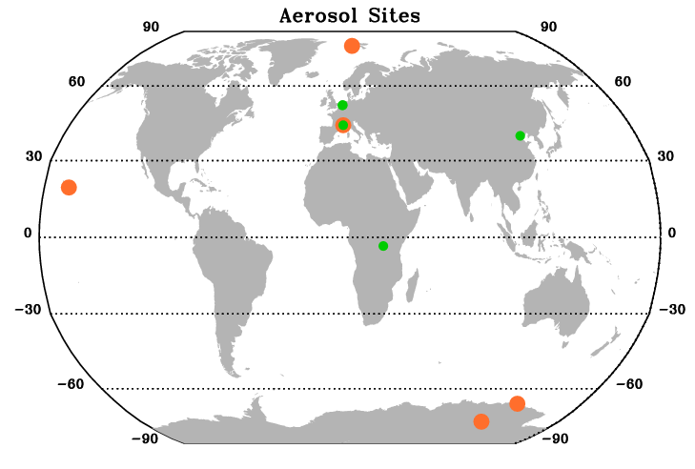
Map of ALL stations with Aerosol data in 2017, 2018.
Notes:
All UV/Vis data is Rapid Delivery; all Lidar data is standard NDACC affiliated data.
Lidar
UV/Vis
SAGE III Science Team Meeting: October 30, 2018, Langley, VA

Slide 15
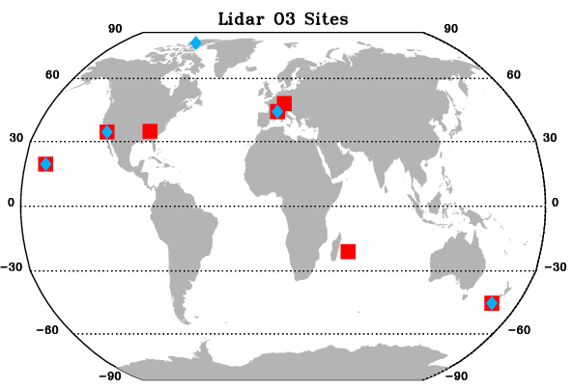
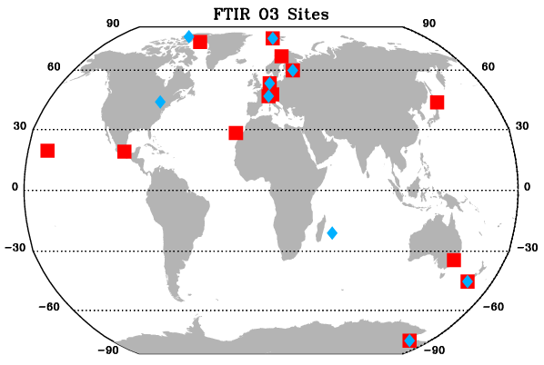
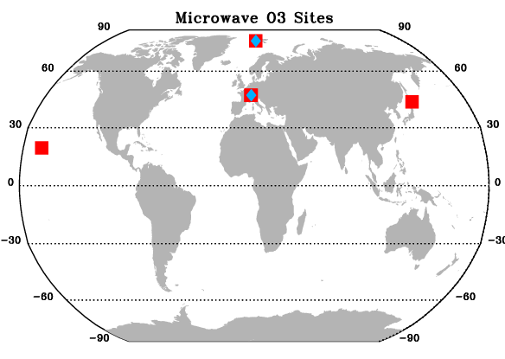
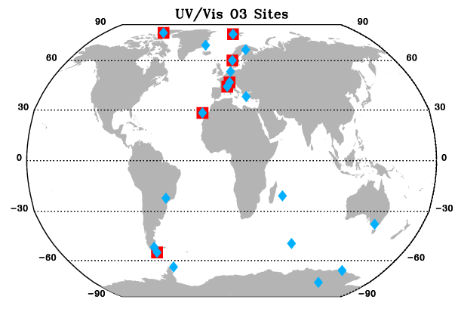
Maps of stations with O₃ data in 2017, 2018: FTIR, Microwave, Lidar and UV/Vis.
Notes:
Includes all but o3sonde.
Affiliated
Rapid Delivery
SAGE III Science Team Meeting: October 30, 2018, Langley, VA

Slide 16
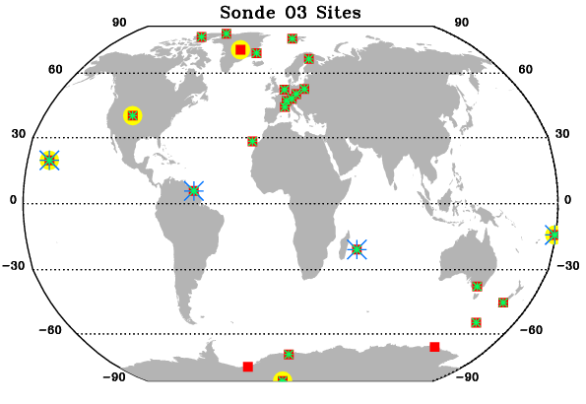
Map of Sonde stations with O₃ data in 2017, 2018.
Notes:
Many o3onde sites are also archived at other databases. NDACC only has o3sonde data for those sites that complement other NDACC instruments.
  Green star: WOUDC
  Blue Star: SHADOZ
  Yellow Circle: ESRL
  Red square: NDACC
*
*
SAGE III Science Team Meeting: October 30, 2018, Langley, VA

Slide 17
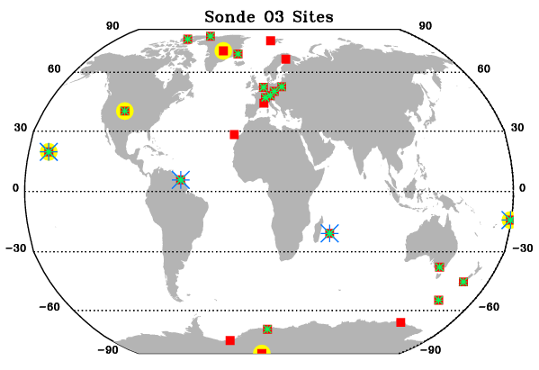
Notes:
Some sites do not yet have data archived for 2017-2018 at WOUDC, but have data at NDACC
Ny Alesund
Sodankyla
OHP
Izana
South Pole
  Green star: WOUDC
  Blue Star: SHADOZ
  Yellow Circle: ESRL
  Red square: NDACC
*
*
SAGE III Science Team Meeting: October 30, 2018, Langley, VA

Slide 18
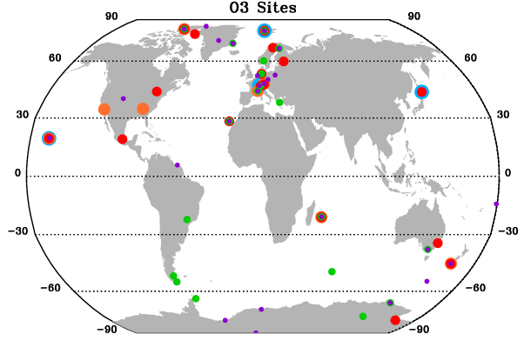
Map of ALL stations with O₃ data in 2017, 2018.
UV/Vis
FTIR
Lidar
Microwave
Sonde
SAGE III Science Team Meeting: October 30, 2018, Langley, VA

Slide 19
NDACC Data – Data Availability Timelines
    H₂O
    NO₂
    Aerosol
    O₃
SAGE III Science Team Meeting: October 30, 2018, Langley, VA

Slide 20
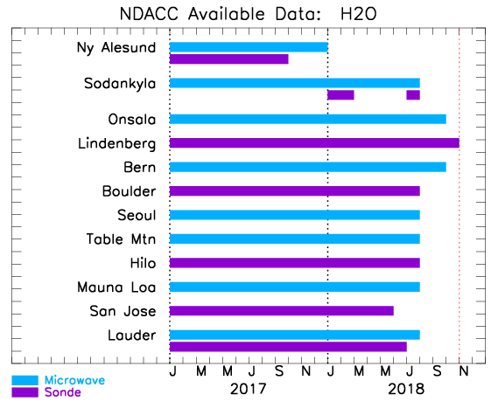
SAGE III Science Team Meeting: October 30, 2018, Langley, VA

Slide 21
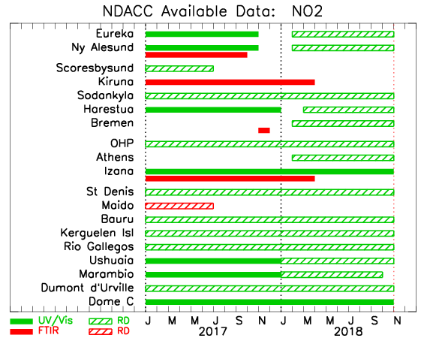
SAGE III Science Team Meeting: October 30, 2018, Langley, VA

Slide 22
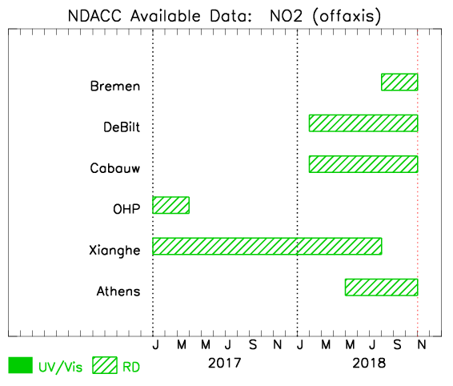
SAGE III Science Team Meeting: October 30, 2018, Langley, VA

Slide 23
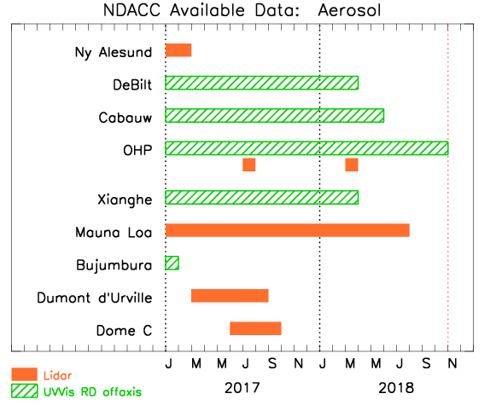
SAGE III Science Team Meeting: October 30, 2018, Langley, VA

Slide 24
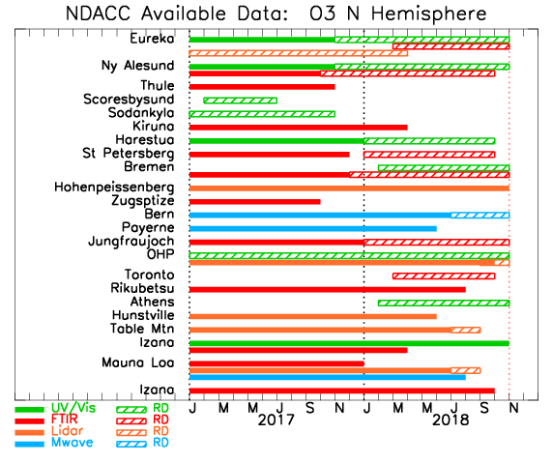
SAGE III Science Team Meeting: October 30, 2018, Langley, VA

Slide 25
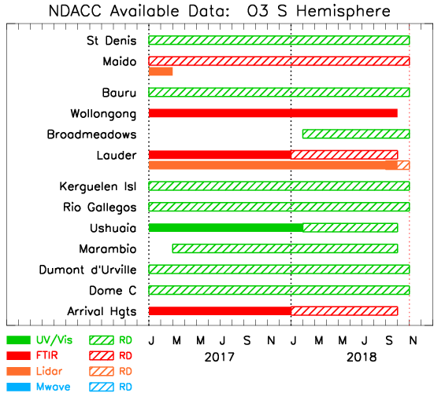
SAGE III Science Team Meeting: October 30, 2018, Langley, VA

Slide 26
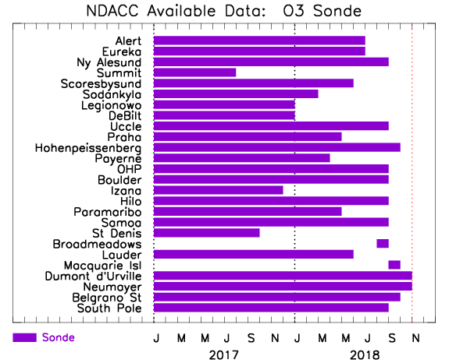
SAGE III Science Team Meeting: October 30, 2018, Langley, VA

Slide 27
A Couple of Example Comparisons
(many more likely in the subsequent talks)
SAGE III Science Team Meeting: October 30, 2018, Langley, VA

Slide 28
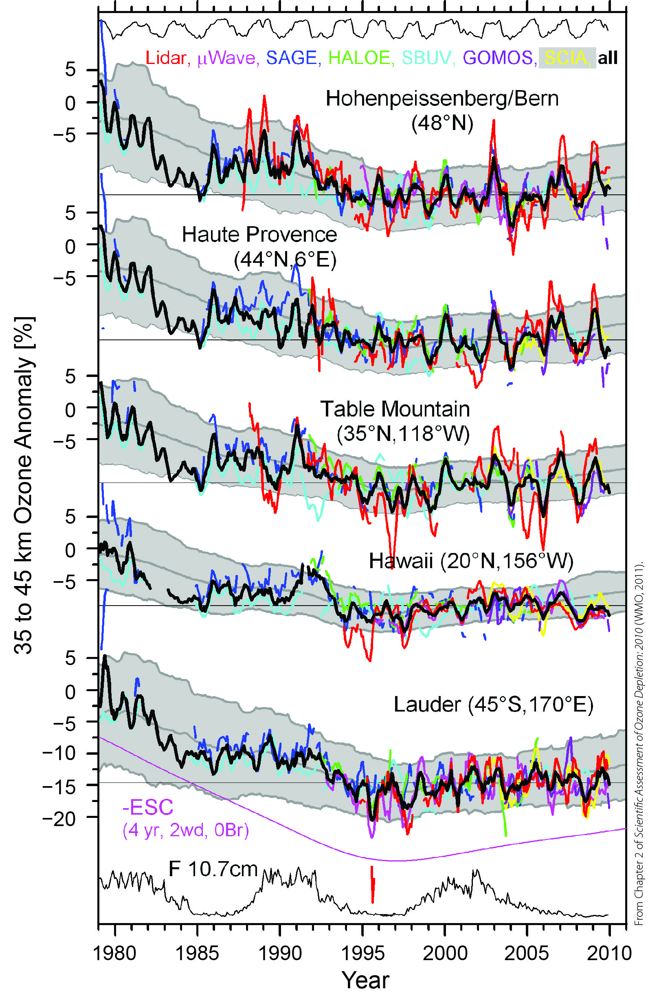
SAGE I/II and NDACC lidars, µwaves
long ozone profile records
document ozone depletion and beginning recovery
key data for ozone assessments
Fig. 2-5
WMO/UNEP Ozone Assessment 2010

Slide 29
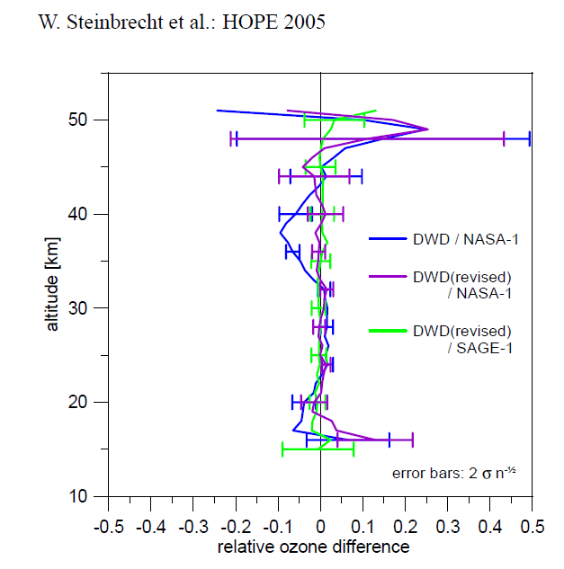
SAGE II and NDACC lidars
campaign in 2005
long-term comparison 1988 to 2003
almost no bias
virtually the same ozone profiles
Fig. 22, Steinbrecht et al. AMT 2008

Slide 30
Final Thoughts
A significant portion of recent data is found in the Rapid Delivery area – some preliminary release, some not fully NDACC participating sites
CAMS (Copernicus Atmospheric Monitoring Service) is providing financial incentives for PIs to supply RD data in less than one month
Data could be Ames (lidar, sonde, microwave) or GEOMS HDF (lidar, microwave, FTIR, UV/Vis). All RD is GEOMS HDF.
Lidar will have H₂O on board soon – likely appearing in RD first
Most instrument groups have data homogenization (algorithm homogenization, or move toward full centralized processing) in progress
Acknowledgements – DOIs likely to come soon.
new web page – www.ndacc.org
SAGE III Science Team Meeting: October 30, 2018, Langley, VA

