Slide 1
2018 SAGE III/ISS Science Team Meeting
NASA Langley Research Center
October 30-31, 2018

Slide 2
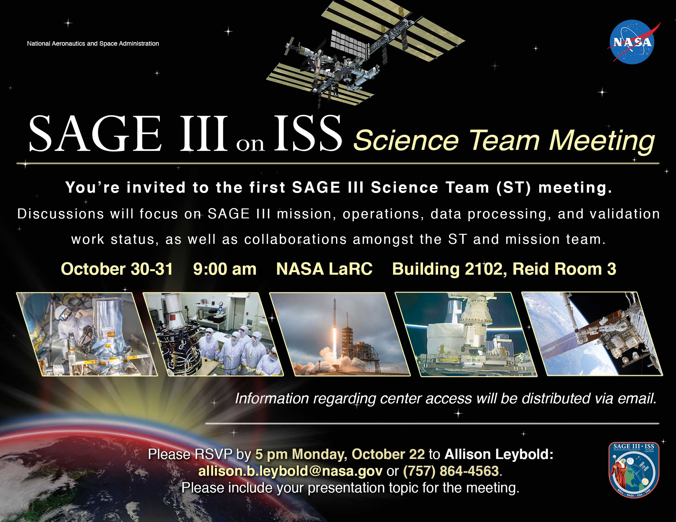
Welcome!

Slide 3
LOGISTICS
Internet access
  Wireless connection for visitors: log into “nasaguest” and open a clean browser window
  Wireless connection for NASA-badged employees: log into “nasa”
Call-in: 1-844-467-6272, #896850
Lunch
  Lunch will be on your own; the LaRC Cafeteria is at the north end of the building
Meeting location:
  Restrooms – out the door, left, then left
  Coffee, etc. in the back of the room
  Flight Mission Support Center (FMSC) on second floor

Slide 4
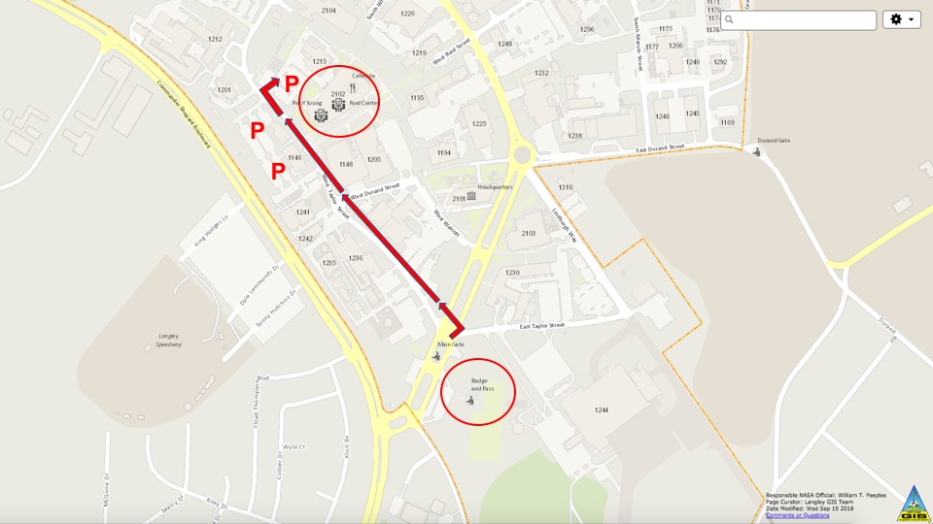
Directions to Meeting (Building 2102)
2102

Slide 5
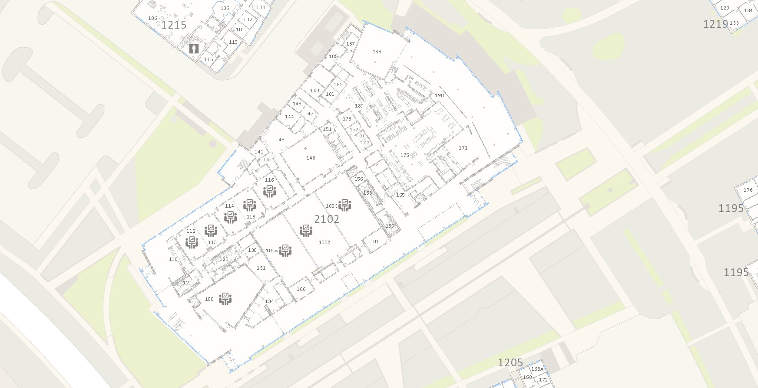
Building 2102
EATING SPACE
CAFETERIA
REID 3

Slide 6
Objectives
Communicate to the ROSES Science Team the status of:
  Mission
  Operations
  Data processing
  Validation
Initiate and foster collaborations amongst the Science Team and the Mission Team
Do good science…

Slide 7
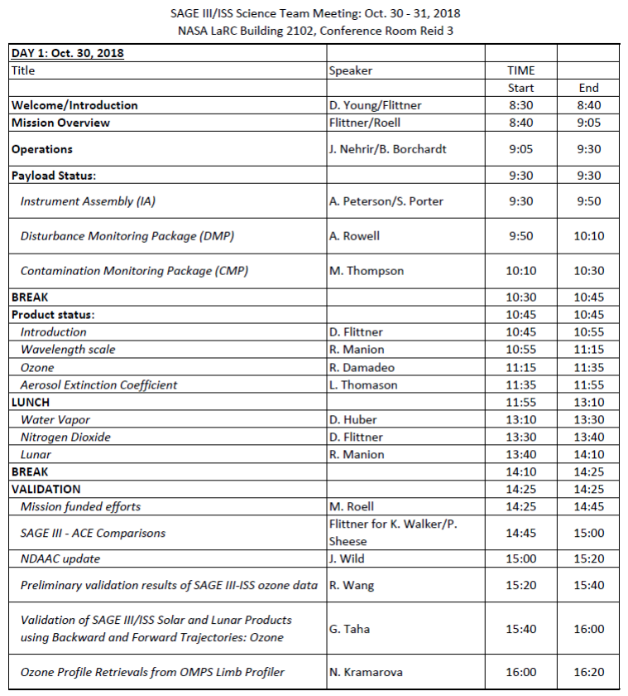
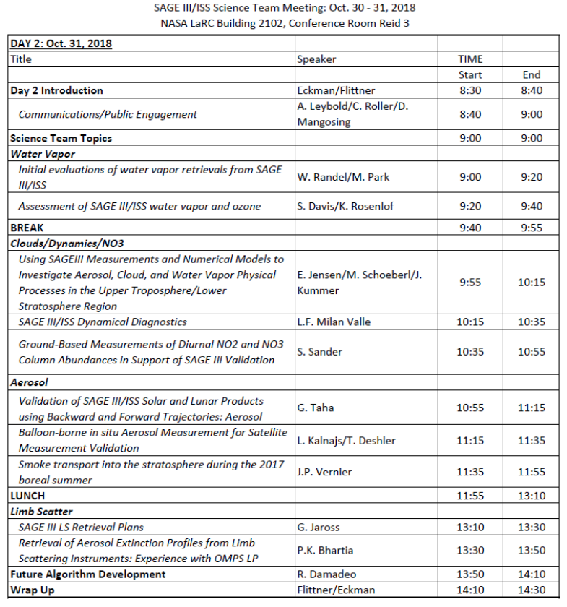
AGENDA

Slide 8
Mission Overview
D. Flittner & M. Roell

Slide 9
Outline
Background
Overview of mission
Current status of mission
Road ahead

Slide 10
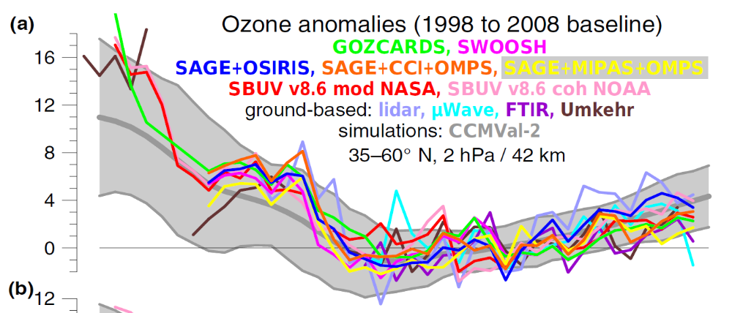
Objective of SAGE
Monitor the vertical distribution of aerosol, ozone and other trace gases in the Earth’s stratosphere and upper troposphere
SAGE III/ISS will provide data necessary to:
  Assess the state of the recovery in the distribution of ozone
  Extend the stratospheric aerosol measurement record needed by Climate and Ozone models
  Gain further insight into key processes contributing to ozone and aerosol variability
Steinbrecht, et al. 2017

Slide 11
Background
Proposal submitted and selected in 1988 as EOS mission
  Three instruments: mid-inclined orbit (SAGE II – like) for most of the globe; high-inclined orbit for polar regions; instrument of opportunity (FOO).
Instruments built by Ball Aerospace
  All units delivered in late 1990s, early 2000
NASA HQ played match maker for two of the three instruments
  High-inclined: Hosted payload on Russian Meteor 3M meteorlogical satellite: Dec. 2001 – Apr. 2006
  Mid-inclined: Hosted payload on International Space Station (ISS)
    ISS arranged additional hardware to place SAGE in the correct orientation – Hexapod provided by European Space Agency via Alenia
ISS mission postponed 2005
  Hardware & Software delivered to close-out Ball contract

Slide 12
Background cont.
Science community support for SAGE measurements prompts NASA to restart SAGE III/ISS in 2010 as climate continuity mission
Strict marching orders to reuse hardware and software
  SAGE taken out of storage showed same performance as day it was stored
  Hexapod removed from storage and refurbished by ESA
Baseline mission period of 3 years
ISS external payload opportunities evolved since 2005
  Need to bring own 90° bracket; secured a choice seat up front
Payload augmented to characterize the relatively unknown ISS external environment for optical Earth remote sensing instruments
  Contamination Monitoring Package
  Disturbance Monitoring Package

Slide 13
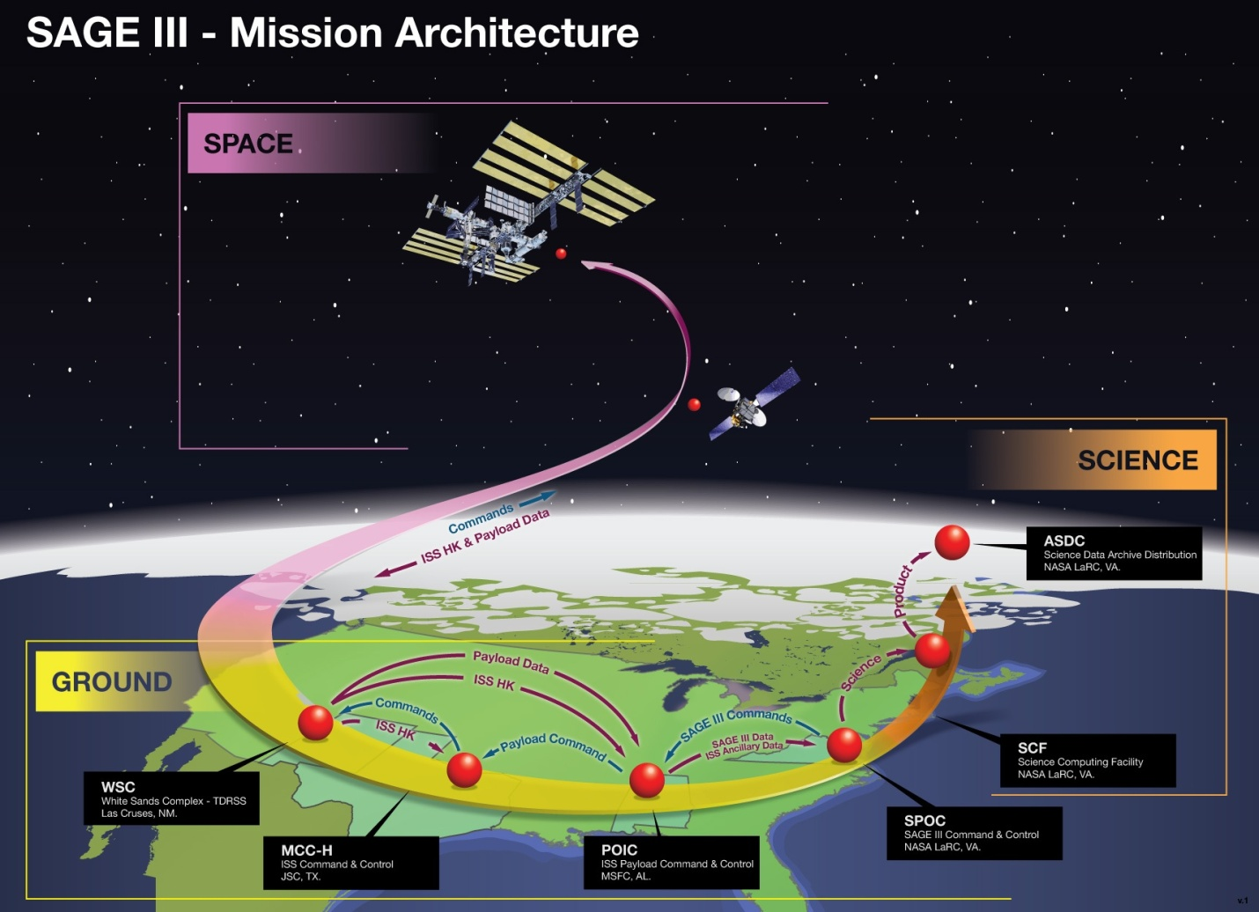
SAGE III – Mission Architecture

Slide 14
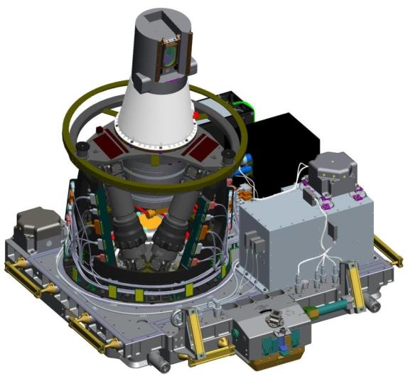
SAGE III/ISS Integrated Payload (IP)
Collaborative effort: NASA (SMD, HEOMD-ISS) & ESA
Sensor Assembly (SA)
Instrument Control Electronics (ICE)
Hexapod Mechanical Assembly
(HMA)
Hexapod Electronics Unit (HEU)
Contamination Monitoring Package (CMP)
Contamination Monitoring Package
(CMP)
Interface Adapter Module (IAM)
Disturbance Monitoring Package
(DMP)
ExPRESS Payload Adapter (ExPA)

Slide 15
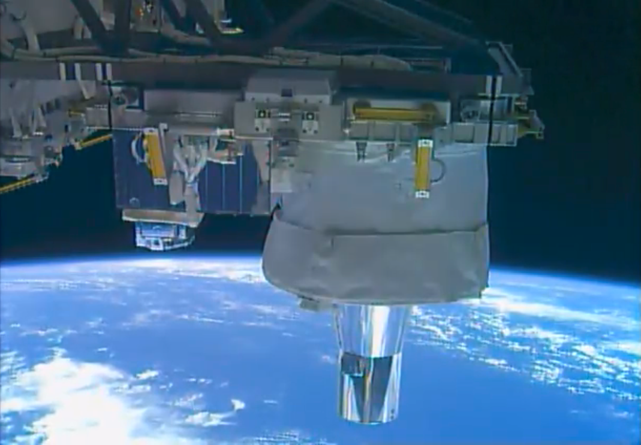
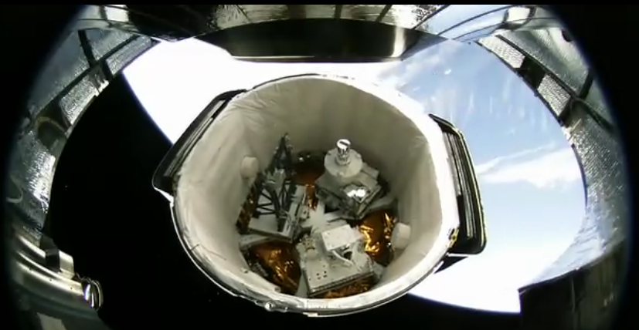
Launch/Installation/Activation
Launched Feb. 19, 2017 in unpressurized payload area of CRS-10
Completed robotic installation process March 9, 2017
First light March 16, 2017
SAGE installed on ISS
2nd Stage Separation of SpaceX Dragon CRS-10

Slide 16
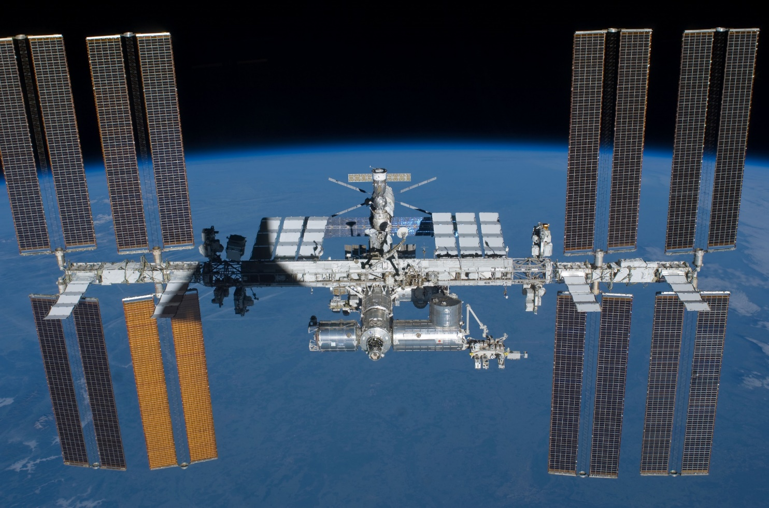
SAGE III’s location

Slide 17
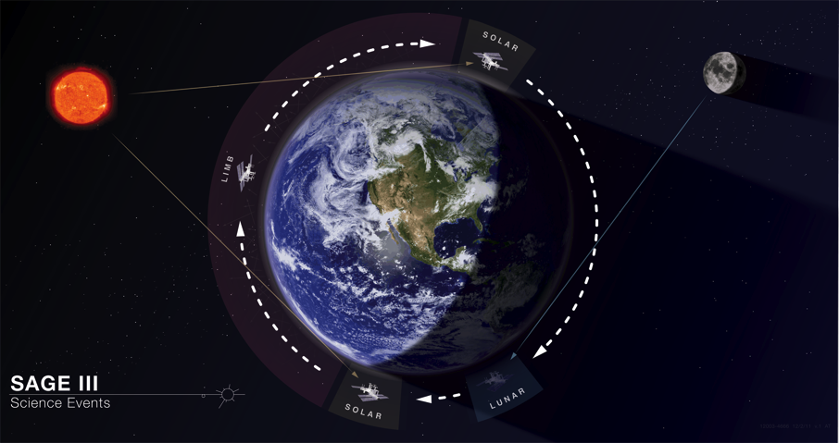
Typical Orbit
Limb Scatter
Sunset
Sunrise
Moonset

Slide 18
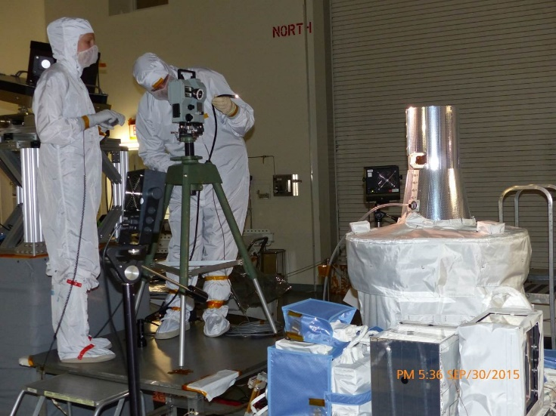
Instrument Assembly
Instrument summary (solar occultation mode):
  0.5 arc-min (0.5 km) IFOV scans the vertical extent of solar disk
  Spectrometer: 290 nm to 1020 nm with 1.4 to 2.0 nm resolution
  Focal plane also includes 1540 nm diode channel
Successfully replaced solar attenuator to eliminate ‘etalon’
Refurbishment examined all mechanisms
Important software upgrades
Extensive ground testing
  Optical characterization
  Complete environmental

Slide 19
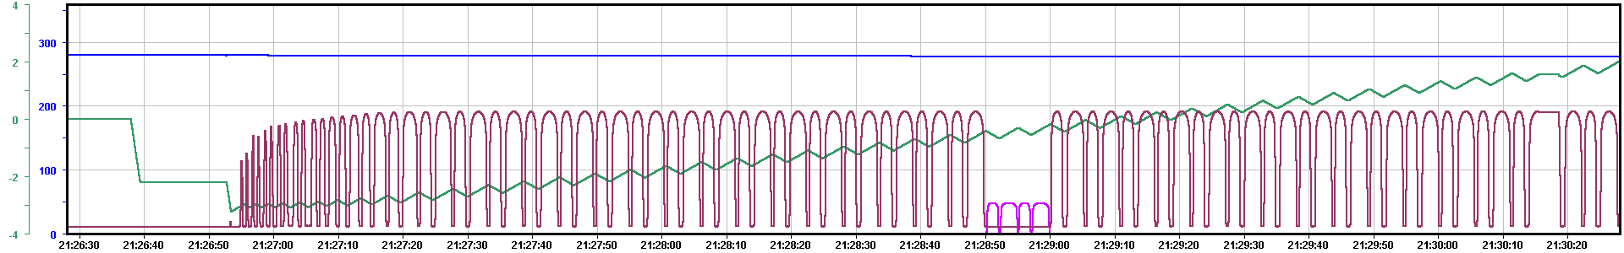
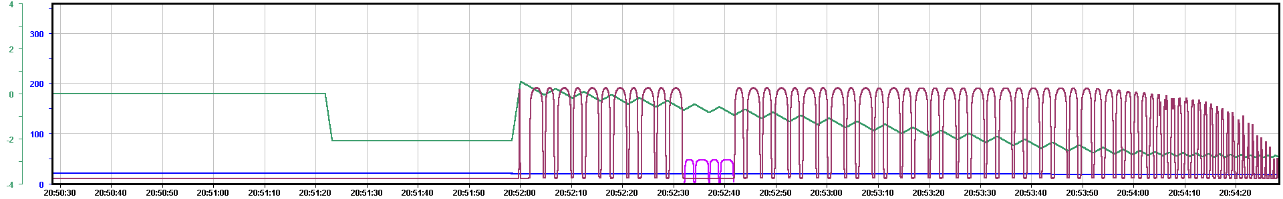
Commissioning
The core SAGE measurements, Solar occultation, were demonstrated at first light on March 16, 2017
Basic functionality and sensitivity to control table parameters were exercised and refined, and important characterizations performed

Slide 20
Etaloning seen during M3M
Soon after operation of the SAGE III/M3M instrument began, anomalous behavior in the high altitude transmission profile was discovered
A low frequency “wave” with amplitude as large as 0.3% was seen in some channels
Wave period varied with wavelength in a manner consistent with a etalon
Inability to fully characterize compromised science
Further analysis concluded that the etalon must be thick, on the order of several millimeters
Candidate sources were assessed and the solar attenuator was identified as the most likely source

Slide 21
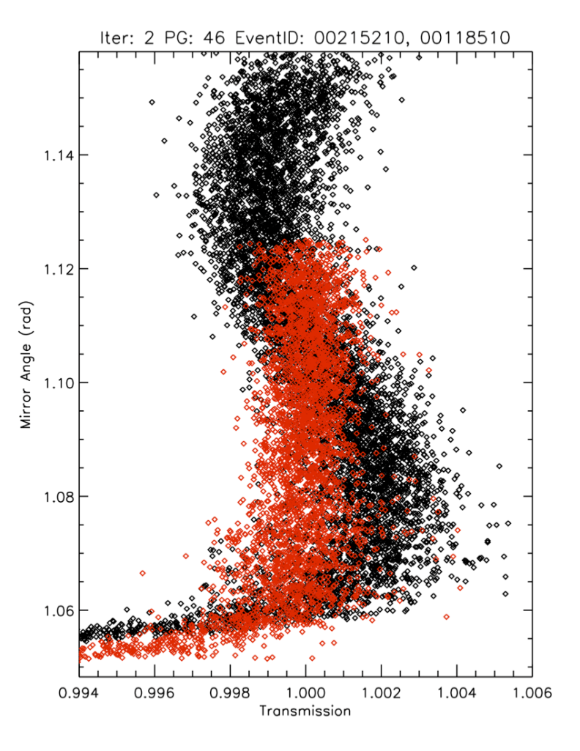
Etaloning Evaluation
The original attenuator for ISS was tested and found to be plane parallel
A replacement attenuator was fabricated with a wedged substrate and tested
The new attenuator and associated mechanism was installed in the flight instrument
On orbit performance demonstrates effectiveness of the replacement

Slide 22
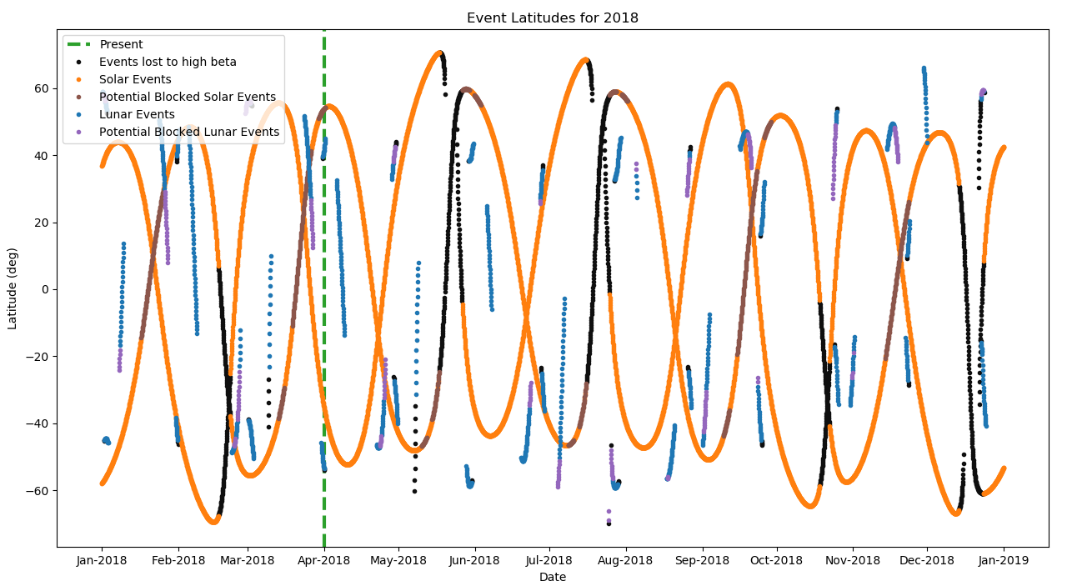
SAGE III/ISS Spatial/Temporal Sampling
No significant sampling issues arise from ISS blockages

Slide 23
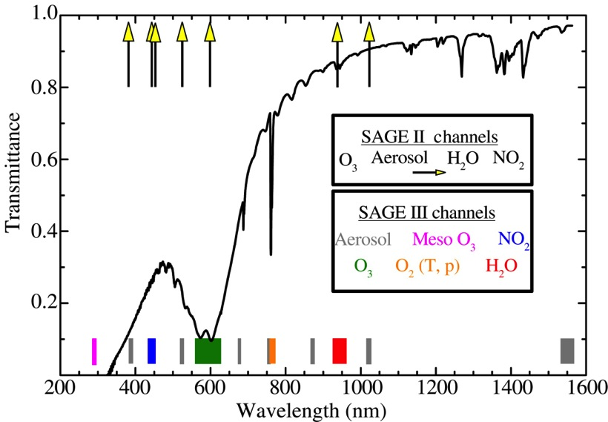
Spectral Sampling
SAGE III Solar:
Aerosol MesO₃ NO₂ O₃ O₂(T,p) H₂O
Limb
Lunar

Slide 24
Standard Data Products: Provisional version, V5.1
PRODUCT | Event Type | Vertical Range & Resolution [km] | Precision [%] | Accuracy Goal [%]
Spectral Transmission | Solar | 0* – 100, 0.75 | 0.1 | 0.1***
Aerosol Extinction & Optical Depth | Solar | 0* – 40, 0.75 | 5 | 5
Ozone# | Solar | 0* – 50, 0.75 | 5 | 5
Water Vapor# | Solar | 5* – 45, 0.75 | 10 | 10
Nitrogen Dioxide# | Solar | TP+2 – 45, 0.75 | 10 | 10
Ozone# | Lunar | 15* - 45, 1.5 | 5 | 6
Nitrogen Trioxide# | Lunar | 25 – 45, 1.5 | 15 | 10
Nitrogen Dioxide# | Lunar | 20 – 45, 1.5 | 10 | 10
Beta
Delayed
# concentration; * Or cloud-top/ISS; ** at 600 nm

Slide 25
Research Data Products
PRODUCT | Event Type | Vertical Range & Resolution [km] | Precision [%] | Accuracy Goal [%]
Temperature | Solar | 0* – 85, 0.75 | 2 K | 2 K
Pressure | Solar | 0* – 85, 0.75 | 2 | 2
Ozone (Mesospheric)# | Solar | 60 – 90, 1.0 | 5 | 10
Chlorine Dioxide# | Lunar | 15* – 25, 1.5 | 20 | 25
Limb Radiance (L1B) | Limb | 0 – 60, 0.75 | 2.5 | 10
See Poster
# concentration; * Or cloud-top

Slide 26
Prime Mission Team
Josh Bangert
Bob Borchardt
Andrea Cowley
Rob Damadeo
Tyler Dawson
Jim Farmer
Mike Heitz
Jon Hicks
Charles Hill
Dave Huber
Carter Hulsey
Susan Kizer
Travis Knepp
Marsha Larosee
Kevin Leavor
Allison Leybold
Kaitlin Liles
Danny Mangosing
Robbie Manion
Josh McDonald
Randy Moore
Sudha Natarajan
Jamie Nehrir
Greg Paxton
Andrew Peterson
Mike Pitts
Sam Porter
Marilee Roell
Carrie Roller
Amy Rowell
Caitlyn Stone
Larry Thomason
Michael Thompson

Slide 27
Extended Mission Review Schedule
March 2020: Senior Review Cycle FY21 – FY23
  Senior Review for Earth Science Projects
  Held every three years
  Mission Extension Review
  Will provide extension funding to bridge to EPMR
July/August 2020: End of Prime Mission Review
  3 year Phase E Prime Mission ends June 30, 2020
  Review cycle has this occurring 30 – 60 days after Senior Review
  Present that we met our Level 1 requirements to closeout the primary mission

Slide 28
Summary
SAGE III/ISS is a climate continuity mission addressing critical international science needs: sage.nasa.gov
SAGE III/ISS is operating nominally with additional data released at monthly intervals: eosweb.larc.nasa.gov/project/sageiii-iss/sageiii-iss_table
Experience on ISS has grown rapidly, consistently collect 90% of solar opportunities, 85% solar+lunar.
Provisional Ozone/Aerosol Data w/ V5.1
Preliminary comparisons of mid-stratosphere ozone within ±10% of validated sources
Beta version of water vapor product w/ V5.1
DMP has potential to mitigate impact of mechanical disturbances on data products
Baseline mission is July 2017 – June 2020; continuation renewed in 3-yr cycles

