Slide 1
Science Team Meeting
NASA Langley Research Center
10/30/2018

Slide 2
Mission Operations
Jamie Nehrir
Acting Mission Operations Manager

Slide 3
Outline
Mission Operation Overview
  Meet the team
  Groundsystems
  Routine Operations
Challenges of being on ISS
  Ops Protocol/Reactions to ISS Activities
  List of ISS activities
Additional Operational Activities
  Calibration activities
  Maintenance activities
Upcoming Activities

Slide 4
Ops Overview
Mission Operations Goals
  Commanding and downloading data on a weekly/daily basis
  Maintaining the health and safety of the SAGE III payload
    Daily engineering checks
    Trending of engineering data and science metrics
  Process and distribute SAGE III data
    Process Ground Support Equipment (GSE) and Solid State Memory Card (SSMC) in near real-time (8-5 ET)
    Processes 24 hours of SSMC data daily
    Generates daily SCF files
      Level 0 and ancillary data
    Generates daily ESA/TASI data files
  Optimizing the science data taken
    Modify IA tables
    Update IAM code
    Generate tools to better understand event blockages and missed events

Slide 5
Ops Team
SAGE III Payload Operations Center
Jamie Nehrir | Acting Mission Operations Manager
Greg Paxton | Ground Systems Lead
Andrew Peterson | Deputy Mission Operations Manager
Robert Borchardt | Lead Technical Payload Engineer
Jonathan Hicks | Ground Systems Engineer
James Farmer | Ground Systems Engineer
Joshua Bangert | Payload Engineer
Michael Thompson | Payload Engineer
Joshua McDonald | Payload Engineer
Samuel Porter | Payload Engineer
Tyler Dawson | Payload Engineer
Andrea Cowley | Payload Engineer
Caitlyn Stone | Payload Engineer

Slide 6
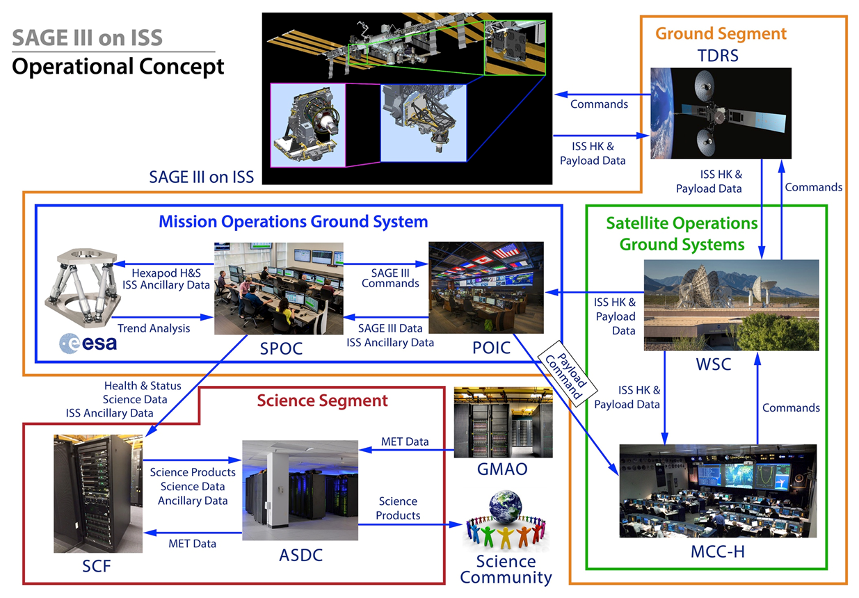
SAGE Website/Ground Systems

Slide 7
Routine Operations
On-Console Team
  Consists of two team members
  Checks in on the payload at the FMSC Monday-Friday and sends commands to the payload if needed
  Executes the weekly command load on Thursdays to load in two weeks worth of science events
  On-call for the week and carries an operations cell phone that HOSC will call if any issues or anomalies arise
Prep Team
  Consists of two team members
  Prepares for the next weeks on-console activities
  Dry-runs the weekly command load at the spreadsystem for the On-console team

Slide 8
Automated Routine Processes
Weekly Command Load generation
  Use STK and Python to automate the production of command files
  Routine files produced control: the downlink schedule, orbit propagation and event prediction, and planned limbs
  Generates planning aids for Operation activities
Event predicts are generated everyday
  Sliding window that updates with more accurate predicts
  Helps external partners coordinate their activities via the validation website

Slide 9
Challenges of Being on ISS
While there are many benefits of being on the ISS, there are also some challenges that come with such an active platform that affect how we take science data
  Visiting vehicles
  Yaw maneuvers
  EVA’s
  GPS lock-ups

Slide 10
Ops Protocol/Reactions to ISS Activities
Station Activity | Operations Response
Soyuz docking | Contamination Door is inhibited a minimum of 2 hours before activity
Progress docking | Contamination Door is inhibited a minimum of 2 hours before activity
Dragon 1 Capture | Contamination Door is inhibited a minimum of 2 hours before activity in addition the contamination door will remain shut for the duration of the Dragon stay
Cygnus Capture | Contamination Door is inhibited a minimum of 2 hours before activity
HTV Capture | Payload must be put into SAFE mode at least 30 minutes prior to the beginning of the Maneuver until observed then this should be reevaluated
OPM to +XVV | Payload must be put into SAFE mode at least 30 minutes prior to the beginning of the Maneuver
OPM to –XVV | Payload must be put into SAFE mode at least 30 minutes prior to the beginning of the Maneuver
Large off nominal attitude changes | Payload must be put into SAFE mode at least 30 minutes prior to the beginning of the Maneuver
Main Engine Reboost | No response needed
Progress Reboost | No response needed
CST-100 | Payload must be put into SAFE mode at least 30 minutes prior to the beginning of the Maneuver until observed then this should be reevaluated
Dragon 2 | Payload must be put into SAFE mode at least 30 minutes prior to the beginning of the Maneuver until observed then this should be reevaluated

Slide 11
Vehicle Dockings/Captures and Undockings/Releases
Summary of SAGE III Observations
Dragon
  6 departures
  5 arrivals
Soyuz
  7 departures
  6 arrivals
Progress
  4 departures
  4 arrivals
Cygnus
  3 departures
  3 arrivals
HTV
  1 arrival
Vehicle | Vehicle # | Port | Arrival | Departure
Dragon | 10 | N2 Nadir | — | 03/29/2017
 | 11 | N2 Nadir | 06/05/2017 | 07/03/2017
 | 12 | N2 Nadir | 08/16/2017 | 09/17/2017
 | 13 | N2 Nadir | 12/17/2017 | 01/13/2018
 | 14 | N2 Nadir | 03/30/2018 | 05/05/2018
 | 15 | N2 Nadir | 07/02/2018 | 08/03/2018
Soyuz | 48 | MRM2 | — | 04/10/2017
 | 49 | MRM1 | — | 06/02/2017
 | 50 | MRM2 | 04/20/2017 | 09/02/2017
 | 51 | MRM1 | 07/28/2017 | 12/14/2017
 | 52 | MRM2 | 09/13/2017 | 02/27/2018
 | 53 | MRM1 | 12/19/2017 | 06/03/2018
 | 54 | MRM2 | 03/23/2018 | 10/04/2018
 | 55 | MRM1 | 06/08/2018
Progress | 67 | SM Aft | 06/16/2017 | 12/27/2017
 | 66 | DC1 | — | 07/20/2017
 | 68 | DC1 | 10/16/2017 | 03/28/2018
 | 69 | SM Aft | 02/15/2018 | 08/23/2018
 | 70 | DC1 | 07/10/2018
Cygnus | 7 | N1 Nadir | 04/22/2017 | 06/04/2017
 | 8 | N1 Nadir | 11/14/2017 | 12/06/2017
 | 9 | N1 Nadir | 05/24/2018 | 07/15/2018
HTV | 7 | N2 Nadir | 09/27/2018

Slide 12
Station Reboosts
18 reboosts have occurred in SAGE III’s over one year and a half on orbit.
Vehicle/Station Section | Reboost Date
Service Module | 04/03/2017
Service Module | 04/27/2017
Service Module | 05/17/2017
Progress 67 | 08/09/2017
Progress 67 | 08/27/2017
Progress 67 | 09/27/2017
Progress 67 | 11/02/2017
Progress 67 | 11/29/2017
Service Module | 01/17/2018
Service Module | 01/30/2018
Progress 69 | 03/13/2018
Progress 69 | 04/18/2018
Progress 69 | 05/12/2018
Progress 69 | 06/23/2018
Cygnus 9 | 07/10/2018
Progress 69 | 07/26/2018
Service Module | 09/05/2018
Service Module | 09/20/2018

Slide 13
Optimization Activity Schedule
Optimization Activities | Constraints/Frequency
Atmospheric Spectral Survey (Sunrise and Sunset) | Minimum of once a year*
Boresight Alignment | Minimum of once a year*
CCD Characterization and Dark Current | Minimum of once a year*
CTE Calibration | Minimum of once a year*
Extended Sunrise Events (Spectral Survey and Mirror Calibration) | Minimum of once a year*
Extended Sunset Events (Spectral Survey and Mirror Calibration) | Measurements of opportunity based on ISS orientation
Off-Nadir Angle | Minimum every six months ISS configuration change
*Increased frequency as needed

Slide 14
Payload Maintenance Activity Schedule
Optimization Activities | Constraints/Frequency
Azimuth Range of motion | Minimum of once a year*
CCD Annealing | Dependent on the dark current assessment
Hexapod Zero Procedure | Quarterly*
*Increased frequency as needed

Slide 15
Instrument Calibrations and Characterizations Performed
2017
30 – 31 March
Extended Spectral Survey – Sunrise
Extended Mirror Calibration – Sunrise and Sunset
7 April
Boresight Alignment – Partial (-7 and +7 arcminutes)
19 – 21 April
Extended Spectral Survey – Sunrise and Sunset
Atmospheric Spectral Survey – Sunset
26 – 28 April
Boresight – Full ( -7, +7, and -11 arcminutes)
28 April
Atmospheric Spectral Survey – Sunrise and Sunset
16 May
Charge Transfer Efficiency Calibration
Off-Nadir Angle – Static Error Quaternion Uploaded
12 June
Atmospheric Spectral Survey – Sunrise and Sunset
23 – 25 August
Extended Spectral Survey – Sunrise and Sunset
Extended Mirror Calibration – Sunrise and Sunset
Atmospheric Spectral Survey – Sunrise and Sunset
20 – 27 December
IA Power Off and CCD Annealing
2018
21 – 22 May
CCD characterizations
04, 08, 11, and 12 June
CCD characterizations
June
Off-Nadir Angle – No Static Error Quaternion Adjustment Needed
12 October
Extended Mirror Calibration – Sunrise and Sunset

Slide 16
Upcoming activities
Robo Survey
  The robotic arm will be used to take pictures and videos of the SAGE III payload on a periodic basis to visualize the affects of space
High negative beta angle which requires the IA to be turned off
  This will occur mid-December and will last approx. 7 days
Possible additional calibration events if ISS rotates to –XVV for EVA purposes
  Dependent on ISS crew availability
IAM code load

Slide 17
New Flight Software
The current IAM Flight Software version in flight is 7.2 loaded 19 December 2017
Build 7.3 will include
  Improvements that aid the operations team:
    Updating how an empty file transfer buffer is handled
    The addition of a command to delete all science events
    An additional software message when science events are added to the event manager
    An increased time-tag buffer size
  An identified software bug that caused science event mispredictions
  Closure of items tracked in the JIRA software during IAM builds:
    Time marker strobe timestamp update
    Synchronization of the IAM and CMP serial interface
    Cleanup of unused inputs to the command handler task
The goal is to load the new version of IAM FSW during the high beta period 14-24 December while the instrument is unable to take solar science.

Slide 18
Questions

