Slide 1
Instrument Assembly Status
Andrew Peterson
Deputy Mission Operations Manager

Slide 2
Outline
Instrument Assembly Health
Life Cycle Tracking
Blockage Maps
Occultation Event Classification
Hexapod Anomalies
Hexapod Error Code 100 Trending

Slide 3
Instrument Assembly Health
Functioning Nominally
No degradation in the instrument’s sensitivity to light
Single Event Upsets (5 occurrences)
  Instrument resets – Attributed to radiation hits, system reboots successfully and is brought back up by ops
  Software glitches – NCR 96 on 10/16/2018: Time Control stopped running, operating nominally after rebooting the instrument

Slide 4
Instrument Life Cycle Trending
Well below most mechanical limits as of 10/24/2018
  Contamination Door Cycles: Approximately 18000 of 95,000 (18.9%)
  Attenuator Life Cycles: Approximately 8631 of 17,000 (50.7%)
  Zero Procedures: 32 of 7300 (0.4%)
  Hexapod Pre-Points: Approximately 19350 of 73000 (26.5%)
As there are no signs of degradation in the attenuator SAGE will return to nominal limb science data collection

Slide 5
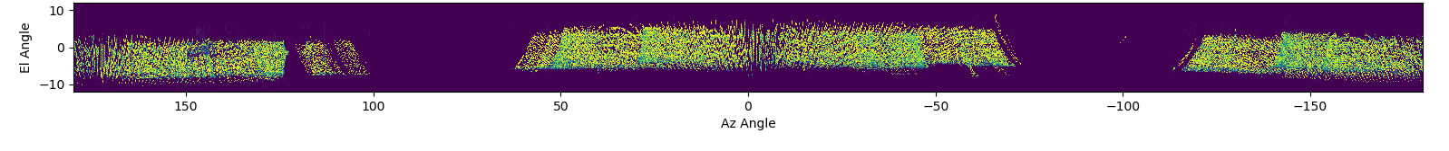
Blockage Maps
Plotted Solar Channel 9 Intensity on an Azimuth vs Elevation Map
  The map is produced by adjusting for ISS attitude and SAGE’s point system
Data from solar events from July 2017 to August 2018
The gaps to the port and starboard are when we cannot take data due to high solar beta
Wake Port Ram Starboard Wake

Slide 6
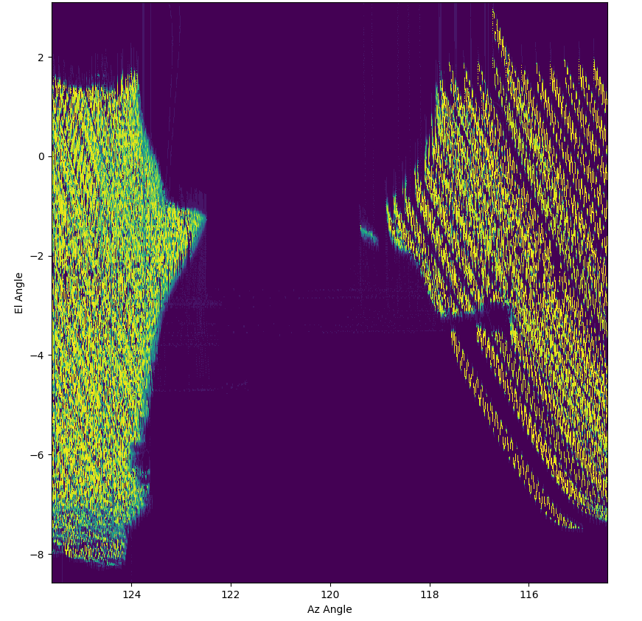
Blockage Maps: Soyuz
Soyuz at MRM1
Scans cover several Soyuz dockings
  Scans when a Soyuz wasn’t docked have been omitted

Slide 7
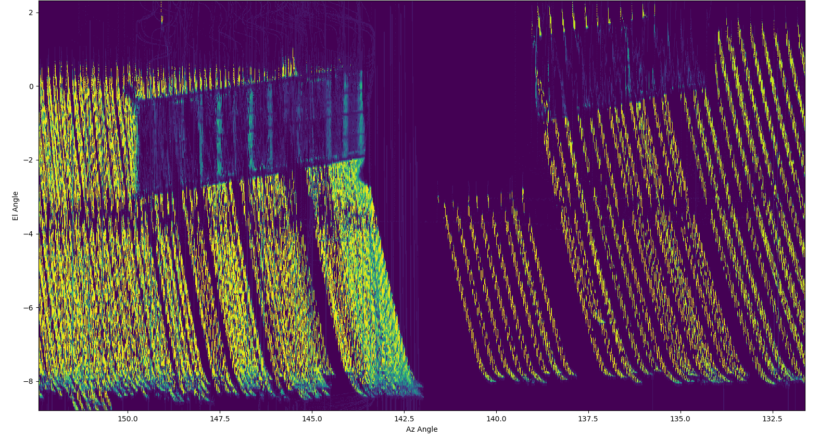
Blockage Maps: Progress
Progress at DC-1
Scans cover several Progress dockings
  Scans when a Progress wasn’t docked have been omitted

Slide 8
Event Classification and Hexapod Status
Samuel Porter
Payload Operations Engineer

Slide 9
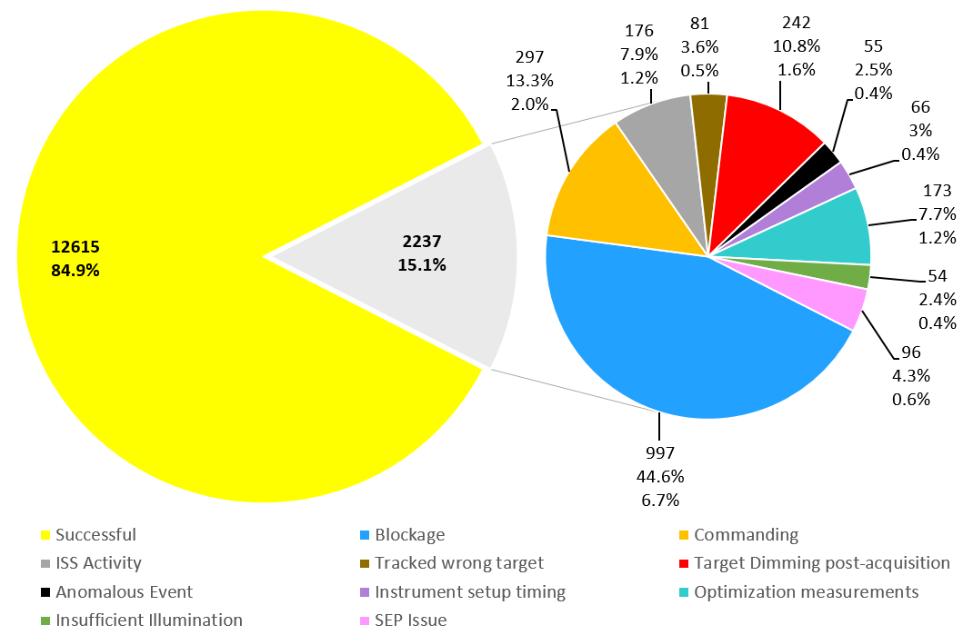
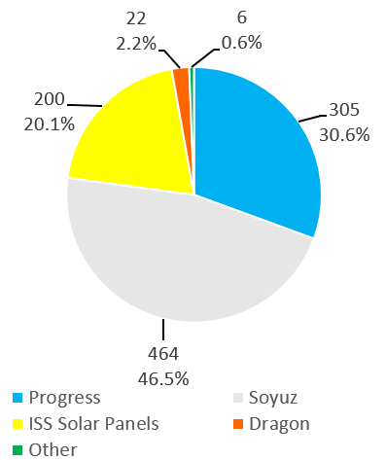
Occultation Event Categorization
Event Outcome
Blocked Events
Numbers and percentages as of 10/17/2018

Slide 10
Hexapod Anomalies (Mitigated)
NCR-32 (4 occurrences – Auroral Zones and in SAA)
  Radiation caused Health Check to fail which triggered the HEU to transition to SBM.
  New FDIRs were made to monitor Hexapod telemetry instead of the Hexapod onboard health check which was disabled.
  If triggered, FDIRs will disable SEM and Hexapod will not go into SBM.
  New FDIR’s uploaded on 1/19/2018
NCR-84 (5 occurrences)
  Occurs when the IAM tries to retrieve the Hexapod LogA and LogB files when one is empty, resulting in a command reject and HEU Error 101.
  If the IAM does not receive the files within a certain period of time it will raise a Watchdog Error.
  Modified the RTS which retrieves the Hexapod files during every science event to only retrieve the Actuator Performance file and no longer retrieve Log files.
  New RTS created to be triggered by Hexapod monitoring TMONs to retrieve Actuator Performance files, and Log files if/when the Hexapod goes to SBM.
  New RTS’s uploaded 7/12/2018

Slide 11
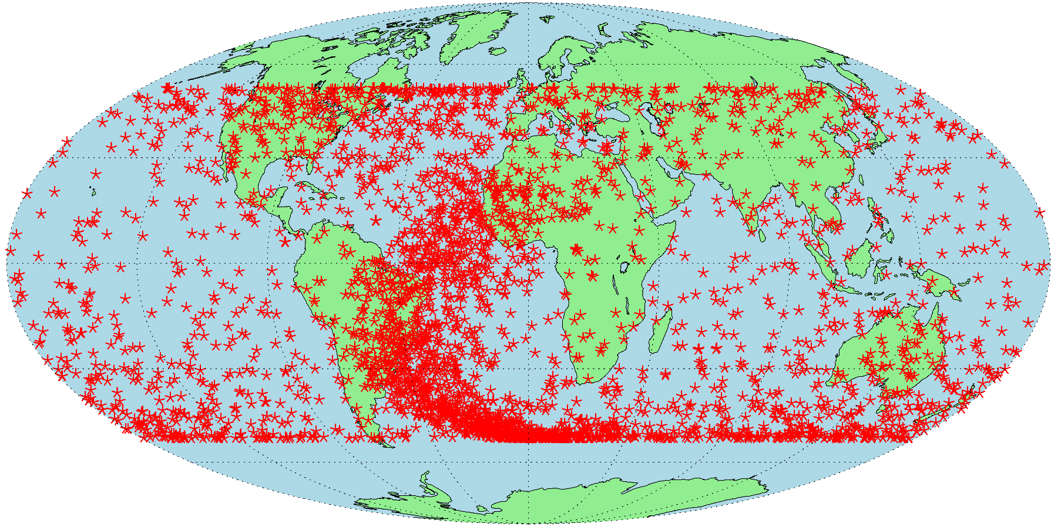
HEU Error 100 Map
3,212 error 100’s between 4/1/2017 and 8/31/2018

