Slide 1
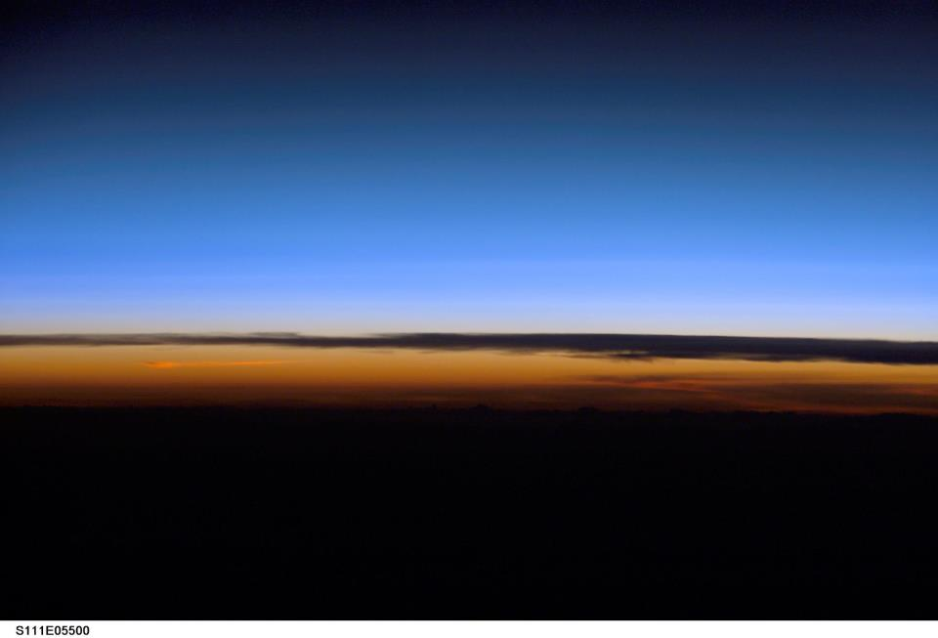



Initial evaluations of water vapor retrievals from SAGE III-ISS
Mijeong Park and Bill Randel
NCAR
Oct 31, 2018
Image from SAGE III-ISS Facebook

Slide 2
Objectives:
Evaluate geophysical variability in SAGE III-ISS H₂O retrievals,
with focus on upper troposphere - lower stratosphere
  Time average behavior
  Tropical tape recorder and summer monsoons
  Comparisons with temperatures near the tropical tropopause

Slide 3
SAGE III-ISS measurements
SAGE III-ISS
good sampling for
monthly averages
Aug2017
Jan2018
201708

Slide 4
SAGE III H₂O Apr2018 SR vs. SS
SAGE III H₂O SR
SAGE III H₂O SS
QBO
dry TTL

Slide 5
MLS vs. SAGE III H₂O Apr2018
MLS H₂O
SAGE III H₂O (SR+SS)
overall good agreement

Slide 6
H₂O tape recorder (2004-2018)
MLS H₂O (15S-15N)
Long term measurements of H₂O are crucial to understanding atmospheric variability
ACE-FTS H₂O (15S-15N)

Slide 7
H₂O tape recorder (2017-2018) SAGE III-ISS vs. MLS
SAGE III-ISS H₂O (ss+sr) 15S-15N
MLS H₂O 15S-15N
wet phase of
tape recorder

Slide 8
H₂O tape recorder (2017-2018) SAGE III-ISS vs. ACE-FTS
SAGE III-ISS H₂O (ss+sr) 15S-15N
ACE-FTS H₂O 15S-15N

Slide 9
Gridding to evaluate longitudinal structure
Aug2018
Aug2018 (Grid)
SAGE III H₂O (16.5km)
SAGE III H₂O (16.5km)
Asian and N. American monsoons

Slide 10
SAGE III vs. MLS H₂O Aug2018
SAGE III H₂O (18.0 km)
MLS H₂O (83 hPa)
Note differences in
vertical resolution:
MLS ～ 3 - 4 km
SAGE III ～ 1 km
?
SAGE III H₂O (16.5 km)
MLS H₂O (100 hPa)

Slide 11
SAGE III vs. MLS H₂O Jan2018
SAGE III H₂O (18.0 km)
MLS H₂O (83 hPa)
SAGE III H₂O (16.5 km)
MLS H₂O (100 hPa)
cold, low H₂O
tropical western Pacific

Slide 12
Comparing SAGE III vs. MLS H₂O profiles for one day (10S-10N)
SAGE III & MLS 20170827
SAGE III & MLS 20171123
noise above
35 km
Reasonable agreement for vertical structure
near tropopause
Summer
Winter

Slide 13
Comparisons with temperatures in TTL:
In the TTL, we expect H₂O to closely follow local temperature,
due to local dehydration. What can we learn from
detailed comparisons?
How does observed H₂O compare to saturated H₂O profile from T(z)?
Calculate Q_{sat} = 100% relative humidity from observed T(z)
(Clausius-Clapeyron)

Slide 14
Comparisons with temperatures in TTL
SAGE III H₂O and analysis temperature
nearby GPS Temperature
Example:
single profile
in Aug 2018
analysis
Temp.
In the future we will
use high vertical
resolution T(z) from GPS
T cpt
H₂O min

Slide 15
SAGE III H₂O & Q_{sat} (winter/summer)
H₂O (10S-10N) 201801
H₂O (25S-0) 201808
Q_{sat} is based on analysis
temperature
A few examples of very low H₂O

Slide 16
SAGE III H₂O vs. Q_{sat} 10S-10N
Summer (Aug2017)
Winter (Jan2018)
H₂O vs. Q_{sat}
H₂O vs. Q_{sat}
above
cold point
< 100% RH
1:1 line =
100% RH
few anomalously
low H₂O values
(12.5-19.5 km)
Color = Temperature

Slide 17
SAGE III H₂O vs. Q_{sat} 10S-10N
Summer (Aug2017)
Winter (Jan2018)
H₂O vs. Q_{sat}
H₂O vs. Q_{sat}
above
cold point
Color =Altitude
(12.5-19.5 km)

Slide 18
Key Points
Overall SAGE III-ISS water vapor shows reasonable geophysical behavior. Good initial comparisons to MLS and ACE-FTS.
Tape recorder signal is evident in SAGE III-ISS water vapor, consistent with MLS & ACE-FTS.
Seasonal structure in the LS is consistent with MLS both in NH summer and winter. Future goal is to explore detailed vertical structure with SAGE III-ISS.
SAGE III-ISS water vapor captures vertical structure of cold point tropopause. Ongoing work to evaluate and quantify H₂O vs. Q_{sat}.

Slide 19
SAGE III H₂O vs. Qsat 10S-10N
SAGE III H₂O vs. Qsat 18 km
Dry at 18 km
(summer/winter)
SAGE III H₂O vs. Qsat 16.5 km
Humid at 16.5 km

Slide 20
SAGE III H₂O 5S-5N (Tropics)
H₂O (ppmv) Aug2017
H₂O (ppmv) Jan2018
Noise (35-60 km)
..we believe these to be due to noise in the measured atmospheric transmission associated with the platform stability,…
(v5.1 release notes)
Temperature
Very low H₂O (winter, tropics)

