Slide 1
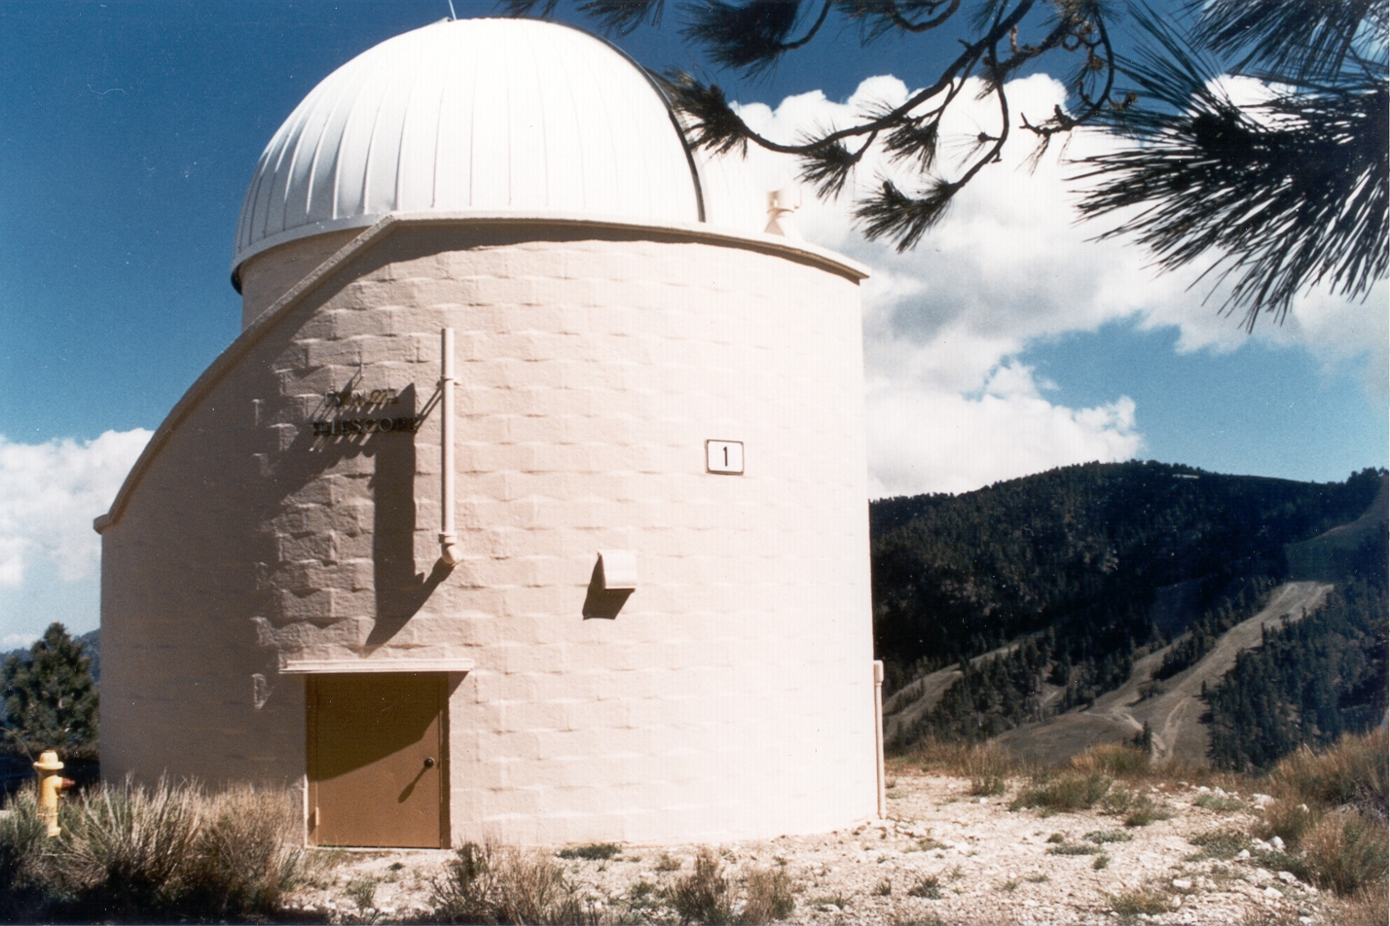

Ground-Based Diurnal Measurements of NO₂ and NO₃ in Support of SAGE-III/ISS Validation
Stanley P. Sander and Thomas J. Pongetti
NASA/Jet Propulsion Laboratory, California Institute of Technology
© 2018, California Institute of Technology. Government sponsorship acknowledged.

Slide 2
Task Objectives
Objective 1: Obtain lunar occultation measurements of nighttime NO₃ and NO₂ from Table Mountain Facility in support of SAGE III/ISS validation.
Objective 2: Utilize in-situ measurements of NO₃ and NO₂ and chemical modeling to separate stratospheric and tropospheric partial columns.
Objective 3: Analyze comparisons with coincident SAGE III/ISS measurements and work with the Science Team to interpret the comparisons and incorporate improvements into retrieval algorithms.
Co-Investigators
Yuk L. Yung, Caltech: 1-D atmospheric modeling
Steven S. Brown, NOAA: In-situ measurements (NO₂, NO₃, N₂O₅)

Slide 3
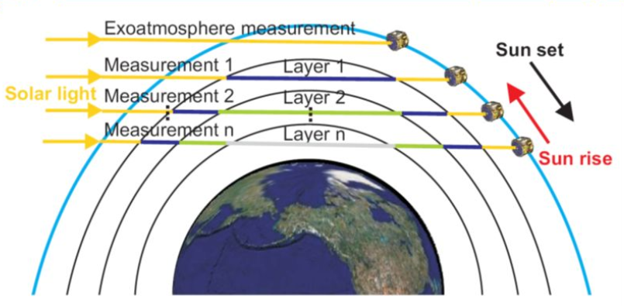
SAGE III/ISS Lunar Occultation Geometry
Moon set
Moonlight
Moon rise
Courtesy D. Fu
Ground-based lunar occultation samples somewhat different spatial and temporal conditions.
Model-derived diurnal corrections must be applied.

Slide 4
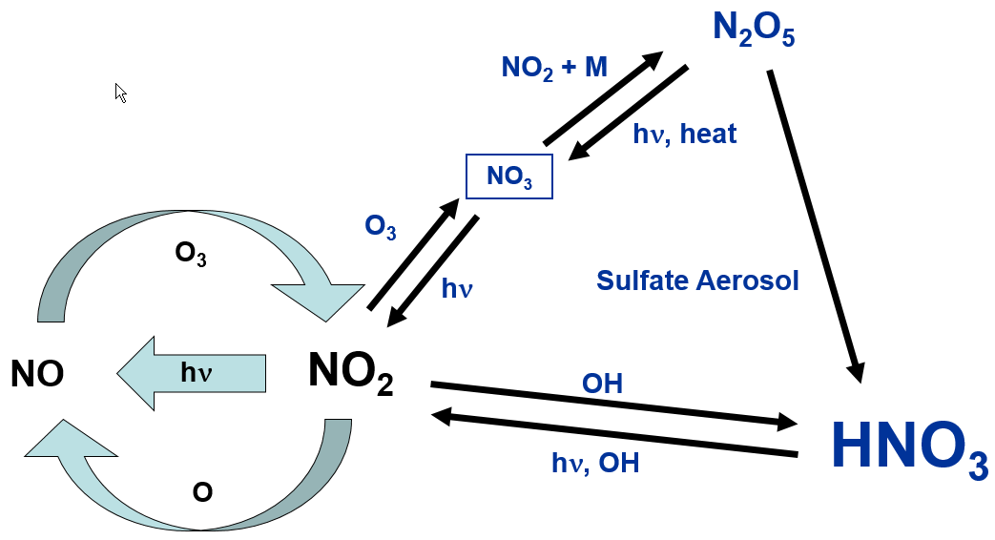
Key Processes in Stratospheric NO_{x}-NO_{y} Photochemistry
Sensitive to Pressure
Sensitive to Temperature
Two pathways to HNO₃ formation:
  Daytime (through OH + NO₂ + M reaction)
  Nighttime (through N₂O₅ + sulfate aerosol reaction, NO₃-mediated

Slide 5
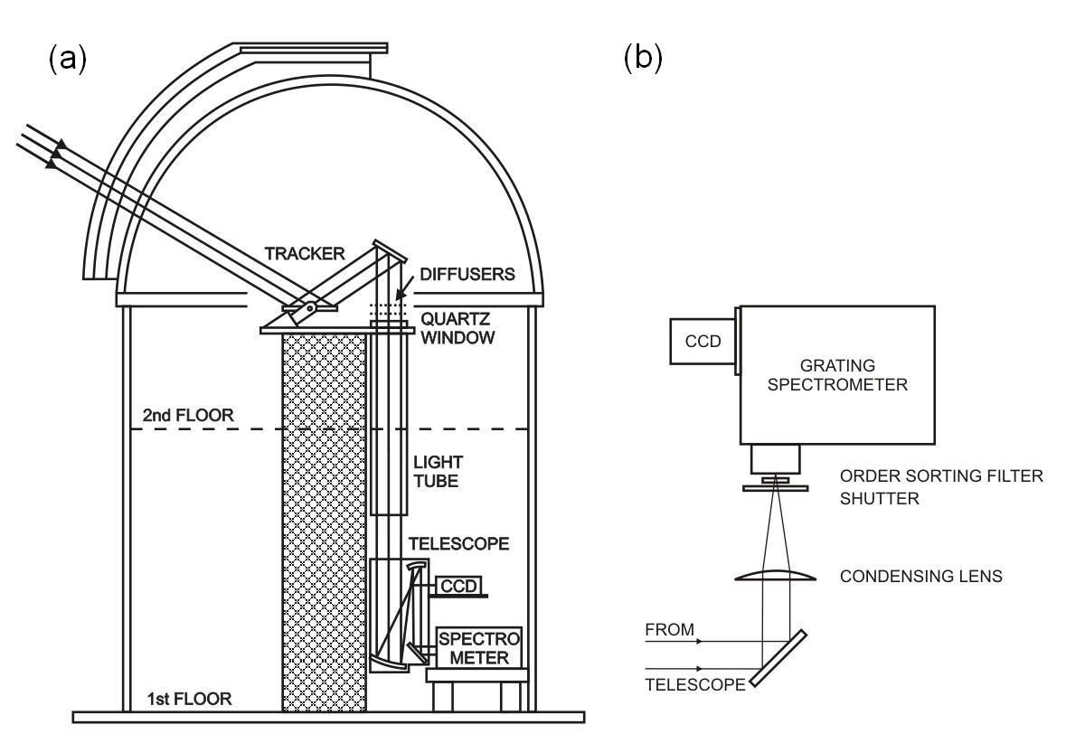
Schematic of the instrument light path. (a) Light is collected by the primary of the heliostat (tracker) then through an off-axis telescope which also serves as a fine guider for the pointing system. (b) The light is directed through a condensing lens, shutter, order-sorting filter, and then into the spectrometer where it is dispersed and recorded by a CCD camera.

Slide 6
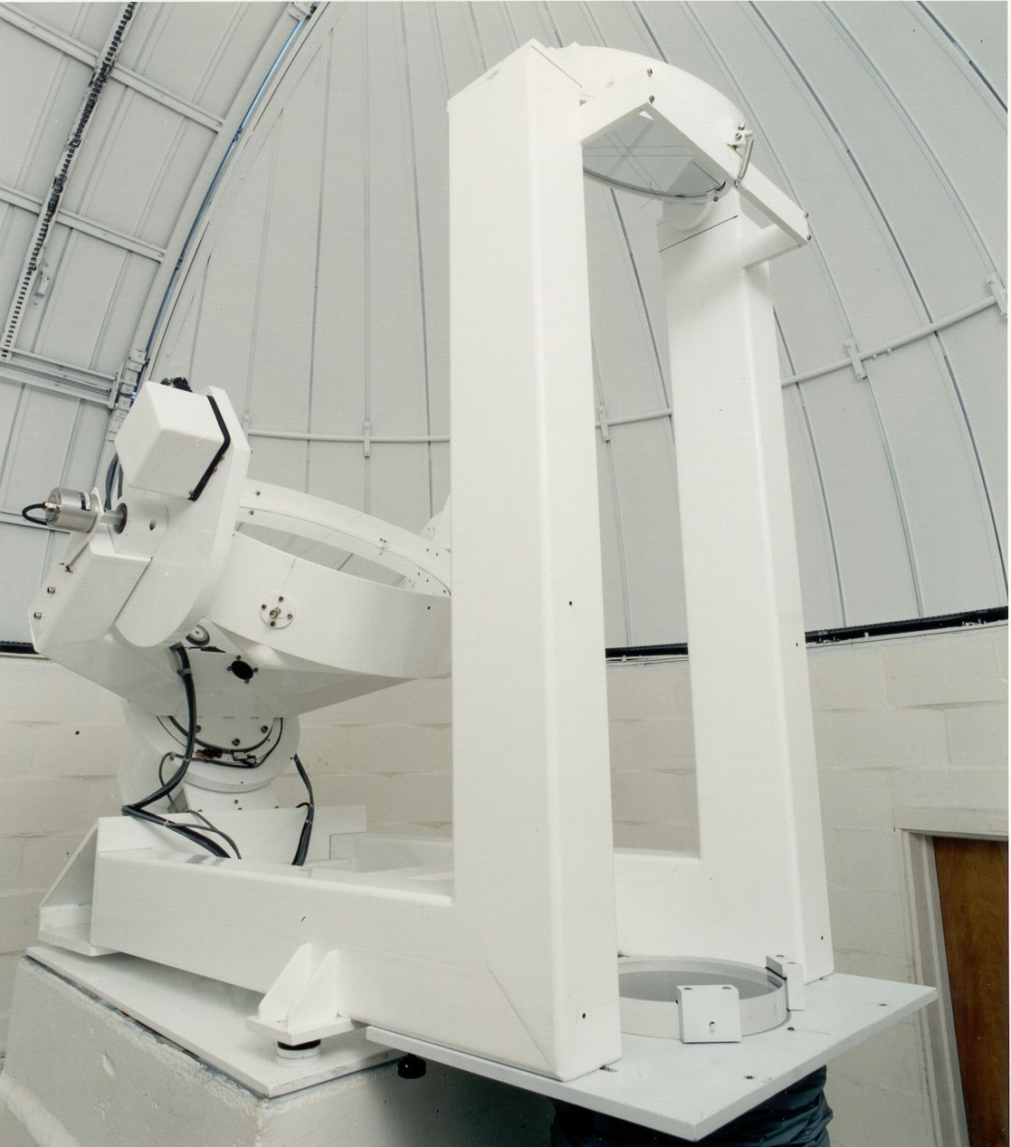

Slide 7
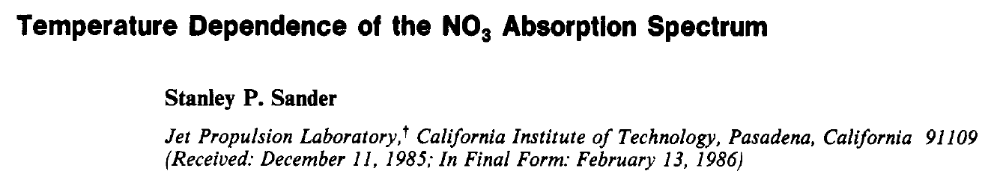
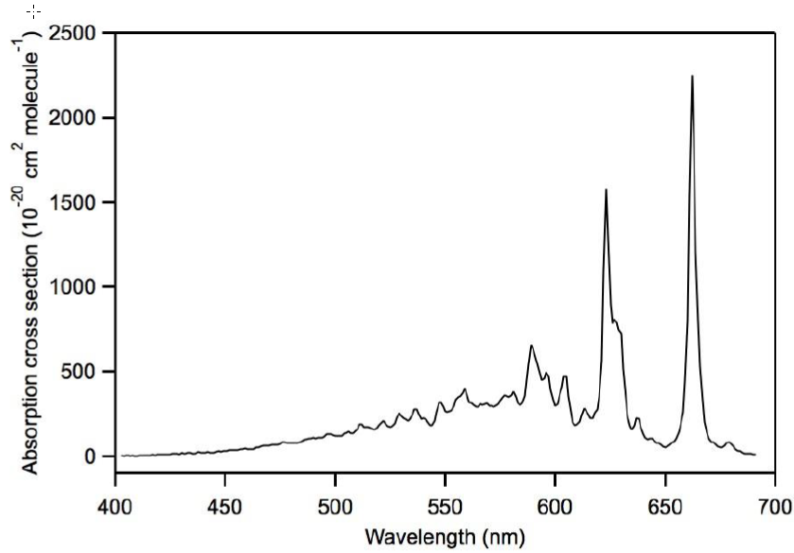
Spectral features measured
by SAGE III
Cross sections increase with decreasing temperature

Slide 8
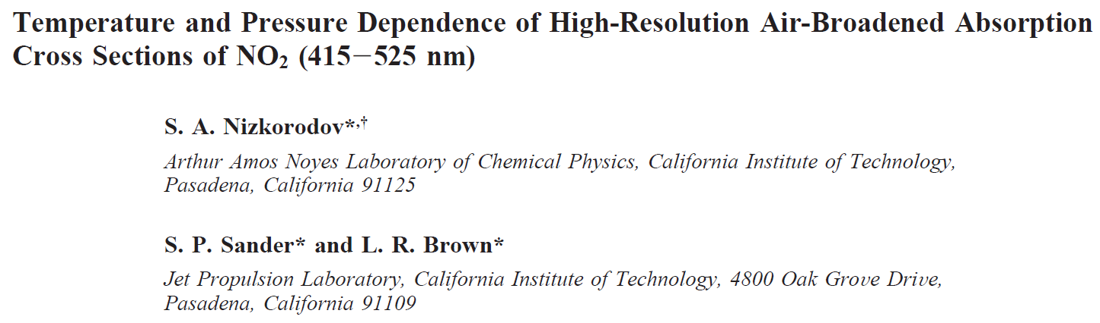
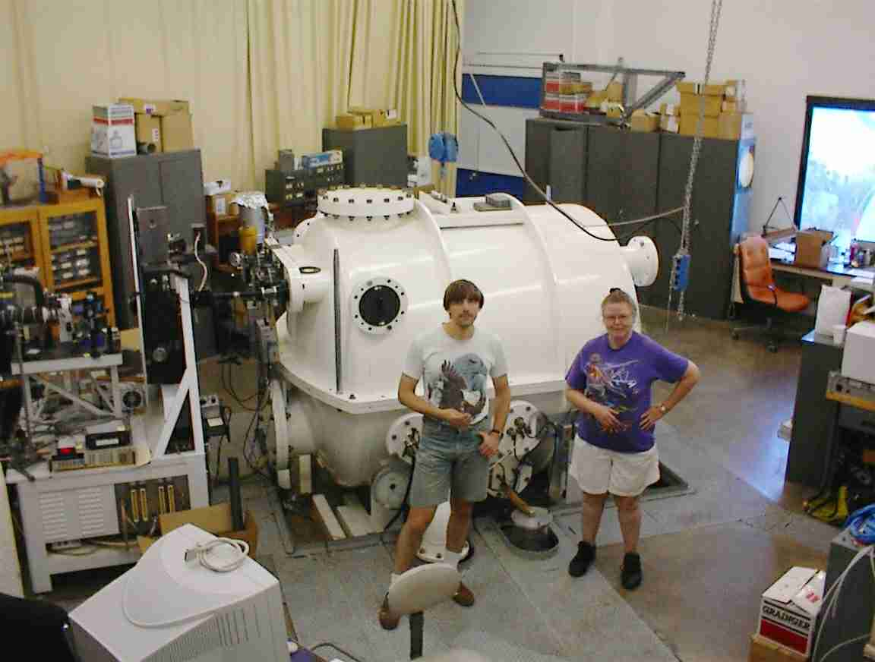

Slide 9
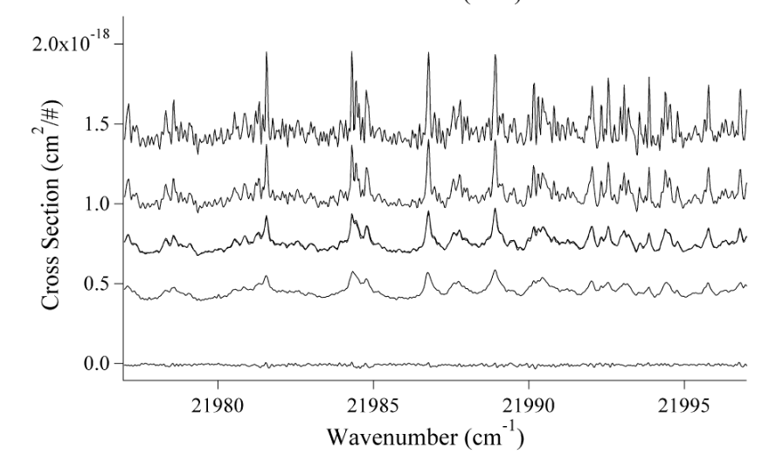
Air Broadening of NO₂ Rovibronic Spectral Features
High resolution NO₂ spectra in a narrow wavelength range near 455 nm showing the effect of pressure on the fine structure. Bath gas pressures (in Torr) are 1.24 (top trace), 151.2, 421.5 and 760.5 (bottom trace) (Nizkorodov et al.)

Slide 10
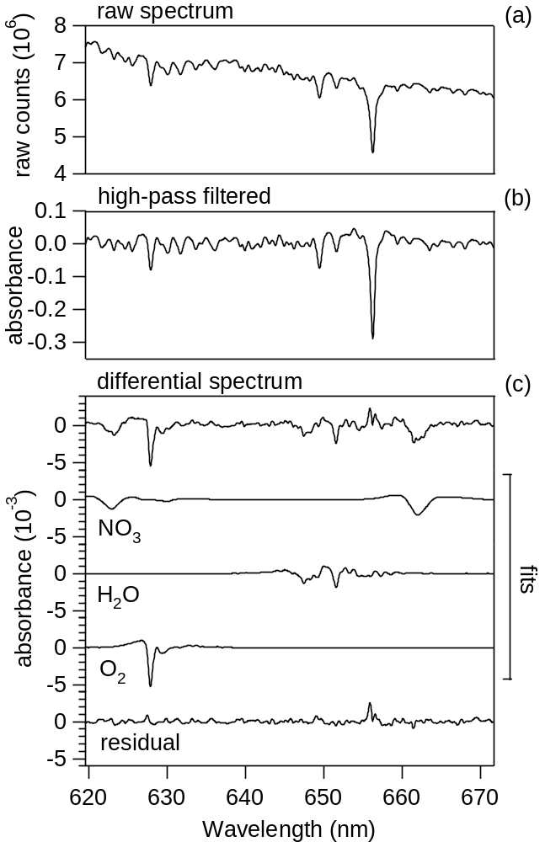
NO₃ Spectral Fitting using the DOAS Approach
Raw spectrum with sloping baseline
High-pass filtered raw spectrum derived by
dividing the raw spectrum by a smoothed version
Differential spectrum after fitting solar, NO₃, water vapor and O₂ reference spectra
Residuals

Slide 11
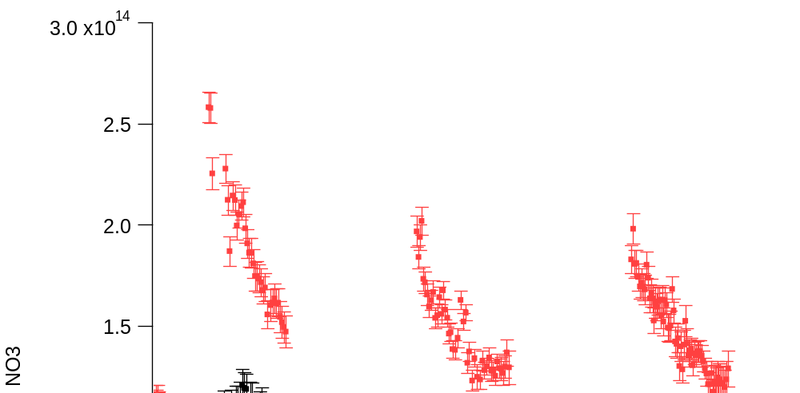
October Lunar NO₂ and NO₃ Retrievals (last week)
Lunar
Lunar
Lunar
Lunar
Lunar
NO₂ depletion by NO₂ + O₃ → NO₃ + O₂
NO₂
NO₃
NO₃ formation by NO₂ + O₃ → NO₃ + O₂
NO₃ depletion by NO₂ + NO₃ + M → N₂O₅ + M
NO₃ Vertical Column Abundance, cm²
NO₂ Vertical Column Abundance, cm²
Diurnal NO₂ and NO₃ profiles behave as expected and may be explained by known gas-phase NO_{x} reactions
Model simulations will provide coupling to SAGE III moon rise/set observations

Slide 12
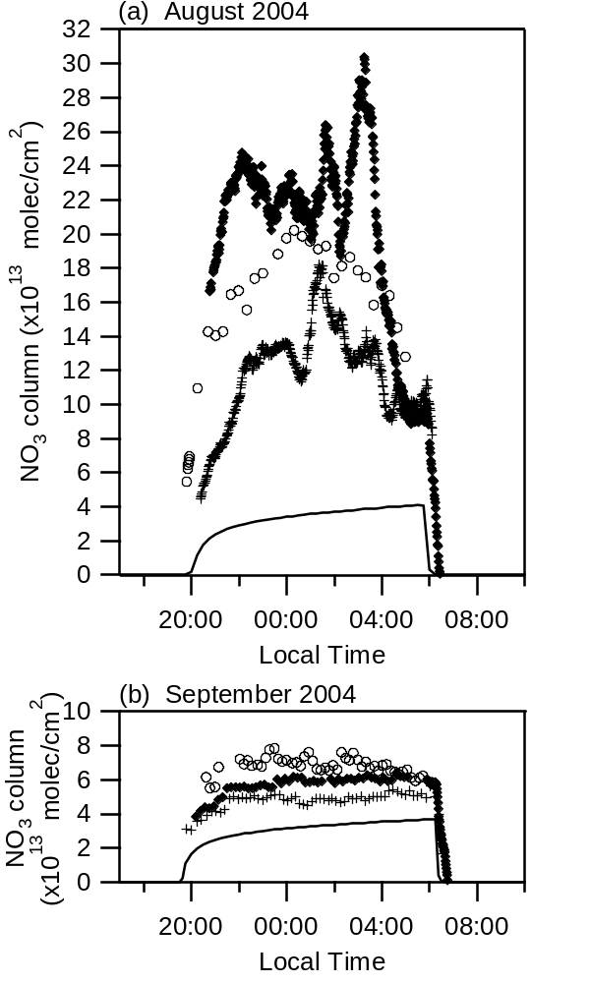
Diurnal variation of NO₃ vertical column measured at Table Mountain, California for August and September 2004, along with calculated vertical columns from the 1-D stratospheric model (line). [Chen et al., 2011]

Slide 13
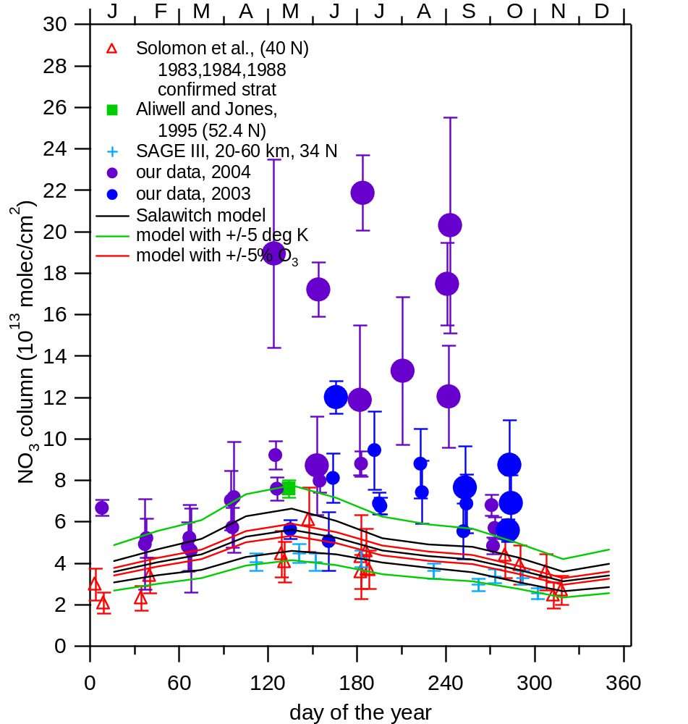
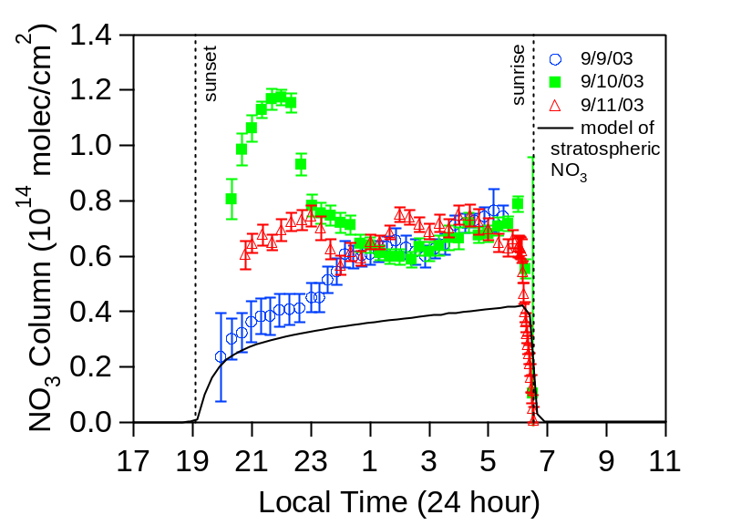
Seasonal Variability and Model Results for NO₃
1D photochemical model
Inputs: T, P, density, aerosol (SAGE II), 9 molecules, including:
O₃ (UARS reference atmosphere project (URAP))
NO_{y} (tracer relations with N₂O))
34.4 N, 18 - 56 km
JPL 2002 kinetics
Our data shows large variability and values above those measured for stratospheric NO₃ column.
Notes:
Reaction rates from 220-275K varies almost by order of mag, (1.7e-18-1.6e-17)
And this shows the seasonal variability of the NO3 column. Data from Solomon and the SAGE III instrument show that stratospheric NO3 columns are a little larger in the summer months than winter, and they range between .2-.4x10^14 molecules/square cm. Our data ranges more between .6-.8, which some outliers.

Slide 14
Simultaneous NO₃ Boundary Layer/
Total Column Measurements
Lunar occultation
(NO₃ vertical column)
Blue Ridge
Retroreflector
6.6 km path length
Long path DOAS
(NO₃ concentration
in boundary layer)
Table Mtn.
UCLA DOAS
Spectrometer
JPL MUGS
(Grating
Spectrometer)

Slide 15
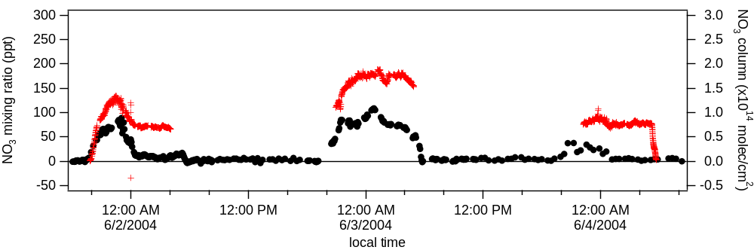
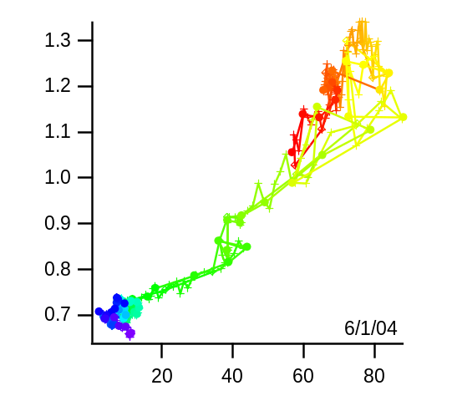
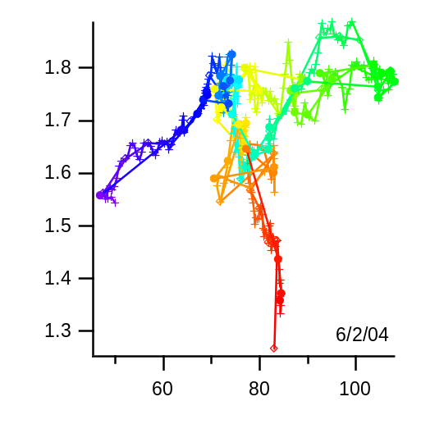
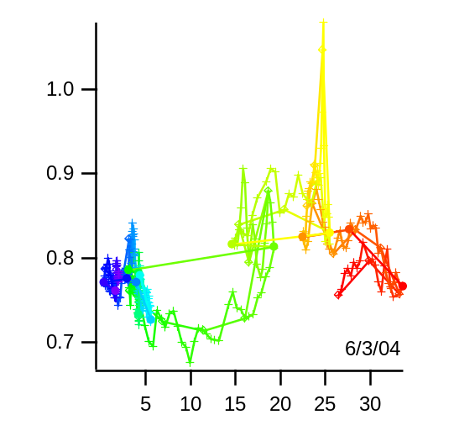
Example Comparison: Column vs. Free Troposphere
Vertical Column
Free Trop.
June 2004
Correlations
Column
Column
Column
Free Trop. Mixing Ratio
Free Trop. Mixing Ratio
Free Trop. Mixing Ratio

Slide 16
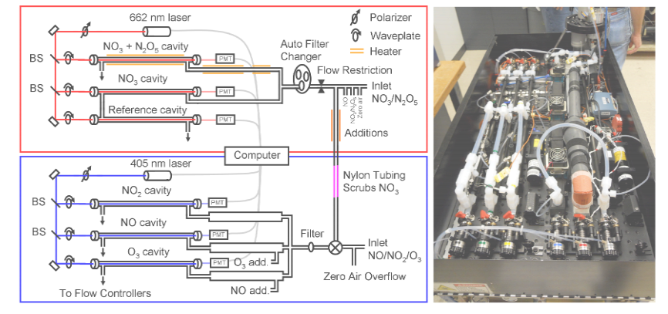
NOAA in situ CRDS Instrument for
NO, NO₂, NO₃, N₂O₅, NO_{y}, O₃
Wagner et al., AMT (2011)

Slide 17
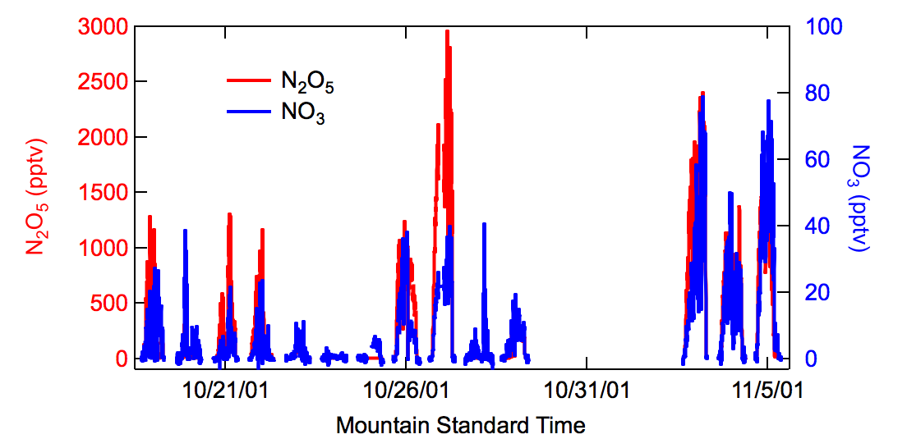
Example NO₃ and N₂O₅ data from the NOAA CRDS instrument. Data are from a mesa above the city of Boulder in 2001, a site in complex terrain subject to upslope and downslope flows impacted by urban emissions, similar to what might be expected at TMF

Slide 18
Summary
Major challenge for validation of SAGE III/ISS nighttime using a ground-based spectrometer is to compare limb profiles with measured total columns
Long-term monitoring + models provide a means to identify nights with minimal tropospheric NO_{x} pollution
We will accomplish this by using an in situ NO₂ and NO₃ analyzer to filter the column data.
Specific criteria have been developed for data filtering that minimize the interference from excess free tropospheric NO₂ and NO₃ allowing for comparisons with SAGE III partial columns.

