Slide 1
SAGE III/ISS Future Algorithm Development
Rob Damadeo

Slide 2
Solar Algorithm Breakdown
Ephemeris
  Mostly SDP Toolkit routines
Meteorological Processing
  MERRA-2 Reanalysis
Refraction
  Fairly straightforward but slightly different from SAGE II
Transmission
  The “meat” of the algorithm; also the trickiest
Inversion
  Fairly straightforward with good transmission profiles

Slide 3
Priorities for Next Version
General algorithm scrub to flush out remaining “surprises” in the inherited code
Make it “Version 7” (i.e., standardize across platforms to extent possible and reasonable)
Improve robustness of water vapor algorithm for normal release
Incorporate DMP data for better pointing knowledge and to mitigate anomalous influences … Pointing Knowledge is Critical!

Slide 4
Future Development
In no particular order …
Revisit spectral stray light correction for mesospheric ozone
Investigate and compare internal aerosol products (MLR vs. AO3)
Incorporate ancillary aerosol products (e.g., SAD or R_{eff})
Use Wulf band retrieval to investigate fidelity of ozone cross-sections (could be used to improve SAGE II H2O)
Optimize channel locations to perhaps free up channels for new species retrievals or increased SNR
Implement temperature and pressure retrievals …

Slide 5
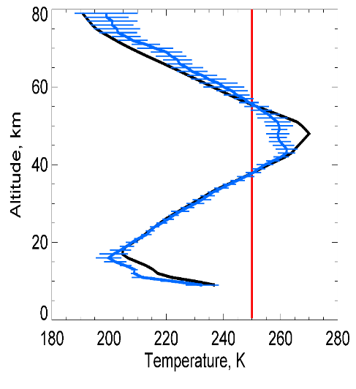
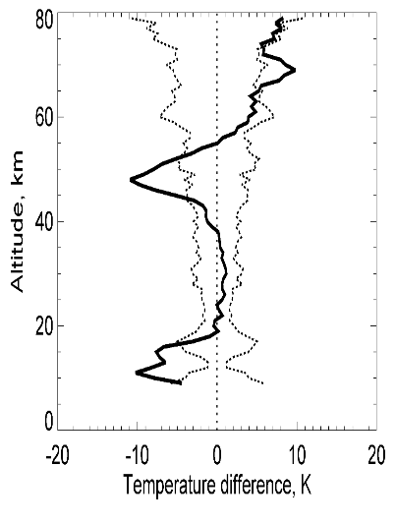
SAGE III/ISS Temperature and Pressure Research Products
Composite of 15 Sunset Events on 2017-11-14 (~27.5º S)
Strategy
  SAGE III/ISS retrieves profiles of T/p from multi-spectral measurements of the O₂ A-band absorption feature near 762 nm
  T/p products from the METEOR/3M mission were of limited science value due to instrument issues
Preliminary assessment:
  SAGE III/ISS O₂ A-band measurements are of higher fidelity than SAGE III/Meteor 3-M’s with no apparent instrument issues
  Sensitivity tests indicate an apparent small wavelength shift in A-band channels relative to nominal registration (approximately 0.03-0.04 nm for sunset and 0.04-0.05 nm for sunrise)
  Preliminary retrievals look encouraging with near science quality products, but some issues remain
ΔT MERRA-2 – SAGE III/ISS, K
Future work:
  Refine wavelength registration
  Examine sensitivity to forward model parameters
    Bandpass (width, wings, etc.)
    Spectroscopy (line intensities, line shape)
    Solar spectrum
  Exclude weaker channels and/or solar feature
See poster for more details

Slide 6
Lunar and Limb
Focus so far has been on solar
Lunar
  Similar algorithm scrub to look for areas to improve
  Are we fundamentally limited by SNR or algorithm?
Limb:
  Looking to implement Level 1B retrieval algorithm
  Community supported effort to develop L2 products

Slide 7
Questions?

