Slide 1
Disturbance Monitoring Package Status Report
Amy Rowell

Slide 2
DMP Overview
The DMP is a Honeywell Miniature Inertial Measurement Unit comprised of three orthogonal ring laser gyros to measure angular rates in three orthogonal axes.
The DMP's primary requirement is to flag periods when vibration conditions can negatively impact the science data product.

Slide 3
DMP Operations Activities
ISS yaw maneuvers for coordinate system calibrations:
  SAGE III requested maneuvers in April and June 2017.
  A similar maneuver for a different payload occurred July 2018.
DMP EEPROM Refresh command sent 3 October 2018.
  This DMP software reset is recommended to be sent every two to three years.
DMP pressure leak rate outperforms Honeywell specification with projected usability beyond two decades

Slide 4
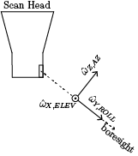
Additional Analyses In-Work
Incorporation of boresight rates algorithm for relative attitude correction in the science inversion algorithm
  Scheduled to be included in version 5.2
Absolute attitude product
  Improved latitude/longitude/altitude registration for limb scattering measurements
  Payload vibration environment at ELC-4 beneficial to ISSP and external payload community
ISS truss bending mode characterization

Slide 5
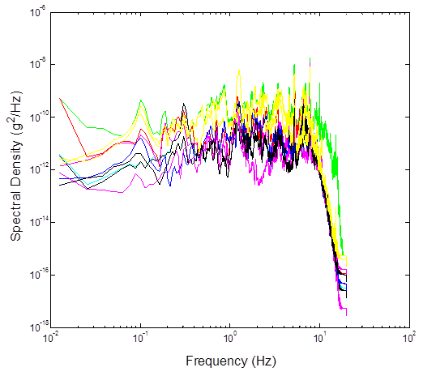
Expected Disturbance Environment
Pre-launch data are from a three axis accelerometer (S3B1N) located on the nadir side of the ISS S3 truss segment, which is where ELC-4 attaches to ISS
Predicted Acceleration Spectral Density (ASD) comes from SER SAGE III-STR-001 V2 (shown right)

Slide 6
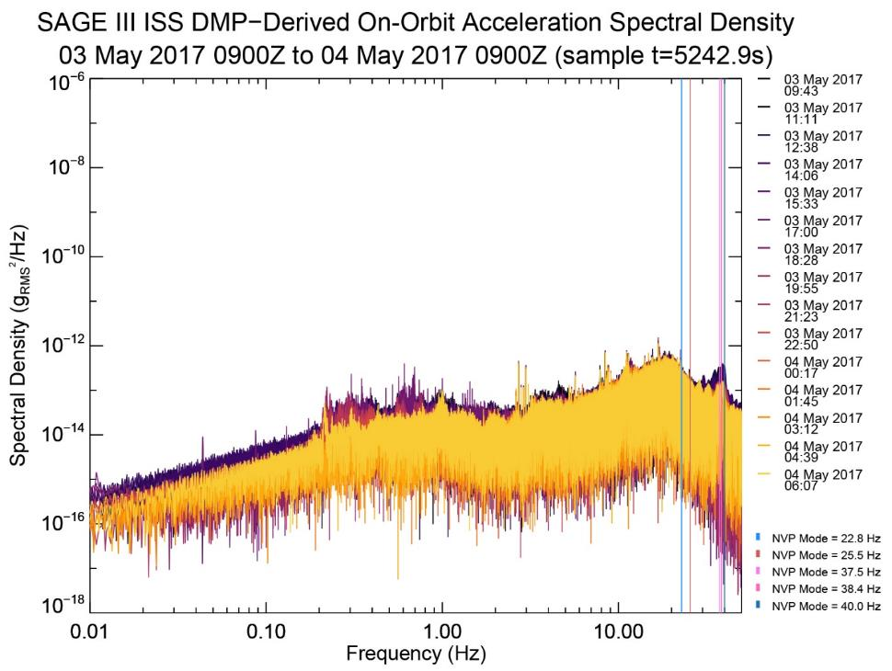
Observed Disturbance Environment
Similar to what was expected, and NVP mode resonances are observed
DMP can successfully measure the ASD environment
NVP modes come from SER SAGE III STR-057

Slide 7
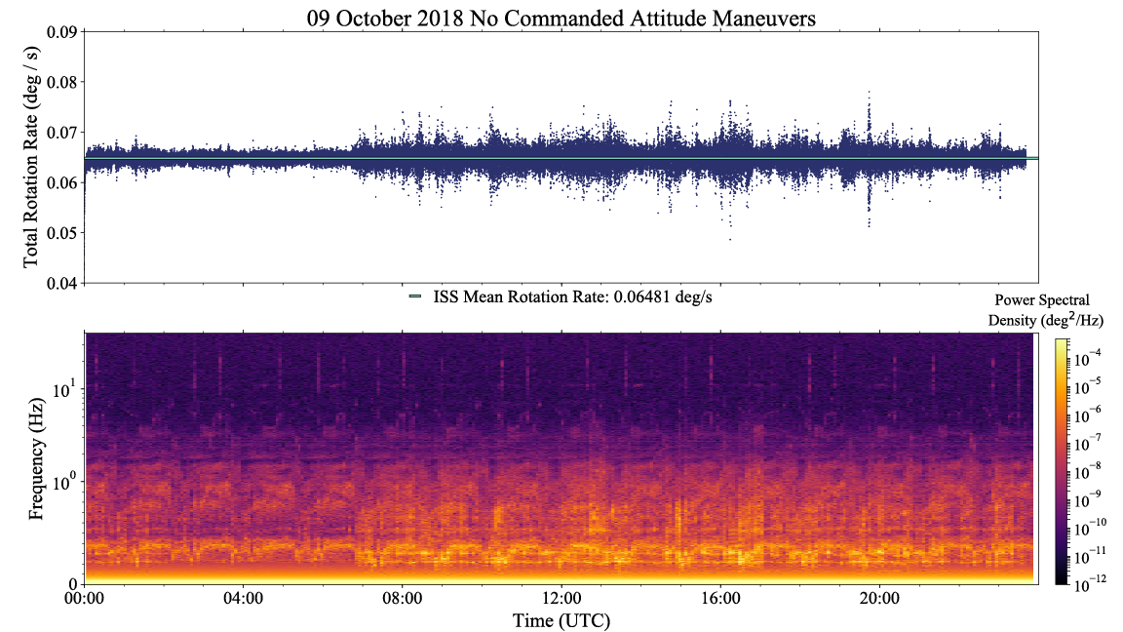
Quiescent Day as Observed from ELC-4

Slide 8
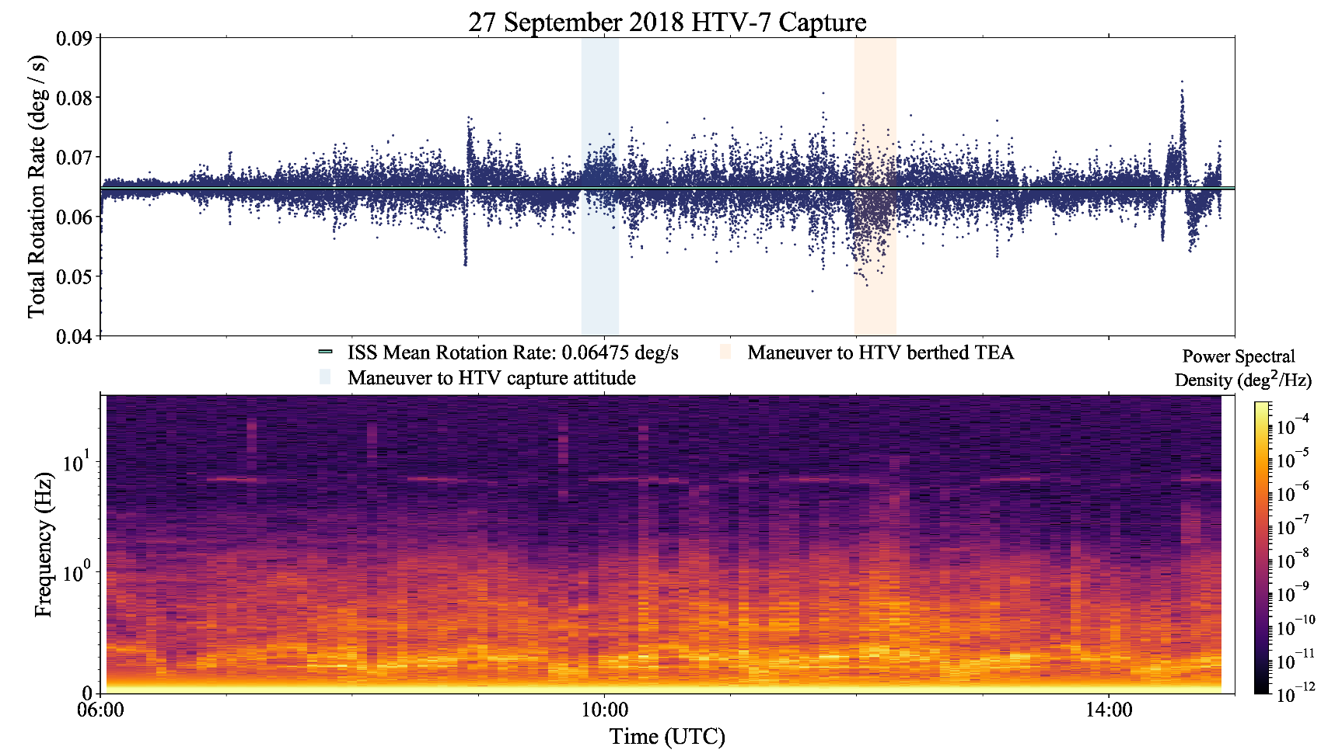
Small Shock from Vehicle Capture from ELC-4

Slide 9
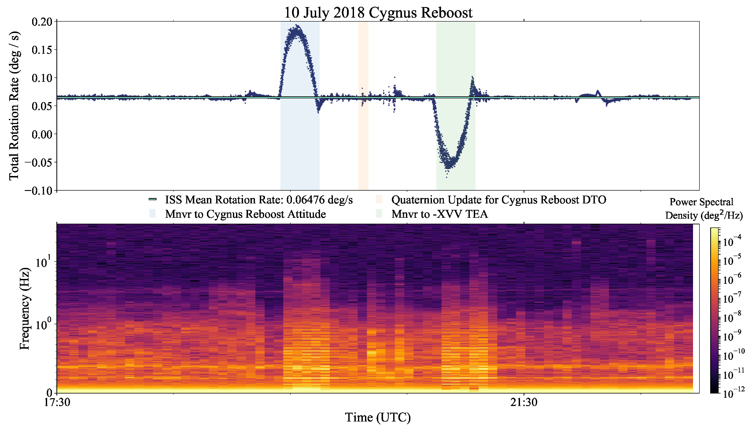
Large Shock from Reboost Observed from ELC-4

