Slide 1
Contamination Monitoring Package
Michael Thompson
Michael.Thompson@nasa.gov
Dr. Charles Hill¹, Amy Rowell¹, Tyler Dawson², Dr. Kevin Leavor²
¹ NASA Langley Research Center
² Science Systems and Applications, Inc.
1 Enterprise Parkway, Suite 200 Hampton, Virginia 23666

Slide 2
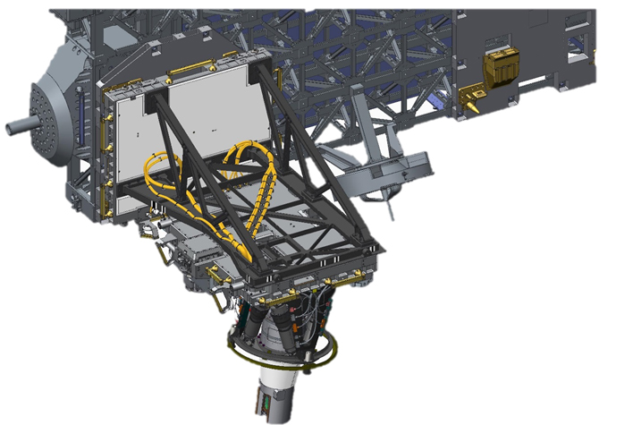
Payload
The Stratospheric Aerosol and Gas Experiment (SAGE) III is an external payload on the International Space Station (ISS) launched on SpaceX CRS-10 on 19 February 2017 and robotically installed on ExPRESS Logistics Carrier-4 (ELC-4). First light was acquired on 17 March 2017.

Slide 3
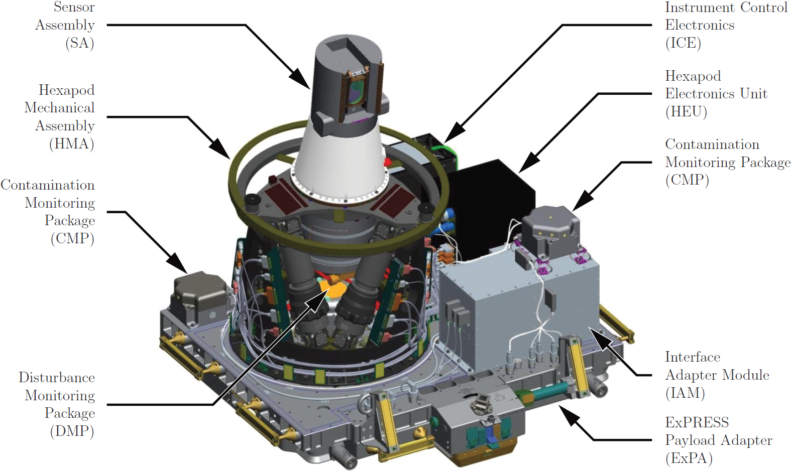
SAGE III ISS

Slide 4
SAGE III Contamination Monitoring
Why does SAGE III monitor contamination?
  The instrument optics are susceptible and sensitive to contamination.
  The goal of the Contamination Monitoring Packages (CMPs) is to aid in efforts to minimize contamination impacts to the payload and by extension the science data product.
The instrument contamination window can be closed to protect the telescope.
  The flight computer Fault Detection Isolation and Recovery (FDIR) system monitors CMP telemetry and has the ability to automatically close the contamination window if necessary.
  The window can be manually commanded to close.
CMP measurements aid the SAGE III team in determining where to stow the contamination window for minimal exposure to contamination sources.

Slide 5
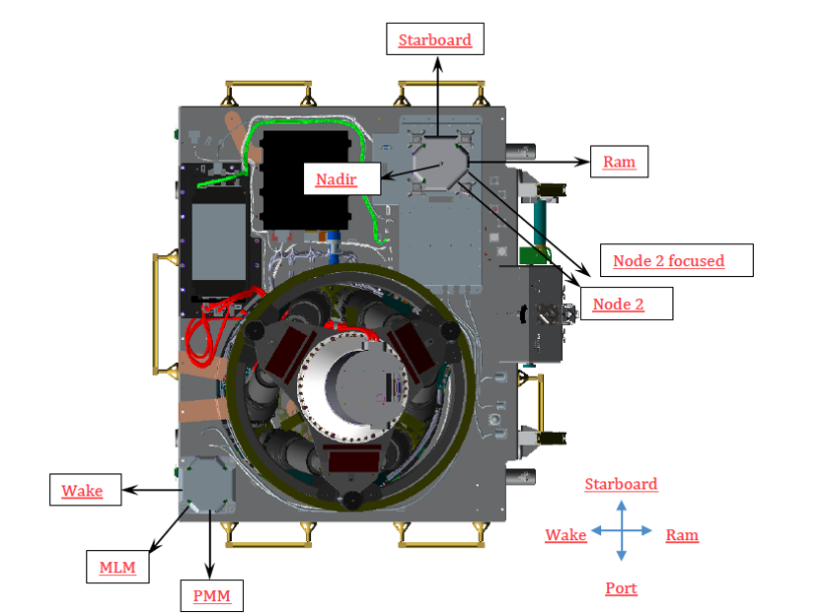
Contamination Monitoring Package (CMP)s
Two CMPs monitor particulate contaminant flux in the 2π steradian solid angle on the payload side of the ExPRESS Payload Adapter.
The packages are comprised of eight Quartz Crystal Microbalance (QCM) sensors.

Slide 6
SAGE III Contamination Environment Coverage
CMP, Sensor | Half Angle | Direction of View | Field of View
CMP1, Sensor0 | 70.3 | Starboard | ELC-4
CMP1, Sensor1 | 70.3 | Ram | N2 Zenith and Nadir, partially N2 Fwd
CMP1, Sensor2 | 50.0 | Node 2 Focused | N2 Zenith and Nadir, possibly N2 Fwd
CMP1, Sensor3 | 70.3 | Node 2 Broad | N2 Zenith and Nadir, N1 Nadir, possibly N2 Fwd
CMP1, Sensor4 | 70.3 | Nadir | N2 and N1 Nadir depending on vehicle, MRM1
CMP2, Sensor0 | 70.3 | Wake | MRM1, MRM2, DC1, SM Aft
CMP2, Sensor1 | 70.3 | PMM | N2 Zenith and Nadir, N1 Nadir, MRM1, MRM2, DC1, SM Aft, possibly N2 Fwd
CMP2, Sensor2 | 70.3 | MLM | MRM1, MRM2, DC1, SM Aft, slightly N2 Nadir

Slide 7
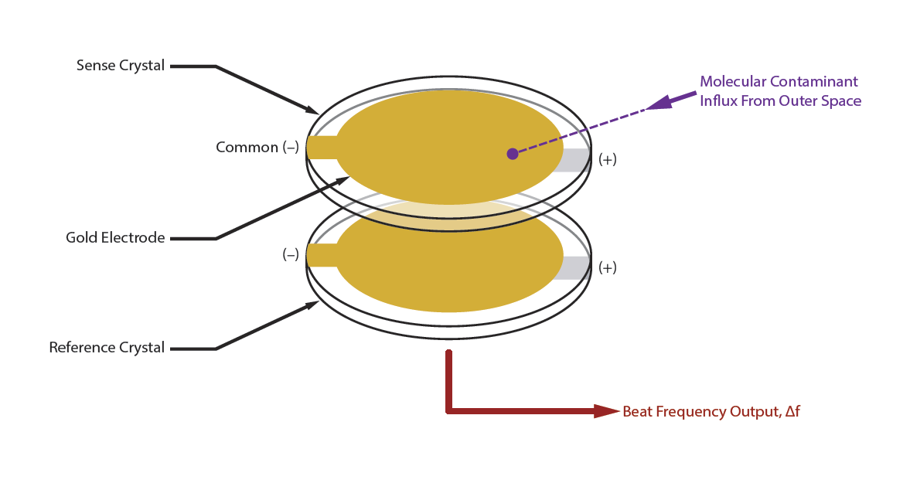
How Quartz Crystal Microbalances Work

Slide 8
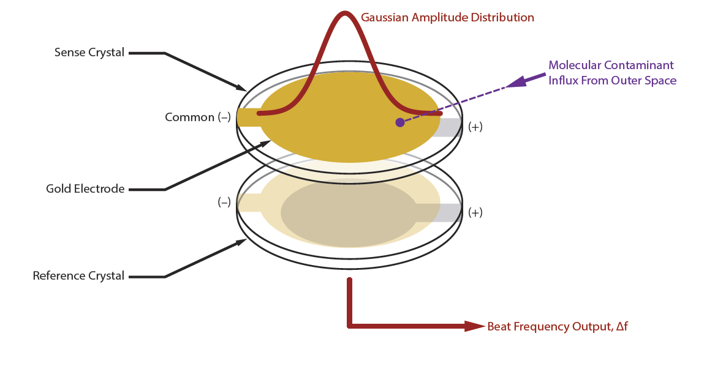
How Quartz Crystal Microbalances Work

Slide 9
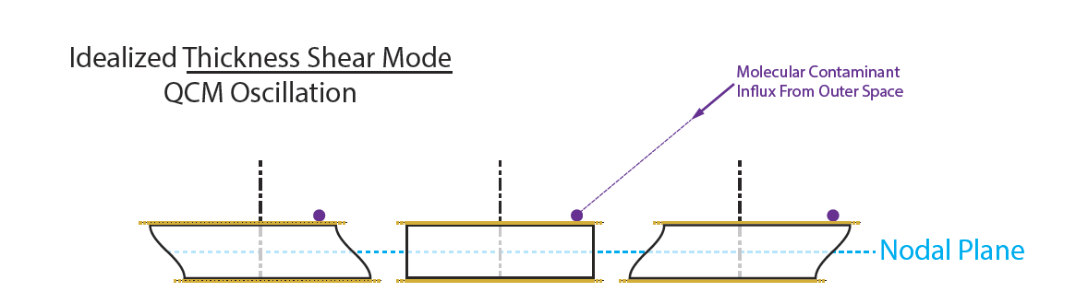
How Quartz Crystal Microbalances Work
Two Sunwise-cut quartz crystals vibrate in resonance and a resulting beat frequency is telemetered at 1 Hz.
The SENSE crystal is exposed to the environment and the REFERENCE crystal is shielded below.
The electrode configuration is designed to apply acoustical “energy trapping" which enforces a Gaussian amplitude distribution.
The piezoelectric effect of quartz allows it to govern the frequency of an oscillator circuit while vibrating in a thickness shear mode.

Slide 10
Thermoelectric Quartz Crystal Microbalance (TQCM)
Mark 24 Thermoelectric Quartz Crystal Microbalances (TQCMs) purchased from QCM Research
  Maximum beat frequency in the linear range is conservatively about 150kHz.
  Crystal temperature controlled by an internal, single-stage Peltier heat pump
  Temperature control range on SAGE III : -25º C to +80º C
  Burnoffs raise the TQCM temperatures to +80º C
  Active surface area of the electrode is 0.1007 cm²
Contaminants adsorb on the gold electrode covering the SENSE crystal.
QCMs are sensitive to solar radiation. The resulting temperature gradient causes a stress-induced frequency change.
  The amplitude of the frequency change induced by thermal radiation is dependent on the angle of the Sun to each crystal.
  The Sunwise-cut crystal reduces internal stresses and drastically reduces solar-flux-induced frequency change.

Slide 11
Surface Chemistry
The exact nature of the bonding depends on the details of the species involved, but the adsorption process is generally classified as physisorption or chemisorption.
Physisorption
Characteristic of weak Van der Waals forces
Example: Water condensing on a window
Reversible process that is not highly surface-dependent
Adsorbed constituents spontaneously desorb, can be burned off, or scrubbed by atomic oxygen in Low Earth Orbit (as seen on our Ram-facing sensor)
Chemisorption
Characteristic of covalent bonding
Example: Rust on an iron nail
Irreversible surface chemistry reaction
UV photofixation can encourage chemisorption
Unable to burnoff our two Node 2-facing sensor, implying gold chemisorption

Slide 12
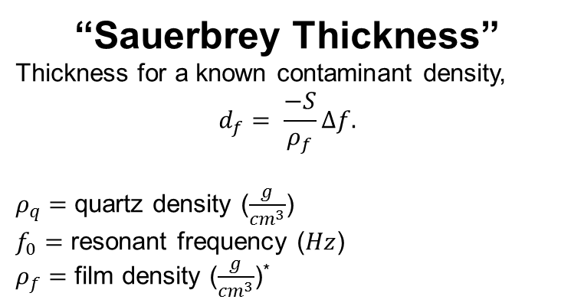
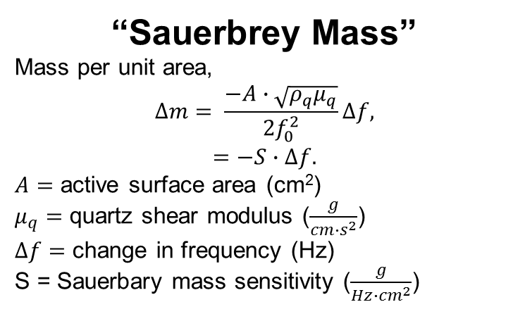
Mass and Thickness Calculations
TQCMs are highly precise and accurate for rigid, homogeneous thin films. However, when these assumptions are not met viscoelastic effects emerge, and Sauerbrey calculations are precise but not accurate.
“Sauerbrey Mass”
Mass per unit area,
$$∆m= \frac{−A∙\sqrt{ρ_{q}μ_{q}}}{2f_{0}^{2}}∆f,$$
$$=−S∙∆f.$$
$A=$ active surface area (cm²)
$μ_{q}=$ quartz shear modulus ($\frac{g}{cm∙s^{2}}$)
$∆f=$ change in frequency (Hz)
S = Sauerbary mass sensitivity ($\frac{g}{Hz∙{cm}^{2}}$)
“Sauerbrey Thickness”
Thickness for a known contaminant density,
$$d_{f}= \frac{−S}{ρ_{f}}∆f.$$
$ρ_{q}=$ quartz density ($\frac{g}{{cm}^{3}}$)
$f_{0}=$ resonant frequency ($Hz$)
$ρ_{f}=$ film density ($\frac{g}{{cm}^{3}}$)*
* Industry standard for $ρ_{f}$ assume 1 $\frac{g}{{cm}^{3}}$ at 4º C. The maximum density of water at any temperature

Slide 13
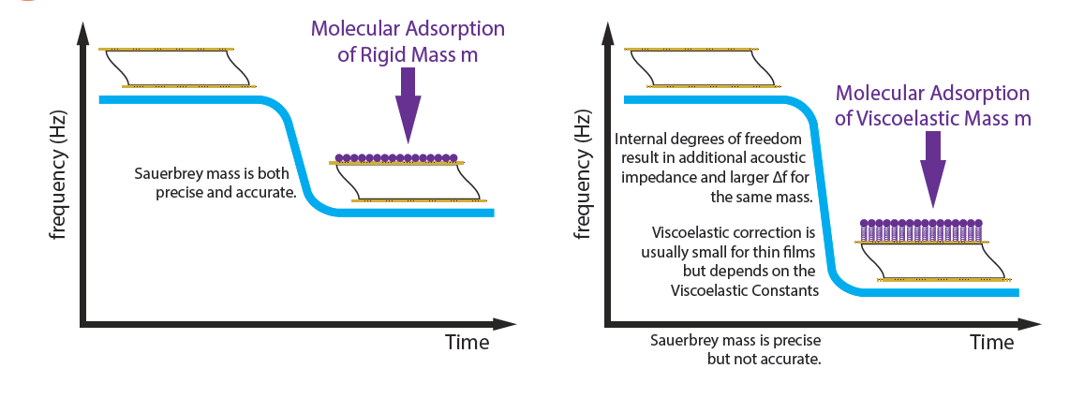
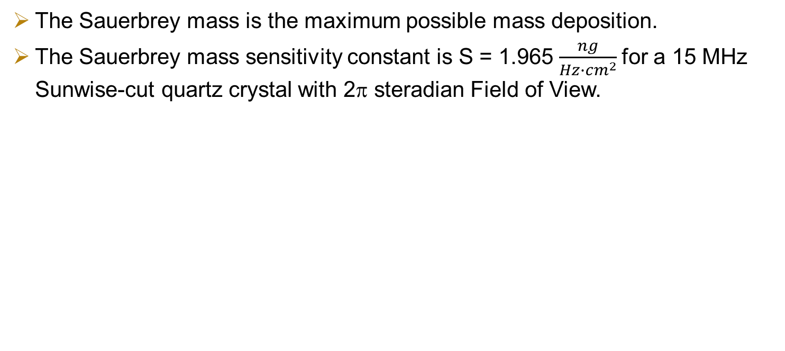
Mass and Thickness Calculations
The Sauerbrey mass is the maximum possible mass deposition.
The Sauerbrey mass sensitivity constant is S = 1.965 $\frac{ng}{Hz∙{cm}^{2}}$for a 15 MHz Sunwise-cut quartz crystal with 2π steradian Field of View.

Slide 14
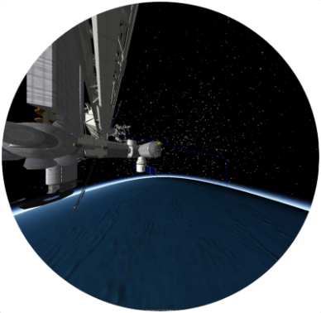
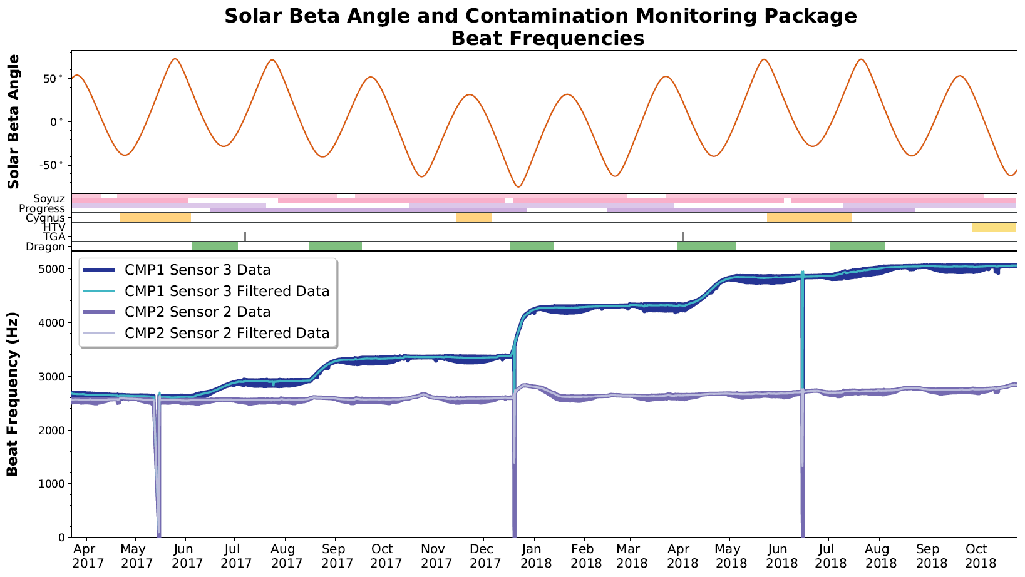
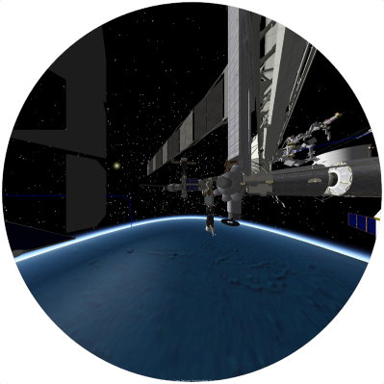
MLM and Node 2 Beat Frequencies
Node 2 Broad FOV
MLM FOV

Slide 15
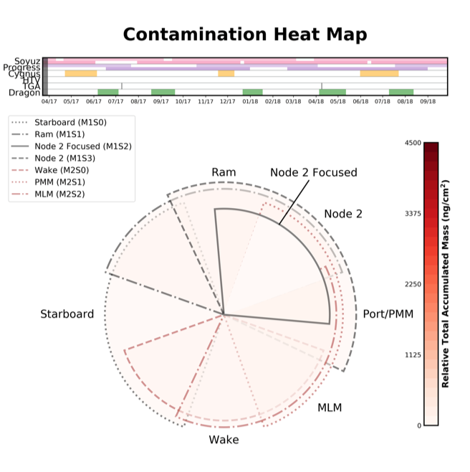
SAGE III ELC-4 Observed Contamination Deposition

Slide 16
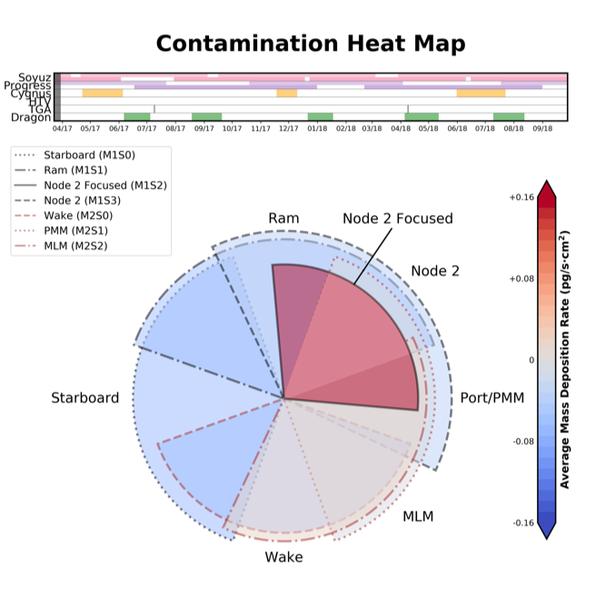
SAGE III ELC-4 Observed Contamination Rate

Slide 17
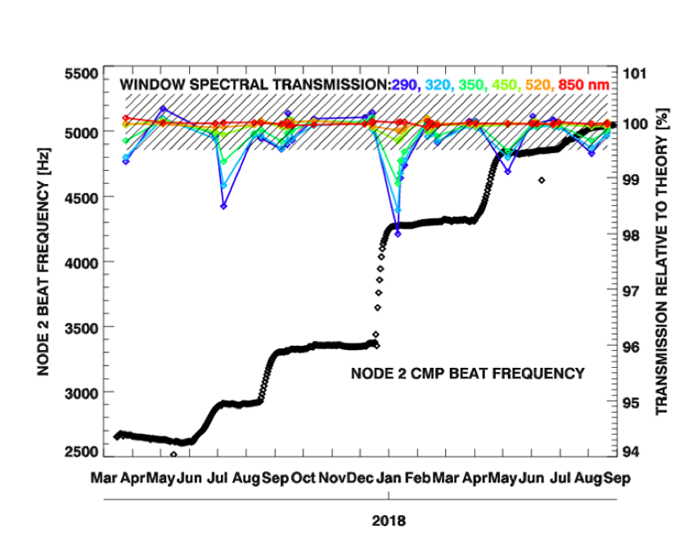
SAGE III Contamination Window Transmission

Slide 18
Conclusion
The CMPs allow for detailed monitoring of the contamination environment at the SAGE III ELC-4 location on ISS.
Since launch, contamination levels (either from nominal operations or ISS activities) have not triggered an auto safe or inhibited the contamination window.
The operations team has maintained the starboard stow direction because there is no direct line of site with docking nodes and the CMP measurements support the conclusion that it is one of the cleanest possible directions to stow
There has been no long-term change in transmission through the contamination window from adsorbed material.

Slide 19
Backup

Slide 20
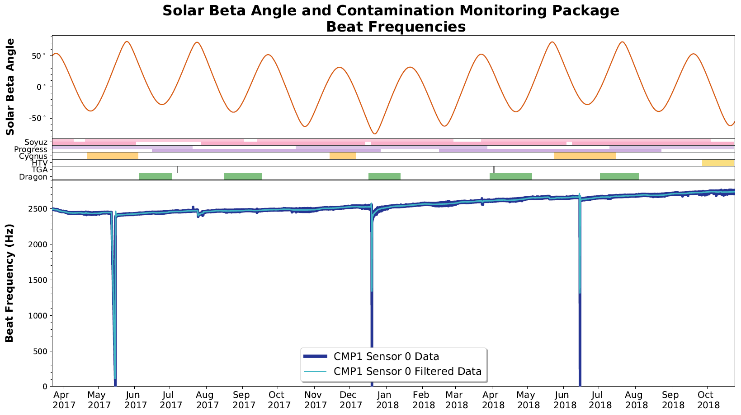
Starboard Beat Frequency

Slide 21
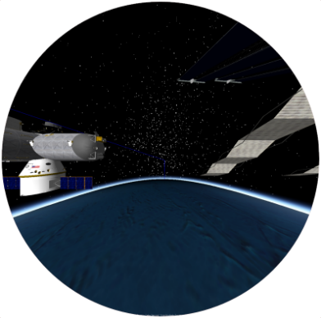
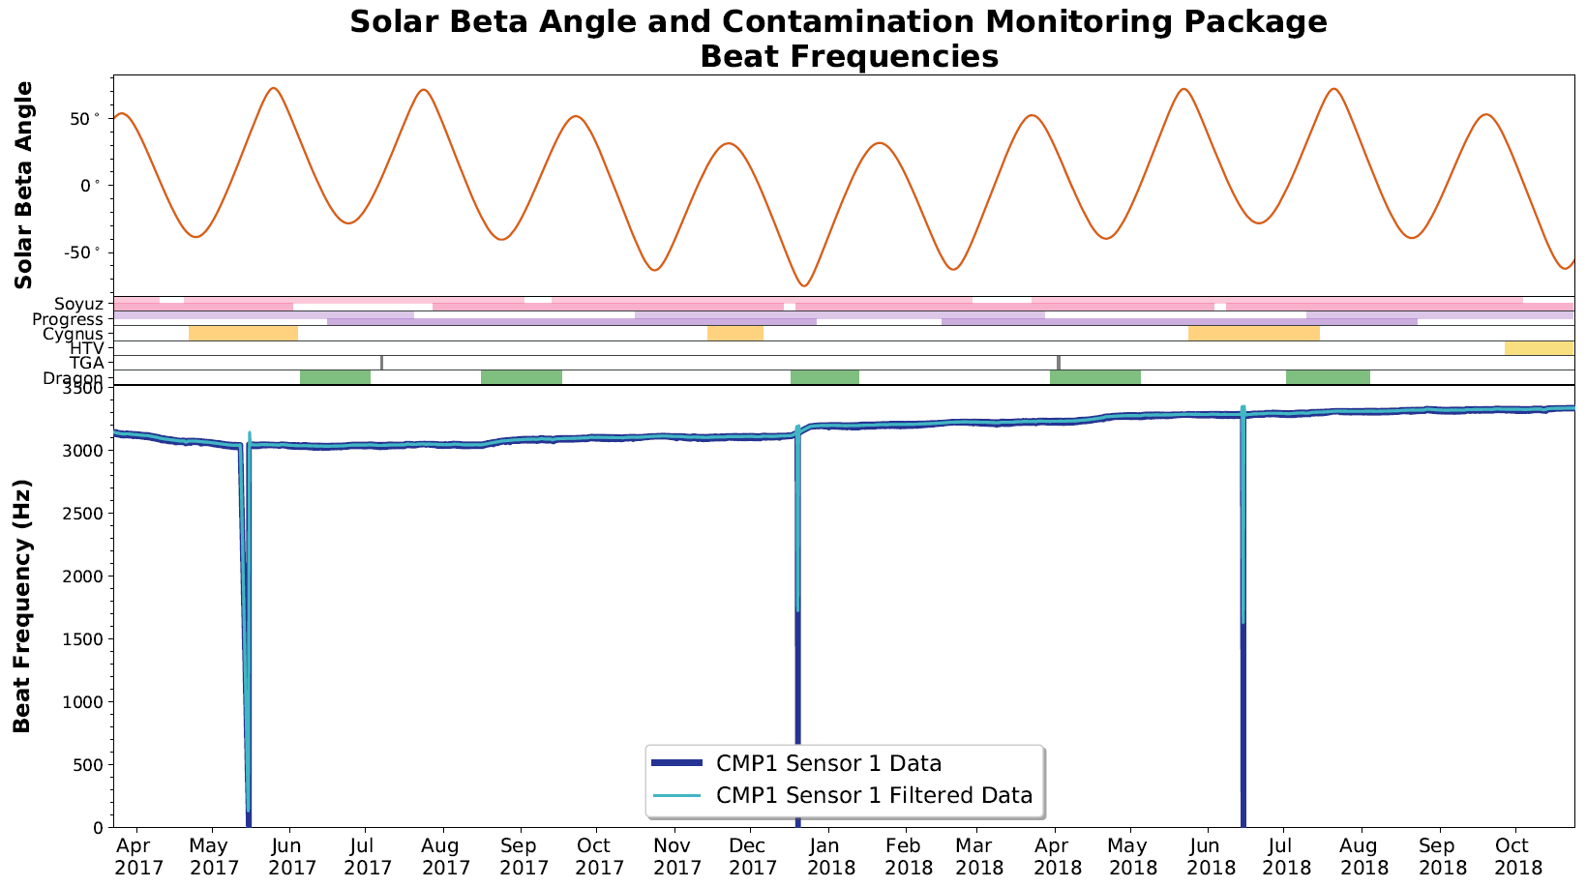
Ram Beat Frequency
Ram FOV

Slide 22
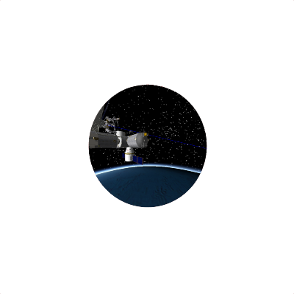
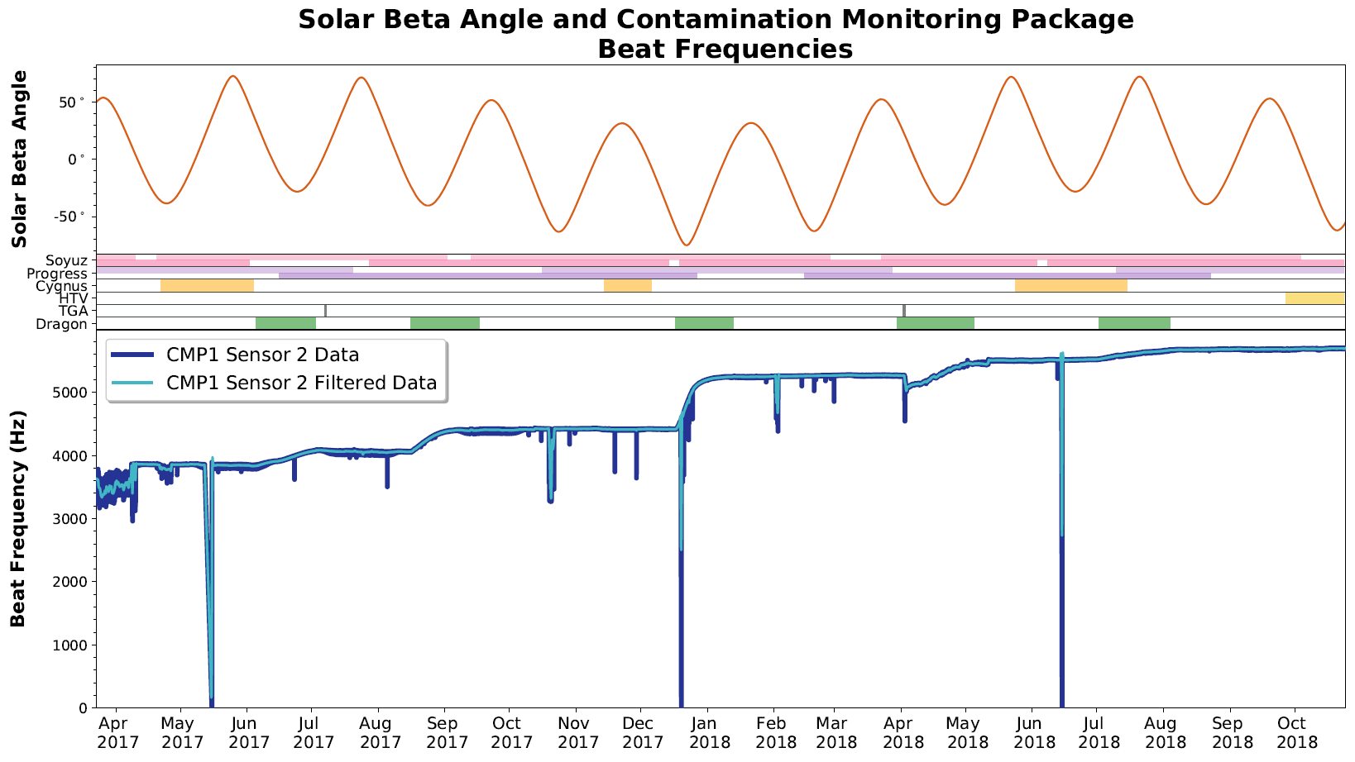
Node 2 Focused Beat Frequency
Node 2 Focused FOV

Slide 23
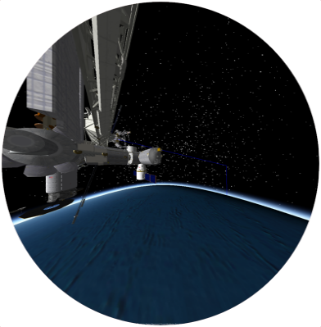
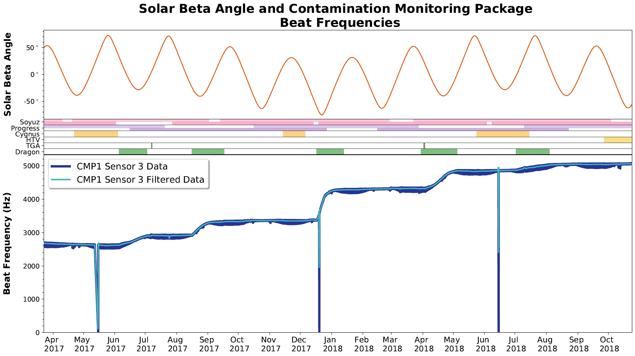
Node 2 Beat Frequency
Node 2 Broad FOV

Slide 24
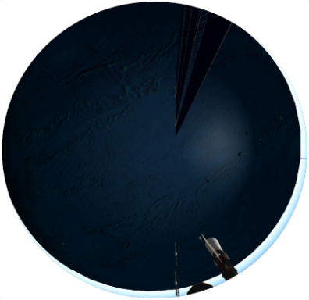
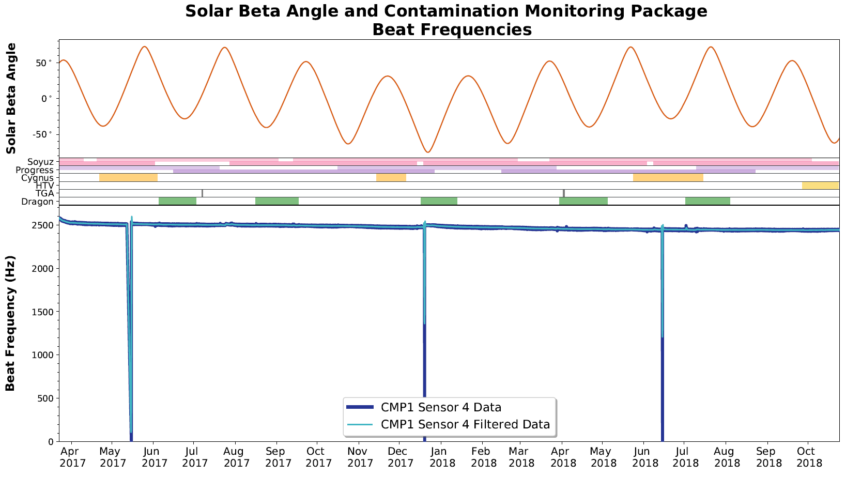
Nadir Beat Frequency
Nadir FOV

Slide 25
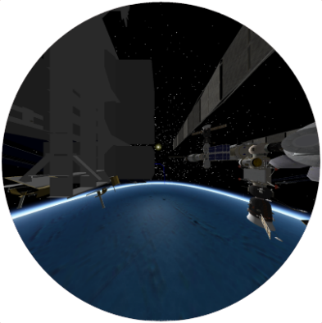
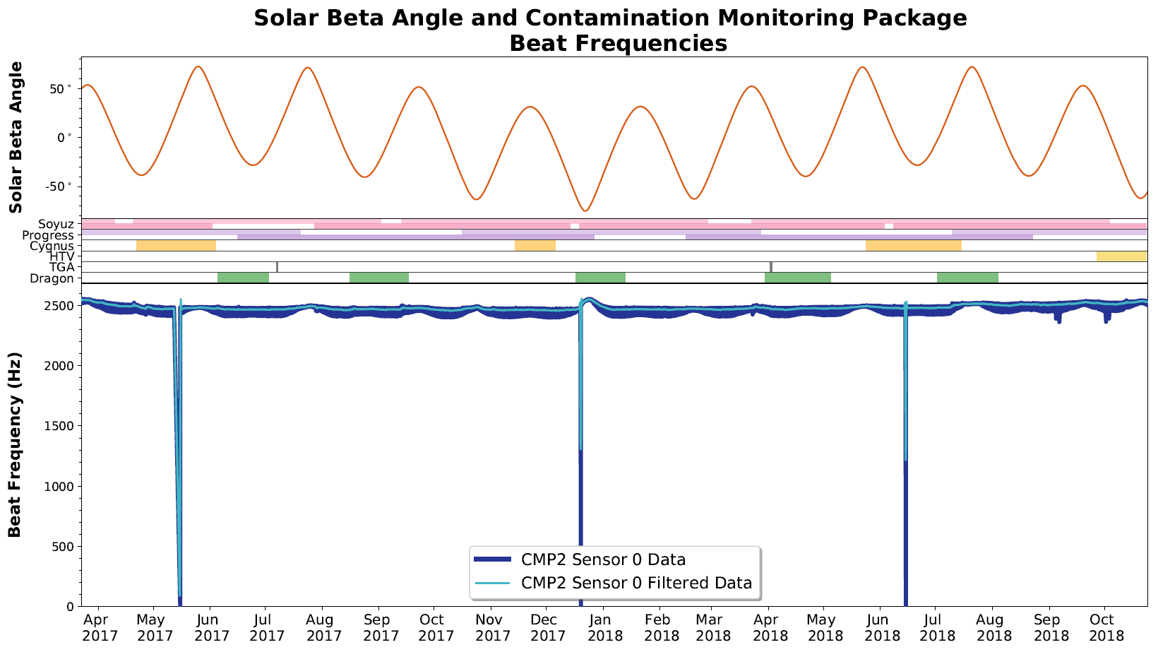
Wake Beat Frequency
Wake FOV

Slide 26
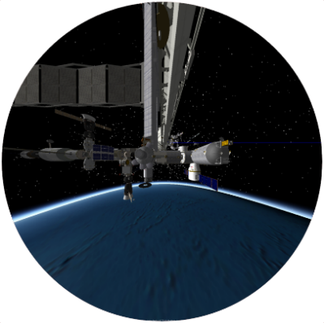
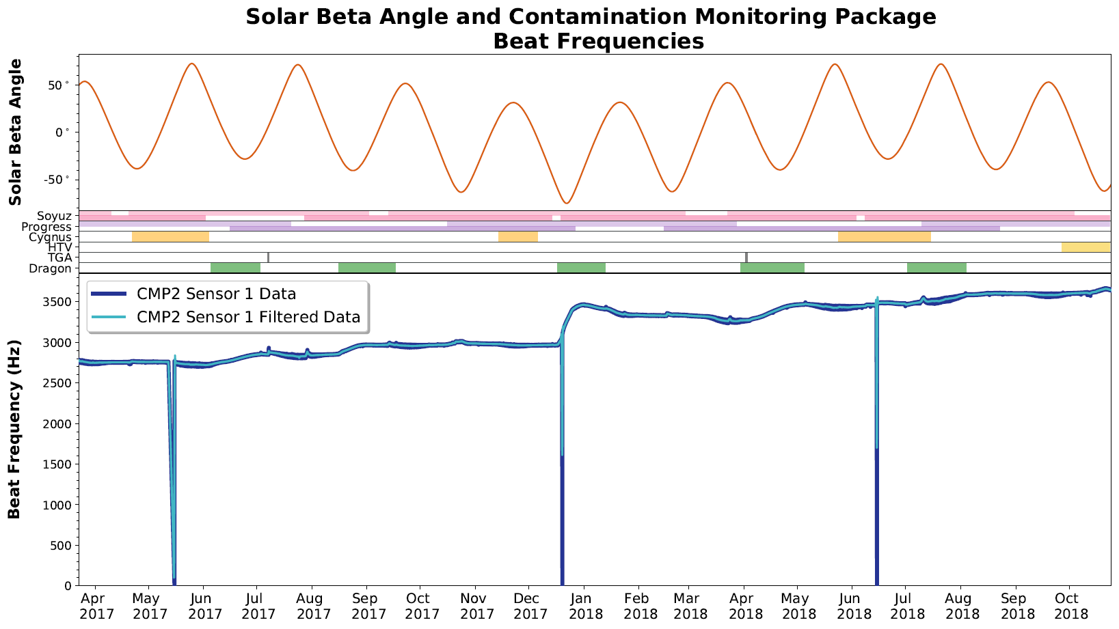
PMM Beat Frequency
PMM FOV

Slide 27
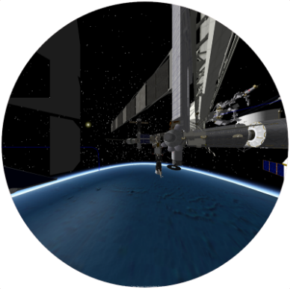
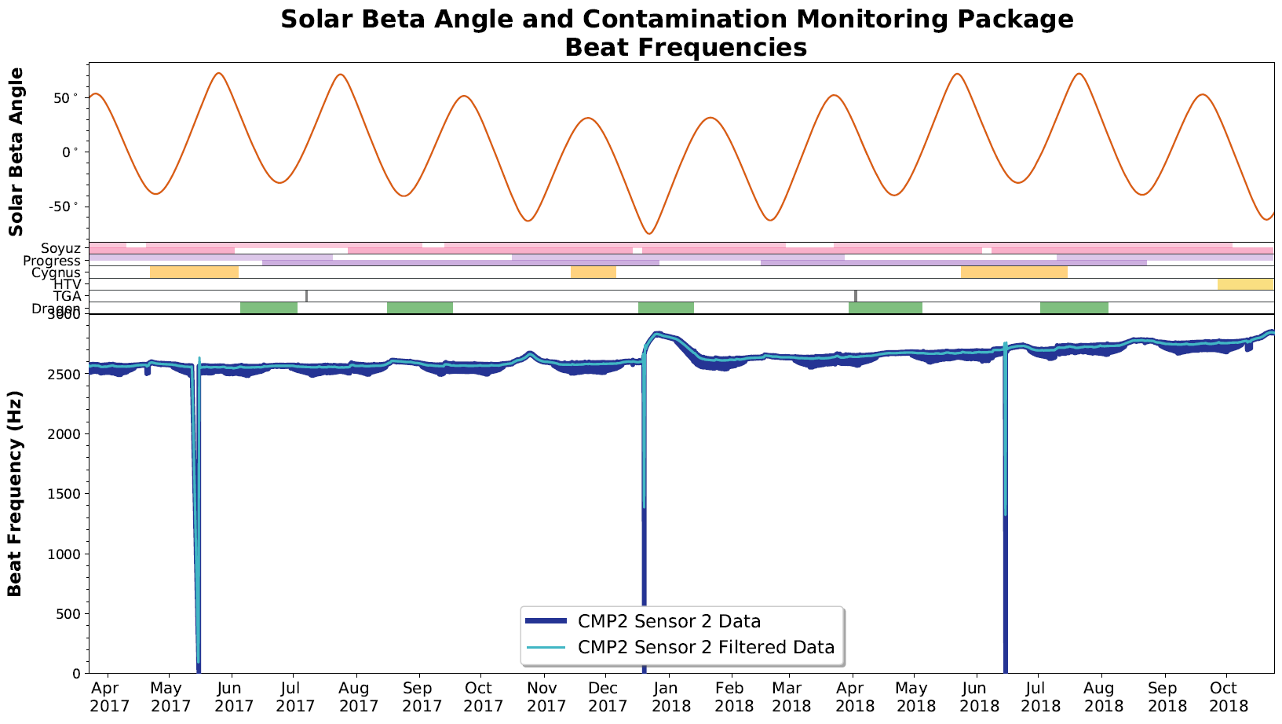
MLM Beat Frequency
MLM FOV

