Slide 1
Communications and Public Engagement
Allison Leybold
SAGE III/ISS Communications Lead

Slide 2

SAGE Website
sage.nasa.gov

Slide 3
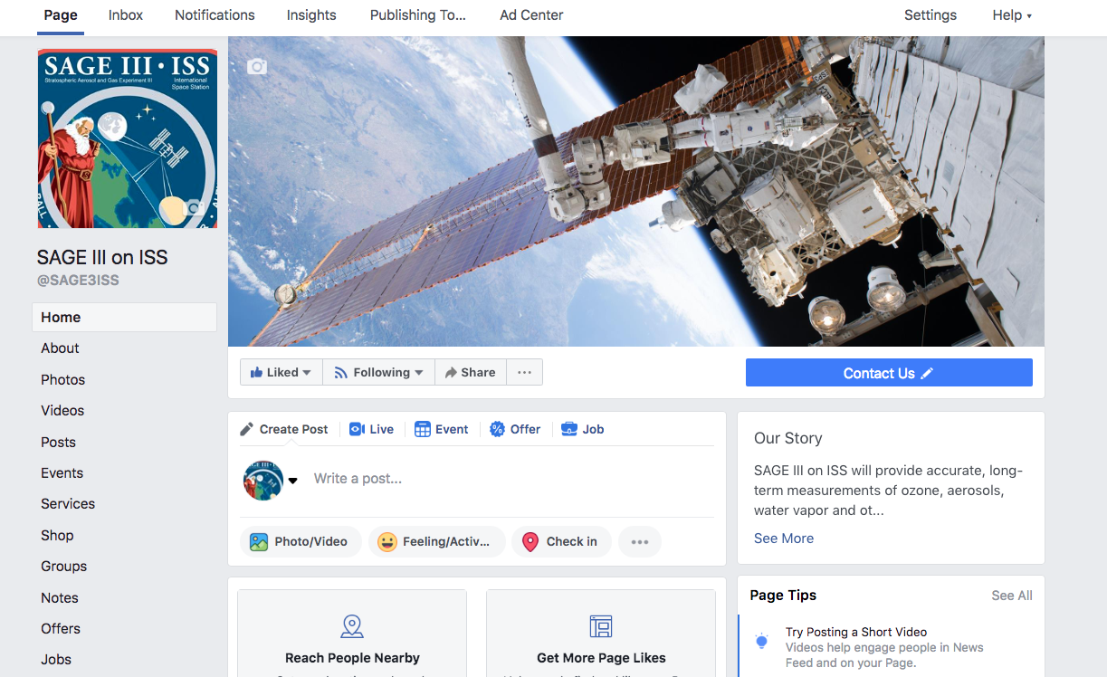
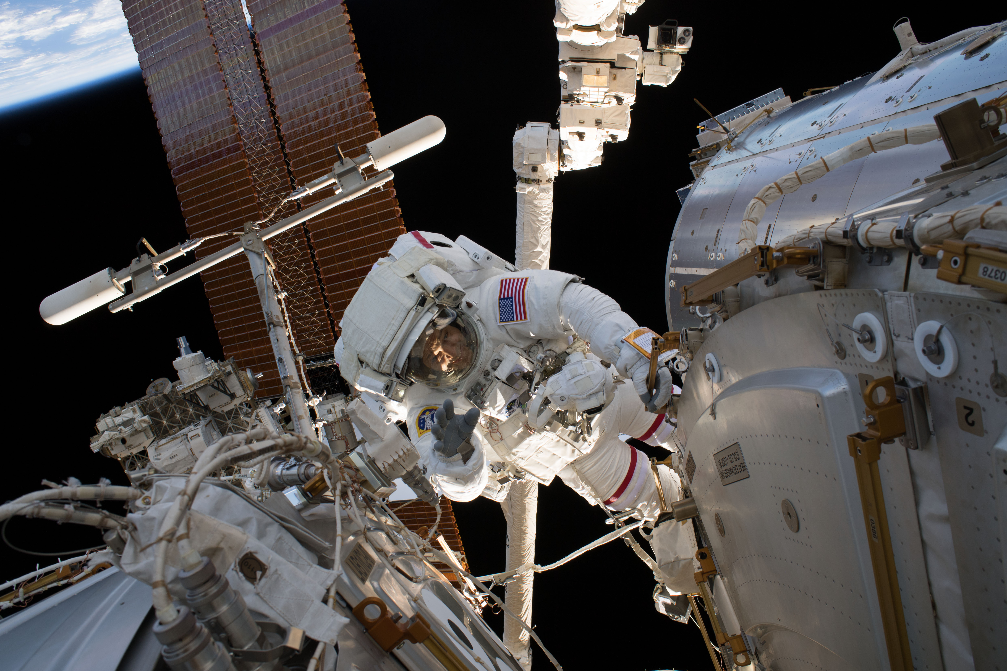
SAGE III/ISS Social Media

Slide 4

Life at the Lab
Life at the Lab: Observing Ozone

Slide 5
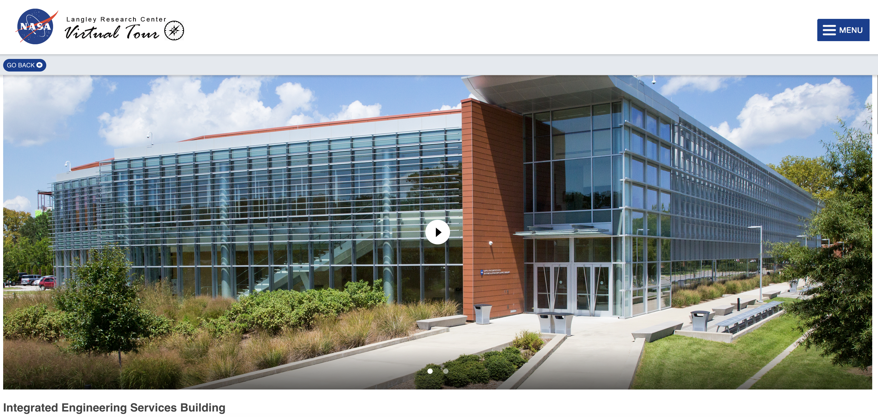
Flight Mission Support Center
Hosted tours for:
Senator Tim Kaine
Congressman Rob Wittman
South African Ambassador
ONERA French Aerospace Lab
Executive Director of SpaceCom
NASA LaRC Youth Day
LaRC Virtual Tour

Slide 6
Contact Information
Please contact me if you are interested in featuring your work on our website or Facebook page, or if you are in need of SAGE III/ISS outreach materials for your organization.
Allison Leybold
SAGE III/ISS Communications Lead
757.864.4563
allison.b.leybold@nasa.gov

Slide 7
Questions?

