Slide 1
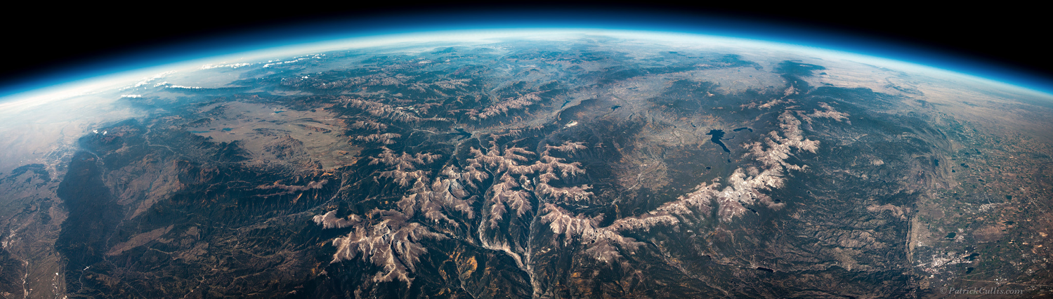


Assessment of SAGE III/ISS water vapor and ozone
Sean Davis^{1,2}, Karen Rosenlof¹, Craig Long³, Irina Petropavlovskikh^{1,2}, Jeannette Wild^{3,4}
Contributors: Dale Hurst^{1,2}, Rennie Selkirk⁵, Holger Voemel⁶, Koji Miyagawa^{1,2}, Allen Jordan^{1,2}
¹NOAA Earth System Research Laboratory Chemical Sciences Division, Boulder, CO
²Cooperative Institute for Research in Environmental Sciences (CIRES), University of Colorado
³ NOAA NCEP/CPC, College Park, MD
⁴ ESSIC/UMD
⁵

Slide 2
Overview of our project
Comparison to ground- and balloon-based measurements
  Dobson/Umkehr measurements (O₃)
  Balloon-borne frostpoint hygrometers (WV)
Comparison to satellites
  SBUV/2
  Aura MLS
Using SAGE III/ISS in merged data records
  Incorporating SAGE III/ISS into SWOOSH
  Using SAGE III/ISS for assessing homogeneity in SBUV-Cohesive

Slide 3
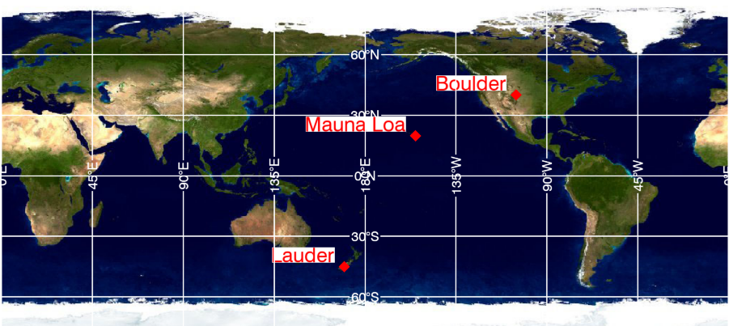
Satellite-Umkehr matched data
Matching criteria
  Time +/- 24 hrs
  Latitude +/- 2 degree ~200 km
  Longitude +/- 20 degree ~2000 km
Data processing
  Satellite profile is smoothed using Umkehr averaging kernel
  Interpolate to Umkehr 61 layer pressure grid (~1 km)
SAGE data
  SAGE II v7 (1985-2005)
  SAGE III/ISS v5.0 (2017.06-2018.07)
Umkehr data
  Special processed data (stray light-corrected) from 3 stations currently
  Boulder (43), Mauna Loa (9), and Lauder (22)

Slide 4
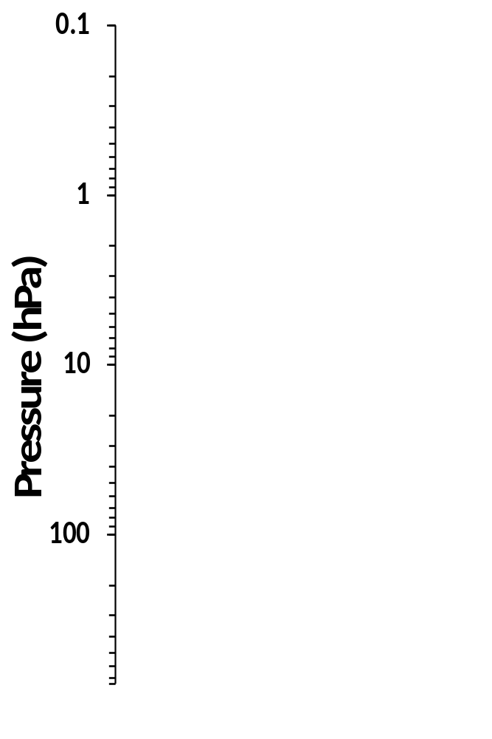
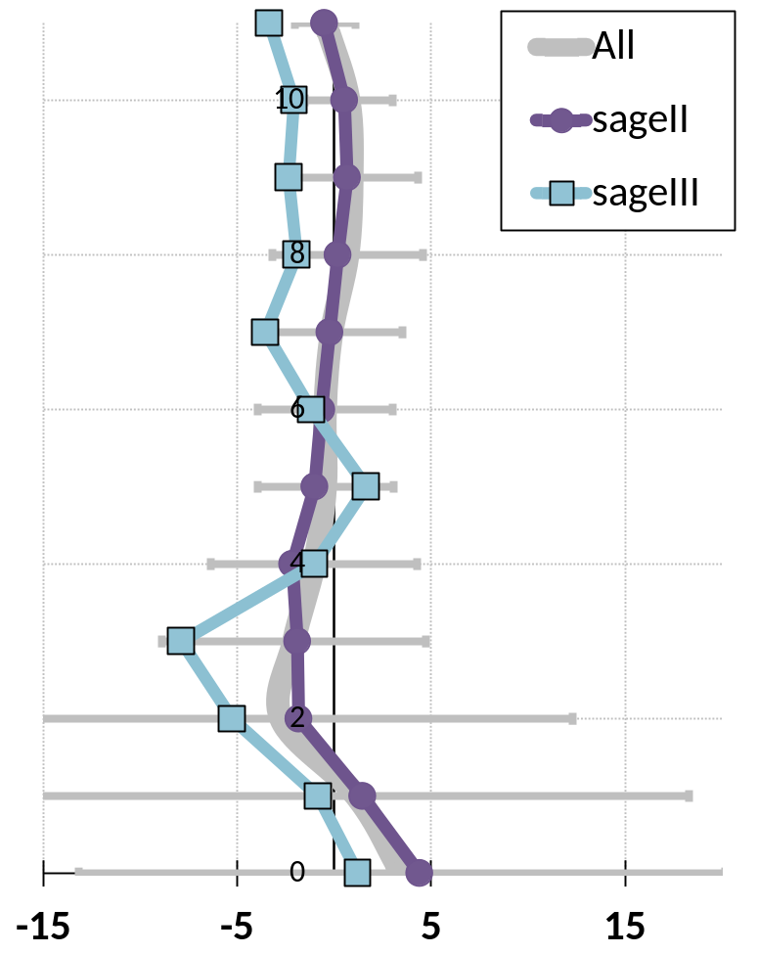
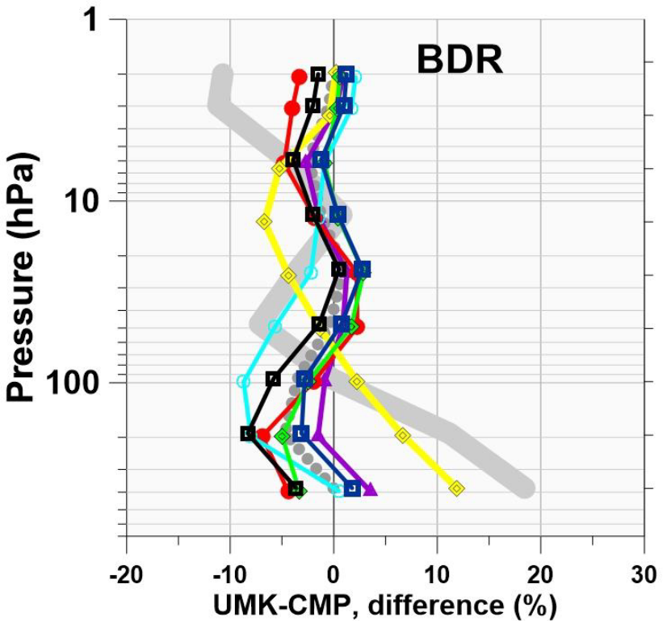
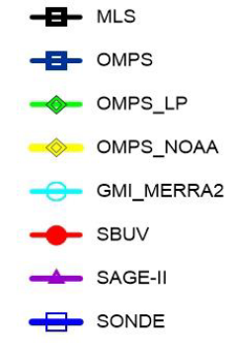
Satellite – Umkehr comparisons
Umkehr stray light correction greatly improves agreement
SAGE III/ISS a few to ~10% greater than Umkehr
Boulder
Grey line: operational Umkehr
Grey dots: with stray light correction
UMPF-SAGE, % difference

Slide 5
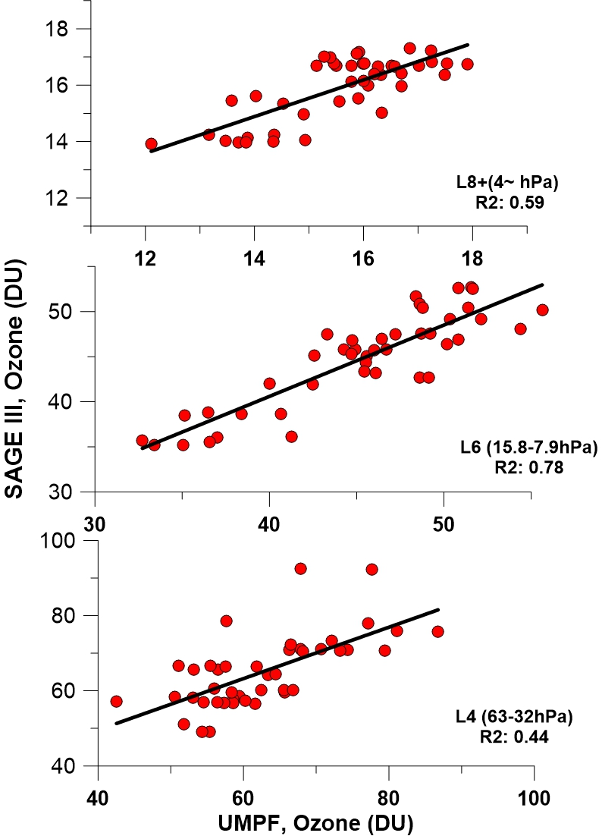
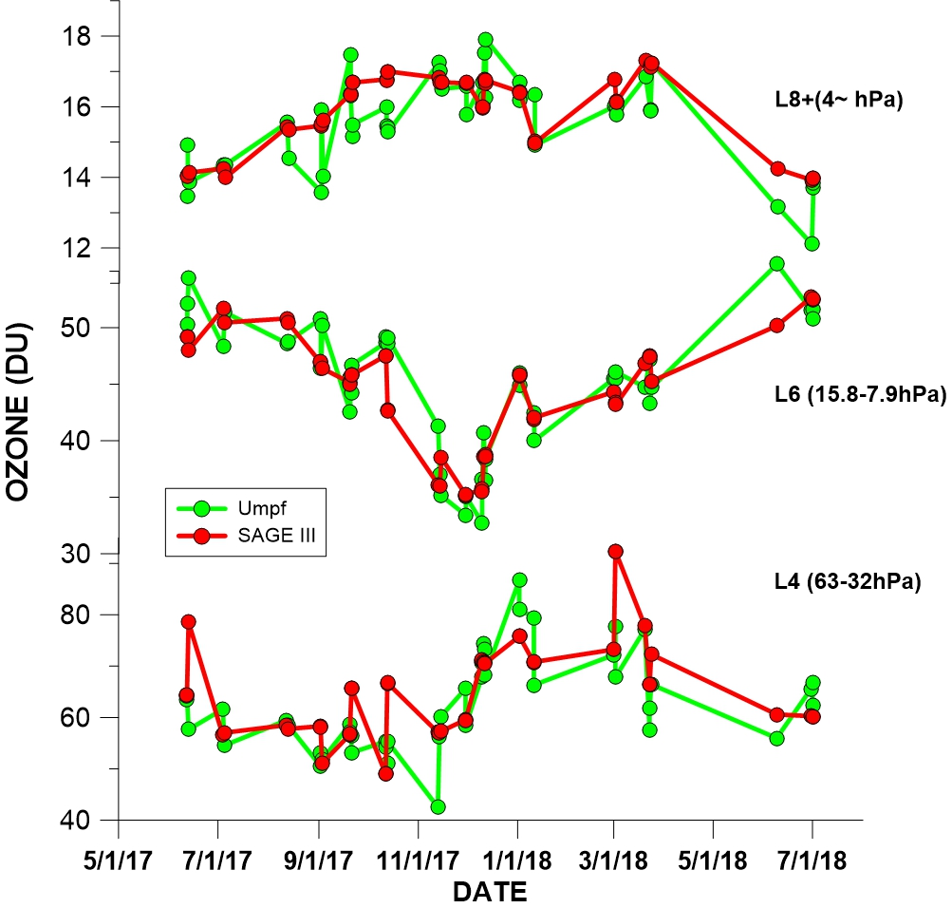
SAGE III/ISS – Umkehr comparisons (Boulder)
Good agreement, but more scatter in lower stratosphere
Outliers –different airmass

Slide 6
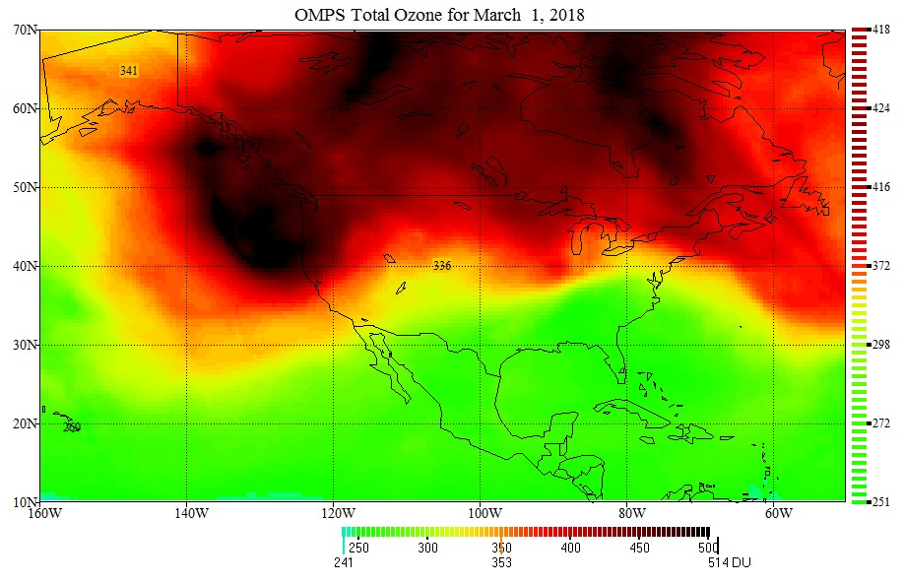
SAGE III/ISS – Umkehr comparisons (Boulder)
SAGE III
SAGE III
Dobson
Dobson

Slide 7
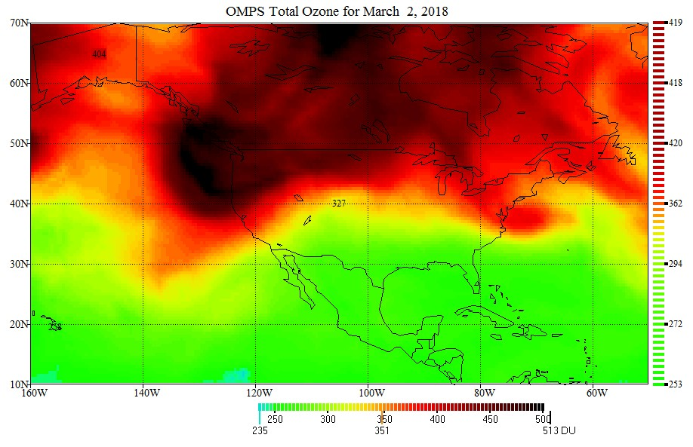
SAGE III/ISS – Umkehr comparisons (Boulder)
SAGE III
Dobson

Slide 8
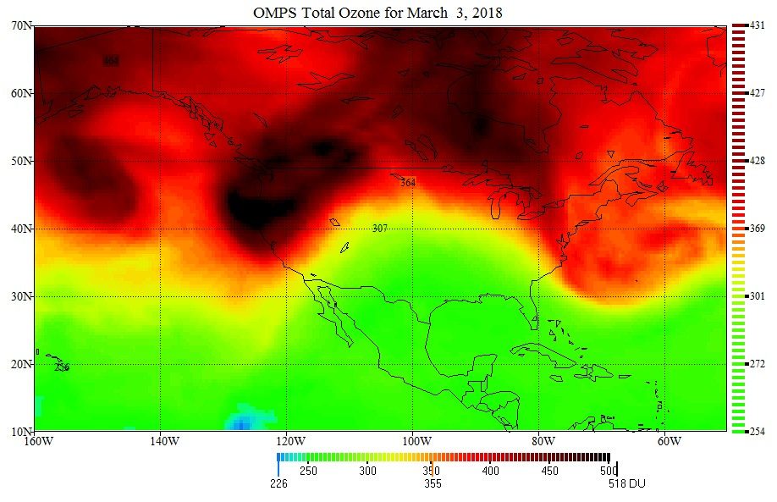
SAGE III/ISS – Umkehr comparisons (Boulder)
SAGE III
Dobson
Need improved matching in lower layers. We will address this using output from a Chemistry-Climate model

Slide 9
SAGE III/ISS – MLS coincident profile comparison
For each SAGE III profile, look for MLS within
|Δt| ≤ 18 h
|Δx| ≤ 10° at equator ( 1100 km)
|Δy| ≤ 5°
|Δ eq. lat [100 – 10 hPa]| ≤ 5°
→ Take closest eq. lat if > 1 profile match
Data
  SAGE III/ISS v5.10 (6/2017 – 8/2018)
  Aura MLS v4.2

Slide 10
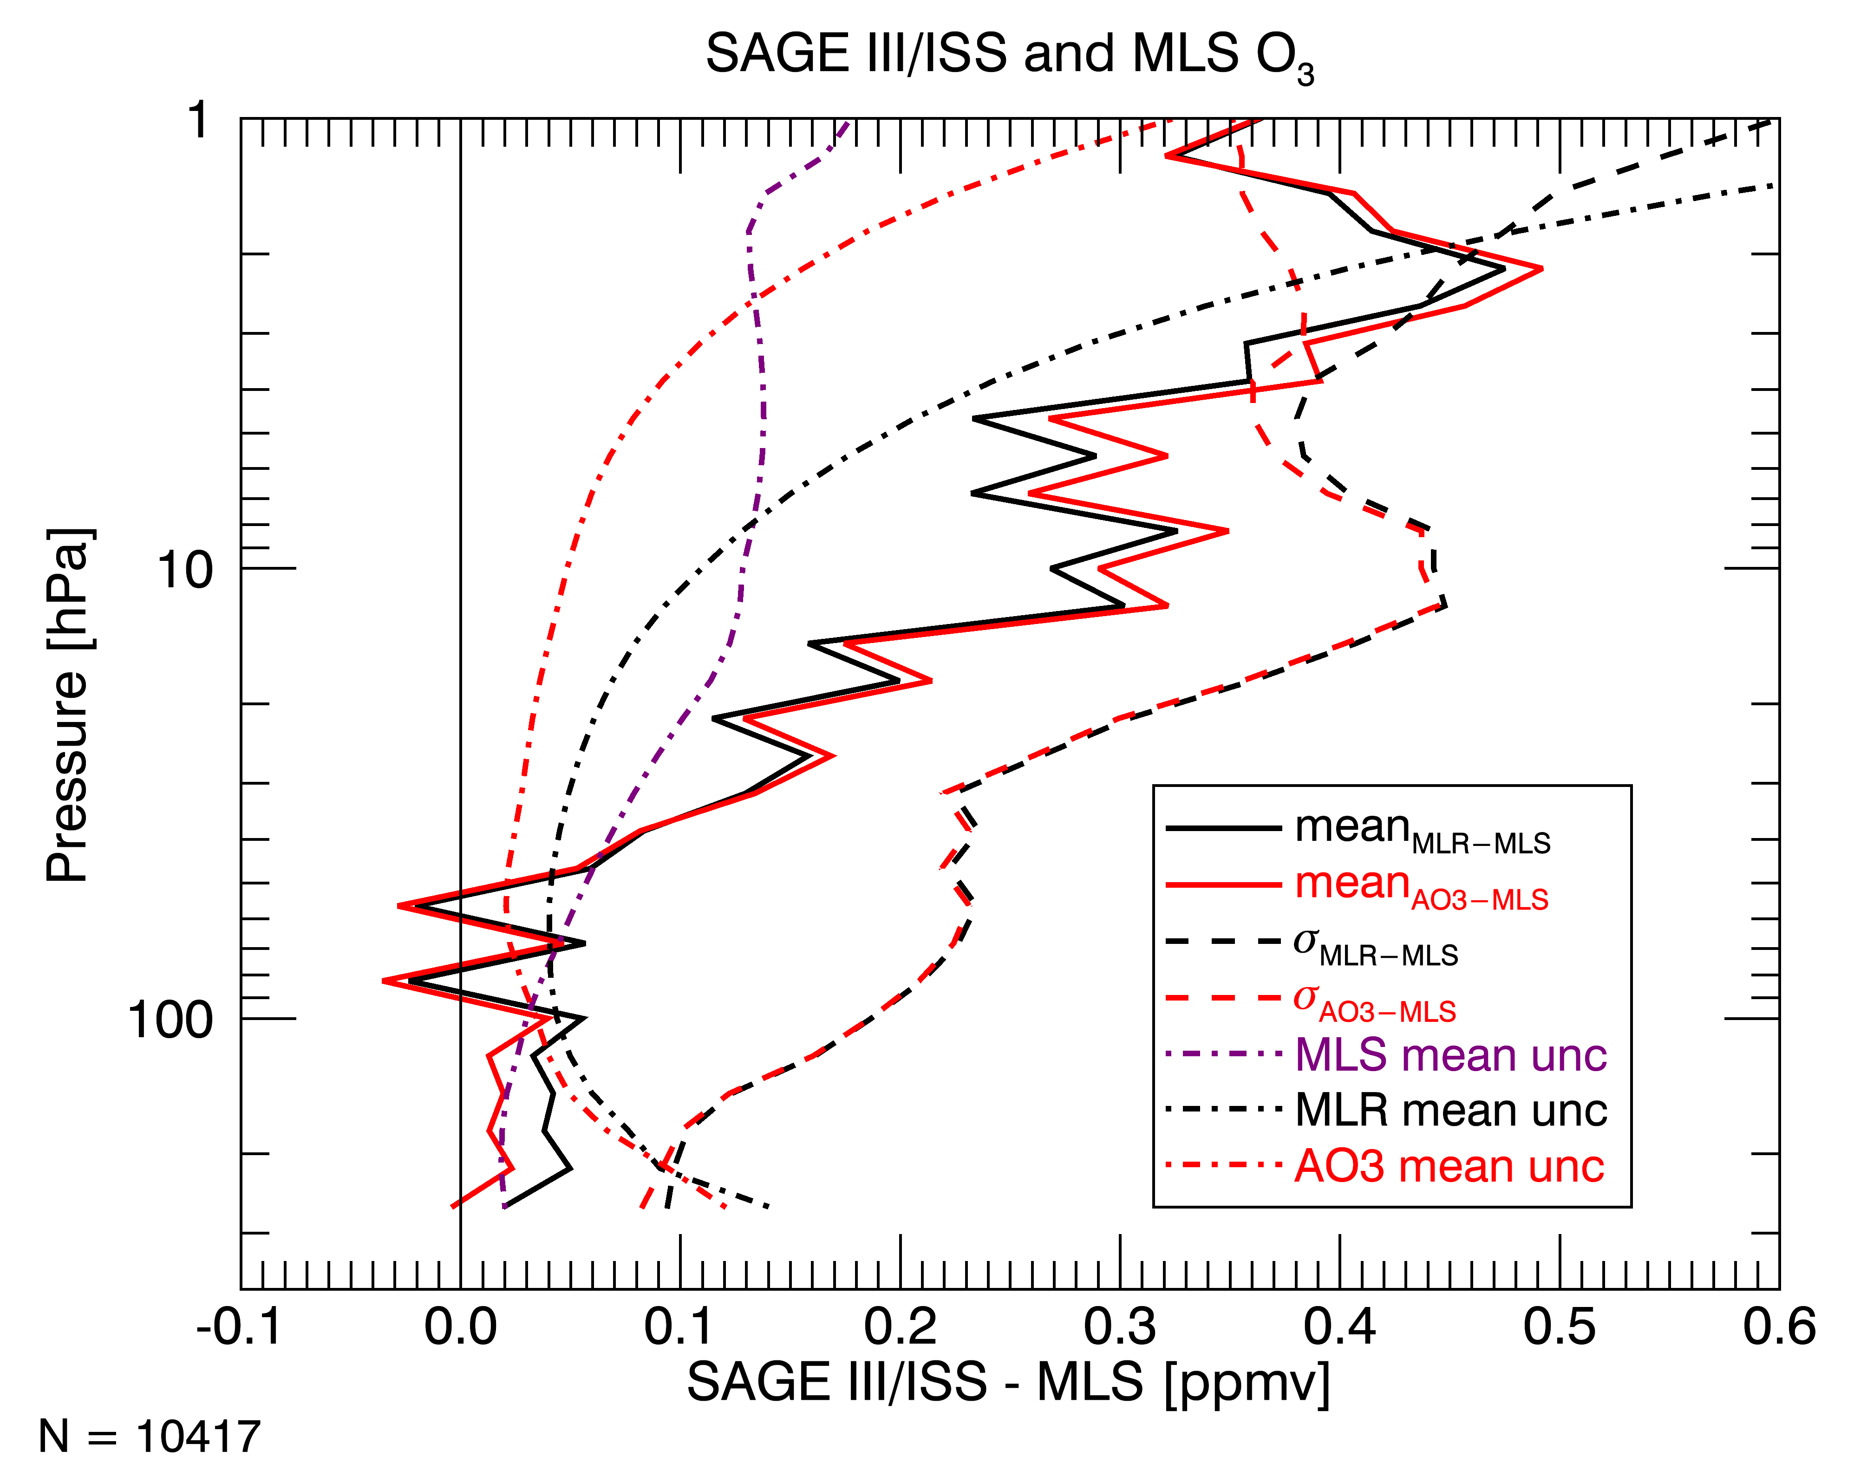
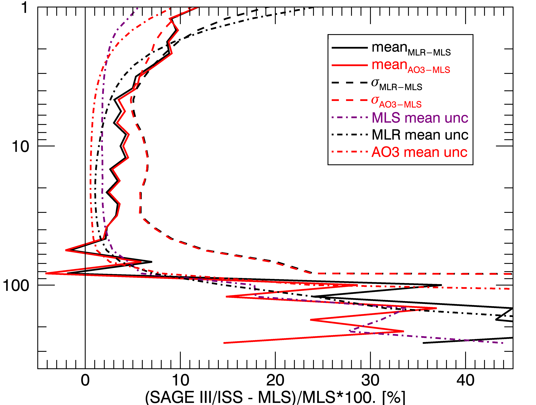
SAGE III/ISS – MLS comparison (O₃)

Slide 11
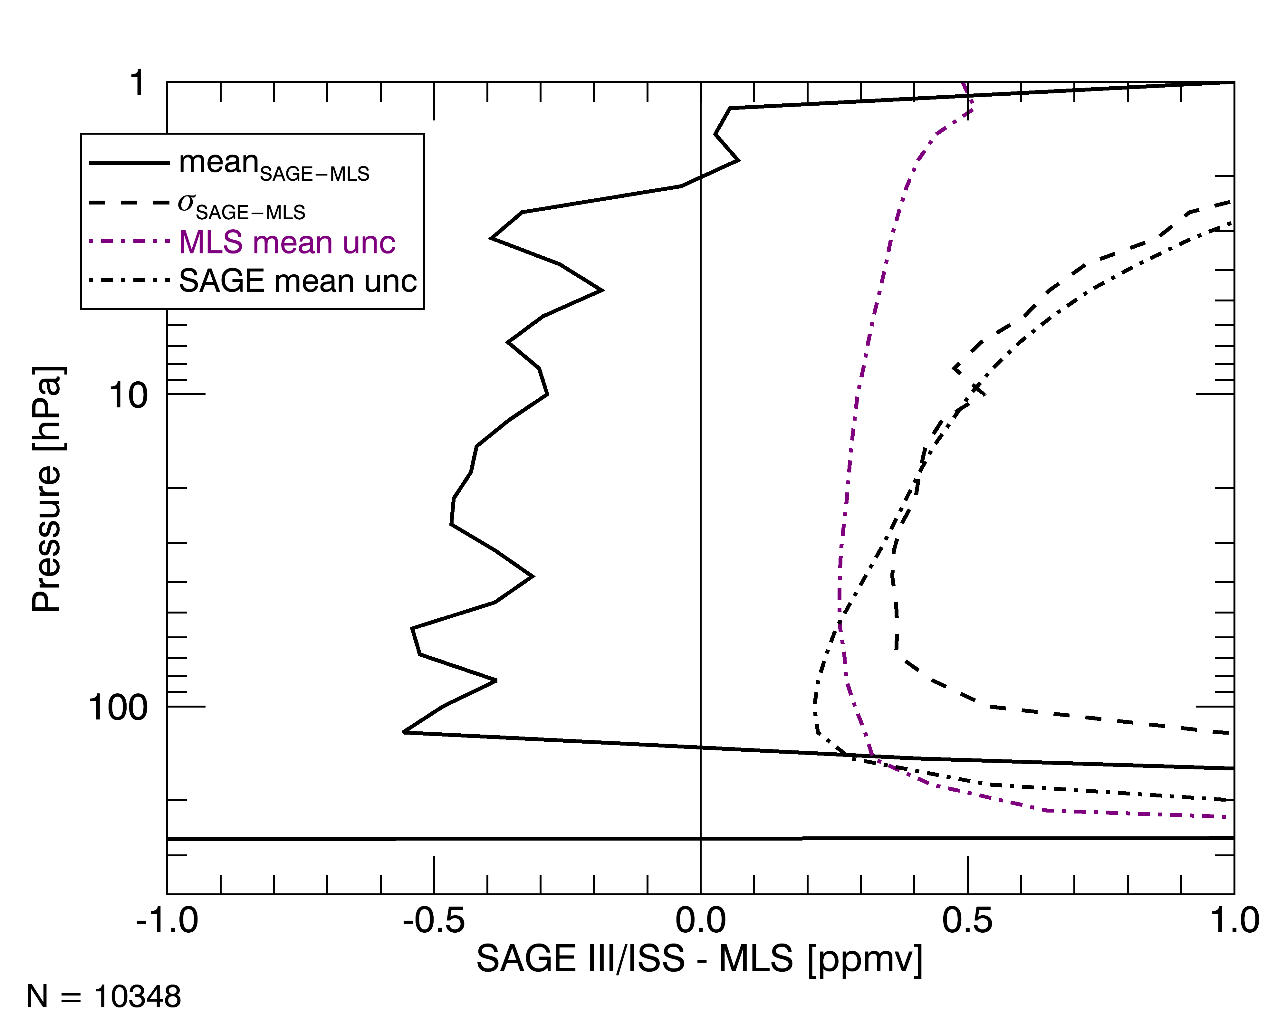
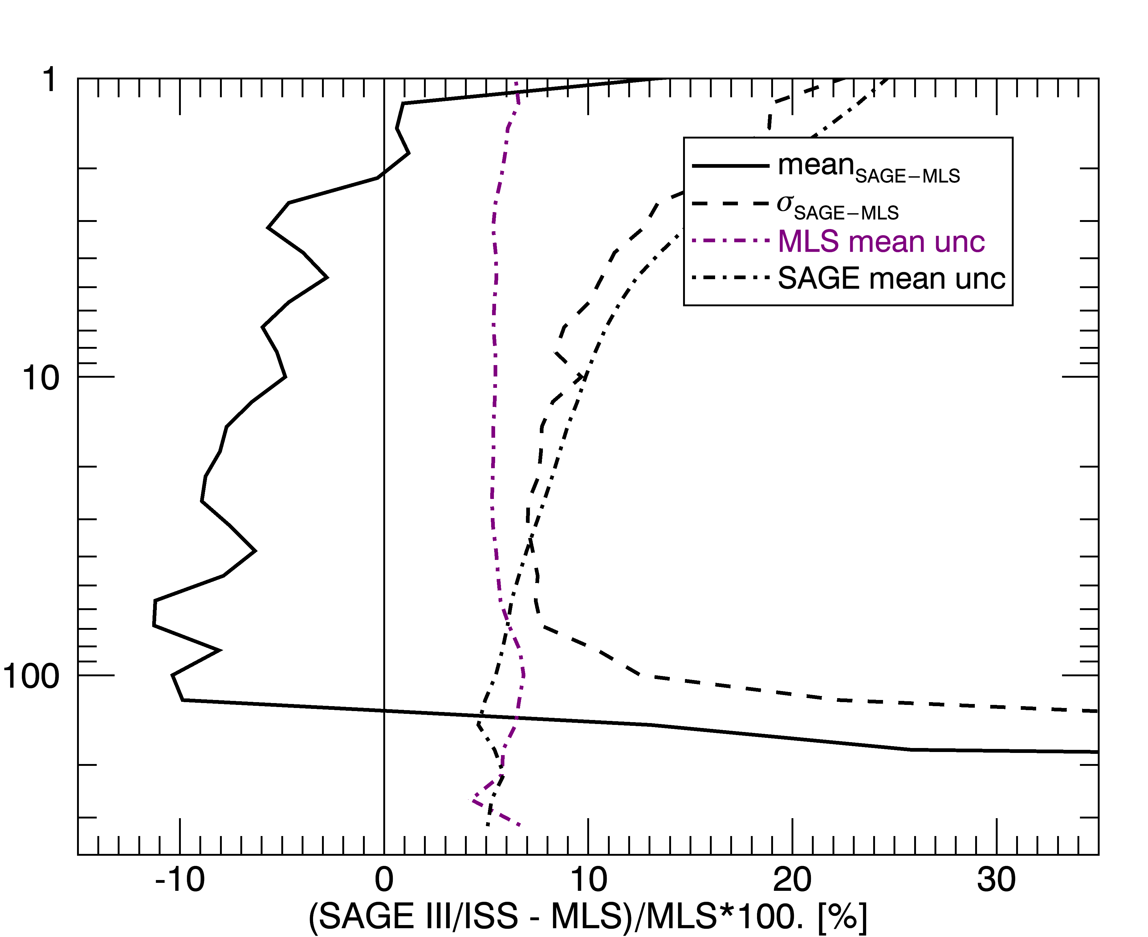
SAGE III/ISS – MLS comparison (WV)

Slide 12
SAGE III/ISS – frostpoint coincident profile comparison
For each FPH profile, look for SAGE III within
|Δt| ≤ 18 h
|Δx| ≤ 10° at equator ( 1100 km)
|Δy| ≤ 5°
→ Take closest time if > 1 profile match
Data
  SAGE III/ISS v5.10 (6/2017 – 8/2018)
  NOAA FPH from Boulder (9), Hilo (1), and Lauder (5)
  CFH from Costa Rica (1)

Slide 13
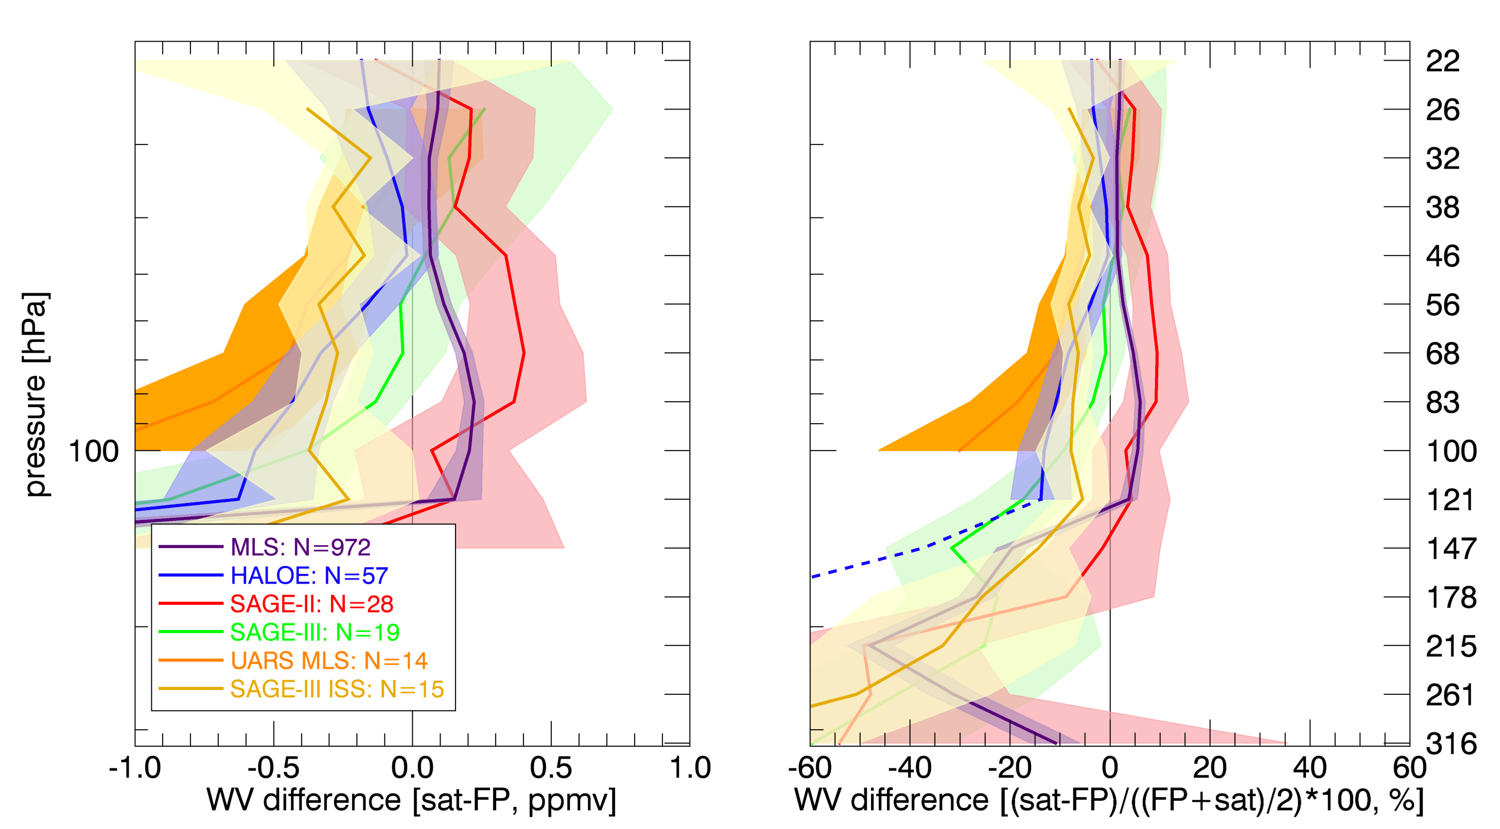
SAGE III/ISS – frostpoint coincident profile comparison

Slide 14
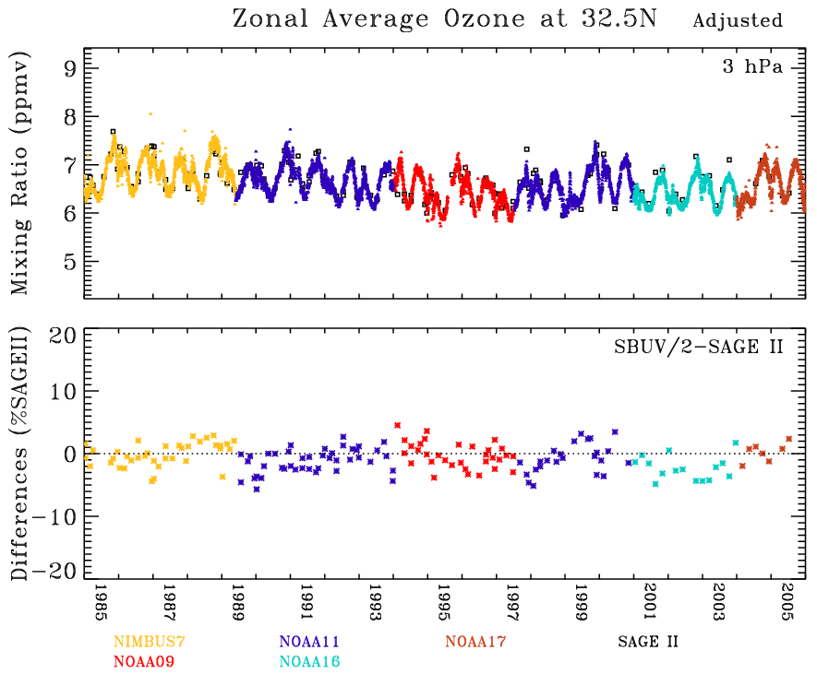
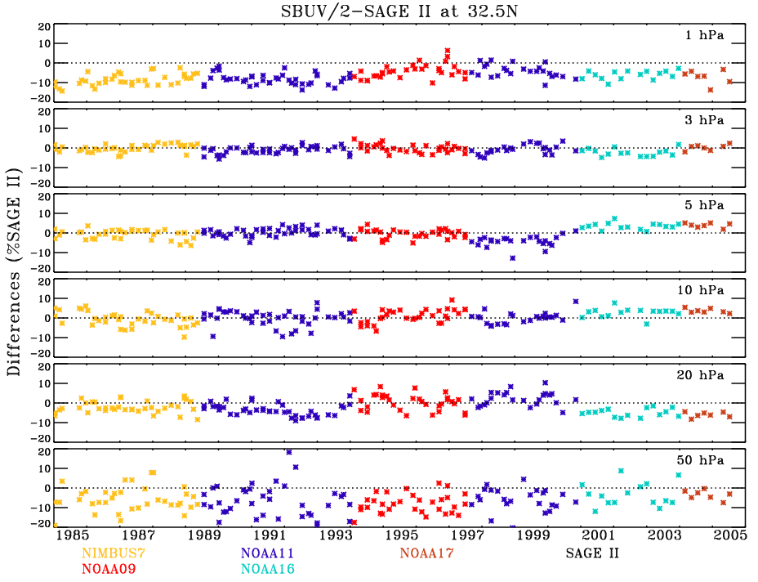
Comparisons with SBUV/2 – an example from SAGE II
Daily SBUV/2 and SAGE II zonal average differences are created -> sweeps the globe in approximately one month.
For SAGE II this was used as a sanity check on the consistency of the multiple platform SBUV/2 instruments.
These types of comparisons can be used to validate SAGE III from NOAA-19 SBUV/2 and Suomi-NP and NOAA-20 OMPS.

Slide 15
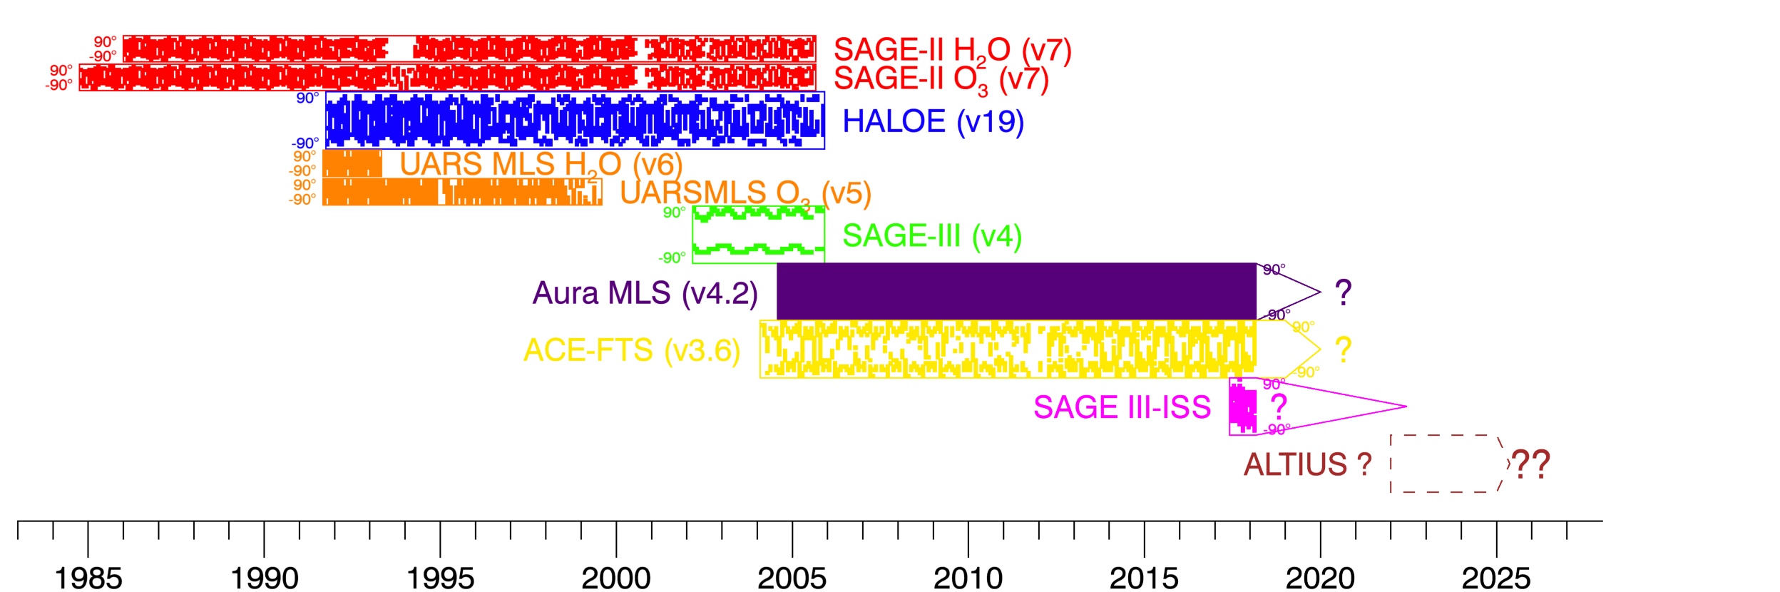
SWOOSH: The Stratospheric Water and Ozone Satellite Homogenized database
SWOOSH is …
  … vertically resolved
  … horizontally gridded
  … monthly-mean H₂O and O₃
  ... from satellite limb profilers
SWOOSH contains …
  … a merged data record
  … individual instrument records
  … multiple horizontal grids
    Zonal mean 2.5°, 5°, 10°; 30° x 10°, 20° x 5°
    Geographic and equivalent latitude
  … data on two vertical grids
  Pressure (Aura MLS 12 decade⁻¹, 316 – 1 hPa) and isentropic
  https://www.esrl.noaa.gov/csd/swoosh/
Adapted from Davis et al., Earth Syst. Sci. Data, 2016

Slide 16
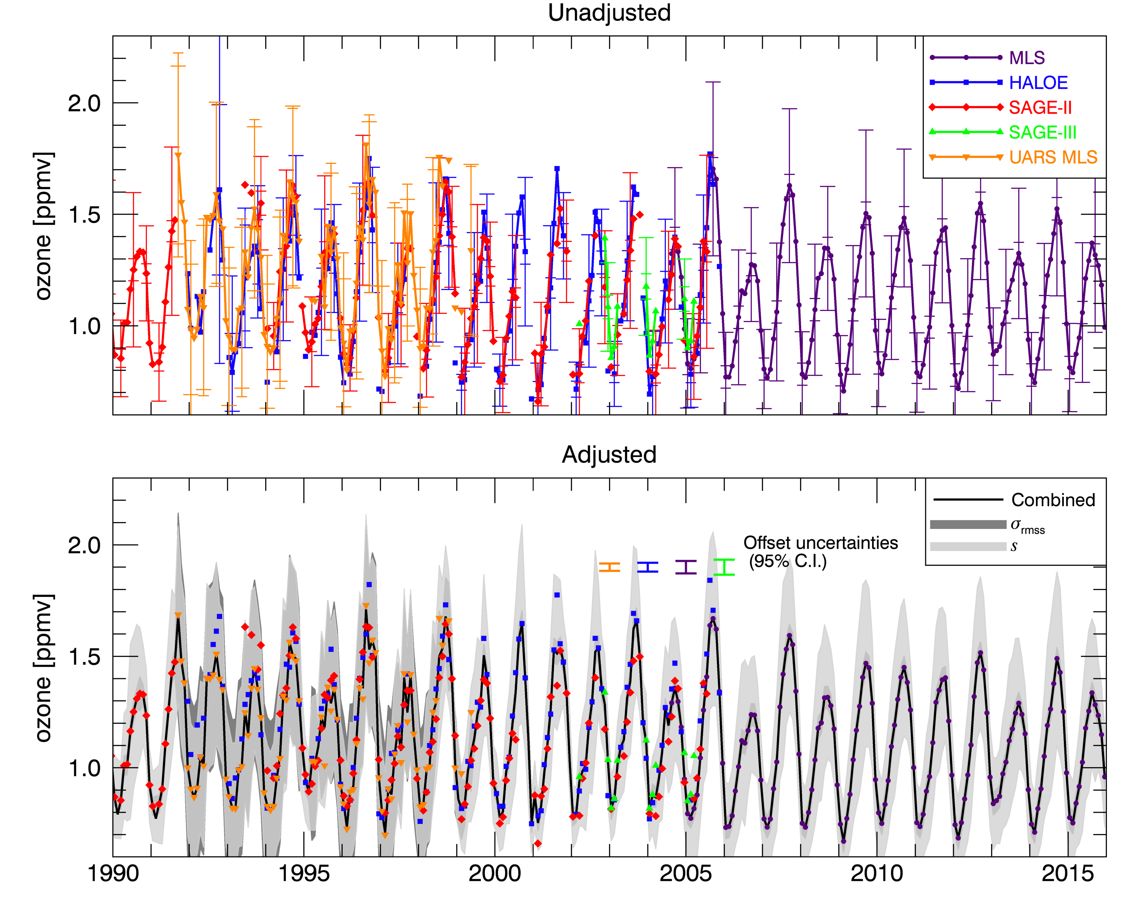
SWOOSH data merging
Satellite measurements are biased and need to be adjusted.
We adjust to MLS for WV and SAGE II for O₃
30 – 40°S, 68 hPa
Davis et al., ESSD, 2016

Slide 17

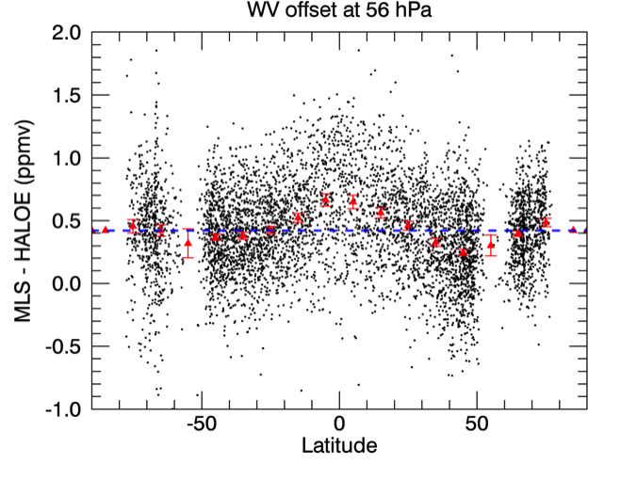
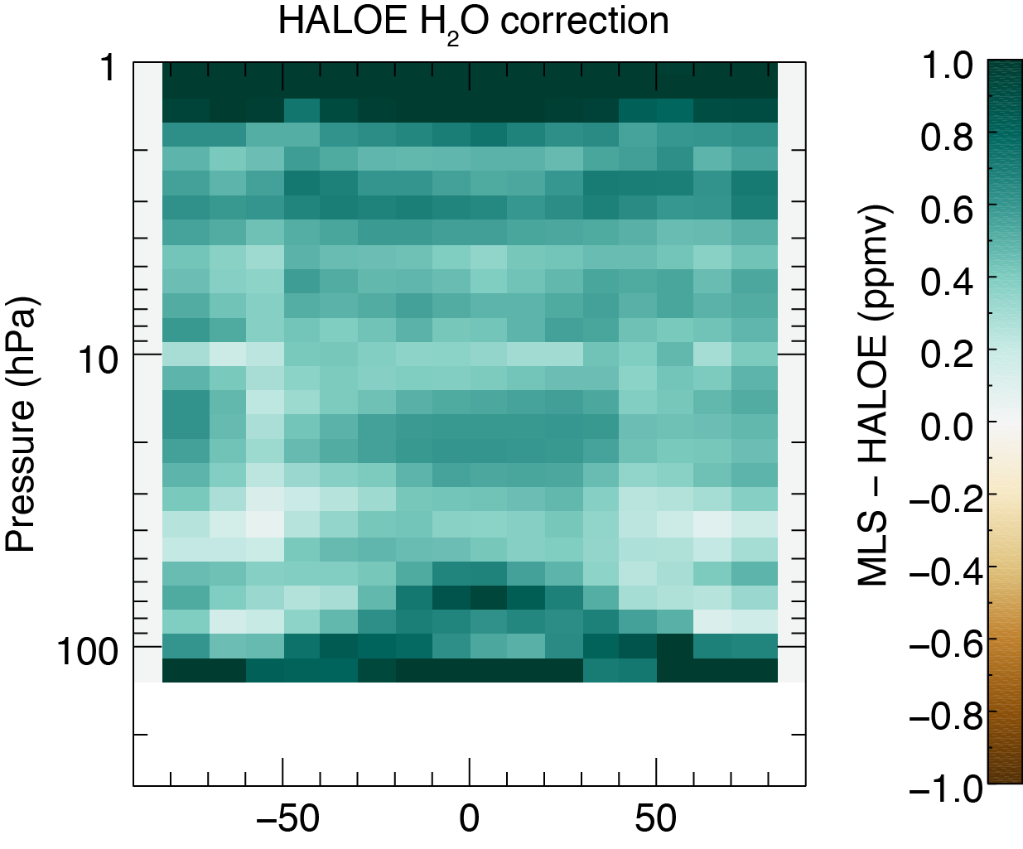
SWOOSH: adjustment to reference data
Uses coincident satellite-satellite matches
  criteria based on time, distance, eq. latitude
Adjustment mean difference from reference
  Varies as a function of height/latitude only
Latitude
Davis et al., ESSD, 2016

Slide 18
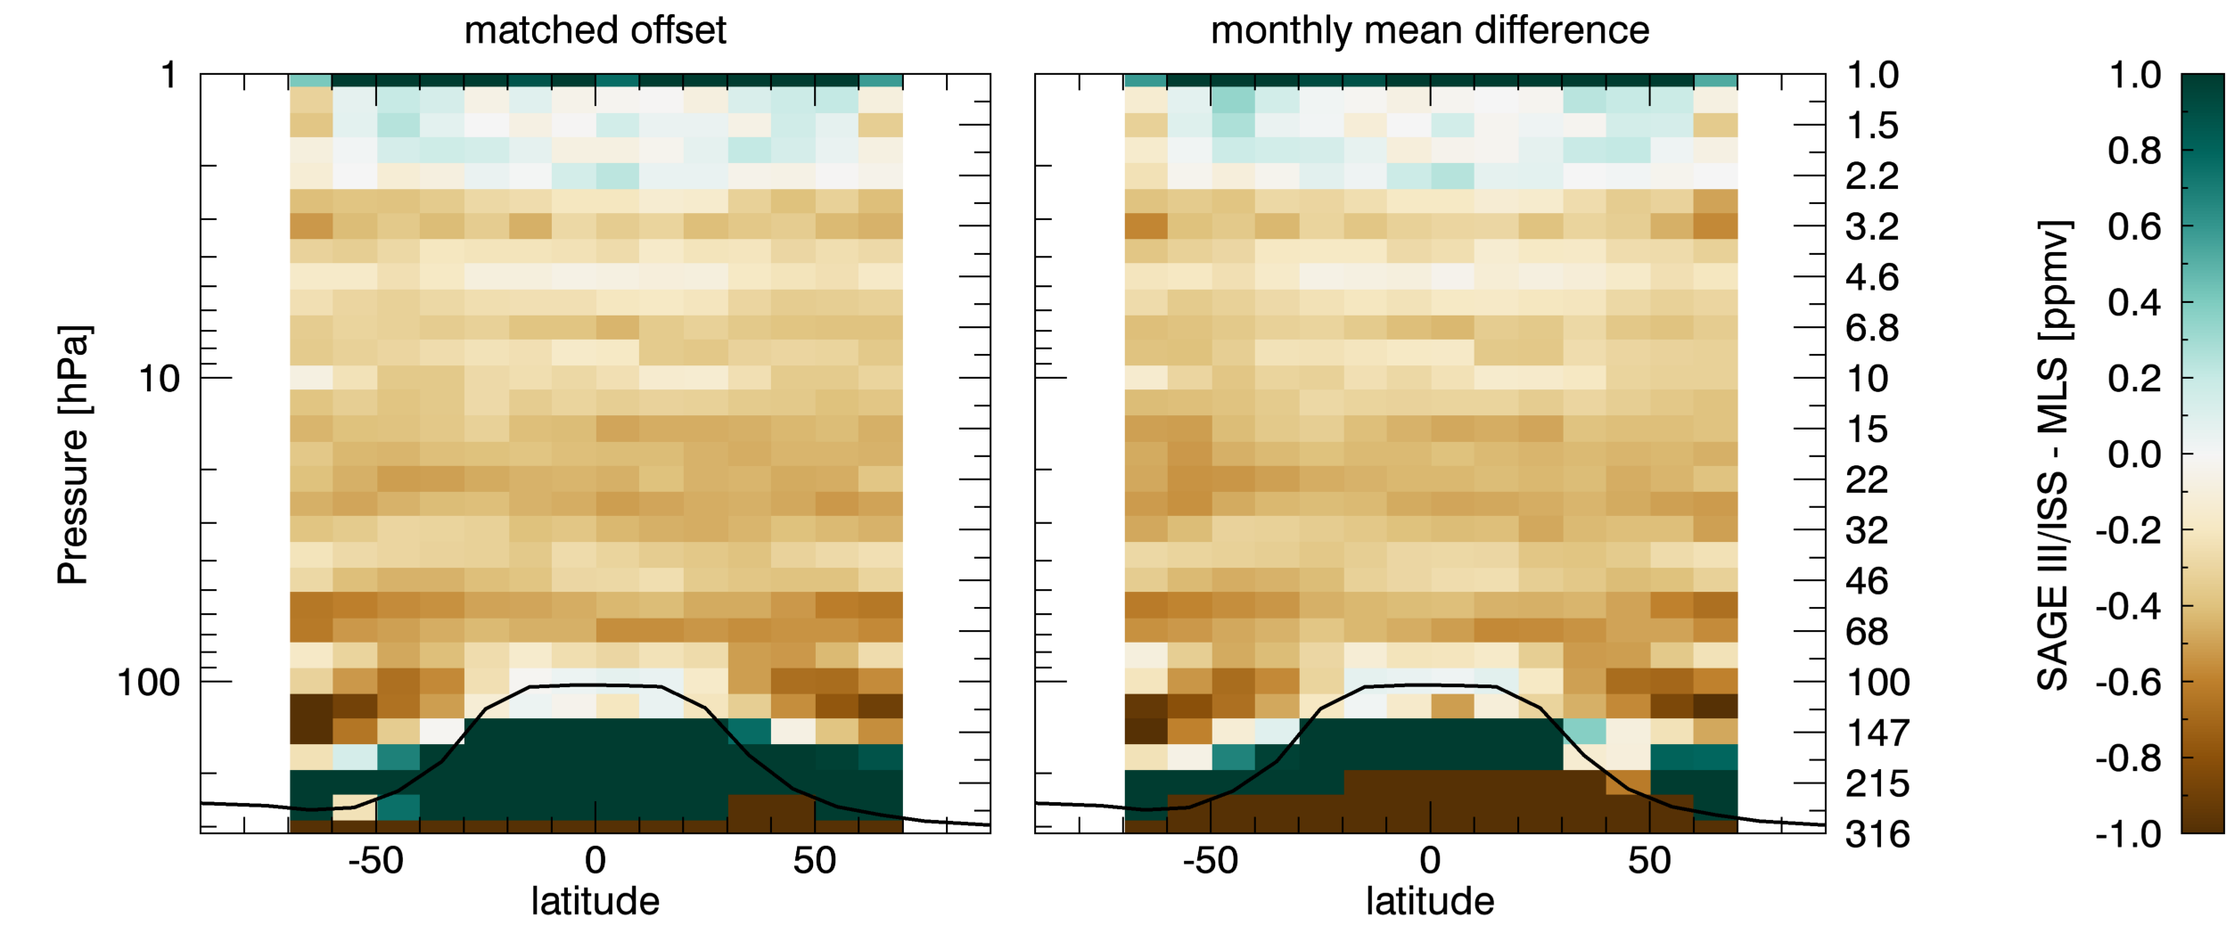
Offsets between SAGE III/ISS and MLS

Slide 19
Conclusions
SAGE III has good agreement with Umkehr (< 5 %), similar to SAGE II
SAGE III has slightly larger (> 5 %) negative bias in Umkehr layer 4 (63-32 hPa) and 3 (125-63 hPa)
  need to improve matching criteria due to larger ozone variability in these layers
SAGE III – MLS O₃ comparisons look promising (~ 5%)
SAGE III / ISS WV shows a ~ 10% (0.5 ppmv) dry bias relative to MLS in stratosphere
Some vertical structure apparent in both WV and O₃ comparisons

Slide 20
Future work
Extend correlative analysis, and iterate on data QC
  Umkehr, Sondes, Aura MLS
  Need help with QC filtering
Assess sensitivity of O₃/WV mixing ratios to use of alternative reanalyses (e.g., ERA-I, ERA-5)
Assess match criteria using a model and implement improvements
Finalize incorporation of SAGE III/ISS into SWOOSH

Slide 21
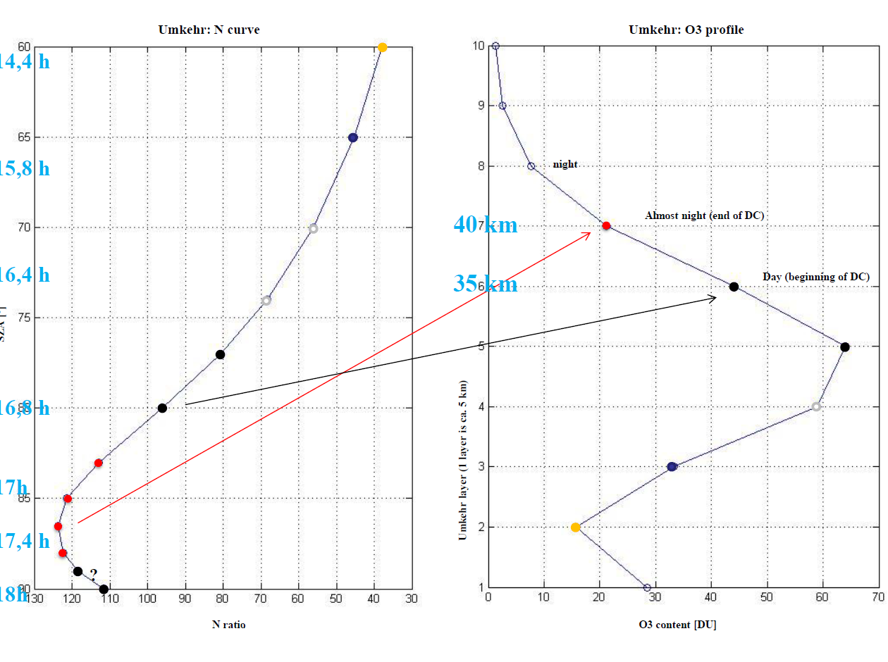
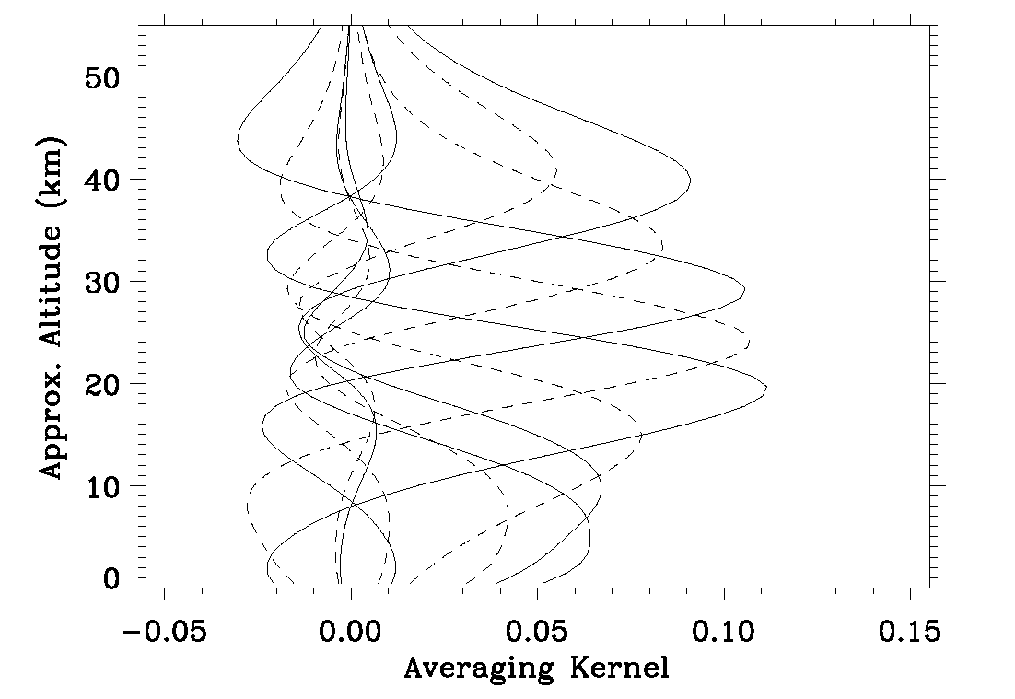
Umkehr, retrieved ozone profile, AK smoothing
Umkehr N-curve
4:25 pm
twilight
5:25 pm
sunset
8 km res.
5:25 pm
daylight
SZA
8 km res.
6:40 pm
7:00 pm
Umkehr layers
15 km res.
7:25 pm
15 km res.
8:00 pm
N-value
Ozone, DU

Slide 22
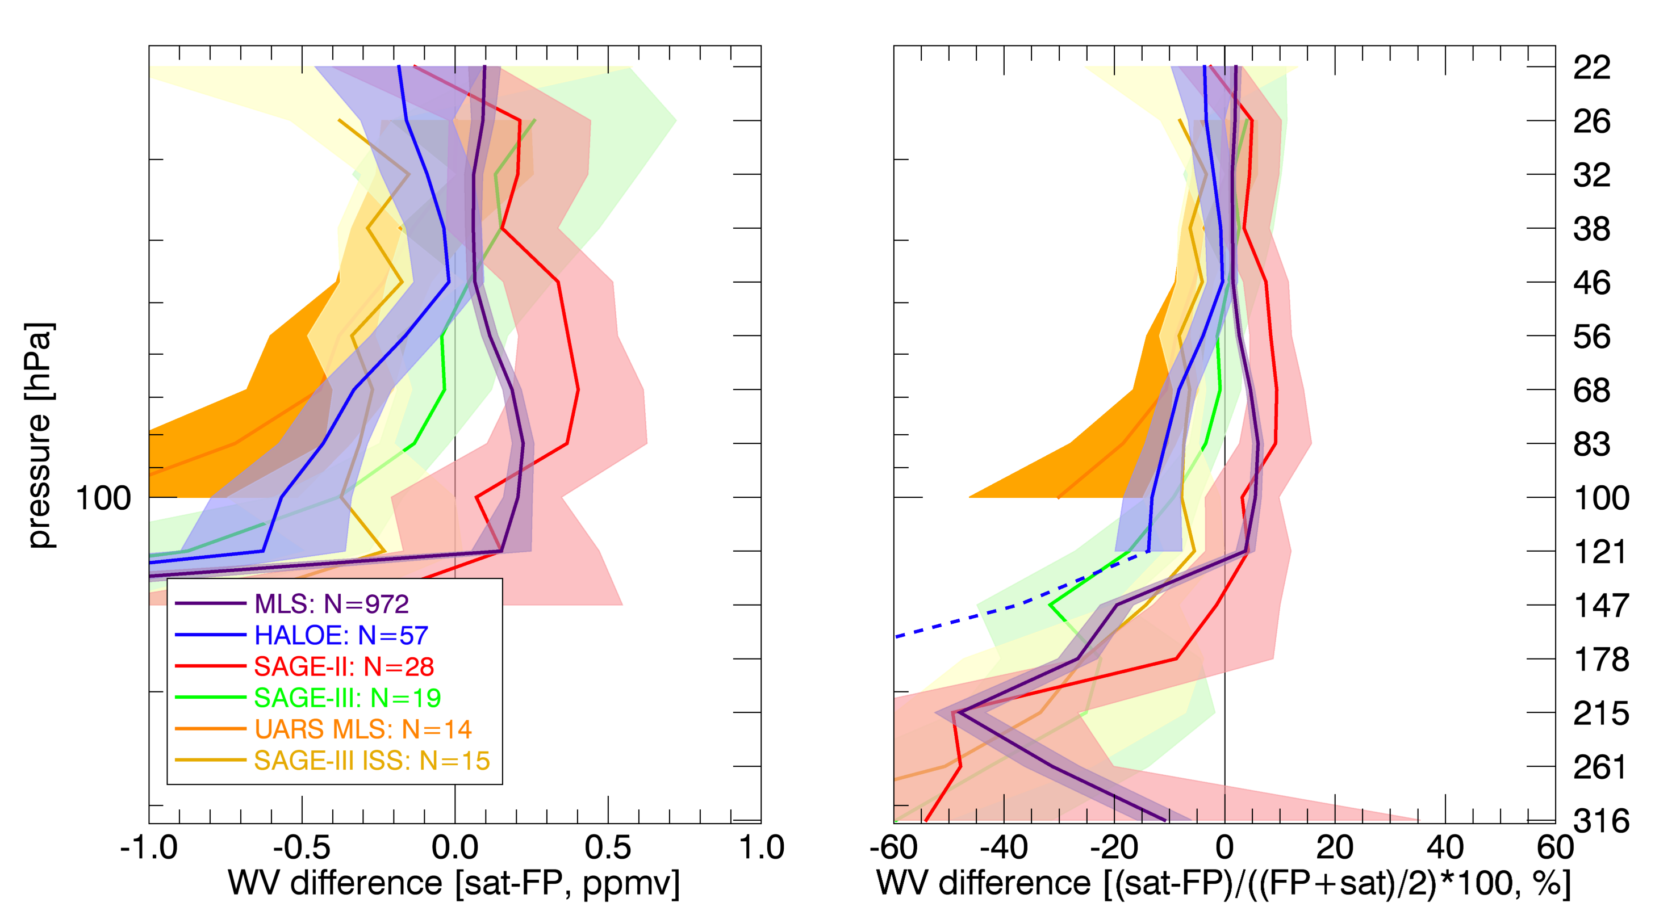
SAGE III/ISS – NOAA FPH (1.5 km FWHM FP smooth)

Slide 23
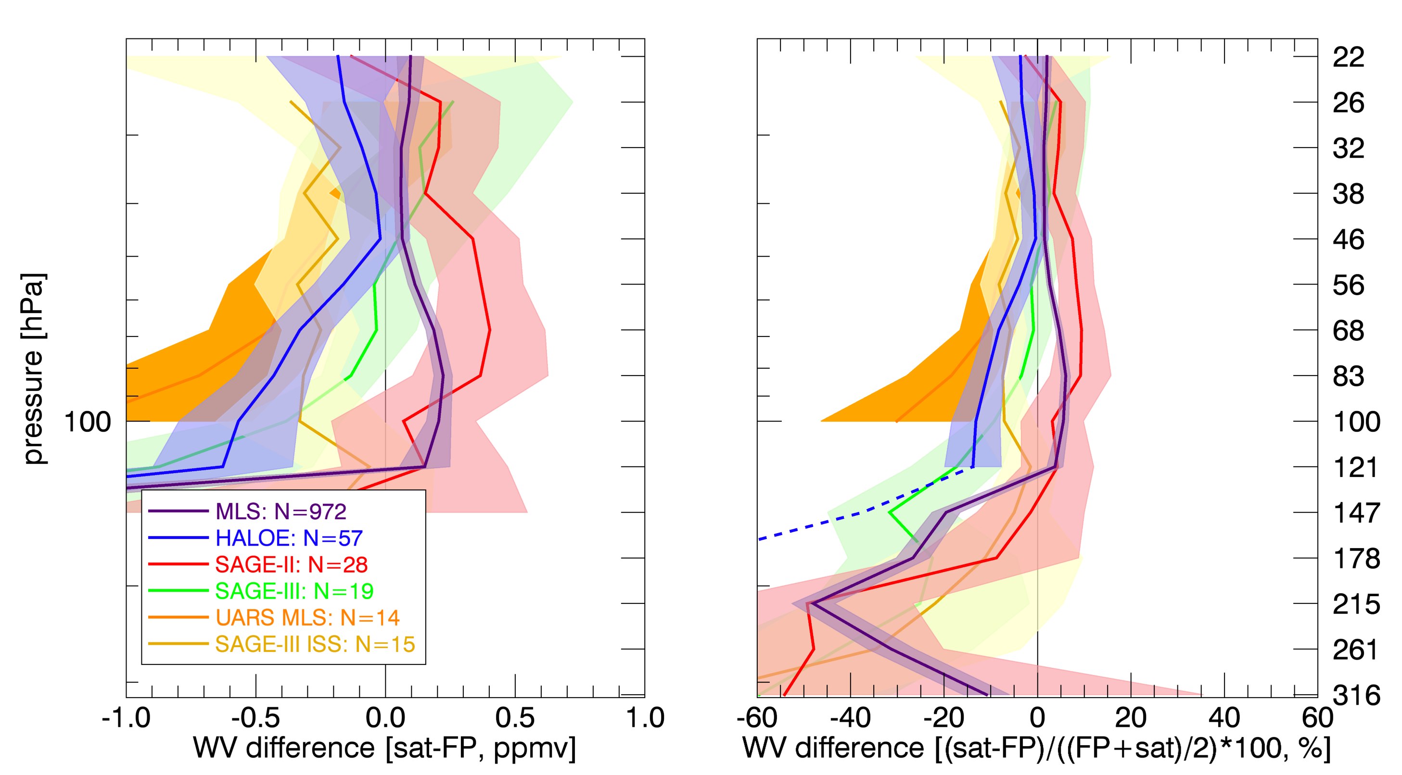
SAGE III/ISS – NOAA FPH (no FP smooth)

