Slide 1
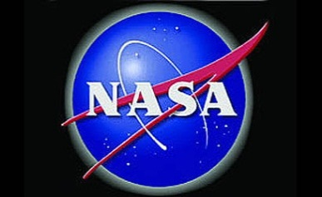



Solar Storms
2000 years of calamity!
Dr. Sten Odenwald
NASA HEAT
Notes:
Originally prepared for National Institute of Aerospace. Northern Virginia Astronomy Club, Fairfax, VA, April 12, 2015. Updated Feb 19, 2025.

Slide 2
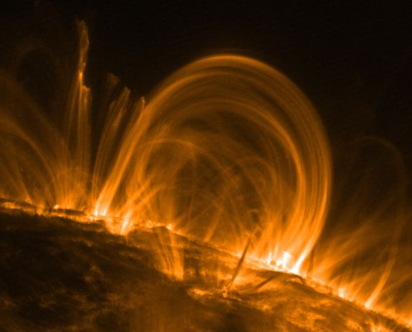
Notes:
The sun’s surface is a complex network of magnetic fields and heated plasma. These components can explosively rearrange themselves causing solar flares, prominences and coronal mass ejections.
2

Slide 3
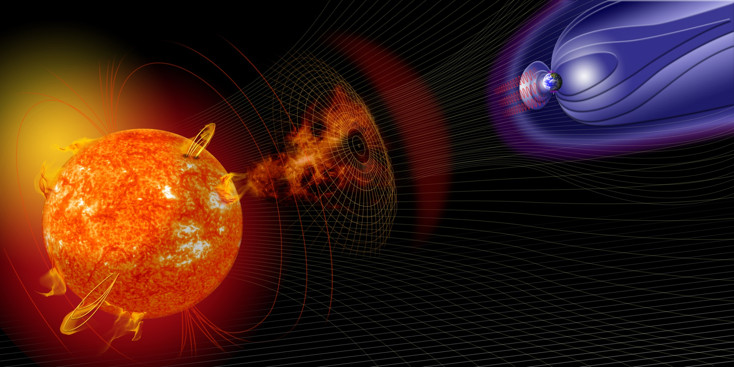
Notes:
Coronal mass ejections are billion-ton clods of magnetized plasma that can travel up to 3000 km/s and occasionally reach Earth in a few days.
3

Slide 4
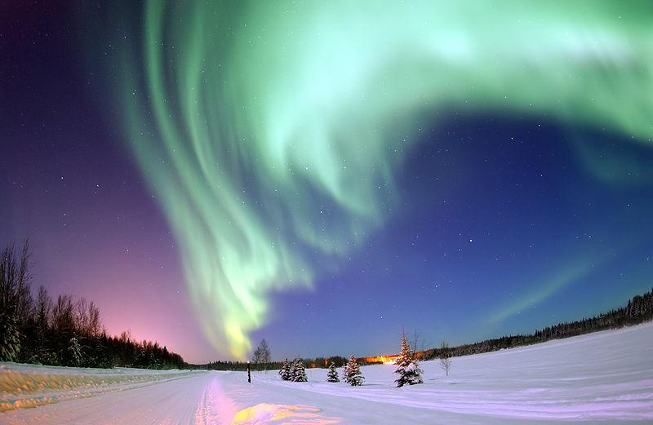
Notes:
Earth’s magnetic field rearranges itself and causes flows of particles to enter the polar regions causing spectacular aurora.
4

Slide 5
Space Weather
‘Bad Hair Days’
Solar Storms
Solar Wind
Coronal Holes
Cosmic
Rays
Solar Flares
Coronal Mass Ejections
X-rays
8 min.
Energetic
Particles
~1-hr
Plasma + magnetic field
14-hr to 4 days
Milder
Geomagnetic
Storms
Ionosphere
disruption
and Heating
Geomagnetic Storms
No SPEs
SPEs
Satellite
Anomalies
Satellite
Anomalies
Satellite
Anomalies
GPS problems
Satellite drag
Power Grid problems
GLEs
Notes:
A collection of events that affect Earth are called space weather and each type leads to specific problems with our technology in space and on the ground.
5

Slide 6
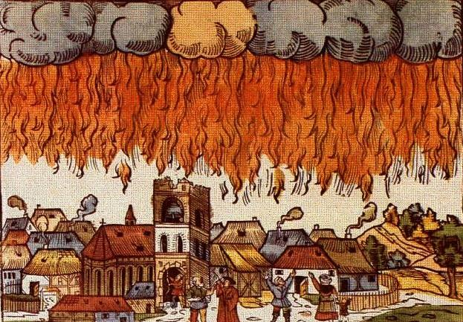
Nuremberg, 1561
Notes:
Aurora have been observed as far back as the earliest ancient Chinese records in the first millennium BC. By the Middle Ages, they were considered to be ill-omens.
6

Slide 7
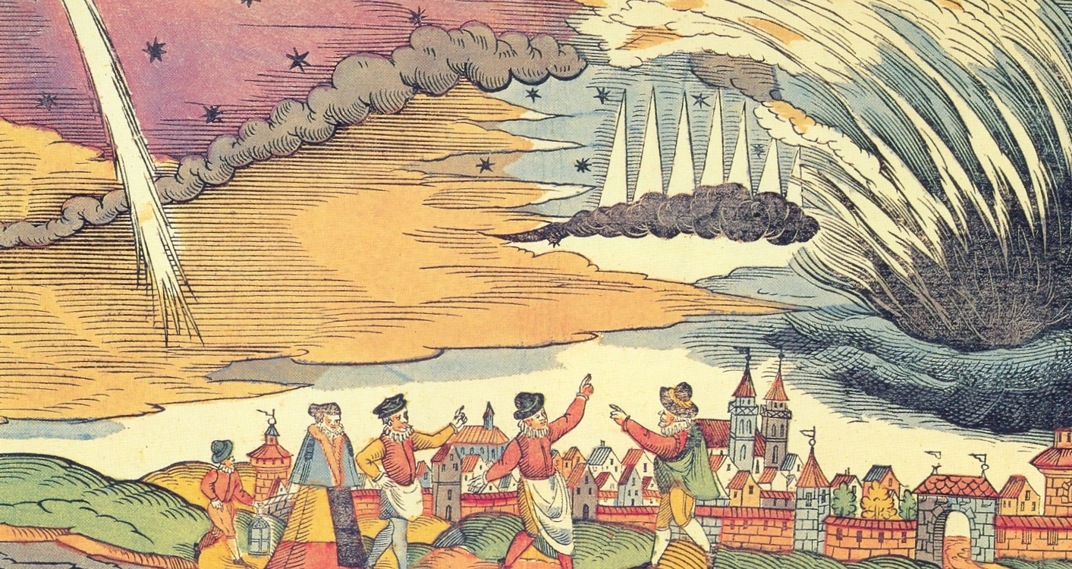
Aurora …
Notes:
Generally, people were frightened of aurora and though they were celestial battles played out across the skies.
7

Slide 8
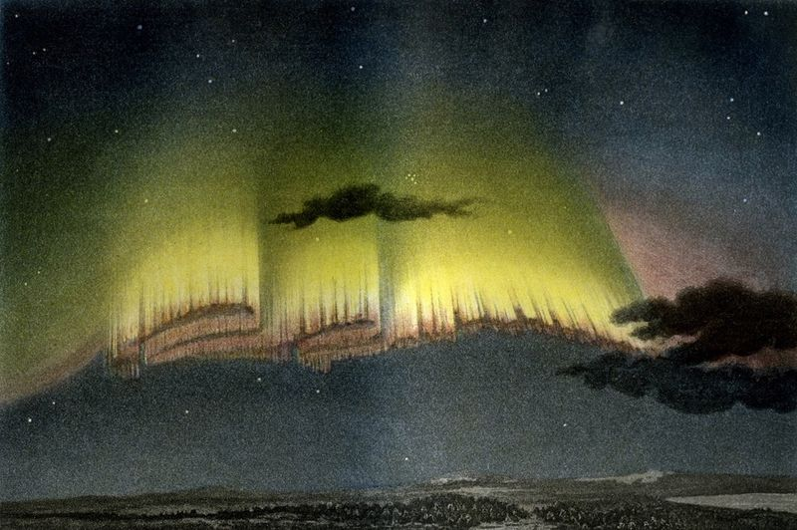
Aurora 1839
Notes:
By the 19th century, people were much better at artistically reproducing their many shapes so that they could be studied.
8

Slide 9
The Sun

Slide 10
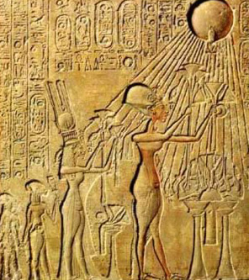
Akenaten 1352-1336 BC
Total solar eclipse May 1338 BC
Notes:
The earliest sighting of a total solar eclipse may have been at the time of Pharaoh Akhenaten, who originated the worship of a single god: Aten the sun disk.
10

Slide 11
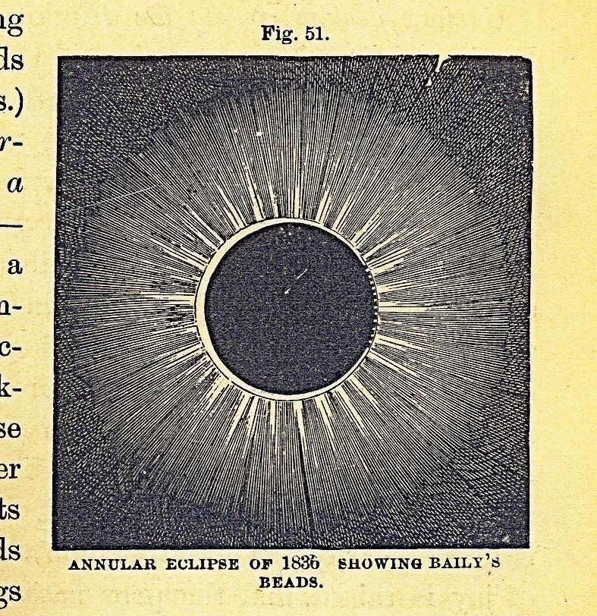
Eclipse 1836
Notes:
Almost no one bothered to draw a total solar eclipse until the 19th century when it became the most important way to study the solar corona.
11

Slide 12
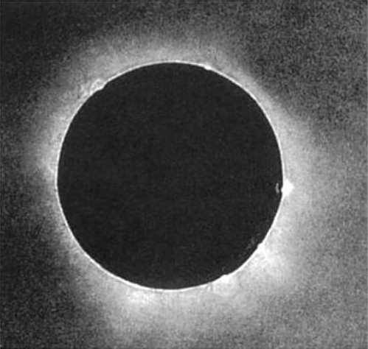
First photograph, 1851
Notes:
The advent of photography soon replaced drawing as the scientific means for recording auroral details.
12

Slide 13
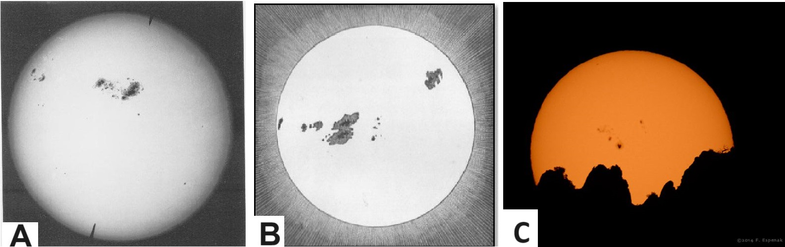
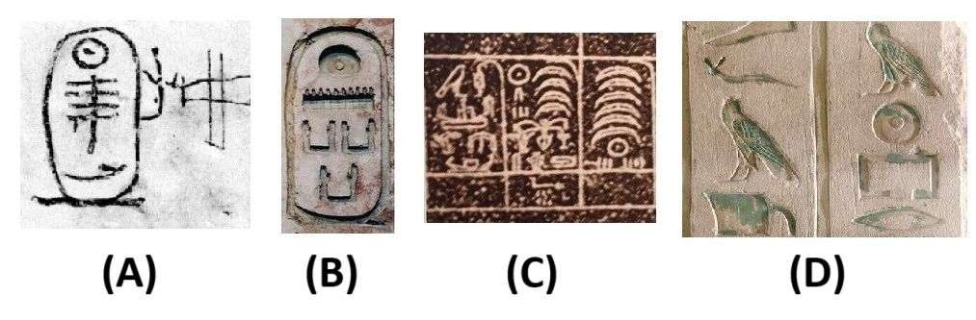
Sunspots
Notes:
The earliest records of sunspots were from the 700s BCE by ancient Chinese astrologers who used them as omens and could spot naked-eye sunspots when the sun was low in the horizon. A similar discovery made by the ancient Egyptians 2000 years before the Chinese may have been memorialized in the Egyptian hieroglyph for the solar disk, which has a central spot. We use this symbol today to denote the Sun.
13

Slide 14
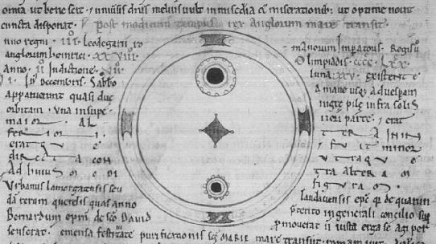
Chronicles of John of Worcester. 1128
Notes:
The earliest surviving drawing of a sunspot comes from 1128 CE but it is unclear exactly what was being drawn!
14

Slide 15
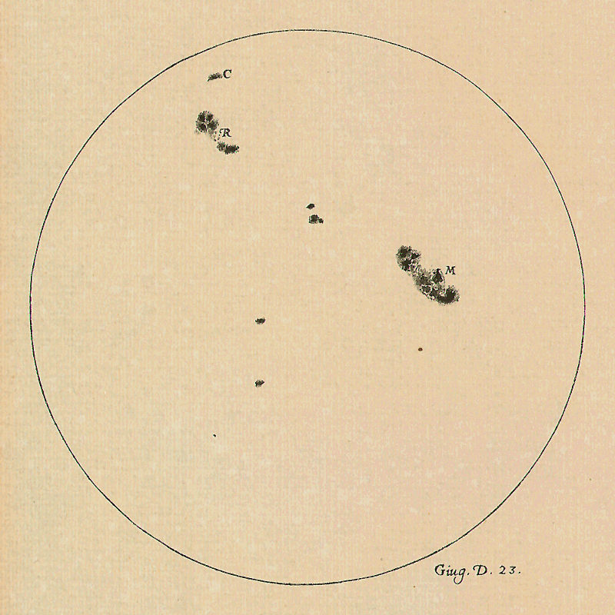
Galileo ca 1612
Notes:
The first detailed drawing had to await the invention of the optical telescope in ca 1608 CE by Galileo.
15

Slide 16
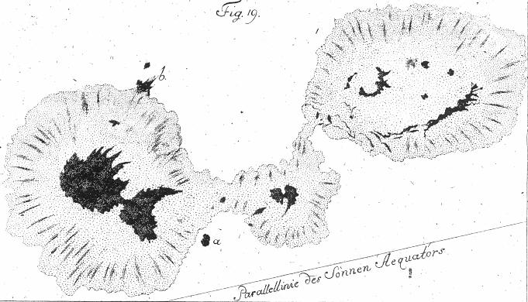
Johann Schroeter ca 1785
Notes:
AS telescopic studies improved, so too did the details that could be seen in sunspots.
16

Slide 17
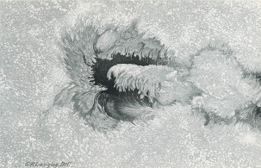
Langley 1871
Notes:
Some of the nicest drawings occurred in the 19th century just before photography came into common usage.
17

Slide 18
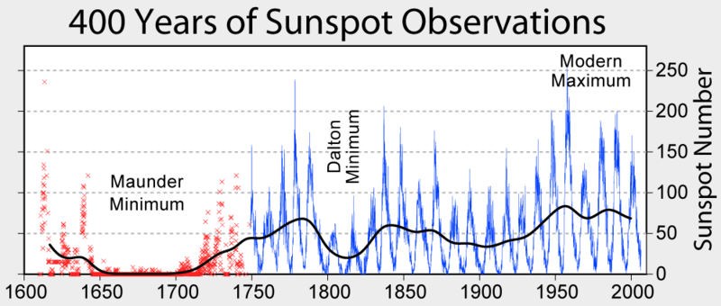
Heinrich Schwabe ca 1843
Notes:
By counting the number of sunspots over time, it was discovered that they follow an 11-year cycle.
18

Slide 19
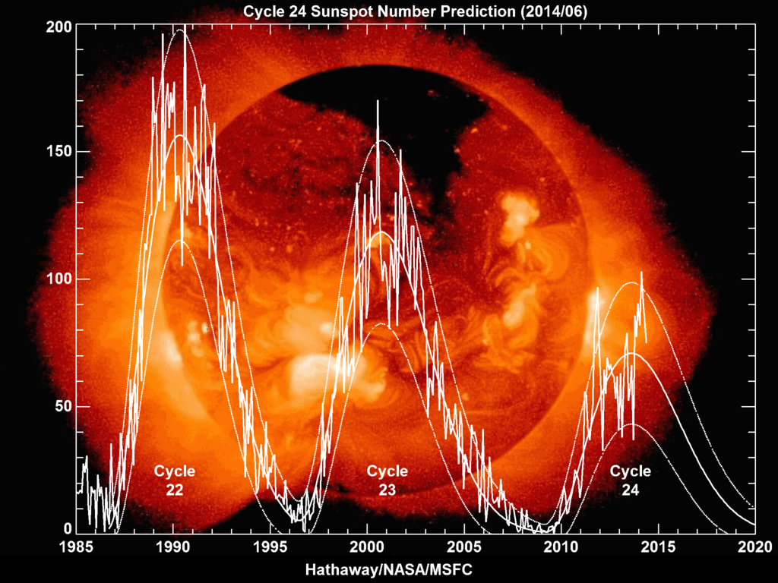
Notes:
Modern observations continue to follow the sunspot cycles along with solar surface details visible at many different wavelengths such as this x-ray image of the Sun.
19

Slide 20
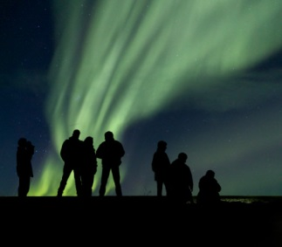
Ingredients for
turning sunspots into Calamity
People
Notes:
Sunspots and solar storms cause a variety of stormy events that can directly affect our technology in space and on the ground. These phenomena are collectively called space weather.
20

Slide 21
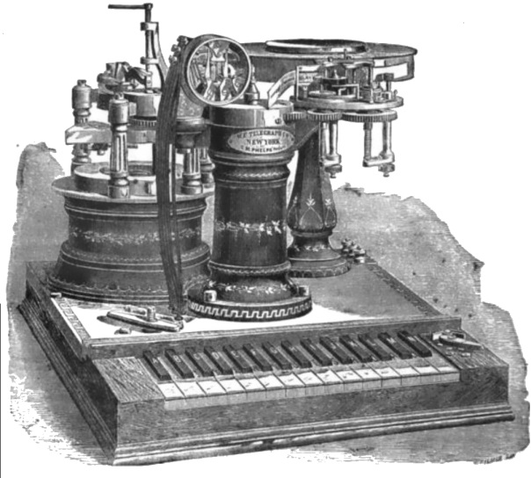
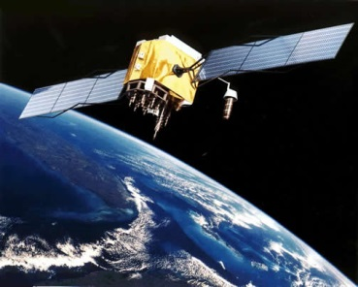
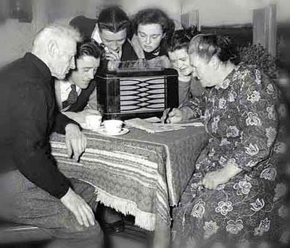
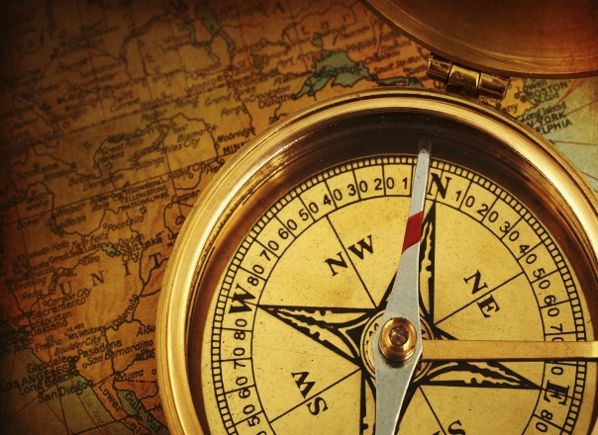
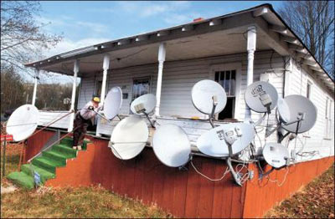
Ingredients for
turning sunspots into Calamity.
Technology

Slide 22
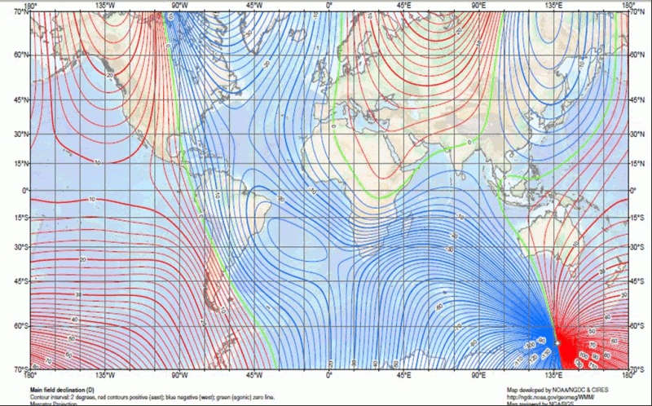
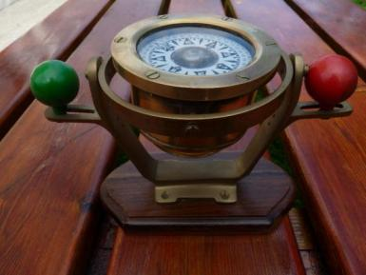
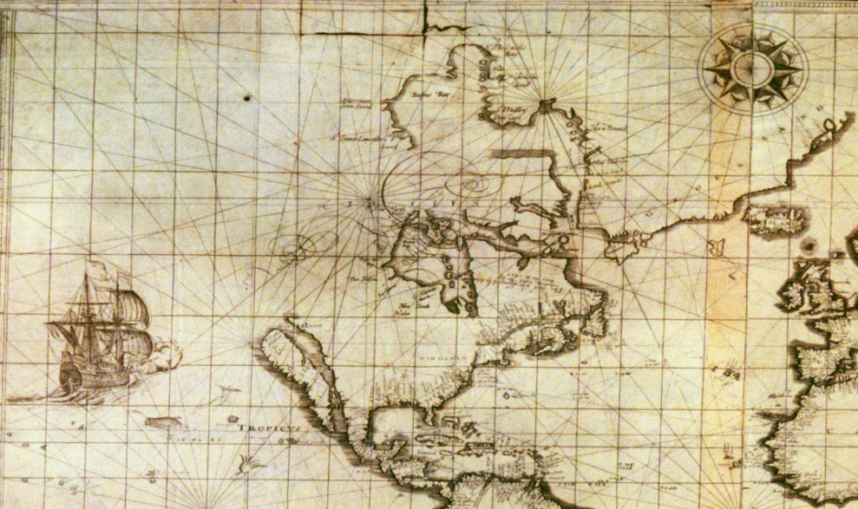
Magnetic Compass
Notes:
Changes in Earth’s magnetic field called magnetic storms create problems for compass navigation that can last up to several days at a time.
22

Slide 23
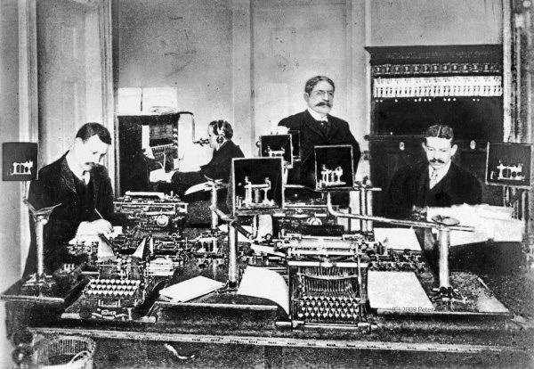
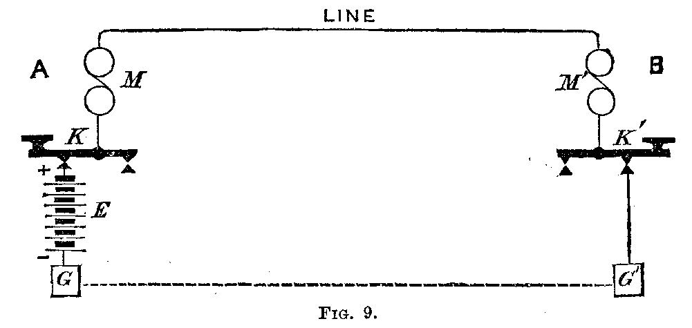
Telegraph circuit
Notes:
Magnetic storms also cause currents to flow in the ground that invade telegraph systems and cause them to fail.
23

Slide 24
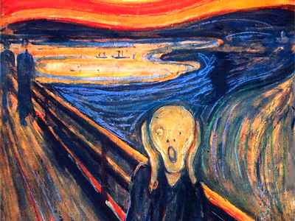
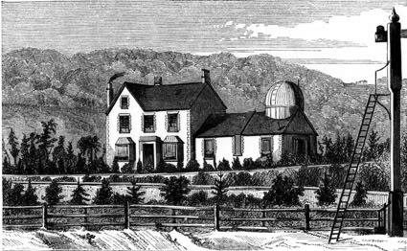
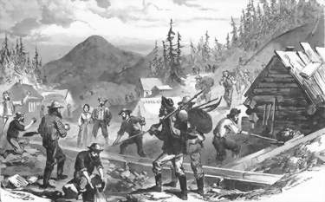
The 1859 Superstorm
Notes:
The August-September, 1859 Carrington-Hodgson Storm was a world-wide phenomenon that caused telegraph and cable systems to fail for many days.
24

Slide 25
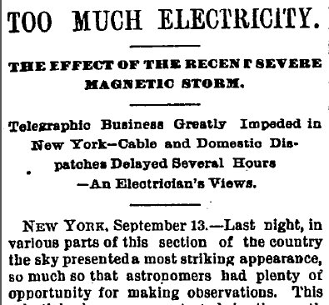
NYT 1881
Notes:
Over time, solar storms continued to cause upsets in a variety of early technologies and were widely reported on the front pages of newspapers.
25

Slide 26
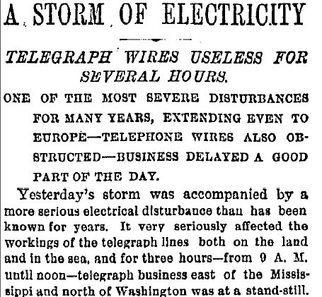
NYT 1882

Slide 27
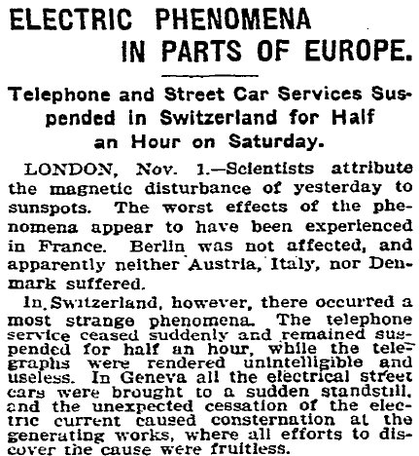
NYT 1903
Notes:
In 1903, these intense solar disturbances even began to affect some electrical systems such as the streetcar system in Switzerland.
27

Slide 28
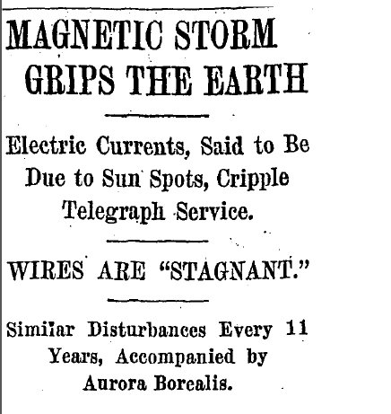
NYT 1909

Slide 29
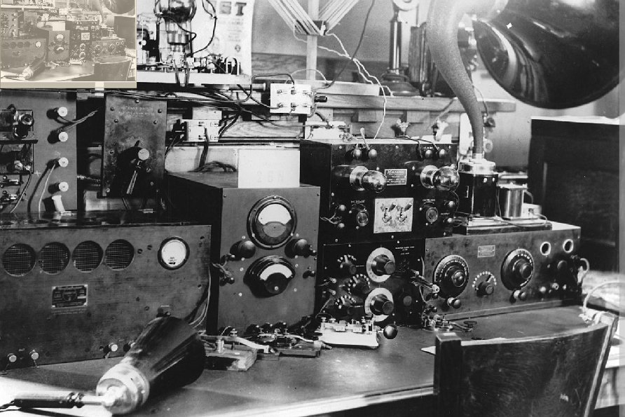
Wireless radio, 1915
Notes:
The advent of radio communications temporarily made communication possible during storms, however as the technology moved to higher frequencies, short wave radios began to fail too.
29

Slide 30
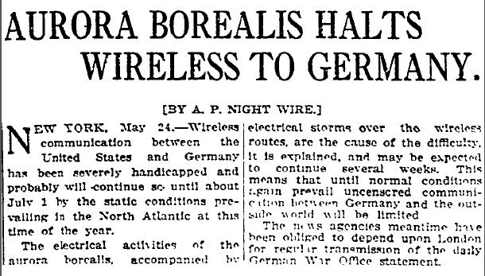
NYT 1915

Slide 31
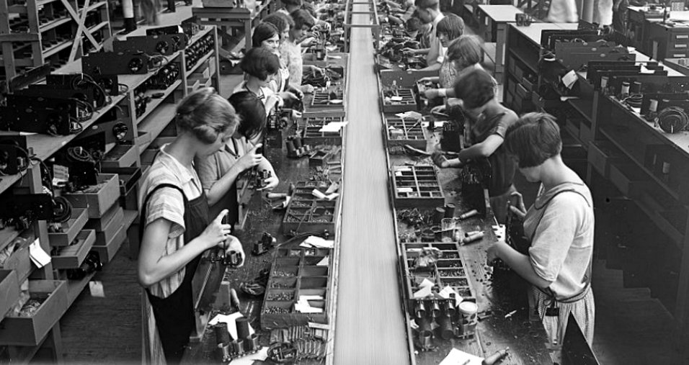
Radio assembly line ca 1925

Slide 32
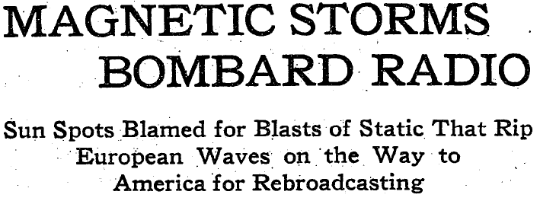
NYT 1930

Slide 33
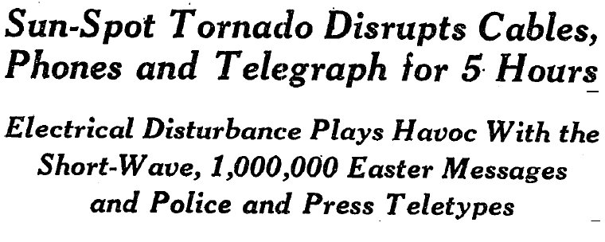
NYT 1940

Slide 34
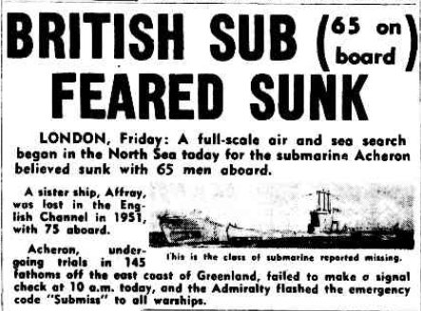
NYT 1956

Slide 35
During the Space Age,
Reporting has been sporadic and superficial.
Few specific incidents reported,
but there have been notable exceptions:

Slide 36
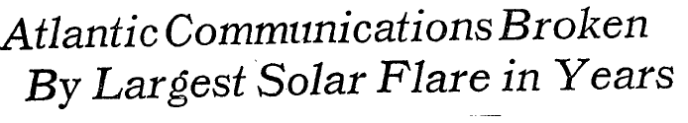

NYT 1978

Slide 37
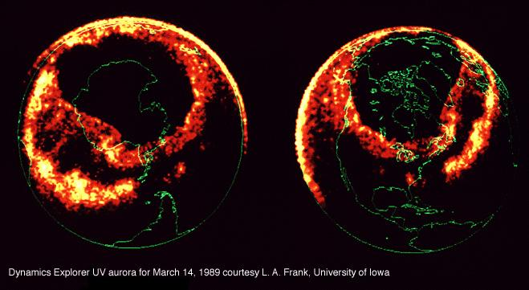
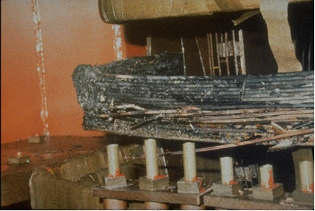
Quebec Blackout 1989
Notes:
Some intense solar flares and magnetic storms began to cause electric power grid failures in some limited geographic regions and powerful ground currents invaded transformers and caused them to fail.
37

Slide 38
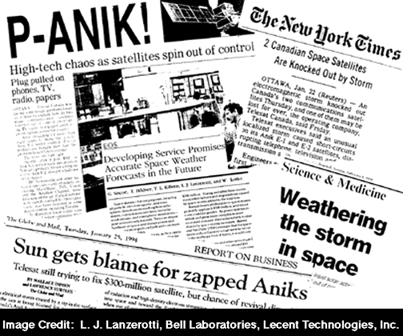
Canadian Anik Satellites 1994
Notes:
Satellite systems were also frequently targets for the energetic particles that accompanies solar storms.
38

Slide 39
Satellite Outage Felt By Millions
Not Just Pagers Were Affected As Radio
And TV Networks And Various Other Businesses
Using Galaxy IV Scrambled To Stay Connected.
“A satellite spinning aimlessly in space turned vital high-tech
equipment across the country into useless plastic Wednesday
and threatened to slow the forward surge of the Information Age.
Computer failure aboard the Galaxy IV telecommunications
satellite sent hospitals, radio and television networks, businesses
big and small, and millions of ordinary people scrambling to find
alternatives to pagers, automated tellers and other
satellite - dependent equipment.”
– Chicago Tribune, May 21, 1998
Galaxy IV - Pager Satellite Outrage, 1998

Slide 40
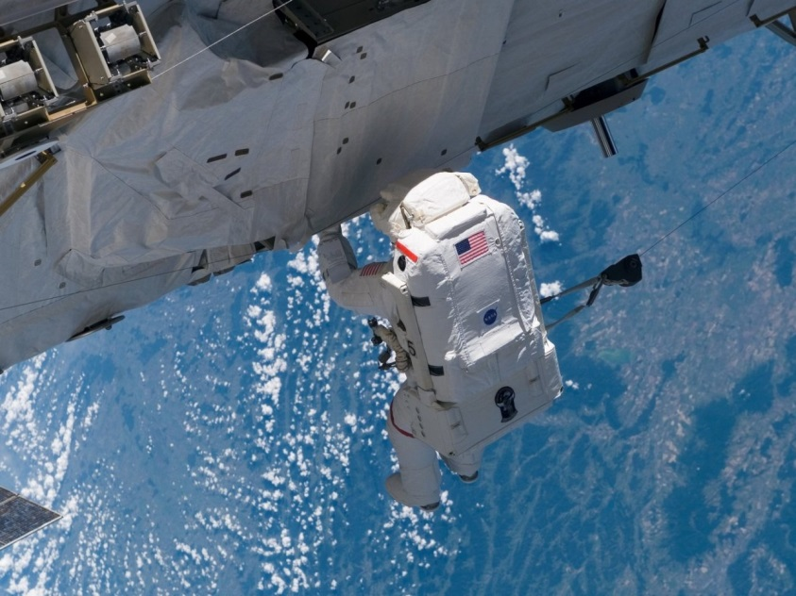
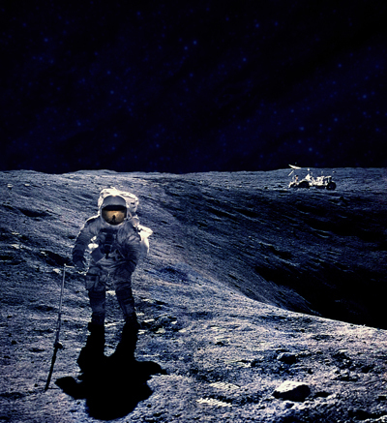
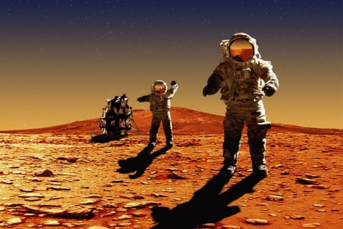
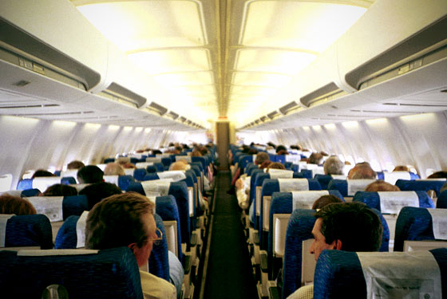

Radiation Effects
(100 Rem=1 Sv)
50 rem/mission
0.2 rem/flight
0.5 rem/mission
0.4 rem/yr
0.002 rem/flight (Crew=0.2 rem/yr)
Notes:
Radiation events also became a severe hazard to astronauts and high-altitude passenger flights.
40

Slide 41
Other large economic events…
San Francisco Earthquake.......1906…………$ 500 billion
California Santa Anna Fire 2025……………..$ 250 billion
Hurricane Katrina………………2005……..….$ 120 billion
Annual loss from electricity interruptions…….$ 80 billion
North American Power Grid Blackout…….....$ 30 billion/day
GEO satellite revenue loss………………..…..$ >25 billion
Blackout of East Coast.............1965……..….$ 10 billion
Mt Lassen Volcanic Eruption…1915……..….$ 5 billion
Quebec Blackout………………1989…………$ 2 billion
Notes:
Were a Carrington-level storm to re-occur today, it would cause damages comparable to the costliest natural catastrophes we have experienced thus far.
41

