Slide 1

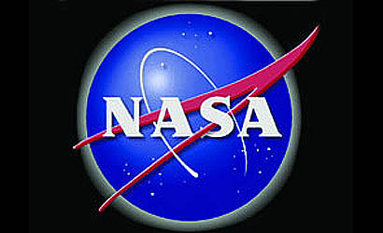
Space Weather from
A to B
Dr. Sten Odenwald
NASA / ADNET
NASA Inspire Webcast
NASA Goddard Spaceflight Center
November 3, 2011

Slide 2
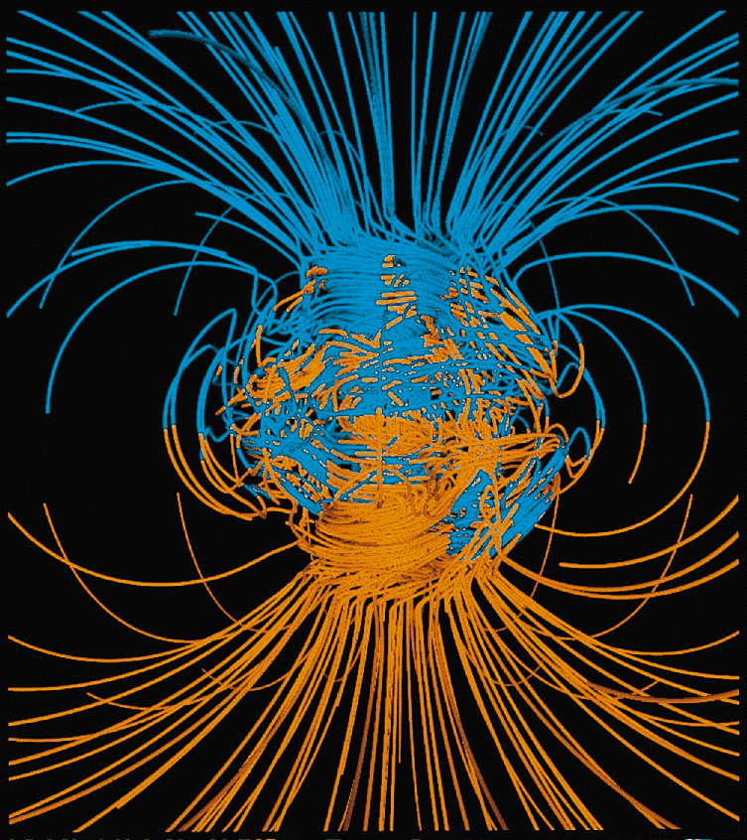
Notes:
Our Earth has a magnetic field that reaches far out into space. This supercomputer model shows its general shape close to Earth.

Slide 3
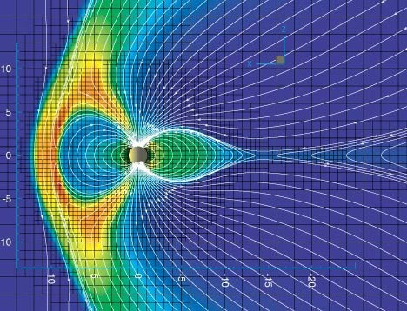
Notes:
In space it looks like the magnetic field of a bar magnet but is more complex because the solar wind flows past Earth (left to right)

Slide 4
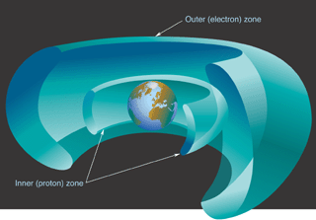
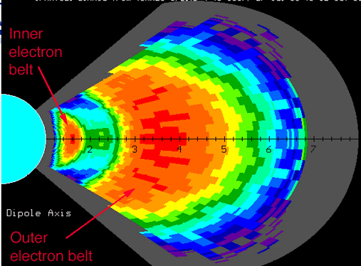
Notes:
Some energetic particles and cosmic rays get trapped in this field, which is why we have the van Allen radiation belts

Slide 5
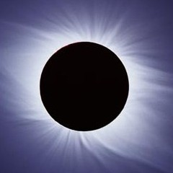
Notes:
Our sun is also a magnetic star with its own field trapped in the high temperature plasmas.

Slide 6
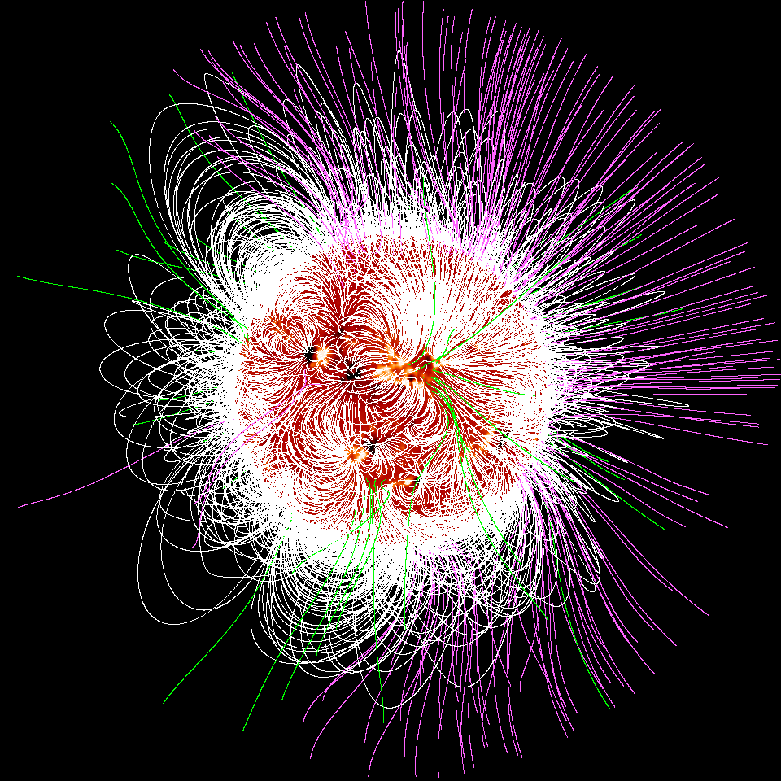
Notes:
iIt is a complex field concentrated in sunspots but sometimes these fields release their stormed energy to heat the local plasmas to millions of degrees

Slide 7
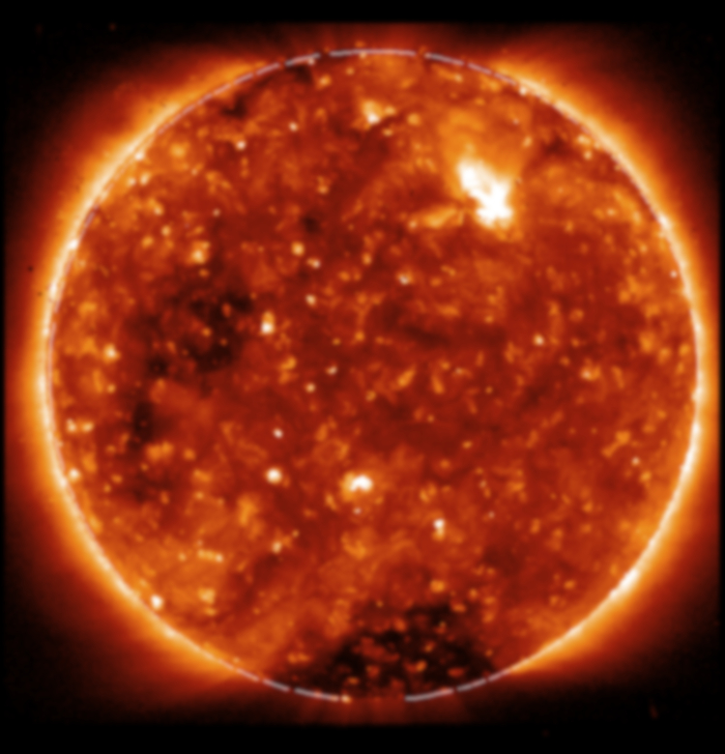
Notes:
These heated plasmas emit x-rays and dapple the entire surface with pinpoint dots of energy shown in this x-ray image

Slide 8
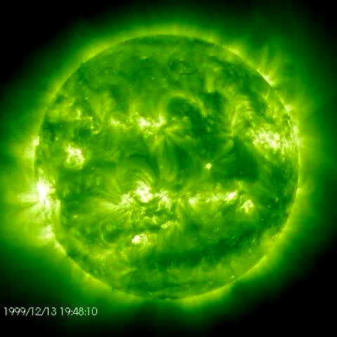
Notes:
Plasmas at lower temperatures tend to follow along the magnetic lines of force of the sun

Slide 9
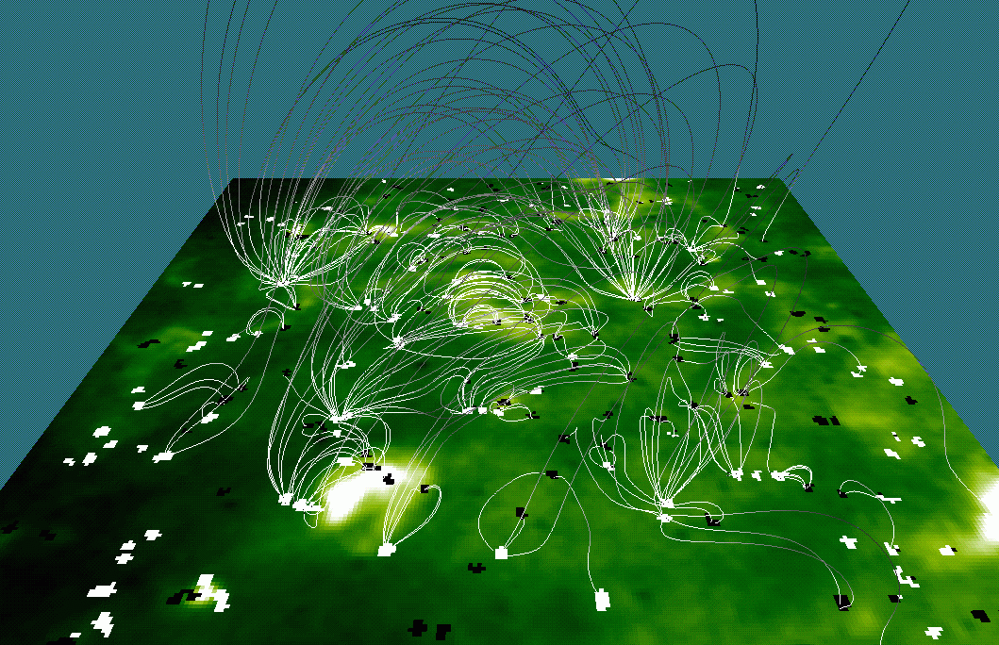
Notes:
The solar surface is a vast network of these tangled magnetic fields that connect sunspots

Slide 10
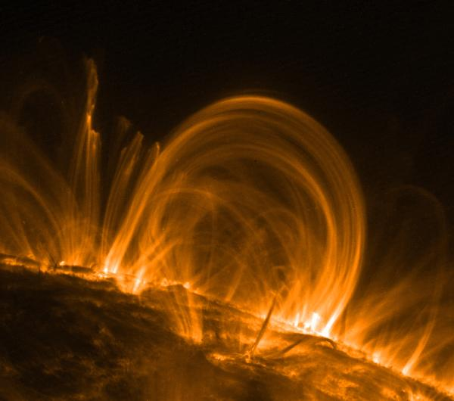
Notes:
Some of these magnetic fields are illuminated by the heated plasma so that we can actually see the magnetic lines of force

Slide 11
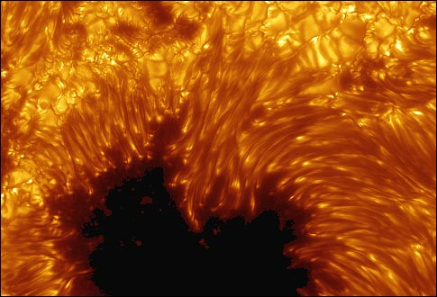
Notes:
Sunspots are regions of the surface where magnetic fields have been concentrated ,which makes the plasma cooler and emitting much less light than the surrounding photosphere

Slide 12
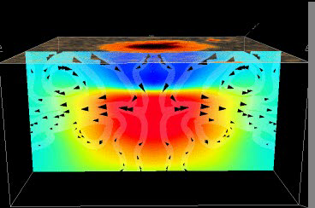
Notes:
Convention flows are responsible for concentrating magnetic fields and even generating them deeper under the solar surface

Slide 13
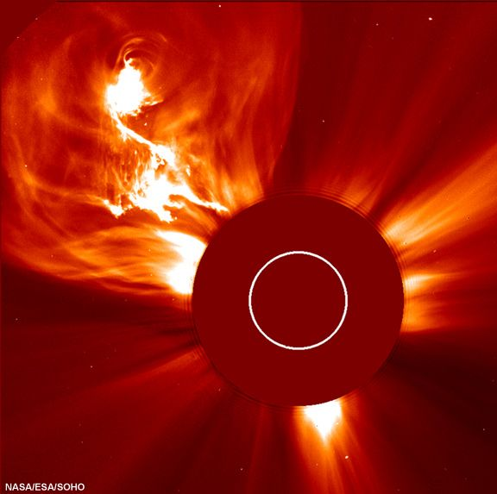
Courtesy - SOHO
Notes:
Some magnetic fields get so entangled that they release energy and eject plasma into space, called coronal mass ejections

Slide 14
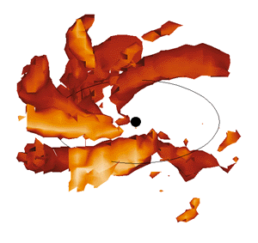
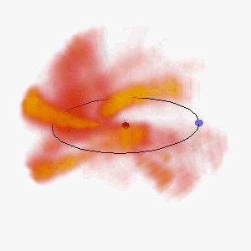
Courtesy – B. Jackson (UCLA)
Notes:
Coronal mass ejections can contain billions of tons of plasma and travel up to 3000 km/s, making the trip to Earth in less than a day from the time they were ejected

Slide 15
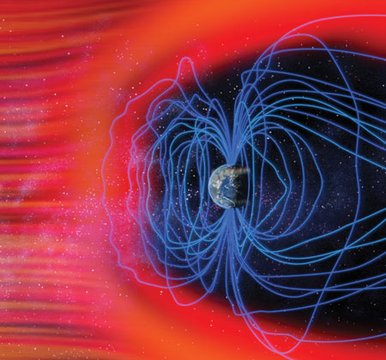
Notes:
What this magnetized plasma arrives near earth, it can cause rapid changes in Earth’s magnetic field allowing energetic particles to travel into the polar regions

Slide 16
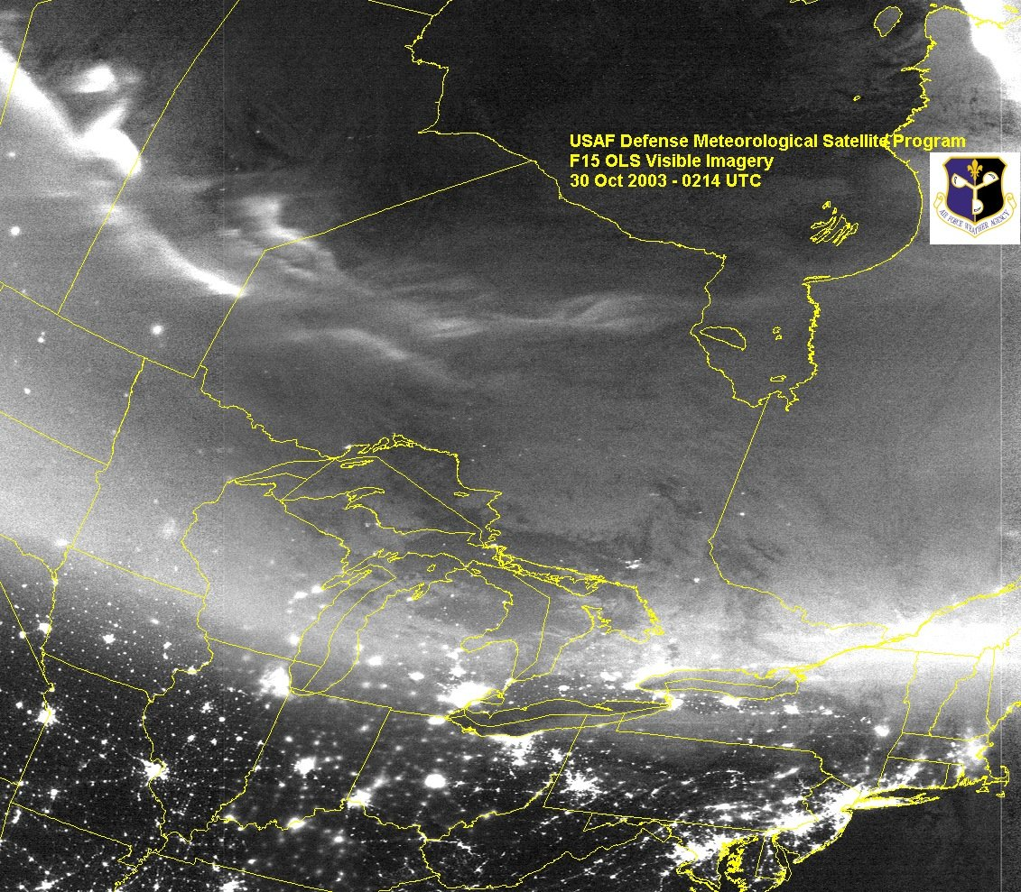
Courtesy - DMSP
Notes:
These particles collide with atoms of nitrogen and oxygen to reveal the beautiful aurora

Slide 17
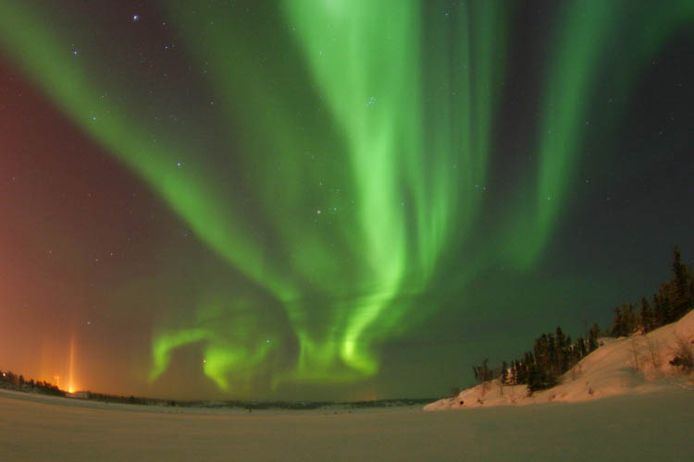

Slide 18
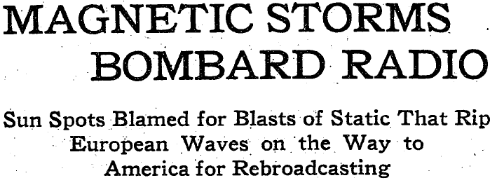
New York Times….. March 2, 1930
Notes:
These changes also cause magnetic storms near ground level that can lead to a variety of problems with our technology

Slide 19
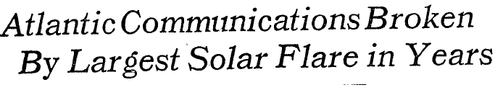

New York Times…April 29, 1978

Slide 20
Space Weather
‘Bad Hair Days’
Solar Storms
Solar Wind
Coronal Holes
Cosmic
Rays
Solar Flares
Coronal Mass Ejections
X-rays
8 min.
Energetic
Particles
~1-hr
Plasma + magnetic field
14-hr to 4 days
Milder
Geomagnetic
Storms
Ionosphere
disruption
and Heating
Geomagnetic Storms
No SPEs
SPEs
Satellite
Anomalies
Satellite
Anomalies
Satellite
Anomalies
GPS problems
Satellite drag
Power Grid problems
GLEs
Notes:
A summary of the various ways that ‘space weather’ storms can affect our technology

Slide 21
Famous Recent Storms
AA*
April 17, 1882 292
November 17, 1882 304
October 31, 1903 308
September 25, 1909 329
May 15, 1921 258
January 22, 1938 239
March 25, 1940 242
July 5, 1941 302
September 19, 1941 349
March 28, 1946 322
February 11, 1958 298
July 15, 1959 347
November 13, 1960 352
March 13, 1989 348
October 29, 2003 298
Notes:
A list of some of the most historically consequential storms in the ;last few hundred years

Slide 22
Human and Technology Impacts
1830, 1837, 1839, 1859, 1870, 1892, 1921, 1926, 1927, 1938, 1940, 1958, 1960, 1981 | Perceptions of cities on fire, fire department calls
1851, 1852, 1858, 1859, 1870, 1872, 1877, 1882, 1894, 1921, 1926, 1938, 1940 | Telegraph outages
1919, 1921, 1930, 1938, 1940, 1941, 1946, 1958, 1960, 1972 | Radio or TV interference
1832, 1837, 1859, 1882, 1926, 1938, 1960, 1989 | Severe psychic anxiety, mass panic, 'Doomsday'
1903, 1918, 1989, 1991, 2003 | Electrical system failures or disruptions
1835, 1837, 1859, 1872, 1946 | Compass and navigation problems
1859, 1882, 1921, 1940 | Fires and equipment damage.
1859, 1860, 1882, 1903, 1909, 1921, 1940, 1958 | Electrical shocks and high-voltage conditions
1972, 1989, 1998, 2000, 2003 | Satellite failures and upsets
1972, 1989, 2000, 2003 | Excessive astronaut radiation dosages
1938, 1940, 1946, 1989 | Air Travel issues
1915, 1918, 1926, 1940, 1941, 1943, 1950, 1957, 1958, 1989 | Military communications problems
2003 | GPS positioning errors

Slide 23
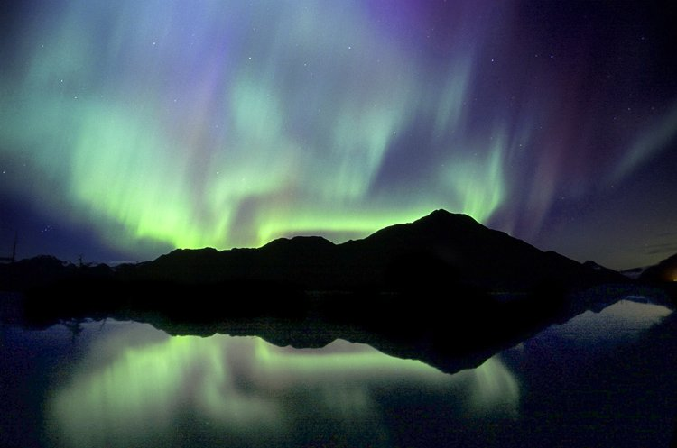
The light streaks shot upwards from the horizon and varied in width and length,
and changed as long as the phenomenon was visible. It was a grand sight,
and was witnessed by thousands of persons, many of whom never saw the
like before. [The Baltimore Sun, , 1859, p.1 ]

Slide 24
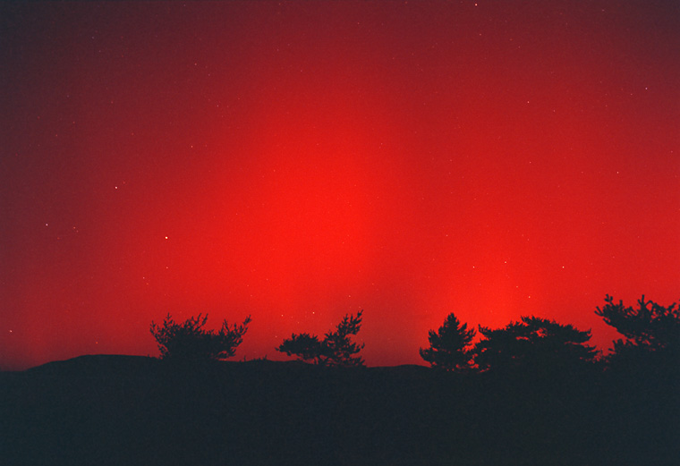
Crowds of people gathered at the street corners, admiring and commenting upon the singular spectacle…Several old women were nearly frightened to death, thinking it announced the end of the world, and immediately took to saying their prayers. A fat old citizen tremblingly stated that this was the avant courier of a dreadful epidemic like cholera of 1833. [New Orleans Daily Picayune, p.5]

Slide 25
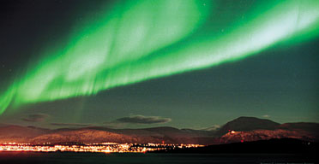
The French telegraph communications at Paris were greatly affected, and on interrupting the circuit of the conducting wire strong sparks were observed. The same thing occurred at the same time at all the telegraphic station in France…[The Illustrated London News, September 24, 1859].

Slide 26
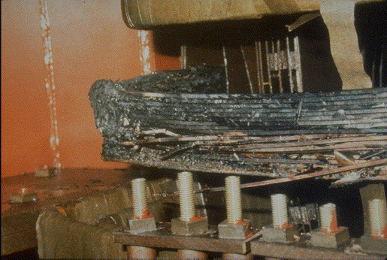
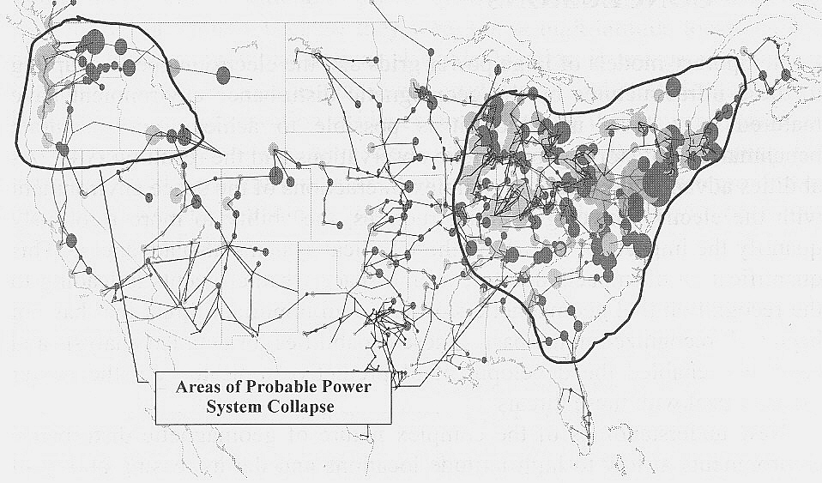
Power grid damage
$30 billion per day
GDP loss
Notes:
Our electric power grid is susceptible to geomagnetic storms because many transformers are ‘grounded’ to Earth where currents can flow into them from magnetic storm events

Slide 27
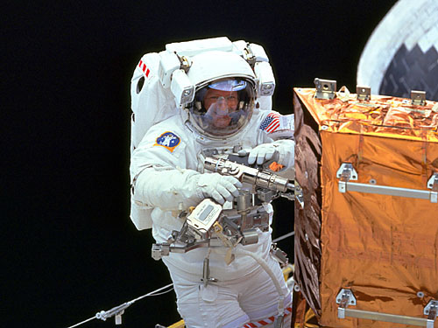
Spacesuit
~1 gm/cm2
Nausea, Malaise
Blood cell damage
Slight chance of death
Spacecraft
~10 gm/cm2
No significant health effects
Below 30-day limit for Astronauts
Notes:
Space weather storms can also involve bursts of high energy radiation that can be harmful to astronauts not properly shielded

Slide 28
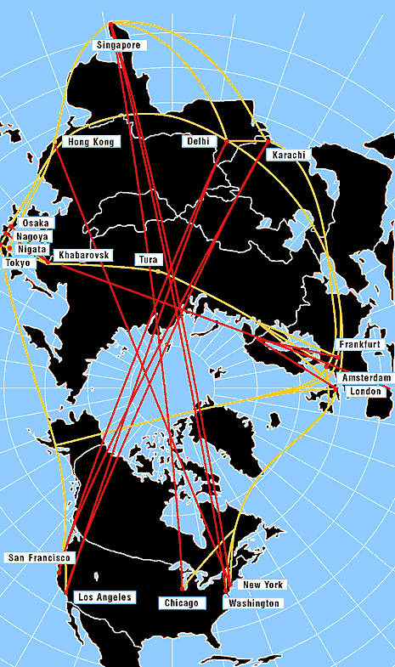
Airline Traffic:
Polar traffic re-routed
1995 20 flights
2012 6000 flights
Polar Cap Absorption Zone
Extends to Lower-48
Notes:
High altitude polar airline flights can also receive large doses of radiation during their flight times equal to several chest x-rays for each event

Slide 29
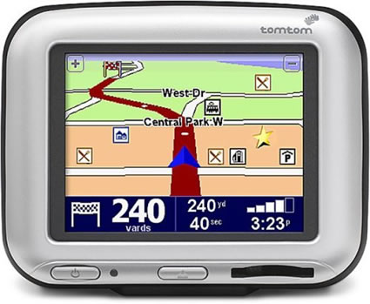
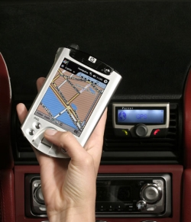
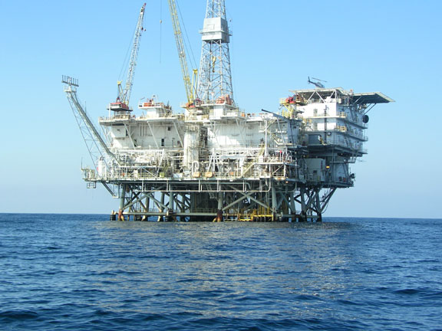
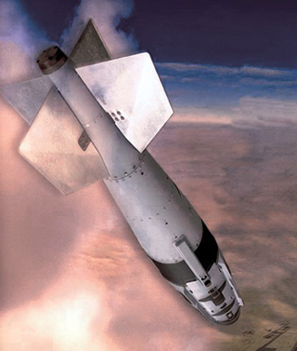
GPS Satellite System:
200-meter errors for hours
Notes:
A variety of satellite systems can also be affected by space weather events and have to be constantly monitored

Slide 30
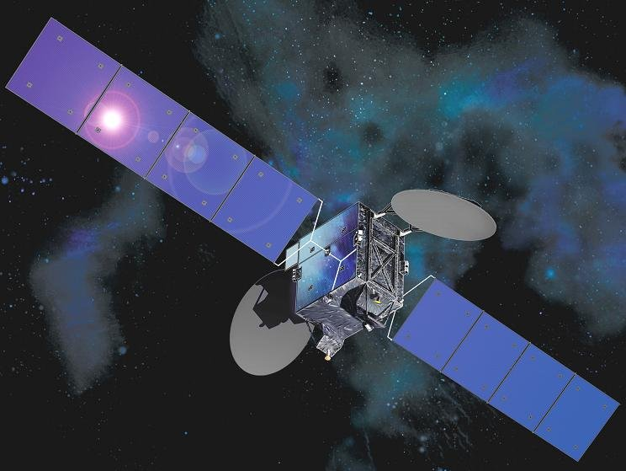

Slide 31
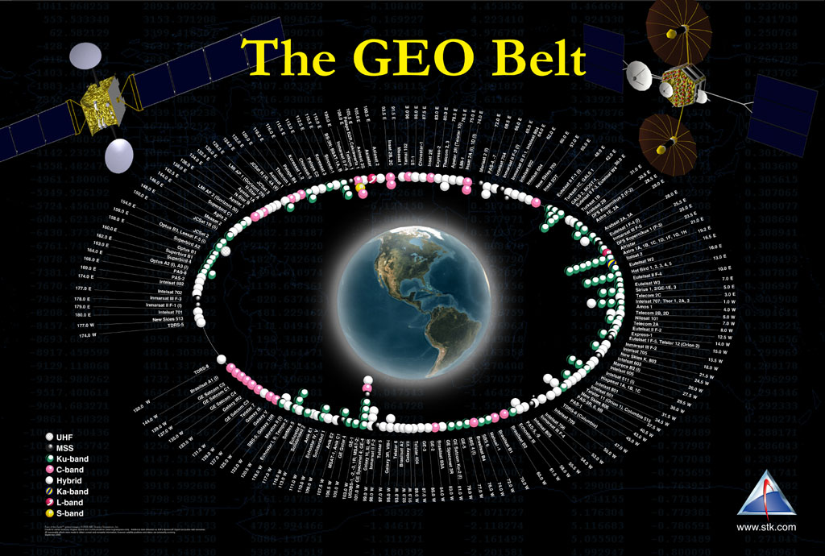
Notes:
Geosynchronous satellites of which there are over 400 in operation, can be damaged or fail to perform during ‘anomalies’

Slide 32
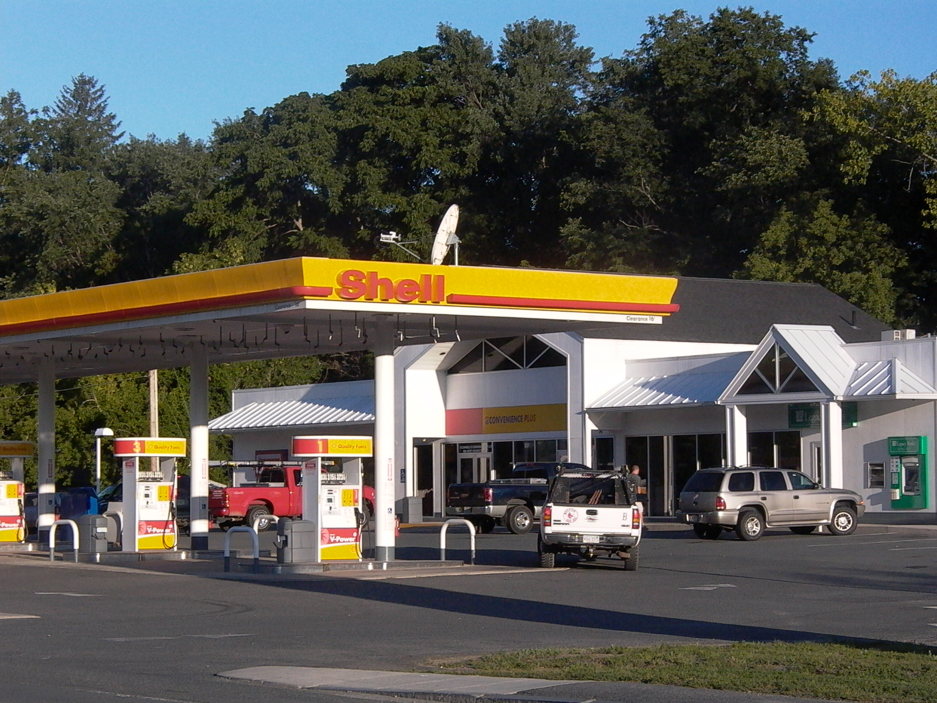
Notes:
Our dependence on reliable satellites grows every year

Slide 33
Satellite Impacts
Notes:
Space weather affects a variety of satellite systems in many different ways

Slide 34
23rd Cycle Satellite Outages
(1997-2004)
Telstar 401 $ 250 million
Tempo-2 $ 150 million
Adeos $ 474 million
PAS-6 $ 150 million
Equator-S $ 12 million
ASCA $ 100 million
Midori-II $ 640 million
Total = $1.8 billion to $2.95 billion
Notes:
Some satellites have actually been fatally affected because of severe space weather storms

Slide 35
Other large economic events…
San Francisco Earthquake.......1906…………$ 500 billion
California Santa Anna Fire……2025…………$ 250 billion
Hurricane Katrina………………2005……..….$ 120 billion
Annual loss from electricity interruptions…….$ 80 billion
North American Power Grid Blackout…….....$ 30 billion/day
GEO satellite revenue loss………………..…..$ >25 billion
Blackout of East Coast.............1965……..….$ 10 billion
Mt Lassen Volcanic Eruption…1915……..….$ 5 billion
Quebec Blackout………………1989…………$ 2 billion
Notes:
The most severe space weather event in 1859, were it to happen today, would rank among the most expensive natural disasters in history

Slide 36
Space Weather Resources…
YouTube Videos: ‘Sten Odenwald’
http://www.youtube.com/watch?v=DSfAI6_7bjU

