Slide 1
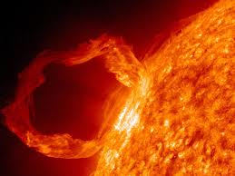
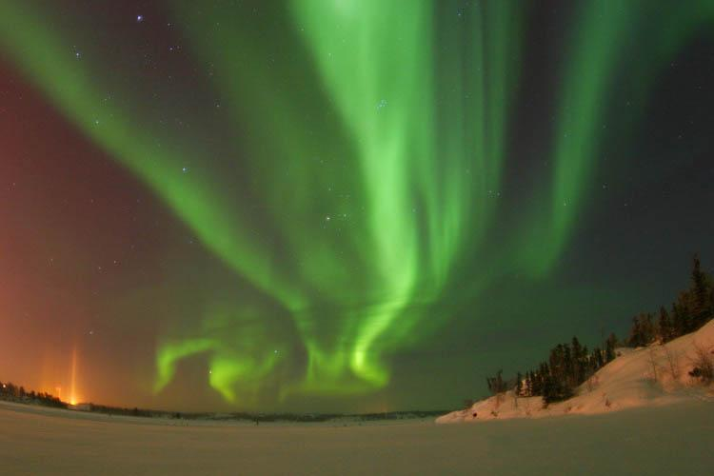
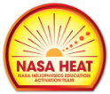
Space Weather
Basics
Dr. Sten Odenwald
NASA HEAT
Notes:
Originally created by Dr. Odenwald for NSSEC in January 2016. Updated 2/18/25

Slide 2
Basic components to space weather
Solar Flares
Coronal Mass Ejections
Solar Proton Events
Solar Wind
Geomagnetic Storms
Van Allen Belts
Cosmic Rays

Slide 3
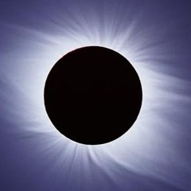
Notes:
The sun has a magnetic field that can be seen in the corona with the right kind of photography.
3

Slide 4
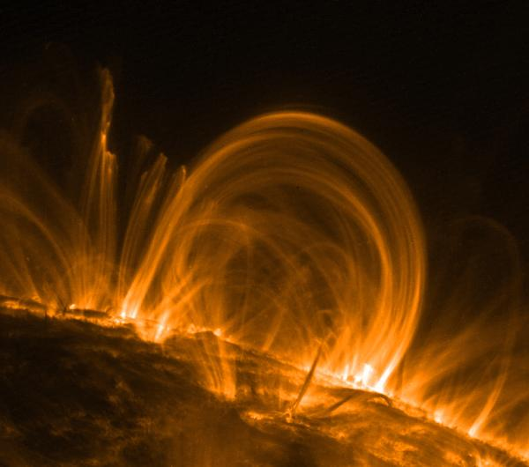
Notes:
On the surface the magnetic field often gets concentrated into sunspots.
4

Slide 5
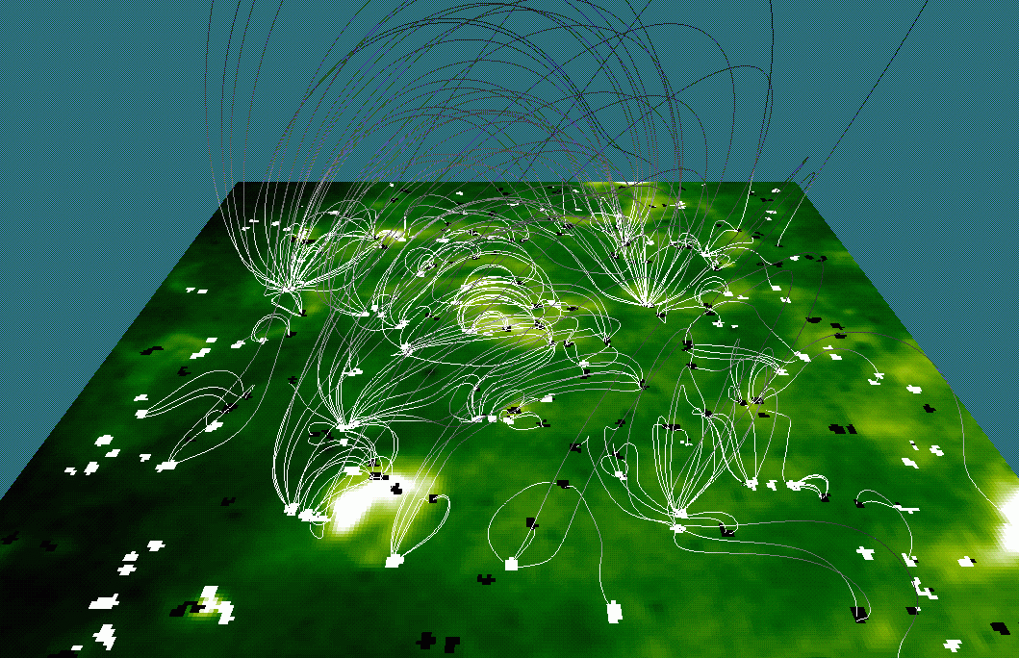
Notes:
The entire surface is covered with a complex network of magnetic fields that can get tangles up when sunspots move around.
5

Slide 6
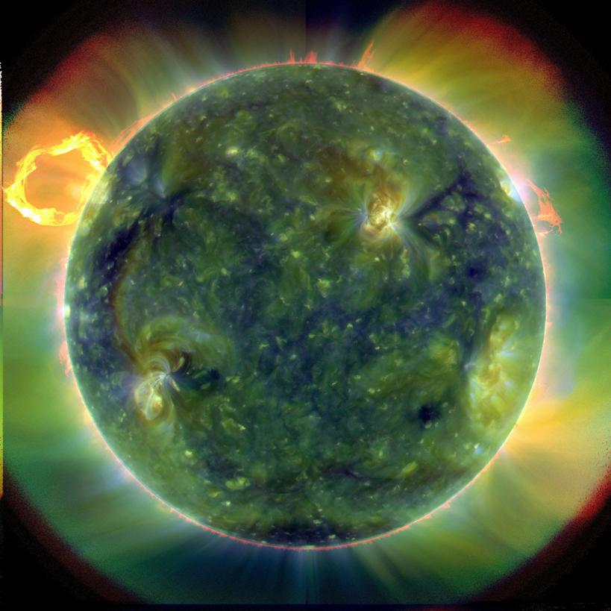
Notes:
Tangles magnetic fields often release stored energy and heat the solar surface, causing x-ray hot spots.
6

Slide 7
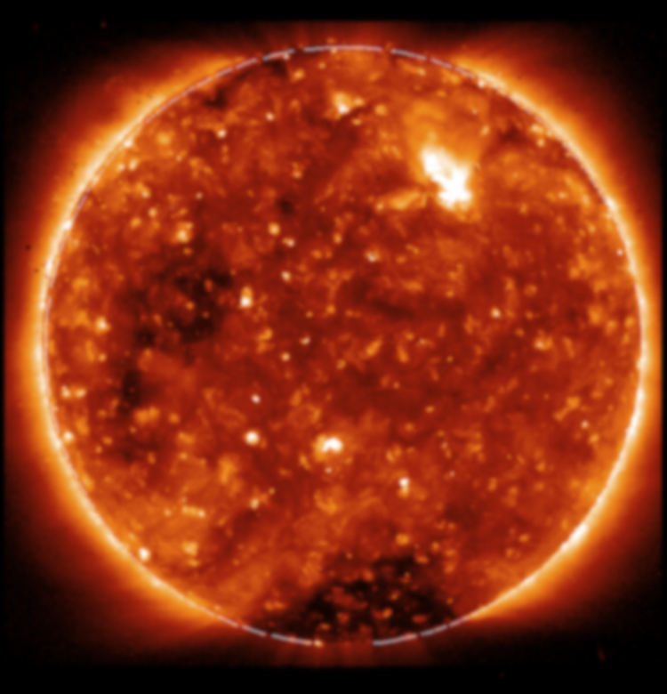
Notes:
These hotsspots can be seen at many different wavelengths because they contain heated plasma at many different temperatures.
7

Slide 8
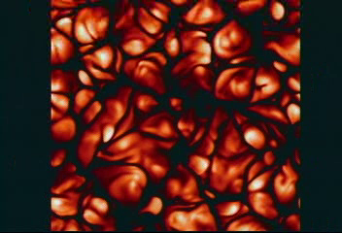
Notes:
The surface magnetic field originates below its convecting surface and is dragged to the visible surface by convection cells.
8

Slide 9
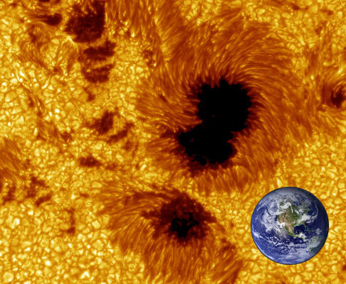
Notes:
Sunspots are created when these magnetic fields are amplified and focused into small regions of the surface.
9

Slide 10
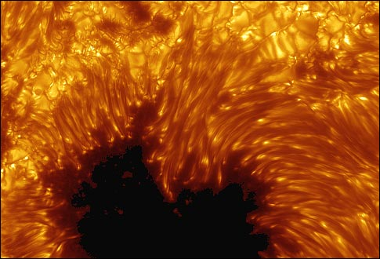
Notes:
Sunspots are very complex systems of magnetic fields interacting with the local solar surface plasma.
10

Slide 11
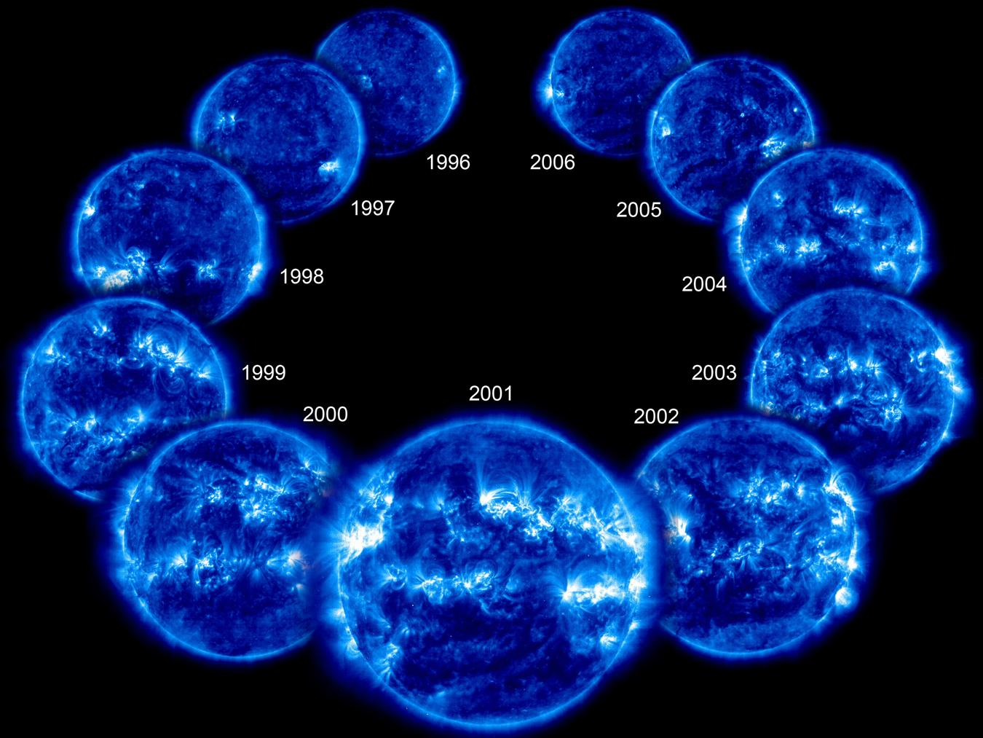
Notes:
Because of complex convection, differential rotation and meridional surface flows, the number of sunspots increase and decrease with an 11-year cycle.
11

Slide 12
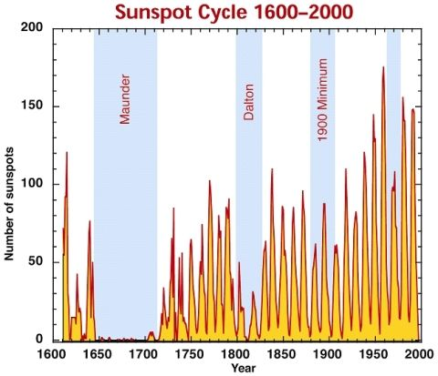
Sunspots
Notes:
These sunspots cycles have been observed since the 1600s but sometimes they vanish completely for decades like the Maunder Minimum between 1650-1710.
12

Slide 13
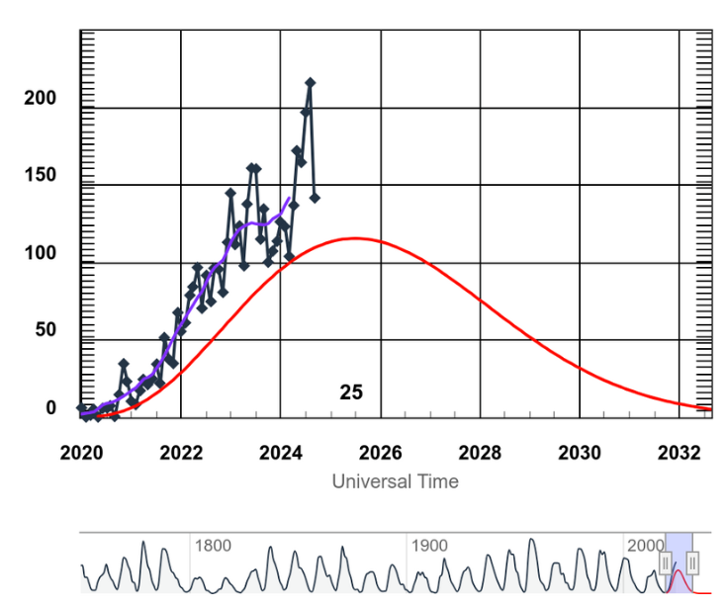
Sunspot Cycle 25
Courtesy - SOHO
Notes:
We are currently at the peak of Sunspot Cycle 25 (SC25).
13

Slide 14
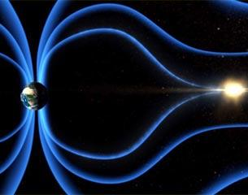
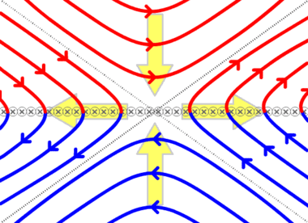
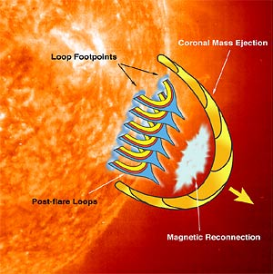
Magnetic Reconnection
Notes:
When sunspots collide, opposing magnetic field systems reconnect into new shapes and release stored magnetic energy, which can heat the local plasma to millions of degrees.
14

Slide 15
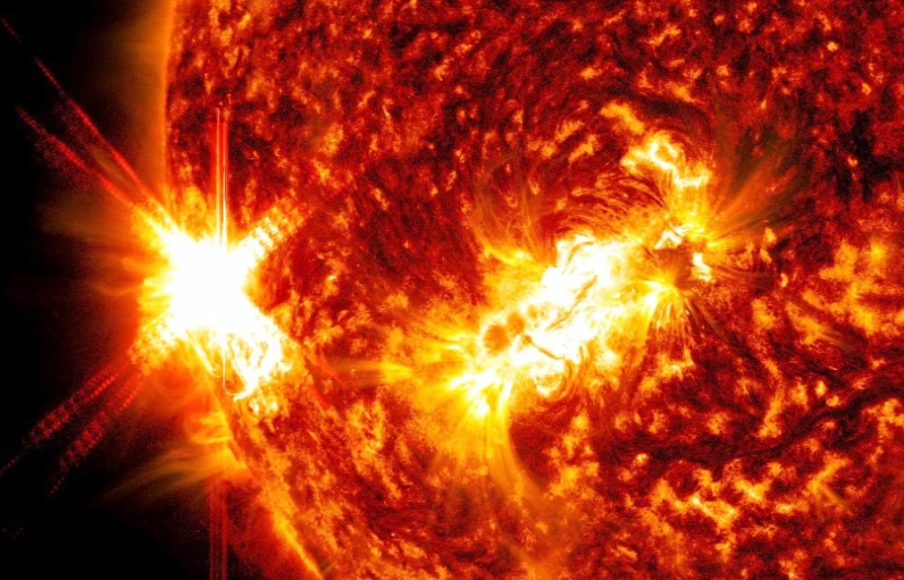
Solar Flares
Courtesy – SOHO January 9, 2023
Notes:
Magnetic reconnection energy causes intense bursts of x-rays which are called solar flares.
15

Slide 16
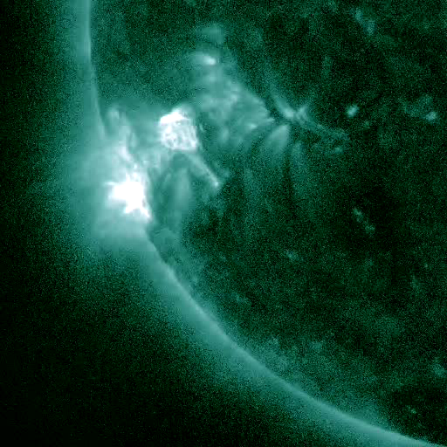
Solar Flares
Courtesy – SDO April 21-23, 2011

Slide 17
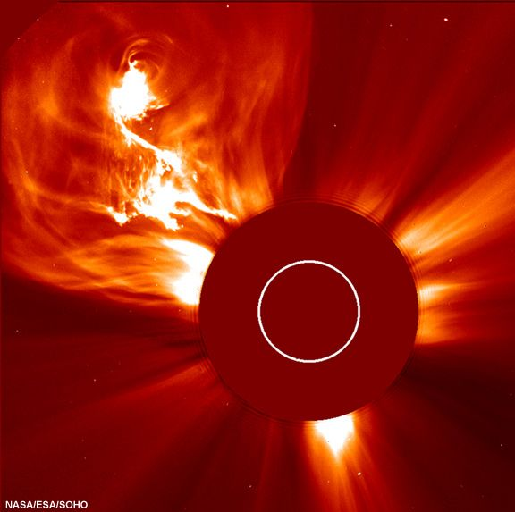
Coronal Mass Ejections
Courtesy - SOHO
Notes:
Intense solar flares can release billions of tons of plasma into interplanetary space called coronal mass ejections.
17

Slide 18
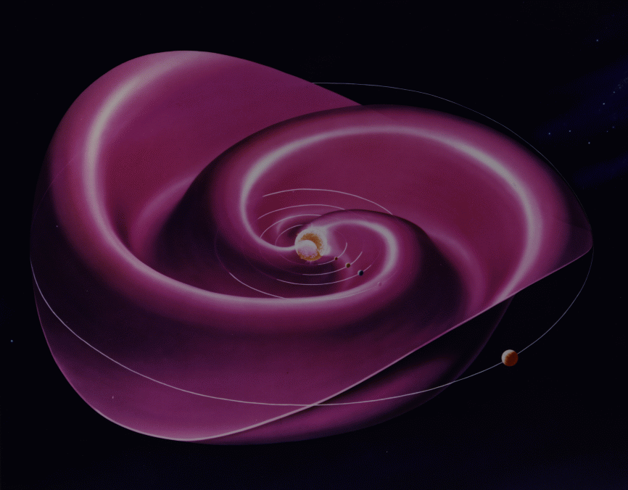
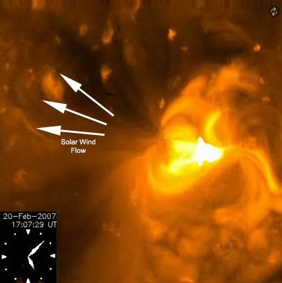
Solar Wind
Courtesy - SOHO
Notes:
Some of the energy and plasma from thousands of mini-flares also provide the mass and momentum to create a wind from the sun that flows out into interplanetary space.
18

Slide 19
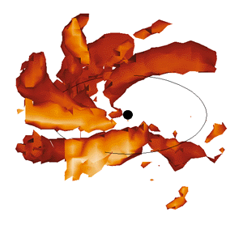
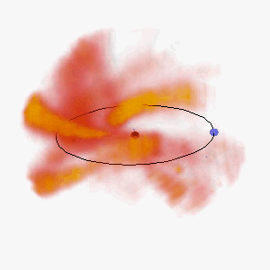
Courtesy – B. Jackson (UCLA)
Notes:
The solar wind can also transport matter from coronal mass ejections and other outflows like a conveyor belt in space.
19

Slide 20
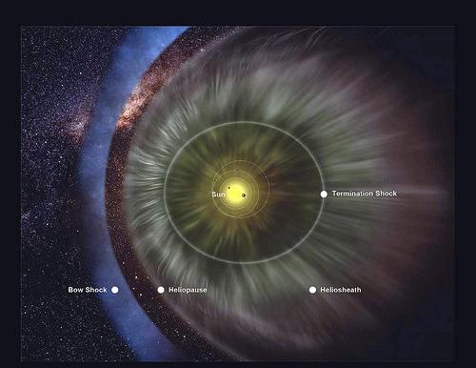
Heliopause
Courtesy - SOHO
Notes:
Eventually the solar wind collides with the interstellar medium to form the heliopause, making the solar system look like a comet.
20

Slide 21
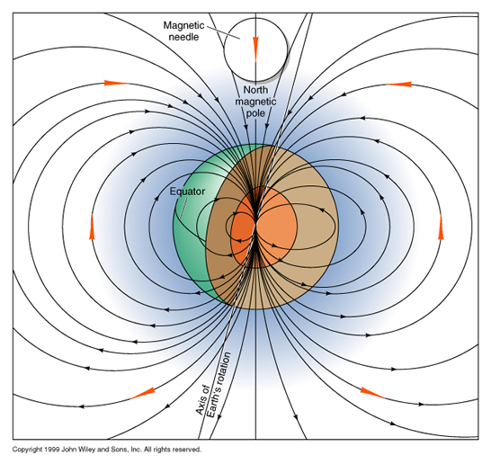
Geomagnetic Field
Notes:
Our Earth’s magnetic field is generated in the outer liquid core and extends millions of miles into space.
21

Slide 22
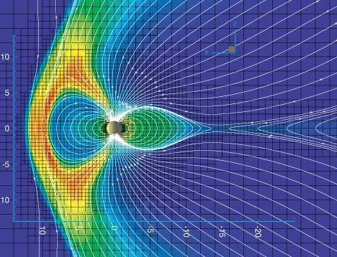
Notes:
Models of this ‘geomagnetic’ field show how it is organized in a complex way because of the charged and magnetic solar wind plasma streaming by.
22

Slide 23
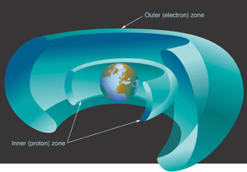
Van Allen Belts
Notes:
Close-in to Earth, energetic particles such as electrons and protons can be trapped by the intense geomagnetic field to form the Van Allen radiation belts.
23

Slide 24
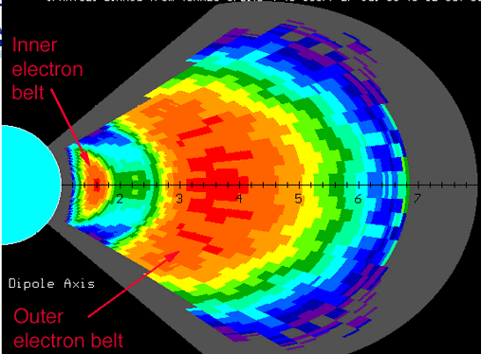
Van Allen Belts

Slide 25
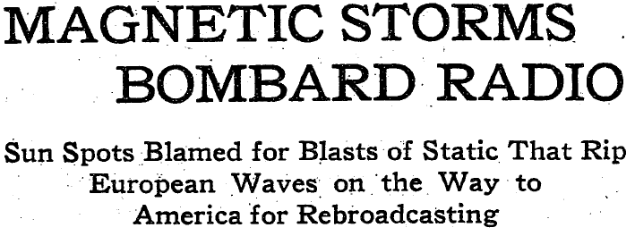
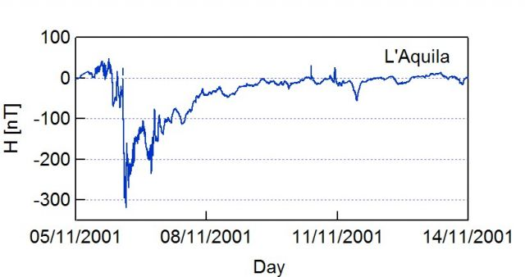
Courtesy - SOHO
Notes:
Suring intense solar storms and coronal mass ejection events, Earth’s magnetic field changes in complex ways to create what are called magnetic storms.
25

Slide 26
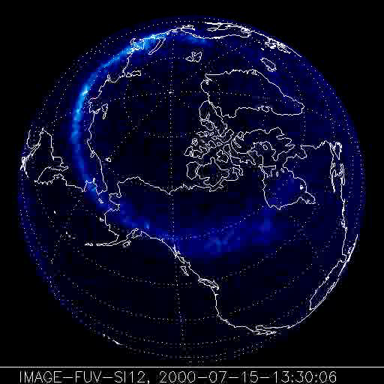
Courtesy - IMAGE
Notes:
At the same time, trapped particles in the comet-like magnetic tail flow into the polar regions to form the aurora.
26

Slide 27
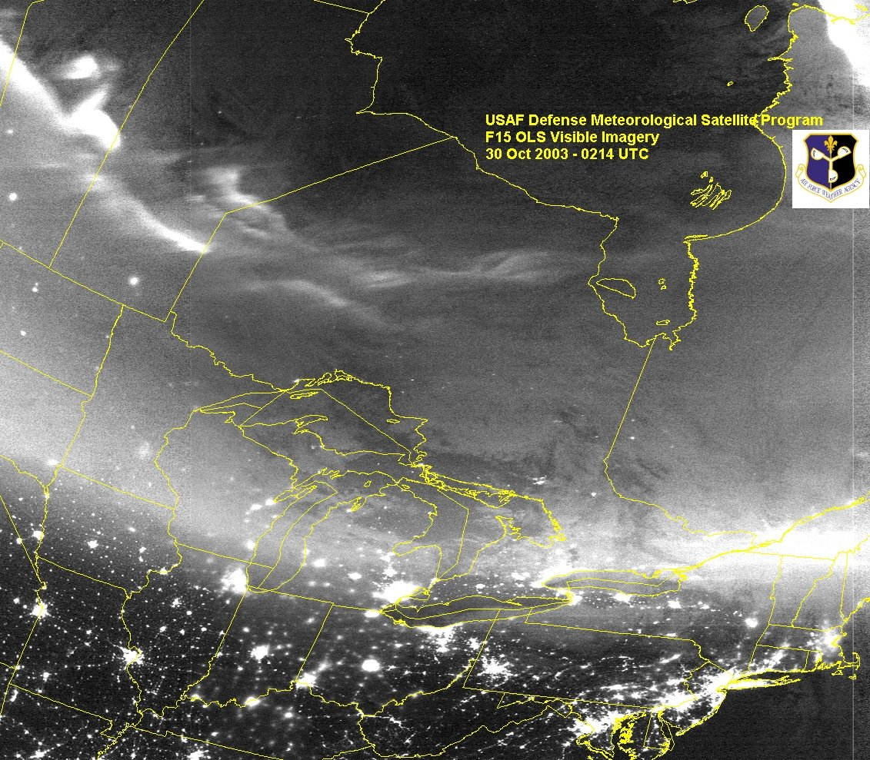
Courtesy - DMSP
Notes:
Aurora can be seen from satellites.
27

Slide 28
Notes:
But we all know them from how beautiful they look from the ground.
28

Slide 29
Famous Recent Storms
AA*
April 17, 1882 292
November 17, 1882 304
October 31, 1903 308
September 25, 1909 329
May 15, 1921 258
January 22, 1938 239
March 25, 1940 242
July 5, 1941 302
September 19, 1941 349
March 28, 1946 322
February 11, 1958 298
July 15, 1959 347
November 13, 1960 352
March 13, 1989 348
October 29, 2003 298
Notes:
There have been many intense solar storms that have affected Earth, and many of these caused upsets in the performance of telegraph, radio and satellite communications.
29

Slide 30
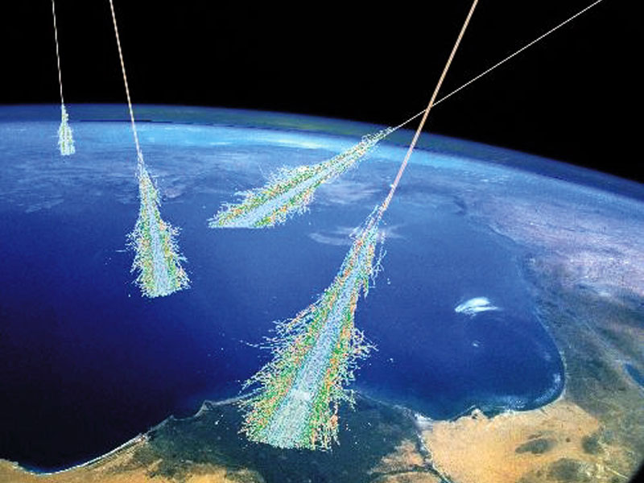
Cosmic Rays
Courtesy - SOHO
Notes:
Another feature of space weather are cosmic rays. Many of them come from our sun, but the most energetic cosmic ray particles come from supernovae and distant galaxies beyond our Milky Way.
30

Slide 31
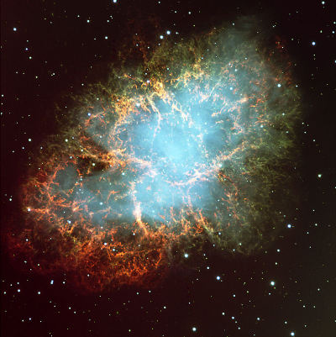
Cosmic Rays
Courtesy - SOHO
Notes:
The most powerful source of cosmic rays in our local Milky Way is the supernova remnant called the Crab Nebula in the constellation Taurus.
31

Slide 32
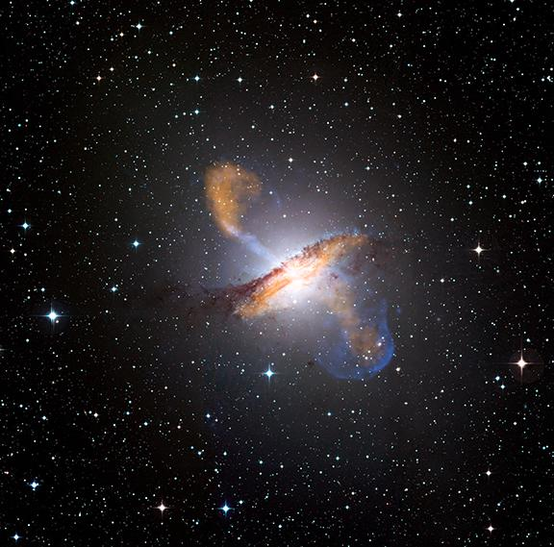
Cosmic Rays
Courtesy - SOHO
Notes:
The most powerful source of cosmic rays in our local universe is the galaxy called Centaurus-A which has a supermassive black hole in its dense core region.
32

Slide 33
Space Weather
‘Bad Hair Days’
Solar Storms
Solar Wind
Coronal Holes
Cosmic
Rays
Solar Flares
Coronal Mass Ejections
X-rays
8 min.
Energetic
Particles
~1-hr
Plasma + magnetic field
14-hr to 4 days
Milder
Geomagnetic
Storms
Ionosphere
disruption
and Heating
Geomagnetic Storms
No SPEs
SPEs
Satellite
Anomalies
Satellite
Anomalies
Satellite
Anomalies
GPS problems
Satellite drag
Power Grid problems
GLEs
Notes:
In summary, space weather is a collection of solar and geophysical phenomena that each cause specific problems with our technology, which is why space weather is such an important subject of investigation and steadily improved forecasting.
33

