Slide 1
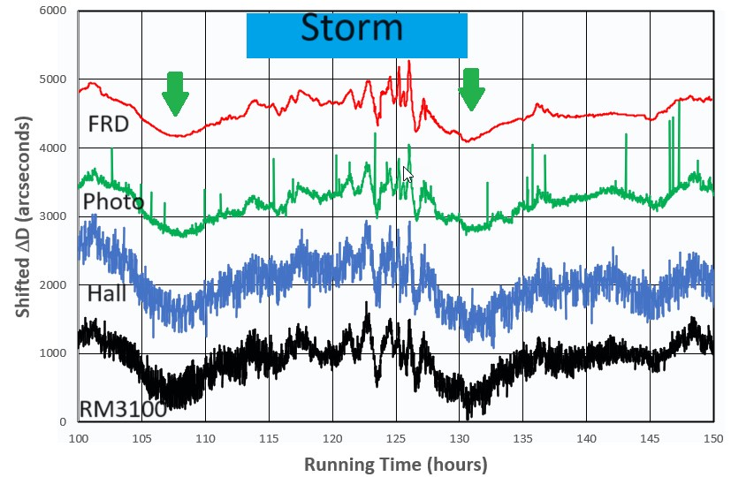
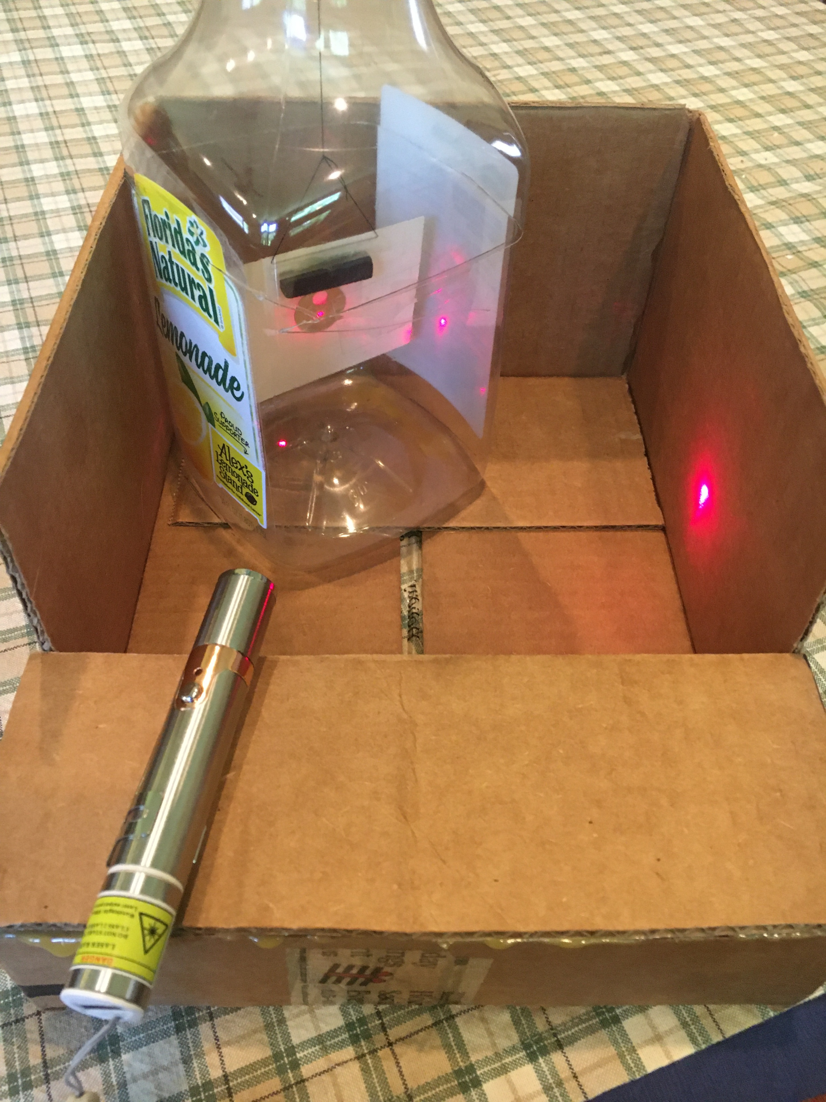
DIY Magnetometers
for Studying Space Weather
Sten Odenwald
NASA HEAT
February, 2025

Slide 2
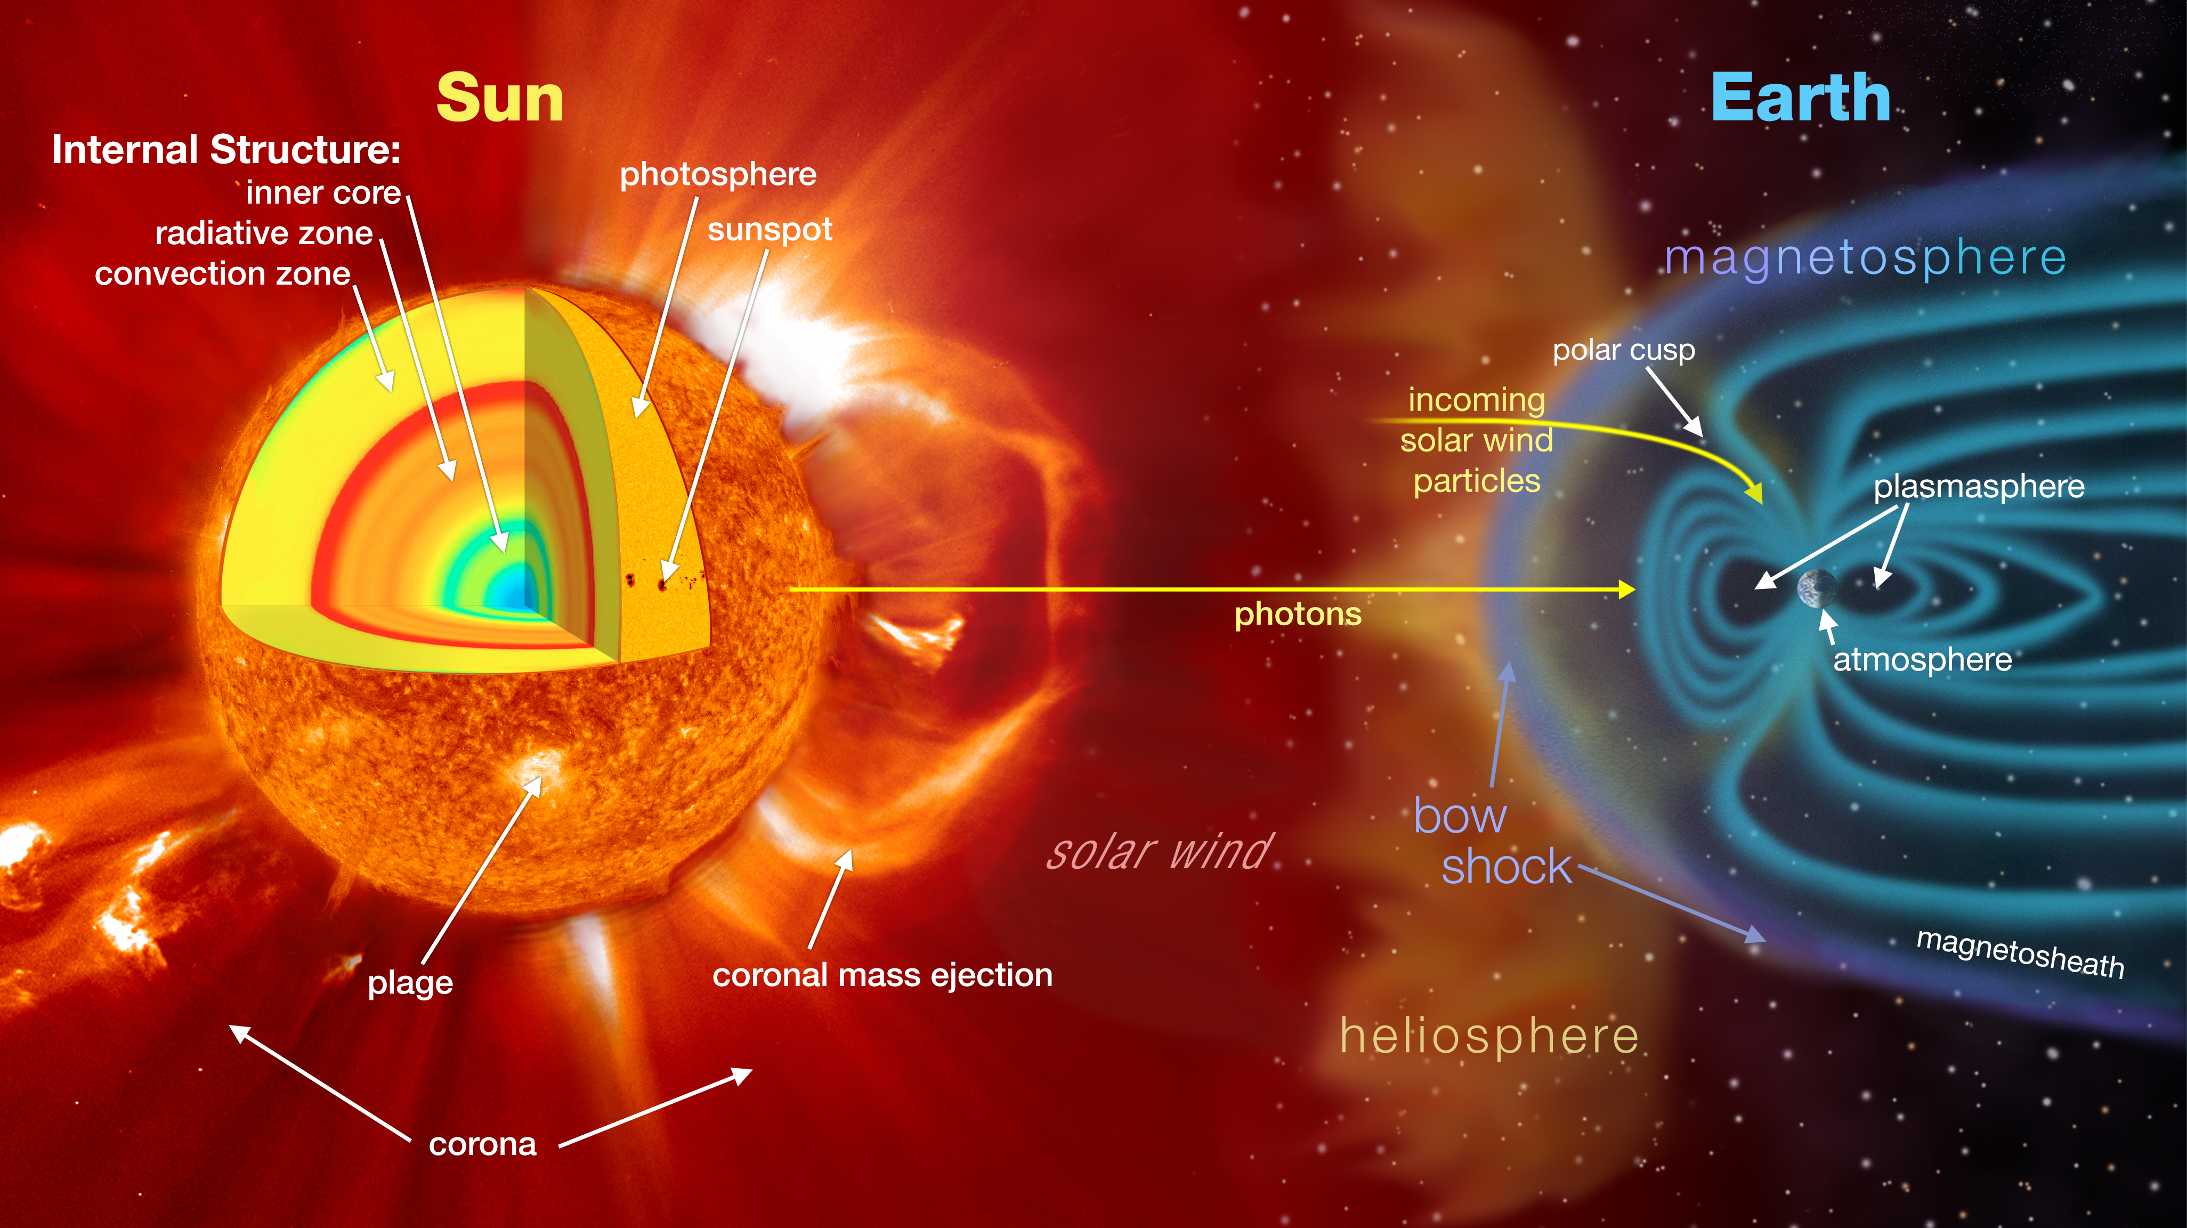
Credit: NASA/GSFC/Scientific Visualization Studio
Notes:
The sun-earth connection contains many ingredients that are usually referred to as simply aspects of ‘space weather’

Slide 3
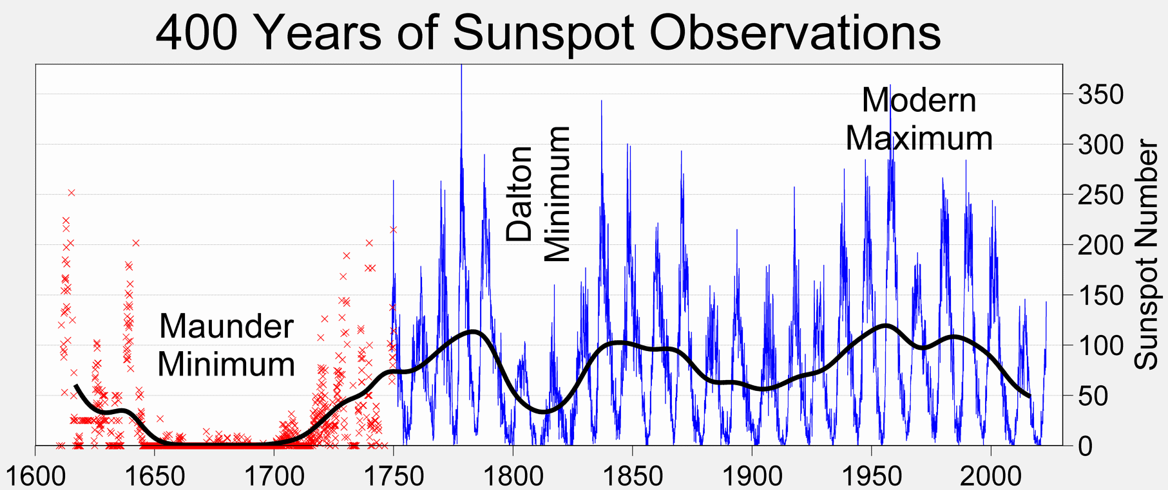
Sunspots
Credit: Wikipedia / Robert A. Rohde / Global Warming Art project.
Notes:
These sunspots cycles have been observed wince the 1600s but sometimes they vanish completely for decades like the Maunder Minimum between 1650-1710

Slide 4
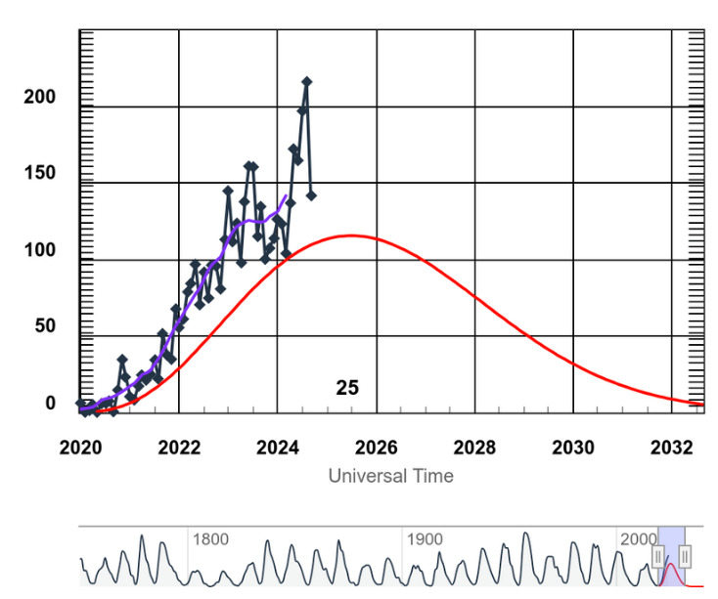
Sunspot Cycle 25
Credit: NOAA/ SWPC
Notes:
We are currently at the peak of Sunspot Cycle 25 (SC25)

Slide 5
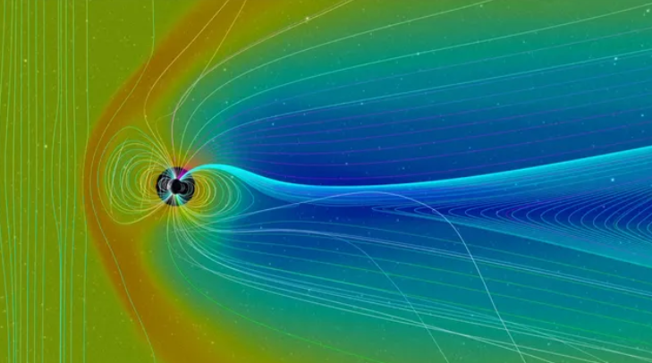
Credit: NASA Scientific Visualization Studio
Notes:
Models of this ‘geomagnetic’ field show how it is organized in a complex way because of the charged and magnetic solar wind plasma streaming by

Slide 6
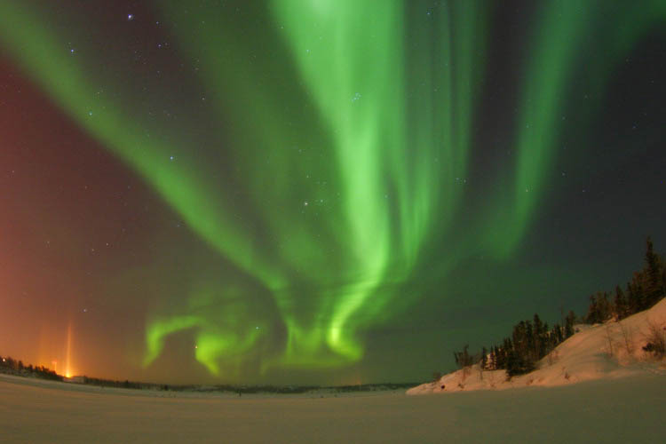
Credit: Andrew Eaton
Notes:
But we all know them from how beautiful they look from the ground

Slide 7
Space Weather
‘Bad Hair Days’
Solar Storms
Solar Wind
Coronal Holes
Cosmic
Rays
Solar Flares
Coronal Mass Ejections
X-rays
8 min.
Energetic
Particles
~1-hr
Plasma + magnetic field
14-hr to 4 days
Milder
Geomagnetic
Storms
Ionosphere
disruption
and Heating
Geomagnetic Storms
No SPEs
SPEs
Satellite
Anomalies
Satellite
Anomalies
Satellite
Anomalies
GPS problems
Satellite drag
Power Grid problems
GLEs
Notes:
A summary of the various ways that ‘space weather’ storms can affect our technology

Slide 8
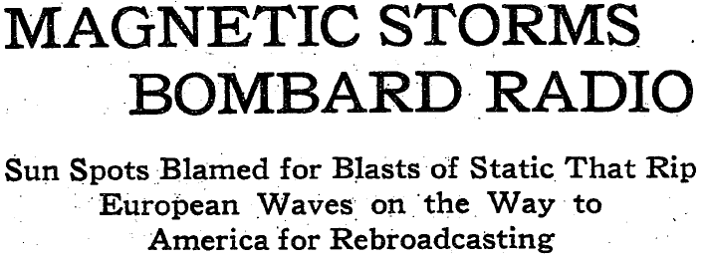
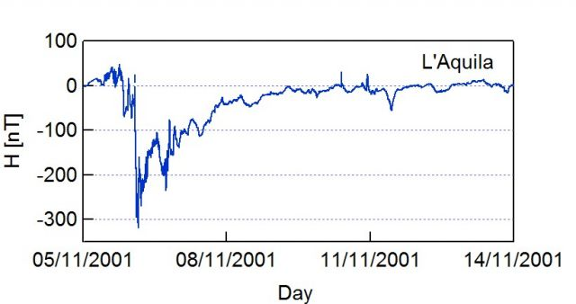
Credit: New York Times /. L'Aquila Observatory (Italy)
Notes:
Suring intense solar storms and coronal mass ejection events, Earth’s magnetic field changes in complex ways to create what are called magnetic storms

Slide 9
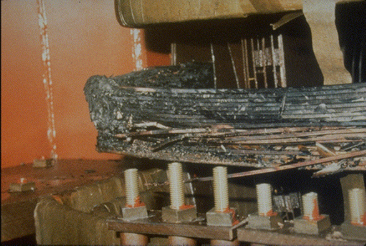
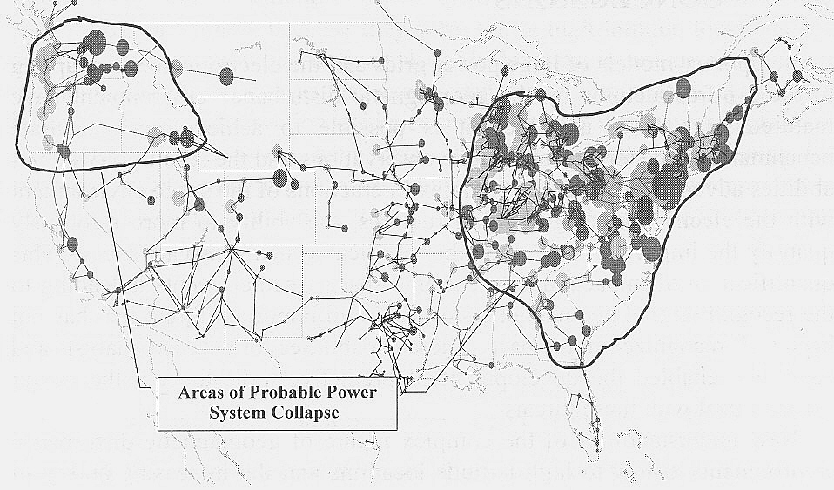
Power grid damage
$30 billion per day
GDP loss
Credit: John Kappenmann / FEMA
Notes:
Our electric power grid is susceptible to geomagnetic storms because many transformers are ‘grounded’ to Earth where currents can flow into them from magnetic storm events

Slide 10
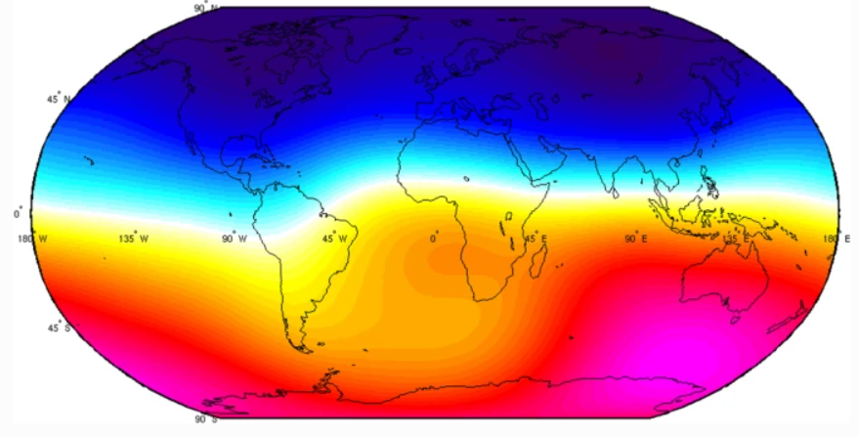
Credit: China Seismo-Electromagnetic Satellite Mission
Notes:
The main portion of Earth’s magnetic field has a dipolar south-north polarity as shown in this satellite map where south is shown in blue and north is shown in red

Slide 11
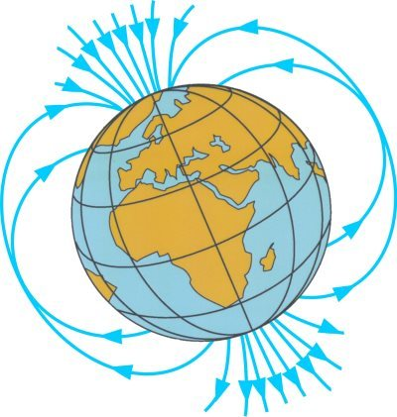
B
3-D map of B vector
B vector at a single
geographic point
Notes:
Magnetic fields are defined as mathematical vectors in 3-dimensional space. They are represented at each point by an arrow whose length equals the strength of the field and a direction given by the head of the arrow.

Slide 12
Y = north-south
X = east-west
B
Z = zenith-nadir
Notes:
We can represent this directed arrow in the usual cartesian coordinate system but where the coordinates align with Earth’s geographic coordinates

Slide 13
Y
X
B
Bz
Z
Notes:
The X-Y plane at a single geographic point forms the tangent plane at this point, with the third ‘Z’ coordinate aligned with the zenith-nadir axis

Slide 14
Y
Y
X
B
X
Bz
Z
Notes:
The 3-d magnetic vector can be projected onto this tangent plane

Slide 15
Y
Y
By
D
H
X
B
X
Bx
Bz
Z
Notes:
From this geometry we can specify all three components to the local magnetic field

Slide 16
Y
Y
By
D
H
X
B
X
Bx
Bz
H = B sin θ
Bz = B cos θ
Bx = H sin D
Z
By = H cos D
Notes:
The geometry of this coordinate system defines the three components of the magnetic field using basic trigonometry

Slide 17
Y
Y
By
D
H
X
B
X
Bx
Bz
H = B sin θ
Bz = B cos θ
Bx = H sin D
Z
By = H cos D
(Bx, By, Bz)
(H, D, Bz)
Notes:
These coordinates can be combined in consistent sets of triplets to define the magnetic components for convenient measurement

Slide 18
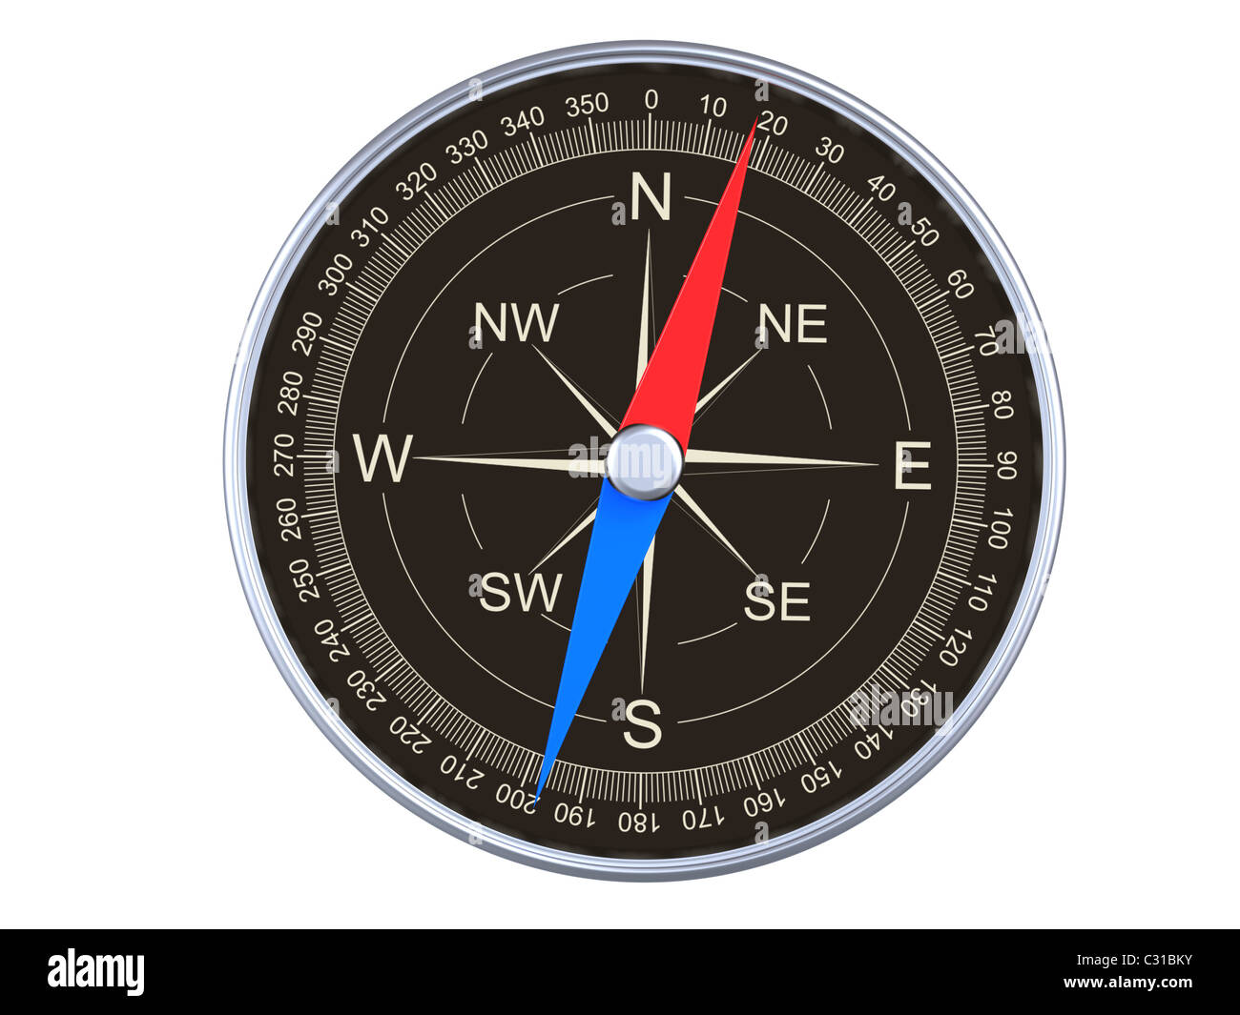
Compasses measure D
Y
H
D
X
Notes:
Compasses used in magnetic navigation on Earth’s surface measure the angle D between geographic North (Y) and the projected direction of the magnetic field in the horizontal tangent plane

Slide 19
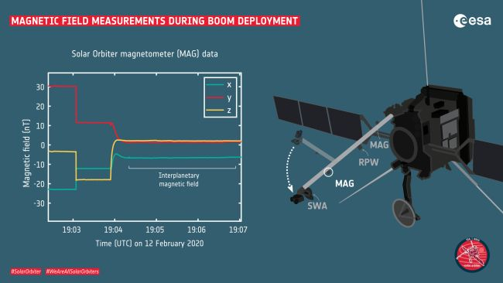
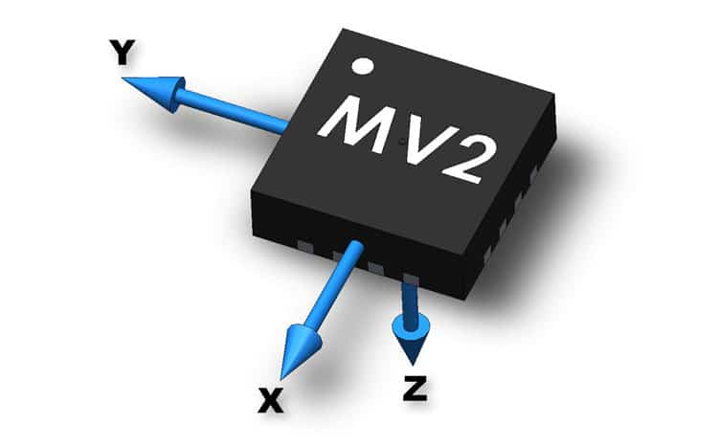
Magnetometers measure By, Bz, Bx
Credit: Metrolab / THM1176
ESAs Solar Orbiter magnetometer data
Notes:
Other magnetometers actually measure the strength of each of the three components in units of micro-Teslas, nano-Teslas or gauss

Slide 20
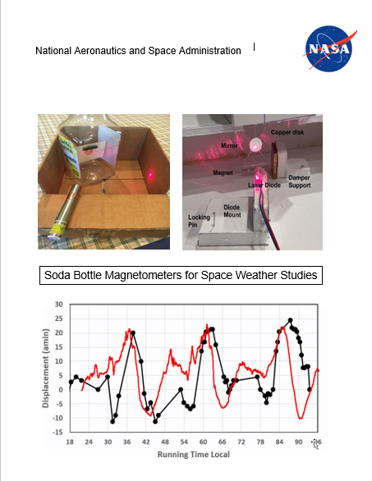
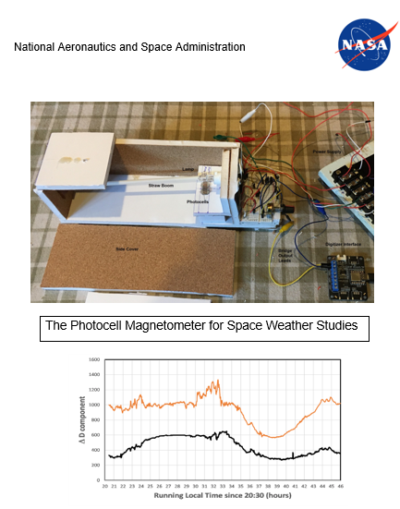
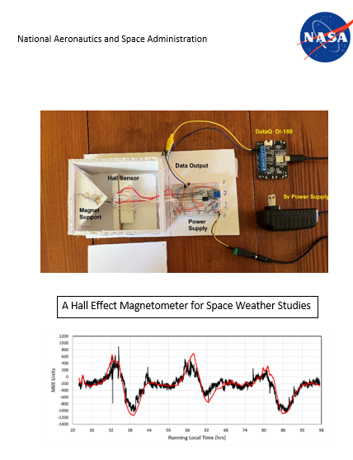
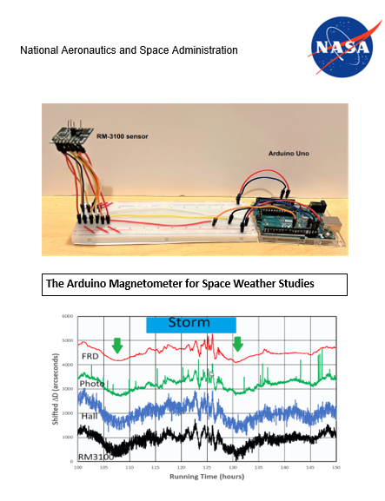
NASA DIY Guides
Soda Bottle Photocell Hall Effect RM3100
Notes:
You can build inexpensive magnetometers that will let you track hourly or daily changes in Earth’s magnetic field during ‘magnetic storms’

Slide 21
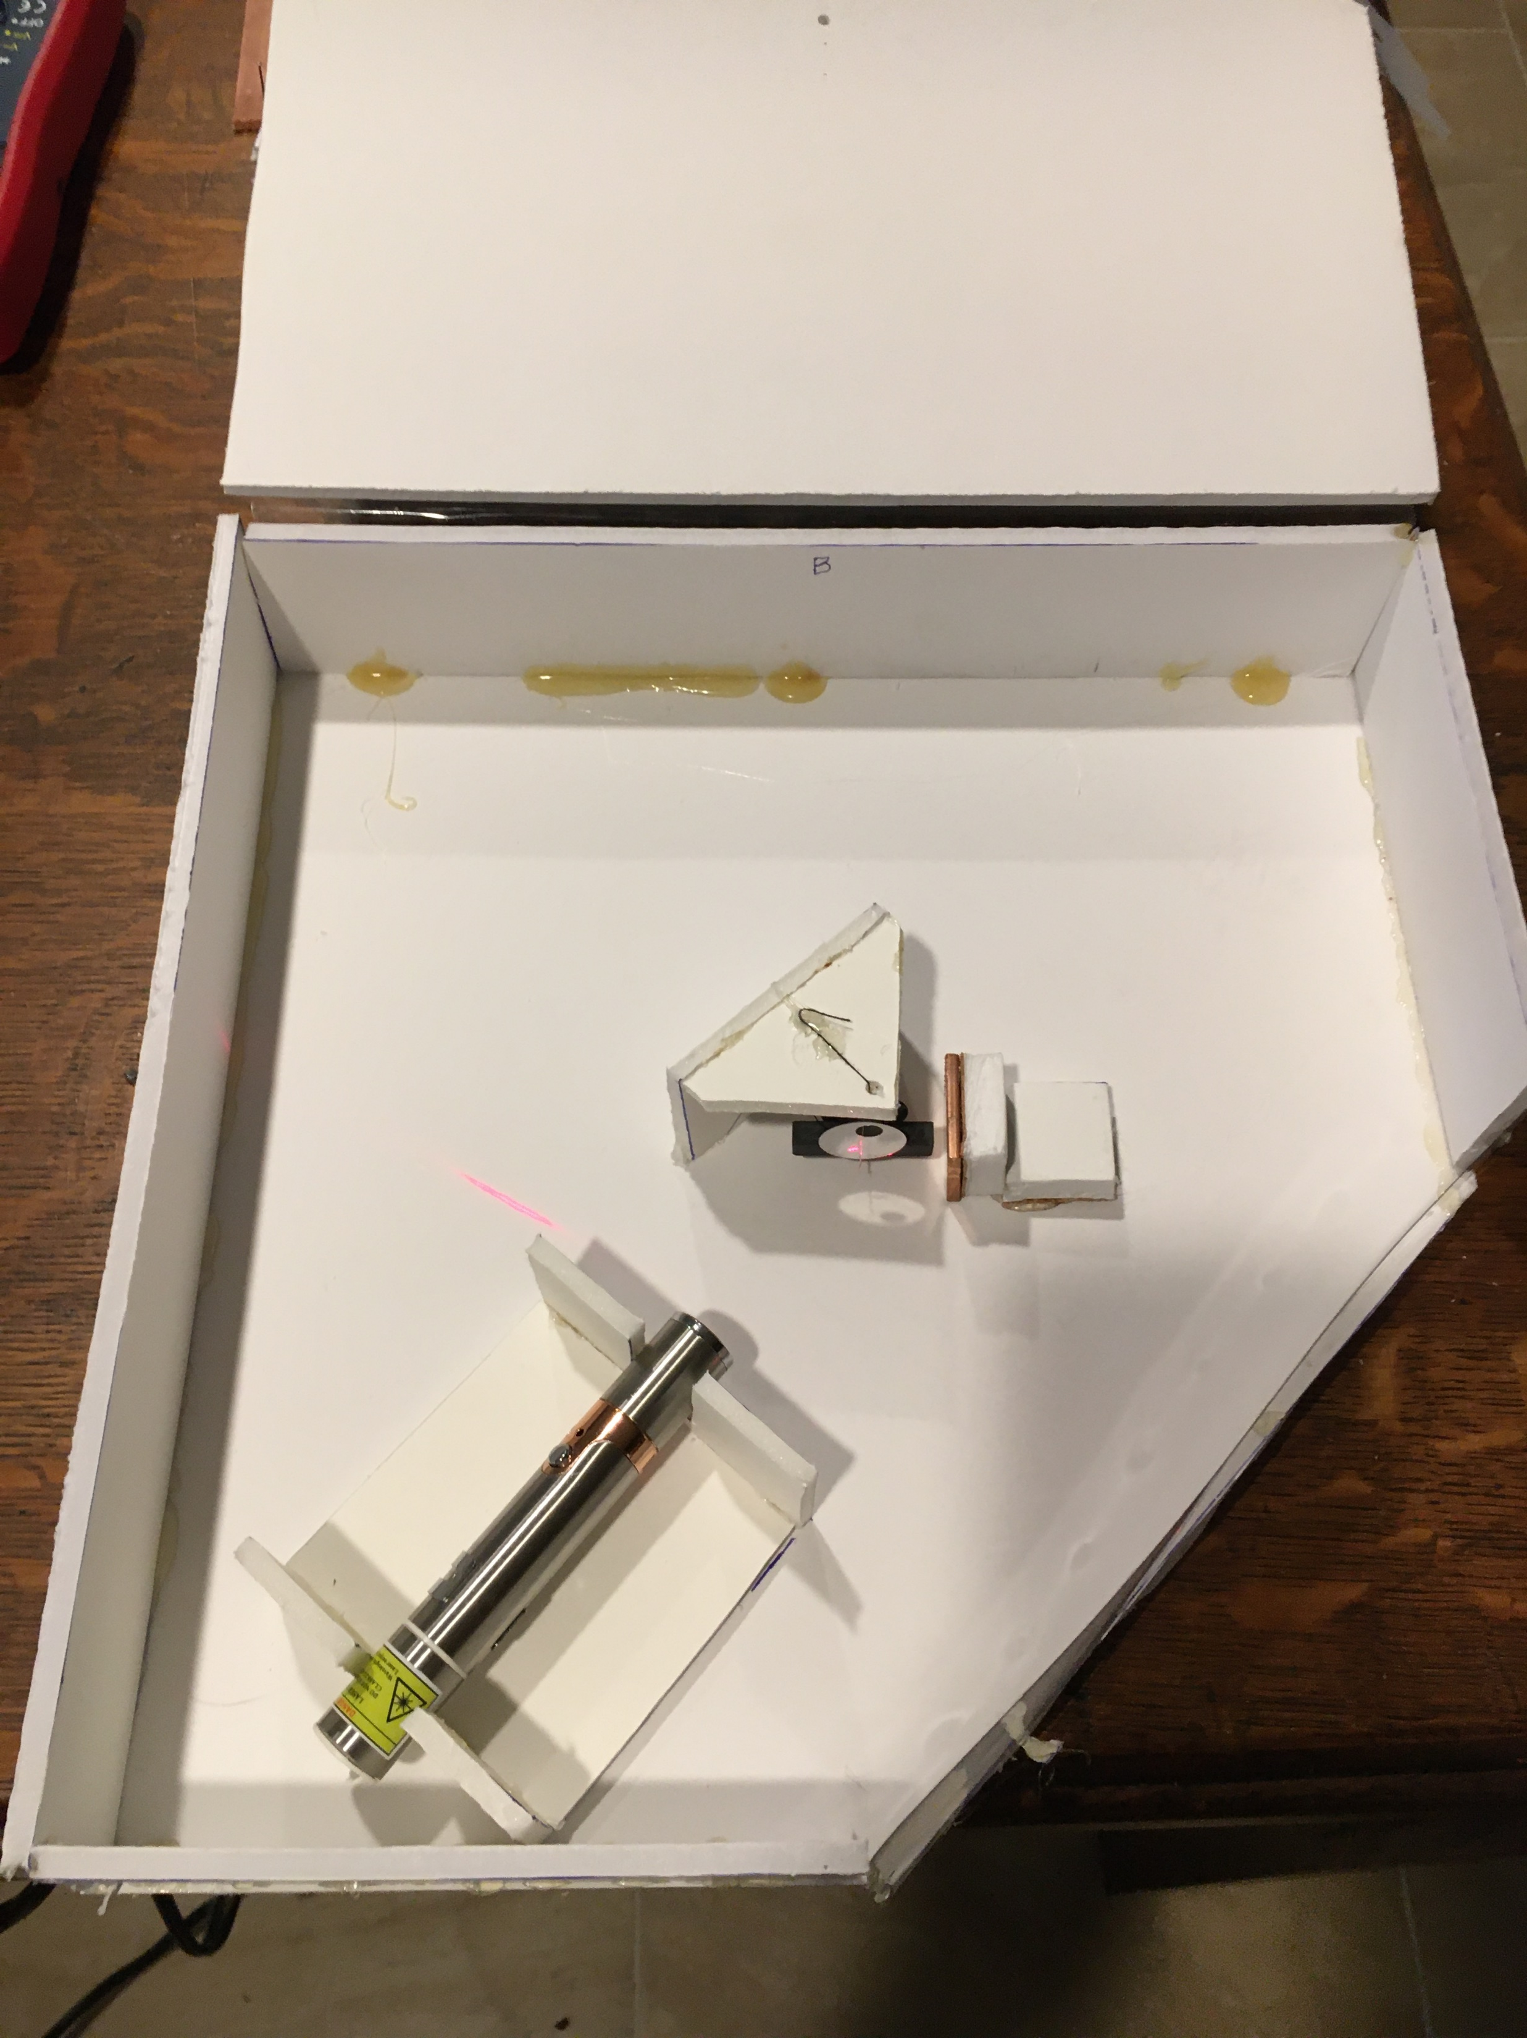
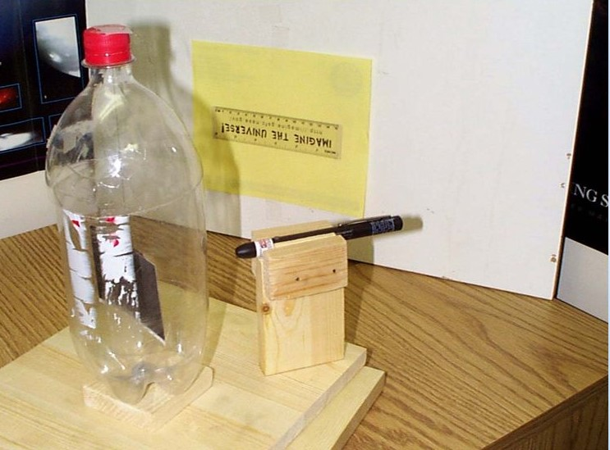
Soda Bottle
Notes:
The simplest of these is the soda bottle magnetometer, which consists of a suspended magnet and a reflective mirror. As the field direction, D, changes, the magnet will follow the projected H component and with the help of a laser, a reflected spot will move along a distant wall where a meter stick measures the spot displacement.

Slide 22
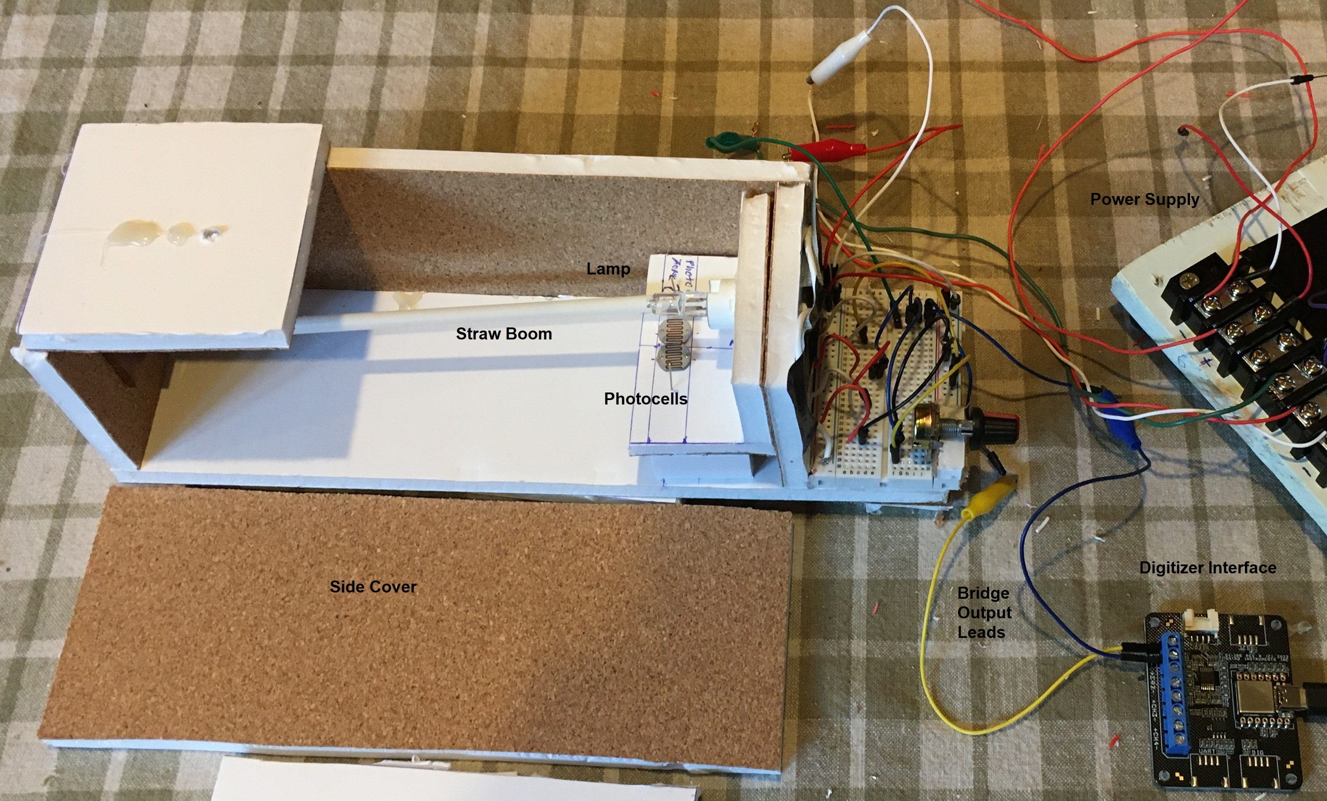
Differential Photocell Comparator
Notes:
In this design, a suspended magnet attached to a soda straw will move the tip of the straw across a pair of photocells and shadow them. A simple electrical circuit measures the amount of shadowing and converts this into a measurable electrical signal.

Slide 23
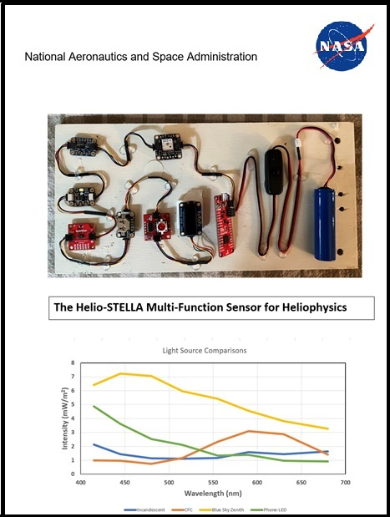
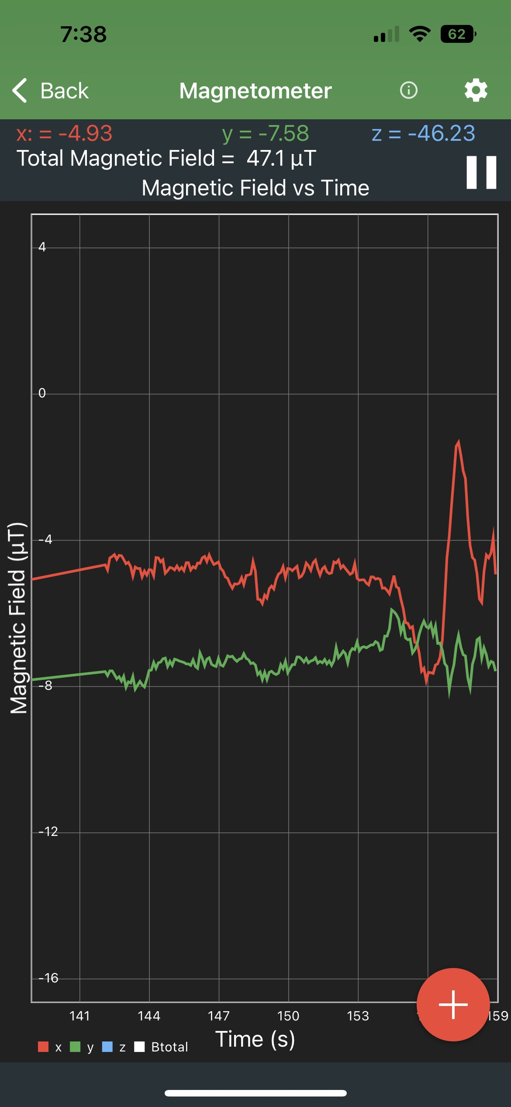
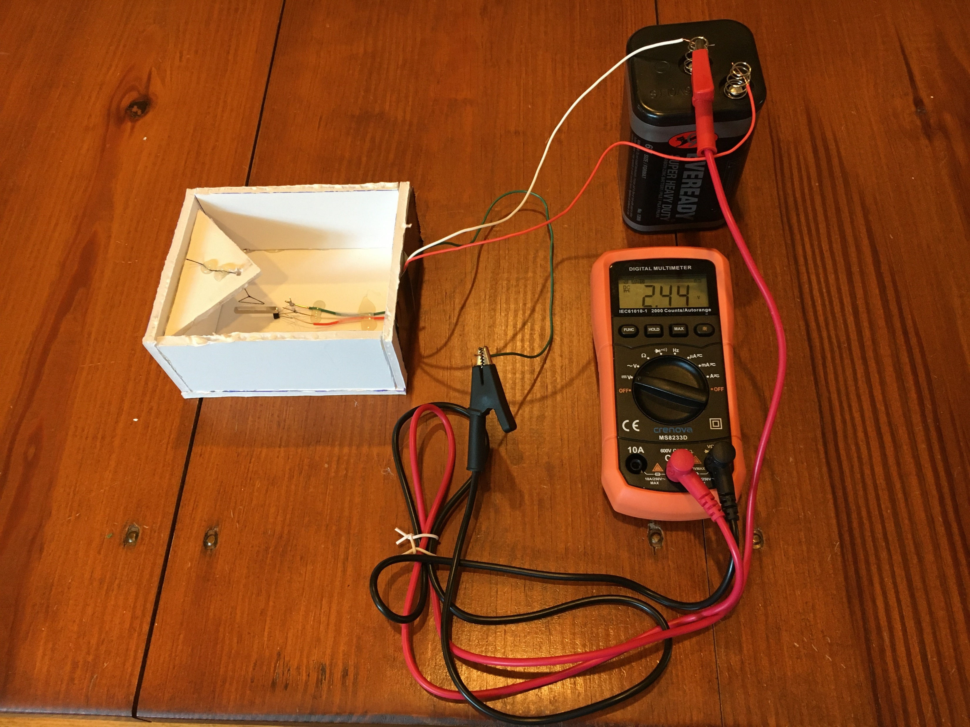
Hall Effect Sensors
Differential Hall Sensor Helio-STELLA Smartphone w/app
Notes:
In this design, the tip of a suspended magnet passes across two side-by-side Hall sensors. Their electrical output is measured by a simple electrical circuit and as the value of D changes, the voltage output changes. Simple smartphone apps also use three built-in Hall sensor aligned along each axis to measure Bx, By, Bz directly

Slide 24
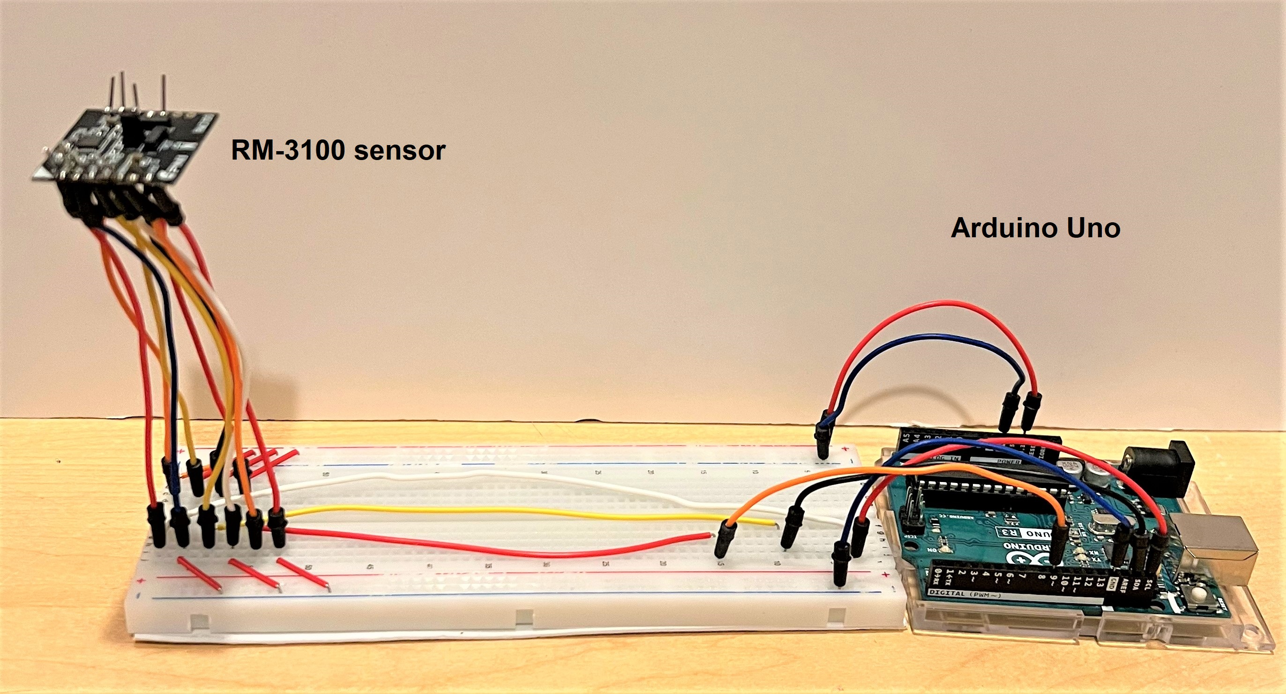
RM3100/Arduino Magnetometer
Notes:
The most sensitive magnetometer design uses a $25.00 RM-3100 magnetometer sensor attached to an Arduino microcontroller and is about 50 times more sensitive to magnetic disturbances than the other designs. This system allows tracking of even the weakest magnetic storms and other phenomena.

Slide 25
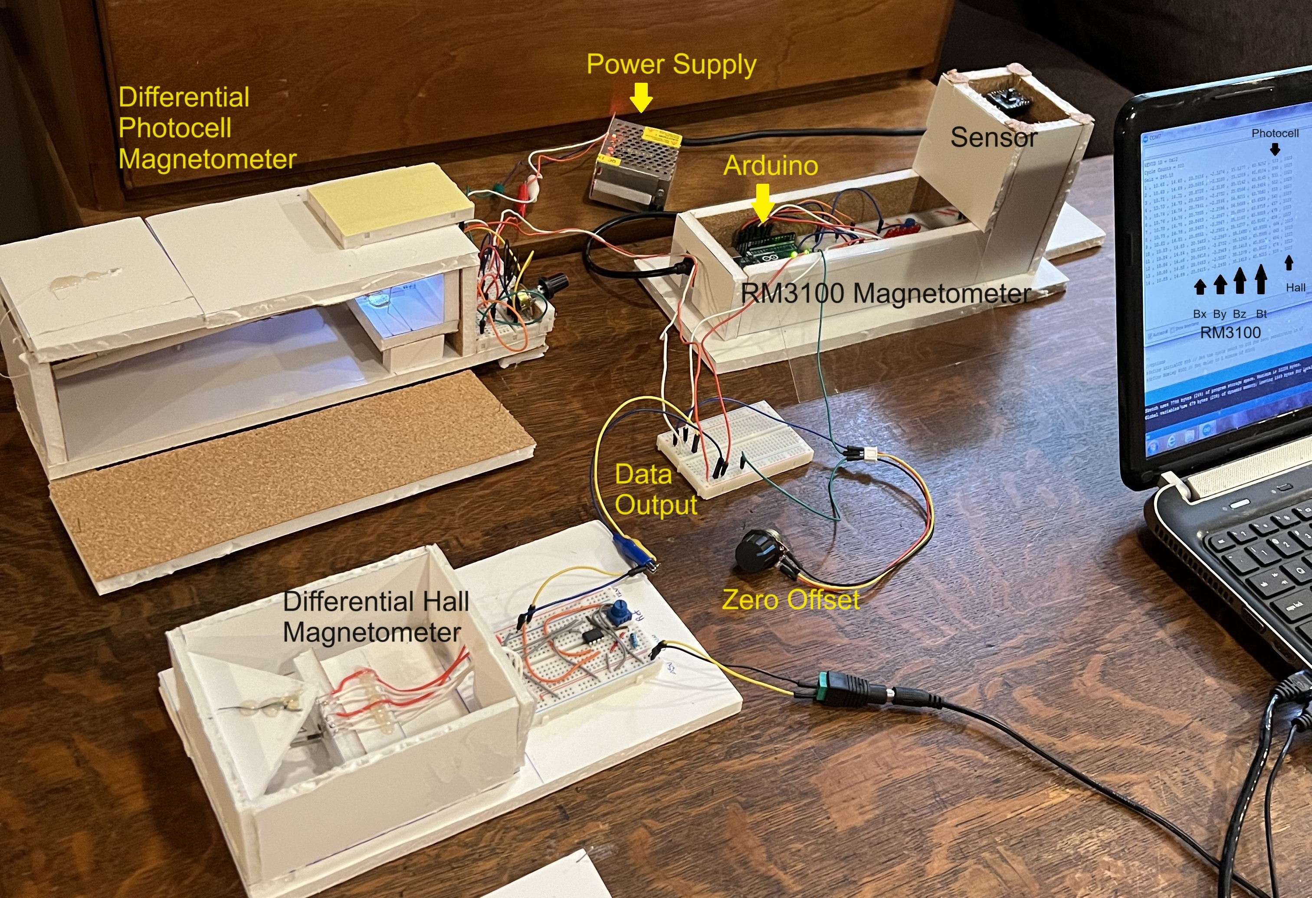
Simultaneous monitoring set-up
Notes:
These systems can be operated simultaneously to compare their sensitivities and to confirm a geomagnetic event by its simultaneous appearance on different sensors.

Slide 26
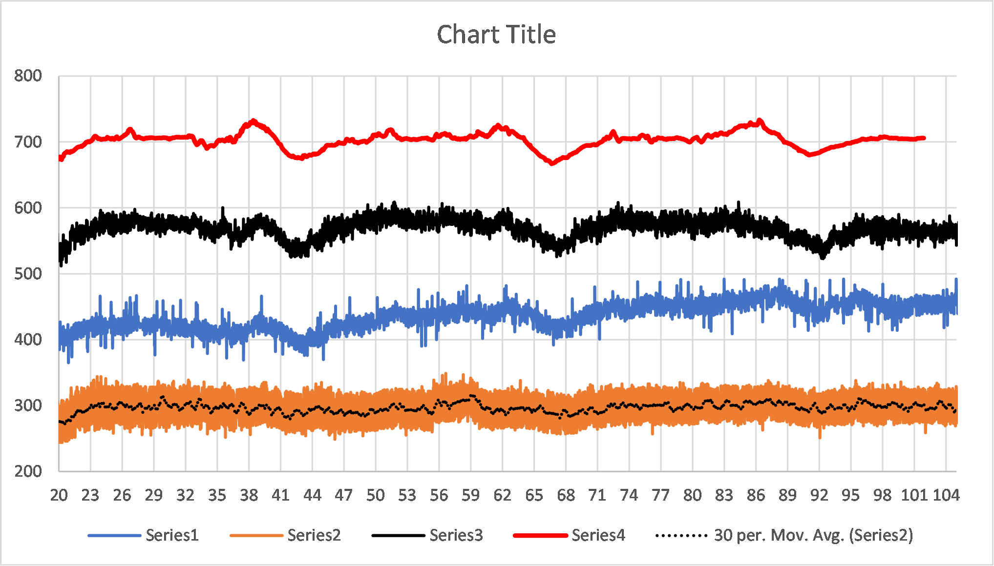
Sq current effect
Amplitude = 5 to 50 nT
Sensitivity
+/- 0.1 nT
+/- 5 nT
+/- 5 nT
+/- 150 nT
FRD
RM3100
Photocell
Hall Effect/5
Notes:
Every day, the sun induces currents in the ionosphere that lead to magnetic variations on the ground. These can be detected with these DIY magnetometers and provide a lively classroom experience every day of the year and not just when space weather events are occurring.

Slide 27
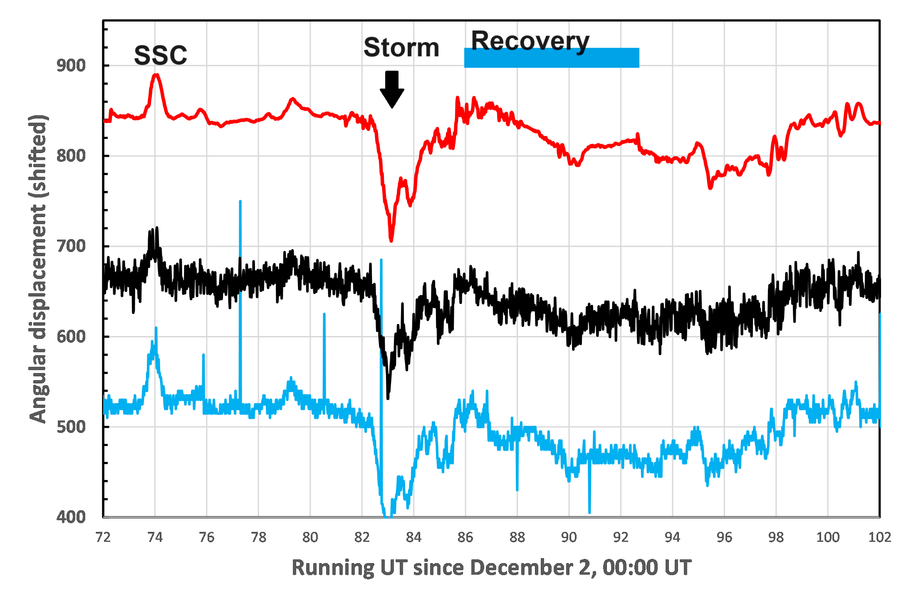
December 3, 2023 Kp=6
USGS - FRD
RM3100
Photocell
Notes:
This is an example of a significant geomagnetic storm tracked with the RM/Arduino and photocell systems, and also compared to the data from a nearby professional magnetic observatory in Fredericksburg, Virginia (FRD).

Slide 28
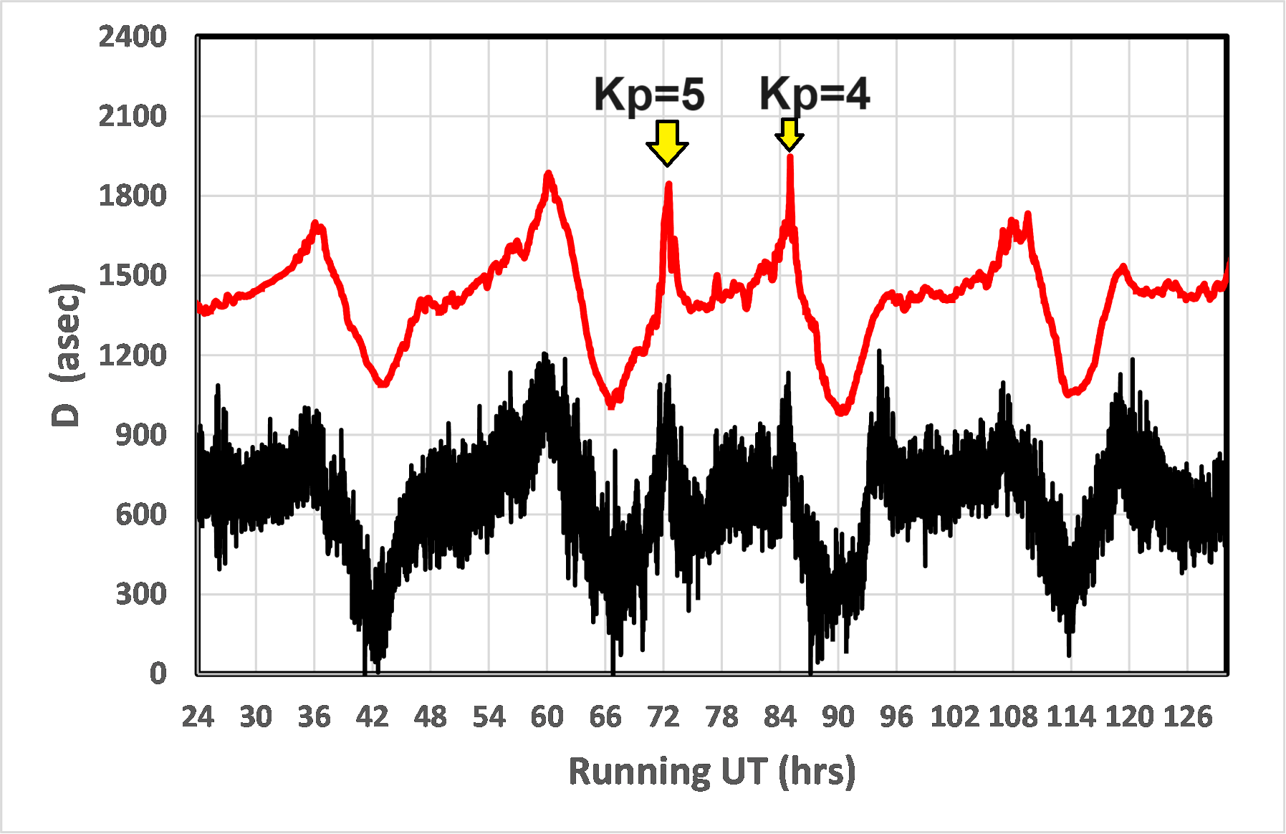
May 5, 2024 Kp=5
USGS-FRD
RM3100
Notes:
This is an example of a weak geomagnetic storm detected by the RM3100/Arduino system. Many of the details in the magnetic trace follow the FRD data with high accuracy.

Slide 29
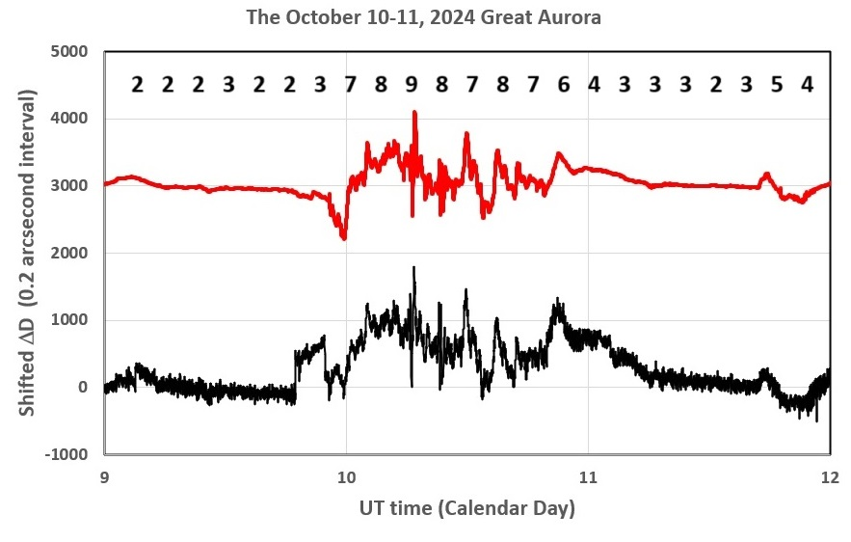
October 10, 2024 Kp=9
USGS-FRD
RM3100
Notes:
This is an example of a severe geomagnetic storm shows aurora were observed as far south as Florida and Texas. Notice all of the very fast variations in the traces between 10:00 and 11:00 UT

Slide 30
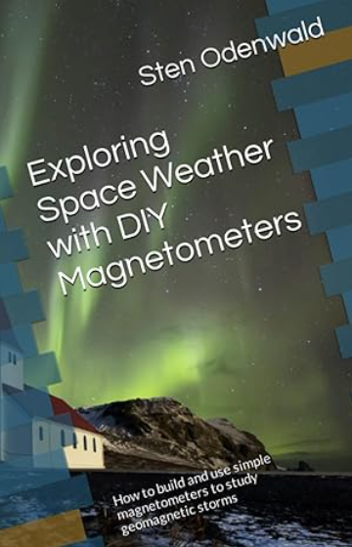
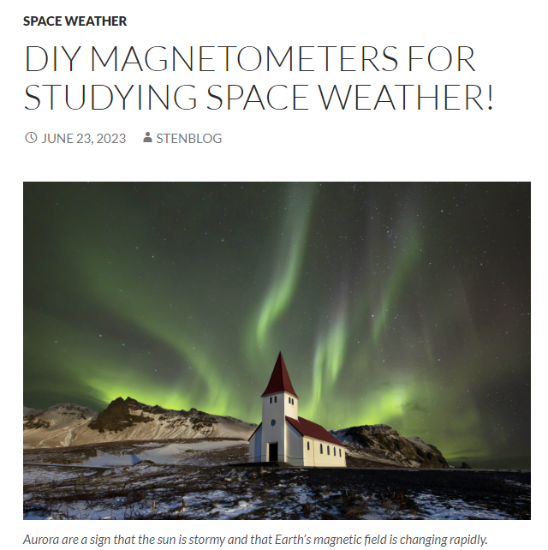
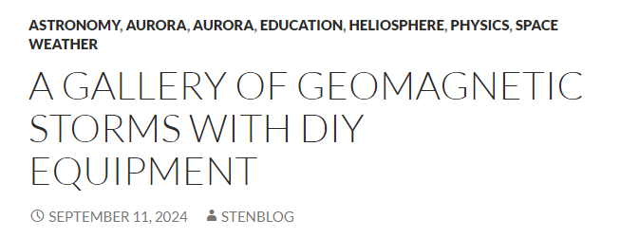
Sten’s Space Blog
E-mail:
odenwald@astronomycafe.net
Google search on keywords ‘Sten Odenwald’
Notes:
For more information on building and using these DIY magnetometers, contact Dr. Sten Odenwald or have a look at his many popular writings on the subject

