Slide 1
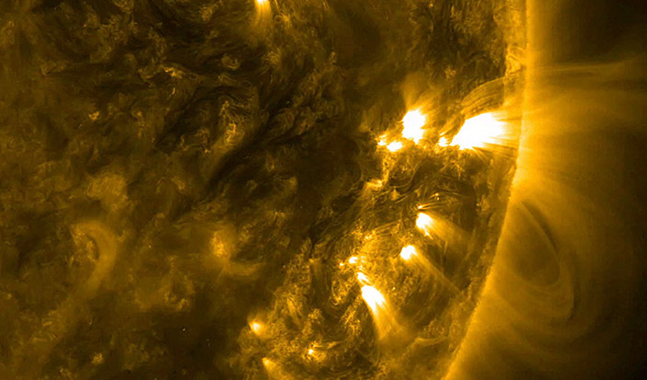

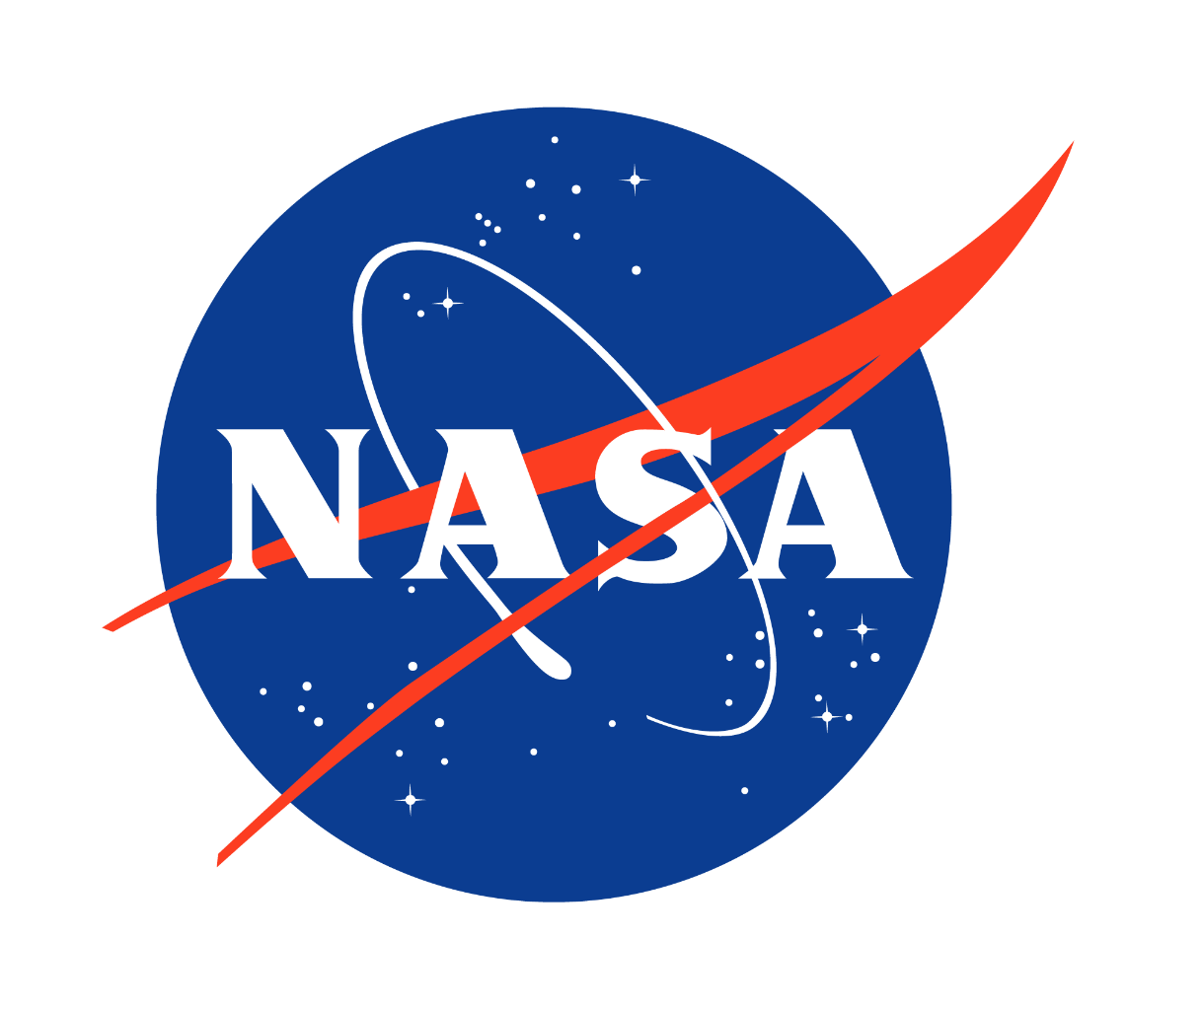

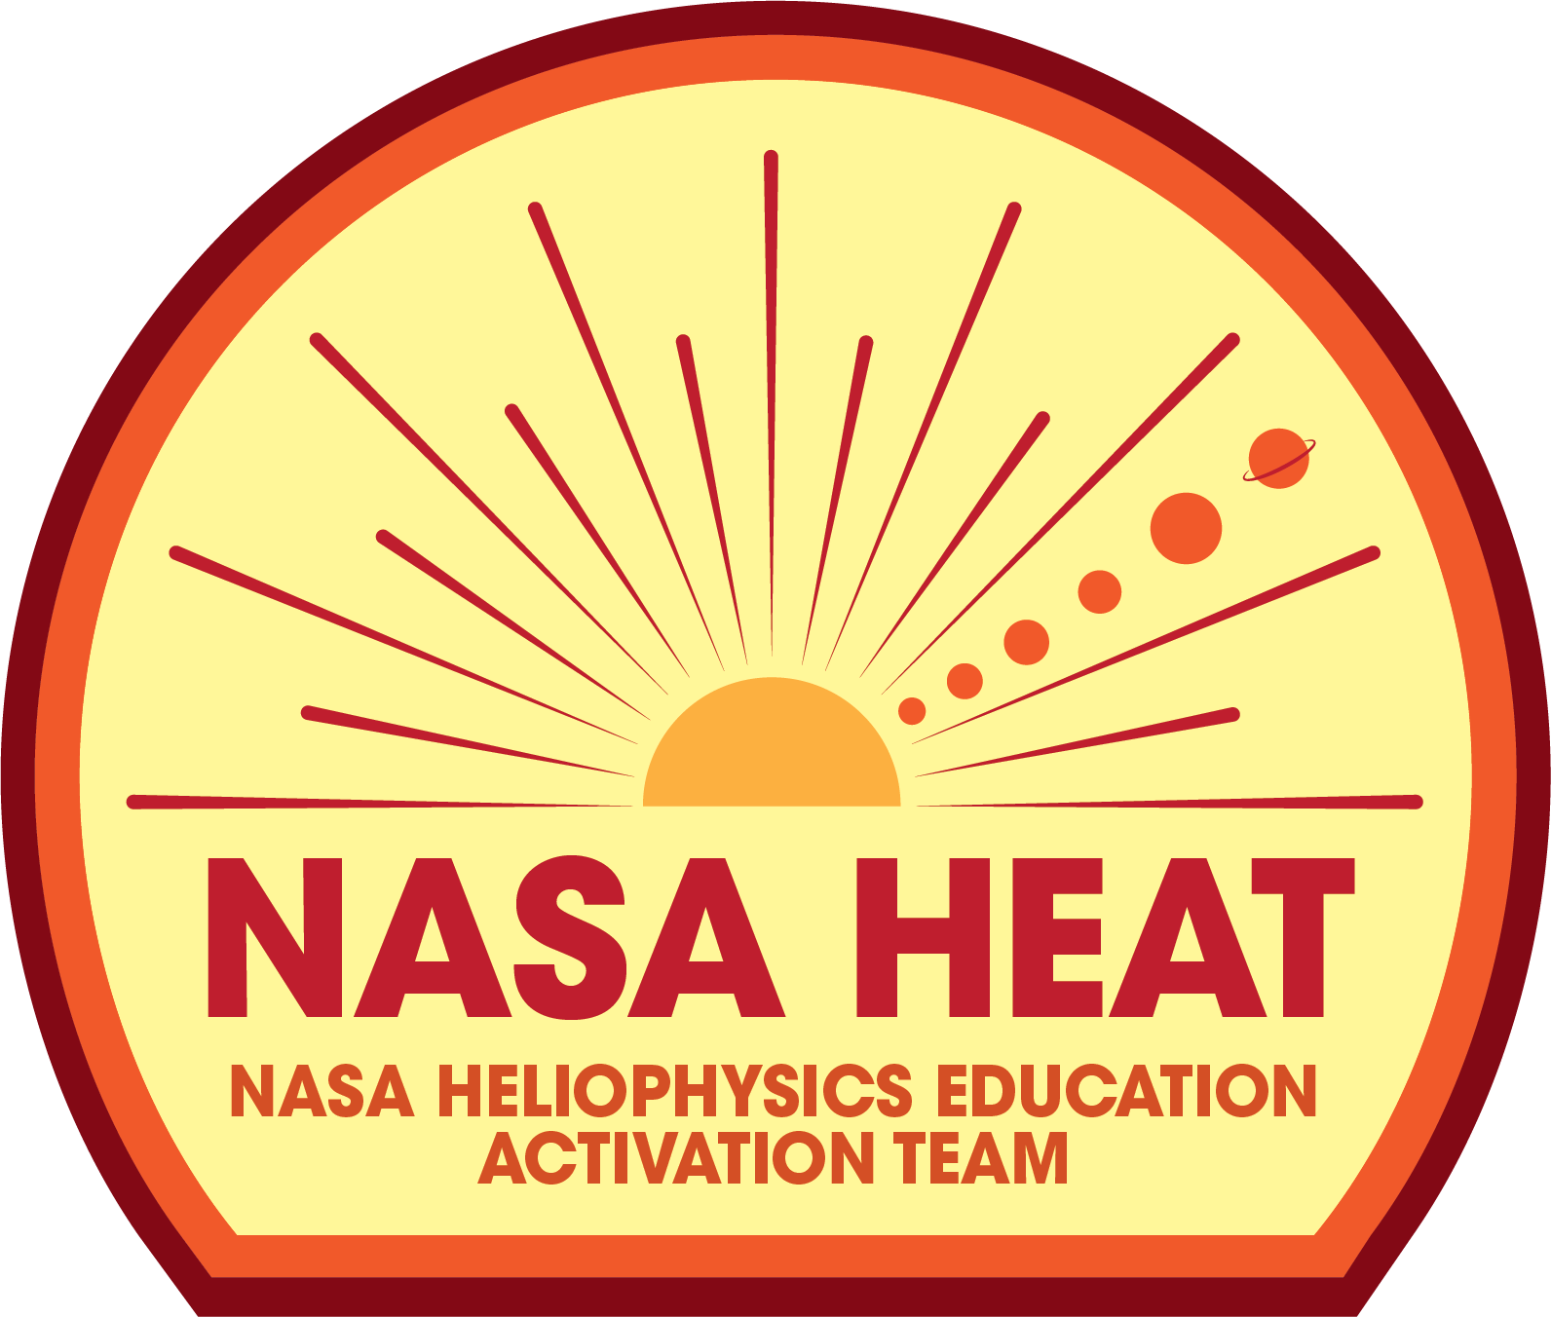
National Aeronautics and Space Administration
NASA
Helio Club
Session 2
Observing the Sun
NASA Heliophysics Education Activation Team

Slide 2
Materials Needed for this Session
Youth Guide
Page 12
Basics
Writing tools (pens or pencils)
Art supplies (markers or crayons)
(1) pair of scissors
(1) roll of tape
Prior Knowledge/Evaluate
Handout_KWL_Session 2
Engage
digital resources only
Explore: Activity 1
Handout_Build a Pinhole Projector
Handout_Solar Observation Data Sheet
Handout_2023 & 2024 Solar Eclipse US Map
(1) Solar Eclipse Glasses
(2) pieces of 8.5”x11”white cardstock
(1) 5”x 5” piece of aluminum foil
(1) paperclip
tape
scissors
Explain: Activity 2
Handout_Sample Data for Investigating the Sun
Handout_The EM Spectrum
Handout_UV Bead Data Sheet
Handout_UV Bead Bookmark
(10-15) UV-reactive beads
(1) invisible ink pen (UV reactive ink)
(1) UV light (often included with invisible ink pens)
string
Extend: Activity 3
Handout_Coronagraph Flip Book
(1) medium binder clip
scissors

Slide 3
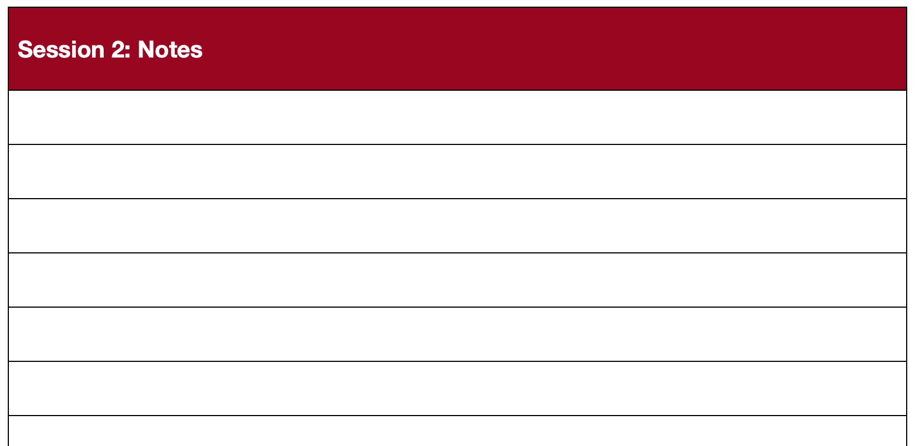
Use a notebook or the extra paper in the Helio Club Youth Guide to record observations, collect data, and organize ideas.
Youth Guide
Page 35
Notes:
Emphasize that scientists and engineers record everything! If you don’t use the Youth Guide, have learners use a notebook to record their observations, draw diagrams, and collect data.

Slide 4
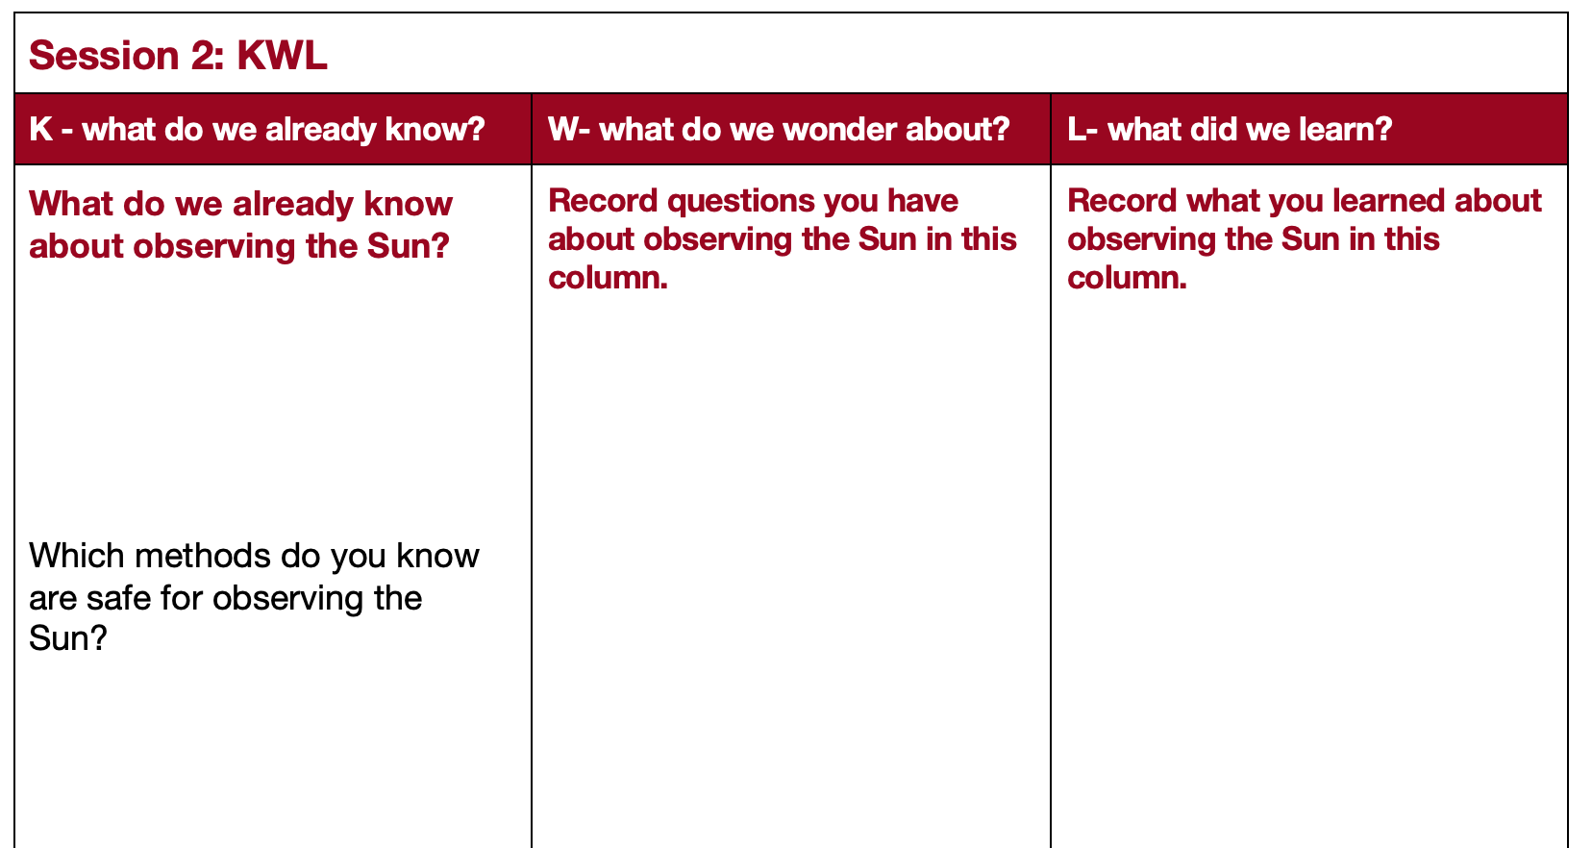
What do you already know about the Sun ?
Youth Guide
Page 14
Notes:
Have learners complete the K and W columns of the KWL chart.
A KWL chart is an effective way to assess learners’ prior knowledge, identify misconceptions, and measure growth. Use the guiding questions provided in the chart below to focus learners on the content that is explored in this session.
As students share their ideas and predictions, don’t give them the answers just yet; rather, encourage them to investigate their questions throughout the session.

Slide 5
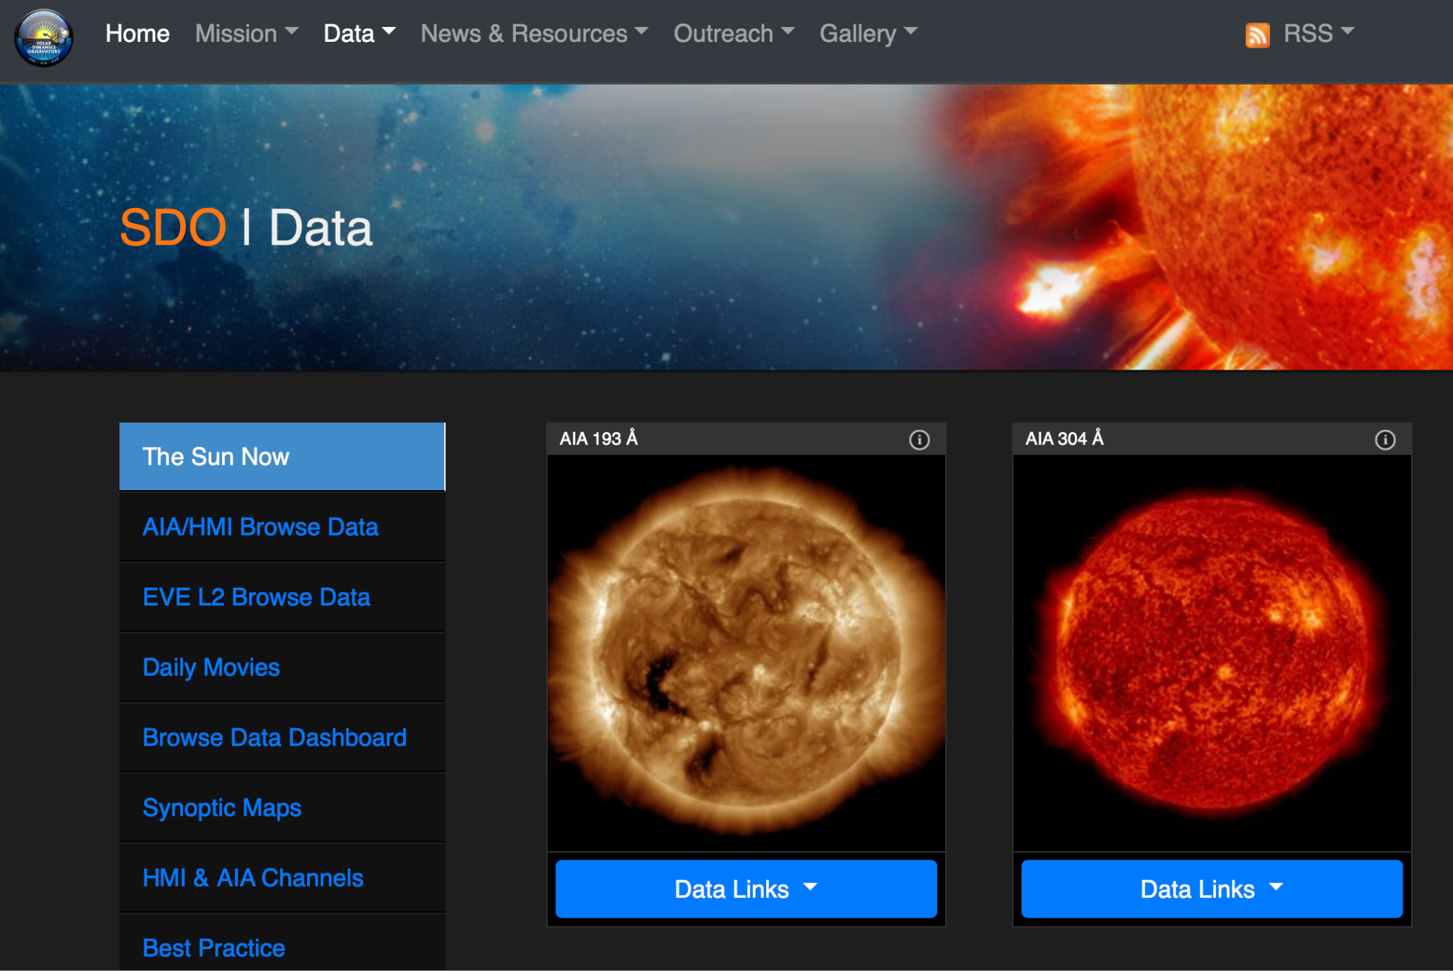
The Sun Now!
Click on each image to increase in size.
Check out the “Daily Movies” to see movies of the Sun.
Notes:
The Sun Now, provided by NASA’s Solar Dynamics Observatory (SDO), allows users to see images of the Sun captured in the last few days, taken in multiple wavelengths of light.
Each image shows the Sun in a different wavelength. You will see the letters “AIA” and then a number for each image.
AIA stands for Atmospheric Imaging Assembly, which refers to the four telescopes aboard SDO; the number refers to the wavelength of light the telescopes are collecting.
These telescopes operate in the extreme ultraviolet (EUV) portion of the EM spectrum. Because we can’t see this type of light, the colors in the images are added so we can distinguish different frequencies of light from each other.

Slide 6
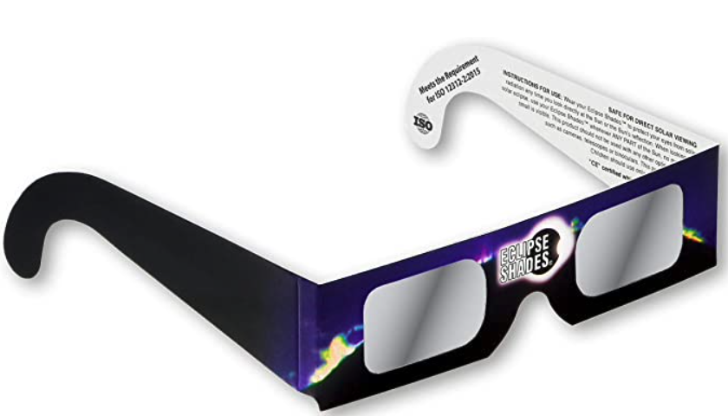
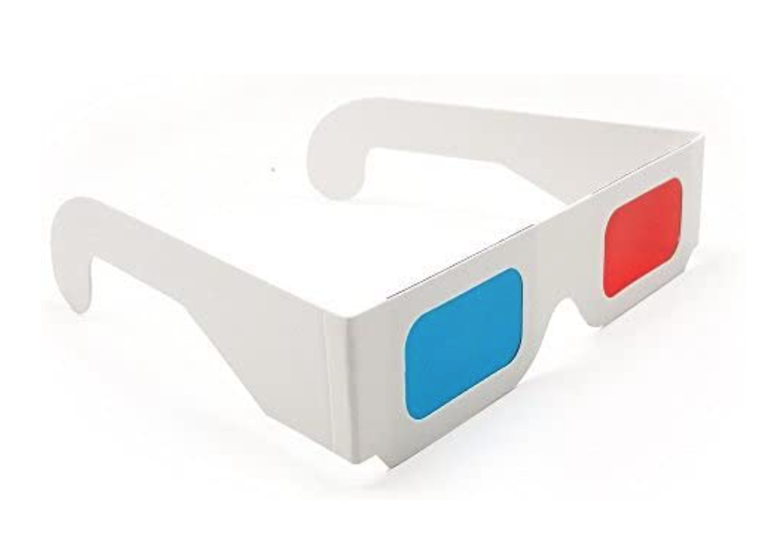

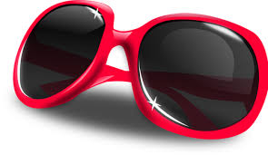
Safe Solar Viewing Methods:
Never look at the Sun without proper safety equipment.
Solar Eclipse Glasses
Sunglasses are not appropriate for looking at the Sun.
Solar eclipse glasses are typically 100,000 times darker than sunglasses and are made of black polymer, a flexible resin infused with carbon particles. This blocks out all UV rays and nearly all visible light.
3D or “stereo glasses” cyan /red lenses only filter color (visible light).
YES!
NO!
NO!
Notes:
Never look directly at the Sun without special safety equipment.
Solar Eclipse Glasses are designed to allow users, when used properly, to look directly at the Sun. Most often used to safely view solar eclipses, they can also be used to make other observations about the Sun, too.

Slide 7
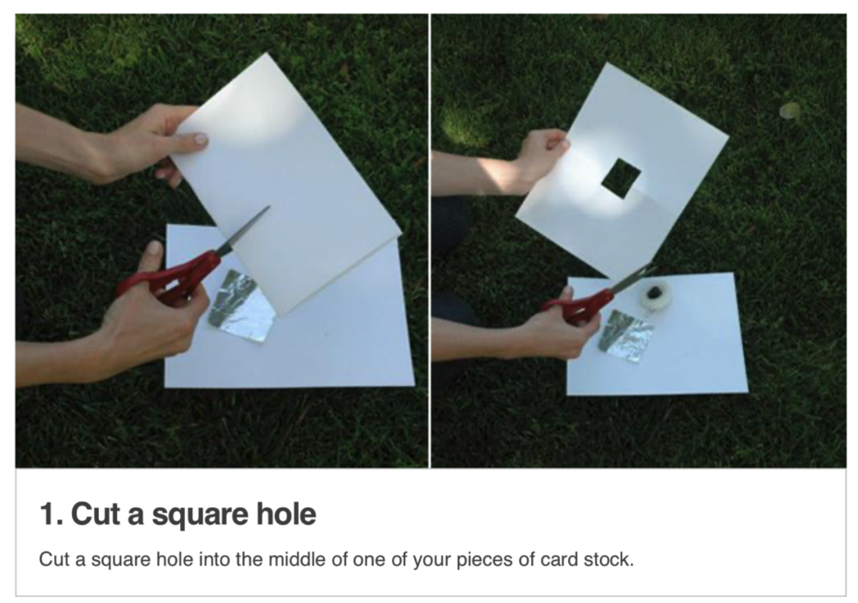
Safe Solar Viewing Methods:
Youth Guide
Page 15
Pinhole Projector
Never look at the Sun without proper safety equipment.
Credit: NASA / JPL
Notes:
Pinhole Projectors are designed to view a projection of the Sun on a white piece of paper. This method of observation occurs with the Sun behind the observer.

Slide 8
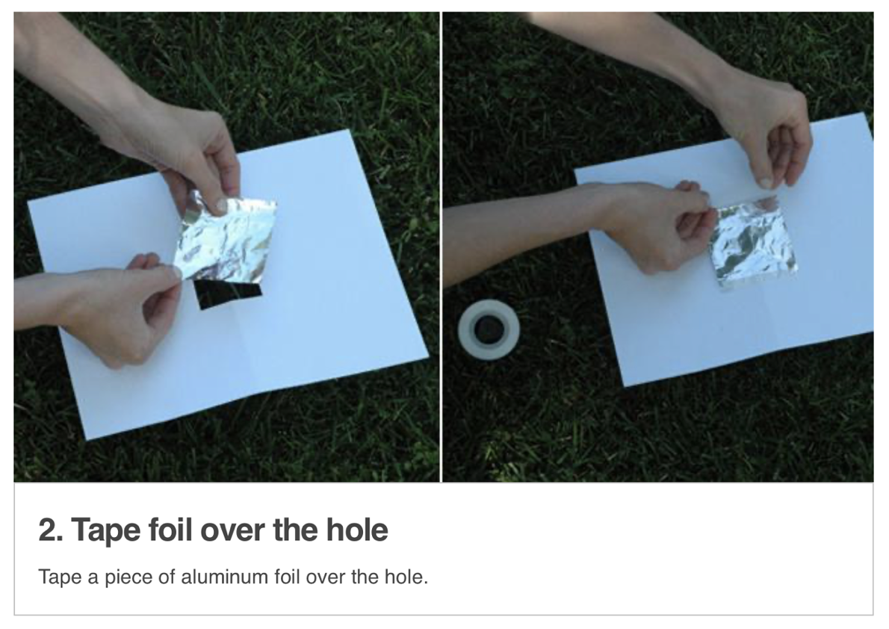
Pinhole Projector
Youth Guide
Page 15

Slide 9
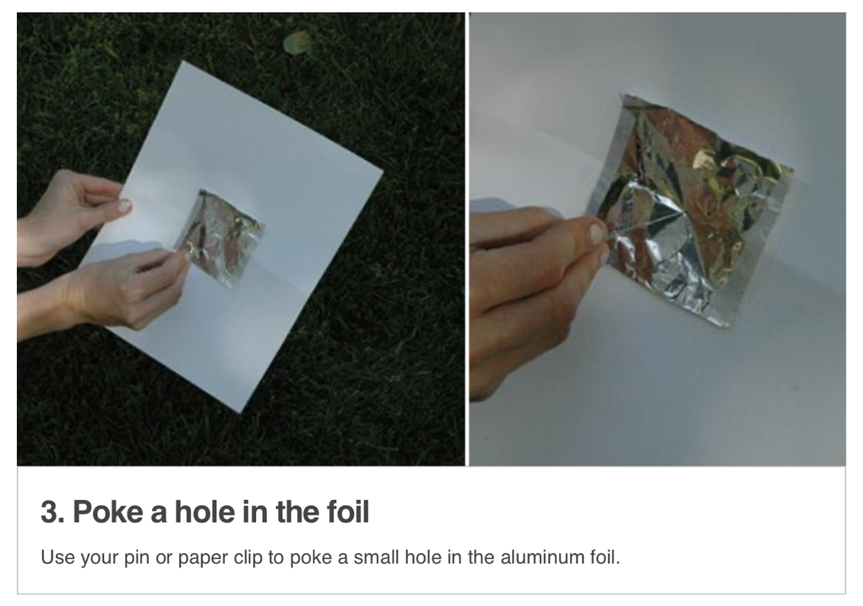
Pinhole Projector
Youth Guide
Page 16

Slide 10
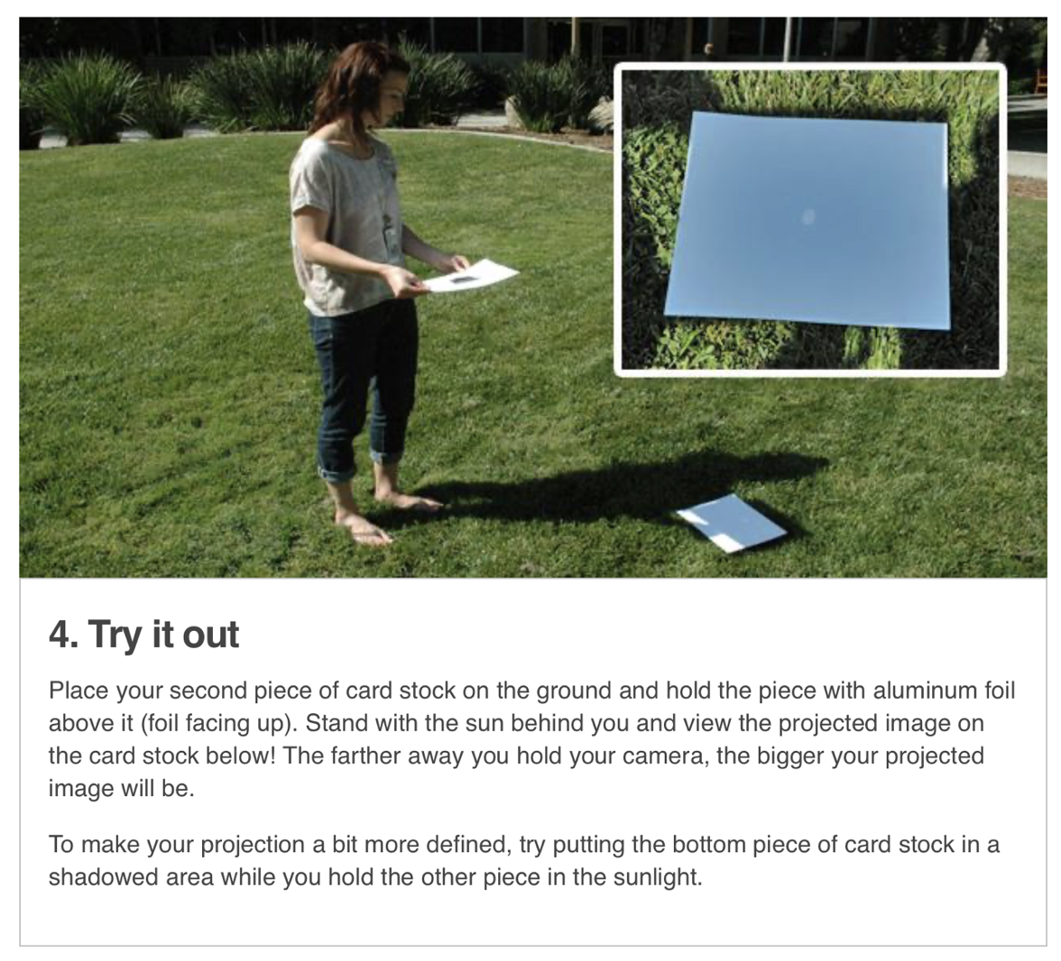
Pinhole Projector
Youth Guide
Page 16
Place a second piece of white cardstock on the ground in front of you with your back to the Sun.
Foil-side-up, let the Sun shine through the hole, projecting the shape of the Sun on the piece of cardstock on the ground.
Notes:
Remind learners to always keep their back to the Sun when using a pinhole projector.

Slide 11
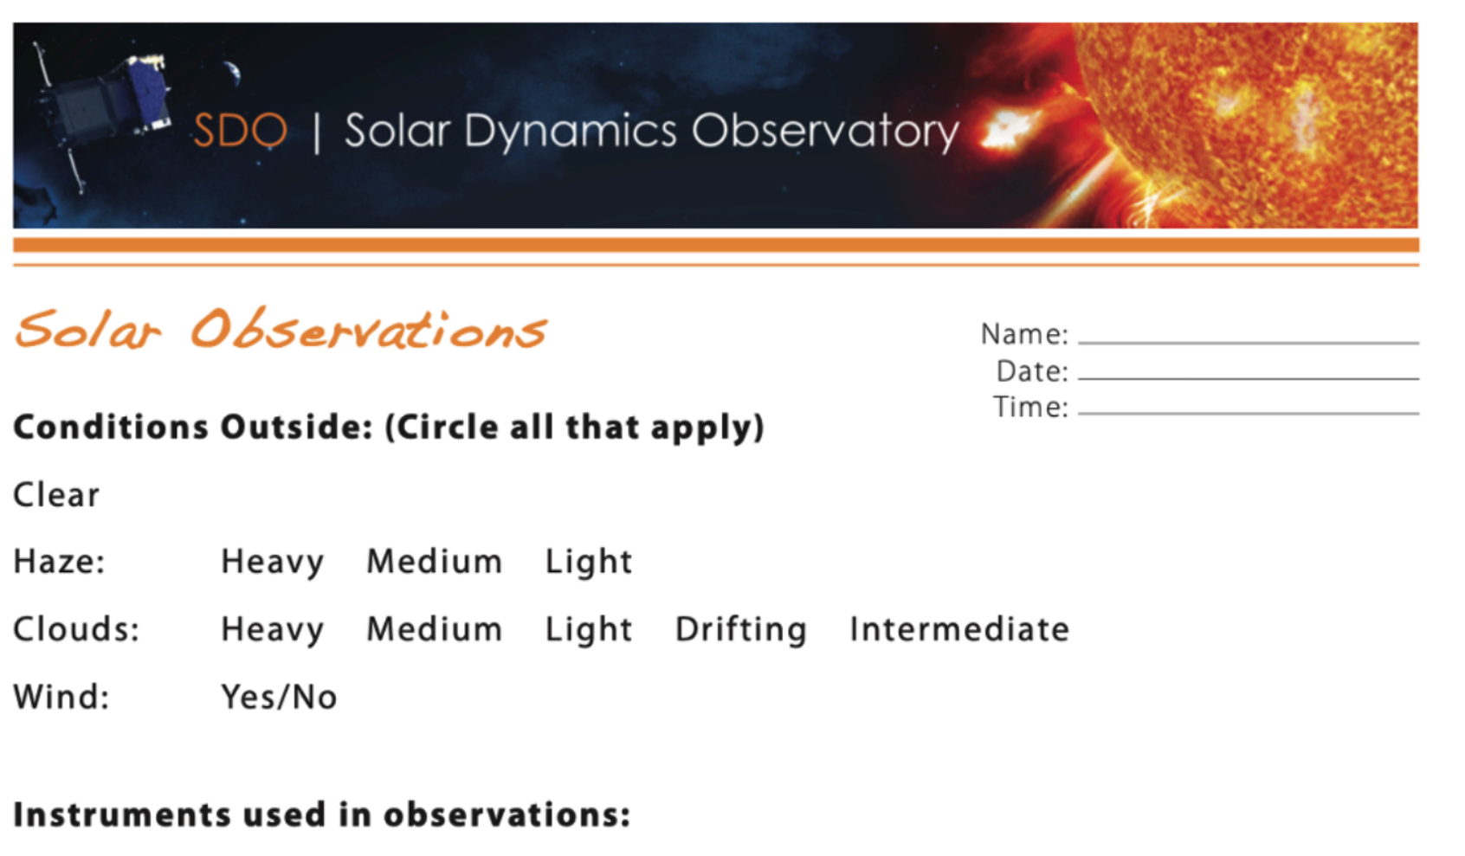
Solar Observations
Youth Guide
Page 17-21
Use the solar eclipse glasses and the pinhole projector to make observations of the Sun.
Record your data on the Solar Observation Data Sheets.
Notes:
Have learners record their observations of the Sun with both safe solar viewing methods. Provide them with several observation sheets to use to make observations over a number of days. Encourage learners to draw what they see and compare the accuracy of each method for viewing different features of the Sun.

Slide 12
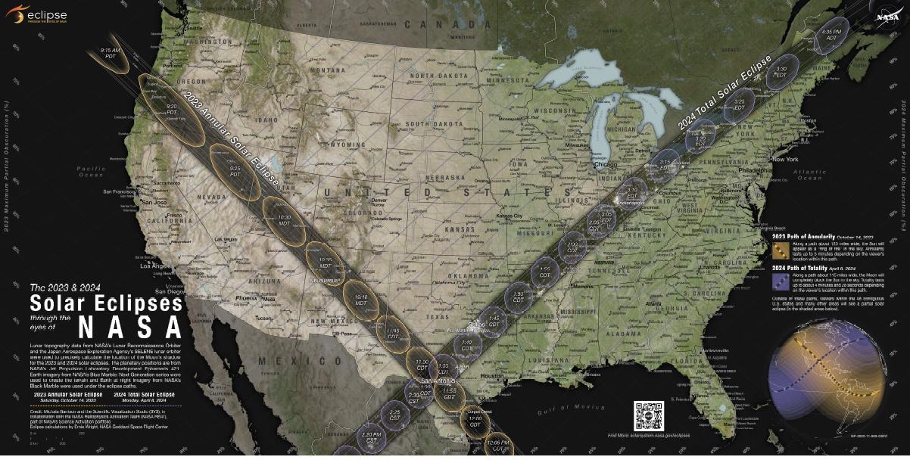
2023 & 2024 Solar Eclipse Map
Youth Guide
Page 22
Notes:
This map illustrates the paths of the Moon’s shadow across the U.S. during two upcoming solar eclipses.
On October 14, 2023, an annular solar eclipse will cross North, Central, and South America creating a path of annularity. Solar eclipse glasses must be worn during the entire duration of the eclipse, or use a pinhole projector.
On April 8, 2024, a total solar eclipse will cross North and Central America creating a path of totality. During a total solar eclipse, the Moon completely blocks the Sun while it passes between the Sun and Earth. The sky will darken as if it were dawn or dusk and those standing in the path of totality may see the Sun’s outer atmosphere (the corona) if weather permits. Solar eclipse glasses may be removed, briefly, when the Moon completely blocks out the Sun, in the path of totality.
Everyone in the continental US, and Alaska, will experience a partial solar eclipse. Solar eclipse glasses must be worn during the entire duration of the eclipse, or use a pinhole projector.

Slide 13
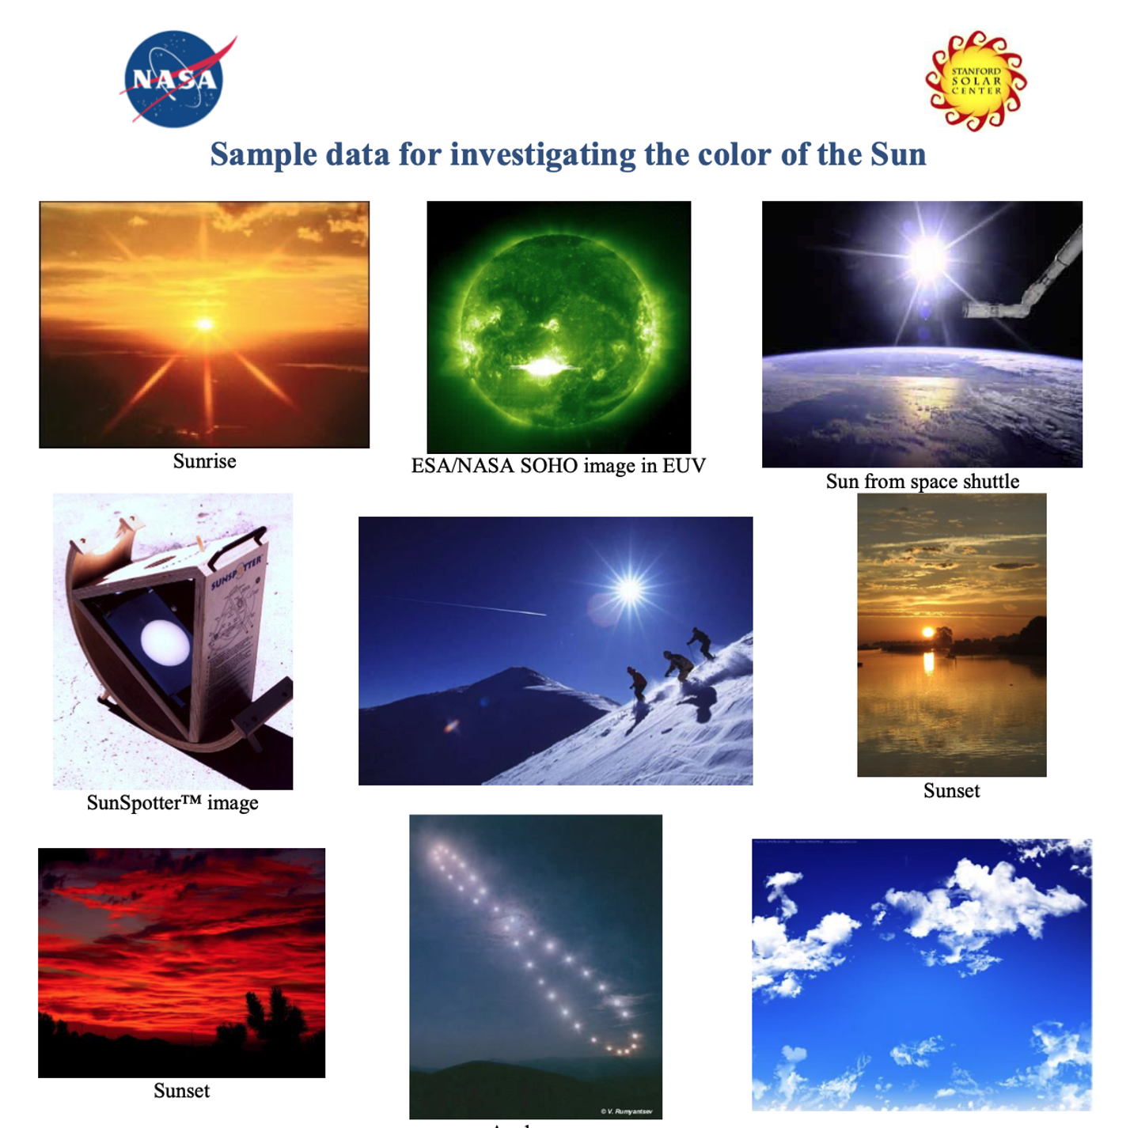
What color is the Sun?
Youth Guide
Page 23-24
What colors are the Sun in these images?
Why is the Sun different colors in different images?
What color do you think the Sun is based on both your observations of the Sun outside and of these images? What is your reasoning?
Notes:
After learners have observed the Sun through the solar eclipse glasses and the pinhole projector, ask them, what do you think the color of the Sun is?

Slide 14
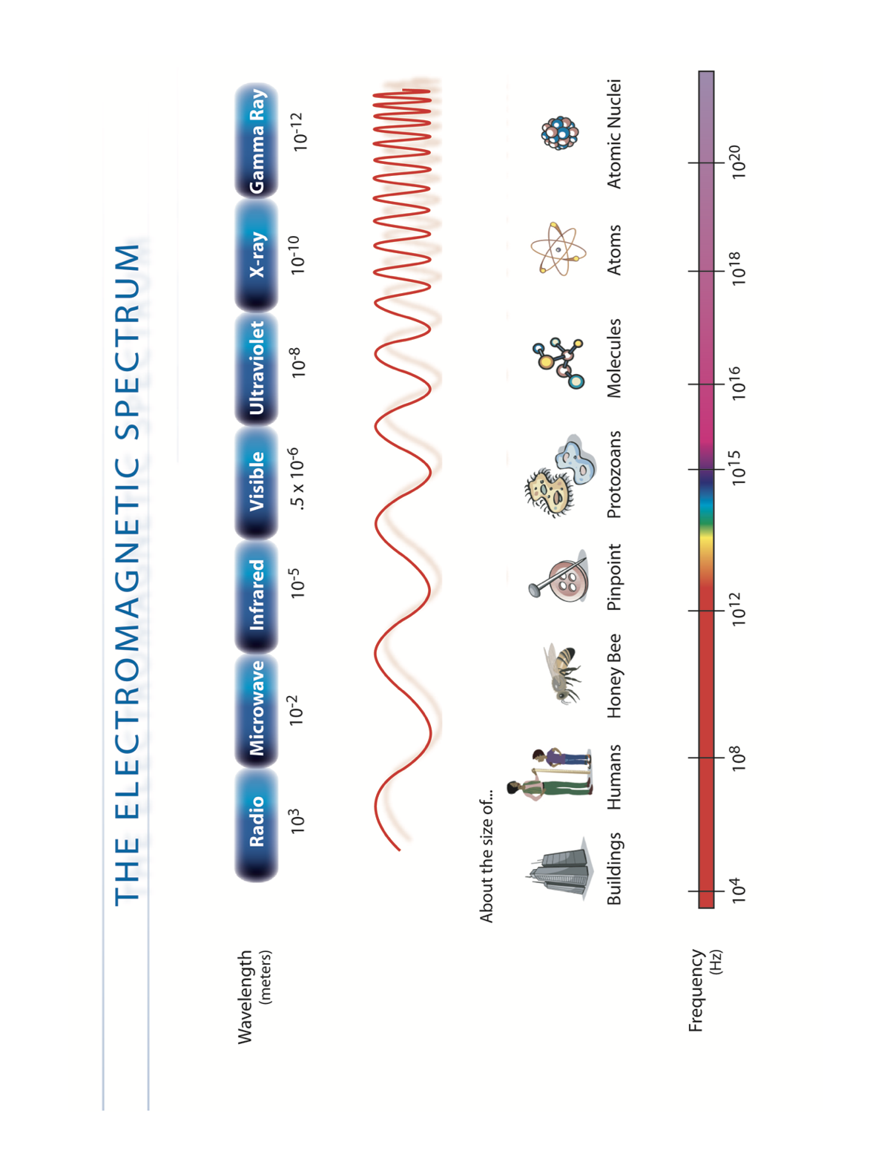
The Sun emits radiation across ALL of the EM spectrum, you could say the Sun is all colors!
Youth Guide
Page 25
Credit: NASA / Afterschool Universe
Notes:
This diagram of the electromagnetic spectrum, or the ‘EM spectrum’ for short, shows all of the different kinds of light in the universe.
Humans can only see a small part of the EM spectrum, the visible portion. Each color in the visible portion of the spectrum is defined by a different wavelength. Red light has longer wavelengths than blue light. Each type of light behaves differently because of properties like wavelength. All other parts of the spectrum are invisible to the human eye.

Slide 15
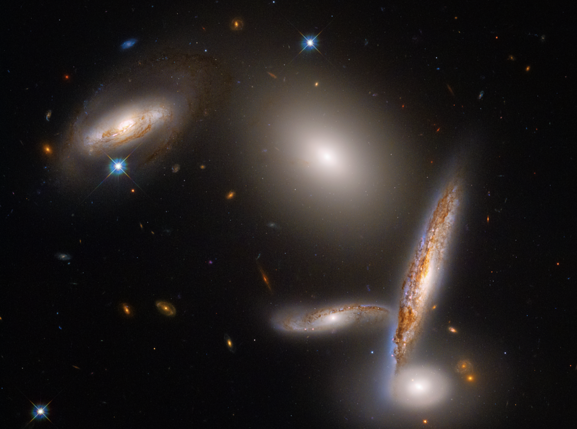
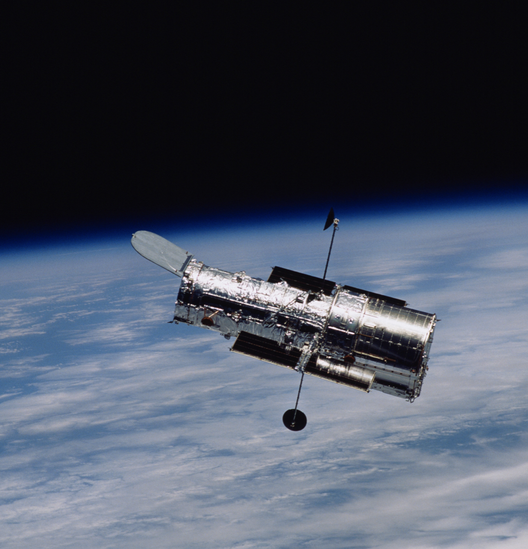
Hubble Space Telescope
Hubble Space Telescope Mission Homepage
Primary: Visible Light
Image Credit: NASA, ESA, STScI; Image Processing: Alyssa Pagan (STScI)
Image Credit: NASA, ESA
Notes:
Telescopes are designed to collect light from different portions of the EM spectrum, providing more information than the human eye could detect on its own.
“Viewing” objects by collecting multiple types of light gives NASA scientists more information about the object.
One of the most famous NASA telescopes, the Hubble Space Telescope, can detect visible light, as well as a portion of infrared and ultraviolet (UV) wavelengths, which lie just beyond the visible spectrum.

Slide 16
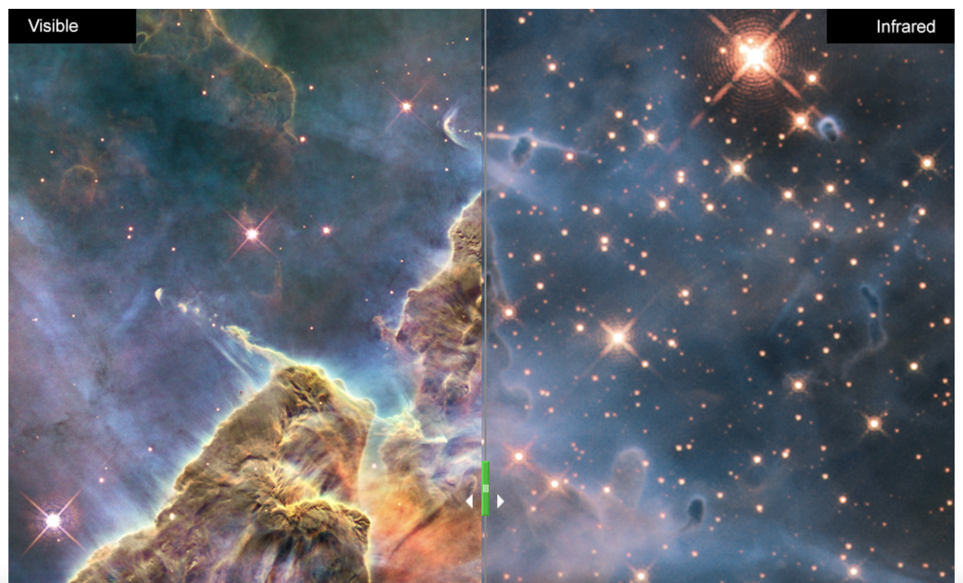
Visible vs. Infrared Light: Hubble
Visible
Infrared
Different light gives scientists different information.
Record your observations.
Slide
Explore Light with NASA's Hubble Space Telescope
Credits: NASA, ESA, and M. Livio and the Hubble 20th Anniversary Team (STScI)
Notes:
Direct learners to this NASA resource from the Hubble Space Telescope to explore more about the electromagnetic spectrum. Instruct learners to slide the divider back and forth to examine some of the most famous images taken by Hubble and compare the images between visible and infrared light, and between visible and ultraviolet light.
What differences can you see in the image between the two types of light?

Slide 17
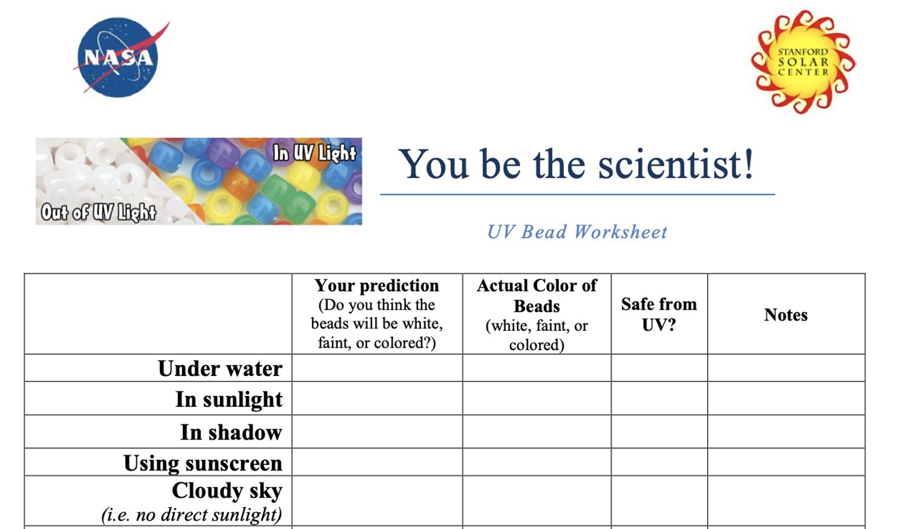
UV Light Investigation
Youth Guide
Page 26
Use the UV beads to experiment with UV light inside and outside, if possible.
Experiment with the invisible-ink pen, too, which has the same UV-reactive properties as the beads.
Record your observations on the data sheet.
Notes:
The white, translucent beads are UV-sensitive beads. They may not be white anymore if they have been exposed to sunlight. They turn color when they react to UV light. Because UV light can be harmful to humans, scientists are interested in the types of materials that we can use to protect us from UV light.
Experiment: What types of materials block UV light?

Slide 18
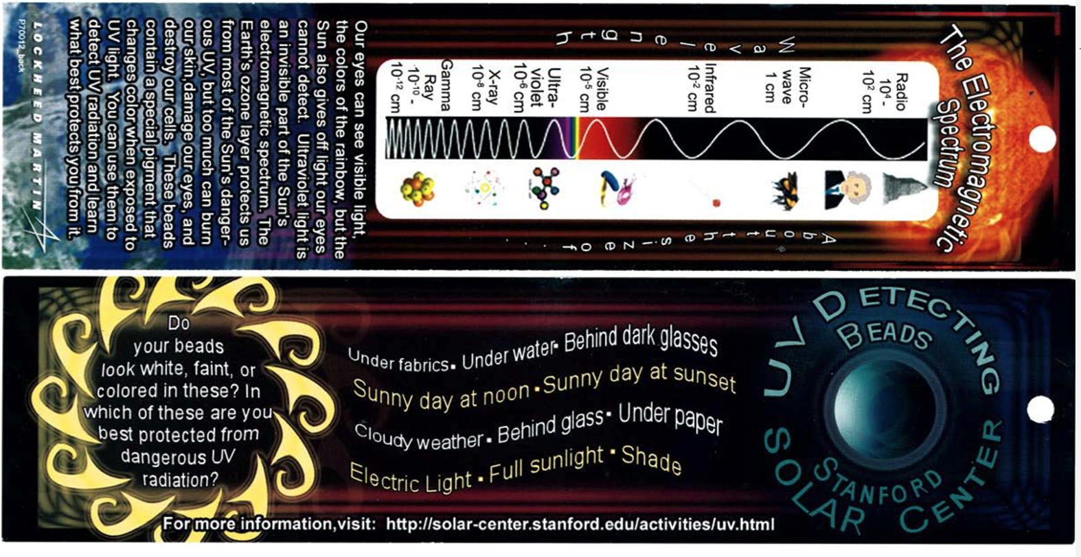
UV Bead/EM Spectrum Bookmark (optional)
Youth Guide
Page 27
Notes:
Give learners the option of adding the UV-reactive beads to the bookmark, using string.

Slide 19
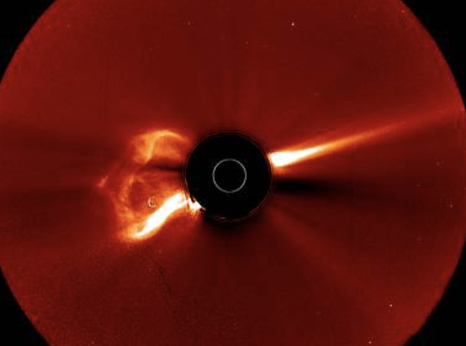
What is a coronagraph?
A coronagraph image blocks the Sun’s bright surface (black circle).
Light orange circle shows the outline of the hidden Sun.
A coronagraph shows the features of the Sun’s atmosphere, the corona.
A coronagraph showing a CME Credit: NASA SDO
Notes:
Many NASA missions that study the Sun use an instrument called a coronagraph, which are images used to study part of the atmosphere of the Sun called the corona. Coronagraphs are equipped with a metal disk that blocks the bright light of the Sun’s photosphere and makes it possible to study the detailed features of the surrounding corona. Otherwise, the Sun is too bright to view the corona.
This mimics a total solar eclipse. When the Moon blocks the bright light of the Sun, it gives scientists an opportunity to study the Sun’s corona.

Slide 20
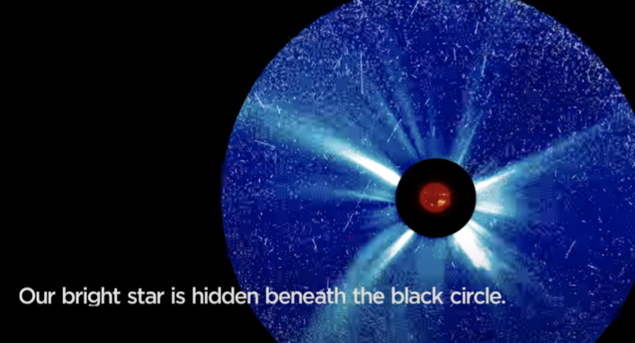
Video: NASA’s STEREO Mission
How to Read a NASA STEREO Image
Coronagraphs allow us to view the Sun’s corona.
Solar TErrestrial RElations Observatory (STEREO)
Credit: NASA SVS/ GSFC
Notes:
Just like in the images we have been examining, (Handout_Sample Data for Investigating the Sun), colors are added to the coronagraph to communicate information.
The orange ball in the middle represents the hidden Sun behind the black circle, which is the result of the metal disk (occulting disk) used to block out the light of the photosphere. The result of a coronagraph is images of the Sun’s atmosphere, the corona, represented by the blue region. In the blue region we can see the solar wind (white light).

Slide 21
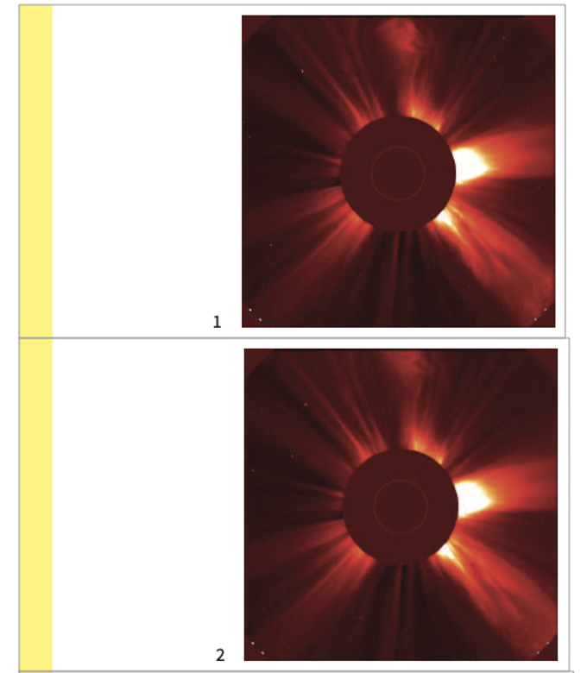
Make a Coronagraph Flipbook of a Solar Flare
Youth Guide
Page 29-33
Cut out the images.
Put the images in order.
Clip the images together using the binder clip.
Flip through the book to see a solar flare in action!
Credit: DIY Sun Science / Lawrence Hall of Science / UC Berkeley
Notes:
We are going to create a flipbook using coronagraphs taken of a solar flare that occurred in 2000. Solar flares are energetic bursts of light triggered by the release of magnetic energy on the Sun.
Just like the image in the video, colors are added to the coronagraph to communicate information. The occulting disk is the dark, brownish-red circle in the center of the coronagraph image, and the outline of the Sun, which is behind the disk, is a faint, thin outline of a brighter circle in the center of the darker circle. The corona is represented by bright yellow-orange.

Slide 22
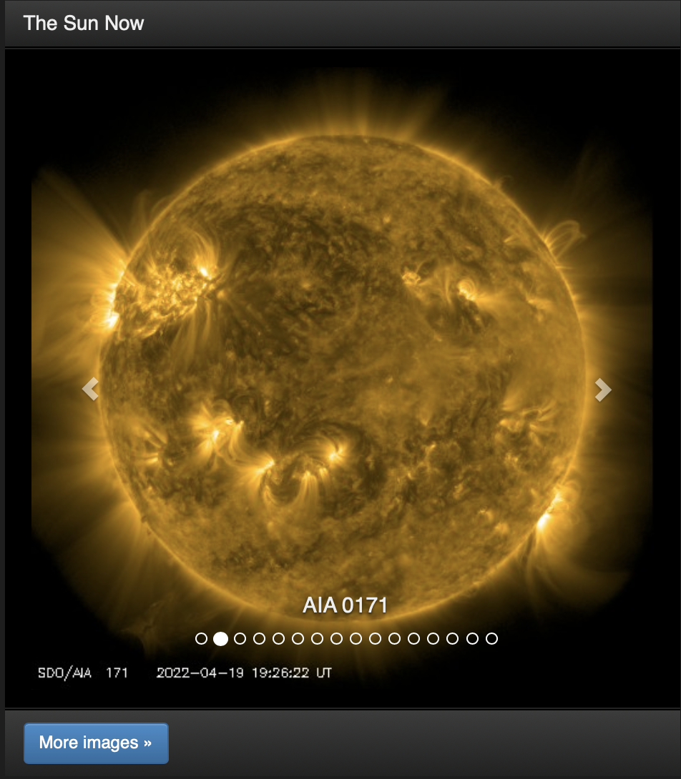
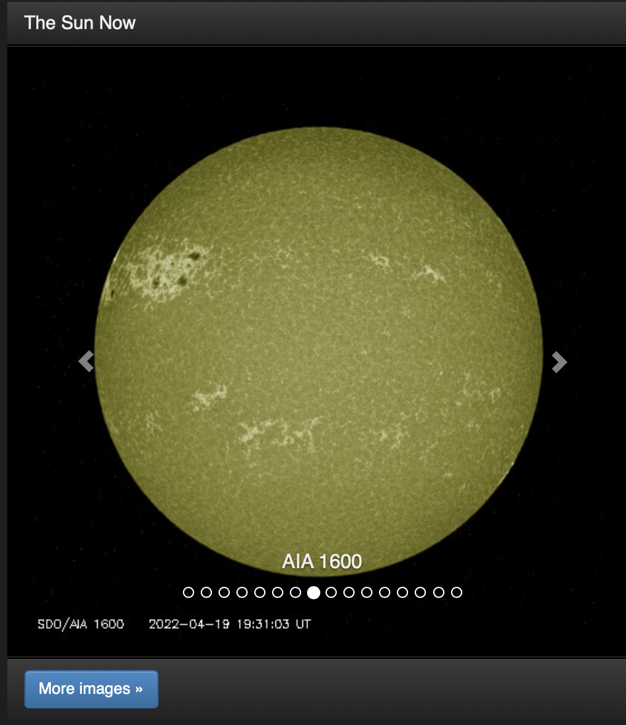
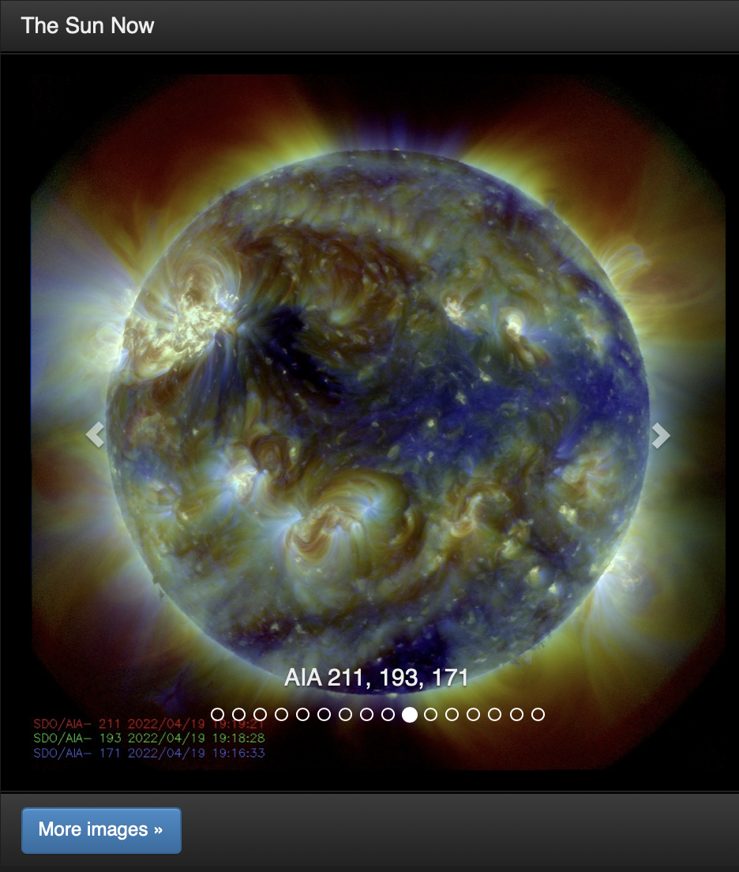
Reflect
What advantages are there to making observations of the Sun using multiple methods?
Provide evidence for your claim.
Credit: NASA / SDO
A coronagraph showing a CME Credit: NASA SDO
Notes:
Review the methods we looked at in this session: solar eclipse glasses (solar filter), pinhole projector (indirect viewing method), using telescopes to see different kinds of light, and coronagraphs.

Slide 23
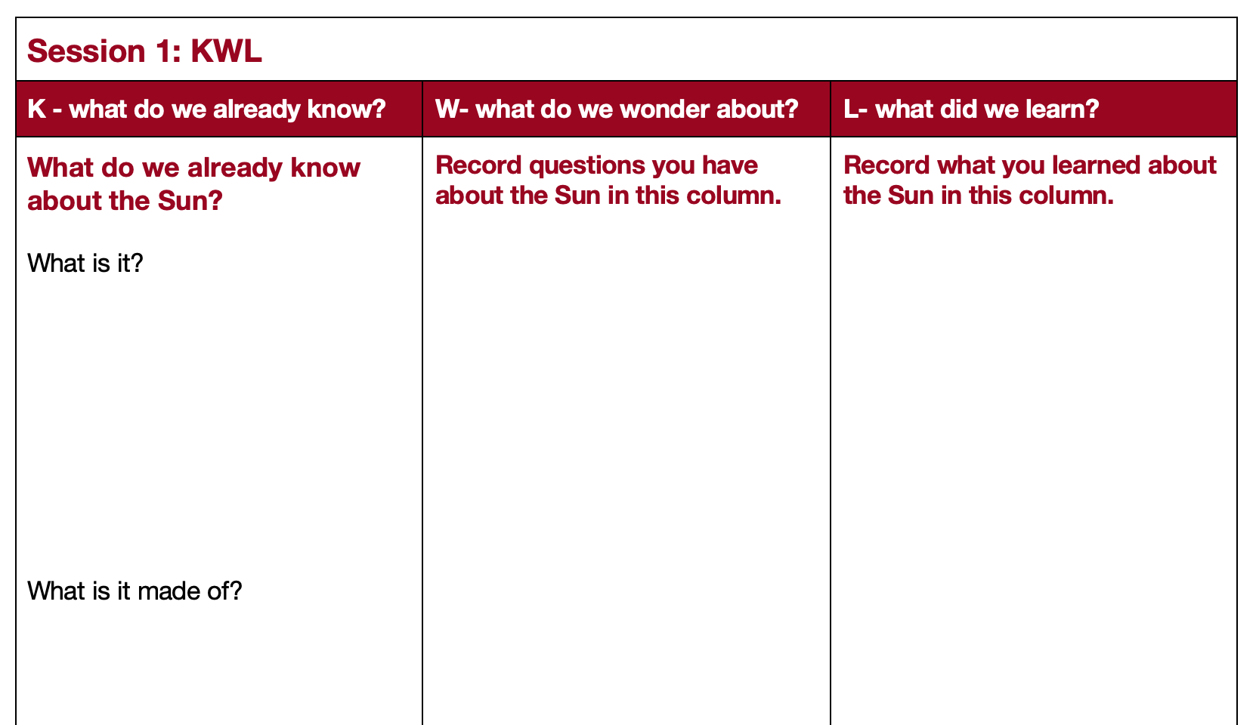
What did you learn about observing the Sun?
Youth Guide
Page 14
KWL: What did you learn about the Sun?
Notes:
Have learners complete the [Learn Column] of the KWL chart.
Emphasize to learners that they should also be correcting any misconceptions they had prior to the session, from the [Know] column, and answering any questions from the [Wonder] column, if they are able to.

Slide 24
Session 2 Major Concepts
The Sun is a star and is hard to observe because it is so bright.
Eye safety is important when observing the Sun. Solar eclipse glasses and pinhole projectors are safe methods for observing the Sun.
The Sun gives off all types of light on the electromagnetic spectrum. Humans can only see visible light.
A solar eclipse provides a great opportunity to make observations of the Sun.
Scientists make observations of the Sun in multiple wavelengths of light, which gives them more detail of different features of the Sun, like solar flares and sunspots.
The Sun’s atmosphere is called the corona.
It is challenging to study the Sun’s corona, because the Sun is so bright, and the corona is dimmer than the Sun’s surface.
NASA uses coronagraphs, which use an occulting disk to block the Sun’s light so that scientists can view the corona.
Using a coronagraph, scientists can observe features of the Sun, including the solar wind and solar flares.

