Slide 1
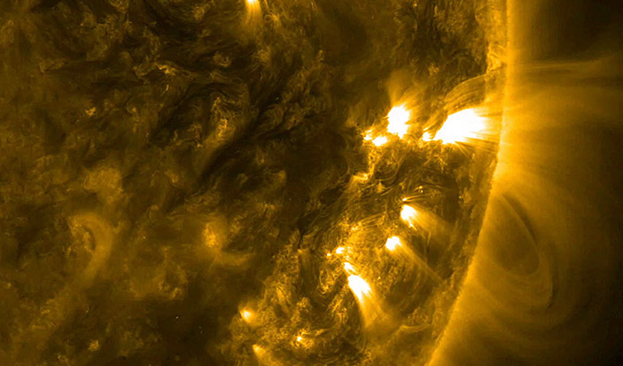




National Aeronautics and Space Administration
NASA
Helio Club
Session 1
Heliophysics 101
NASA Heliophysics Education Activation Team

Slide 2
Materials Needed for this Session
Youth Guide
Page 5
Basics
Writing tools (pens or pencils)
Art supplies (markers or crayons)
(1) pair of scissors
(1) roll of tape
Prior Knowledge/Evaluate
(1) Handout_KWL_Session 1
Engage
(1) Handout_The Sun's Energy Graphic PDF
or find the digital version here NASA Space Place: Where does the Sun’s energy come from?
Explore: Activity 1
(1) Handout_The Heliosphere Graphic PDF (needs to be printed in color on cardstock, laminated)
Explain: Activity 2
(1) 5” x 7” index card
Extend: Activity 3
(1) measuring tape
(1) Handout_Sun-Earth Day Model PDF

Slide 3
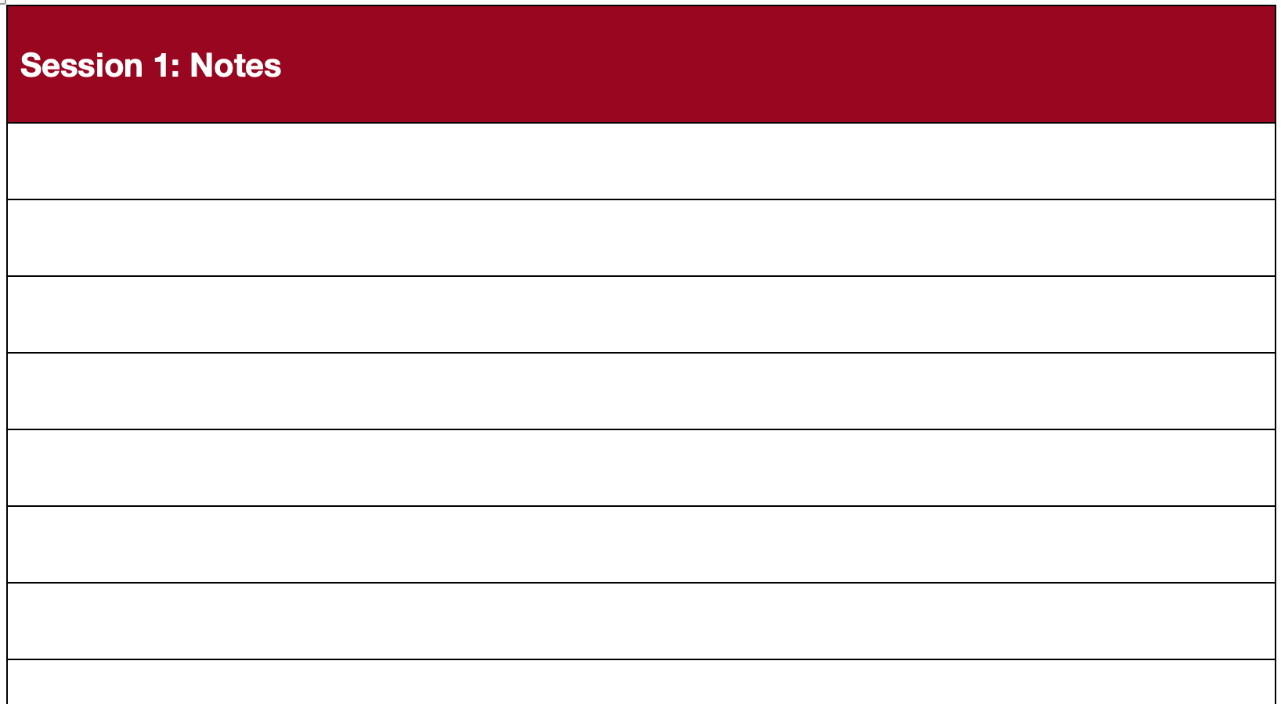
Scientist and engineers record everything!
Youth Guide
Page 11
Grab a notebook or use the extra paper provided in the Helio Club Youth Guide to record observations, collect data, and organize ideas.
Notes:
Emphasize that scientists and engineers record everything! If you don’t use the NASA Helio Club Youth Guide, have learners use a notebook to record their observations, draw diagrams, and collect data.

Slide 4
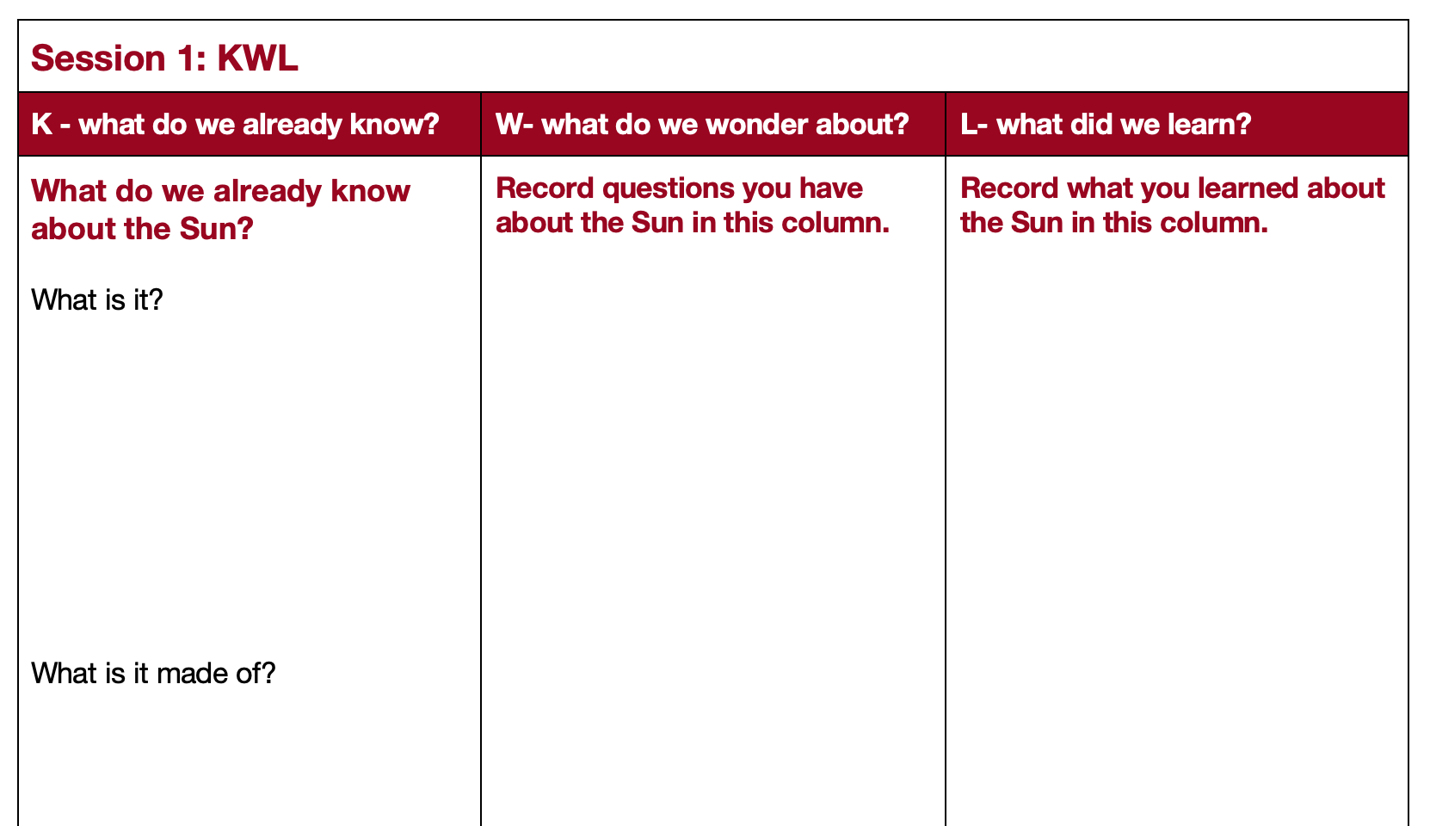
What do you already know about the Sun ?
Youth Guide
Page 5
Notes:
Have learners complete the K and W columns of the KWL chart.
A KWL chart is an effective way to assess learners’ prior knowledge, identify misconceptions, and measure growth. Use the guiding questions provided in the chart below to focus learners on the content that is explored in this session.
As students share their ideas and predictions, don’t give them the answers just yet; rather, encourage them to investigate their questions throughout the session.

Slide 5
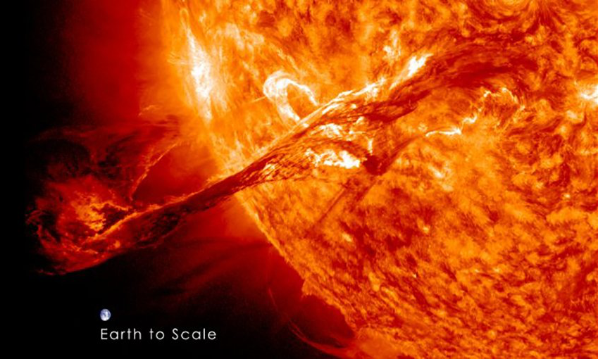
What is Heliophysics?
Heliophysics is the study of the Sun and its influence on the Solar System.
There are a lot of very interesting heliophysics topics that NASA studies.
For example: a
Coronal Mass Ejection
A 2012 coronal mass ejection (CME) from the sun. Earth is placed into the image to give a sense of the size of the CME, but our planet is, of course, nowhere near the Sun. Credit: NASA/ Goddard Media Studios
Notes:
Begin by defining the word heliophysics.

Slide 6
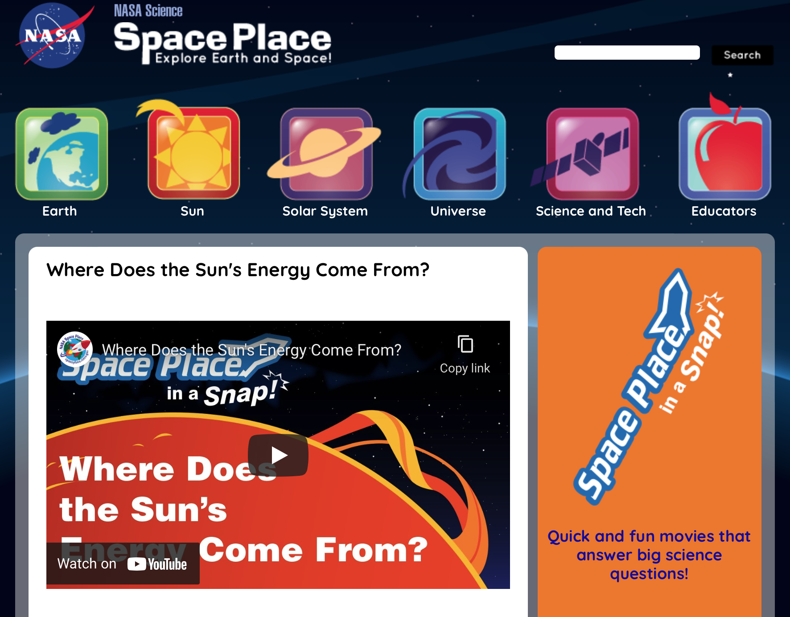
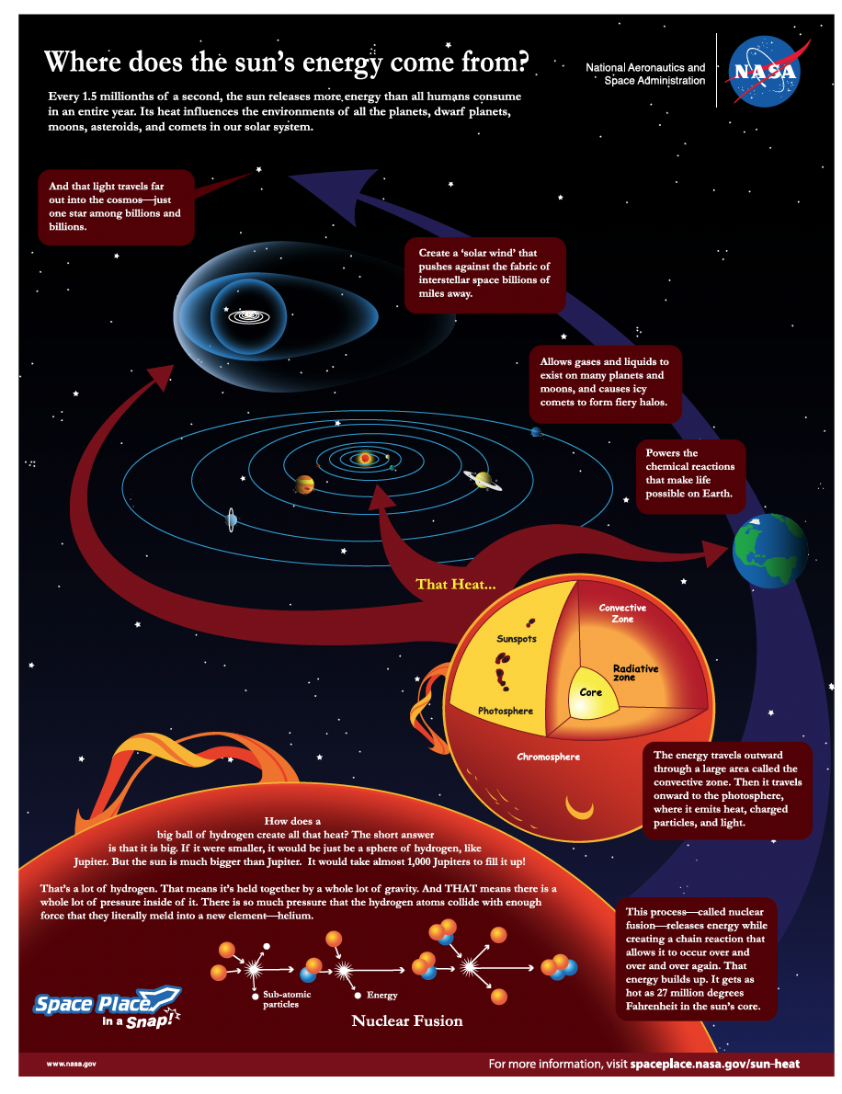
Video
Youth Guide
Page 6
Where does the Sun’s energy come from?
Focus Questions:
What is the Sun?
Why isn’t it a planet, like Mars or Venus, for example?
How big is the Sun?
How does it make energy?
Notes:
This short video about the Sun from NASA Space Place provides a brief overview of the heliophysics concepts that we will be exploring throughout the club sessions.
After learners are finished watching the video, have them take a closer look at the graphic to review some of the key points from the video. Have learners use the graphic to help answer the questions in the KWL chart.
What is the Sun?
Why isn’t it a planet, like Jupiter, for example?
How big is the Sun?
How does it make energy?

Slide 7
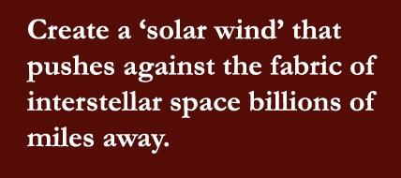
Asking Questions
Have you heard of solar wind?
What about interstellar space?
Notes:
Allow time for learners to share their answers.

Slide 8
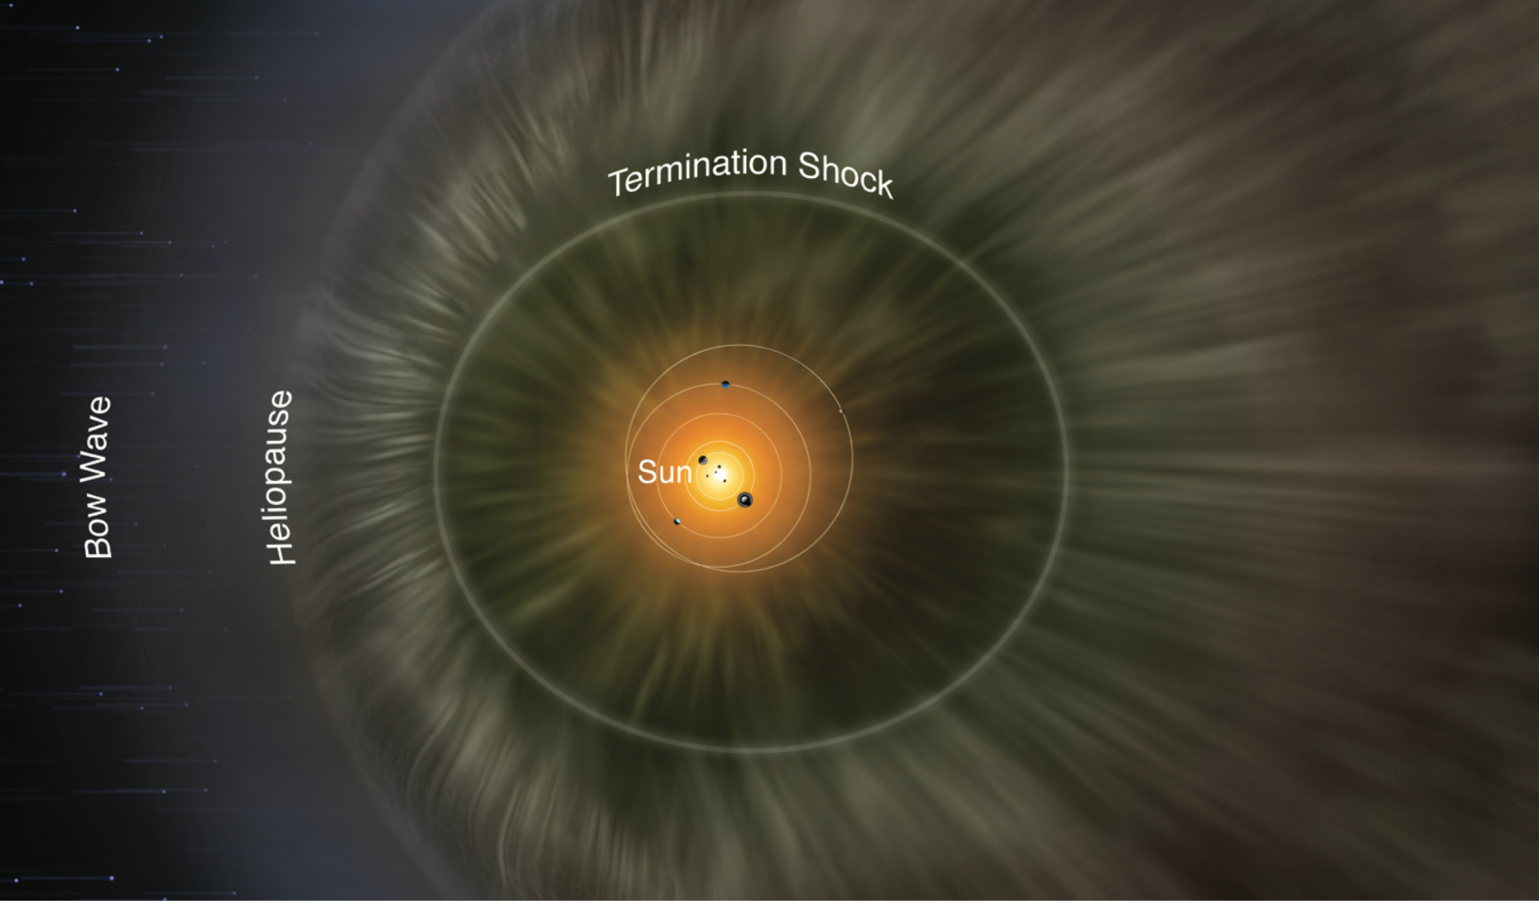
Modeling the Heliosphere
Youth Guide
Page 7
Key terms:
Solar Wind
Interstellar Space
Notes:
The heliosphere has different parts, depending on how it interacts with the boundary of interstellar space. We know this from NASA missions like Voyager and IBEX, which have measured this boundary.
This illustration was created from a 3D model of the heliosphere using actual data collected by the IBEX Mission. Colors are meant to enhance features and show structure.
The solar wind is represented by the greenish, wavy lines coming out from the Sun.
The heliopause is the outermost boundary of the heliosphere. Beyond the heliopause is interstellar space.
The termination shock is the innermost boundary of the heliosphere, where the solar wind begins to interact with interstellar space. The termination shock is still inside the heliosphere.
The heliosphere creates a bow wave because the Sun is moving through interstellar space, as it orbits the center of the Milky Way galaxy. It is just like how a bow wave is created as a boat moves through the water.
Take a few minutes to examine the heliosphere handout and make some observations.
What do you notice about the boundary?
What shape is it?

Slide 9
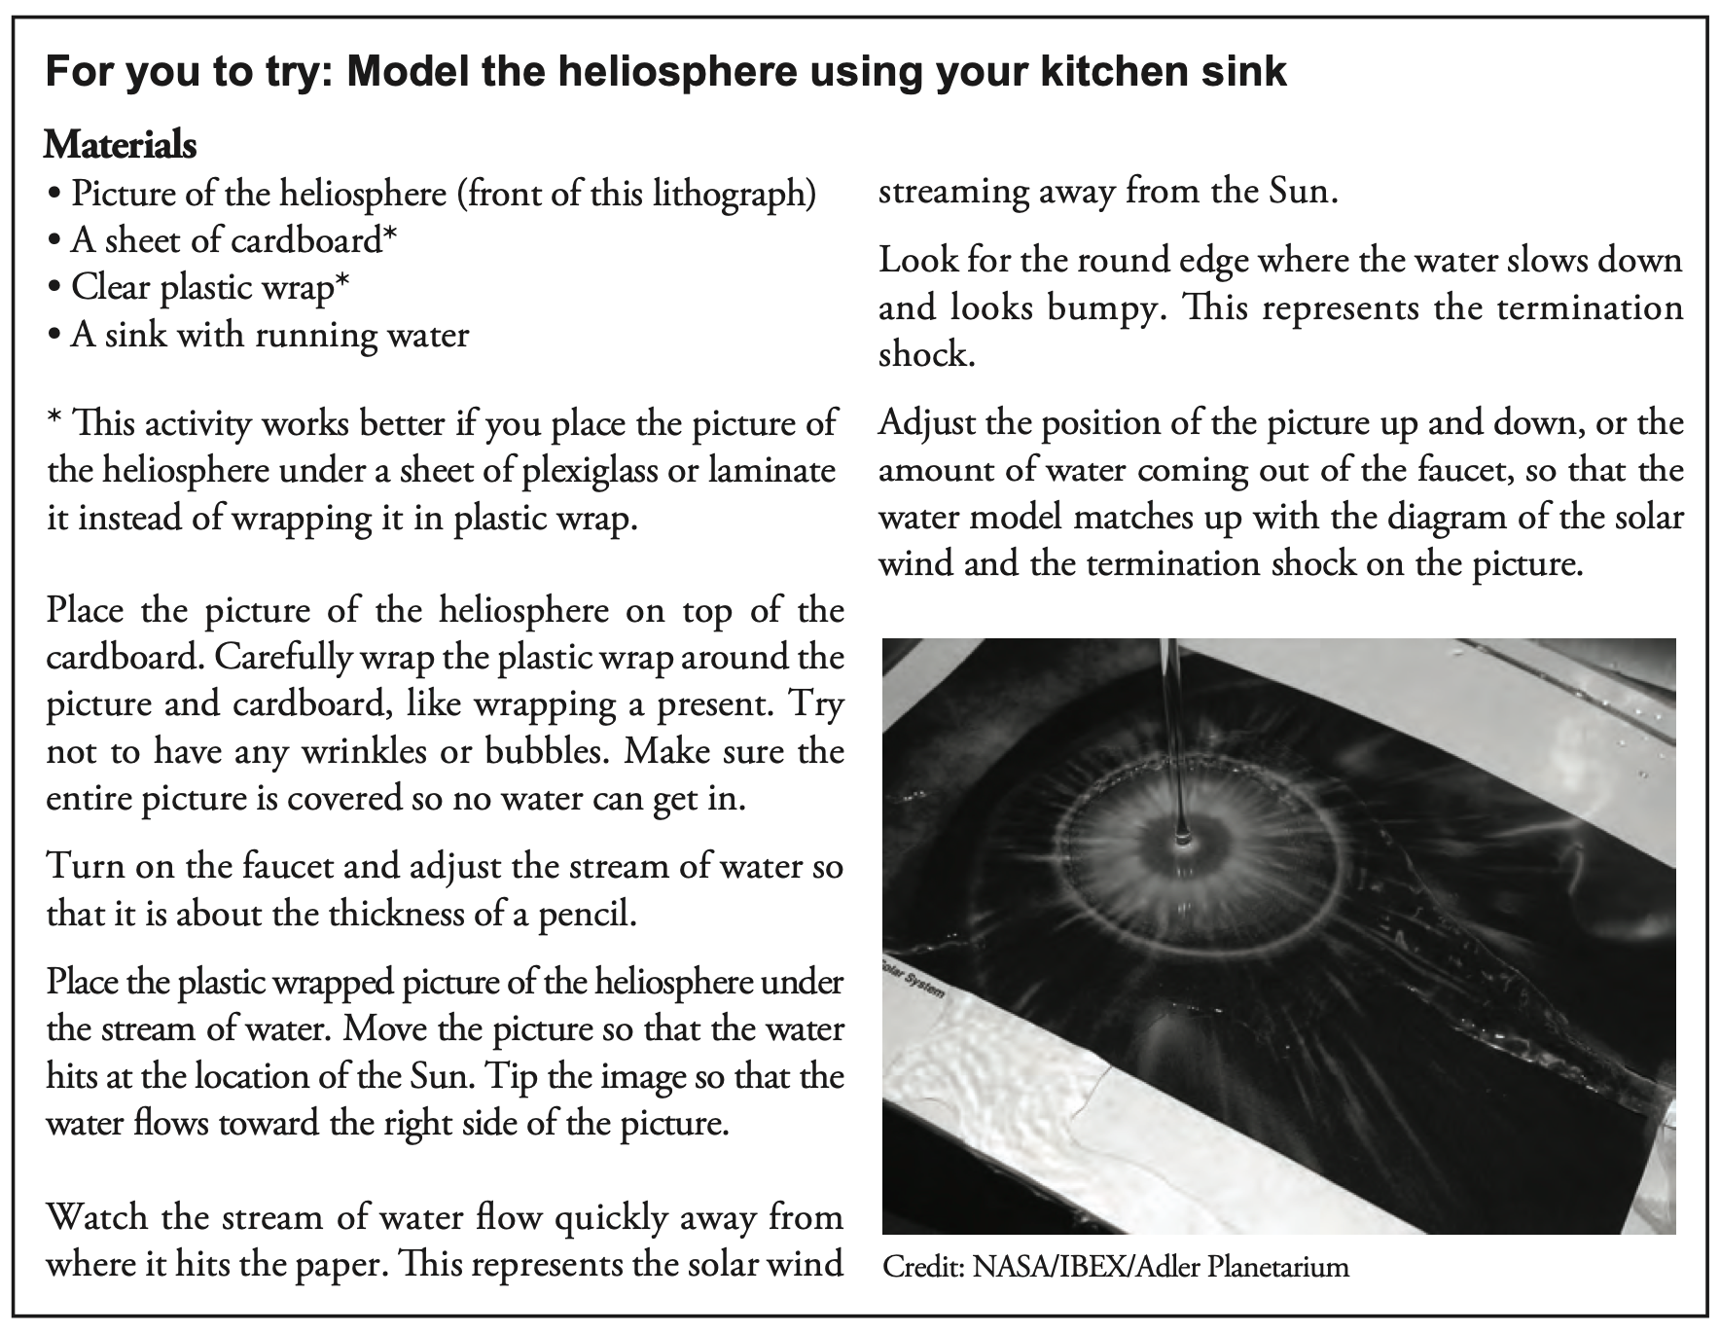
Modeling the Heliosphere
Youth Guide
Page 8
Directions:
Skip the first step if your handout is already waterproof.
Notes:
Take learners through the directions. If you laminated the handout, instruct learners to skip the instructions for wrapping the handout in plastic wrap. You can show learners the Modeling the Heliosphere Video on the next slide to help them construct the model. Then instruct learners to go to the sink and experiment.

Slide 10

Heliosphere in the Sink

Slide 11
Modeling the Heliosphere
Results:
Record your results. Include drawings and diagrams and note any modifications you made in order to perfect the model, perhaps adjusting the water pressure or the position of the image, for example.
How does this model help us learn about the properties (characteristics) of the solar wind and the heliosphere boundary?
Why would a soap bubble not be an appropriate model for the heliosphere?
Notes:
Allow time for learners to share their answers.

Slide 12
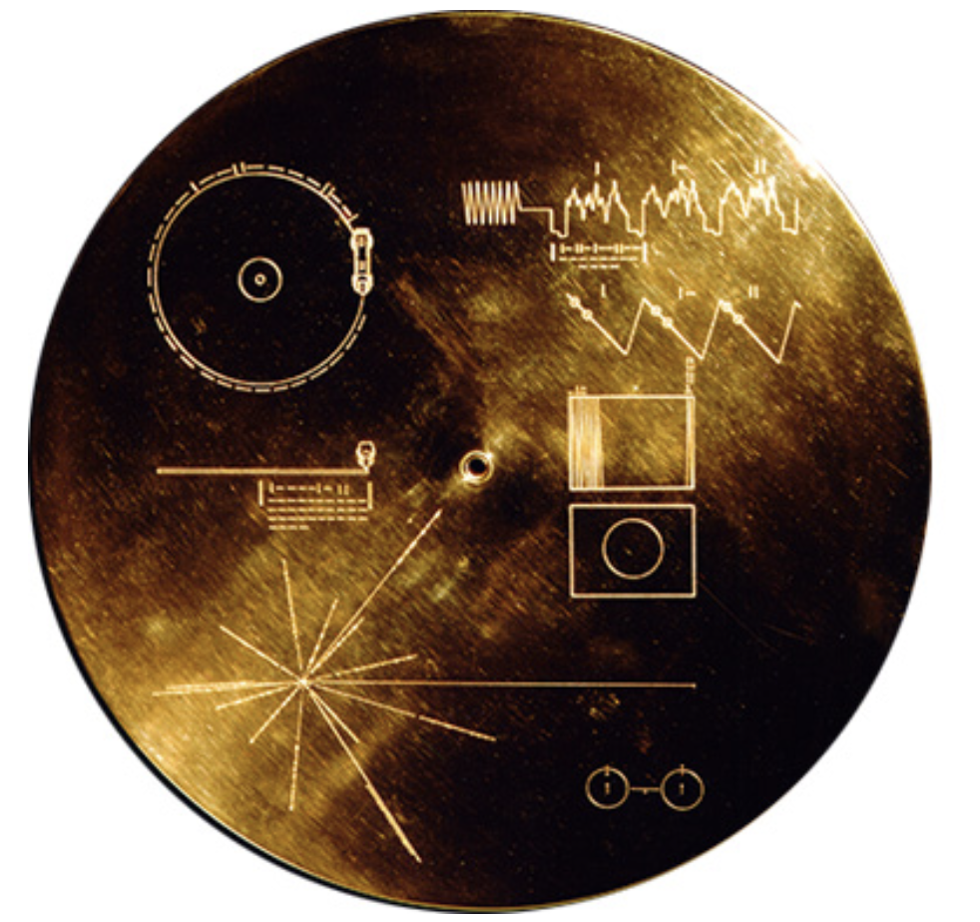
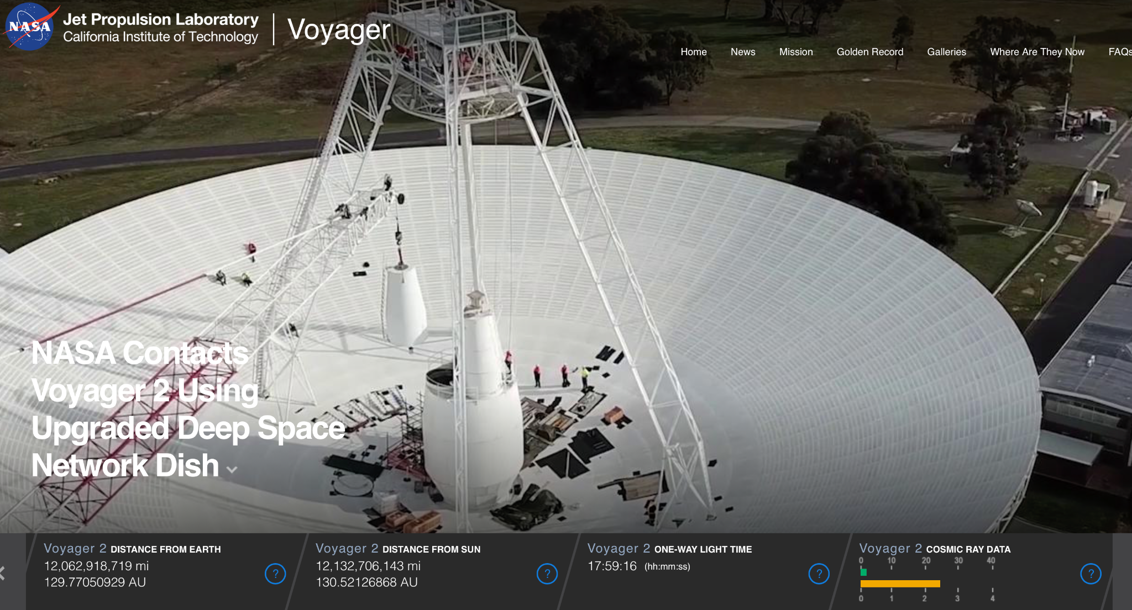
The Golden Record
Voyager Mission
Notes:
Have you heard of the Golden Record?
The Golden Record, a kind of time capsule, is aboard both Voyager 1 and 2 and is intended to communicate a story of our world to extraterrestrials. The Voyager message is carried by a 12-inch gold-plated phonograph record containing sounds and images selected to portray the diversity of life and culture on Earth.
Imagine that an extraterrestrial actually found the Golden Record! How would they find their way back to Earth for a friendly visit?
NASA put directions to Earth on the Golden Record, so our new alien friends can find their way! What do you think these directions would look like?

Slide 13
Postcards in Space
Greetings! [message] Sincerely, The Earthlings | PLACE STAMP HERE What information is included in an address?
Notes:
Here on Earth, we use addresses to find locations. What is your address (or school address)? What are the key components to an address on Earth?
Have learners begin to construct their address. Because many young people don’t write letters, you may need to guide them through this. Give them a hint: an address goes from smallest (the person) to the biggest (the country).

Slide 14
Postcards in Space
Greetings! [message] Sincerely, The Earthlings | PLACE STAMP HERE Name

Slide 15
Postcards in Space
Greetings! [message] Sincerely, The Earthlings | PLACE STAMP HERE Name Street

Slide 16
Postcards in Space
Greetings! [message] Sincerely, The Earthlings | PLACE STAMP HERE Name Street City

Slide 17
Postcards in Space
Greetings! [message] Sincerely, The Earthlings | PLACE STAMP HERE Name Street City State + ZIP code

Slide 18
Postcards in Space
Greetings! [message] Sincerely, The Earthlings | PLACE STAMP HERE Name Street City State + ZIP code Country

Slide 19
Postcards in Space
Greetings! [message] Sincerely, The Earthlings | PLACE STAMP HERE What information would that address need to include if your new friends came from outside of our heliosphere? What about from outside of our galaxy?
Notes:
What information would you need to add to your address if your new friends came from outside of the heliosphere? What about from outside of our galaxy?
Have learners add to their address, after the country. Use questions to probe learners for ideas about the additional information required to receive a “postcard from space.”
Planet: Earth
Planetary System: Solar System
Solar System Boundary: Heliosphere
Galaxy: Milky Way

Slide 20
Postcards in Space
Greetings! [Leave blank for now] Sincerely, The Earthlings | PLACE STAMP HERE Name Street City State + ZIP code Country Planet

Slide 21
Postcards in Space
Greetings! [message] Sincerely, The Earthlings | PLACE STAMP HERE Name Street City State + ZIP code Country Planet Planetary System

Slide 22
Postcards in Space
Greetings! [Message] Sincerely, The Earthlings | PLACE STAMP HERE Name Street City State + ZIP code Country Planet Planetary System Heliosphere Boundary

Slide 23
Postcards in Space
Greetings! [Message] Sincerely, The Earthlings | PLACE STAMP HERE Name Street City State + zip code Country Planet Planetary System Heliosphere Boundary Galaxy

Slide 24
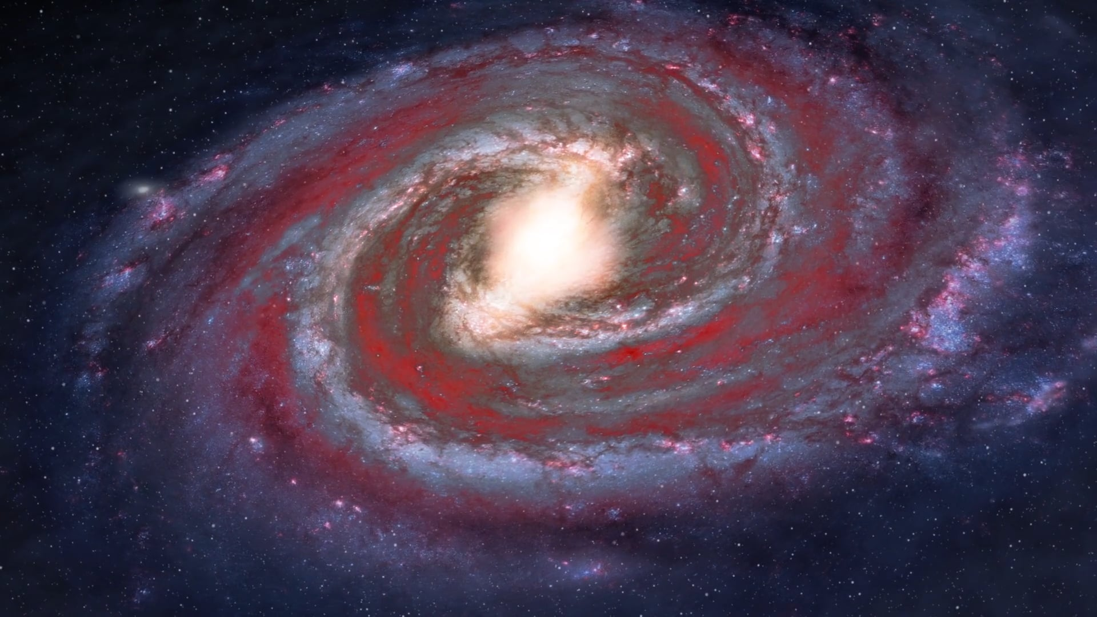
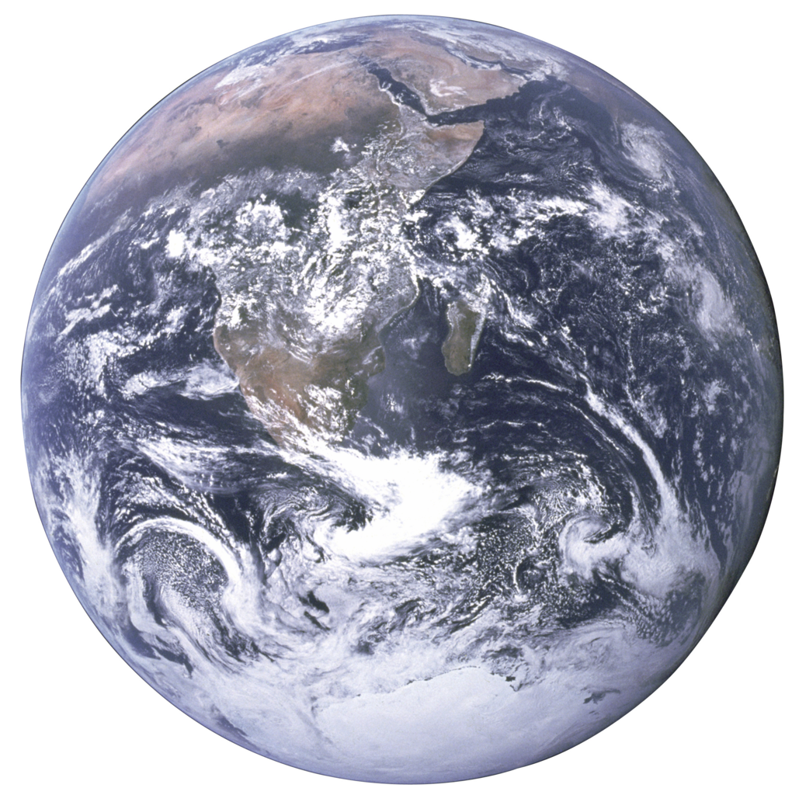
Welcome Extraterrestrials!
Front of Postcard
Draw a map from outside the Milky Way Galaxy to Earth.
Back of Postcard
Greetings! Welcome to Earth! Earth is a really cool place because… Sincerely, The Earthlings | PLACE STAMP HERE Learner Name: ___________________ House #, Street: __________________ City, State, ZIP Code: _____________ Country: _________________________ Planet: ___________________________ Planetary System: ________________ Solar System Boundary: ___________ Galaxy: ___________________________
Notes:
We don’t have any extra records made of gold for you to encode your address on, but we do have postcards! Your challenge is to write your own “golden-record type message” welcoming extraterrestrials to Earth, providing your return address, so they can find your exact location on Earth.
Have learners write their chosen address (home, school, library, etc.) on the 5” x 7” index card. Have learners write a message to an extraterrestrial. What are the best parts of Earth they would want to share with a visitor?
Have learners decorate the other side of the postcard with directions to Earth. Now that they have a better understanding of what is outside the solar system, could they draw a map for the extraterrestrials to follow?
Note: We do not have any pictures of the Milky Way Galaxy. Remind learners how long it took the Voyager spacecraft to leave the heliosphere (35 years). We do not have the capabilities to get a spacecraft out of the Milky Way. However, telescopes like Hubble and Webb have given us amazing pictures of lots of other galaxies.

Slide 25
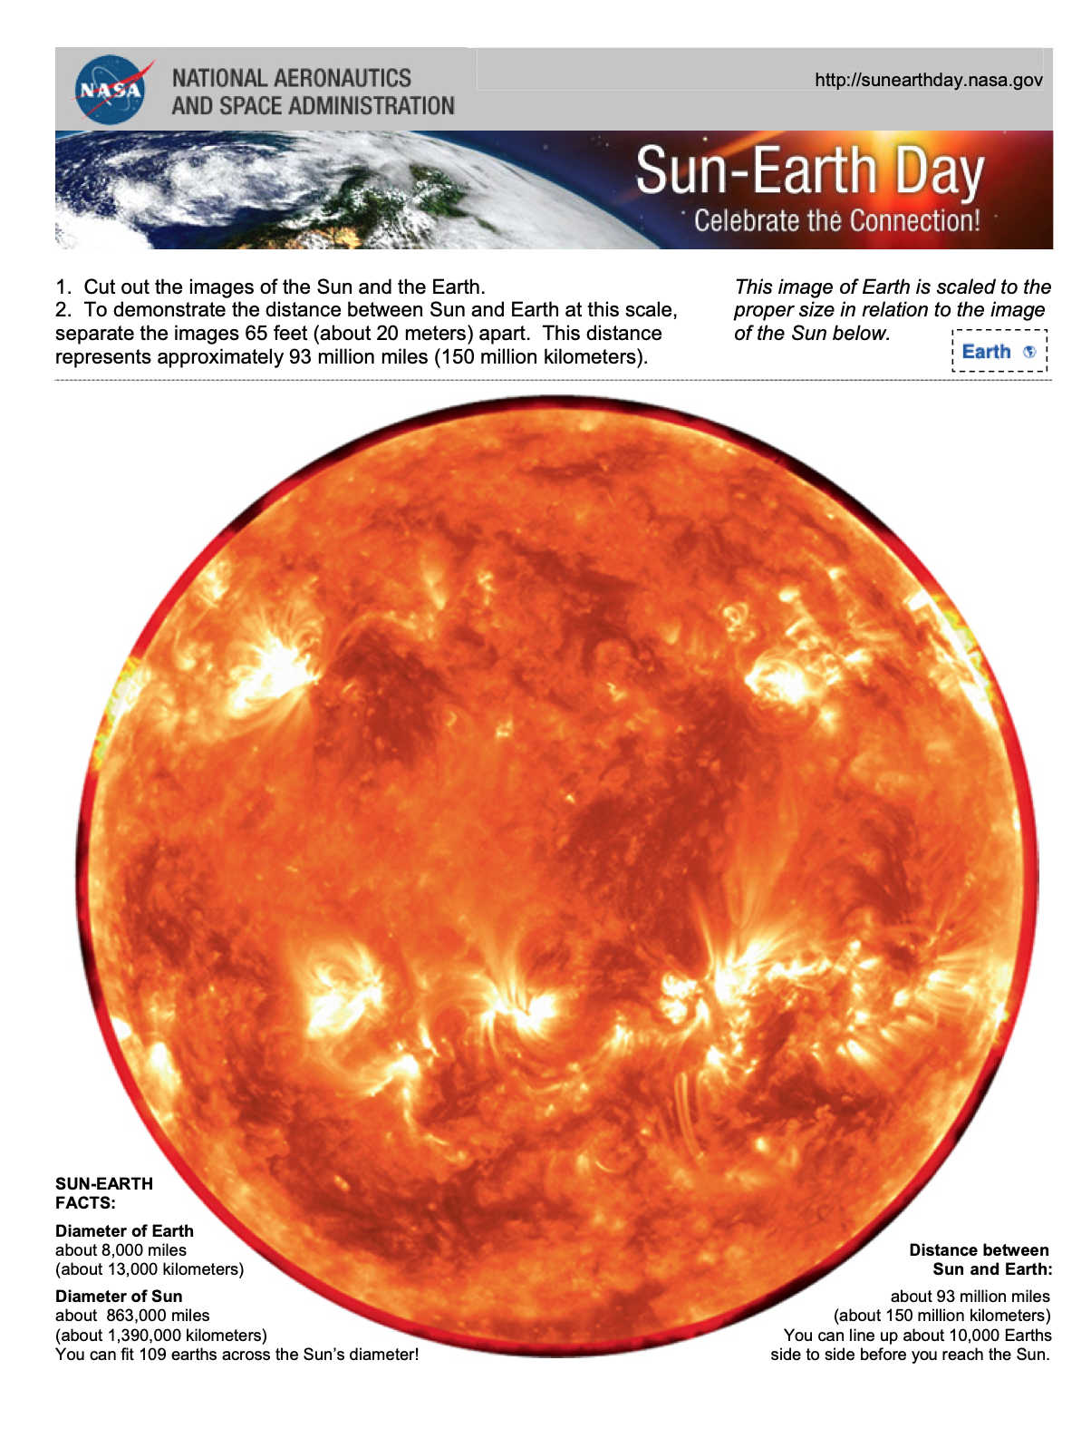
Sun-Earth Scale Model
Youth Guide
Page 9
Tear out page 9 of the NASA Helio Youth Guide, or use the Handout_Sun-Earth Day Model PDF.
Cut out the Sun and the Earth.
To demonstrate the distance between Sun and Earth at this scale, separate the images 65 feet (about 20 meters) apart. This distance represents approximately 93 million miles (150 million kilometers).
Notes:
Have learners cut out the Sun and the Earth. To demonstrate the distance between Sun and Earth at this scale, separate the images 65 feet (about 20 meters) apart. This distance represents approximately 93 million miles (150 million kilometers).

Slide 26
Sun-Earth Scale Model
Observations:
What is a scale model?
Why do both size and distance matter when making a model to scale?
Was the model of the heliosphere in the sink a scale model? Why or why not?
Do both scale and not-to-scale models serve a purpose? Explain.
Was there anything that surprised you about the sizes and distance between the Sun and Earth?
Notes:
Allow time for learners to share their answers.
Models are a representation of something real that is difficult to observe directly, because of its size, for example. Using models of the heliosphere can help us visualize something very big.
Both scale and not-to-scale models help scientists in different ways.

Slide 27
What did you learn about the Sun?
Youth Guide
Page 5
KWL: What did you learn about the Sun?
Notes:
Have learners complete the Learn Column [L] of the KWL chart.
Emphasize to learners that they should also be correcting any misconceptions they had prior to the session, from the Know [K] column, and answering any questions from the Wonder [W] column, if they are able to.

Slide 28
Session 1 Major Concepts
The Sun is a star and is the largest object in the Solar System; 1.3 million Earths can fit into the Sun.
The Sun is just one of billions of stars in the Milky Way Galaxy; there are billions of galaxies in the universe.
The Sun is so big and has so much gravity and pressure, it can create energy. The Sun makes energy in its core through the nuclear fusion of hydrogen into helium. Nuclear fusion releases a lot of energy.
The Sun is made of a super-heated, ionized gas called plasma.
The Sun releases heat, light, and charged particles. These charged particles make up the solar wind.
Solar wind is created by the intense super-heated plasma of the Sun, which flows outward in all directions, pushing against the material that is in between the stars, creating a sort of bubble that surrounds our Solar System. We call this bubble the heliosphere.
The heliosphere is the region of space influenced by the solar wind, and it extends far beyond Pluto.
The space between stars is called interstellar space. This kind of space turns out to be a little different from the space inside the boundary of the Sun’s influence.

