Slide 1
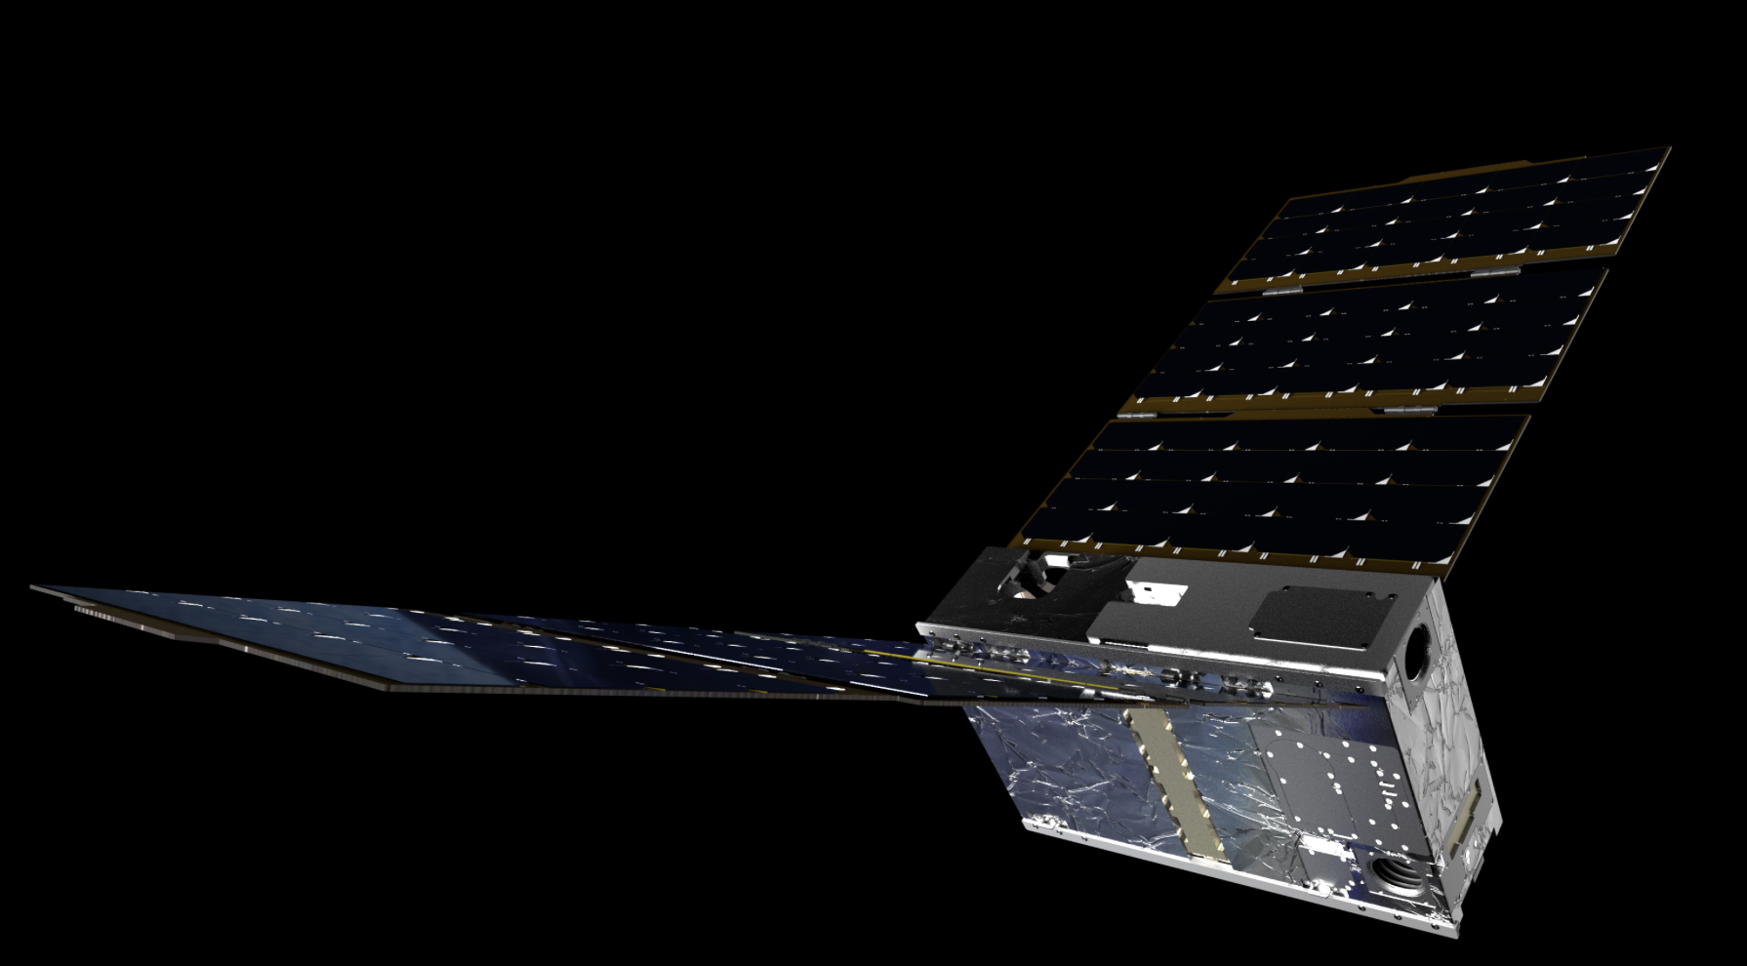




Electrojet Zeeman Imaging Explorer (EZIE)
National Aeronautics and Space Administration
Heliophysics Investigations by Dr. Hilarie Davis 5/6/25
NASA Heliophysics Education Activation Team Note all images are from NASA EZIE

Slide 2

Understanding Space Weather
EZIE is a mission to explore the Sun and the system that drives space weather near Earth.
EZIE mission’s trio of small satellites fly in a pearls-on-a-string configuration approximately 260 to 370 miles above Earth’s surface to map the auroral electrojets, powerful electric currents that flow through our upper atmosphere in the polar regions where auroras glow in the sky. Electrojets flow too high for aircraft and too low for traditional satellites to directly measure.
Heliophysics Education Activation Team

Slide 3
Framework for Heliophysics Education (FHE)
Developed by NASA HEAT in 2022
https://science.nasa.gov/learn/heat/big-ideas/
Structured around NASA’s Big Heliophysics Questions:
What are the impacts of the Sun on humanity?
How do the Earth, the solar system, and heliosphere respond to changes on the Sun?
What causes the Sun to vary?
Heliophysics Education Activation Team

Slide 4
FHE has Developed Big Ideas for the NASA Questions
1. What are the impacts of the Sun on humanity?
1.1 The Sun is really big and its gravity influences all objects in the solar system. (PS2, ESS1)
1.2 The Sun is active and can impact technology on Earth via space weather. (PS1, PS2, PS4, ESS2, ESS3)
1.3 The Sun’s energy drives Earth’s climate, but the climate is in a delicate balance and is changing due to human activity. (PS1, PS2, PS3, LS4, ESS2, ESS3)
2. How do the Earth, the solar system, and heliosphere respond to changes on the Sun?
2.1 Life on Earth has evolved with complex diversity because of our location near the Sun. It is just right! (PS3, PS4, LS1, LS2, ESS2)
2.2 The Sun defines the space around it, which is different from interstellar space. (PS2, ESS1, ESS2)
2.3 The Sun is the primary source of light in our solar system. (PS1, PS2, PS3,PS4, ESS1)
3. What causes the Sun to vary?
3.1 The Sun is made of churning plasma, causing the surface to be made of complex, tangled magnetic fields. (PS1, PS2, ESS1, ESS2)
3.2 Energy from the Sun is created in the core and travels outward through the Sun and into the heliosphere. (PS1, PS3, PS4, ESS1, ESS2, ESS3)
3.3 Our Sun, like all stars, has a life cycle. (PS1, LS1, ESS1)
Heliophysics Education Activation Team

Slide 5
EZIE Connections to the Framework
NASA Heliophysics Question 1: What are the impacts of the Sun on humanity?
Big Idea 1.1 The Sun is really big and its gravity influences all objects in the solar system. (PS2, ESS1)
NASA Heliophysics Question 2: How do the Earth, the solar system, and heliosphere respond to changes on the Sun?
2.2 The Sun defines the space around it, which is different from interstellar space. (PS2, ESS1, ESS2)
Heliophysics Education Activation Team

Slide 6
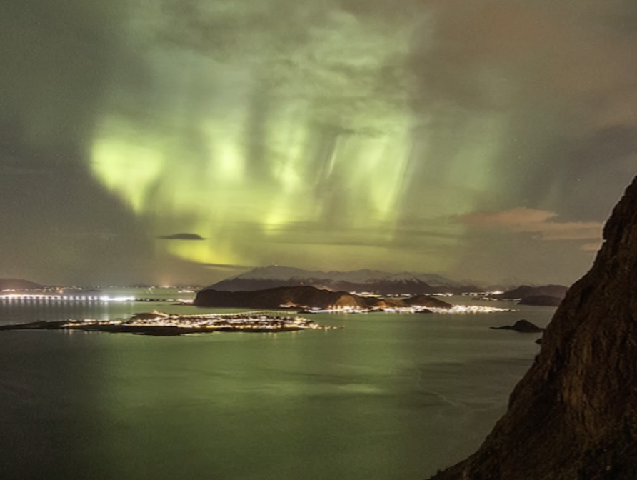
Introductory Level Investigation
Aren’t the auroras beautiful? Why does NASA want to study them more? Do they cause problems for us?
Find out more about NASA’s reasons and how students are helping.
https://ezie.jhuapl.edu/content/media/videos/22-03981%20-%20EZIE%20Maker%20Kit%20Evergreen%20Video%20Series%20-withNASAlogo.mp4
Heliophysics Education Activation Team

Slide 7
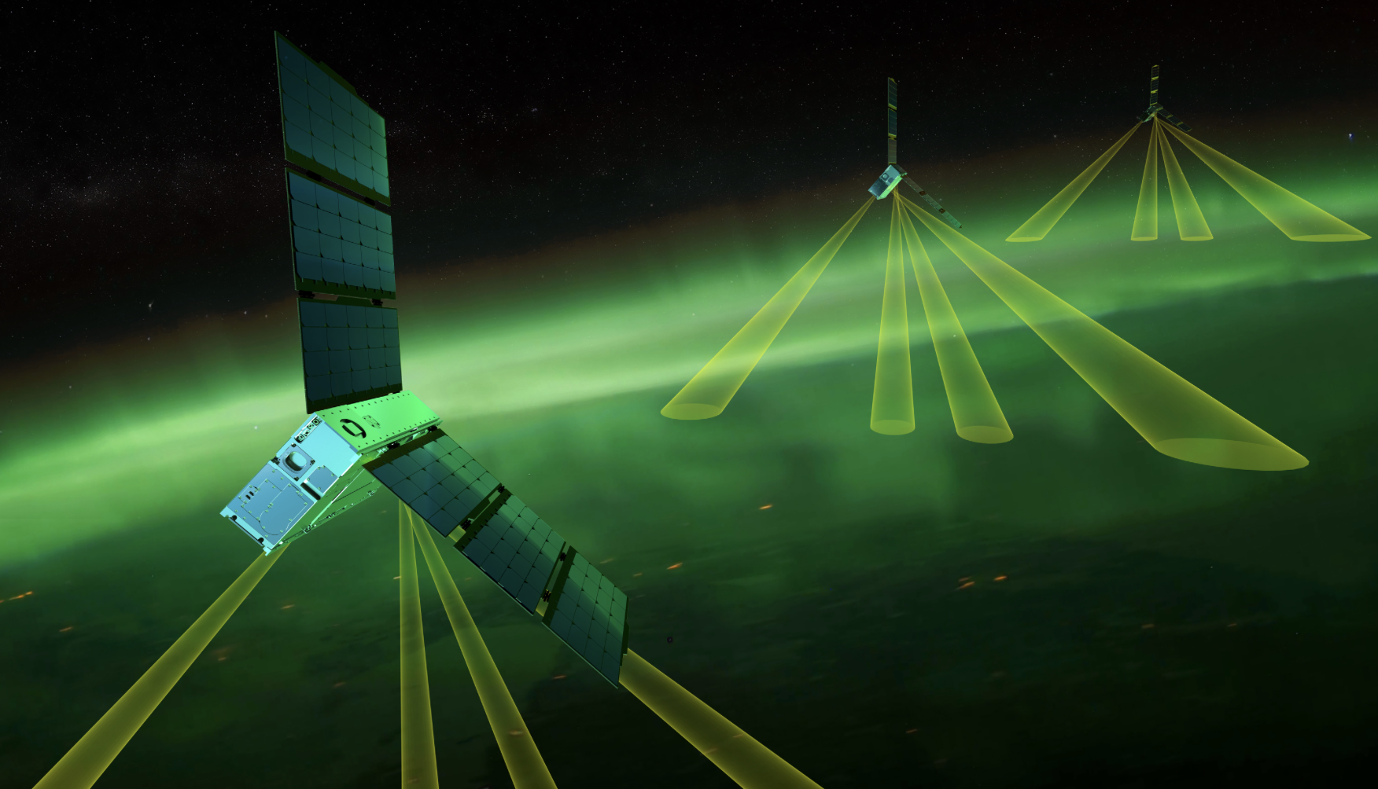
Intermediate Level Investigation
How do the EZIE CubeSats stay the same distance apart all the time? Why
is this important?
Resources
https://science.nasa.gov/science-research/heliophysics/nasas-ezie-launches-on-mission-to-study-earths-electrojets/
https://svs.gsfc.nasa.gov/14542/#media_group_373605
Heliophysics Education Activation Team

Slide 8
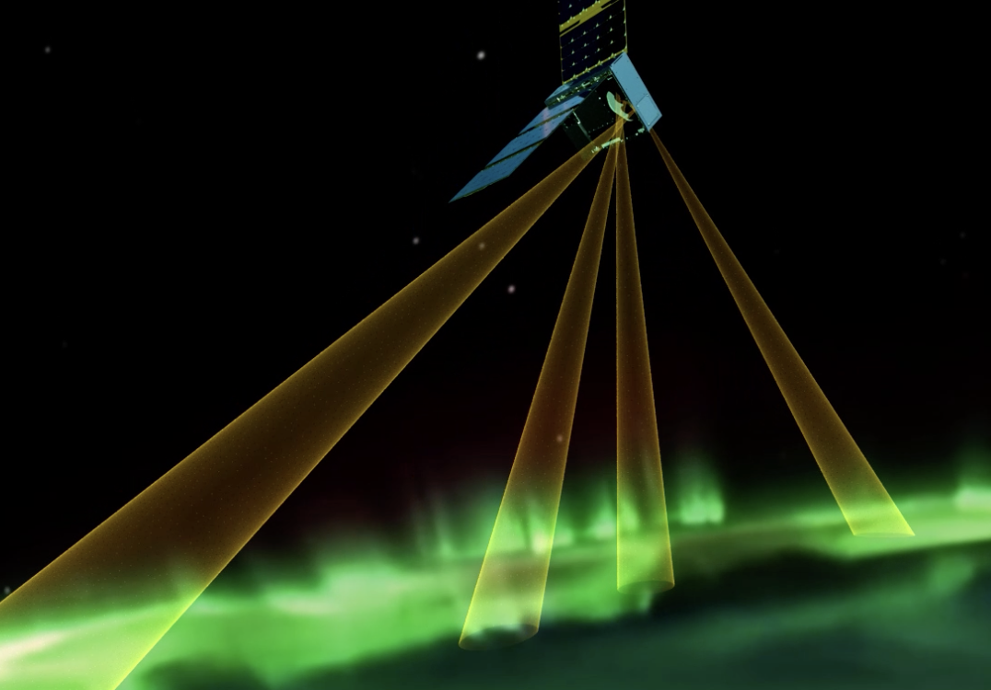
Advanced Level Investigation
EZIE collects data from above the electrojets? What is the benefit of this? What data is collected?
Resources
https://ezie.jhuapl.edu/content/media/videos/23-01703-EZIEscienceandengineeringoverview-Final.mp4
https://ezie.jhuapl.edu/content/media/images/ezie-instrument-01.png
https://science.nasa.gov/blogs/ezie/2025/04/22/nasas-ezie-mission-captures-first-light/
Heliophysics Education Activation Team

Slide 9
NASA HEAT
For more information on the
Framework for Heliophysics Education
https://science.nasa.gov/learn/heat/big-ideas/
Heliophysics Education Activation Team

